Slide 1
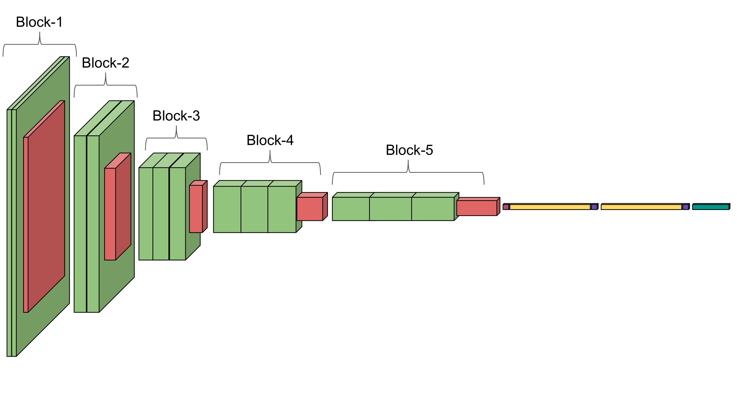
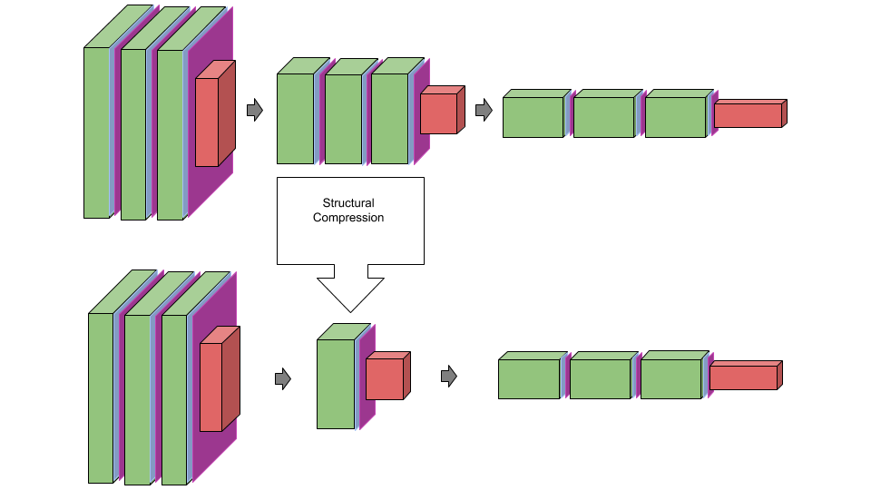
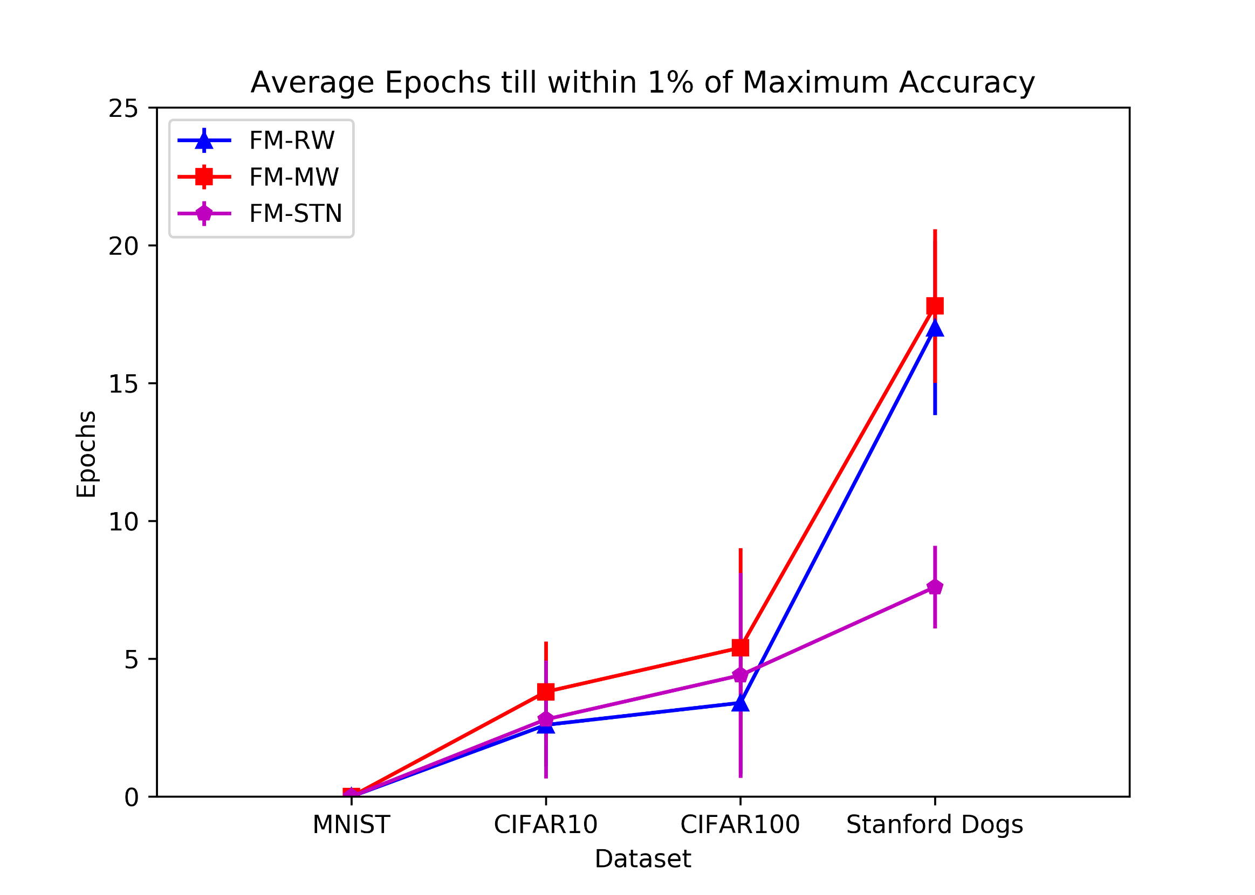
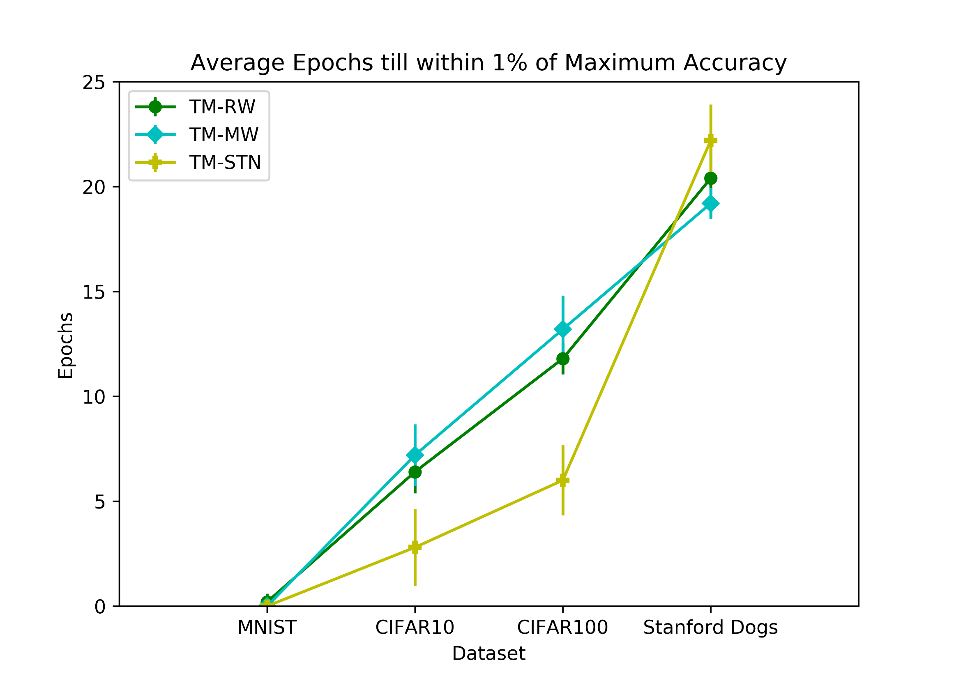
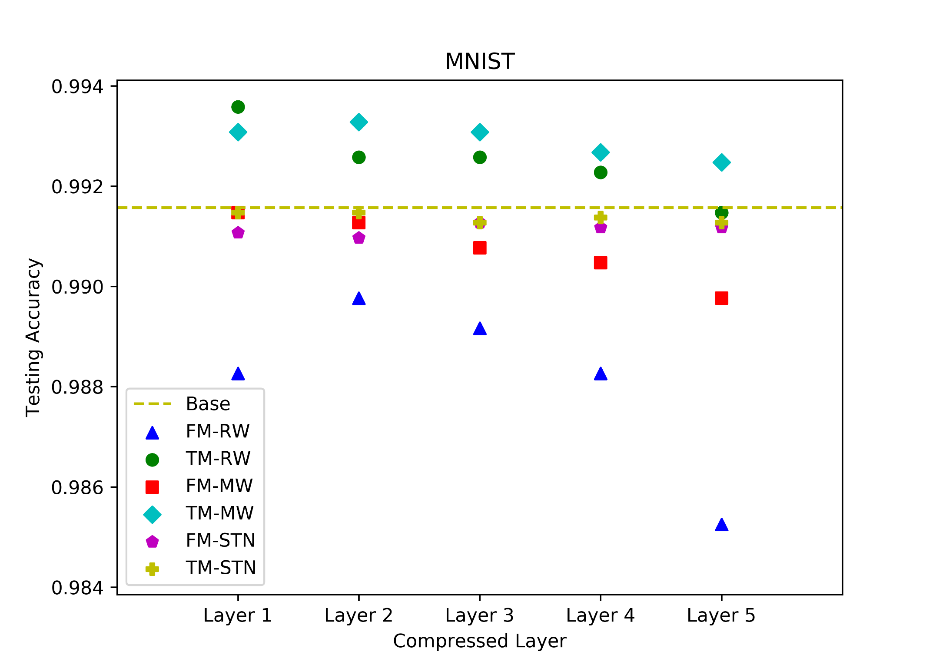
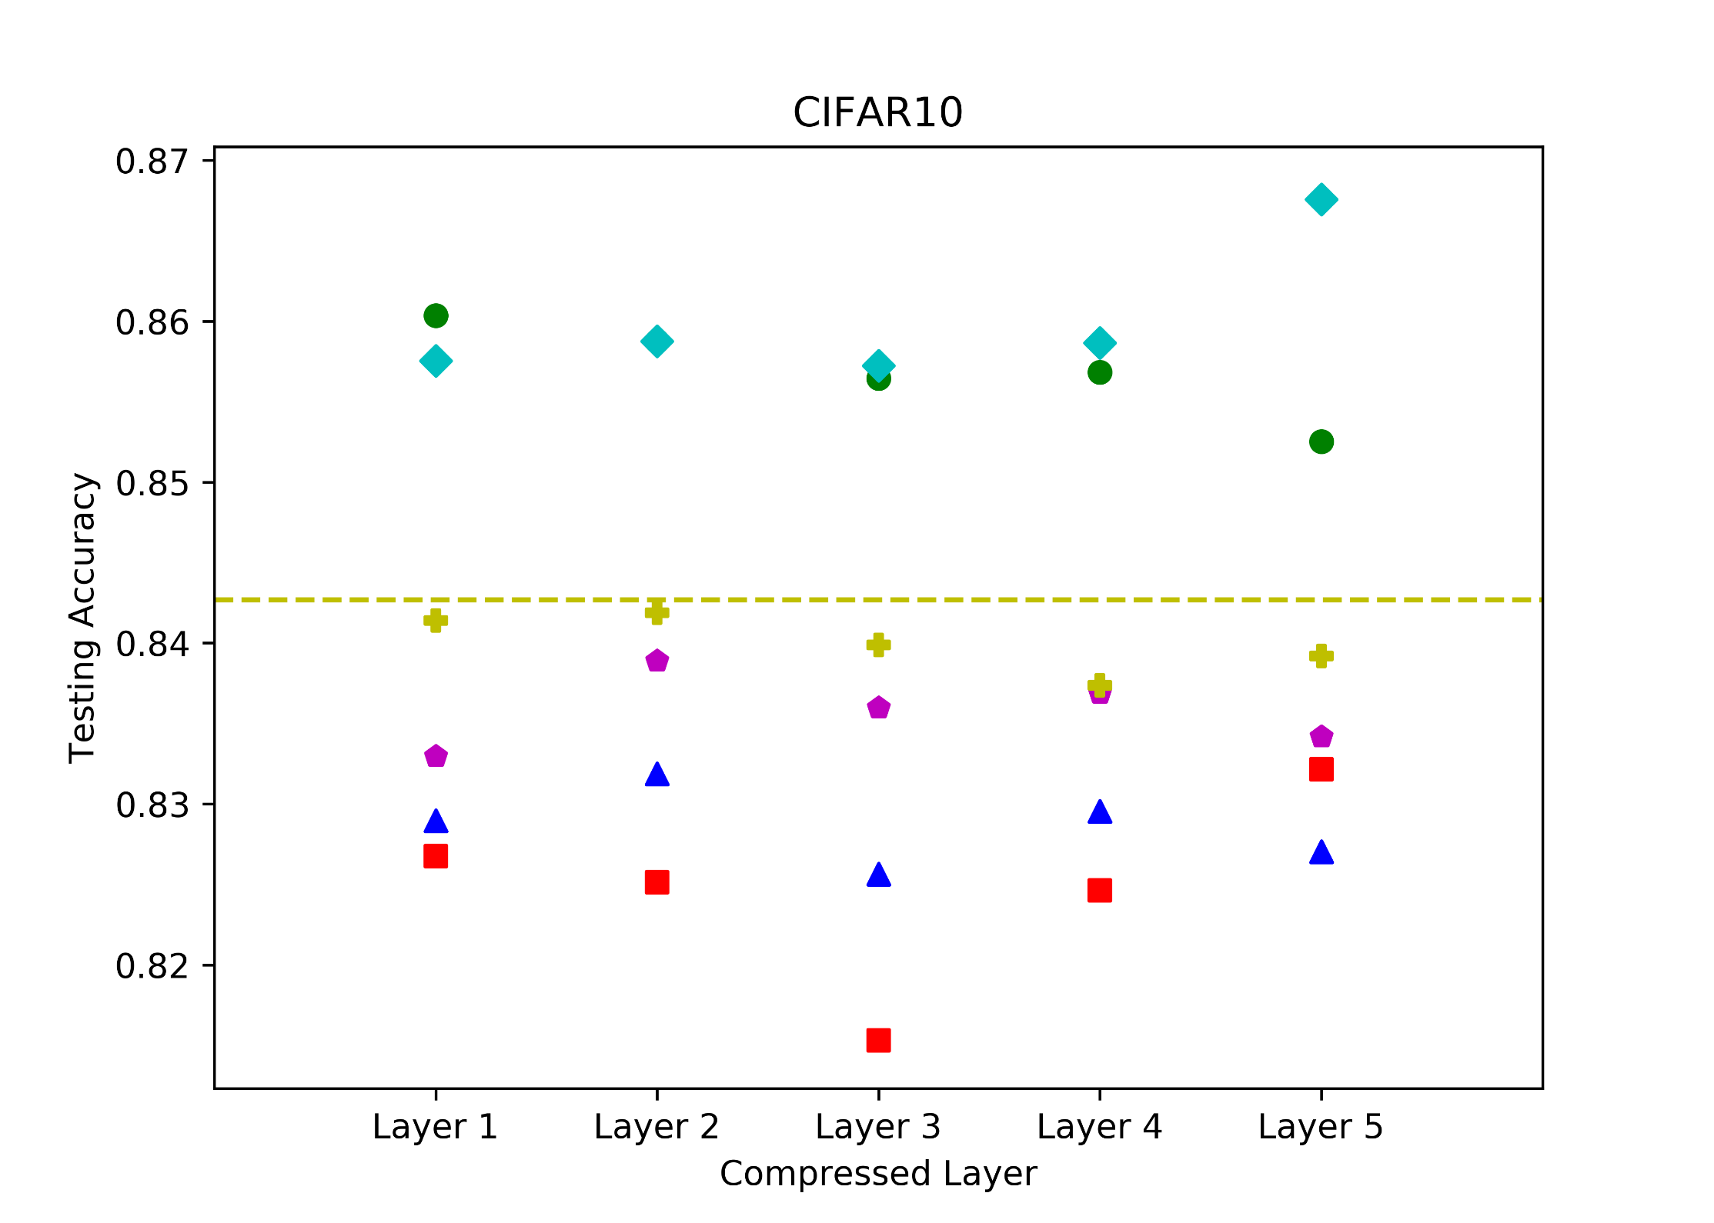
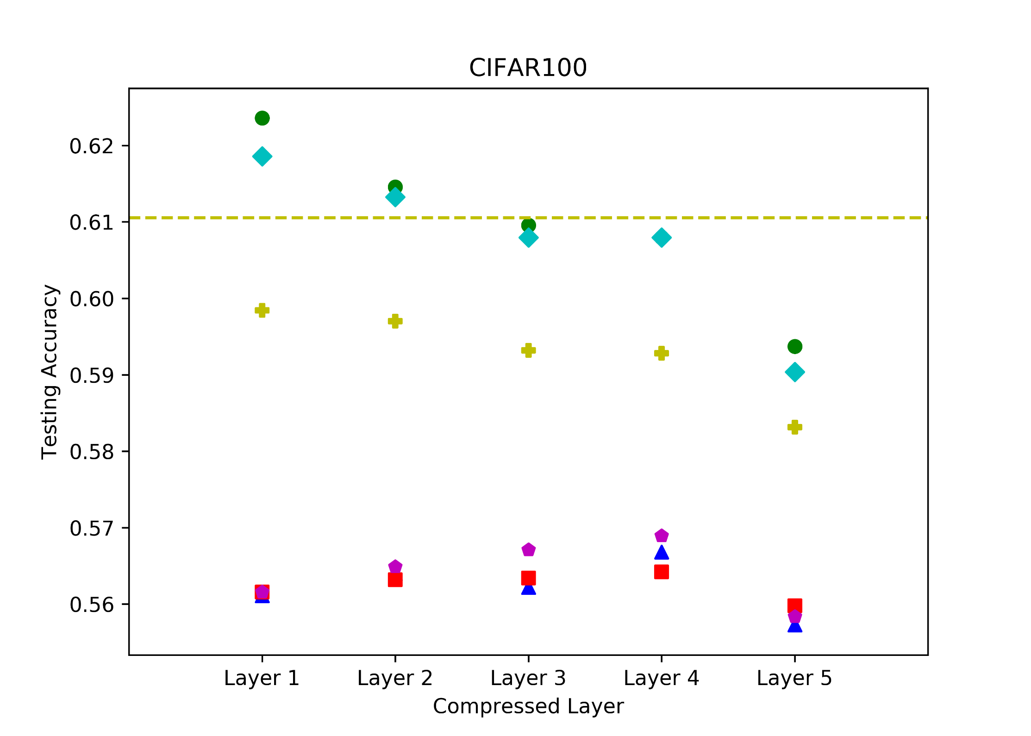
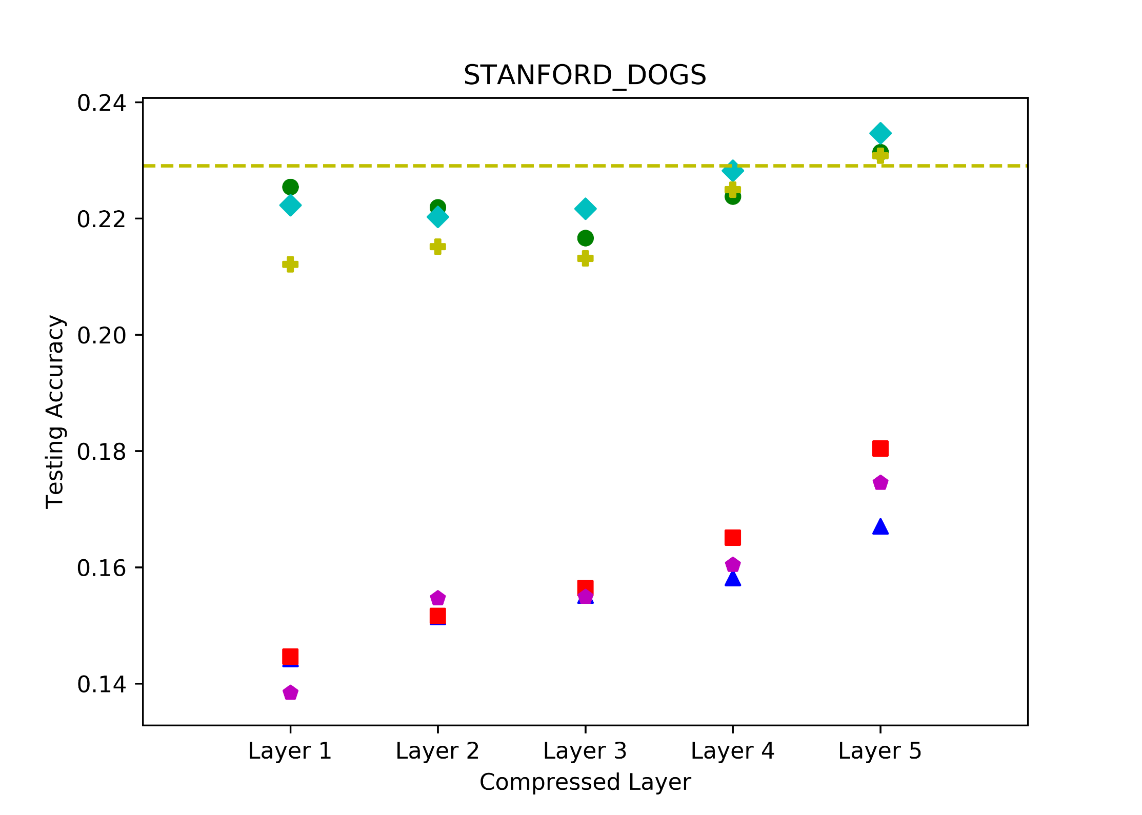
Deep Net Triage: Analyzing the Importance of Network Layers via Structural Compression
Theodore Nowak¹ and Jason J. Corso²
Robotics Institute^{1,2} and Electrical Engineering and Computer Science², University of Michigan, Ann Arbor, MI
Abstract
Method: Structural Compression
Results: Rate of Convergence
Investigation of model quality after model compression, and varying initialization and training regimes
4 data sets of varying complexity, 124 experimental network combinations
No layer is more contributory to overall accuracy
Accuracy can be improved by a compressed network
Knowledge Distillation caps accuracy at that of the parent
The VGG16 network structure consists of 5 repeated blocks of convolution layers followed by max pooling.
Structural Compression reduces one of these blocks of 2 to 3 layers down to a single layer, and reinitializes its weights.
Relative to accuracy, STN networks tend to converge more quickly, while otherwise, convergence rate and relative accuracy are directly correlated.
Introduction
Deep network models are poorly understood
Model pruning and compression has been shown to reduce overhead and maintain accuracy of networks [2]
Knowledge Distillation has been used to approximate model ensembles and deeper models [3]
How does the model cope with parameter loss, and what is the optimal model structure?
Method: Experimental Methods
Mean Initialization
Student-Teacher Network
Frozen vs. Thawed Model
Initialize the compressed layer as an average of the layers it replaces.
Compute and backpropagate the loss after the compressed layer.
We test whether the compressed layer can learn filters to fit into the existing model. The frozen model freezes the rest of the model parameters, while the thawed model allows for gradient updates across the entire model.
Problem Statement
$$f_{avg}=\frac{1}{N}\sum_{i=1}^{N}{f_{i} where f_{i}∈R^{3x3x1}}$$
$$L_{STN}=\min_{W_{s}, b_{s}}{\frac{1}{N}\sum_{i=1}^{N}{{\left\|s\left(x_{i}, W_{s},b_{s}\right)−t\left(x_{i}, W_{t}, b_{t}\right)|\right|}^{2}}}$$
Given the VGG16 network:
How do the filters learned, the accuracy, and the rate of convergence change as groups of layers are replaced by a single layer?
How does varying initialization and training regimes affect this?
How does this vary across data set complexity?
Results: Accuracy
Maximal accuracy achieved by each model on each data set for each compressed layer.
Results: Qualitative
Q: Why does knowledge distillation cap the accuracy at that of the base model?
Experimental Overview
A: The Student network is encouraged to learn the same filters as the Parent rather than different, more efficient filters.
No layer is more contributory
Accuracy can be improved by compression
Knowledge Distillation caps accuracy -- Why?
Every combination of experiments was performed in addition to the 4 base models
Experiment Sets
Data Sets | { MNIST, CIFAR10, CIFAR100, Stanford Dogs }
Layer Blocks Compressed | { Block-1, Block-2, Block-3, Block-4, Block-5 }
Initialization Schemes | { Random, Mean, Student-Teacher Network }
Training Regimes | { Frozen Model, Thawed Model }
Key Acronyms
Base: Uncompressed
FM: Frozen Model
TM: Thawed Model
RW: Random Weights
MW: Mean Weights
STN: Student-Teacher Network
References
[1] Nowak and Corso. Deep Net Triage: Analyzing the Importance of Network Layers via Structural Compression. ArXiv 2018.
[2] Han et al. Deep Compression: Compressing Deep Neural Networks with Pruning, Trained Quantization and Huffman Coding. ICLR 2015.
[3] Hinton et al. Distilling the Knowledge in a Neural Network. ICLR 2015.

