Slide 1


Beyond Ranking:
Optimizing Whole-Page Presentation
Yue Wang, Dawei Yin, Luo Jie,
Pengyuan Wang, Makoto Yamada
Yi Chang, Qiaozhu Mei

Slide 2
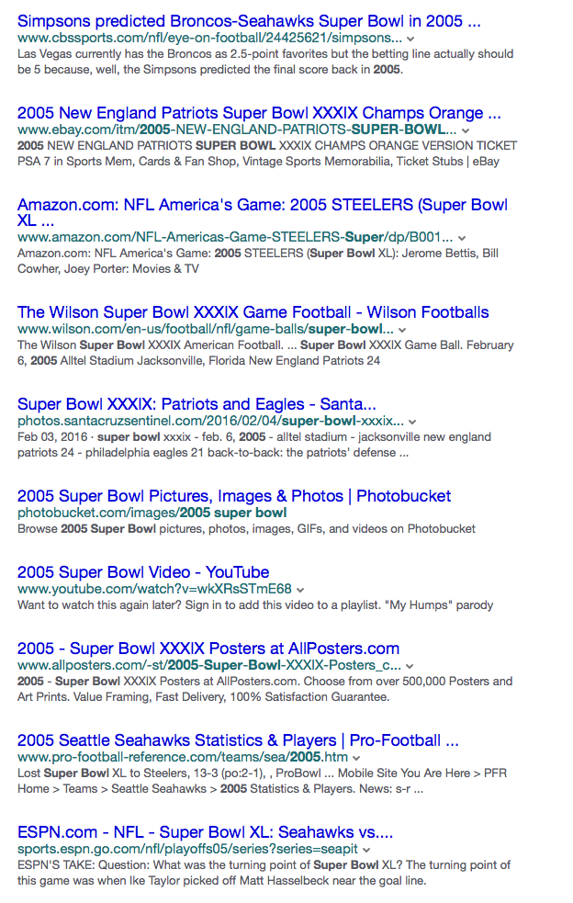
Ranking in IR
Probability ranking principle [Robertson 1977]:
Relevance ranking is optimal if:
  Document utility are independent
  User browsing are sequential

Slide 3
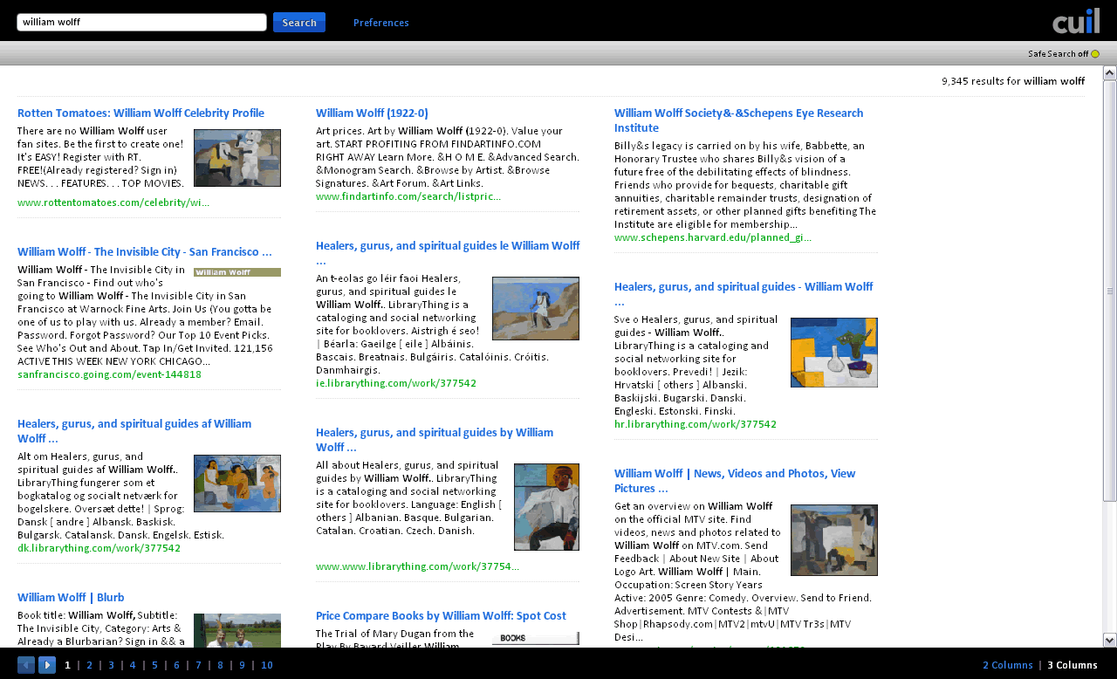
Beyond ranking?
Cuil search engine (2008 ~ 2010)

Slide 4
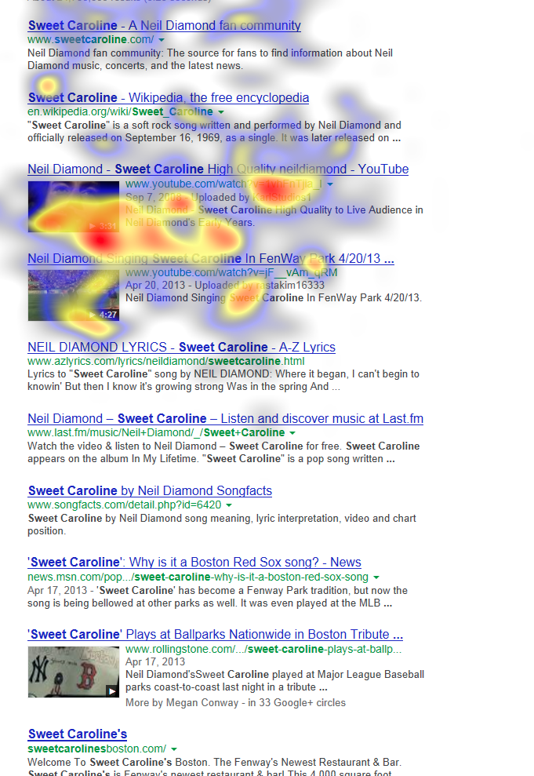
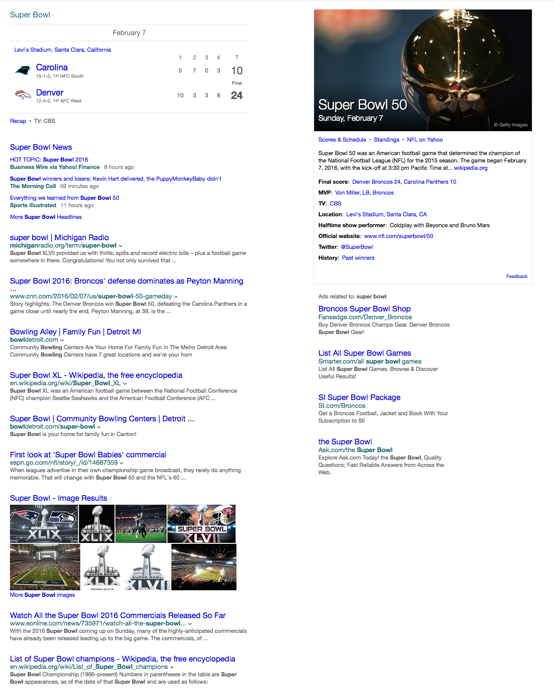

Beyond ranking
“san francisco”
“superbowl”
“obama”
^{Credit: Matthew Campion.} ^{Eye tracking study:}
Google results with videos. 2013/9.

Slide 5
How can we find
the optimal whole-page presentation?

Slide 6
A toy example
content = { , , }
presentation options:

Slide 7
A toy example
content = { , , }
presentation options:

Slide 8




A toy example
content = { , , }
presentation options:

Slide 9
Presentation >> layout
content = { , , }
>
Optimizing two-dimensional search results presentation
Chierichetti, Kumar, and Raghavan. WSDM ’11

Slide 10


query
search engine
backend
content
presentation strategy space

Slide 11

query
search engine
backend
content
satisfaction
Q( content , presentation ) = satisfaction
presentation strategy space

Slide 12
General framework
Phase 1:
Phase 2:
satisfaction = Q(content, presentation)
presentation* = argmax Q(content, presentation)
presentation

Slide 13
label?
How to find Q:
(content, presentation)
satisfaction
Q
User ratings?

Slide 14
define satisfaction
How to find Q:
(content, presentation)
user response
satisfaction

Slide 15
selection bias by existing algorithm
How to find Q:
(content, presentation)
satisfaction
Q
search engine
presentation
strategy

Slide 16
presentation exploration
How to find Q:
(content, presentation)
user response
satisfaction
presentation strategy space
…
…
…

Slide 17
model consideration
How to find Q:
(content, presentation)
satisfaction
Q
Q Linear?
Q = a^{T}content + b^{T}presentation
+ content^{T} W presentation + …

Slide 18

example models
How to find Q:
Quadratic interaction model
Gradient boosted decision tree model
Q(x, p) = a^{T}x + b^{T}p + x ^{T} W p + c
Q(x, p) = h_{GBDT} (x, p)
p* = argmax Q(x, p)
p
p* = argmax h_{GBDT} (x, p)
= argmax θ^{T}p
p
p
(subject to constraints on p)
(subject to constraints on p)
Linear assignment problem:
No polynomial-time solution
2GHz single core:
dim(p) = 2500 ~ 0.01 sec
search space pruned by
business and design constraints

Slide 19
Search traffic flow
presentation exploration bucket
Phase 1: offline
satisfaction = Q(content, presentation)
deploy learned Q
Phase 2: online
presentation*= argmax Q(content, presentation)
presentation
normal search traffic
14
presentation exploration bucket
presentation exploration bucket
Phase 1: offline
satisfaction = Q(content, presentation)
presentation exploration bucket
Phase 1: offline
satisfaction = Q(content, presentation)
presentation exploration bucket
Phase 1: offline
satisfaction = Q(content, presentation)
presentation exploration bucket
Phase 1: offline
satisfaction = Q(content, presentation)
Phase 1: offline
satisfaction = Q(content, presentation)
deploy learned Q
deploy learned Q
deploy learned Q
deploy learned Q
deploy learned Q
normal search traffic
normal search traffic
normal search traffic
Phase 2: online
normal search traffic
Phase 2: online
normal search traffic
Phase 2: online
presentation*= argmax Q(content, presentation)
Phase 2: online
presentation*= argmax Q(content, presentation)
presentation
Phase 2: online
presentation*= argmax Q(content, presentation)
presentation
presentation*= argmax Q(content, presentation)
presentation
presentation*= argmax Q(content, presentation)
presentation
presentation

Slide 20
Experiment: Yahoo Search
Presentation exploration bucket
8 million page views, 12 months (2013)
  first 6 months for training; last 6 month for test
4 verticals: news, shopping, single local listing, multiple local listings
Satisfaction = sum of clicks (+1) and skips (-1)

Slide 21
Less skips, more clicks
Sum of click (+1) and skip (-1)
x 10⁻³

Slide 22
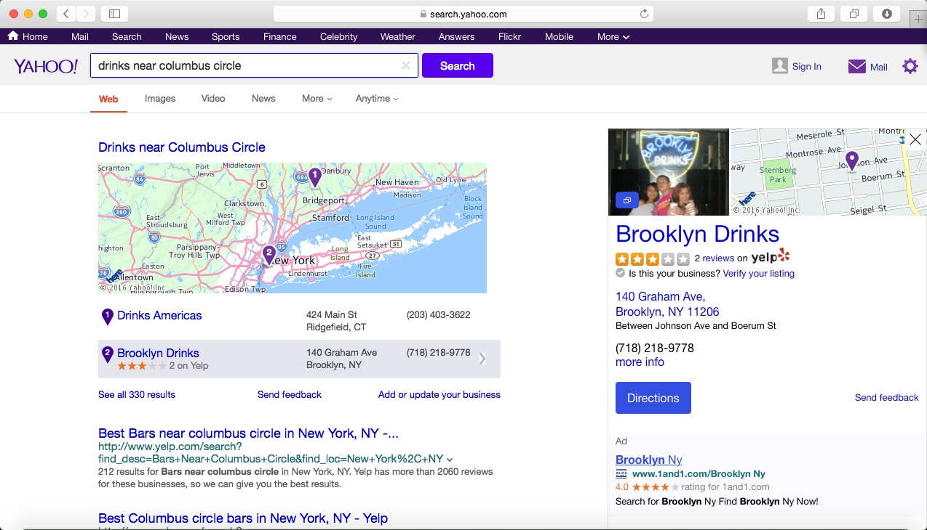
“drinks near Columbus circle”

Slide 23
Takeaway
New problem: whole-page presentation optimization
    Rich content in search results
    Joint effort in machine learning & HCI communities
  Presentation is quantified as parameters, so that it can be optimized

Slide 24
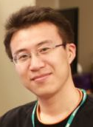
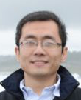
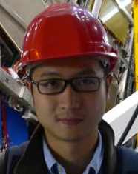
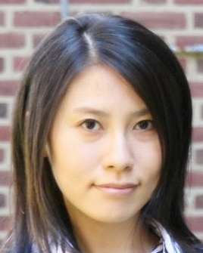
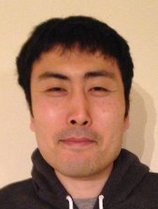
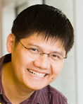
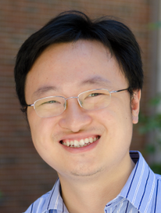
Thank you!
Yue Wang
Dawei
Yin
Luo
Jie
Pengyuan
Wang
Makoto
Yamada
Yi
Chang
Qiaozhu
Mei

Slide 25
References
[Robertson'77] S. E. Robertson. The probability ranking principle in ir. In Journal of Documentation, pages 294–304, 1977.
[Chierichetti'11] F. Chierichetti, R. Kumar, and P. Raghavan. Optimizing two-dimensional search results presentation. In Proceedings of the fourth ACM conference on Web search and data mining, pages 257–266, 2011.
[Luo'13] J, Luo, S. Lamkhede, R. Sapra, E. Hsu, H. Song, and Y. Chang. A unified search federation system based on online user feedback. In Proceedings of the 19th ACM SIGKDD conference on Knowledge discovery and data mining, pages 1195–1203. ACM, 2013.

Slide 26
Future directions
Explore more possible page layouts
  Type of verticals, # of columns, vertical canvas sizes
Experiment on more devices
  mobile & tablet search
Fine-grained user responses
  Cursor position, dwell time on clicks
Advanced user satisfaction metric

Slide 27
Click though rate
4 items on page
 | News | Shopping | Single Local | Multi. Local
Coverage | 3.8% | 0.18% | 0.11% | 3.4%
Baseline | 14.5% | 21.5% | 13.8% | 9.7%
GBDT-rank | 12.5% | 43.0% | 24.9% | 22.4%
Quadratic | 11.5% | 12.9% | 15.5% | 24.4%
GBDT-pres. | 14.1% | 36.0% | 24.7% | 30.7%

