Slide 1
THE JAMES WEBB SPACE TELESCOPE
Philip Hughes
Department of Astronomy
University of Michigan
phughes@umich.edu
www-personal.umich.edu/~phughes/

Slide 2
Plan
Day 1:
Introduction – motivation
Modern astronomical telescopes
JWST – history, design and deployment
Day 2:
Star & planet formation – the background
JWST – new results
Day 3:
Galaxy formation & cosmology – the background
JWST – new results

Slide 3
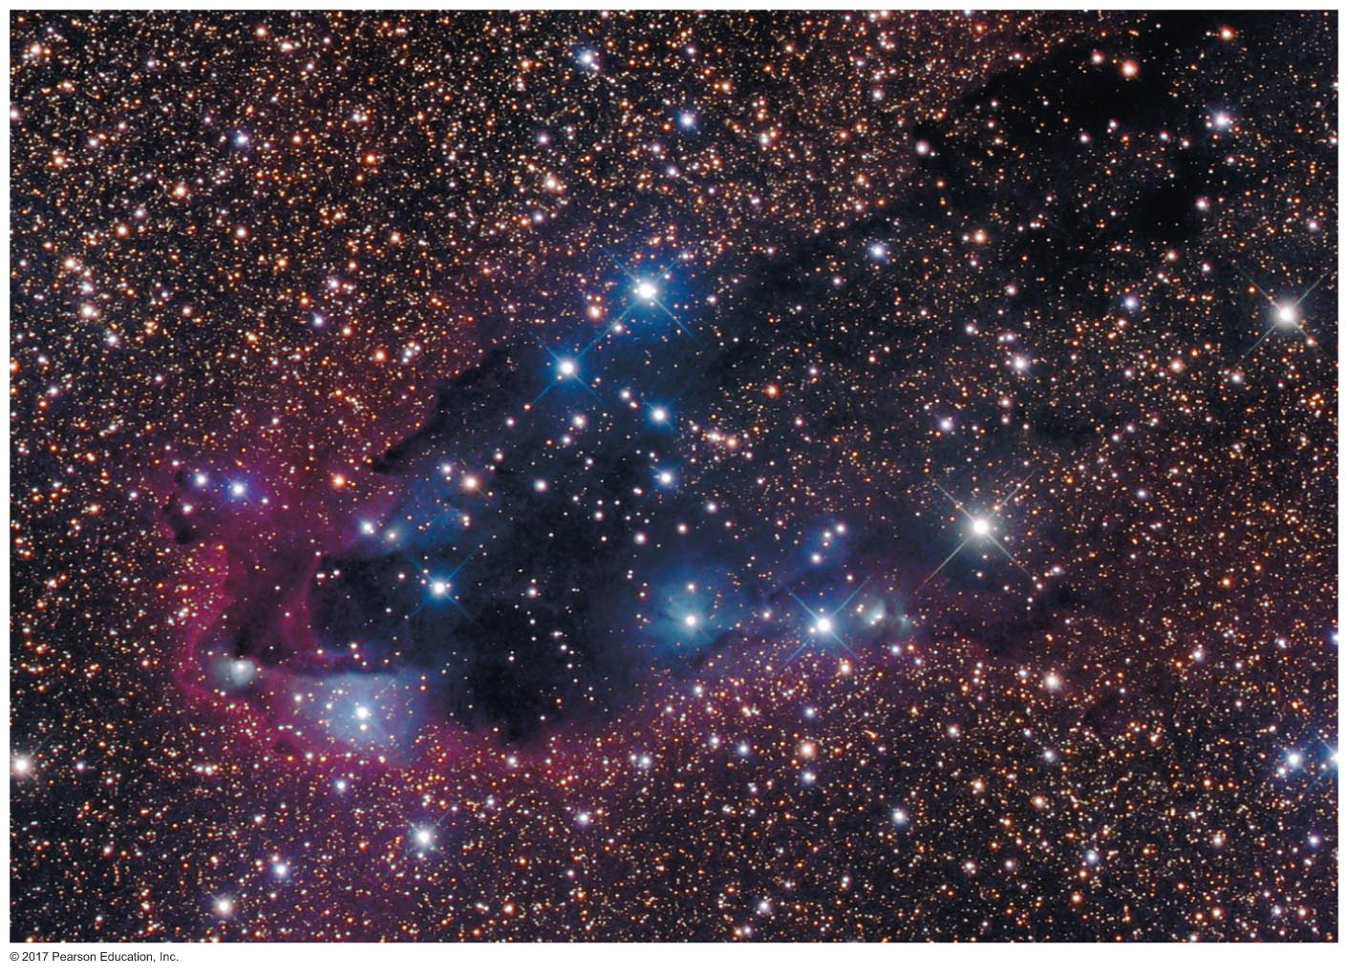
Star-Forming Clouds
The matter between the stars is called the interstellar medium.
Stars form in dark clouds of dusty, molecular gas in interstellar space, because there it’s cold and dense.

Slide 4
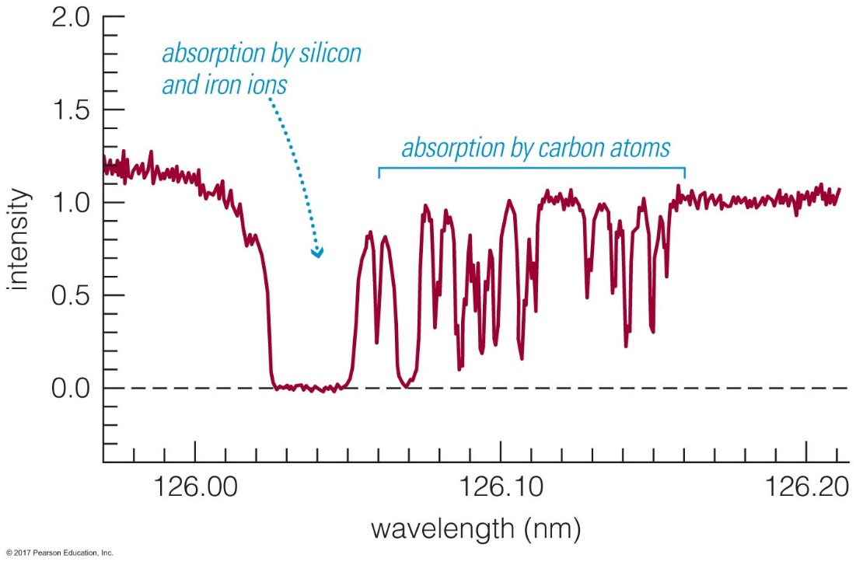
Composition of Clouds
We were able to determine the composition of interstellar gas from its absorption lines in the spectra of stars, long before modern molecular emission line observations became common.
70% H, 28% He, 2% heavier elements: the “stuff” of the Universe.

Slide 5
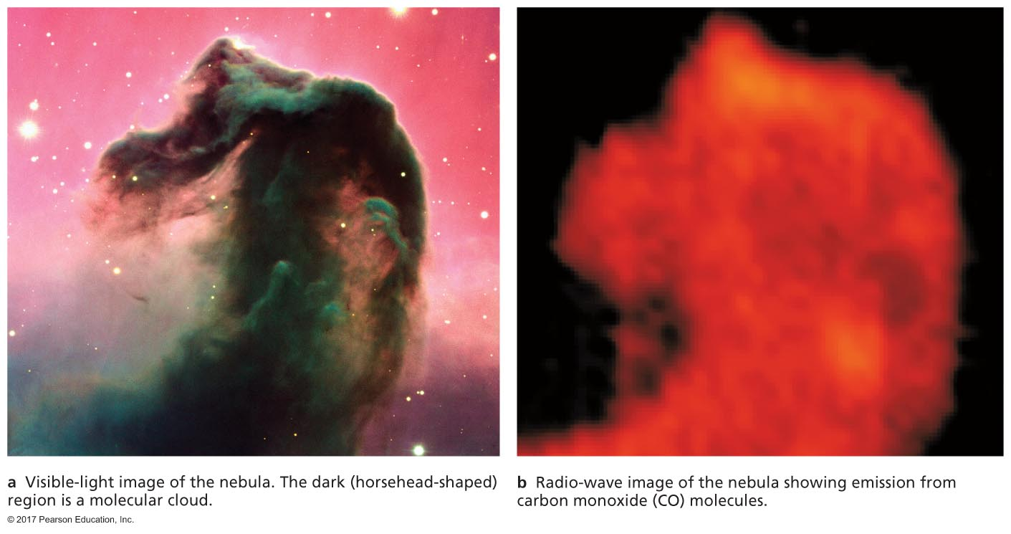
Molecular Clouds
Most of the matter in star-forming clouds is in the form of molecules (H₂, CO, etc.).
These molecular clouds have a temperature of 10–30 K, protected from starlight by dust.

Slide 6
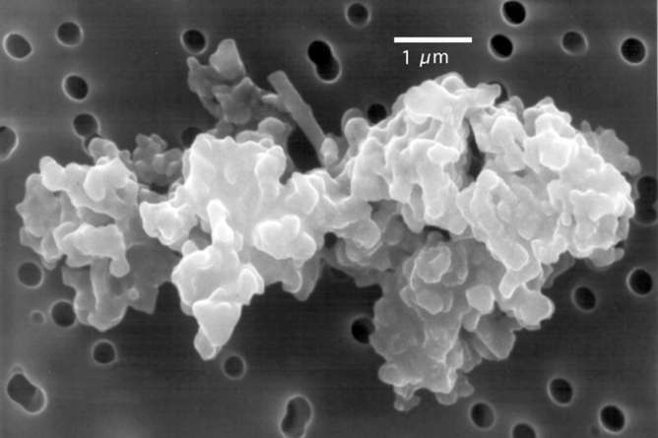
Interstellar Dust
Particles are < 1 micrometer in size and made of elements like C, O, Si, and Fe.
Interstellar dust is very effective at scattering visible light, and blocks our view of stars within and beyond clouds.
Interplanetary dust – possibly pre-solar nebula

Slide 7
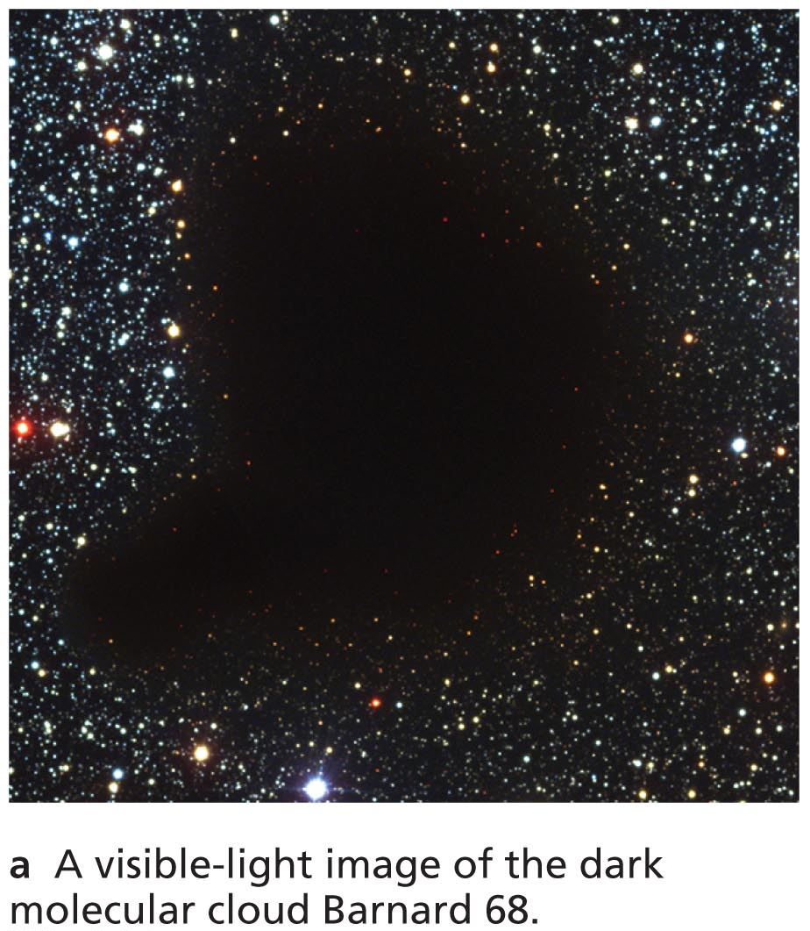
Interstellar Reddening
Stars viewed through the edges of the cloud look redder because dust blocks (shorter-wavelength) blue light more effectively than (longer-wavelength) red light.

Slide 8
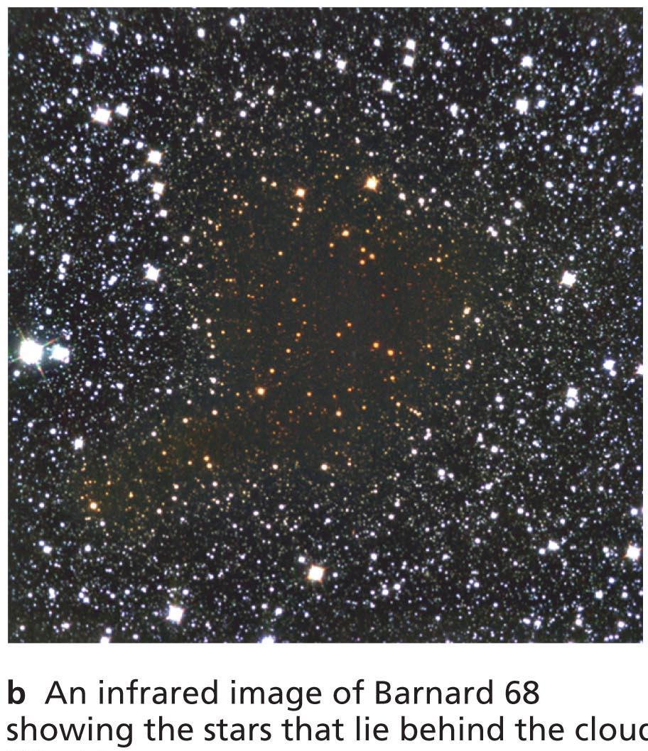
Interstellar Reddening
Long-wavelength infrared light passes through a cloud more easily than visible light.
Observations of infrared light reveal stars on the other side of the cloud.

Slide 9
Observing Newborn Stars
Visible light from a newborn star is often trapped within the dark, dusty gas clouds where the star formed.

Slide 10
Observing Newborn Stars
Observing the infrared light from a cloud can reveal the newborn star embedded inside it.

Slide 11
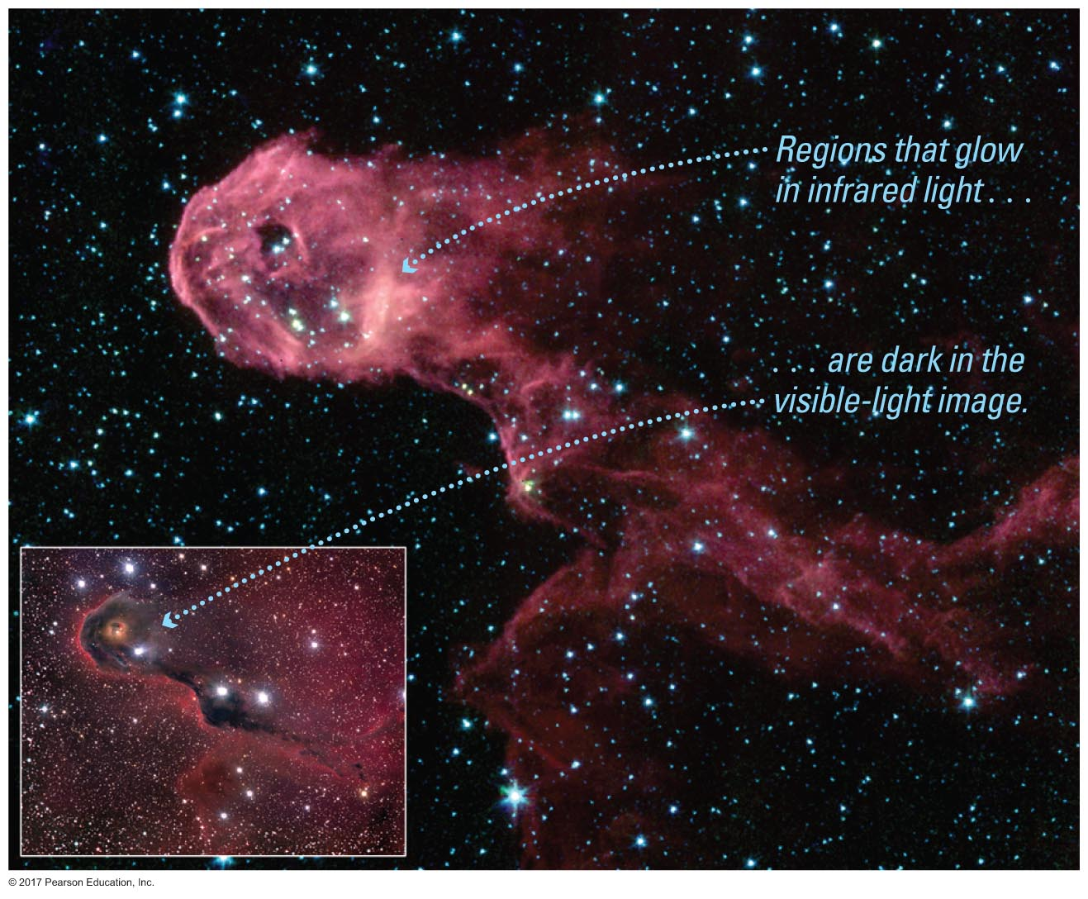
Glowing Dust Grains
Dust grains that absorb visible light heat up and emit infrared light of even longer wavelength.

Slide 12
Gravity versus Pressure
Gravity can create stars only if it can overcome the force of gas pressure in a cloud.
A typical molecular cloud (T∼30 K, n∼300 particles/cm³; air has almost 10²⁰ molecules/cm³) must contain at least a few hundred solar masses for gravity to overcome pressure.

Slide 13
Fragmentation of a Cloud
Gravity within a contracting gas cloud becomes stronger as the gas becomes denser.
Gravity can therefore overcome pressure in smaller pieces of the cloud, causing it to break apart into multiple fragments, each of which may go on to form a star.
gravitational force ∝ density²
pressure force ∝ density

Slide 14
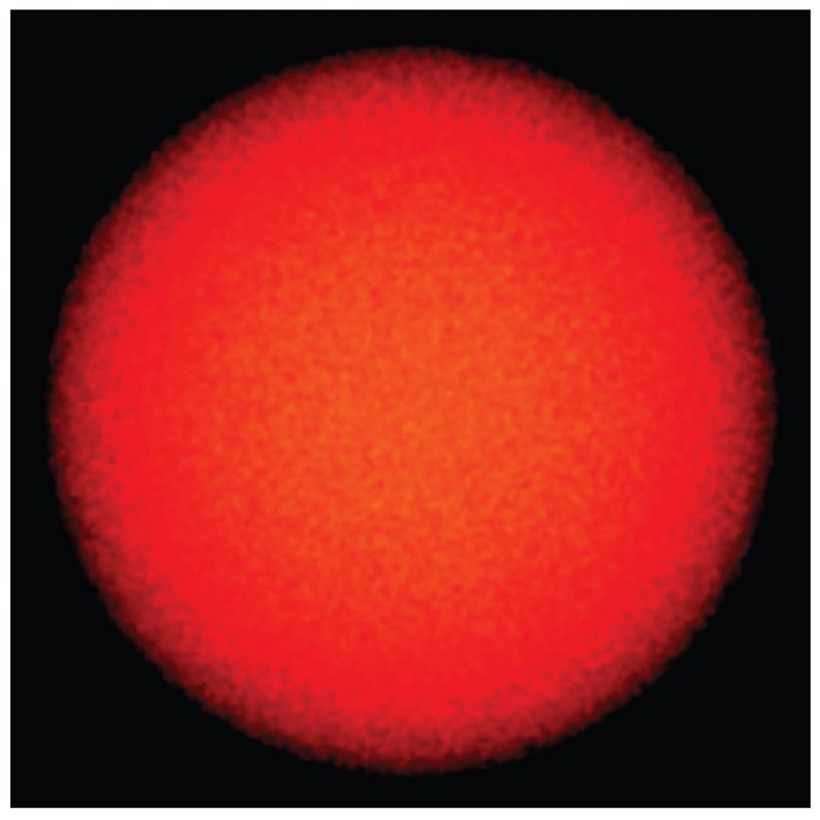
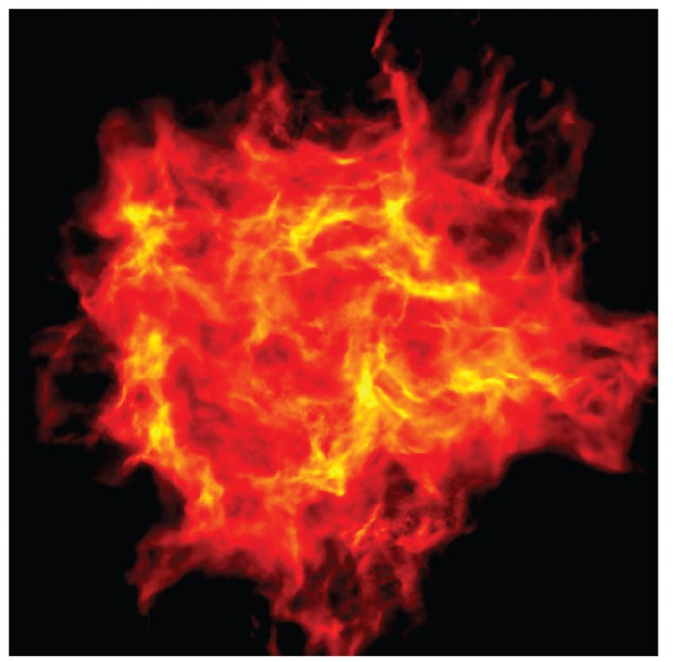
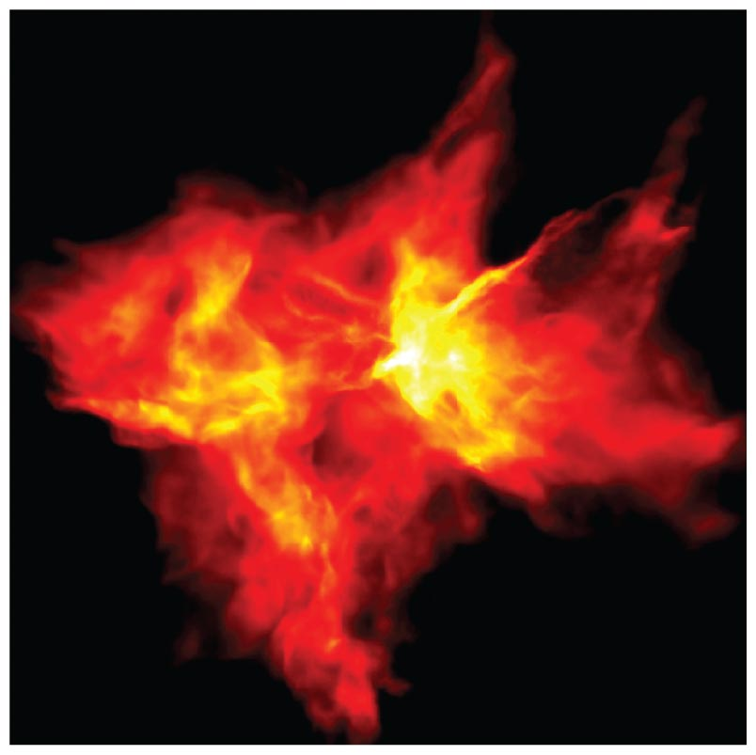
Fragmentation of a Cloud: Star Cluster
Cloud containing 50 solar masses of gas.

Slide 15
Trapping of Energy
During contraction half the liberated potential energy goes into heat, half is radiated away.
As contraction packs the molecules and dust particles of a cloud fragment closer together, it becomes harder for infrared and radio photons (from molecular emission lines) to escape.
Contraction slows down, and the center of the cloud fragment becomes a protostar.

Slide 16
Trapping of Energy
Gravity always wins, and contraction continues, but at a rate set by the time scale for energy to radiate away.
Note balloon analogy.

Slide 17
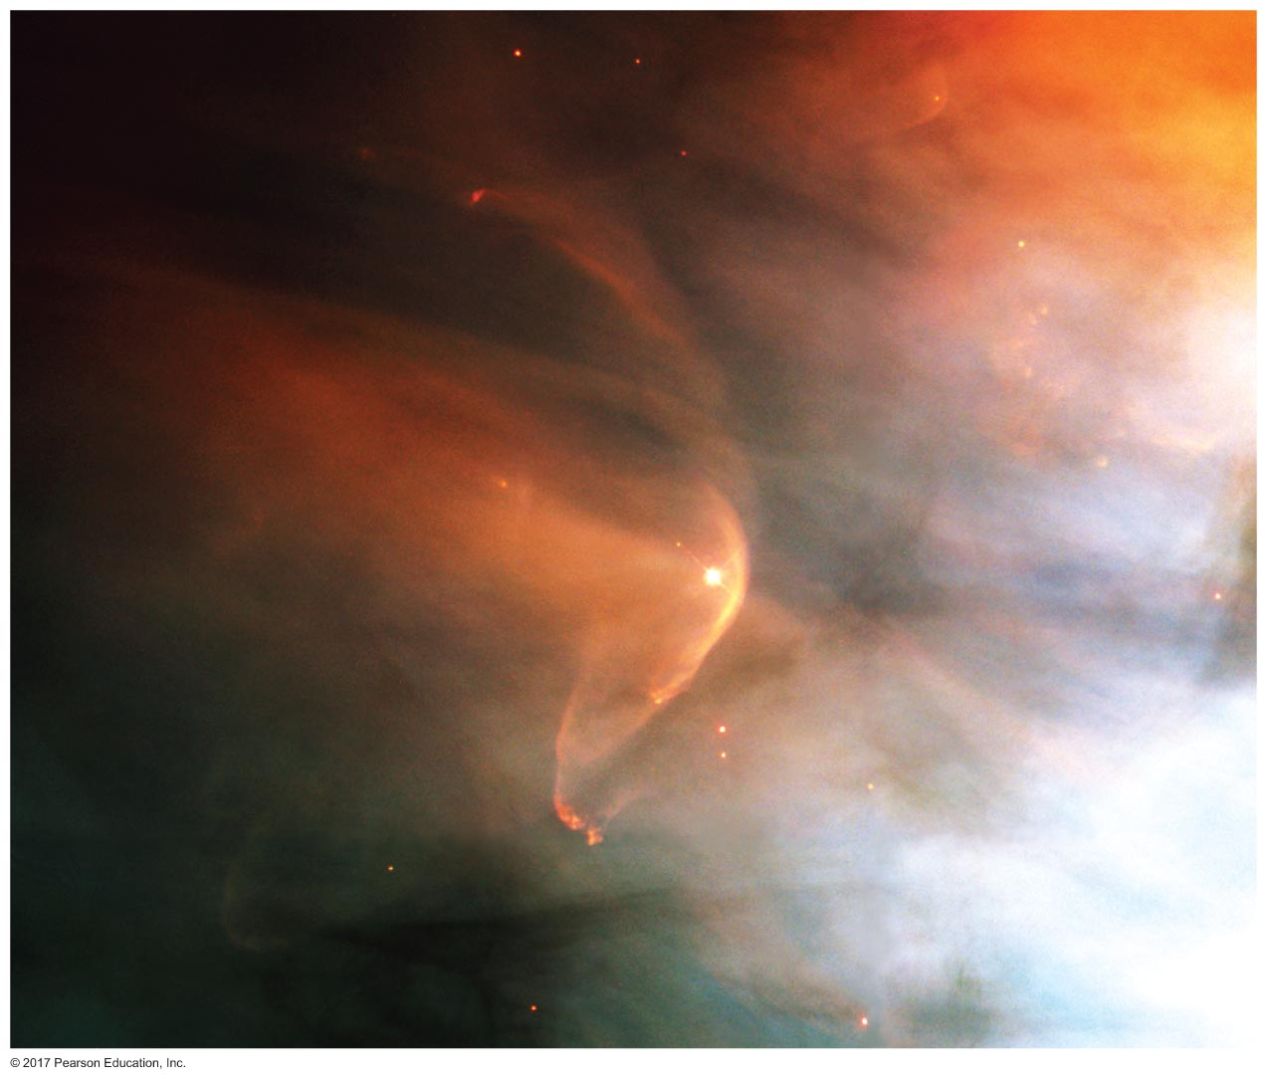
Growth of a Protostar
Matter from the cloud continues to fall onto the protostar until either the protostar or a neighboring star blows the surrounding gas away.
Bow shock in outflow from young star LL Orionis.

Slide 18
Collapse contd.
The original nebula had some spin: conservation of angular momentum causes the cloud to spin up as it contracts.
Centripetal force holds up the cloud in the 'spin plane', but not along the axis; collisions
allow collapse to disk;
order motions in the disk.

Slide 19
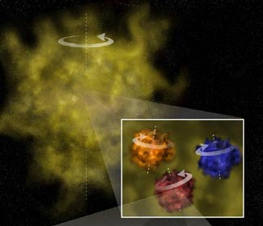
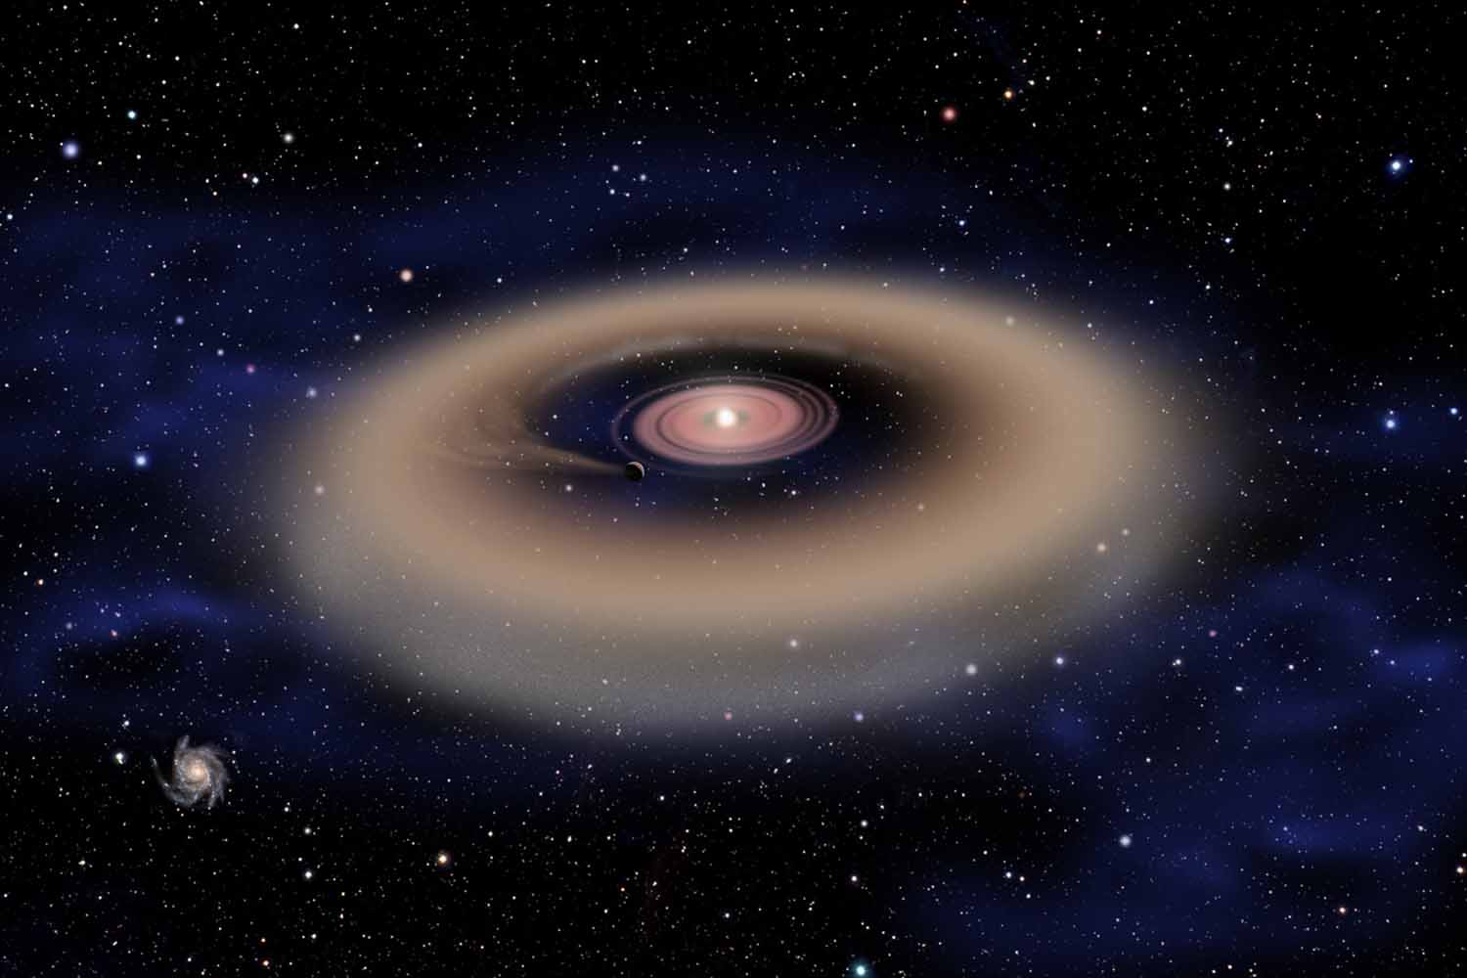
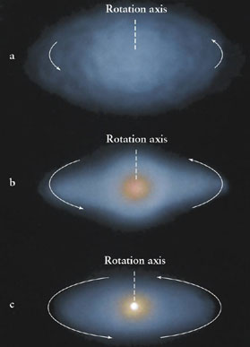

Slide 20
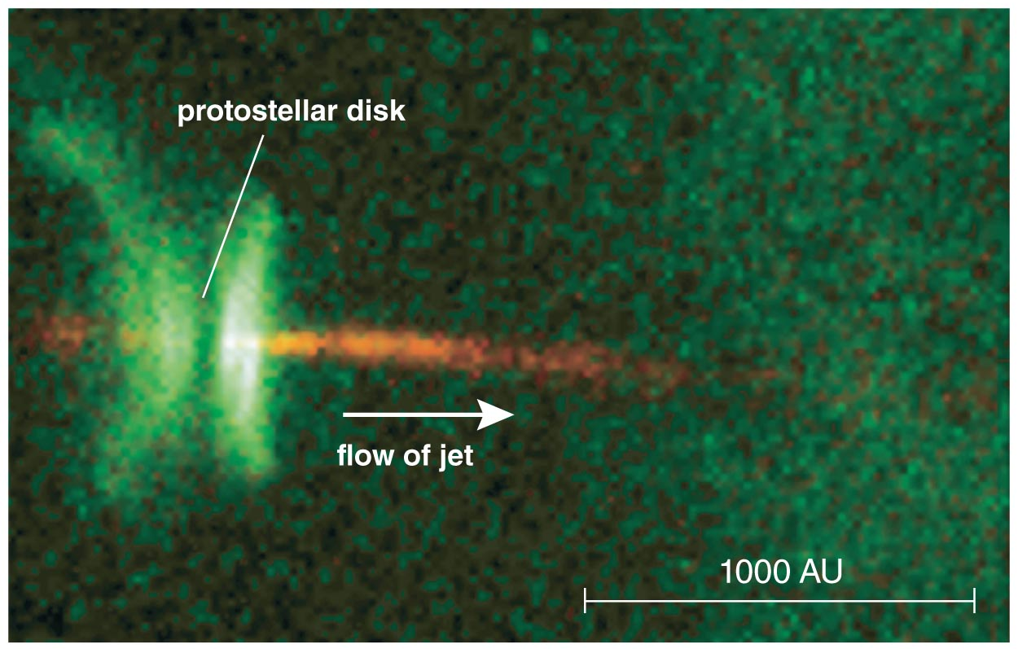
Disk channels released energy
Jets are observed coming from the centers of disks around protostars.

Slide 21
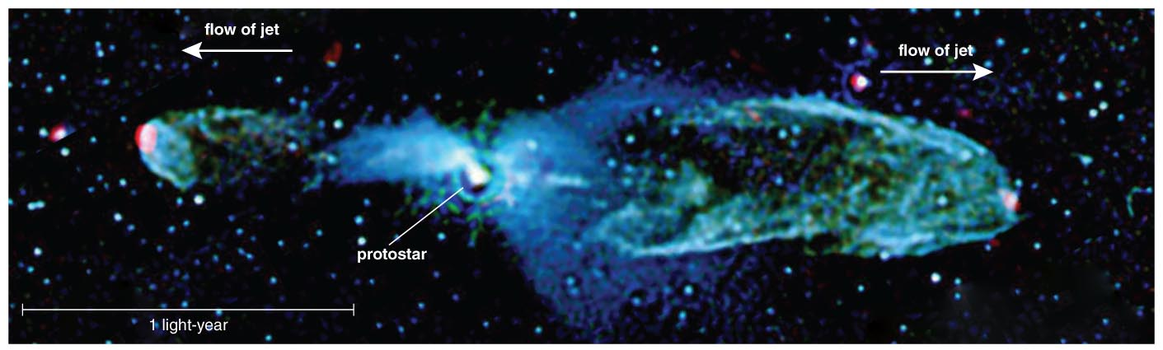
The jets ram into interstellar gas, heating it and causing it to glow.

Slide 22
Inside-out collapse of cloud core
Inner cloud is denser, so free-fall time is less
This is the protostellar phase
Conservation of angular momentum produces
protostar
disk
infalling envelope (optically thick)

Slide 23
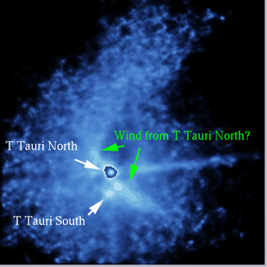
T Tauri phase
Shrouding envelope disperses – forming star/disk becomes visible
< 10 million years old
core too cool for fusion – gravitational potential energy – intermediate between protostar/regular star

Slide 24
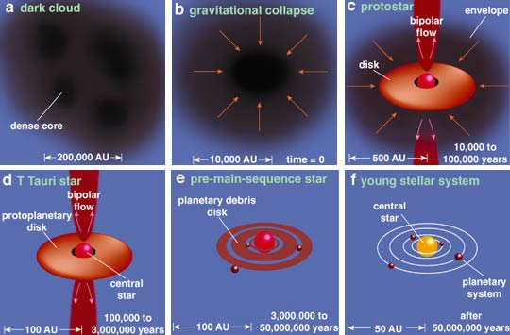

Slide 25
Timescales
The frequency of observed phases tells us the relative time spent in each
Disks seem to have largely dispersed by 8-10 million years, setting constraints on the time for (and thus mechanism for) giant planet formation

Slide 26
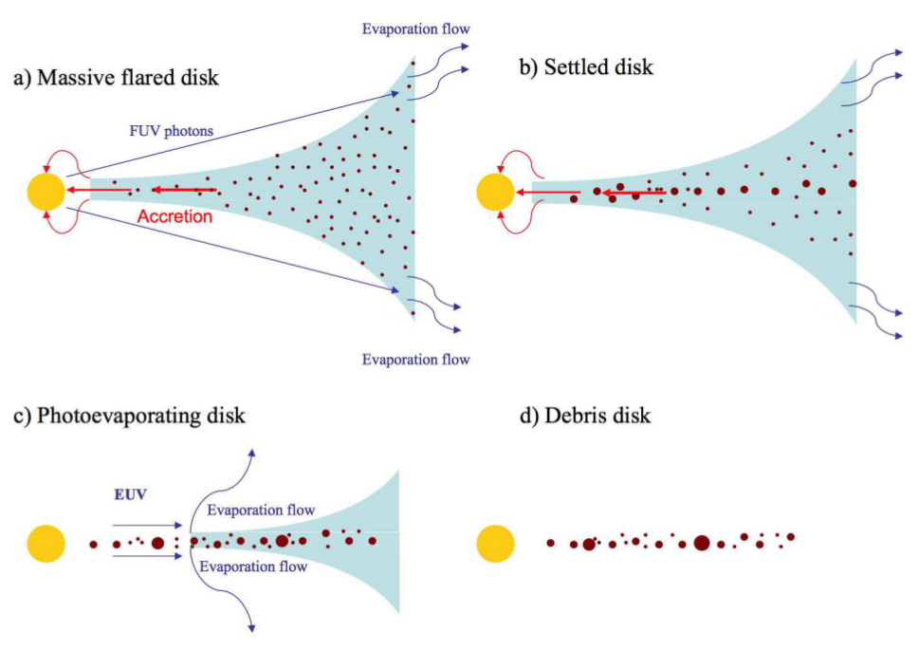
Gas & Grains In Disk

Slide 27
Major Issues: Growth Of Planets
By x 10¹³ in scale!
Electrostatic sticking
Collisional melding – tricky:
shatter wins over sticking
meter size barrier
do big things even stick?
maybe vortices pull stuff together
Gravitational accretion

Slide 28
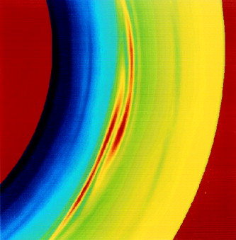
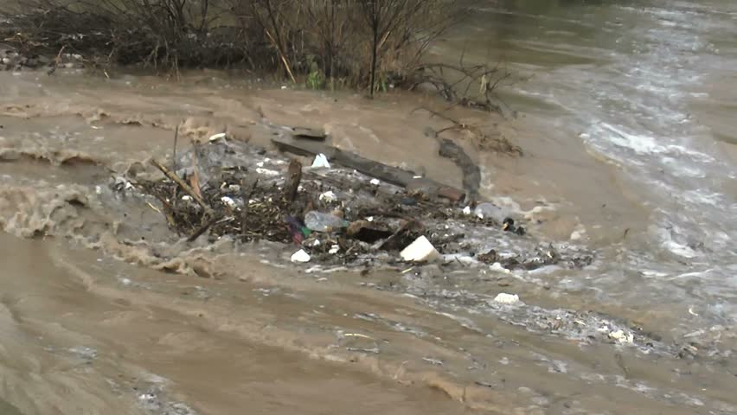
Disk Vortices To The Rescue?

Slide 29
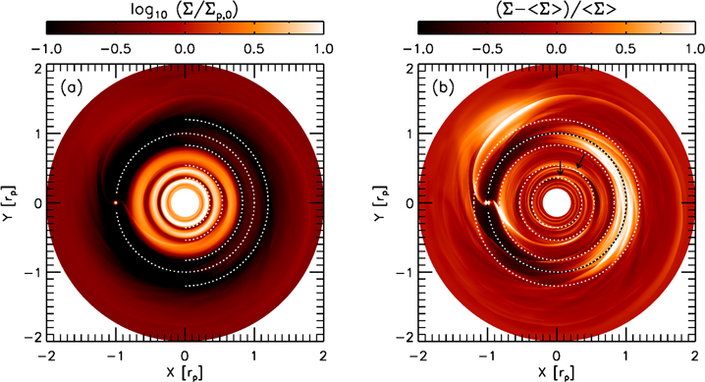
Major Issues: Gaps
Planets open gaps
One planet can open multiple gaps – interior and exterior to orbit
Bae, Zhu,
& Hartmann

Slide 30
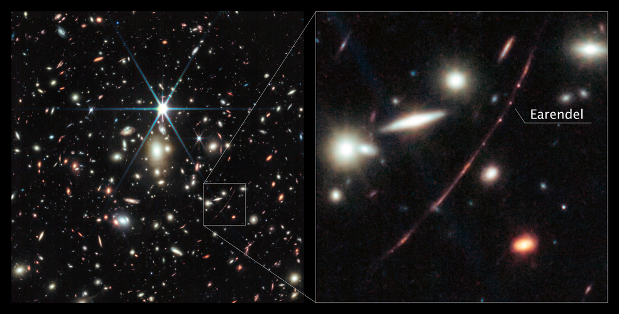
Earendel

Slide 31
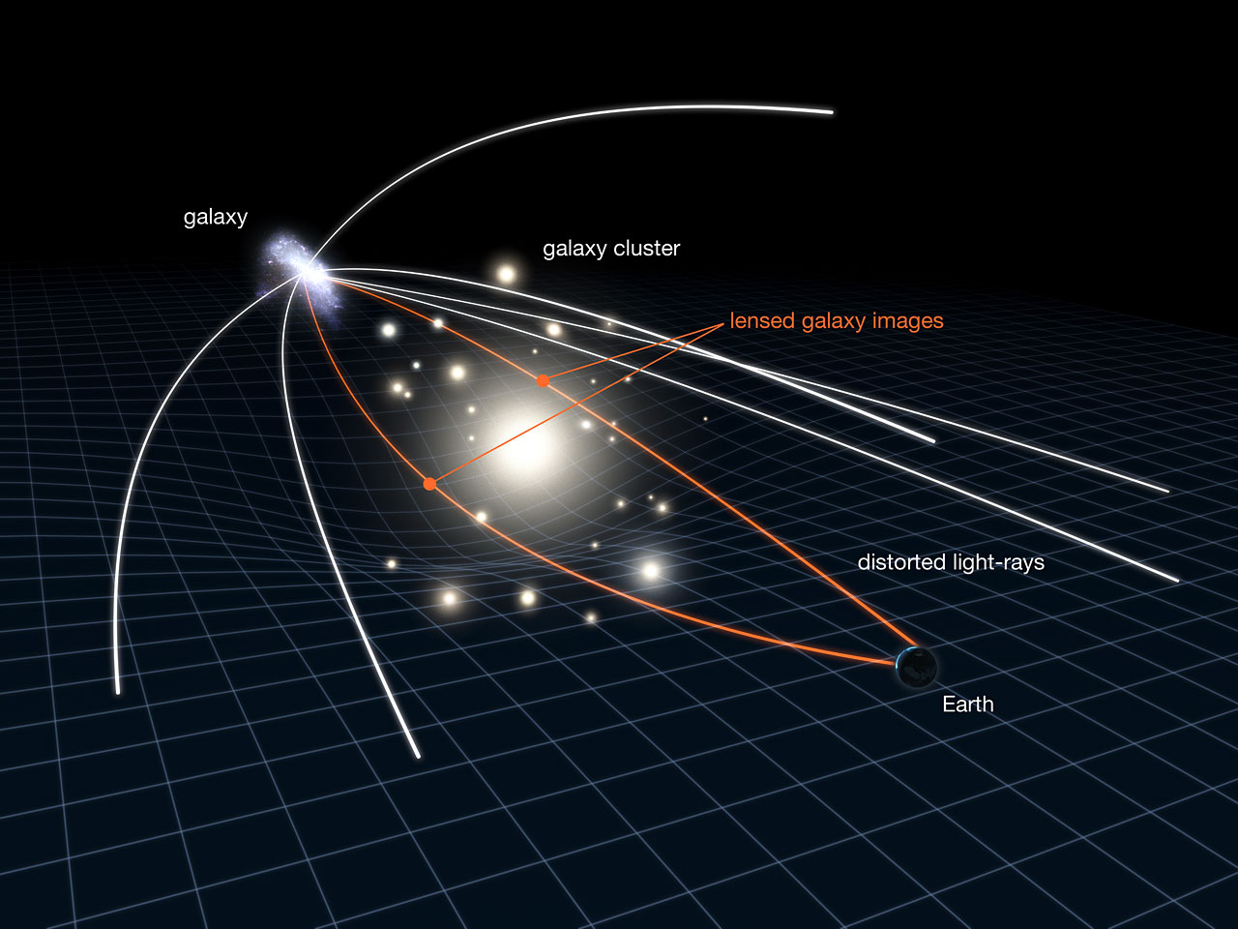
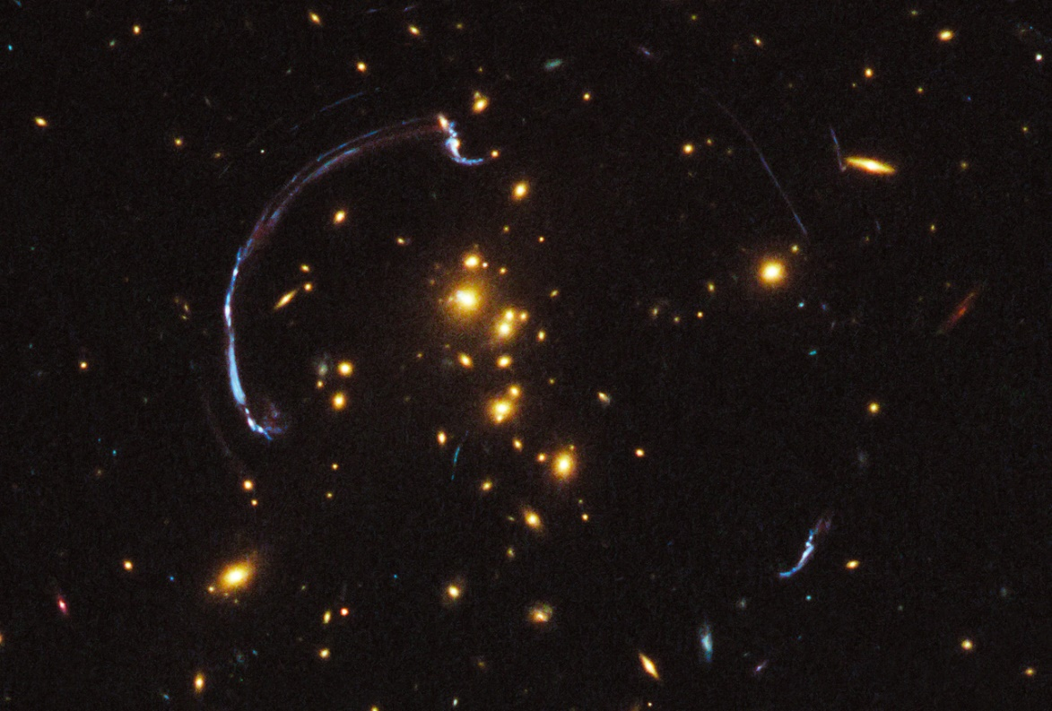

Slide 32
Earendel
NIRCam image reveals “Sunrise arc”, a gravitationally lensed image of a galaxy
Contains a B star (twice as hot as Sun, million times more luminous) from within 1 billion years of Big Bang [brightened by x4000 due to lensing]: most distant star ever detected
Originally found by HST, but JWST data suggests a companion red star, consistent with massive stars often being binary
Patches of light on either side of Earendel are two images of one star cluster 10 million years old; we are probing the earliest stars to form in the Universe

Slide 33
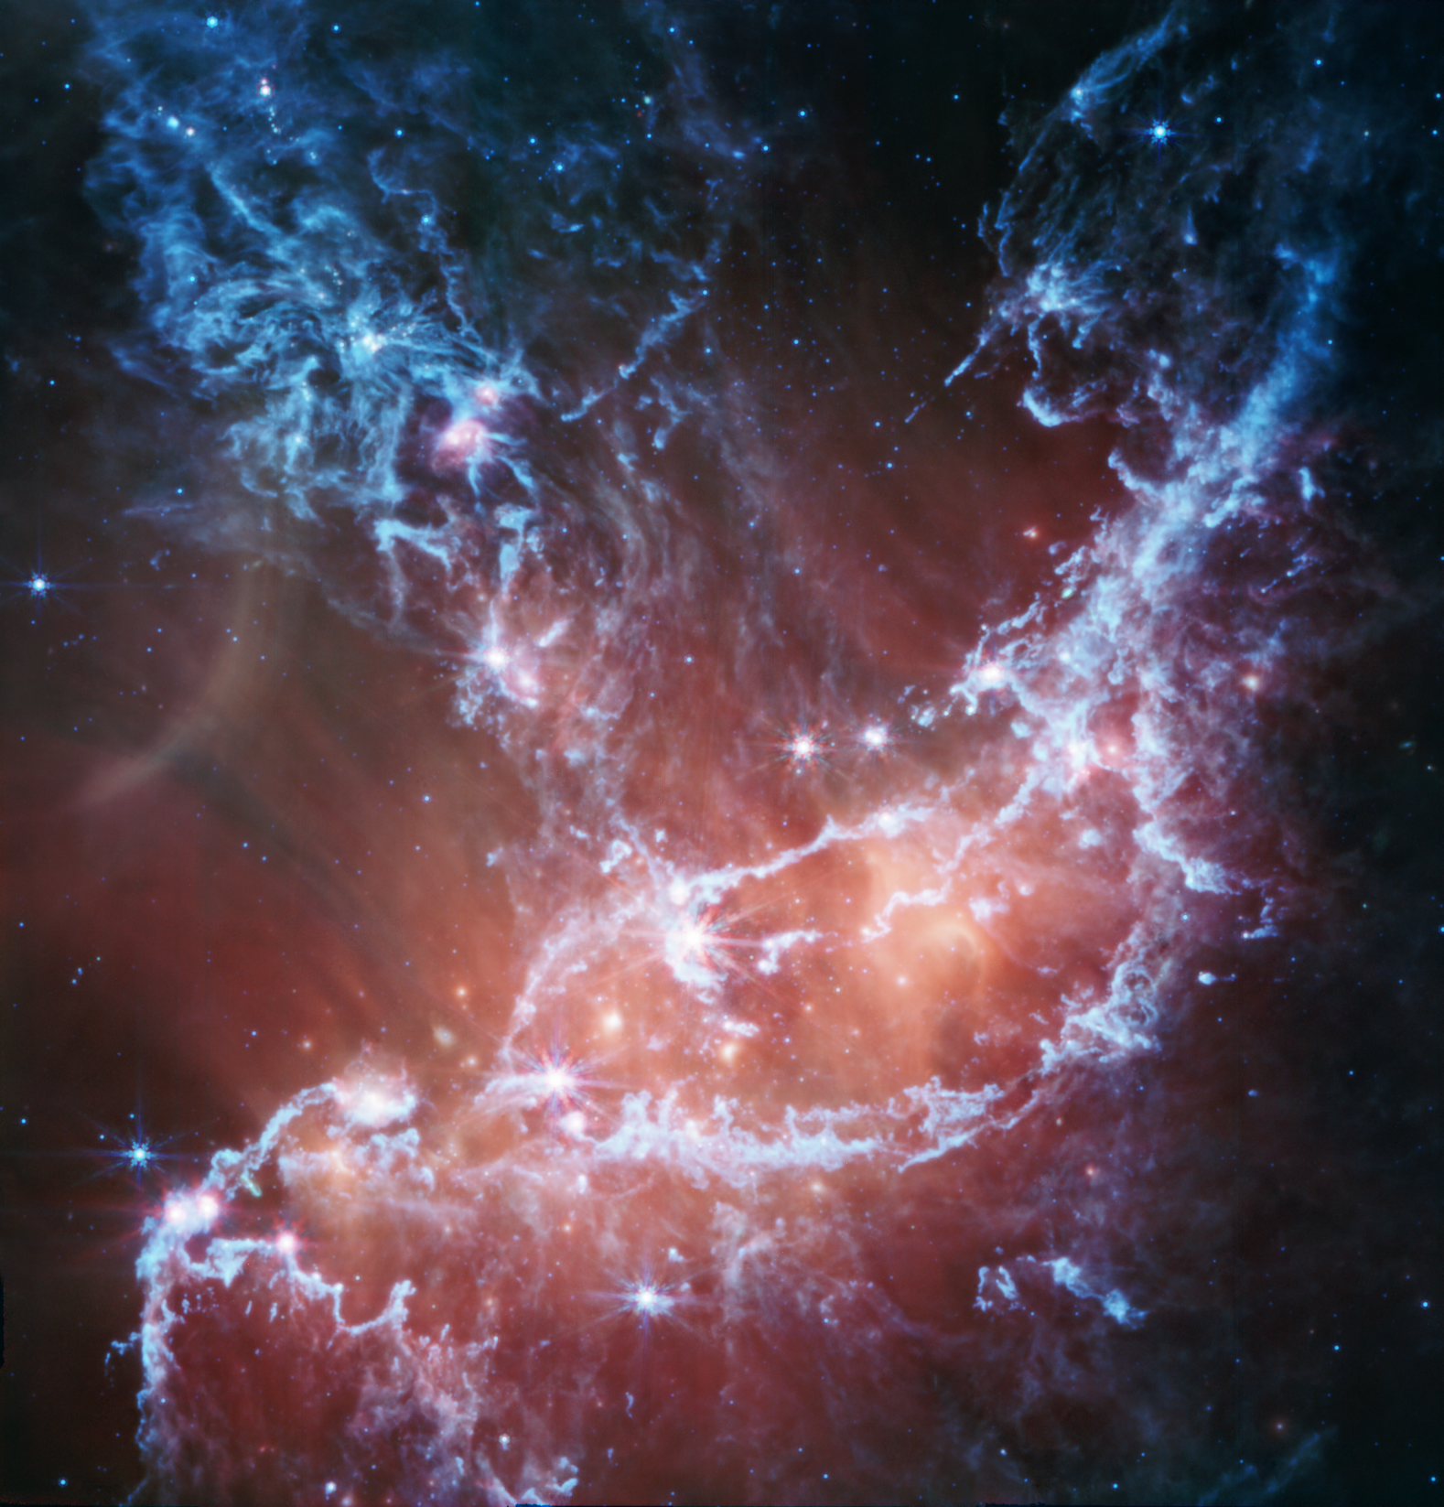
NGC 346

Slide 34
NGC 346
MIRI image of cool gas and dust in a star forming region in SMC
Blue* is emission from silicates and PAHs; red* is warmer dust heated by stars
Filaments are regions with a high density of protostars (over 1000 identified)
Widely thought the SMC is less evolved than Milky Way – fewer heavy elements – less dust – this will cause a rethink!
Will help us understand “cosmic noon” when there was less dust around, but star formation peaked
* “false colors”

Slide 35
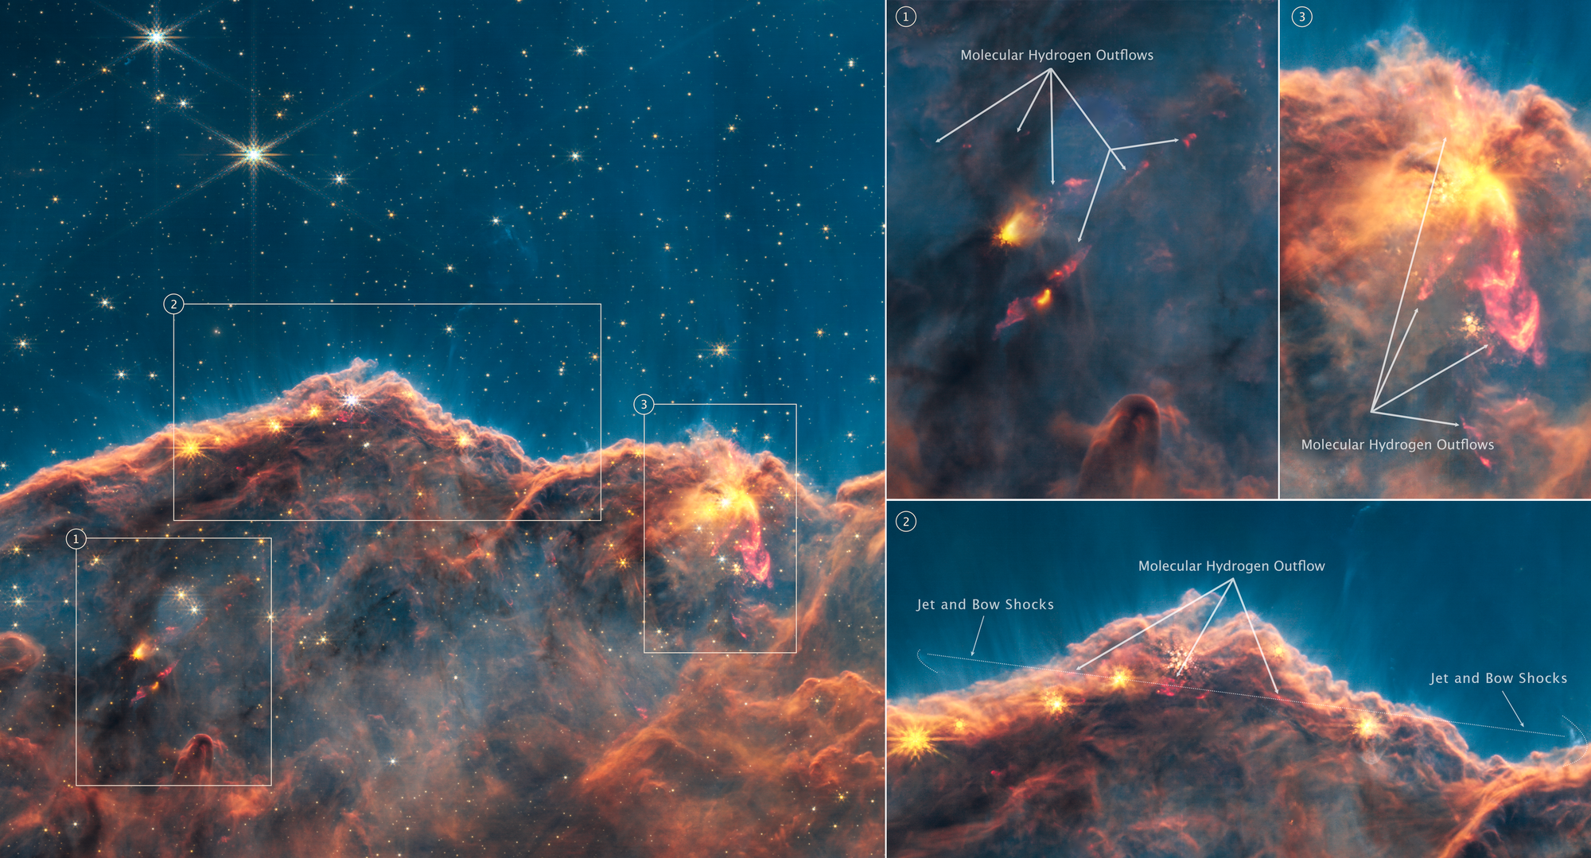
Cosmic Cliffs

Slide 36
Cosmic Cliffs
NIRCam observation of “Cosmic Cliffs”, a large gaseous cavity within star cluster NGC 3324 (NW of the Carina nebula, at about 9,000 ly)
Reveals several dozen jets and outflows from stars in formation within the “cliffs”, interpreted using detailed exploration with multiple filters
Gives new insight into just how active star forming regions are, and the demographics of young star systems

Slide 37
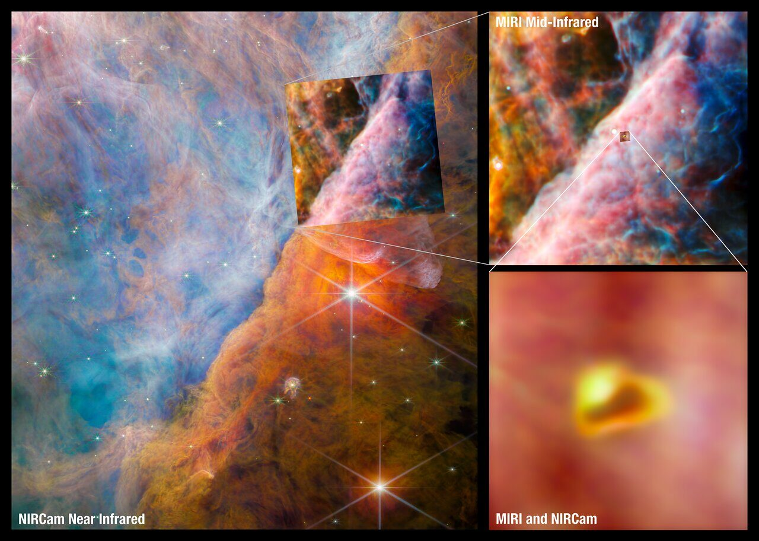
Orion Disk

Slide 38
Orion Disk
NIRCam & MIRI observations of a protoplanetary disk in the Orion star forming region, 1350 ly away
Detect the methyl cation (CH₃⁺) molecule
Initiates the growth of carbon-based molecules
Major impact on our understanding of interstellar chemistry (in particular in the presence of UV radiation from hot stars) and the origins of life
Study by Felipe Alarcón and Ted Bergin
(UM Astronomy)

Slide 39
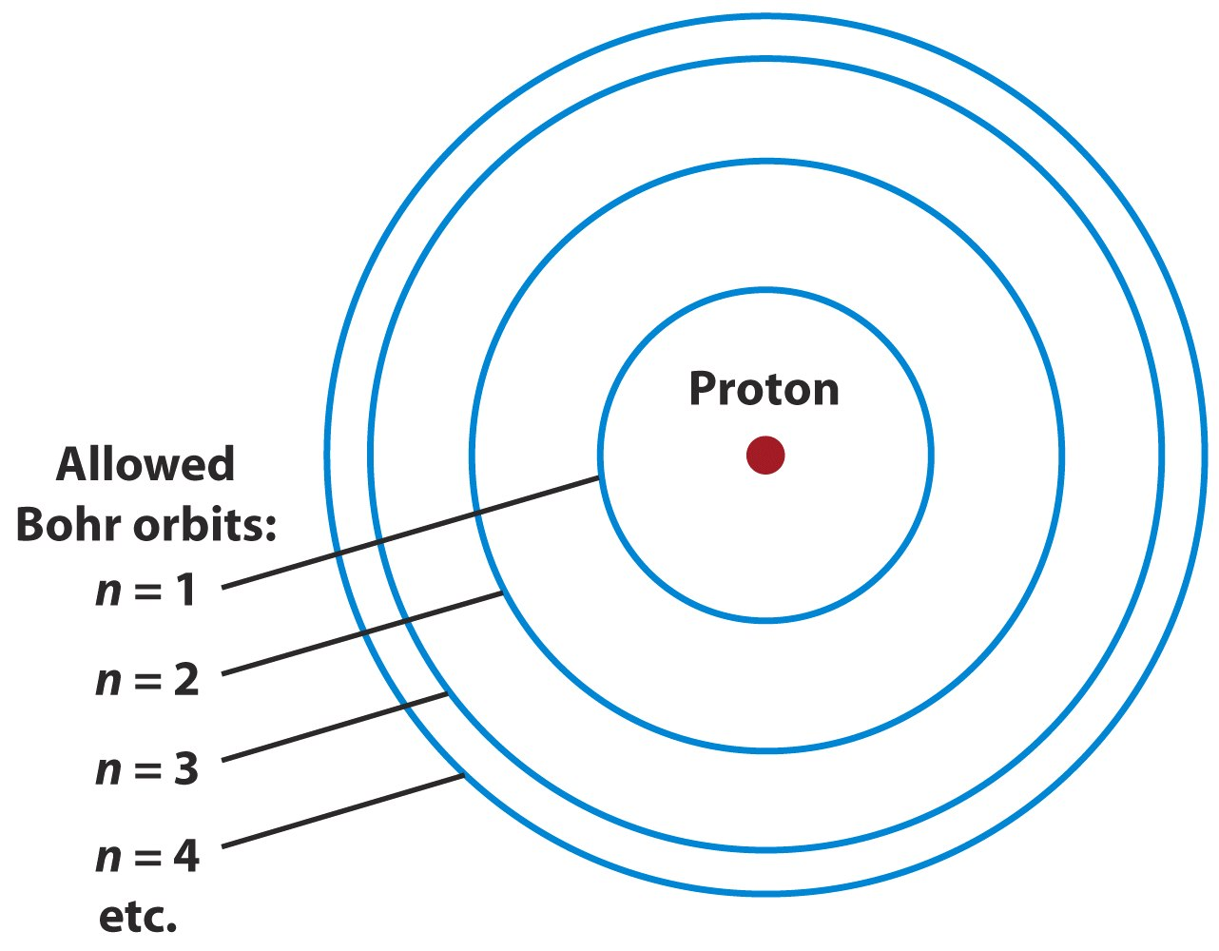
Background: Spectra
Atom is quantized!

Slide 40
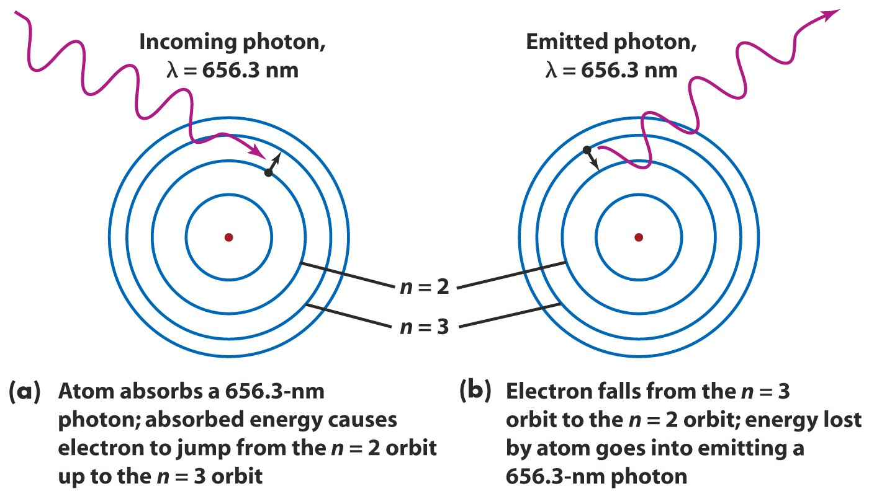
Background: Spectra

Slide 41
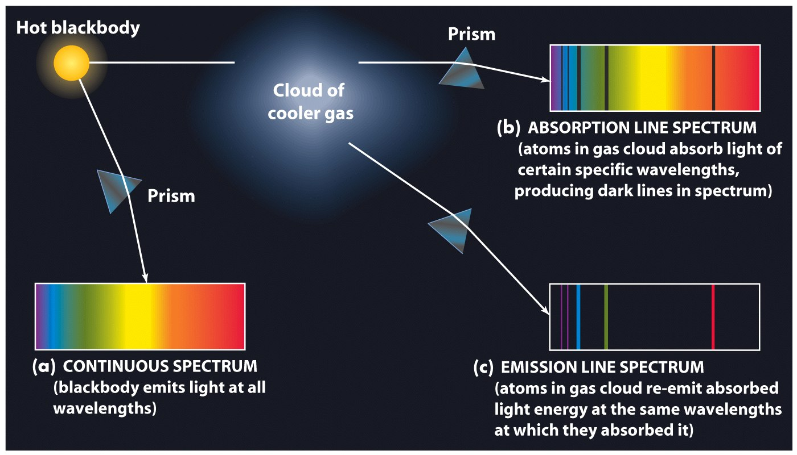
Background: Spectra

Slide 42
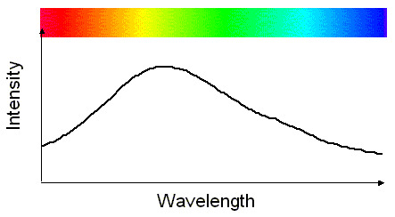
Background: Spectra

Slide 43
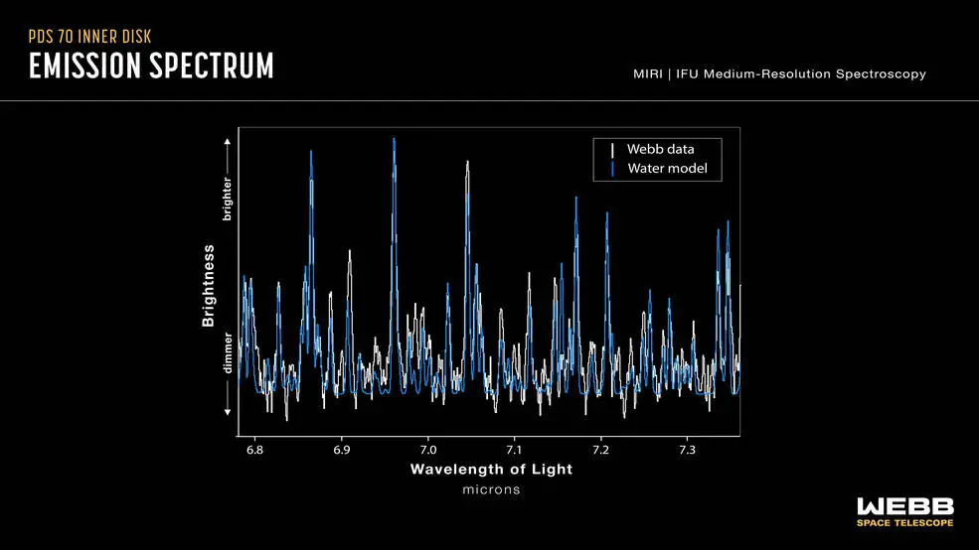
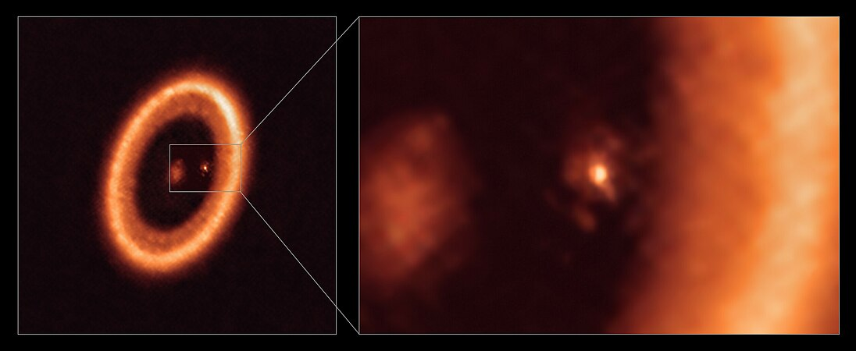
PDS 70
ALMA

Slide 44
PDS 70
MIRI observations of a young star with gapped disk with two giant planets, 370 ly away
Detects water vapor in inner disk, where terrestrial type planets might be forming
Motivates new lines of thought: did the water form in place, or get carried in on ice-coated particles; does dust help it survive UV radiation from star?
Maybe terrestrial planets have access to water from their formation

Slide 45
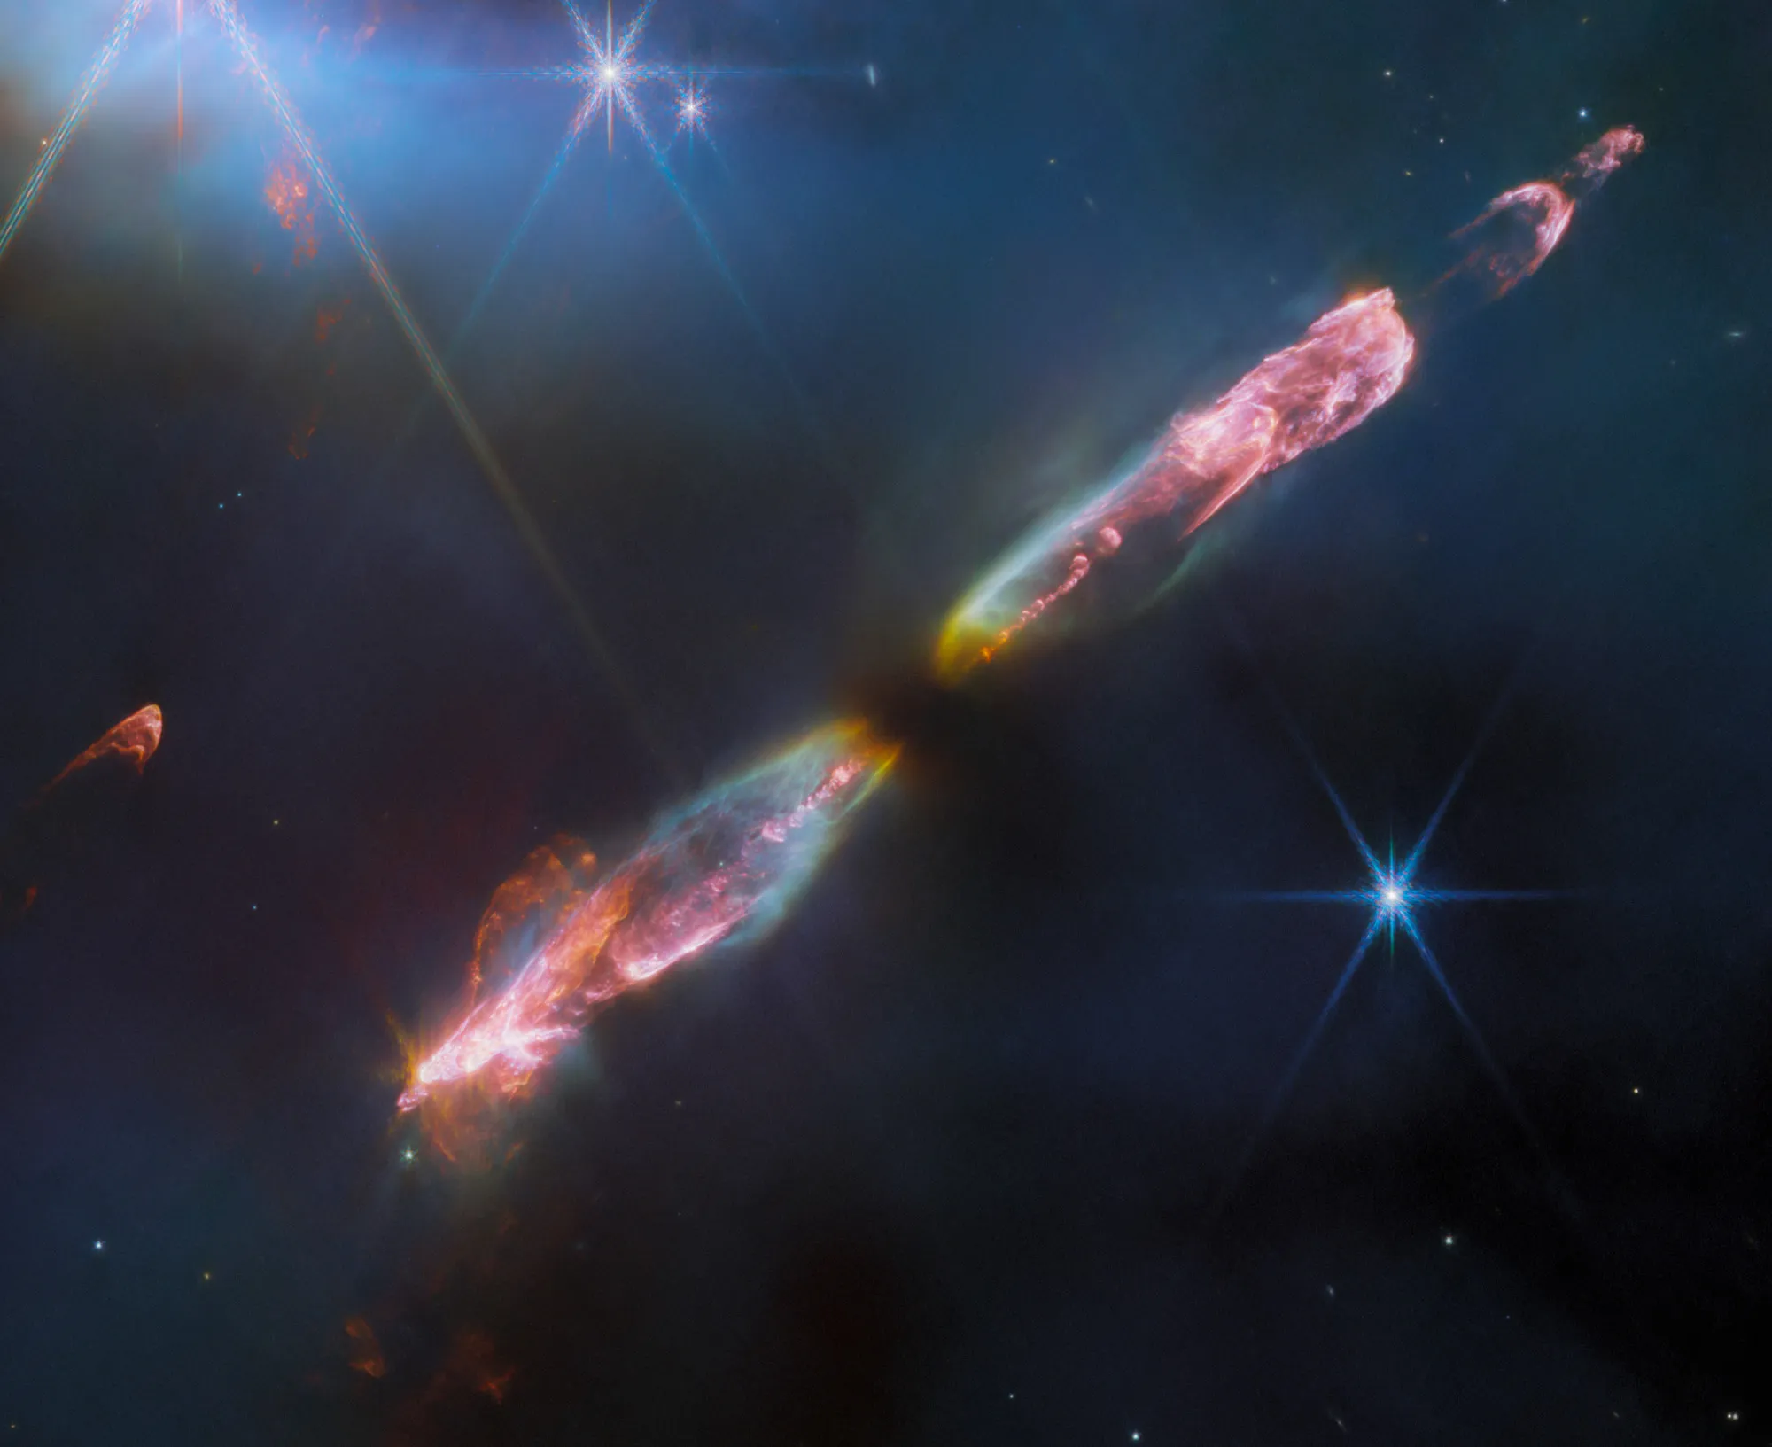
HH 211

Slide 46
HH 211
NIRCam image of Herbig-Haro 211
Reveals bow shocks with unprecedented detail from an infant star; <10% solar mass, 10,000s years old
Note knotty, wiggling supersonic core flow (cf. water jet); binary star?
Innermost flow is ∼100 km/s; not enough energy to break apart molecules, so we now know these are molecular flows
Such observations are better-defining composition and dynamics of these bipolar flows

Slide 47
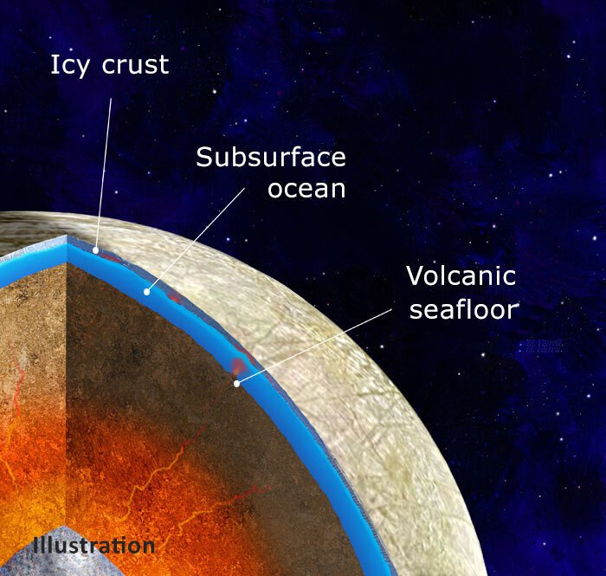
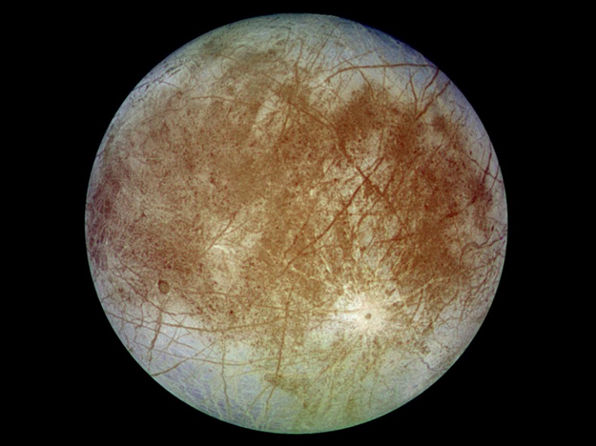
Europa

Slide 48
Europa
Image from NIRCam, composition from NIRSpec
Crystalline or amorphous CO₂ in chaos terrain
From subsurface ocean, not delivered by meteorites! (Most abundant in disrupted chaos terrain area where an exchange between ocean and surface is likely)
Recent! (CO₂ not stable on surface)
Bolsters the argument for life in Europa’s ocean

Slide 49
K2-18 b

Slide 50
K2-18 b
NIRSpec study of atmosphere of exoplanet K2-18 b
Planet is about 8 M_{earth}, about 120 ly from Earth, and in habitable zone of its star
Complements studies suggesting Hydrogen rich atmosphere above water ocean surface
Tentative identification of dimethyl sulfide – found on Earth only due to life: mostly phytoplankton
Large planet mass suggests ocean might be too hot for life – but DMS is intriguing and shows how much exoplanet atmosphere studies have advanced
1.5 sigma result – shameless self-promotion

Slide 51
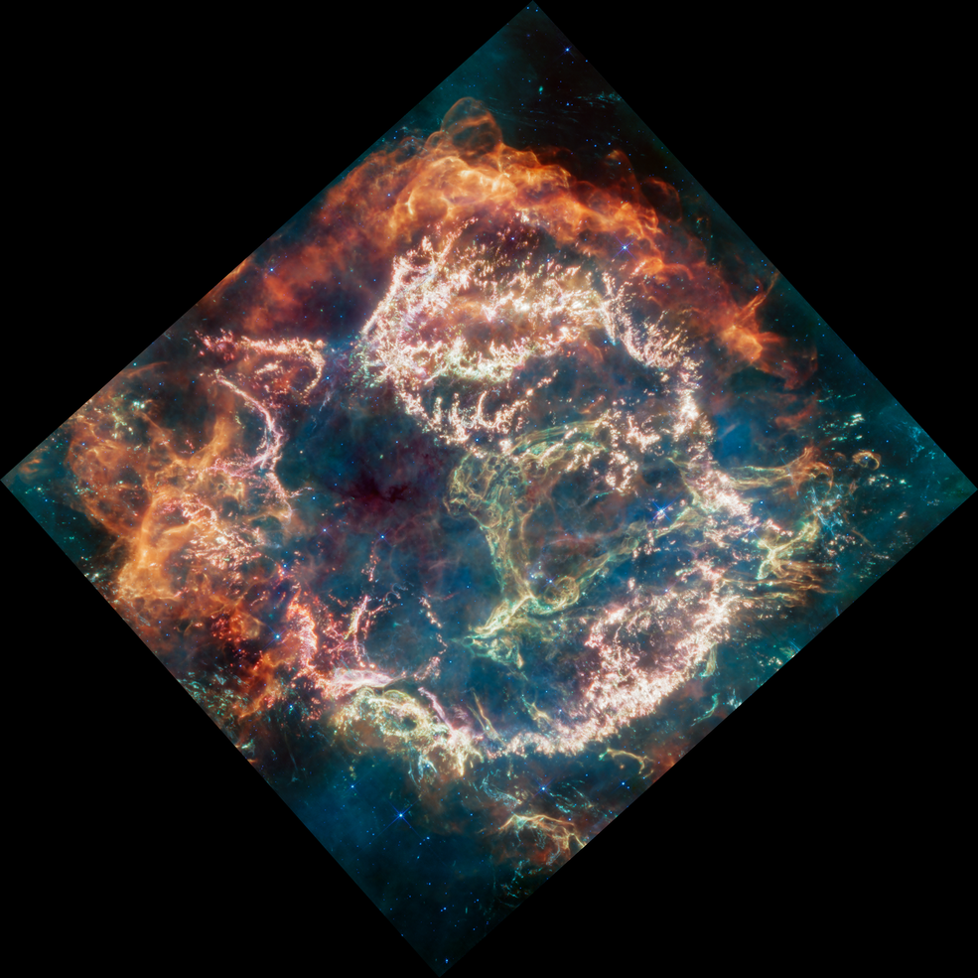
Cas A

Slide 52
Cas A
MIRI image of supernova remnant Cas A, 1100 ly away; image is about 10 ly across
(Massive stars end their life as a supernova + neutron star, black hole, or “nothing”)
Youngest known remnant in Milky Way: 340 years ago from Earth’s perspective
Unprecedented resolution and wavelength coverage

Slide 53
Cas A
Different colors depict emission from different elements:
Exterior orange/red is emission from warm dust where stellar stuff is ramming into circumstellar medium
Interior clumps and knots (pink & white) is stellar material with oxygen, argon, neon, etc. made in the explosion
Allows “stellar autopsy” to find out about original star, how it exploded, and origin of elements/dust

Slide 54
Next Week….
More science: galaxy formation & cosmology

