Slide 1
The Challenge of
DEVELOPING LEAN MANAGEMENT
By Mike Rother
May 2015
v5.0

Slide 2
You can use
these slides
You may use any slides from this presentation, which are copyrighted under a Creative Commons Attribution license. The only requirement is to note the source on each
slide you use, for instance by including “By Mike Rother” somewhere on the slide.

Slide 3
ADOPTING NEW WAYS
Hoping to create different behavior by explaining or trying to convince people generally doesn't work.
We don't behave a certain way because we lack information. We behave one way or another because it's a habit.
What can work is deliberately practicing a different routine, which over time changes how you think.
But don't try to run 20 miles in your first workout! Begin with some starter practice routines, which help you learn fundamentals and build some initial confidence in the new pattern you are trying to learn.

Slide 4
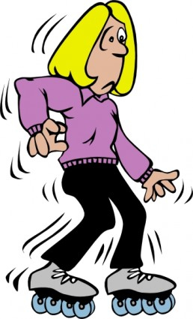
THAT'S WHAT
KATA ARE
Kata are practice routines that help us adopt new ways of acting and thinking

Slide 5
WHAT THE IMPROVEMENT KATA
AND COACHING KATA ARE ABOUT
Scientific Thinking Pattern
+
Deliberate Practice (Kata)
Making Scientific Thinking a Skill
that Can be Learned by Anyone

Slide 6
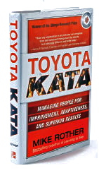
THE TOYOTA KATA RESEARCH
2004 - 2009
Guided by these two research questions:
What are the unseen managerial routines and thinking that lie behind Toyota’s success with continuous improvement and adaptation?
How can other companies develop similar routines and thinking in their organizations?
Let's start with Question 1:
If you study Toyota’s management system enough, a common pattern of thinking and acting emerges, at all levels in the company.

Slide 7
THE 4-STEPS OF THE
IMPROVEMENT KATA
MODEL
1
3
Get the Direction or
Challenge
Establish your Next
Target
Condition
2
4
Conduct Experiments
to get there
Grasp the Current
Condition
The model we used to explain our findings resembles
other creative and scientific models, such as:
Systems thinking, critical thinking, learning organization, design thinking, creative thinking, solution-focused practice, preferred futuring, skills of inquiry, evidence-based learning

Slide 8
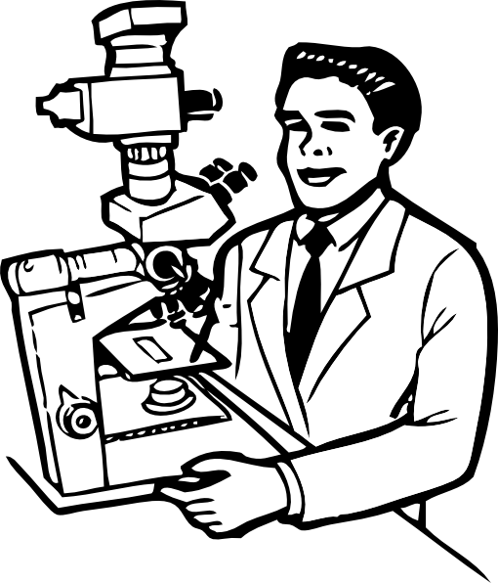
CREATING CAPABILITY TO THINK
AND WORK SCIENTIFICALLY
Finding commonality between Toyota's management approach and models of human creative endeavor makes sense
In their daily work, Toyota managers have people practice a universal pattern for improving, adapting and innovating along uncharted paths.
Toyota's management approach involves teaching everyone in the organization a scientific mindset, which can be applied to an infinite number of challenges and objectives.
Toyota managers are teaching a deliberate, effective, shared way of working throughout the organization.

Slide 9
Scientific Thinking Pattern
+
Deliberate Practice (Kata)
Making Scientific Thinking a Skill
that Can be Learned by Anyone

Slide 10
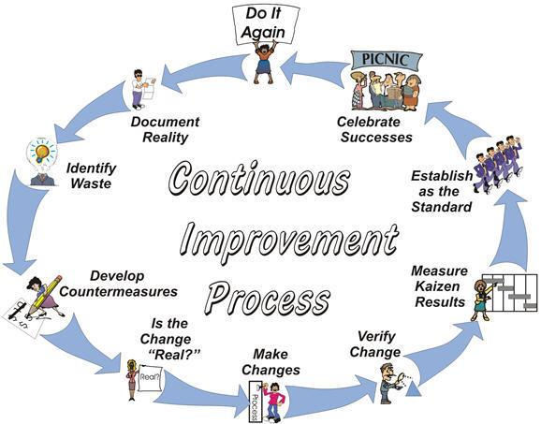
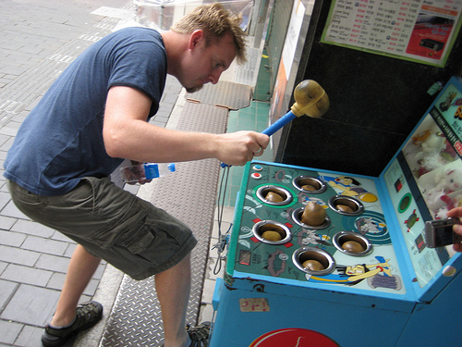
IMPROVEMENT BASED ON
“ELIMINATE WASTE” IS TOO UNSCIENTIFIC
The elimination of waste at Toyota is more
an outcome of pursuing a particular goal

Slide 11
ASK 5 PEOPLE WHAT TO IMPROVE,
GET 5 DIFFERENT ANSWERS
Each according to their perspective, beliefs & bias
= Observed Wastes,
Problems, Opportunities
This seems important!
This seems interesting
There's always too much to do, and by random choices we get nowhere
We have limited time and resources for improvement!
Illustration by Teemu Toivonen

Slide 12
YOU NEED A TARGET CONDITION
What do you want to achieve?
Things
we HAVE
to do
Things we
CAN do

Slide 13
THAT TAKES SOME ANALYSIS & PLANNING
✓
✓
✓
NEXT TARGET CONDITION

Slide 14
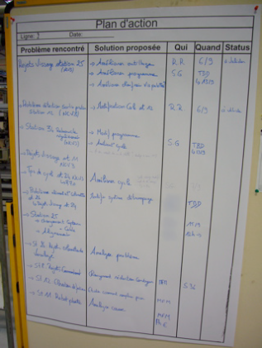
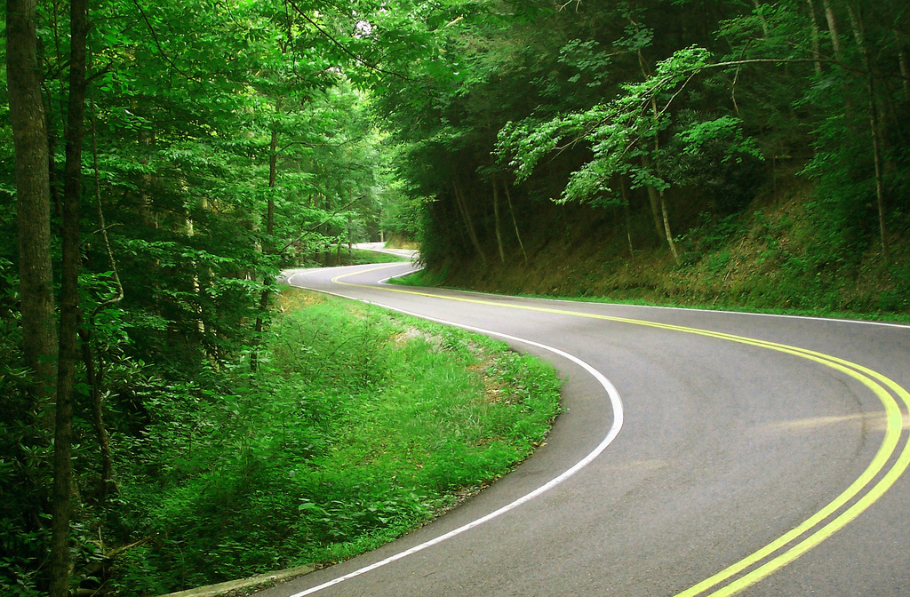
SO NOW WE CAN GET GOING, RIGHT?
We know the overall direction or challenge,
where we are now and our next Target Condition.
It’s time to make a plan for how to get there!
Team's Action Plan

Slide 15
SO NOW WE CAN GET GOING, RIGHT?
We know the overall direction or challenge,
where we are now and our next Target Condition.
It’s time to make a plan for how to get there!
Well, not quite...
Team's Action Plan

Slide 16
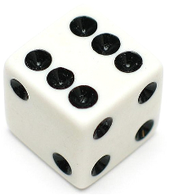
THE DICE EXPERIMENT
I’ll roll a die three (3) times and sum the numbers.
The sum will be a number between 3 and 18.
Before I roll, please write down:
What will be the sum of the 3 rolls?

Slide 17
Those of you who wrote down the incorrect sum...
How do you feel?

Slide 18
Not so bad,
it’s just chance

Slide 19
QUESTION #2
2, 4, 6, 8, 10, 12, ?
What will be the next number in this series?
Please write down your answer

Slide 20
ANSWER
2
2, 4, 6, 8, 10, 12,

Slide 21
ANSWER
2
2, 4, 6, 8, 10, 12,
Those of you who wrote down
the incorrect number...
How do you feel this time?

Slide 22
Hey!

Slide 23
What was different
about these two scenarios?

Slide 24
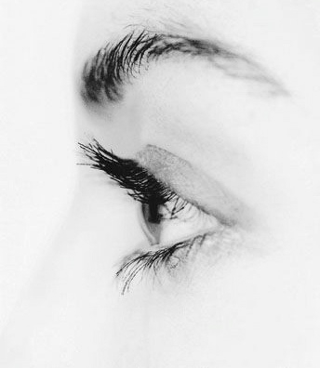
DIFFERENCE BETWEEN THE SCENARIOS
How easy or hard it is to spot the Current Knowledge Threshold
• In Round 1 with the dice, it was easy to see
that we didn’t know what the outcome would be.
• In Round 2 the knowledge threshold was more
difficult to see. We thought we knew the answer,
so we went over the threshold & answered.
Yet in both rounds the knowledge threshold was the same: There were no facts beyond the initial setup
Predictable Zone
2, 4, 6, 8, 10, 12
Current
Knowledge
Threshold
What would be a good answer in both rounds?
Why don’t we say that?

Slide 25
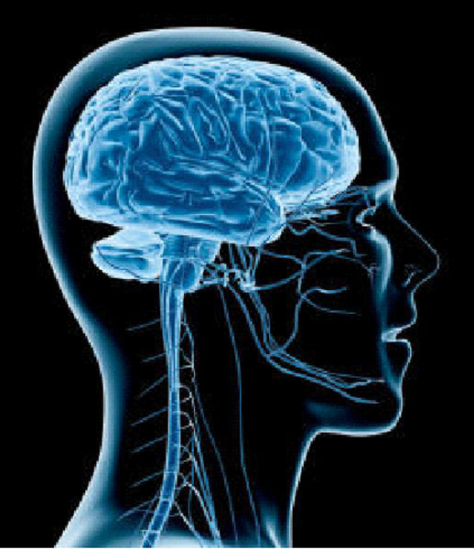
WHY WE GO THROUGH
KNOWLEDGE THRESHOLDS
OUR BRAIN FILLS IN THE BLANKS
(automatically)
Current
Knowledge
Threshold

Slide 26
READ WHAT YOU SEE
IUMRING TQ GQNGIUSIQNS

Slide 27
IUMRING TQ GQNGIUSIQNS

Slide 28
IUMRING TQ GQNGIUSIQNS
We don't notice the Knowledge Threshold because our brain automatically fills in the blanks

Slide 29
WE NEED THIS COGNITIVE MECHANISM
TO GET THROUGH THE DAY
Ca y u rea t is?
But it also causes some problems

Slide 30
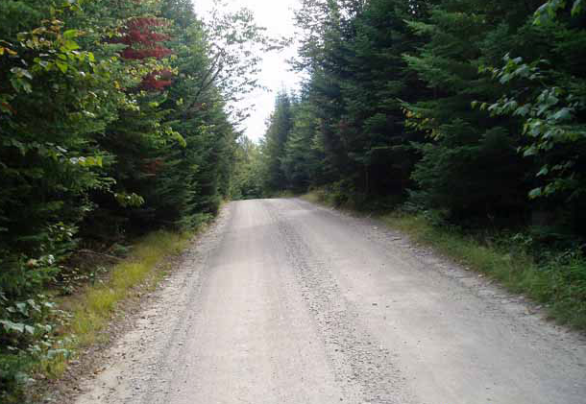
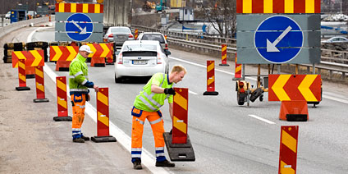
THERE'S ALWAYS A KNOWLEDGE THRESHOLD
The path is unpredictable
Key points about Knowledge Thresholds:
1) They're hard to see (until you practice it)
and we tend to go right through them
2) We actually see farther through experimenting
3) We don’t know in advance what the result
of a step/experiment will be
The Knowledge Threshold is our Learning Edge.
It's where the next experiment should take place.

Slide 31
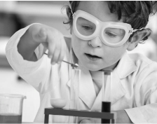
How to Handle Knowledge Thresholds
THE CORE DYNAMIC OF → SCIENTIFIC THINKING
"Let's try it and see"
Scientific thinking is a routine of intentional coordination between what we think will happen (theory), what actually happens (evidence), and learning from the difference.
What we
expect
to happen
What
actually
happened
Learning
This is a working pattern that allows us to reach
challenging new goals through unclear territory

Slide 32
IT'S THE SCIENTIFIC LEARNING CYCLE
A process for acquiring new knowledge.
Sometimes called "Plan-Do-Check-Act"
EVALUATE
Interpret the
evidence
PREDICTION
Testable
ACT
PLAN
4
1
3
2
CHECK
(Study)
DO
EVIDENCE
Collect facts and data
ACTION
Conduct the
experiment
This cycle gives you a practical way to reach a Target Condition, by providing a systematic way of working through the grey zone between here and there

Slide 33
YOU STRIVE TOWARD THE TARGET CONDITION THROUGH ITERATIVE LEARNING
Small, rapid experiments advance your knowledge quickly,
moving you away from what doesn't work to what does
Zone of
Uncertainty
Current Condition
Next
Target Condition
(date)
YOU DO NOT KNOW HOW
TO GET FROM HERE TO THERE!

Slide 34
THE IK IS A GREAT MODEL, SO LET’S GO!
✓
✓
✓
✓
The Scientific IK Pattern:
...suits complex, dynamic conditions!
...makes empowerment possible!

Slide 35
THE IK IS A GREAT MODEL, SO LET’S GO!
✓
✓
✓
✓
The Scientific IK Pattern:
...suits complex, dynamic conditions!
...makes empowerment possible!
But wait, there’s another problem…

Slide 36
Scientific Thinking Pattern
+
Deliberate Practice (Kata)
Problem: A model alone is not enough to change our behavior and thinking

Slide 37
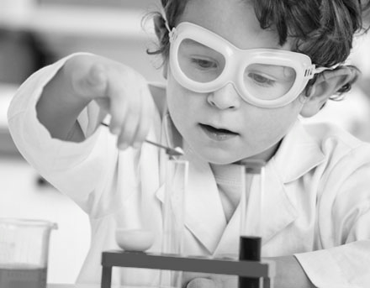
Scientific
Thinking
Born?
Learned?

Slide 38
Scientific
Thinking
Born?
Learned?
We are notoriously bad at scientific thinking, due to those natural, unconscious mental mechanisms. It is not our default mode.
OK... HOW?

Slide 39
REMEMBER QUESTION 2?
How can other companies develop similar routines and thinking in their organizations?
Interestingly, we face a different challenge than does Toyota:
Toyota is trying to maintain an existing culture as it grows worldwide.
We are trying to change our culture.

Slide 40
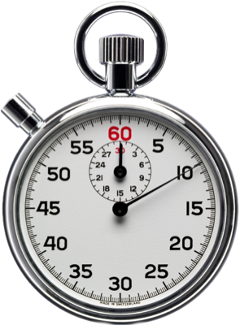
WHAT DOES IT TAKE
TO CHANGE OUR THINKING?
Get a piece of paper and a pen
Start when I say “go”
Sign your name 5 times normally
When you are finished raise your hand

Slide 41
REMEMBER QUESTION 2?
How can other companies develop similar routines and thinking in their organizations?
Interestingly, we face a different challenge than does Toyota:
Toyota is trying to maintain an existing culture as it grows worldwide.
We are trying to change our culture.

Slide 42
LET’S TRY JUST ONE CHANGE, MUCH
SMALLER THAN CHANGING ORG CULTURE
Change hands, to non-dominant
Start when I say “go”
Sign your name 5 times again
Raise your hand when you are finished

Slide 43
HOW DID IT FEEL THE SECOND TIME
COMPARED TO THE FIRST?

Slide 44
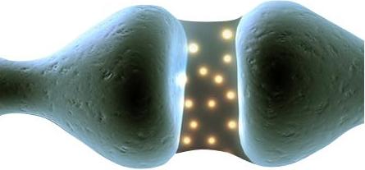
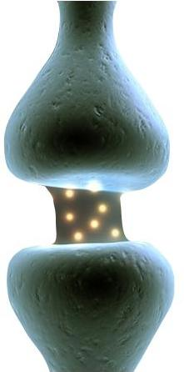
WHY THE SECOND TIME
FEELS ODD
You have to consciously think
about it and be more deliberate
The brain creates and prefers habits for safety & efficiency. Unconscious thinking enables us to get through the day by taking care of routine decisions & conserving brain energy.
Unconscious thinking is fast and instinctive, while deliberate thinking is slow and intentional. It costs a lot of our energy and attention.
Trained
Synapses
Untrained
Synapses
Deliberate
Thinking
Pathways with
low signal resistance
Pathways with
high signal resistance

Slide 45
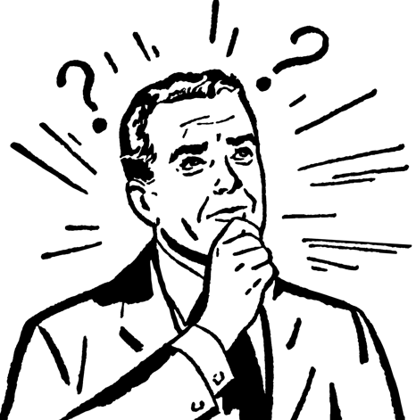
SO WE HAVE A LEAN DILEMMA
How did it feel
the second time?
We have well-established neural pathways for signing with our dominant hand. It’s automatic, fast & comfortable.
We default to already-established thought and behavior patterns because they conserve mental resources.
“Different”
“Difficult”
“Weird”
“Uncomfortable”
Dilemma
We want to change to working scientifically, according to something like the Improvement Kata pattern.
We naturally tend to stick with our current ways of doing things because they use existing neural circuits that require less energy.
-- however --

Slide 46
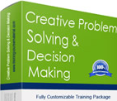
INFORMATION & INCENTIVES ARE NOT
ENOUGH TO CHANGE BEHAVIOR & THINKING
Theories, models, information, examples, lists of steps, etc. may
all be correct, but just knowing them is not likely to change much.
You also have to create new neural circuits.
INSUFFICIENT FOR CHANGE
especially in an organization

Slide 47
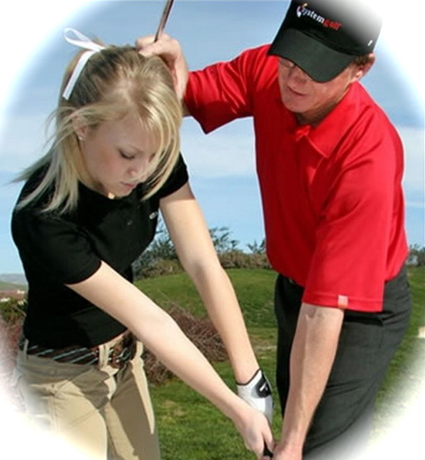
4 INGREDIENTS FOR DEVELOPING NEW SKILLS
With these ingredients you can start to rewire
your brain & acquire new skills and habits
k
l
KATA
COACHING
Structured routines so a beginner can practice fundamentals
Corrective feedback
to ensure the Learner practices the right patterns
m
j
DAILY
PRACTICE
MASTERY
Feeling that:
"I'm getting better at this"

Slide 48
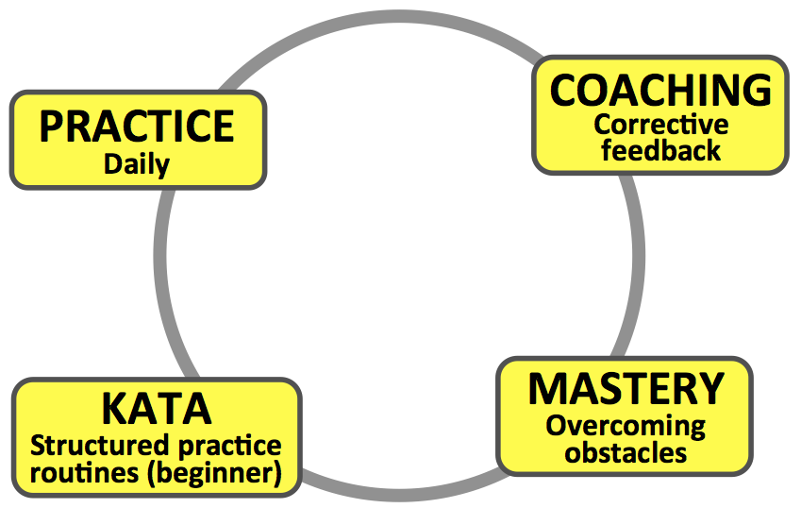
DAILY PRACTICE
If we only periodically conduct training events or only episodically work on improvement -- and the rest of the time itʼs business as usual -- then according to neuroscience what weʼre actually teaching is business as usual.
So the coaches should be line managers,
because they are there every day

Slide 49
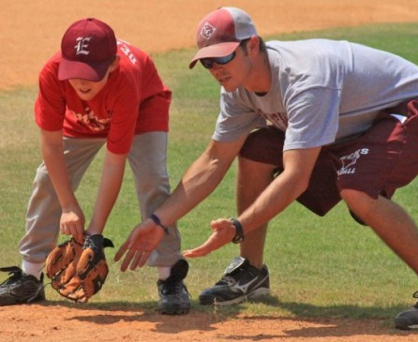
COACHING
Because "Practice Makes Permanent"
The Coach (manager) provides corrective inputs to ensure
that the Learner practices the new routines the right way
Before they can coach the Improvement Kata, managers need to practice the Improvement Kata themselves

Slide 50
THE COACHING KATA
Starter practice routines for learning
how to teach the Improvement Kata pattern
Understand the Challenge
Grasp the Current Condition
Establish the Next Target Condition
Experiment Toward the Target Condition
Improvement
Kata
Learner
‘Planning’ Coaching Cycles
‘Executing’
Coaching Cycles
Coaching
Kata
Coach
(Manager)

Slide 51
MASTERY / SENSE OF PROGRESS
The Learner should practice beyond their current capability
and periodically get a sense they are making progress
in learning the new skill

Slide 52
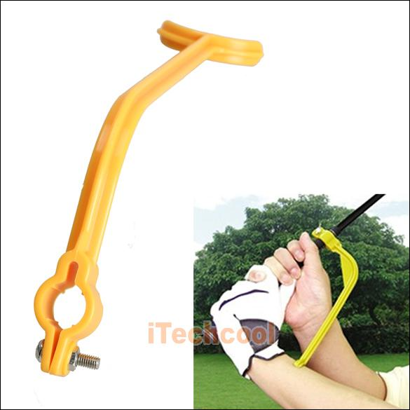
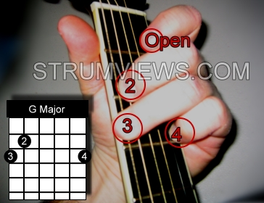
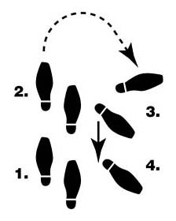
KATA = PRACTICE ROUTINES
You use Kata at the beginning, until their pattern
becomes a habit and leaves you with new abilities
You don't use a Kata forever

Slide 53
THERE ARE PRACTICE ROUTINES
FOR EACH STEP OF THE IK MODEL
The Improvement Kata model
The practice routines are a way to begin to operationalize the IK pattern

Slide 54
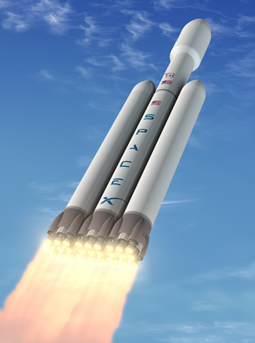
KATA HELP YOU GET STARTED
Beginners should follow Kata exactly.
With increasing proficiency each Learner can start to (within limits) develop their own style.
Similarly, over time each organization can evolve the Kata it began with to better suit and mesh with its culture.
The original Kata evolve into organization-specific practice routines.
KATA

Slide 55
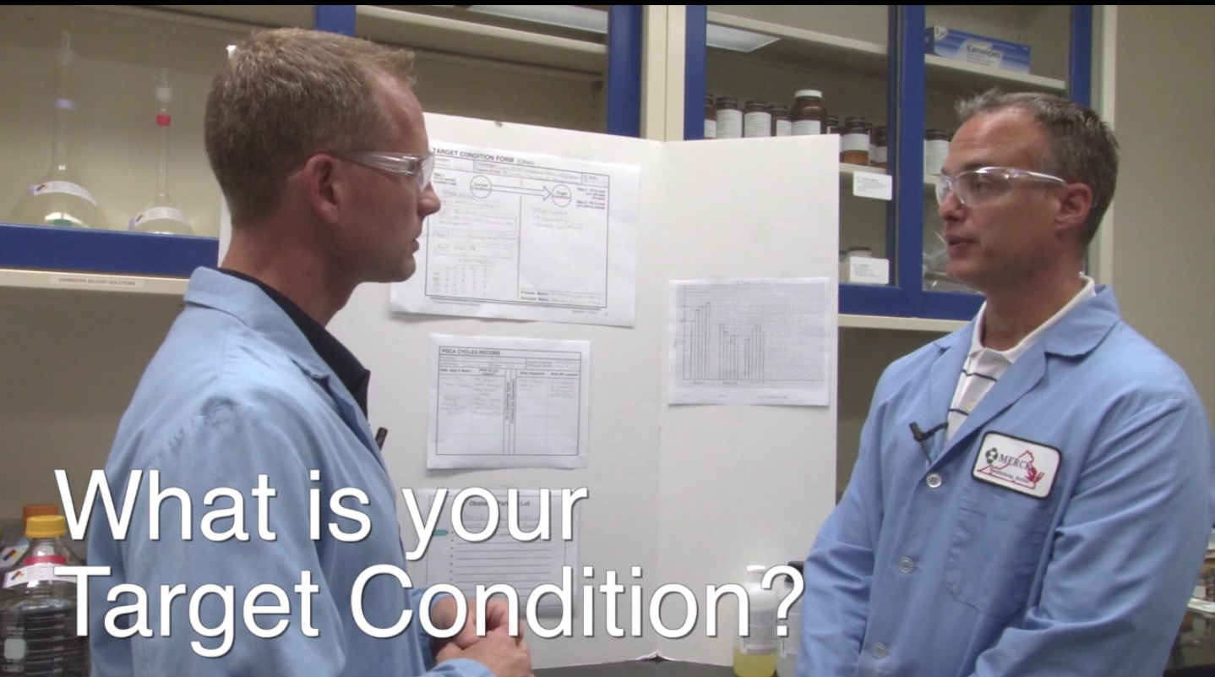
VIDEO - A Coaching Cycle
https://www.youtube.com/watch?v=ySdYX4cNPsQ
Available on the Mike Rother YouTube Channel

Slide 56
The Challenge
of Creating
Lean Management
The goal of this presentation is to
help make us aware of what is the task
The Improvement Kata and Coaching Kata
help with this task!

Slide 57
A SHIFT TO “21ST CENTURY LEAN”

Slide 58
GETTING THERE IS THE CHALLENGE
One obstacle: Managers have to be Learners first
Able to TEACH it
Developing Others
Able to DO it
Skill development begins here
Self Development
AWARE of it
Concepts alone generally
don’t change anything

Slide 59
YOU CAN APPLY THE SAME
IMPROVEMENT KATA PATTERN TO
THIS ORGANIZATION-LEVEL CHALLENGE
Challenge
Next
Target
Condition
(date)
Threshold of Knowledge
Experiments
Toward the TC
Current
Condition

Slide 60
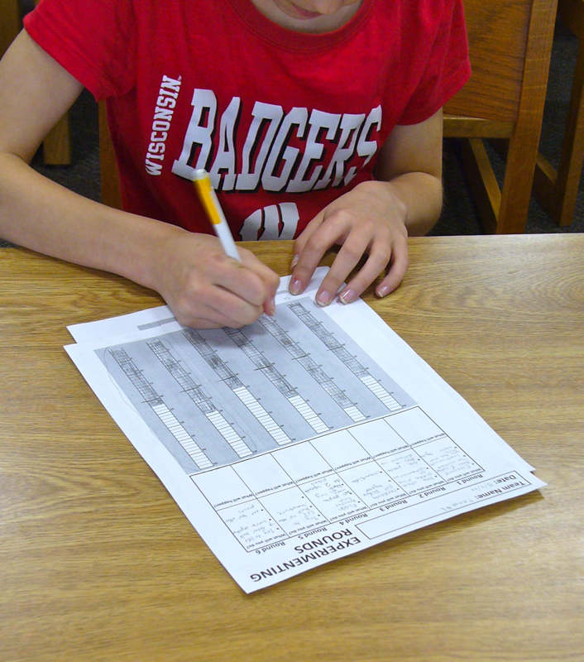
Kata in the Classroom - for Teachers
www.katatogrow.com
Introducing the scientific pattern of
the Improvement Kata in K-12 classrooms

Slide 61
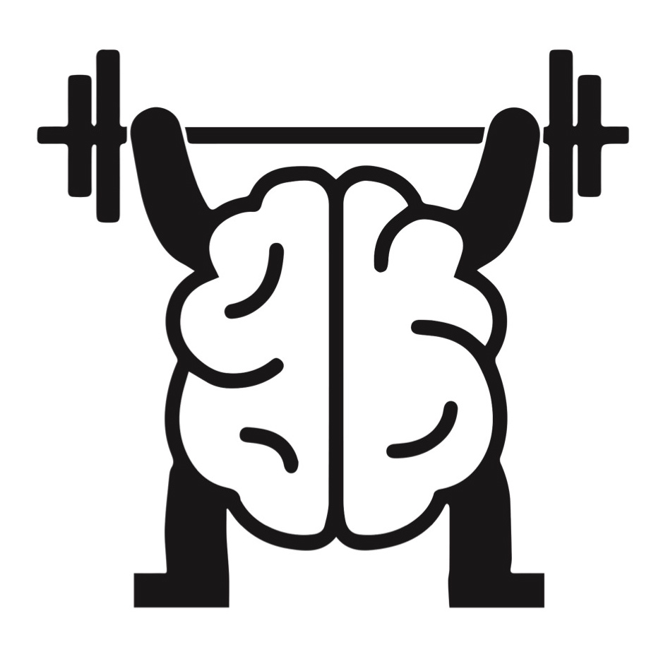
Best wishes
for your practice
Visit the Toyota Kata Website

