Slide 1
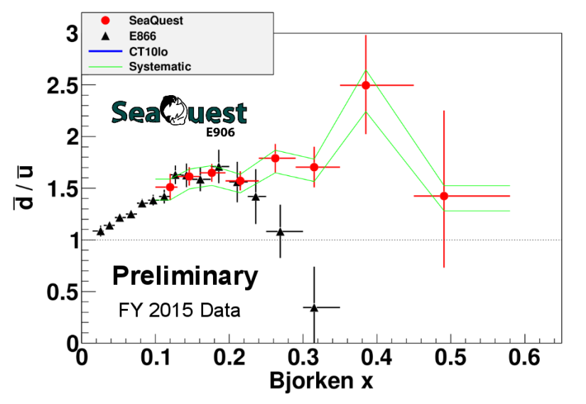







E-906 and future fixed-target Drell Yan
Wolfgang Lorenzon
QCD-N 2016 Workshop, Trento, Italy
(15-July-2016)
This work is supported by

Slide 2
Current and Future D-Y Program at FNAL
Unpolarized Beam and Target w/ SeaQuest detector
E-906: 120 GeV p from Main Injector on LH₂,LD₂, C,Fe,W targets → high-x Drell-Yan
Science run: March 2014 - July 2017
  2015 data set: preliminary results
Polarized Beam and/or Target w/ SeaQuest detector
  → development of high-luminosity facility for polarized Drell-Yan
E-1039: SeaQuest w/ pol NH₃ target (2018-2019?)
  probe sea quark distributions
E-1027: pol p beam on (un)pol tgt (2020-2021?)
  Sivers sign change (valence quark)

Slide 3
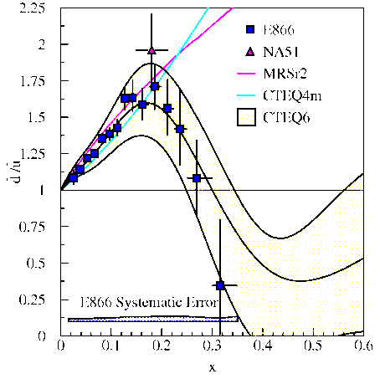
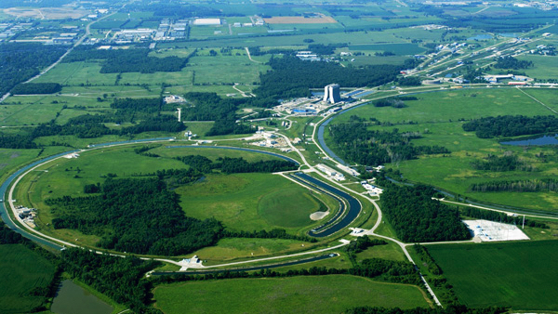
SeaQuest Experiment
Fixed Target Beam lines
Tevatron 800 GeV
Main Injector 120 GeV
10% of available beam to SeaQuest / 90% to neutrino program

Slide 4
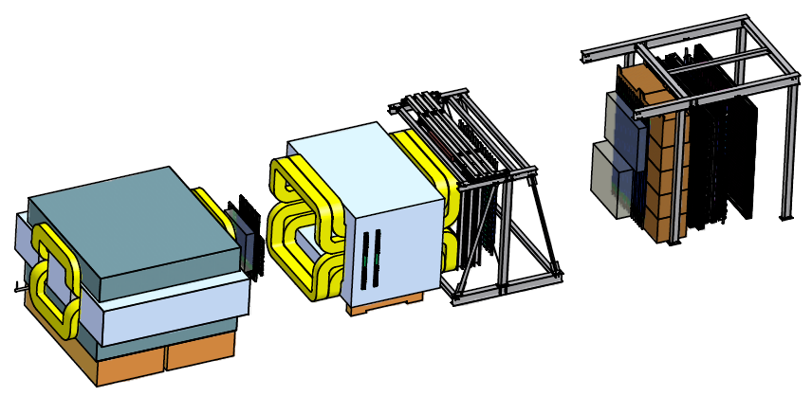
SeaQuest Spectrometer
Station 4:
Hodoscope array
Prop tube tracking
Station 2 and 3:
Hodoscope array
Drift Chamber tracking
Station 1:
Hodoscope array
MWPC tracking
Solid Iron Focusing Magnet, Hadron absorber and beam dump
Mom. Meas.
(KTeV Magnet)
4.9m
Hadron Absorber
(Iron Wall)
Liquid H₂, D₂, and solid targets (Fe, C, W)
25m
Drawing: T. O’Connor and K. Bailey

Slide 5
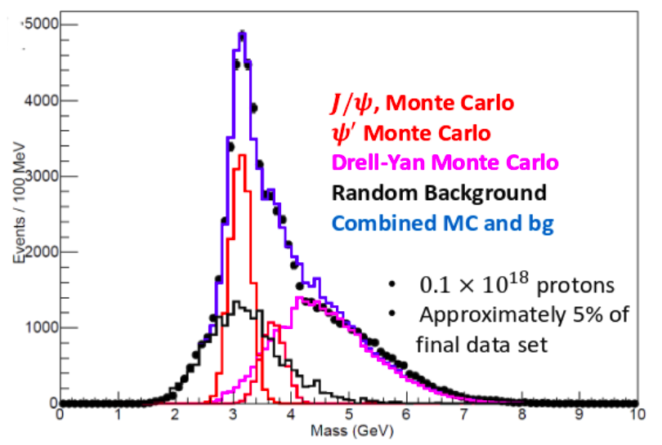
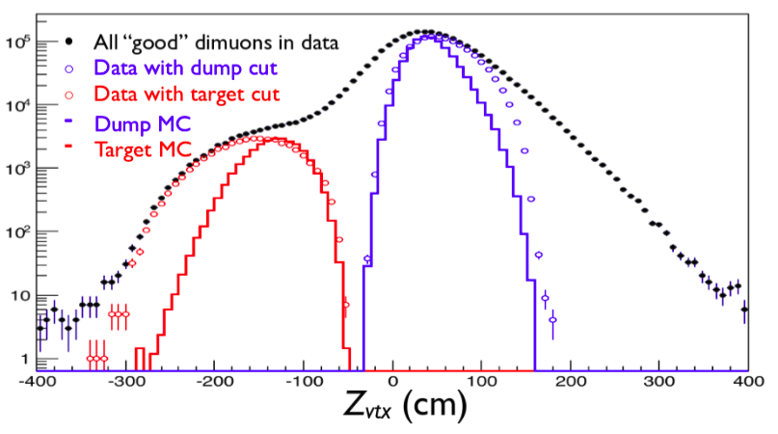
Event Selection & Reconstruction
Monte Carlo describe data well
Resolution better than expected
  σ_{M}(J/ψ ) ~180 MeV
  σ_{M}(D-Y ) ~220 MeV
  J/ψ to ψ’ separation
  lower J/ψ mass cut (more Drell-Yan
  events)
good Target/Dump separation
pointing resolution poor along beam axis
dominated by random coincidences
Notes:
Combinatorial bkg by random event mixing
Remarks of top plot:
• Very tight event multiplicity cuts
• Very tight analysis cuts too

Slide 6
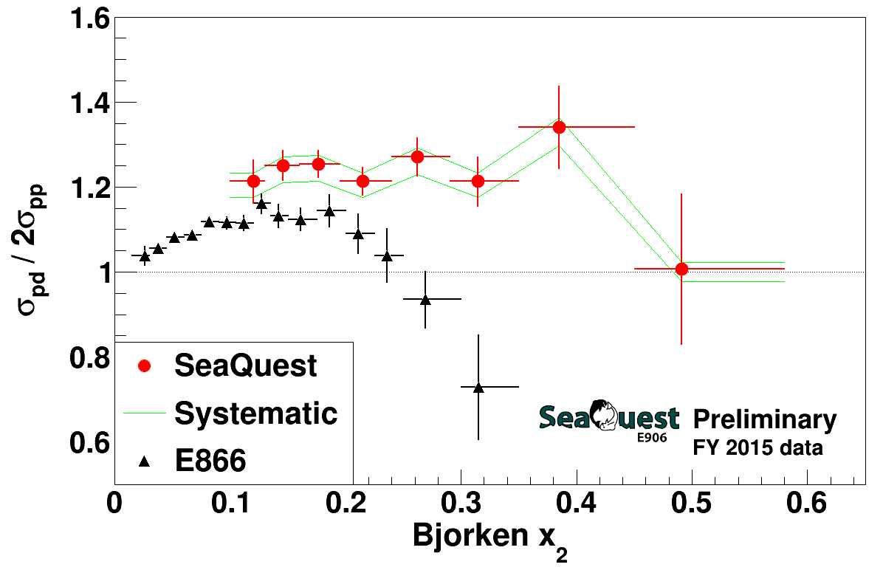
different kinematics and Q² for E866 & SeaQuest data sets
new chambers installed in March 2016: improve acceptance in high x₂ region
30% of anticipated data (~1.2 × 10¹⁸ pot)
approved for 5 × 10¹⁸ pot

Slide 7
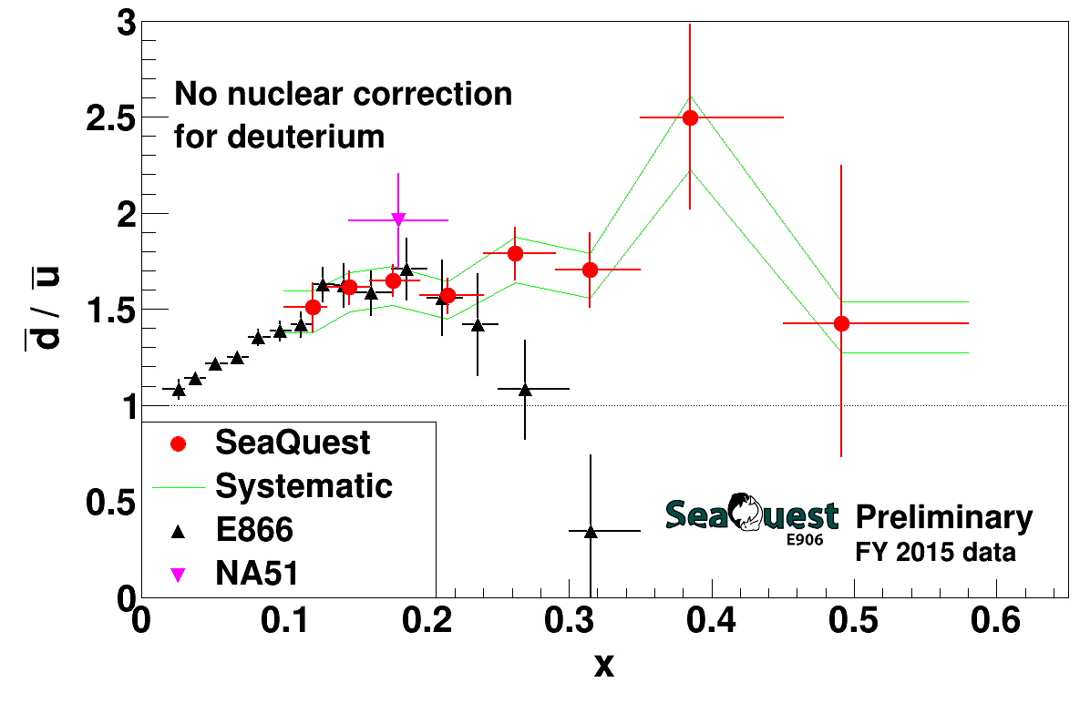
SeaQuest Leading Order extraction (2015 Data Set)
E866 data is for Q² = 54 GeV² while SeaQuest data has Q² ≈ 29 GeV²
  difference should be insignificant
no nuclear correction for deuterium
  expected larger at higher x, but still small compared to error bars
is there disagreement at high x?

Slide 8
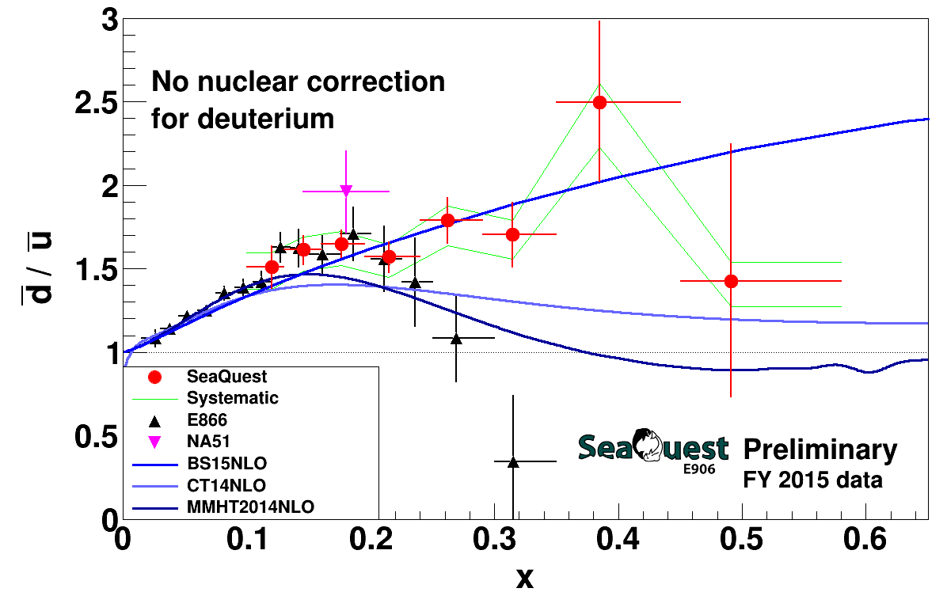
SeaQuest Leading Order extraction (2015 Data Set)
BS15 (statistical model) calculated using parameters from NPA941(2015)307
CT14 and MMHT2014 calculated with the LHAPDF library
PDF scales taken as 29 GeV²
Notes:
Note: BS15 PDF were calculated using the QCD evolution program which evolves PDFs in the moment space, not in x-space. It is required that the initial PDF must be "analytically" Mellin transformed. It is satisfied at least for the BS15 unpolarized sector.
BS15 at Q=1,29,100 GeV^2 are compared in the attachment GS15.png, as done in NPA948(2916)63. The calculated pdfs seem to be consistent with one in NPA948(2016)63.

Slide 9
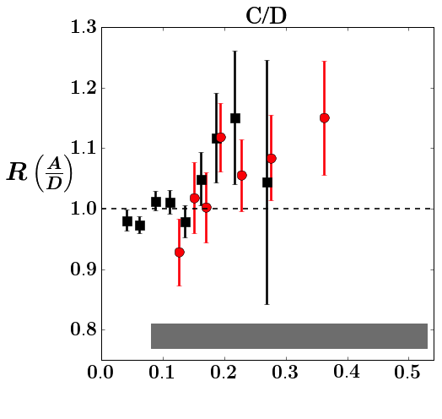
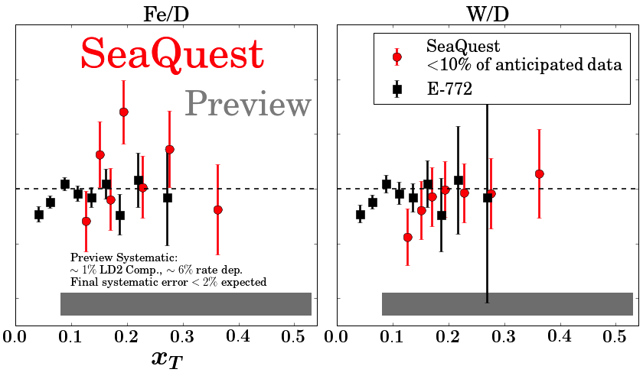
SeaQuest Nuclear Dependence (Preview)
no antiquark enhancement apparent
10% of anticipated statistical precision
increased detector acceptance at large-x_{T} to come (new D1 chamber)

Slide 10
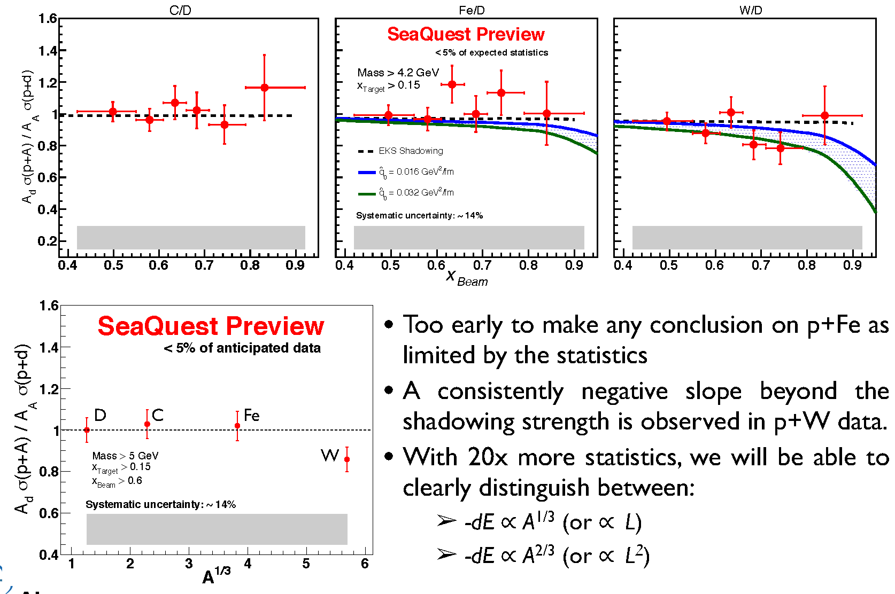

SeaQuest Quark Energy Loss (Preview)
Pre-interaction quark moves through cold nuclear matter and looses energy.
Expect suppression of the per-nucleon cross section ratio to be significant at high x_{Beam} or x_{F}
R.B. Neufeld, I. Vitev and B. W. Zhang,PLB 704, 590 (2011)
collisional
radiative

Slide 11
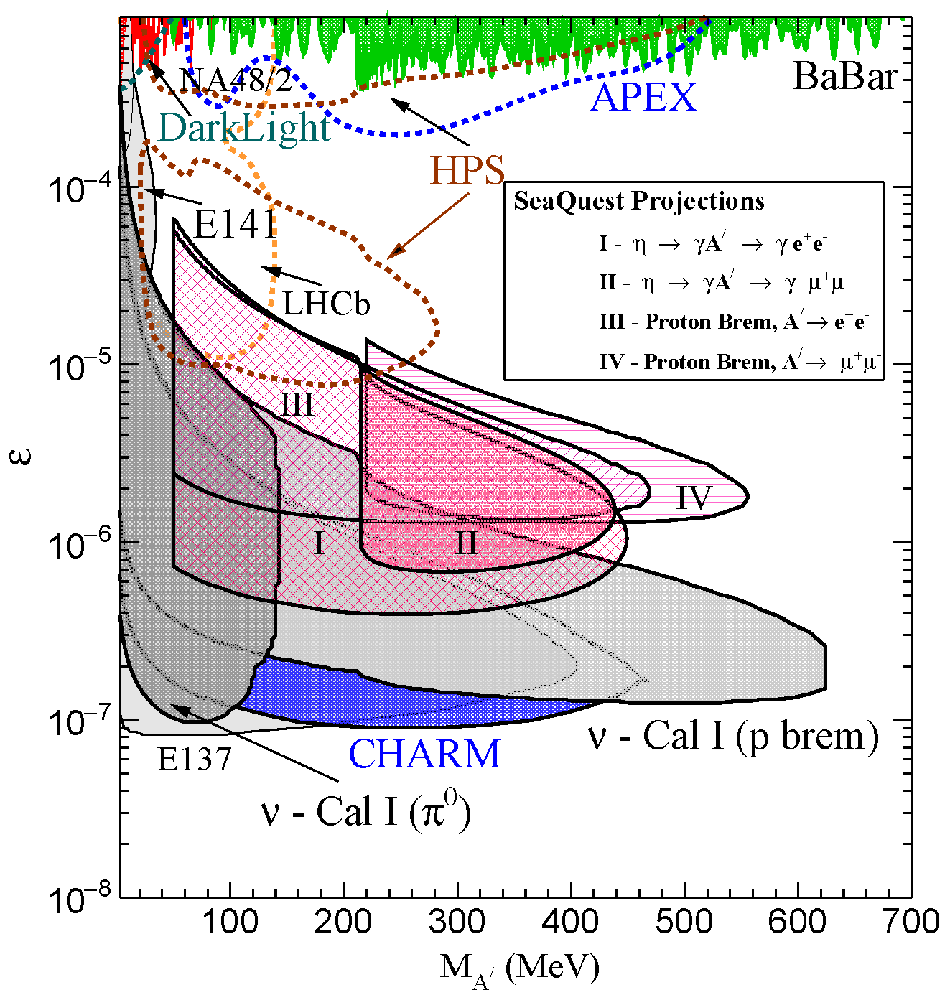
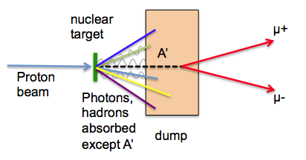
Search for Dark Photons at SeaQuest
Classic Beam Dump Experiment
Minimal impact on Drell-Yan program
  run parasitically during E906
SeaQuest experimental parameters:
  E₀ = 5 - 110 GeV for Proton Bremsstrahlung
  N_{eff} = 2
  l₀ = 0.17m – 5.95m
J. D. Bjorken et al, PRD 80 (2009) 075018
Notes:
95% C.I. assuming 10 events during a 200 day search (@ 30% efficiency), and no decays of the A’ to the invisible sector
Changing either the p beam energy or the length of the iron beam dump can extend the sensitivity of SeaQuest

Slide 12
Let’s Add a Polarized Target (E-1039)
Probe Sea-quark Sivers Asymmetry with a polarized proton target at SeaQuest
Projected Statistical Precision with a Polarized Target at (E-1039)
existing SIDIS data poorly constrain
sea-quark Sivers function (Anselmino)
significant Sivers asymmetry expected
from meson-cloud model (Sun & Yuan)
first Sea Quark Sivers Measurement
determine sign and value of u Sivers distribution
If A_{N}≠0, major discovery: “Smoking Gun” evidence for
Statistics shown for two calendar years of running:
L = 7.2 *10⁴² /cm² ↔ POT = 2.8*10 ¹⁸
P = 85%
Ref: Andi Klein (LANL)

Slide 13
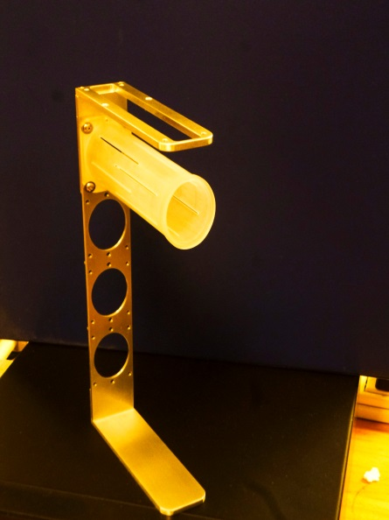
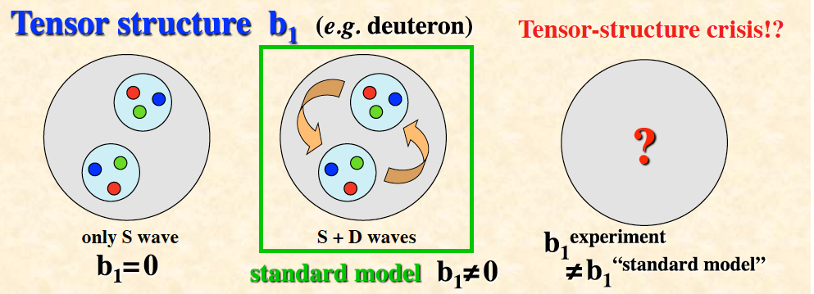
Further Plans with Polarized Targets (E-1039’)
Probe d Sivers Asymmetry with a polarized ND₃
target at SeaQuest
Target holder
SeaQuest only place to measure d-bar (explore during E1039)
measure Sivers asymmetry for pp and pD and take ratio
  requires measuring p and “n” in parallel to control systematic errors
  microwave irradiates both targets at the same time
  one cell NH₃, the other ND₃
NH₃
ND₃
Probe Tensor Polarization Deuteron (40% - 50%)
Ref: Andi Klein (LANL)
Notes:
Use vector and tensor polarization of D

Slide 14
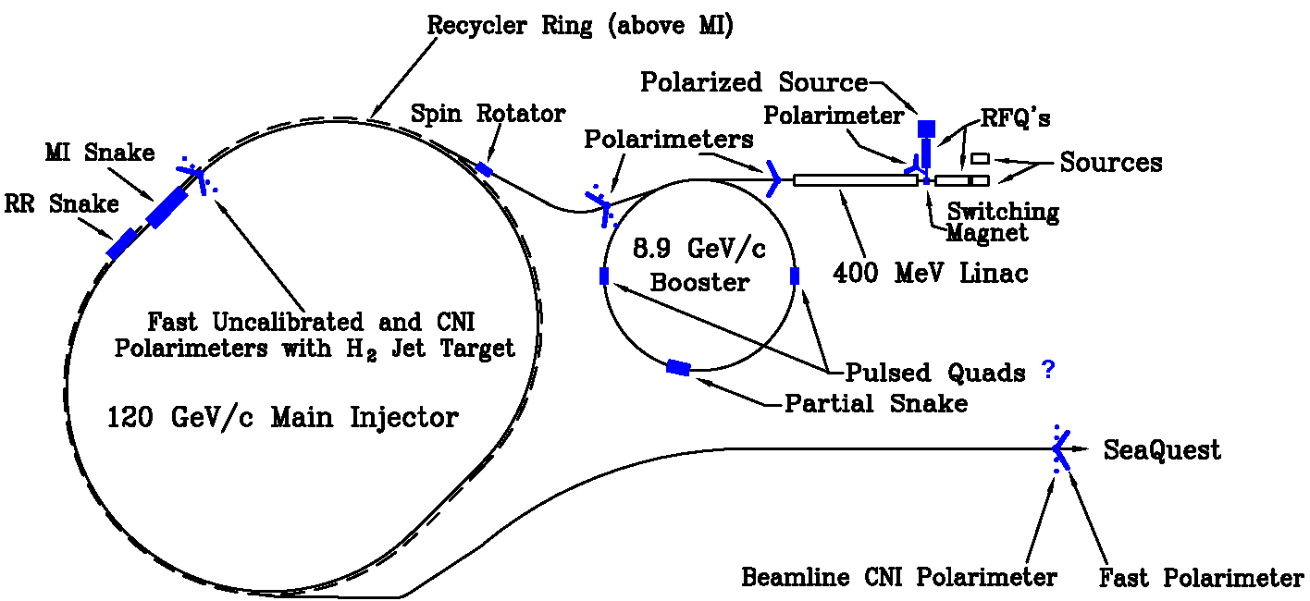

Let’s Polarize the Beam at Fermilab (E-1027)
The Plan:
Use fully understood SeaQuest Spectrometer
Add polarized beam
Measure sign-change in Sivers Function:
  QCD (and factorization) require sign change
  major milestone in hadronic physics (HP13)
Fermilab (best place for polarized DY):
  very high luminosity, large x-coverage (primary beam, fixed target)
Cost Est.: $6M +$4M Contingency & Management = $10M (in 2013)

Slide 15
(Un)Polarized Drell-Yan Experiments
Experiment | Particles | Energy (GeV) | x_{b} or x_{t} | Luminosity (cm⁻² s⁻¹) |  | P_{b} or P_{t} (f) | rFOM# | Timeline
COMPASS (CERN) | π⁻ + p↑ | 160 GeV √s = 17 | x_{t} = 0.1 – 0.3 | 2 x 10³³ | 0.14 | P_{t} = 90% f = 0.22 | 1.1 x 10⁻³ | 2015-2016, 2018
PANDA (GSI) | p + p↑ | 15 GeV √s = 5.5 | x_{t} = 0.2 – 0.4 | 2 x 10³² | 0.07 | P_{t} = 90% f = 0.22 | 1.1 x 10⁻⁴ | >2018
PAX (GSI) | p↑ + p | collider √s = 14 | x_{b} = 0.1 – 0.9 | 2 x 10³⁰ | 0.06 | P_{b} = 90% | 2.3 x 10⁻⁵ | >2020?
NICA (JINR) | p↑ + p | collider √s = 26 | x_{b} = 0.1 – 0.8 | 1 x 10³¹ | 0.04 | P_{b} = 70% | 6.8 x 10⁻⁵ | >2020?
J-PARC (high-p beam line) | π⁻ + p | 10-20 GeV √s = 4.4-6.2 | x_{b} = 0.2 – 0.97 x_{t} = 0.06 – 0.6 | 2 x 10³¹ | --- | --- | --- | >2019? under discussion
fsPHENIX (RHIC) | p↑ + p↑ | √s = 200 √s = 510 | x_{b} = 0.1 – 0.5 x_{b} = 0.05 – 0.6 | 8 x 10³¹ 6 x 10³² | 0.08 | P_{b} = 60% P_{b} = 50% | 4.0 x 10⁻⁴ 2.1 x 10⁻³ | >2021
SeaQuest (FNAL: E-906) | p + p | 120 GeV √s = 15 | x_{b} = 0.35 – 0.9 x_{t} = 0.1 – 0.45 | 3.4 x 10³⁵ | --- | --- | --- | 2012 - 2017
Pol tgt DY‡ (FNAL: E-1039) | p + p↑ | 120 GeV √s = 15 | x_{t} = 0.1 – 0.45 | 4.4 x 10³⁵ | 0 – 0.2* | P_{t} = 85% f = 0.176 | 0.15 | >2018
Pol beam DY§ (FNAL: E-1027) | p↑ + p | 120 GeV √s = 15 | x_{b} = 0.35 – 0.9 | 2 x 10³⁵ | 0.04 | P_{b} = 60% | 1 | >2020
‡ 8 cm NH₃ target / § L= 1 x 10³⁶ cm⁻² s⁻¹ (LH₂ tgt limited) / L= 2 x 10³⁵ cm⁻² s⁻¹ (10% of MI beam limited) *not constrained by SIDIS data / # rFOM = relative lumi * P² * f² wrt E-1027 (f=1 for pol p beams, f=0.22 for π⁻ beam on NH₃)
W. Lorenzon (U-Michigan) 7/2016
Notes:
COMPASS scheduled to run in 2018 not confirmed yet

Slide 16
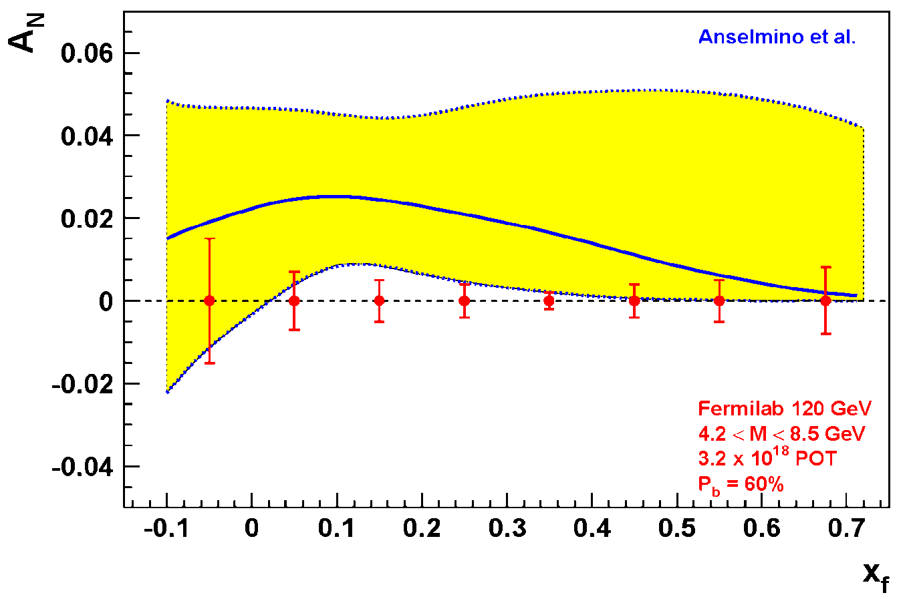
Expected Precision from E-1027 at Fermilab
Probe Valence-quark Sivers Asymmetry with a polarized proton beam at SeaQuest
1.3 Mio
DY events with no dilution
Experimental Conditions
  same as SeaQuest
  luminosity: L_{av} = 2 x 10³⁵ (10% of available beam time: I_{av} = 15 nA)
  3.2 X 10¹⁸ total protons for 5 x 10⁵ min: (= 2 yrs at 50% efficiency) with P_{b} = 60%
Can measure not only sign, but also the size & probably shape of the Sivers function!
as well as TMD evolution!
Notes:
Note that SSA A_N (measured left-right asymmetry) is related to Sivers SSA amplitude (provided in the TMD predictions) by 2/pi. So the red curve is scaled down by factor 2/pi relative to the prediction of Anselmino’s groups
1.3 Mio DY events, error<1% for all points except lowest xf

Slide 17
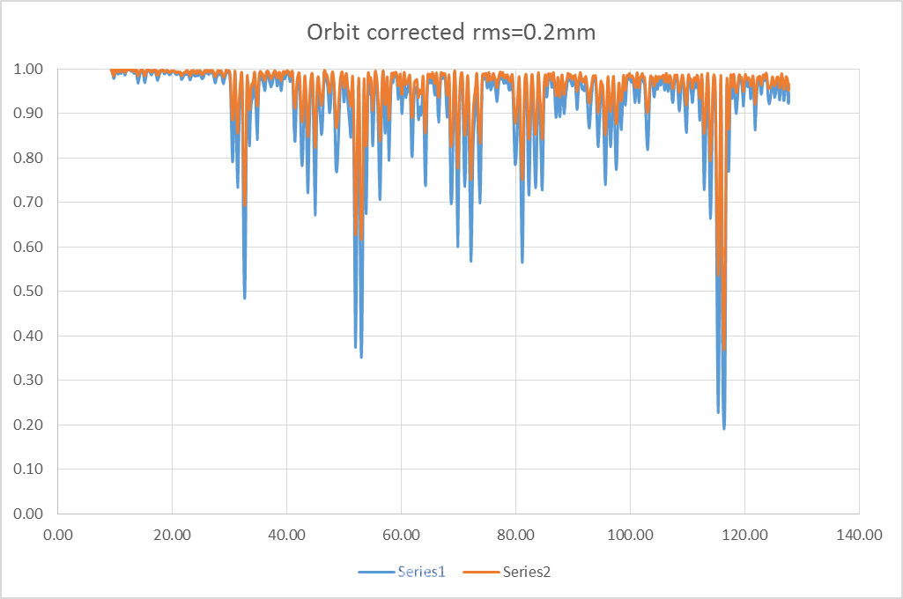
Simulation of final polarization as function of Energy in MI
Point-like snake in correct location, actual ramp rate for acceleration.
Polarizations with magnet field error and misalignment
(from magnet database and survey group), corrected
(for SeaQuest
running conditions)
Final polarization: ~ 90%
P_{y}
beam: Gaussian distribution
beam: flat distribution
gamma
e_{max} = 20 π mm.mrad in y plane and Δp =1.25*10⁻³ in longitudinal plane
Ref: Meiqin Xiao (FNAL)

Slide 18
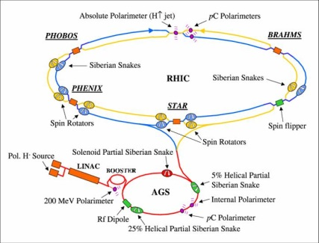
Differences compared to RHIC
Most significant difference:
Ramp time of Main Injector < 0.7 s, at RHIC 1-2 min
  warm magnets at MI vs. superconducting at RHIC
  → pass through all depolarizing resonances much more quickly
Beam remains in MI ~2 s, in RHIC ~8 hours
  extracted beam vs. storage ring
  much less time for cumulative depolarization
Disadvantage compared to RHIC — no institutional history of accelerating polarized proton beams
  Fermilab E704 had polarized beams through hyperon decays

Slide 19
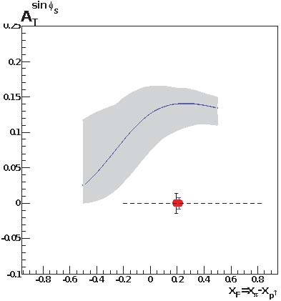
COMPASS Projection & Plans
  COMPASS: 190 GeV π⁻ beam on transverse polarized H target (NH₃)
  first year of polarized running completed
  2015 data ~120 days
  Transverse target polarization ~80%
estimated Statistics
  DY events [M(μ⁺μ⁻) > 4 GeV/c²): ~80,000
  J/ψ events: ~2,000,000
analysis on 2015 DY data underway
First physics results: SPIN 2016
  may be not yet full statistics
2018: second year of polarized DY scheduled
COMPASS statistical significance after two years of running for M_{γ} > M_{J/Ψ}
COMPASS Beyond 2020 (under study: https://indico.cern.ch/event/502879/)
  consider running with radio separated kaon/anti-proton beam for DY and spectroscopy
  improve significantly our knowledge of pion and kaon PDFs
  detailed study of the fundamental Lam-Tung relation violation
  Gluon TMDs ?
Ref: M. Chiosso & Oleg Denisov (Torino)

Slide 20
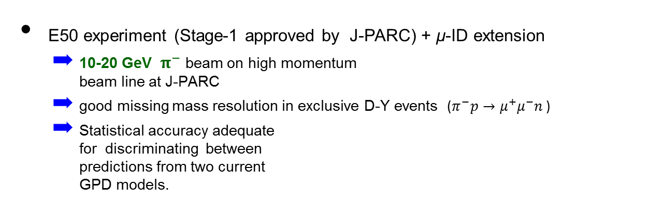
J-PARC Projection & Plans
T. Sawada et al., PRD 93, 114034 (2016)
  Accessing GPD of nucleon via exclusive meson-induced Drell-Yan
  Test of factorization of exclusive Drell-Yan process
  Test of universality of GPD in space-like (DVMP) and time-like processes (D-Y).
Space-like approach: JLAB, HERMES, COMPASS
Time-like approach: J-PARC
E50 experiment (Stage-1 approved by J-PARC) + μ-ID extension
  10-20 GeV ${ π}^{−}$beam on high momentum
  beam line at J-PARC
  good missing mass resolution in exclusive D-Y events ($π^{−}p→μ^{+}μ^{−}n$ )
  Statistical accuracy adequate
  for discriminating between
  predictions from two current
  GPD models.
P_{π} = 10 GeV
GK2013 (red)
BMP2001 (black)
M_{X} (GeV)
GK2013: P. Kroll et al. Eur.Phys.J.C73, 2278 (2013)
BMP2001: E.R. Berger et al. Phys.Lett.B523, 265 (2001)
|t - t₀| (GeV²)
Ref: T. Sawada (Acad. Sinica)
Notes:
The parametrization of H^{~} in "GK2013" is determined by the HERMES's experiment result on the cross sections and the target asymmetries for pi^+ electro-production.
The pion distribution amplitudes for the parametrization of E^{~} in "GK2013" has the term to match the the sharp rise of the pi gamma transition form factor with Q^2 observed in the Babar experiment. This term doesn't exist in "BMP2001".
References for "BMP2001":
ER Berger, M Diehl, B Pire
E.R.Berger et al. Phys.Lett.B523,265(2001)
E.R.Berger et al. Eur.Phys.J.C23,675(2002)
Reference for "GK2013":
P Kroll, H Moutarde, F Sabatie
P.Kroll et al. Eur.Phys.J.C73,2278(2013)

Slide 21
Conclusions
There is an exiting Drell-Yan program with polarized/unpolarized beams and targets underway
Future opportunities look very promising
We are eagerly awaiting results from COMPASS on the sign-change
Hope to answer some of the questions:
  How much do the quarks and gluons contribute to the nucleon spin?
  Is there significant orbital angular momentum?
  Does TMD formalism work? Does Sivers function change sign?

Slide 22
Thank You

Slide 23
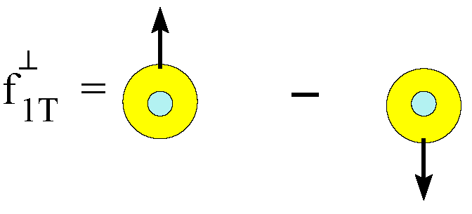
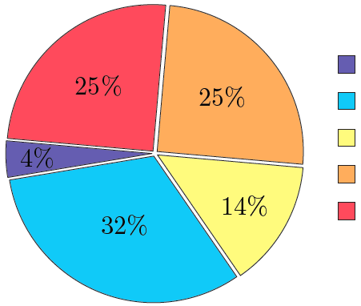
Sivers Function and Spin Crisis
cannot exist w/o quark OAM
describes transverse-momentum distribution of unpolarized quarks inside transversely polarized proton
captures non-perturbative spin-orbit coupling effects inside a polarized proton
How measure quark OAM ?
GPD: Generalized Parton Distribution
TMD: Transverse Momentum Distribution
Lattice QCD:
K.-F. Liu et al arXiv:1203.6388
Notes:
The connection b/w Sivers function and OAM is yet model-dependent, but what is clear is that the existence of the Sivers function requires non-zero quark OAM in the proton

