Slide 1







Fixed-target Drell Yan -- Presence & Future
Wolfgang Lorenzon
Hadron-China 2019 Workshop, Tianjin, China
(25-August-2019)
This work is supported by
Notes:
I have been asked by the organizers to give an overview on fixed-target Drell-Yan experiments and their importance
for unraveling the flavor structure of the nucleon. In order to put DY into the right perspective, I want to start contrasting DY and SIDIS and highlight some of the advantages that DY has over SIDIS. I then want to discuss existing results from fixed-tgt DY programs at SeaQuest and COMPASS and then focus on near and longer term plans for the fixed-tgt DY at a number of facilities.

Slide 2
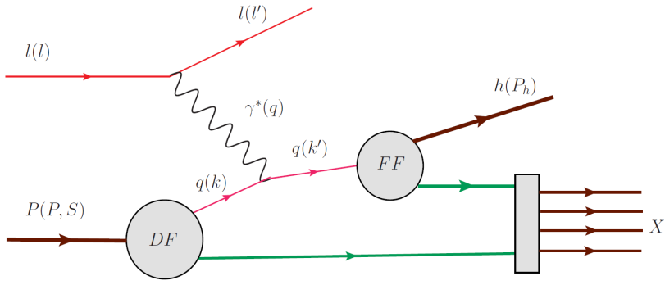
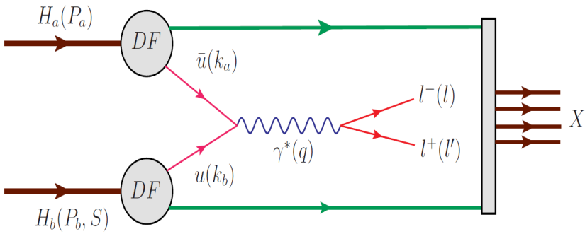
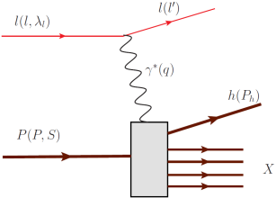
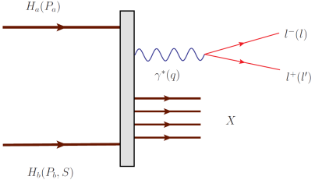
Complementarity between SIDIS and Drell Yan
SIDIS and Drell-Yan have similar physics reach:
  tools to probe quark and antiquark structure of nucleon
  electromagnetic probes
SIDIS (spacelike) Drell-Yan (timelike) virtual photon
credit: A. Kotzinian
Quintessential probe of hadron structure:
  relatively simple to measure and
  calculate
  charge-weighted flavor sensitivity
  QCD final state effects
  fragmentation process
  no quark-antiquark selectivity
Cleanest probe to study hadron structure:
  no QCD final state effects
  no fragmentation process
  production of two TMD parton
  distribution functions
  ability to select sea quark distribution
  hadron beam: σ(DY) / σ(nuclear) ≈ 10⁻⁷
2
Notes:
DY is an interesting process. As you can see in the diagrams for SIDIS and DY, both of these processes are purely leptonic in one half of their hard scattering diagrams. DY has therefore a similar physics reach as SIDIS – which is quite interesting considering that DY is a p-p scattering process. SIDIS has been the principal tool to probe hadron structure, because ……
In fact, DY may be the cleanest probe to study hadron structure: …
The price you have to pay, however, is that the DY cross section is strongly suppressed wrt the hadronic cross section. Special experiments have to be designed, therefore, that can isolate DY events from the vast hadronic background

Slide 3
Factorization and Universality (SIDIS - DY)
SIDIS DY
PDF
FF
credit: A. Kotzinian
PDF
PDF
Probe Universality
are TMD PDFs in SIDIS identical to TMD PDFs in DY?
Test using unpolarized experiments, transverse SSA and DSA
Notes:
Assuming factorization is valid in QCD, Drell-Yan can be written as a hard scattering process, and the direct production of two transverse momentum-dependent (TMD) distribution functions (Sivers, Boer-Mulders, etc); and SIDIS allows to measure convolution of DF with FF.
A central question is whether TMDs in SIDIS are the same as TMDs in DY. While there are good theoretical arguments why this should be true in some cases, but not in others, ultimately, experiment will have to tell.

Slide 4
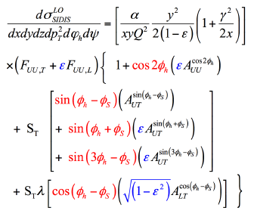
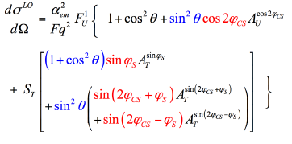
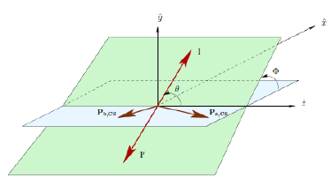
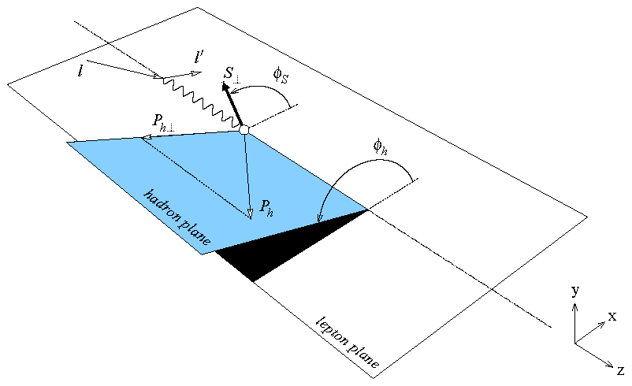
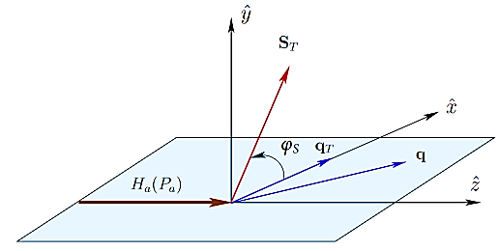
LO SIDIS and single polarized DY cross sections
SIDIS DY
Measure magnitude of
azimuthal modulations in
cross section:
“Single Spin Asymmetries”
credit: M. Chiosso & B. Parsamyan
Collins-Soper frame
(ie. dimuon c.m. frame)
target rest frame
target rest frame
Notes:
It turns out that TMDs are most cleanly accessed via the azimuthal distributions of the final state products of the SIDIS and DY processes with polarized beams and/or targets. Shown here are the LO SIDIS and single pol DY x-sections.
In SIDIS there are two angles of relevance Phi_S and Phi_h, and
for DY there are three: the azimuthal angle Phi_s of the transverse spin orientation of beam (determined in tgt rest frame), and
the polar and azimuthal angles theta and phi_CS of the dimuon pair (determined in C-S frame, ie. dimuon c.m. frame)
So what you do is, you measure the magnitude of azimuthal modulations in the cross section to obtain the asymmetry amplitudes

Slide 5
LO SIDIS and single polarized DY cross sections
SIDIS DY
beam target
BM CF
Sivers FF
Transv CF
Pretz CF
BM BM
f₁ Sivers
BM Transv
BM Pretz
within QCD TMD framework:
Notes:
It is the asymmetry amplitudes which contain the information regarding the TMDs. They are proportional to convolutions of PDFs & FFs in SIDIS and of two PDFs in DY. Shown here are 4 asymmetry amplitudes and their relation to 4 leading twist TMDs. So, again, a central question is whether the PDFs in SIDIS and DY are the same.
Well, w/in the QCD TMD framework, it is predicted that the first two (BM and Sivers) change sign, while the last two (Transv and Pretz) do not.

Slide 6
Drell Yan Advantage
Complementarity is emphasized by (LO): (Arnold,Metz,Schlegel:PRD79,034005(2009))
  in SIDIS: there is 1 F_{U(L),T} per TMD
  in DY: at least 2 F_{(U)T} per TMD
  → same TMDs can be measured in different F_{(U)T}
  → allowing cross checks of TMD extraction
  & even of underlying formalism
beam target
BM CF
Sivers FF
Transv CF
Pretz CF
BM BM
f₁ Sivers
BM Transv
BM Pretz
Notes:
Complementarity is emphasized by the fact in SIDIS there is, at leading twist, one structure function per TMD, while in DY, there are at least two structure functions per TMD. This means that the same TMDs can be measured in different structure functions, allowing to perform cross checks of the TMD extraction and even the underlying formalism.

Slide 7
Complementarity between SIDIS and Drell Yan
Complementarity is emphasized by (LO): (Arnold,Metz,Schlegel:PRD79,034005(2009))
  in SIDIS: there is 1 F_{U(L),T} per TMD
  in DY: at least 2 F_{(U)T} per TMD
  → same TMDs can be measured in different F_{(U)T}
  → allowing cross checks of TMD extraction
  & even of underlying formalism TMD
Systematic study of quark TMDs in Drell Yan
  requires double-polarization
  only then can all 8 leading twist TMD be measured
Double-Spin Drell Yan
  Measure DY with both Beam and Target polarized
    broad spin physics program possible
    truly complementary to spin physics programs at Jlab and RHIC and EIC
Notes:
A systematic study of quark TMDs in DY requires double polarization. Only in that case can all 8 leading twist TMDs be measured.
Having both a polarized beam and a polarized target would allow measurement of a variety of double-spin observables, thus opening up opportunities for a very rich spin physics program, which would be complementary to those at RHIC and Jlab.

Slide 8
(Un)Polarized Drell Yan Experiments
Experiment | Particles | Energy (GeV) | x_{b} or x_{t} | Luminosity (cm⁻² s⁻¹) |  | P_{b} or P_{t} (f) | rFOM# | Timeline
COMPASS (CERN) | π⁻ + p↑ | 160 GeV √s = 17 | x_{t} = 0.1 – 0.3 | 2 x 10³³ |  | P_{t} = 90% f = 0.22 | 1.1 x 10⁻³ | 2015-2016, 2018
J-PARC (high-p beam line) | π⁻ + p | 10-20 GeV √s = 4.4-6.2 | x_{b} = 0.2 – 0.97 x_{t} = 0.06 – 0.6 | 2 x 10³¹ |  | --- | --- | >2020? under discussion
fsPHENIX (RHIC) | p↑ + p↑ | √s = 200 √s = 510 | x_{b} = 0.1 – 0.5 x_{b} = 0.05 – 0.6 | 8 x 10³¹ 6 x 10³² |  | P_{b} = 60% P_{b} = 50% | 4.0 x 10⁻⁴ 2.1 x 10⁻³ | >2021?
SeaQuest (FNAL: E-906) | p + p | 120 GeV √s = 15 | x_{b} = 0.35 – 0.9 x_{t} = 0.1 – 0.45 | 3.4 x 10³⁵ |  | --- | --- | 2012 – 2017
Pol tgt DY‡ (FNAL: E-1039) | p + p↑ p + d↑ | 120 GeV √s = 15 | x_{t} = 0.1 – 0.45 | 3.0 x 10³⁵ 3.5 x 10³⁵ |  | P_{t} = 85% f = 0.176 | 0.15 | 2019-2021+
Pol beam DY§ (FNAL: E-1027) | p↑ + p | 120 GeV √s = 15 | x_{b} = 0.35 – 0.9 | 2 x 10³⁵ |  | P_{b} = 60% | 1 | >2021?
‡ 8 cm NH₃ target / § L= 1 x 10³⁶ cm⁻² s⁻¹ (LH₂ tgt limited) / L= 2 x 10³⁵ cm⁻² s⁻¹ (10% of MI beam limited) *not constrained by SIDIS data / # rFOM = relative lumi * P² * f² wrt E-1027 (f=1 for pol p beams, f=0.22 for π⁻ beam on NH₃)
W. Lorenzon (U-Michigan) 8/2019
Notes:
There is interest in DY at a number of laboratories. Here is a list of experiments either being conducted or planned to measure pol or unpol DY with a variety of beams and targets. At present only COMPASS has collected pol DY data, and we are eagerly awaiting the results from COMPASS on the sign change. Although a lot of information is provided on this list, let me focus on two points:
Running DY w/ a primary beam in fixed tgt mode (SeaQuest) has a huge advantage over running with a secondary beam in fixed tgt mode (COMPASS) or with a primary beam in collider mode (RHIC-fsPHENIX), where you get a penalty of a factor of ~1000 in rFOM. 1 day at FNAL corresponds to 3 years at COMPASS or RHIC
SeaQuest is sensitive to the interaction of valence quarks and sea anti-quarks, while COMPASS measures interaction of valence quarks and valence antiquarks, and is not sensitive to sea anti-quarks. Thus we have to go beyond COMPASS to do pol DY to learn about sea (anti)quarks
These points highlight specific strengths of Fermilab, making SeaQuest is the natural place to measure (pol) DY. It is also the only place that is collecting DY data right now. So let’s discuss the program at SeaQuest

Slide 9
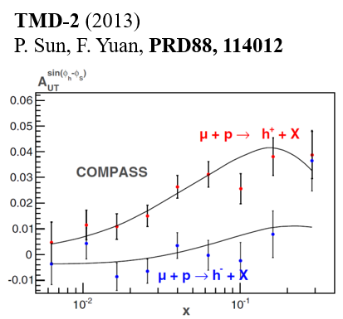
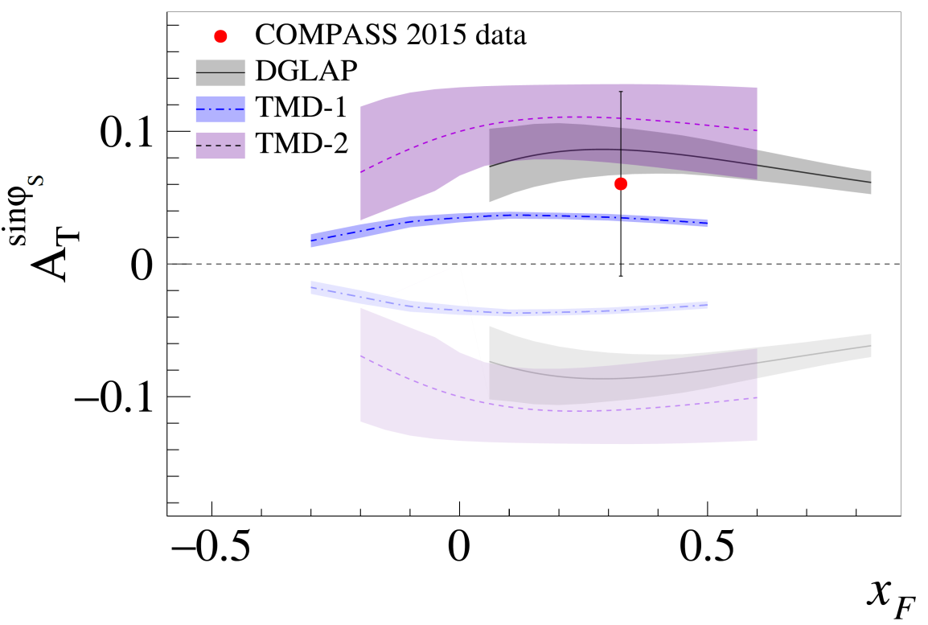
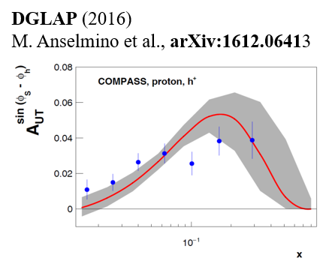
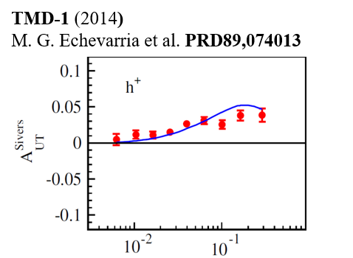
COMPASS 2015 Results
  COMPASS: 190 GeV π⁻ beam on transverse
  polarized H target (NH₃)
  2015 data (4 months)
  Transverse target polarization ~80%
  consistent w/ sign change!
sign change
no sign change
PRL 119, 112002 (2017)
Ref: W.C. Chang (Academia Sinica) & J-C Peng (UIUC)
Notes:
Recent theoretical predictions :
— Based on different Q2-evolution approaches.
— Positive sign of these theoretical predictions,
obtained using the sign-change
hypothesis for Sivers TMD PDFs

Slide 10
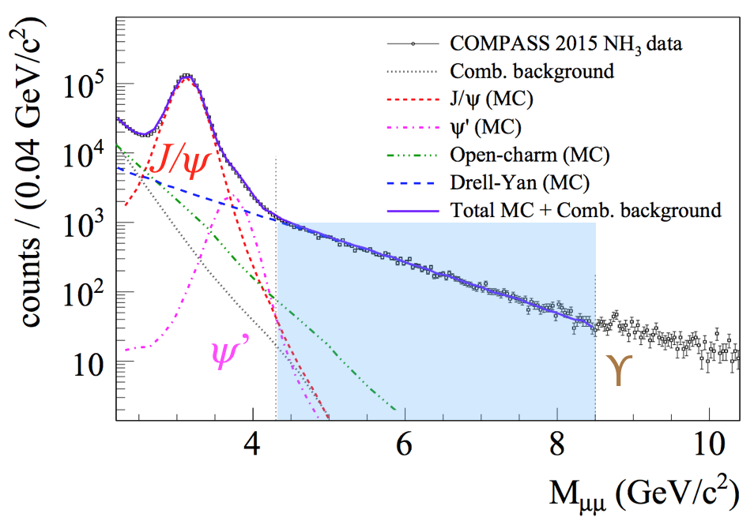
Kinematic Coverage
  Drell-Yan analysis: mass range 4.3 - 8.5 GeV/c² (“high mass range”)
  only 4% background in this mass range
  DY events [M(μ⁺μ⁻) > 4 GeV/c²): ~35,000
Phase space for Drell-Yan and SIDIS partially overlap in the x-Q² plane
  average Q² in Drell-Yan is about 2x that in SIDIS
  allows to minimize the impact of uncertainties from TMD scale evolution
  overlap in kinematic regions of COMPASS Drell-Yan and SIDIS data allows for direct comparisons of TMD amplitudes
COMPASS probes proton's valence quarks in Drell-Yan and SIDIS
HIGH MASS
Ref: M. Meyer-Condea Sinica) & R. Heitz (UIUC)

Slide 11
Updated COMPASS Result
COMPASS 2015 (PRL 119 (2017) + 2018 (~50%)
  (2015 = 4 months; 2018 = 5 months of data taking)
q_{T}/M weighted asymmetries
  access to direct product of TMD PDFs
  no assumption on k_{T} dependence of TMDs
Ref: M. Meyer-Conde (UIUC)
Notes:
qT weighted transverse spin asymmetries in Drell-Yan:
A. Efremov et al., Phys.Lett. B612 (2005) 233
A. Sissakian et al., Phys.Rev. D72 (2005) 054027
SIDIS projections (3 assumptions):
A_T^sin Phi_s prop to Sivers fct
No Q^2 evolution for Sivers fct
Assume sign change for Sivers fct

Slide 12
COMPASS Plans
Sivers asymmetry:
  Sivers asymmetry measured both in polarized Drell-Yan and SIDIS processes with the same apparatus
  no more sign-change data
Unpolarized DY:
  valence quark distributions for pion
  Boer-Mulders TMD extraction
  Nuclear dependence (EMC effect, Energy loss and Cronin effect)
  detailed study of the fundamental Lam-Tung relation violation
COMPASS++ / AMBER
  polarized ⁶LiD target: flavor separation of TMD SSAs.
  long LH₂ and nuclei targets: un-polarized pion-induced DY
  consider running with radio separated kaon/anti-proton beam for DY and spectroscopy
  improve significantly our knowledge of pion and kaon PDFs
  Gluon TMDs ?
Ref: W.C. Chang (Academia Sinica) & O. Denisov (Torino)
Notes:
Double check w/ AMBER proposal

Slide 13
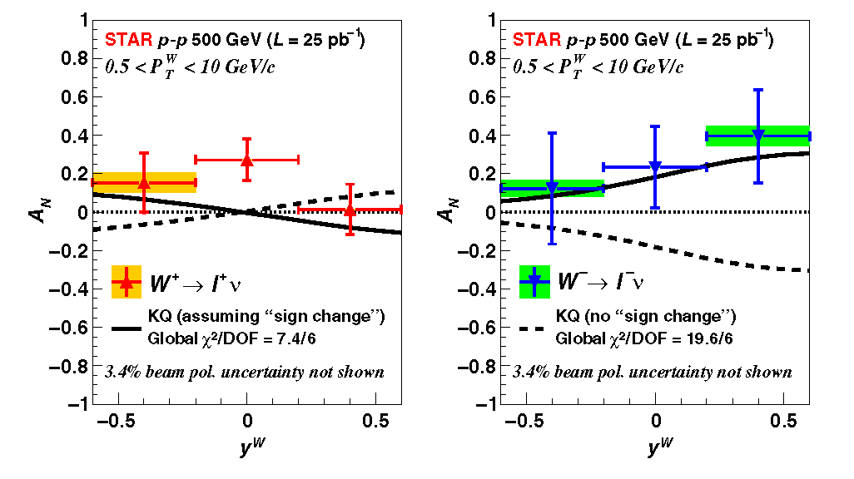


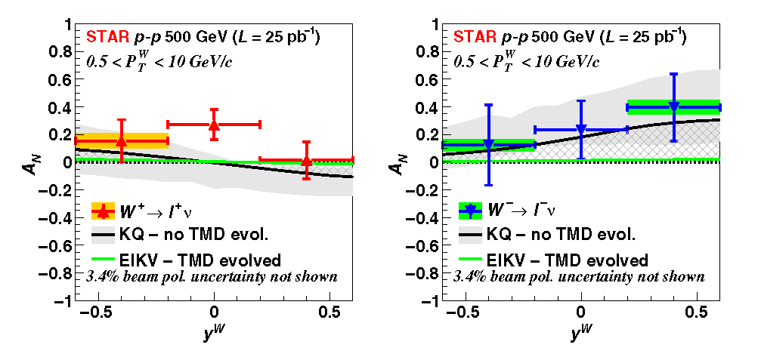
Sivers Program at STAR
RHIC p+p (500 Gev): W^{+/-} TSSA
Sivers asymmetry:
  quark flavor identified
  high Q²
  statistically limited: O(10%)
  data favor sign-change
  if TMD evolution effects small
  more data from 2017 (400 pb⁻¹)
  soon
A_{N}(W⁺) ~
A_{N}(W⁻) ~
PRL 116 (2016) 132301
Ref: M. Liu (LANL)
Notes:
Theoretical curves include no evolution effects. Z.-B. Kang and J. -W. Qiu, Phys. Rev. Lett. 103, 172001.
Note: W^- = d u_bar / W^+ = u d_bar

Slide 14
Past, Current and Future DY Program at FNAL
Unpolarized Beam and Target w/ SeaQuest detector
E-906/SeaQuest: 120 GeV p from Main Injector on LH₂, LD₂, C, Fe, W targets → high-x Drell Yan
Science run: March 2014 - July 2017
  dbar/ubar asymmetry, Quark energy loss
Unpolarized Beam and polarized Target (w/ upgraded SeaQuest detector)
E-1039/SpinQuest: SeaQuest w/ pol NH₃/ND₃ targets: 2019-2021
  probe sea quark distributions
Polarized Beam and polarized Target
→ development of high-luminosity facility for polarized Drell Yan
E-1027: pol p beam on (un)pol tgt (2021+?)
  Sivers sign change (valence quark)
  TMD physics program complementary to future EIC program
Other opportunities
E-1067/DarkQuest
  parasitic dark photon search (2016-2021+)
  dedicated run? (2021+?)

Slide 15
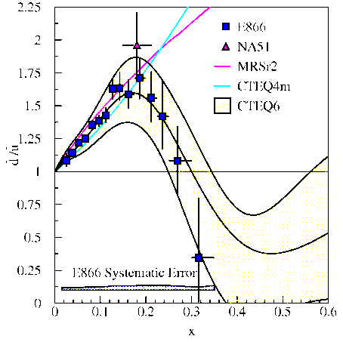
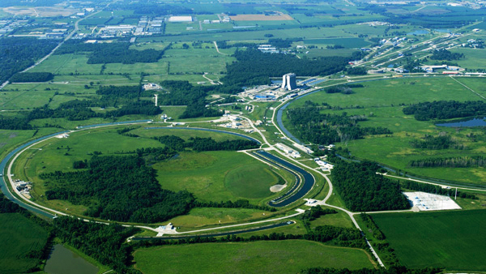
SeaQuest Experiment
Fixed Target Beam lines
Tevatron 800 GeV
Main Injector 120 GeV
10% of available beam to SeaQuest / 90% to neutrino program

Slide 16
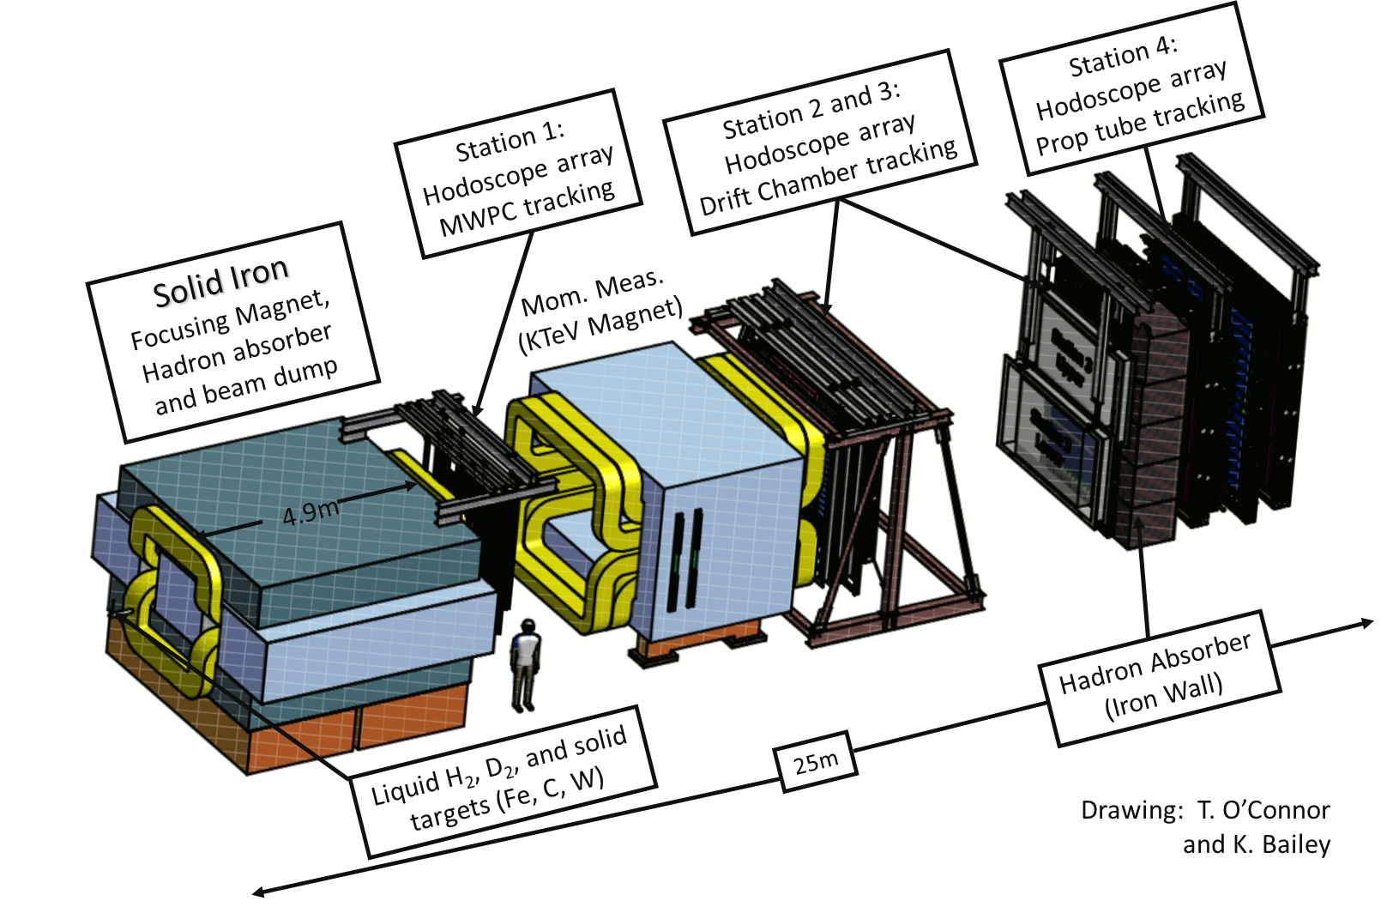
SpinQuest Spectrometer
Year 2015
120 GeV protons from the Main Injector
- 4.3s beam spill every 60 sec
- 19ns RF, ~10Ks p/RF bucket
- 5x10¹² p/spill
- Total integrated POT for E1039 (2-year): 1.4x10¹⁸ POT

Slide 17
Dimuon Mass from SeaQuest
Notes:
Combinatorial bkg by random event mixing
Remarks of top plot:
• Very tight event multiplicity cuts
• Very tight analysis cuts too

Slide 18
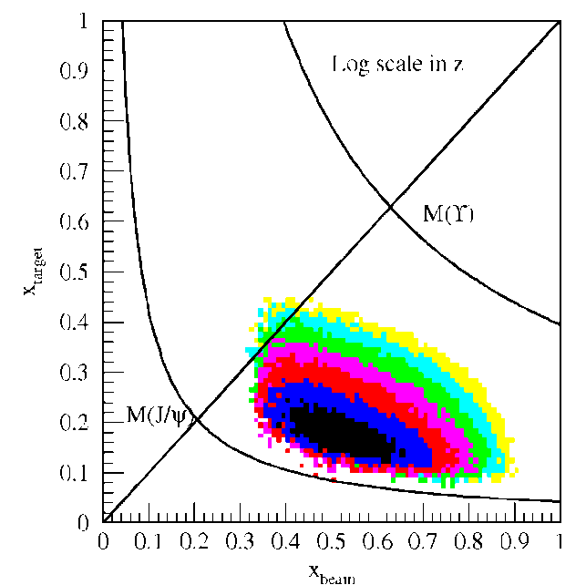

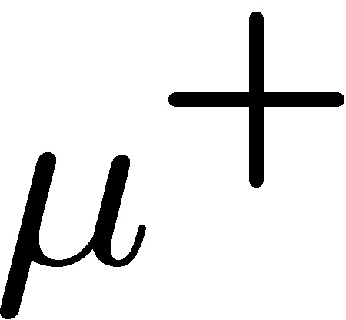


Fixed Target DY at SeaQuest: A Sea Quark Laboratory
Drell-Yan Spectrometer for E906
x_{target}
E906 spect.
acceptance
Cross section: convolution of beam and target parton distributions
x_{beam}
  beam: valence quarks at high x
  target: sea quarks at low/intermediate x
Fixed target kinematics favors sea-quarks from target – a sea quark laboratory!
Notes:
Sensitivity of D-Y process to anti-quark distribution of target or beam become clear from examining diff. cross section
At large x, parton distributions are dominated by valence quarks, at small x by sea quarks.
So in limit of large x_b and small x_t, cross section is dominated by first term -> providing direct sensitivity to antiquark sea of target nuclei

Slide 19
Flavor Asymmetry of SeaQuarks
SeaQuest
preliminary
E866 data is for Q² = 54 GeV² while SeaQuest data has Q² ≈ 29 GeV²
  difference should be insignificant
is there disagreement at high x?
dbar / ubar coming soon!

Slide 20
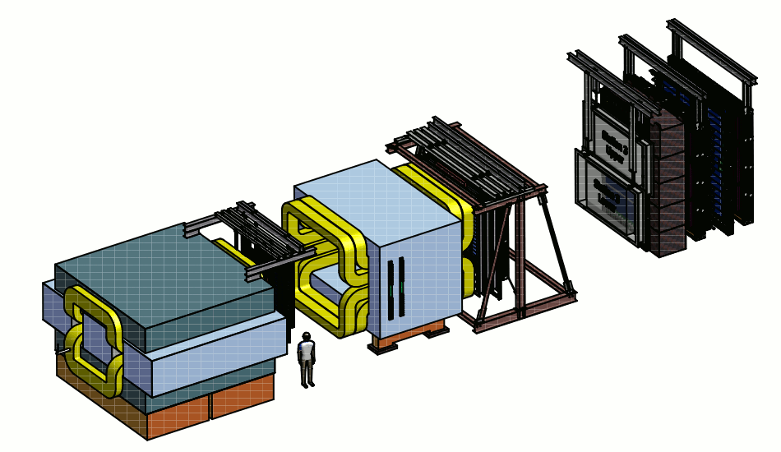
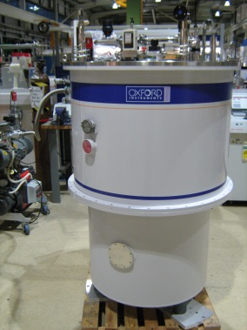
Let’s Add a Polarized Target (E-1039)
Polarized
Target
B-Field
x
μ⁺
E906 Spectrometer
y
μ⁻
x
Proton Beam
120 GeV/c
replace unpolarized w/ polarized target
→ LANL and UVA effort
move polarized target ~2m upstream
→ improves target-dump separation
→ moves acceptance to lower x₂
L_{int} = 1.82 *10⁴²/cm² NH₃ / 2.11 *10⁴²/cm² ND₃ for 2 years
Ref: Andi Klein (LANL)
20

Slide 21
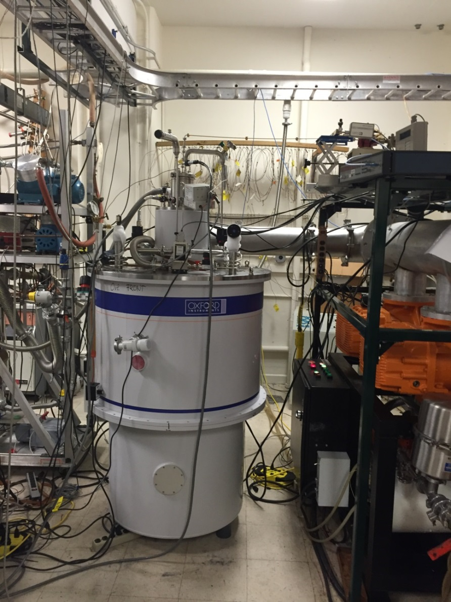
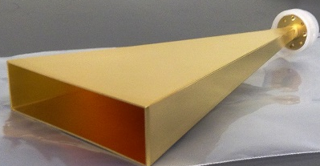
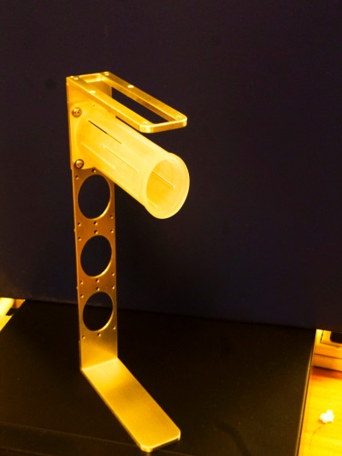
Polarized Target Developed for DY Sivers
field: 5T @ 1K
targets: NH₃ and ND₃
elliptical: 1.9 cm x 2.1 cm (x,y), l:7.9 cm (z)
3 active cells, 1 empty
helium consumption 100 l/day
NH₃
ND₃
Ref: Andi Klein (LANL)
21
Notes:
green pol curve maxes out at ~71% b/c microwave horn irradiated only portion of tgt, while NMR coil sampled entire tgt.
71% is average polarization of entire tgt, but irradiated region is >90%

Slide 22
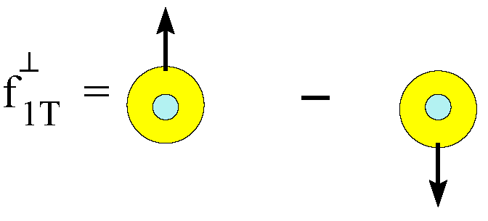
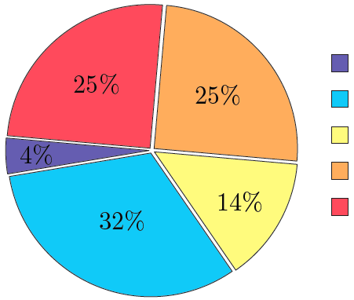
Sivers Function and Spin Crisis
cannot exist w/o quark OAM
describes transverse-momentum distribution of unpolarized quarks inside transversely polarized proton
captures non-perturbative spin-orbit coupling effects inside a polarized proton
How measure quark OAM ?
GPD: Generalized Parton Distribution
TMD: Transverse Momentum Distribution
Lattice QCD:
K.-F. Liu et al arXiv:1203.6388
Notes:
The connection b/w Sivers function and OAM is yet model-dependent, but what is clear is that the existence of the Sivers function requires non-zero quark OAM in the proton

Slide 23
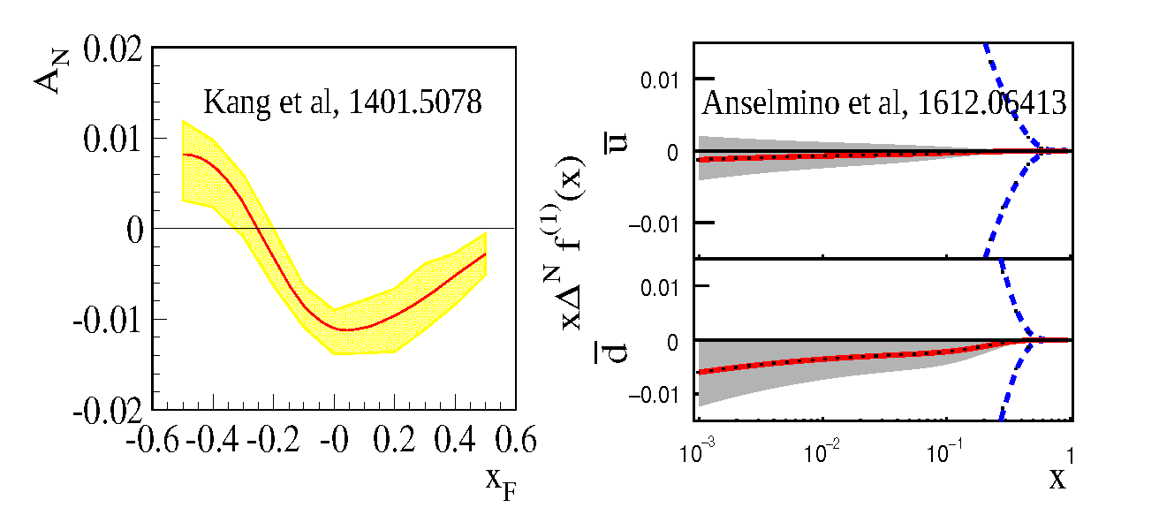
Projected DY Transverse Single Spin Asymmetry
E1039 proposal
More recent calculations
determine sign and value of sea quark Sivers asymmetry
measure sea quark Sivers flavor dependence (H & D targets)
x_{target}
existing SIDIS data poorly constrain
sea-quark Sivers function (Anselmino)
significant Sivers asymmetry expected from meson-cloud model
(Sun & Yuan)
If A_{N}≠0, major discovery: “Smoking Gun” evidence for

Slide 24
E1039 Status & Plans
• DOE approval, March 2018
• Fermilab stage-2 approval, May 2018
• E906 decommissioned 6/2018
• Polarized target to be installed by fall of 2019
- E1039 commissioning starts in late 2019
- Run for 2+ years, 2019-2021+
NH₃ target
120 GeV
beam
Ref: M. Liu (LANL)
24

Slide 25
E1039 Milestones - Fermilab
major modifications in experimental hall (special thanks to Fermilab)
  beamline: new collimator
  new radiation shielding design
  new cryo platform for polarized target infrastructure
  polarized target cave: new location 300cm upstream of FMAG
Ref: M. Yurov (LANL)

Slide 26
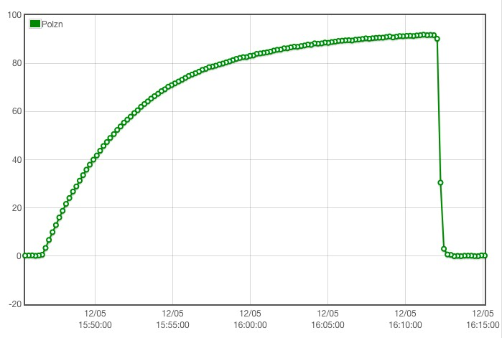
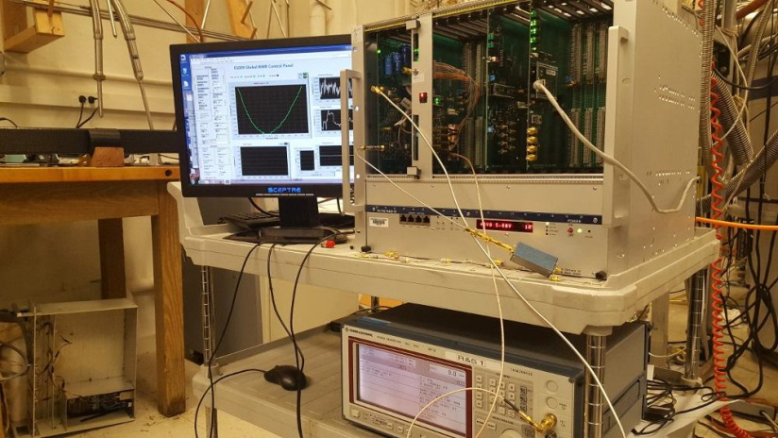
E1039 Milestones - Collaboration
new polarized target construction: LANL and UVA effort
  rebuild magnet; change field direction
  modify 1K refrigerator and insert
  new pump set; high cooling capacity
  new high power microwave source
  polarization of NH₃ > 90%
new NMR system
  replacing Liverpool Q-meter
  cold NMR
He liquefier for liquid helium recirculation
  constructed by "Quantum technologies"
  ~200 L/day capacity
P > 90%
New LANL NMR setup
Ref: M. Yurov (LANL)

Slide 27
E1039 Collaboration
Contact Spokespersons:
Kun Liu (liuk@fnal.gov) - LANL
Dustin Keller (dustin@jlab.org) - UVA
Learn more about SpinQuest/E1039:
https://spinquest.fnal.gov/

Slide 28
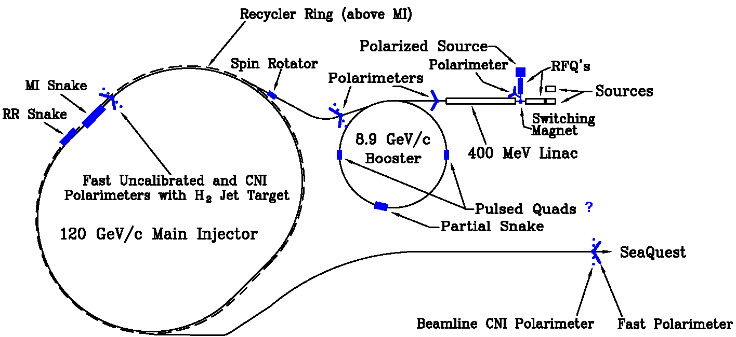
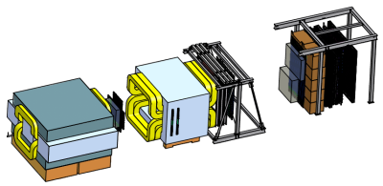
Let’s Polarize the Beam at Fermilab (E-1027)
The Plan:
Use SpinQuest Spectrometer
Add polarized beam
Fermilab (best place for polarized DY):
  very high luminosity, large x-coverage (primary beam, fixed target)
Measure sign-change in Sivers Function:
  sign, size and shape of Sivers function
  and TMD evolution
Access to both valence and sea quarks
Complementary to future EIC TMD Physics

Slide 29
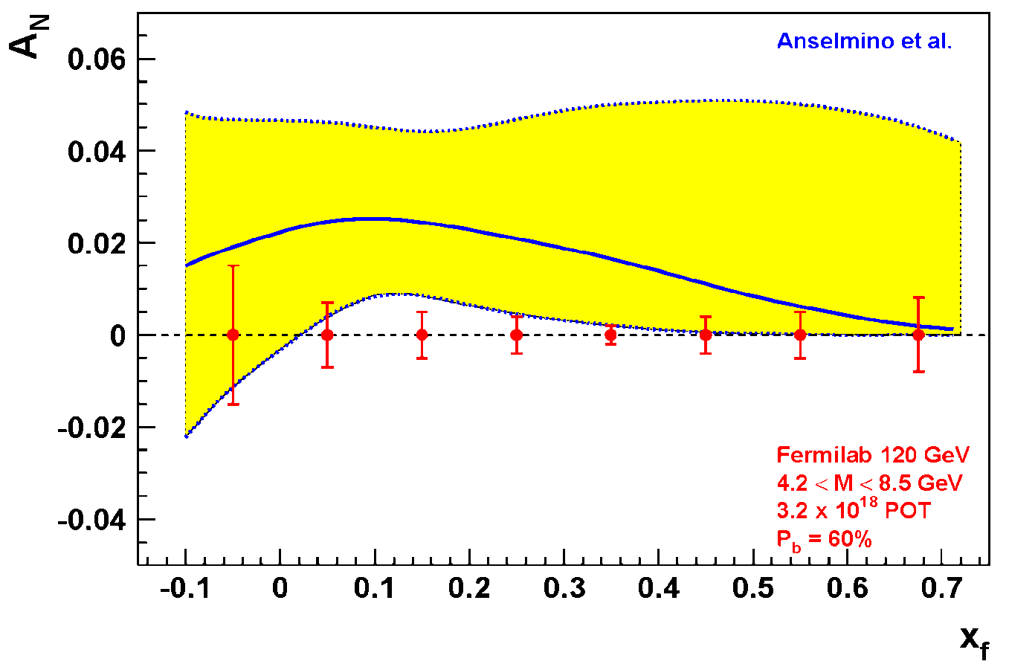
Expected Precision from E-1027 at Fermilab
Probe Valence Quark Sivers Asymmetry with a polarized proton beam at SeaQuest
1.3 Mio
DY events with no dilution
Experimental Conditions
  same as SeaQuest
  luminosity: L_{av} = 2 x 10³⁵ (10% of available beam time: I_{av} = 15 nA)
  3.2 X 10¹⁸ total protons for 5 x 10⁵ min: (= 2 yrs at 50% efficiency) with P_{b} = 60%
Can measure not only sign, but also the size & probably shape of the Sivers function!
as well as TMD evolution!
Notes:
Note that SSA A_N (measured left-right asymmetry) is related to Sivers SSA amplitude (provided in the TMD predictions) by 2/pi. So the red curve is scaled down by factor 2/pi relative to the prediction of Anselmino’s groups
1.3 Mio DY events, error<1% for all points except lowest xf

Slide 30
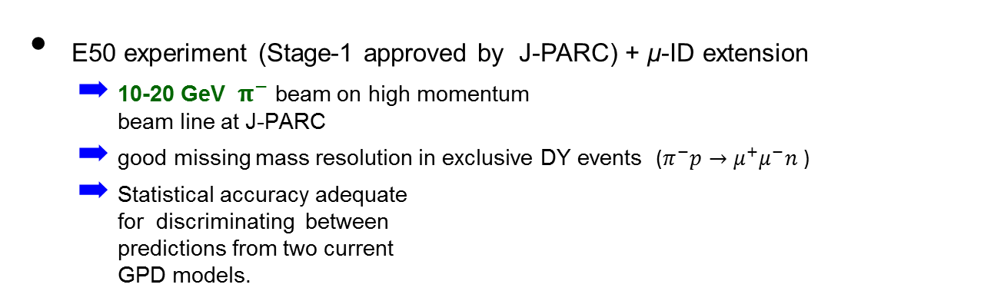
J-PARC Projection & Plans
T. Sawada et al., PRD 93, 114034 (2016)
  Accessing GPD of nucleon via exclusive meson-induced Drell-Yan
  Test of factorization of exclusive Drell-Yan process
  Test of universality of GPD in space-like (DVMP) and time-like processes (DY).
Space-like approach: JLAB, HERMES, COMPASS
Time-like approach: J-PARC
E50 experiment (Stage-1 approved by J-PARC) + μ-ID extension
  10-20 GeV ${ π}^{−}$beam on high momentum
  beam line at J-PARC
  good missing mass resolution in exclusive DY events ($π^{−}p→μ^{+}μ^{−}n$ )
  Statistical accuracy adequate
  for discriminating between
  predictions from two current
  GPD models.
P_{π} = 10 GeV
GK2013 (red)
BMP2001 (black)
M_{X} (GeV)
GK2013: P. Kroll et al. Eur.Phys.J.C73, 2278 (2013)
BMP2001: E.R. Berger et al. Phys.Lett.B523, 265 (2001)
|t - t₀| (GeV²)
Ref: T. Sawada (Acad. Sinica)
Notes:
The parametrization of H^{~} in "GK2013" is determined by the HERMES's experiment result on the cross sections and the target asymmetries for pi^+ electro-production.
The pion distribution amplitudes for the parametrization of E^{~} in "GK2013" has the term to match the sharp rise of the pi gamma transition form factor with Q^2 observed in the Babar experiment. This term doesn't exist in "BMP2001".
References for "BMP2001":
ER Berger, M Diehl, B Pire
E.R.Berger et al. Phys.Lett.B523,265(2001)
E.R.Berger et al. Eur.Phys.J.C23,675(2002)
Reference for "GK2013":
P Kroll, H Moutarde, F Sabatie
P.Kroll et al. Eur.Phys.J.C73,2278(2013)

Slide 31
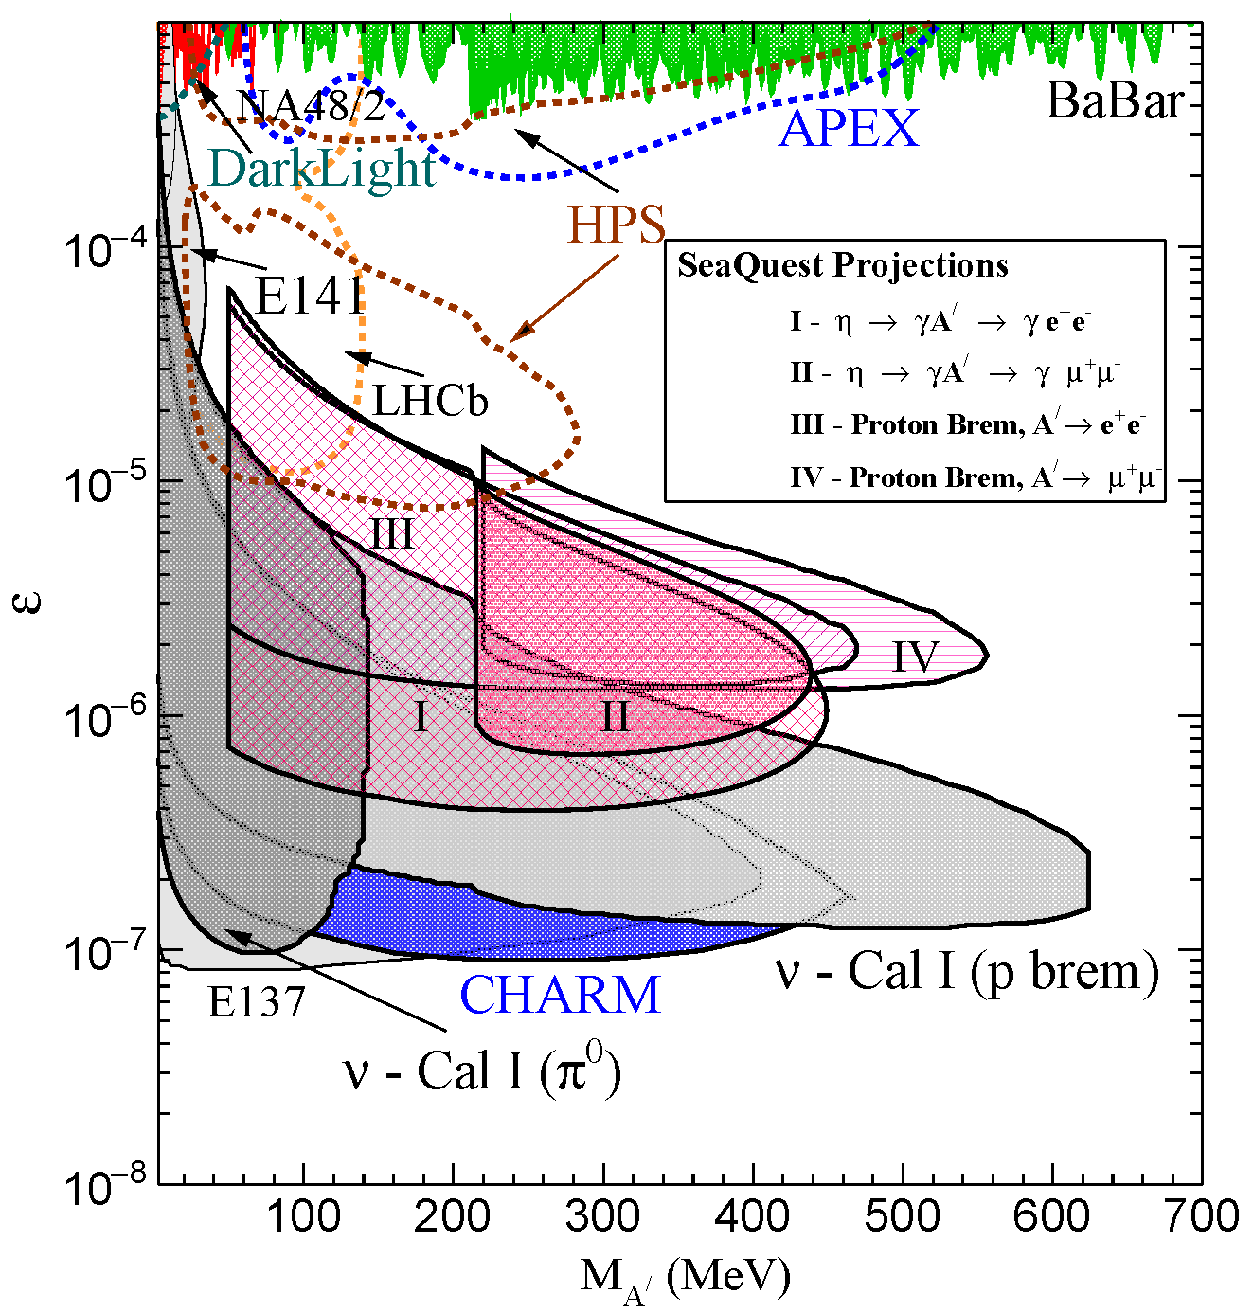
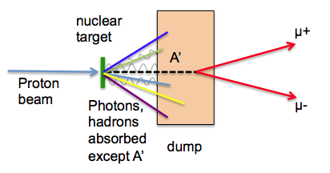
Search for Dark Photons at SeaQuest
Classic Beam Dump Experiment
Minimal impact on Drell-Yan program
  run parasitically during E906 & E1039
SeaQuest experimental parameters:
  E₀ = 5 - 110 GeV for Proton Bremsstrahlung
  N_{eff} = 2
  l₀ = 0.17m – 5.95m
J. D. Bjorken et al, PRD 80 (2009) 075018
Notes:
95% C.I. assuming 10 events during a 200 day search (@ 30% efficiency), and no decays of the A’ to the invisible sector
Changing either the p beam energy or the length of the iron beam dump can extend the sensitivity of SeaQuest

Slide 32
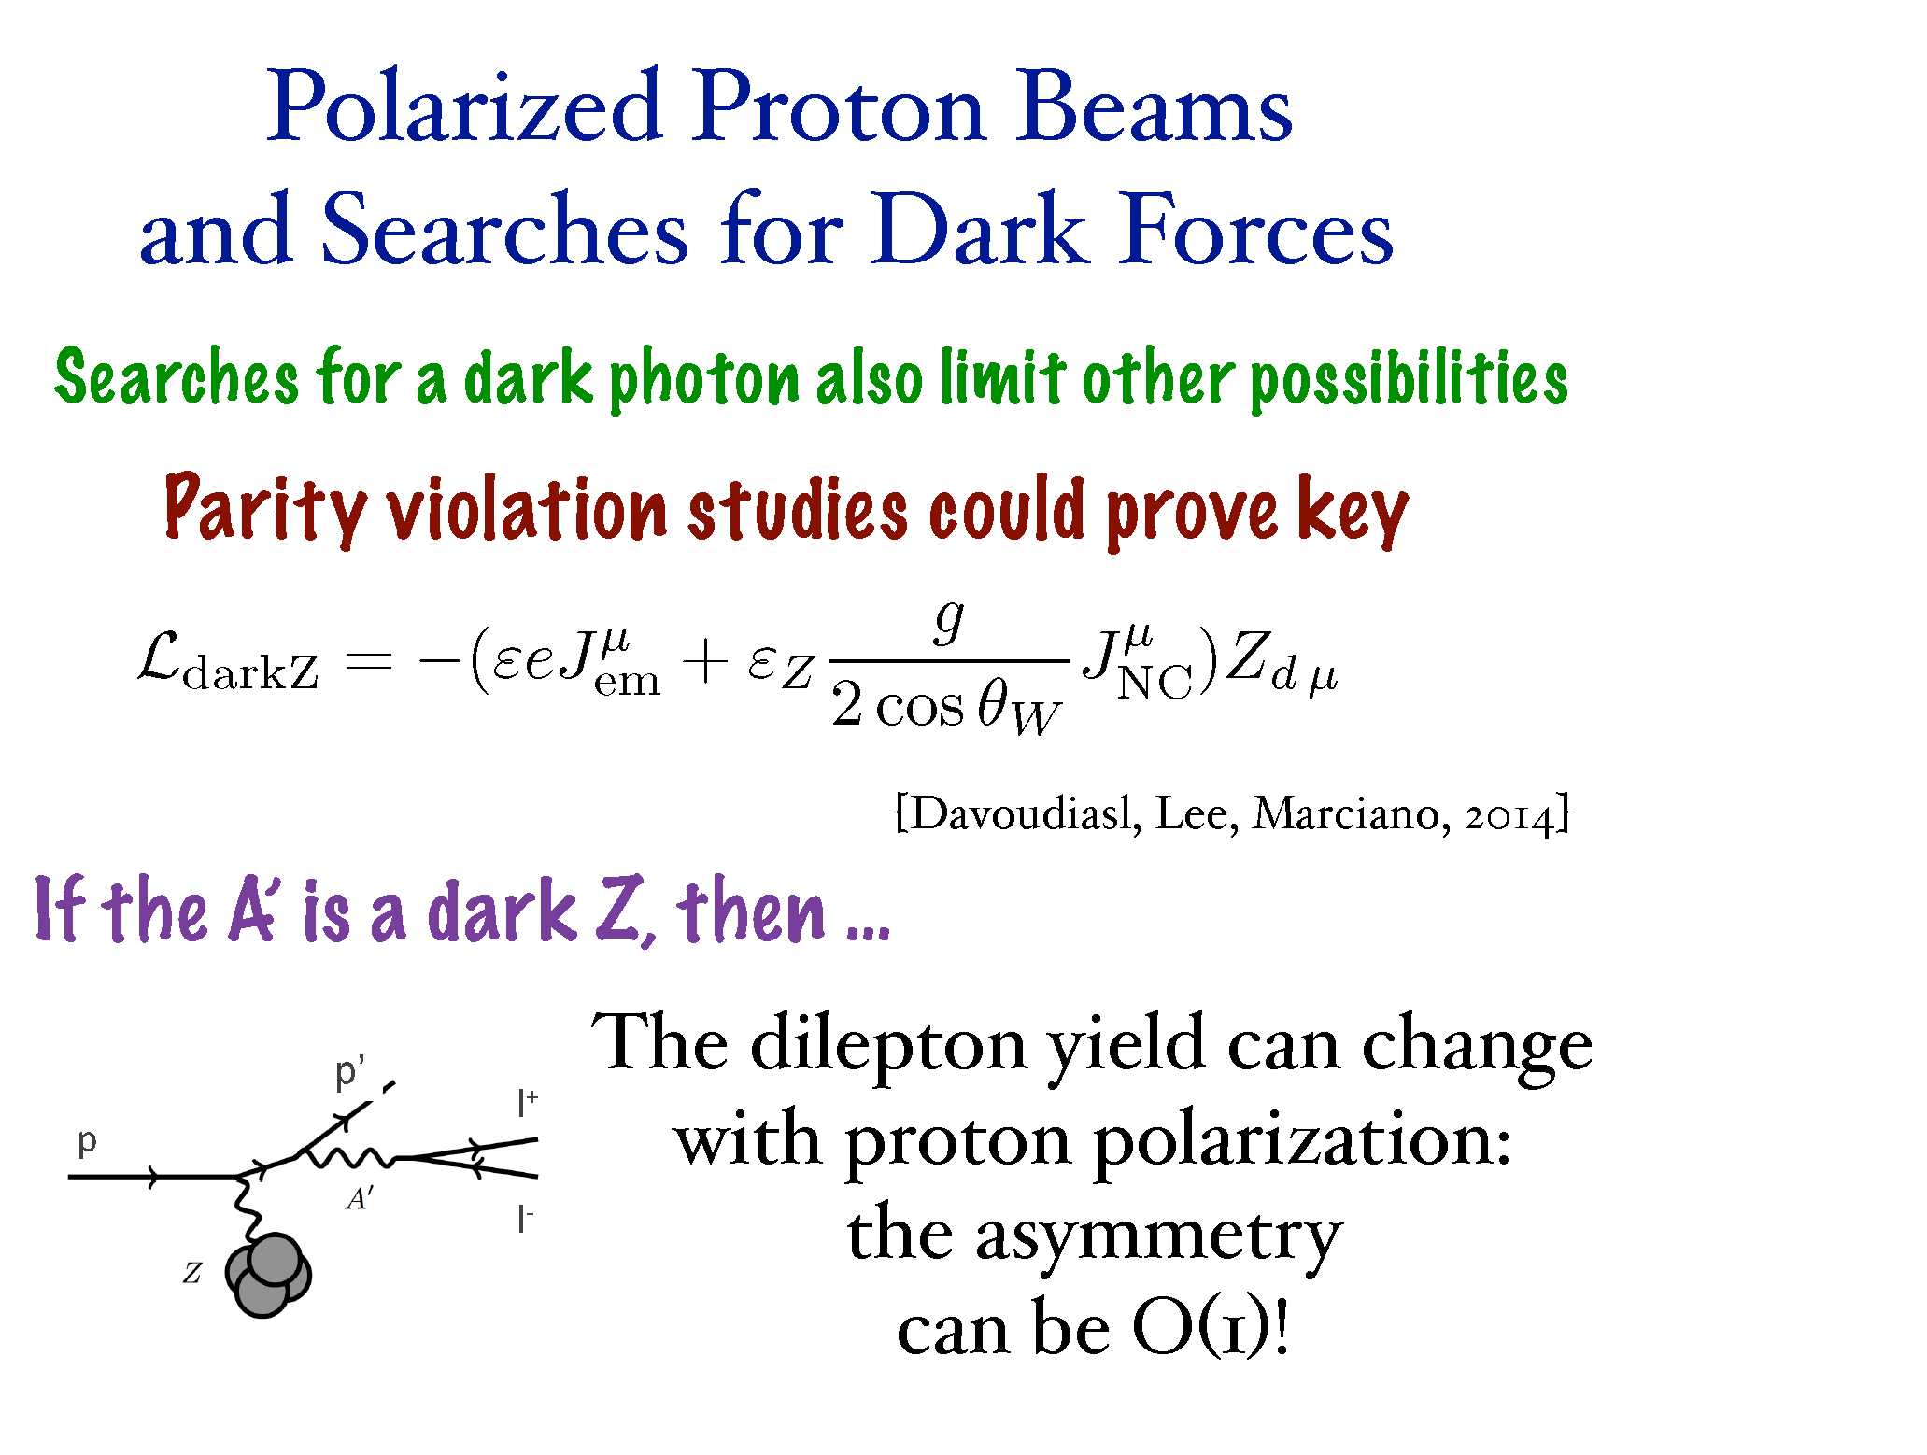
Adding Polarization
32
Notes:
Adding polarization could result in sensitivity to a parity violating dark Z. Specifically, the dark Z can be produced via either vector or axial-vector coupling. These processes can interfere to give different di-lepton yields vs beam helicity

Slide 33
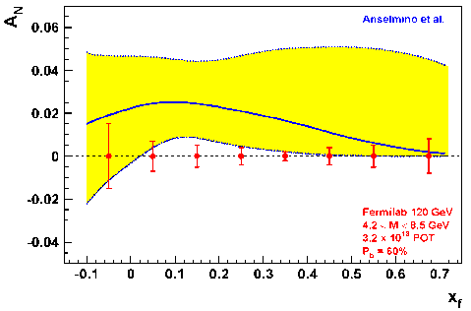
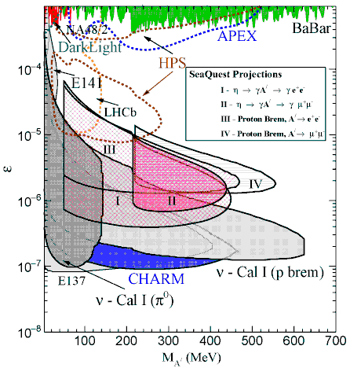
Fermilab - Summary and Outlook
Experiments | Timeline | Interactions | Physics
E906 (SeaQuest) | 2014 - 2017 | p + LH₂ / LD₂ p + C, Fe, W | dbar/ubar, nucl dep quark dE/dx
E1039 (SpinQuest) | 2019 – 2021+ | p + pol NH₃ p + pol ND₃ | sea-quark Sivers, TMD
E1027 | 2021+ (?) | pol p + LH₂ or pol p + NH₃ | Valence quark Sivers, sign change, TMD, spin
E1067 (DarkQuest) | 2017 - 2021+ (para.) 2021+ (dedicated?) | p + any target | dark photon, dark Higgs, …
Ref: M. Liu (LANL)

Slide 34
Conclusions
There is an exciting Drell-Yan program with polarized/unpolarized beams and targets underway
  although experimentally more challenging, it has some clear advantages over SIDIS
Different labs offer complementary probes and processes to study hadronic landscape
  focus on strength of each lab to (minimize cost and) optimize physics output
Future opportunities look very promising
  support from hadronic community (was and remains) vital to move forward
  opportunities to join the Fermilab program
We have seen first results from COMPASS and STAR on the sign-change
  statistics still poor
Now entering an era where we will have first measurement of a sea quark Sivers function (answer some of the questions):
  How much do the quarks and gluons contribute to the nucleon spin?
  In particular, what is the role of the sea quarks?
  Is there significant orbital angular momentum?
  Does TMD formalism work? Does Sivers function change sign (but keep shape and size)?

Slide 35
Thank You

Slide 36
SpinQuest/E1039 Collaboration
Relatively small collaboration
  36 full members, 76 affiliate members
  14 institutions and Fermilab
US collaborators supported by NSF and DOE Medium Energy
New collaborators actively sought
  contribute and lead major detector and physics efforts
  contact co-spokespersons
Abilene Christian University
Argonne National Laboratory
KEK
Los Alamos National Laboratory
Mississippi State University
New Mexico State University
RIKEN
Tokyo Institute of Technology
University of Colorado, Boulder
University of Illinois, Urbana-Champaign
University of Michigan
University of New Hampshire
University of Virginia
Yamagata University

Slide 37

SeaQuest Spectrometer
Station 4:
Hodoscope array
Prop tube tracking
Station 2 and 3:
Hodoscope array
Drift Chamber tracking
Station 1:
Hodoscope array
MWPC tracking
Solid Iron Focusing Magnet, Hadron absorber and beam dump
Mom. Meas.
(KTeV Magnet)
4.9m
Hadron Absorber
(Iron Wall)
Liquid H₂, D₂, and solid targets (Fe, C, W)
25m
Drawing: T. O’Connor and K. Bailey

Slide 38
Fixed Target DY at SeaQuest: A Sea Quark Laboratory
Drell-Yan Spectrometer for E906
SeaQuest.
acceptance
x_{target}
x_{beam}
Fixed target kinematics favors sea-quarks from target – a sea quark laboratory!
Notes:
Sensitivity of D-Y process to anti-quark distribution of target or beam become clear from examining diff. cross section
At large x, parton distributions are dominated by valence quarks, at small x by sea quarks.
So in limit of large x_b and small x_t, cross section is dominated by first term -> providing direct sensitivity to antiquark sea of target nuclei

Slide 39
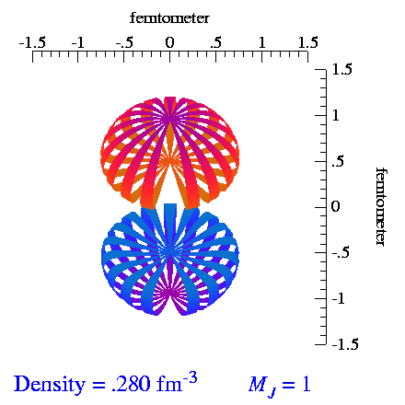
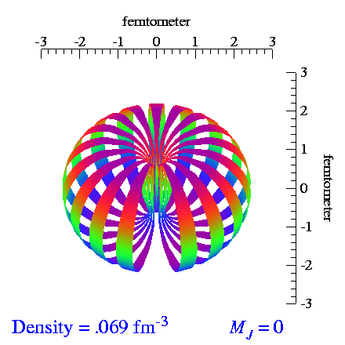
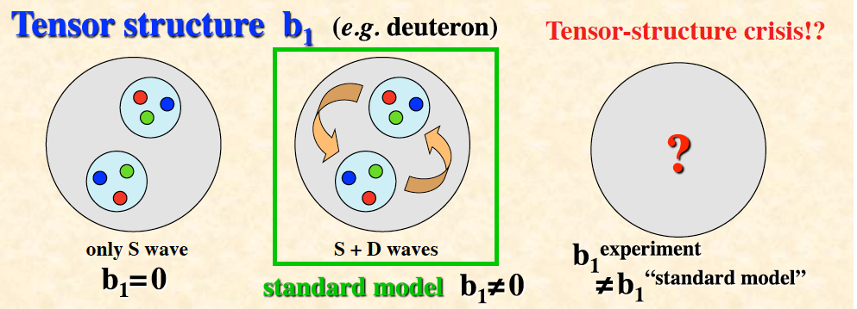
Tensor Polarization of Deuteron
deuteron is spin 1 particle, opens up new physics
spin-1 system in a B-field leads to
3 sublevels via Zeeman interaction
Vector polarization: (n ⁺ - n ⁻); -1 < P_{z} < +1
Tensor polarization: (n ⁺ - n⁰) – (n⁰ – n ⁻); - 2 < P_{zz} < +1
Normalization: (n ⁺ + n ⁻ +n⁰) = 1
From S. Kumano, arxiv.org/1606.03149
39
Notes:
Tensor-polarization asymmetries A_Q.
Very interesting since it means that b1 not only depends on the parton distributions but also on the relative alignment of the two nucleons. Bridge between nuclear and particle physics. Why should there be an asymmetry on the quark level depending on the spin of the nucleons they are embedded in. Why should the quarks be concerned about the coupling of the spin of the two nucleons.
The dashed curves are for the set-1 without antiquark tensor polarization at the initial scale (Q 2 = 2.5 GeV2 ), the solid curves indicate the set-2 results
Set 1: There is no antiquark tensor polarization at the scale Q^2_0 (alpha_ q¯ = 0).
Set 2: There could be finite antiquark tensor polarization at the scale Q^2_0 (alpha_ q¯ is a free parameter).

Slide 40
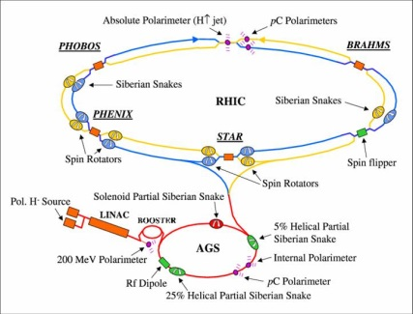
Polarized protons: Fermilab vs RHIC
Most significant difference:
Ramp time of Main Injector < 0.7 s, at RHIC 1-2 min
  warm magnets at MI vs. superconducting at RHIC
  → pass through all depolarizing resonances much more quickly
Beam remains in MI ~2 s, in RHIC ~8 hours
  extracted beam vs. storage ring
  much less time for cumulative depolarization
Disadvantage compared to RHIC — no institutional history of accelerating polarized proton beams
  Fermilab E704 had polarized beams through hyperon decays

Slide 41
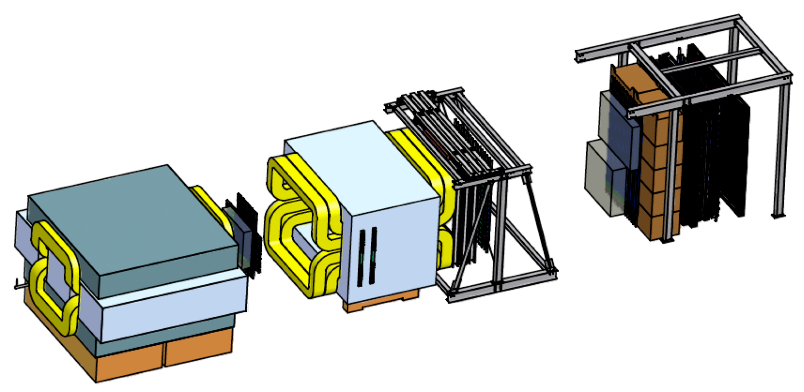
Let’s Add a Polarized Target (E-1039)
ST2
Polarized
Target
ST1
KMAG
B-Field
FMAG
μ⁺
ST3
ST4
x
y
μ⁻
x
Proton Beam
120 GeV/c
E906 Spectrometer
replace unpolarized w/ polarized target
→ LANL and UVA effort
move polarized target ~2m upstream
→ improves target-dump separation
→ moves acceptance to lower x₂
L_{int} = 1.82 *10⁴²/cm² NH₃ / 2.11 *10⁴²/cm² ND₃ for 2 years
Ref: Andi Klein (LANL)
41

