Slide 1
Configuring and Using the Space Weather Modeling Framework
D. Welling

Slide 2
What is the SWMF?
The Space Weather Modeling Framework is
a flexible framework that allows us to execute, synchronize, and couple many independent models of the space environment to create a comprehensive and self-consistent model of the space environment.

Slide 3
SWMF and BATS-R-US are different things
The first and most-used model within the SWMF is BATS-R-US.
Because of this, most people assume that “SWMF” is an synonym of “BATS-R-US”.
THE SWMF AND BATS-R-US ARE DIFFERENT THINGS.
THE SWMF AND BATS-R-US ARE DIFFERENT THINGS.

Slide 4
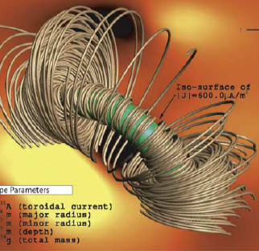
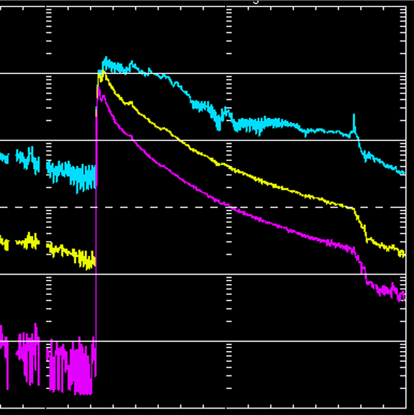
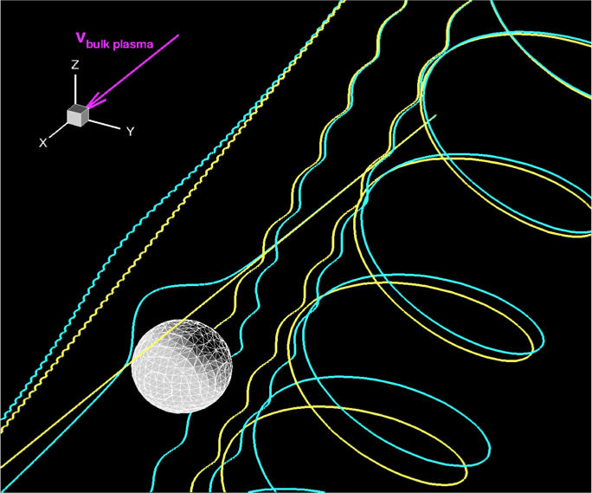
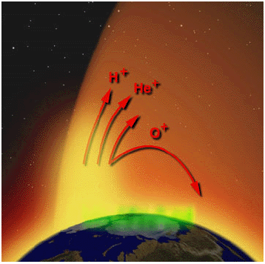
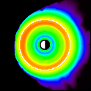
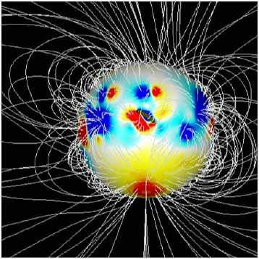
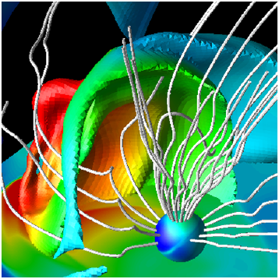
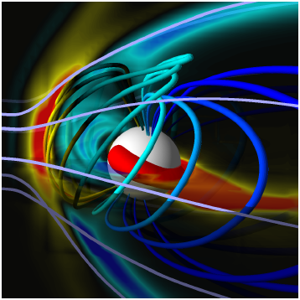
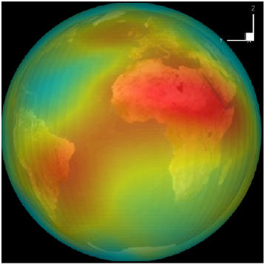
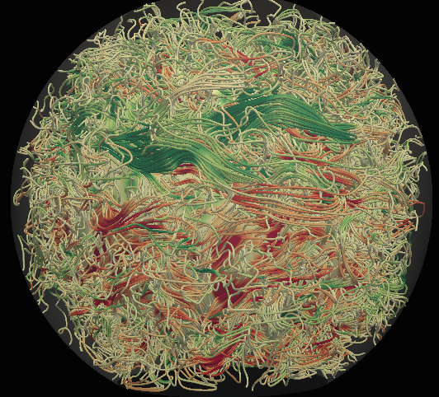
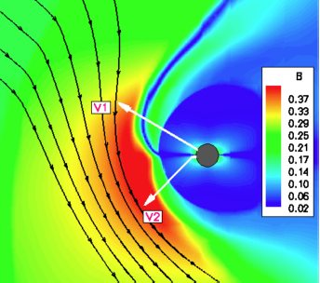
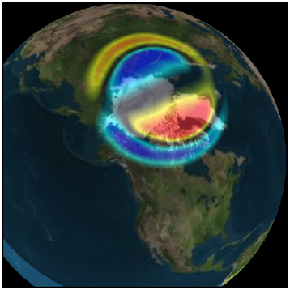
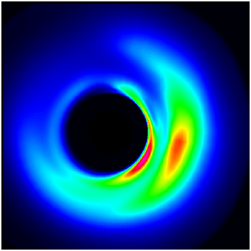
Flare/CME
Observations
Upstream
Monitors
Each component represents a physics domain.
Each has a two-letter identifier (e.g., GM or SC).
The components are empty sockets into which an arbitrary code can be integrated.
The SWMF allows the different components to couple to each other.
SWMF Control & Infrastructure
Eruption
Generator
Radiation
Belts
Solar
Energetic
Particles
Particle
Tracker
Polar Wind
Inner
Heliosphere
Magneto-grams,
rotation tomography
Couplers
F10.7 Flux
Gravity
Waves
Global
Magnetosphere
Thermosphere
& Ionosphere
Solar Corona
3D Outer
Heliosphere
Inner
Magnetosphere
Convection
Zone
Ionospheric
Electrodynamics
Particle in Cell
Radars
Magnetometers
In-situ

Slide 5
Flare/CME
Observations
Upstream
Monitors
SWMF Control & Infrastructure
Eruption
Generator
Radiation
Belts
EEGL
SWARM
Kota
MFLAMPA
PWOM
GPW
RBE
RiceV5
Solar
Energetic
Particles
AMPS
Particle
Tracker
Polar Wind
Inner
Heliosphere
Magneto-grams,
rotation tomography
AWSoM
BATSRUS
BATSRUS
Couplers
GITM
F10.7 Flux
Gravity
Waves
Global
Magnetosphere
Thermosphere
& Ionosphere
Solar Corona
Inner
Magnetosphere
3D Outer
Heliosphere
RCM CRCM
RAM-SCB HEIDI
IPIC3D, ALTOR
FSAM
BATSRUS
RIM
Convection
Zone
Ionospheric
Electrodynamics
Particle in Cell
Radars
Magnetometers
In-situ

Slide 6
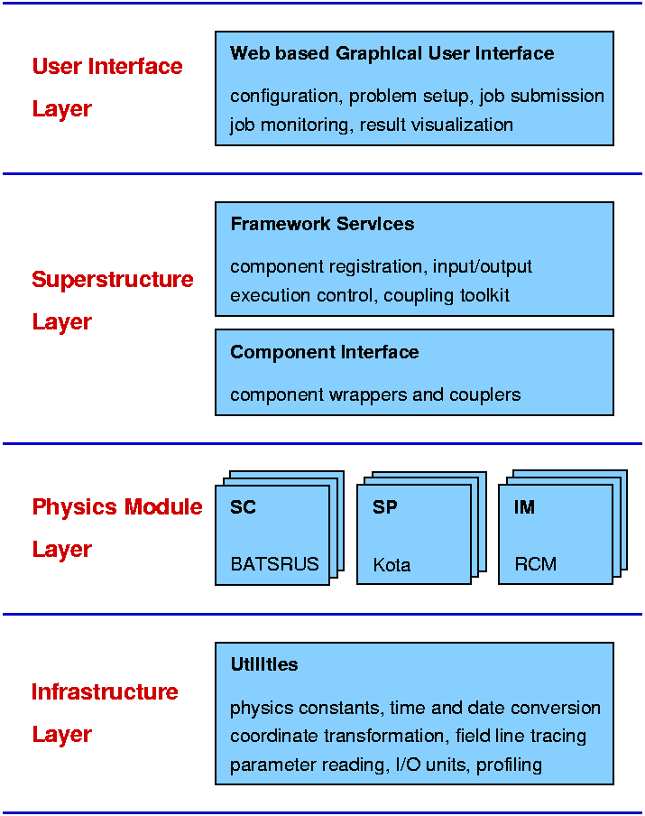
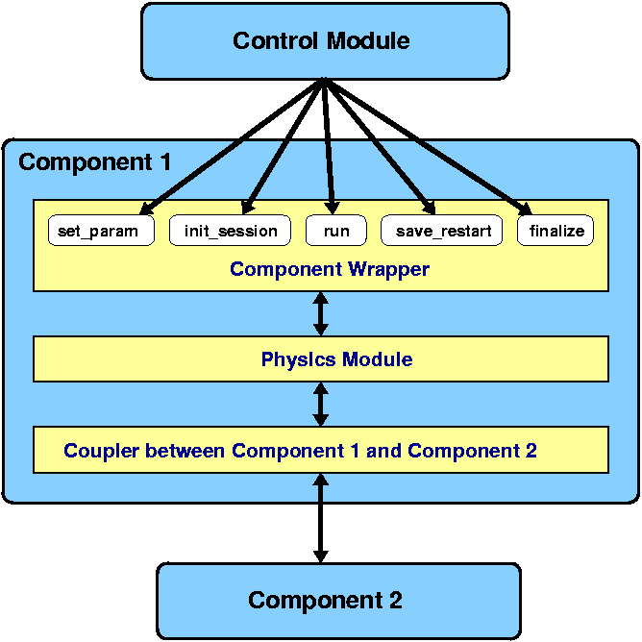

Slide 7
SWMF Resources
Project webpage with access to code http://csem.engin.umich.edu/tools/swmf/
Real-time SWMF simulations http://www.swpc.noaa.gov/products/ (“geospace” links)
Up-to-date documentation http://herot.engin.umich.edu/~gtoth/SWMF/doc/index.html
Nightly test results and status http://herot.engin.umich.edu/~gtoth/

Slide 8
Check the Tests!

Slide 9
Getting the SWMF
Legacy/stable version available via the CSEM website
>1 year out-of-date but “stable”
Development version available via CVS repository
Updated daily, possibly unstable
Requirements: Fortran, C/C++, Perl, MPI, Gnu Make

Slide 10
Configuring & Compiling
Use Config.pl to configure code
Install code, select compilers.
Select what components and codes to use.
Perform pre-compile configuration of models (equation set, etc).
Use Gnu make to compile an executable and post-processing programs
A single executable = single configuration.

Slide 11
Performing Simulations
Create one or more “run directories”
rundirs are soft-linked to SWMF installation path.
Create & gather input files
Create PARAM.in, LAYOUT.in, and other files.
Execute SWMF.exe
Requires submission to que on super computers
Use PostProc.pl to gather & reduce output
On some machines, this must happen during run!

Slide 12
Example PARAM.in
#STARTTIME
2014 year
04 month
10 day
00 hour
00 minute
00 second
0.0 FracSecond
#COMPONENT
IM NameComp
F UseComp
#COUPLE2
GM NameComp1
IE NameComp2
10 DnCouple
-1.0 DtCouple
#BEGIN_COMP GM -----------------
#TIMESTEPPING
1 nStage
0.80 CflExlp
#END_COMP GM -------------------
#ENDTIME
2014 year
04 month
10 day
00 hour
02 minute
00 second
0.0 FracSecond
#END ###########################
Commands begin with a hash tag (#).
Most have a set of parameters.
Parameter names are helpful but not required.
Everything else is a comment and not read by SWMF.

Slide 13
Example PARAM.in
#STARTTIME
2014 year
04 month
10 day
00 hour
00 minute
00 second
0.0 FracSecond
#COMPONENT
IM NameComp
F UseComp
#COUPLE2
GM NameComp1
IE NameComp2
10 DnCouple
-1.0 DtCouple
#BEGIN_COMP GM -----------------
#TIMESTEPPING
1 nStage
0.80 CflExlp
#END_COMP GM -------------------
#ENDTIME
2014 year
04 month
10 day
00 hour
02 minute
00 second
0.0 FracSecond
#END ###########################
Component-level configuration is inside component blocks.
SWMF-level commands control the overall simulation configuration.
#END or #RUN commands will begin the simulation. Can use #RUN more than once!

Slide 14
Example LAYOUT.in
SC/IH GM IM/IE
LAYOUT.in for 20 PE-s
ID ROOT LAST STRIDE
#COMPONENTMAP
SC 0 9 1
IH 0 9 1
GM 10 17 1
IE 18 19 1
IM 19 19 1
#END
Situation:
20 CPUs Available
LAYOUT.in tells SWMF what processors each component will use.

Slide 15
Example LAYOUT.in
SC/IH GM IM/IE
LAYOUT.in for 20 PE-s
ID ROOT LAST STRIDE
#COMPONENTMAP
SC 0 9 1
IH 0 9 1
GM 10 17 1
IE 18 19 1
IM 19 19 1
#END
This Example
SC/IH share 9 processors.
IM/IE share 1 processor.
GM does not share.

Slide 16
Visualization Options
Tecplot GUI-based 3D visualization; CLaSP has group licensing. Great for MHD 3D viz.
IDL Dr. Toth maintains a library for reading & visualizing SWMF output. Included within SWMF.
Python Spacepy has library for reading/plotting SWMF output over broad range of variables.
https://sourceforge.net/projects/spacepy/
http://www-personal.umich.edu/~dwelling/python/

Slide 17
Hierarchy of Help – Who to ask?
Documentation
Yourself
Peers running the model
Yourself
More experienced users
Yourself
Development team
Developers will help you fix it, we will not fix it for you.
First
Last

Slide 18
Shameless Self Promotion
CLaSP 605-1: Intro to Scientific Programming
3 credit programming course.
LaTeX, Python, Fortran, Make, and more.
Plotting, reading/writing, scripting, web fetching, etc.
Memes.

