Slide 1
Labeling the Languages of Words in Mixed-Language Documents using Weakly Supervised Methods
Ben King and Steven Abney
University of Michigan

Slide 2
Language identification background
Language identification is one of the older problems in NLP
Especially in regards to spoken language
Performance in this task tends to be quite high (>99% accuracy)
Most previous formulations assume monolingual documents

Slide 3
Problem Background
We were trying to replicate An Crúbadán (Scannell, 2007)
Crawls the web to build corpora for minority languages
Problem: most pages retrieved have multiple languages mixed together

Slide 4
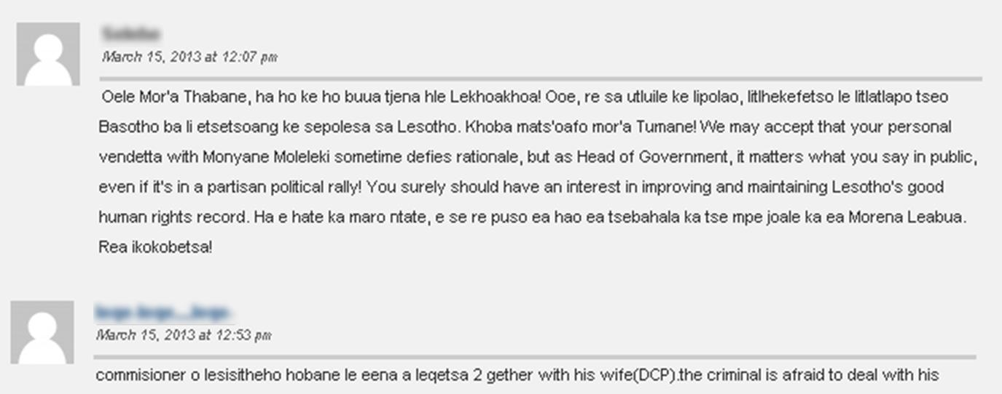
Problem Definition
Input:
Plain text documents with multiple languages mixed
The names of the two languages present

Slide 5
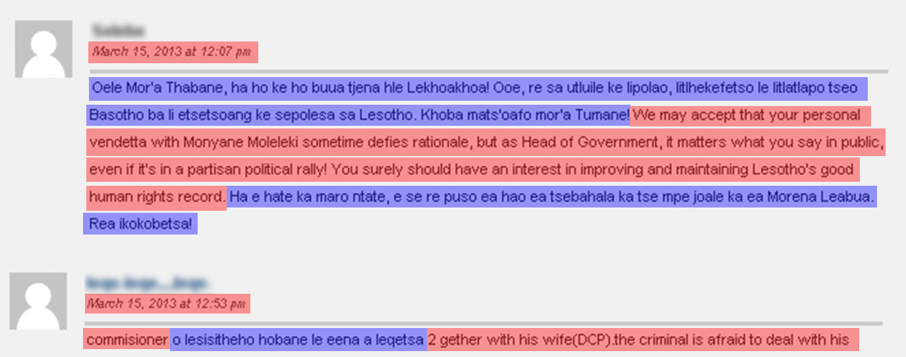
Problem Definition
Output:
A language tag for every word in the document

Slide 6
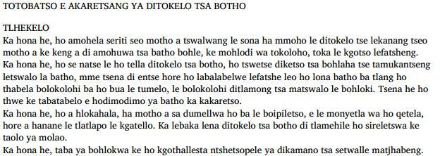
Problem Definition
Training data:
Small monolingual samples of 643 languages
Approximately 1700 words on average

Slide 7
Problem Definition
Q: what makes this problem interesting?
A: its weakly supervised nature
The training data and the testing data are of different types
Many properties do not generalize across documents

Slide 8
Contribution of this work
In 2006, Hughes et al. published a survey of language identification and suggested 11 areas of future work
This project covers three:
Supporting minority languages
Sparse training data
Multilingual documents

Slide 9
Test corpus creation
Following An Crúbadán, we build a test corpus of mixed-language documents from the Web
Using the Bootcat tool (Baroni and Bernardini, 2004), we search the web for foreign words
Automatically and manually filter the result set
Find documents with:
Search the web for:
Sotho
“tsa”, “ohle”, “ya”, “ke”

Slide 10
Test corpus creation
Our test corpus contains
Over 250K words
30 non-English languages
Corpus is available for download at
http://www-personal.umich.edu/~benking/resources/
mixed-language-annotations-release-v1.0.tgz

Slide 11
Test corpus creation
Language | # of words | Language | # of words
Azerbaijani Banjar Basque Cebuano Chippewa Cornish Croatian Czech Faroese Fulfulde Hausa Hungarian Igbo Kiribati Kurdish | 4114 10485 5488 17994 15721 2284 17318 886 8307 458 2899 9598 11828 2187 531 | Lingala Lombard Malagasy Nahuatl Ojibwa Oromo Pular Serbian Slovak Somali Sotho Tswana Uzbek Yoruba Zulu | 1359 18512 6779 1133 24974 28636 3648 2457 8403 11613 8198 879 43 4845 20783

Slide 12
Test corpus annotation
Each document was manually annotated according to language

Slide 13
Approach
We found many possible reasons why a webpage might contain multiple languages
Code-switching
Multiple authors who speak different languages
An English platform for non-English blogs
Our machine learning approach doesn’t assume any specific process

Slide 14
Features
Character n-grams
Full word
Non-word characters between words
horse
Unigrams
“h”, “o”, “r”, “s”, “e”
Bigrams
“_h”, “ho”, “or”, “rs”, “se”, “e_”
Trigrams
“_ho”, “hor”, “ors”, “rse”, “se_”
4-grams
“_hor”, “hors”, “orse”, “rse_”
5-grams
“_hors”, “horse”, “orse_”
Full Word
“horse”
the horse, ‘94 bred
Before
“space_present”
After
“comma_present”
“space_present”
“apostrophe_present”
“9_present”
“4_present”

Slide 15
Methods – CRF with GE
Conditional Random Fields trained with Generalized Expectation Criteria (Druck, et al., 2008)
Semi- and weakly-supervised training method for CRFs
$\hat{p}$ is a preferred distribution for the model
We try to guide the learning so that the marginal label distributions over features match our training data

Slide 16
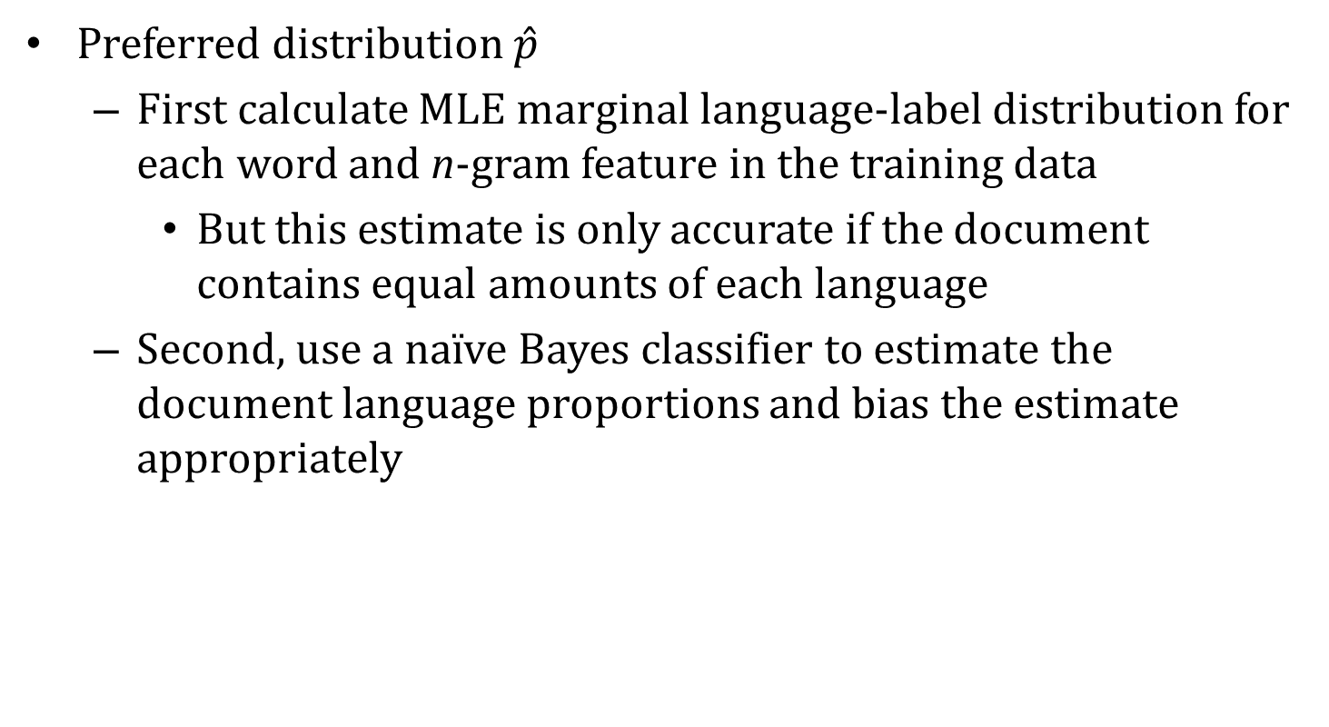
Methods – CRF with GE
Preferred distribution $\hat{p}$
First calculate MLE marginal language-label distribution for each word and n-gram feature in the training data
But this estimate is only accurate if the document contains equal amounts of each language
Second, use a naïve Bayes classifier to estimate the document language proportions and bias the estimate appropriately
Testing Data
Eng:Sot = 2:1
English: 83%
English: 0.75
Training Data
“tre”
Sotho: 0.25
Sotho: 17%

Slide 17
Methods – HMM with EM
Hidden Markov Model trained with Expectation Maximization
Initialize the emission probabilities using a Naïve Bayes classifier, transition probabilities uniform
E-step: label the document with the current HMM
M-step: re-estimate the transition and emission probabilities from the labeled document

Slide 18
Methods
Baselines:
Logistic Regression trained with Generalized Expectation
Naïve Bayes classifier

Slide 19
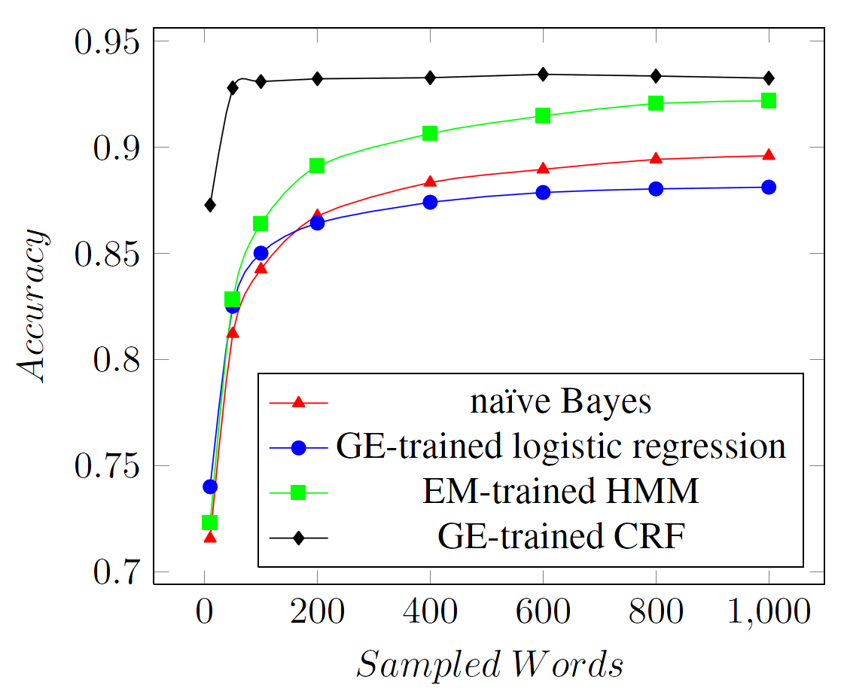
Results

Slide 20
Discussion
CRF with GE is consistently accurate across different amounts of training data
But its learning curve looks kind of strange
There is some evidence that the CRF is being over-constrained

Slide 21
Discussion
As the size of the training data grows, the number of unique features grows
But all constraints in GE are equally important
With pruning we may be able to get even better performance from the CRF
“tre”
“kga”
Occurs 132 times
English: 85%
Sotho: 15%
Occurs 1 time
English: 0%
Sotho: 100%
May not generalize well!

Slide 22
Future Work
We would like to not have to rely on user-provided labels
We are working on a system that can analyze an unknown document and identify the set of languages present
That system could be the first stage of a pipeline that includes this work

Slide 23
Questions?

