Slide 1
Class 24 Economic Sanctions by Alan V. Deardorff University of Michigan 2022
PubPol/Econ 541

Slide 2
Outline
What are sanctions?
Who has used them, and why?
What effects do they have?
Do they work?

Slide 3
What economic sanctions are
From my Glossary:
Sanctions are “coercive measures used by a nation or group of nations against another as a penalty for violating international law or international norms”
Most apply to economic transactions or assets, and thus are “economic sanctions”
From Masters:
“the withdrawal of customary trade and financial relations for foreign- and security-policy purposes”

Slide 4
What economic sanctions are
Types of sanctions
Primary: When a a government prohibits its own people and firms from doing business with a target country
Secondary: When a a government prohibits people and firms of third countries from doing business with a target country
Also “extraterritorial”.
Many governments object to these
Smart: sanctions that “aim to minimize the suffering of innocent civilians”

Slide 5
What economic sanctions are
Forms of sanctions (per Masters)
*Travel bans
*Asset freezes
*Arms embargoes
Capital restraints
Foreign aid reductions
Trade restrictions
Other forms (per Haass)
Negative votes in international financial institutions
Withdrawal of diplomatic relations
Visa denials
Cancellation of air links
*Most common types of UN sanctions, per Masters (2019)
Notes:
Masters, Jonathan, “What Are Economic Sanctions?” Backgrounder, Council on Foreign Relations, August 12, 2019. 12 pp.
https://www.cfr.org/backgrounder/what-are-economic-sanctions

Slide 6
What economic sanctions are
Purposes of sanctions (per Masters)
counterterrorism,
counternarcotics,
nonproliferation,
democracy and human rights promotion,
conflict resolution, and
cybersecurity.
Other purposes (per Haass)
Discourage WMDs
Thwart drug trafficking
Discourage armed aggression
Promote market access
Protect environment
Replace governments
Notes:
Masters, Jonathan, “What Are Economic Sanctions?” Backgrounder, Council on Foreign Relations, August 12, 2019. 12 pp.
https://www.cfr.org/backgrounder/what-are-economic-sanctions

Slide 7
Sanctions Regimes
Masters (2019) identifies 3 regimes of sanctions:
United Nations
Decided by Security Council
European Union (but called “restrictive measures”)
Requires unanimous consent by member states
Member states are free to impose harsher ones
United States
Originate in either executive or legislative branch
“US uses [them] more than any other country”
Notes:
Masters, Jonathan, “What Are Economic Sanctions?” Backgrounder, Council on Foreign Relations, August 12, 2019. 12 pp.
https://www.cfr.org/backgrounder/what-are-economic-sanctions

Slide 8
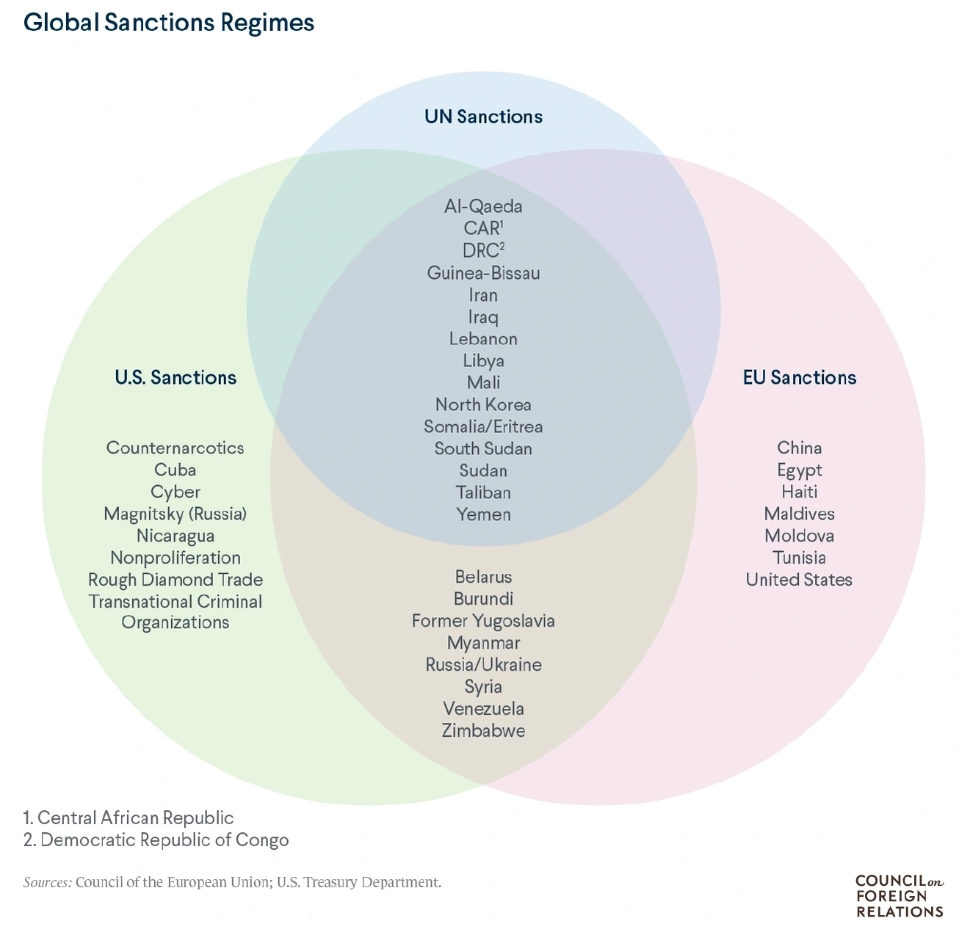
Notes:
Masters, Jonathan, “What Are Economic Sanctions?” Backgrounder, Council on Foreign Relations, August 12, 2019. 12 pp.
https://www.cfr.org/backgrounder/what-are-economic-sanctions

Slide 9
Sanctions Regimes
Sanctions used by others
China on
Australia 2020
Lithuania 2021
Taiwan 2022

Slide 10
Pause for Discussion

Slide 11
Questions on Masters, “What Are Economic Sanctions?
Are trade restrictions among the most used forms of sanctions by the UN?
Does this say that sanctions work?
Why is the US best positioned to use sanctions, and why might their use undermine that position?

Slide 12
Questions on Haass, “Too Much of a Bad Thing”
Why are economic sanctions so popular?
Overall, does Haass favor the use of sanctions?
He argues for comparing costs and benefits with those of alternatives. What alternatives does he mention?

Slide 13
Sanctions History
After World War I:
Sanctions were envisioned as alternative to war
League of Nations tried to oversee their use
Used in 1935 against Mussolini’s invasion of Ethiopia by Italy
Sanctions implemented by 52 states, but not US and Germany
Failed to stop conquest of Ethiopia
Used against Japan 1939-41, prompting attack on
European colonies in Southeast Asia
US
Notes:
Mulder, Nicholas, “The Sanctions Weapon,” Finance and Development, June 2022, pp. 20-23. 4 pp.
https://www.imf.org/en/Publications/fandd/issues/2022/06/the-sanctions-weapon-mulder

Slide 14
Sanctions History
After World War II:
UN and Western sanctions against Rhodesia (now Zimbabwe)
UN against apartheid-era South Africa
US against Cuba and Iran
Notes:
Mulder, Nicholas, “The Sanctions Weapon,” Finance and Development, June 2022, pp. 20-23. 4 pp.
https://www.imf.org/en/Publications/fandd/issues/2022/06/the-sanctions-weapon-mulder

Slide 15
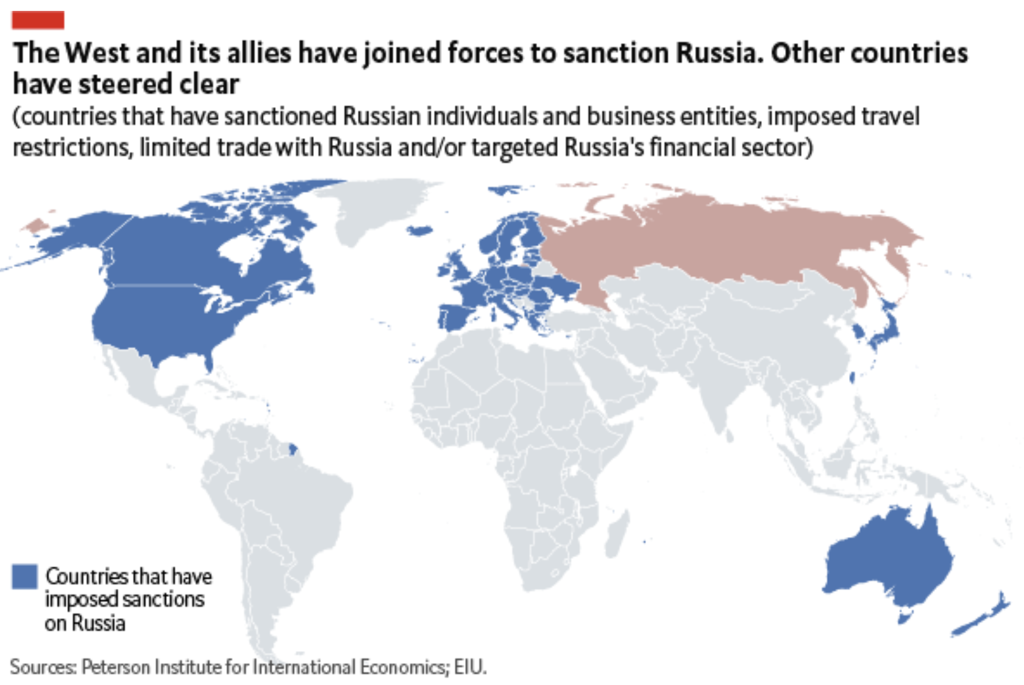
Source: Economist Intelligence Unit, April 13, 2022

Slide 16
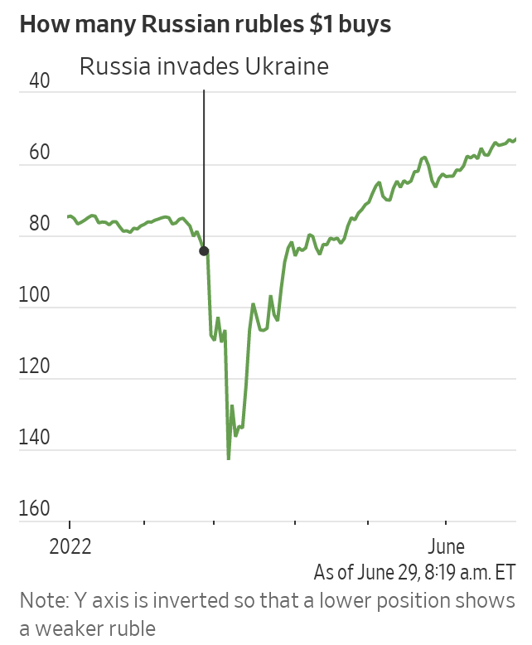
Russia’s Surprising Economic Headache: A Strong Ruble
Wall Street Journal
June 29, 2022
Notes:
McCabe, Caitlin and Kate Vtorygina, “Russia’s Surprising Economic Headache: A Strong Ruble,” Wall Street Journal, June 29, 2022.
https://www.wsj.com/articles/russias-surprising-economic-headache-a-strong-ruble-11656530936

Slide 17
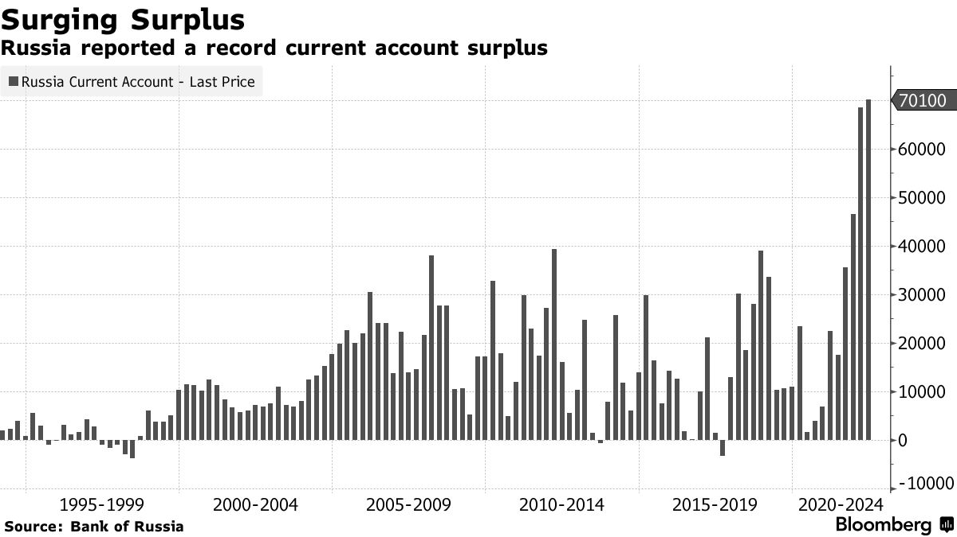
Source: Bloomberg July 11, 2022
Notes:
https://www.bloomberg.com/news/articles/2022-07-11/russian-current-account-hits-record-on-surging-energy-exports?leadSource=uverify%20wall

Slide 18
Effects of Russia Sanctions
Per Mulder, June 2022
Today’s sanctions have greater effects than seen before, due to
More integrated global economy
Russia’s importance as exporter of
Grain
Oil
“…globalization has thereby increased the economic costs of using sanctions against large, highly integrated economies.”

Slide 19
Pause for Discussion

Slide 20
Questions on Mulder, “The Sanctions Weapon
How many governments imposed sanctions on Russia, and from which continents?
Why does the author view sanctions as more problematic today than previously?
What “policy adjustments” does he suggest?

Slide 21
Do Sanctions Work?
Elliott [optional reading]
Writing in 1997, she reports that US sanctions since 1970 have
Achieved foreign policy objectives only 13% of the time\
Cost US $15-19 billion annually in potential exports
Cost >200,000 jobs in (high-wage) export sector
Conclusion: “unilateral economic sanctions are decreasingly useful yet increasingly costly”

Slide 22
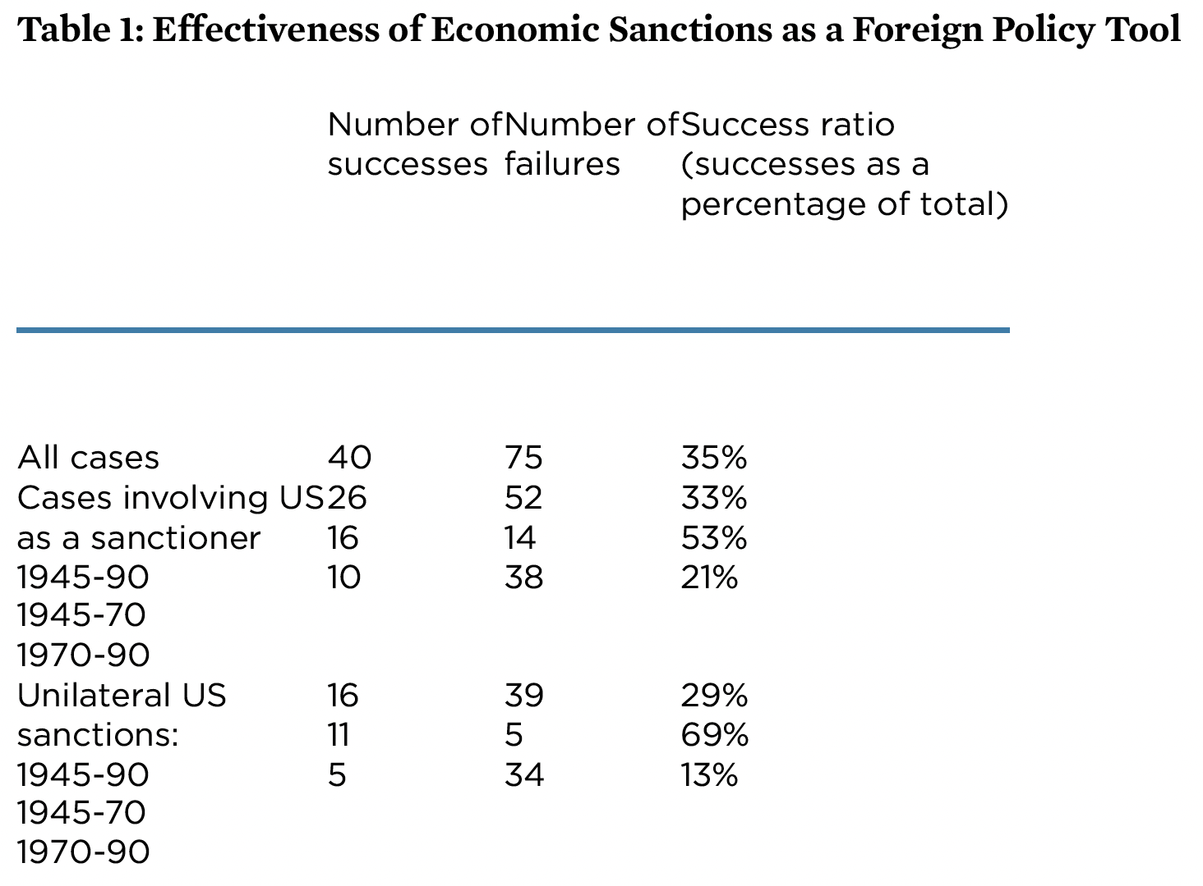
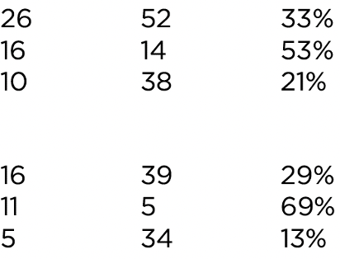
Notes:
Elliott, Kimberly Ann, “Evidence on the Costs and Benefits of Economic Sanctions,” Speech given before the Subcommittee on Trade Committee on Ways and Means United States House of Representatives Washington, DC, October 23, 1997, Peterson Institute for International Economics. 6 pp.
https://www.piie.com/commentary/testimonies/evidence-costs-and-benefits-economic-sanctions
[Original had data too high. I moved it down.]

Slide 23
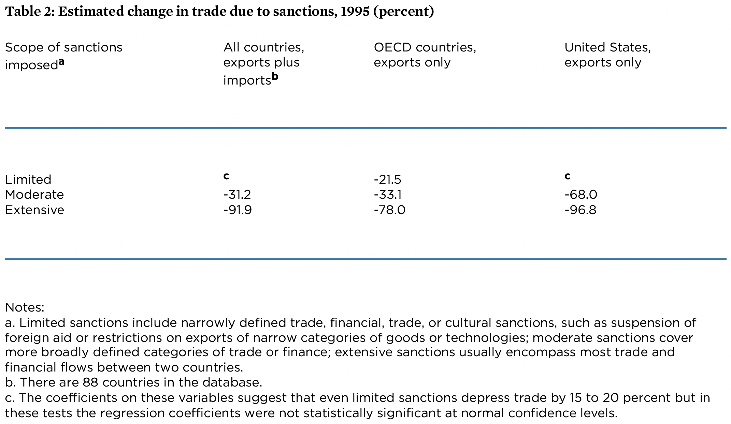
Notes:
Elliott, Kimberly Ann, “Evidence on the Costs and Benefits of Economic Sanctions,” Speech given before the Subcommittee on Trade Committee on Ways and Means United States House of Representatives Washington, DC, October 23, 1997, Peterson Institute for International Economics. 6 pp.
https://www.piie.com/commentary/testimonies/evidence-costs-and-benefits-economic-sanctions

Slide 24
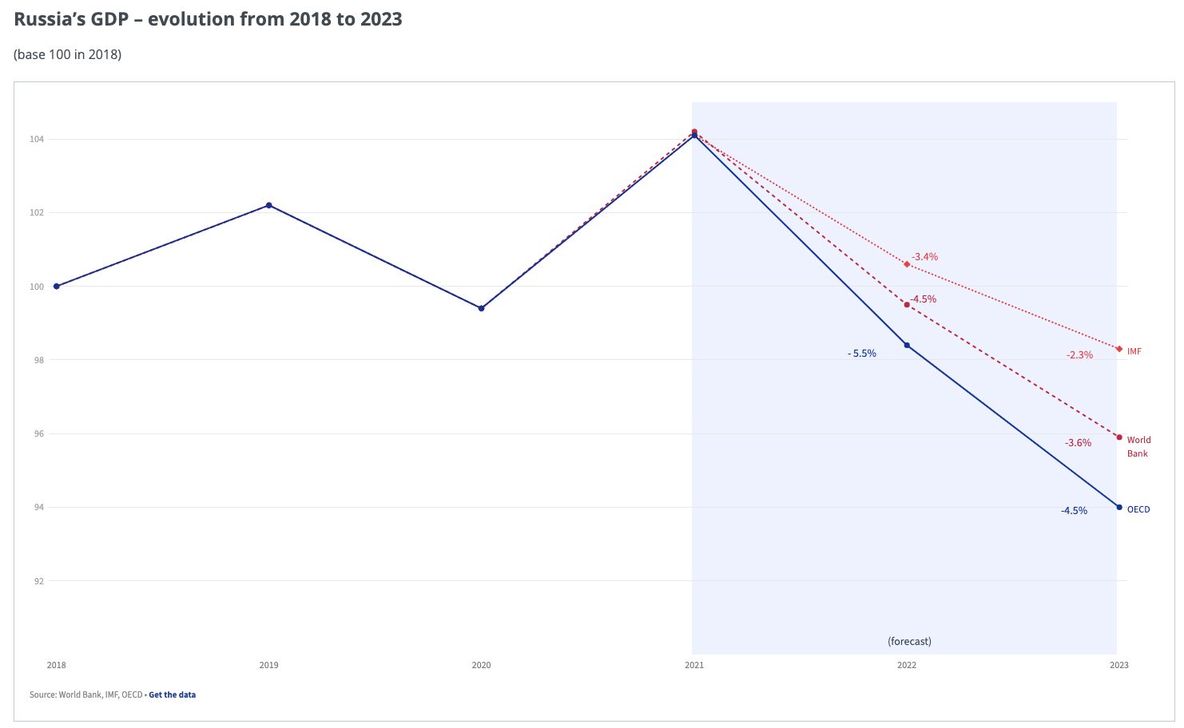
Effects of Russia Sanctions
Source: IMF, WB, OECD, via European Council
Notes:
European Council, Infographic - Impact of sanctions on the Russian economy
https://www.consilium.europa.eu/en/infographics/impact-sanctions-russian-economy/

Slide 25
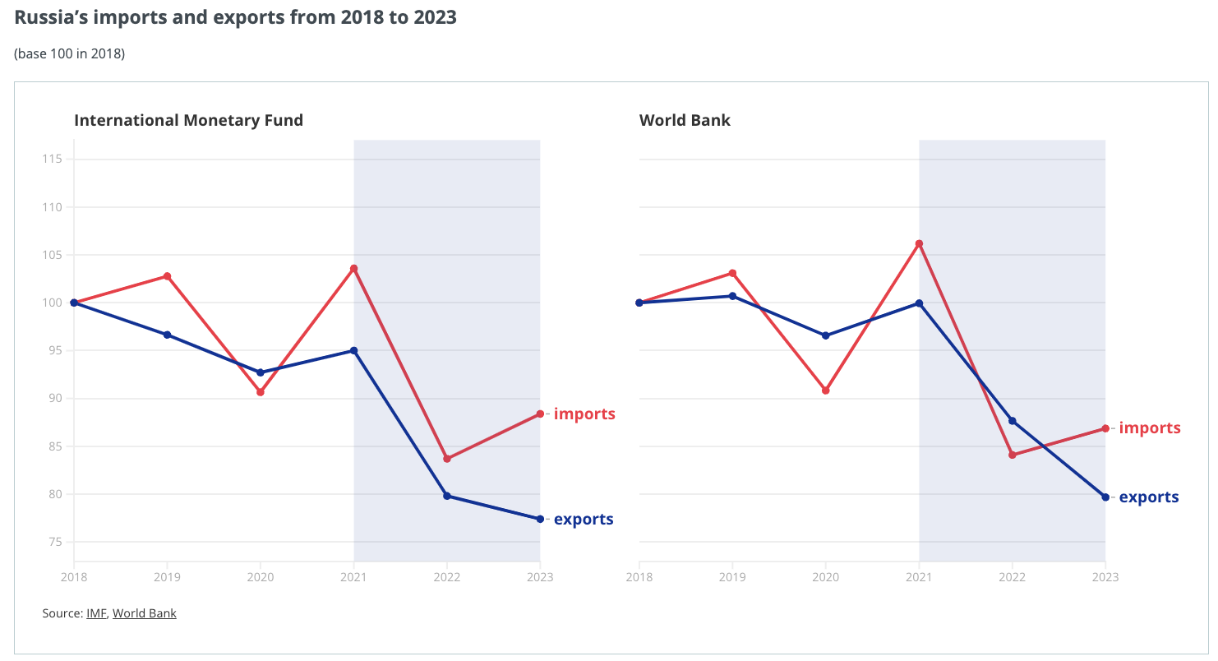
Effects of Russia Sanctions
Source: IMF, WB, via European Council
Notes:
European Council, Infographic - Impact of sanctions on the Russian economy
https://www.consilium.europa.eu/en/infographics/impact-sanctions-russian-economy/

Slide 26
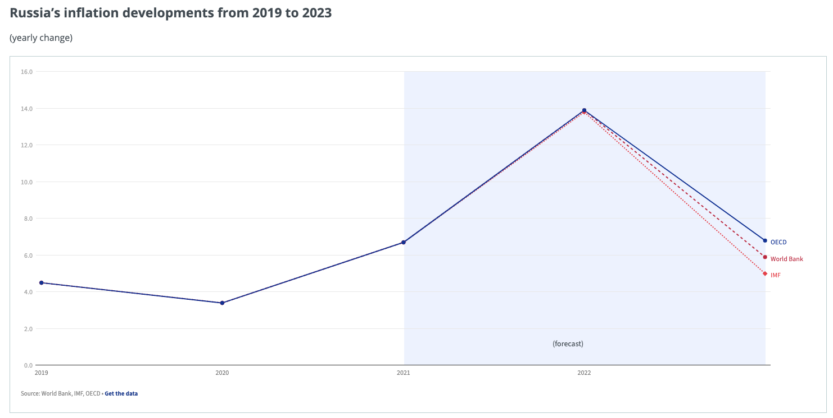
Effects of Russia Sanctions
Source: IMF, WB, OECD, via European Council
Notes:
European Council, Infographic - Impact of sanctions on the Russian economy
https://www.consilium.europa.eu/en/infographics/impact-sanctions-russian-economy/

Slide 27
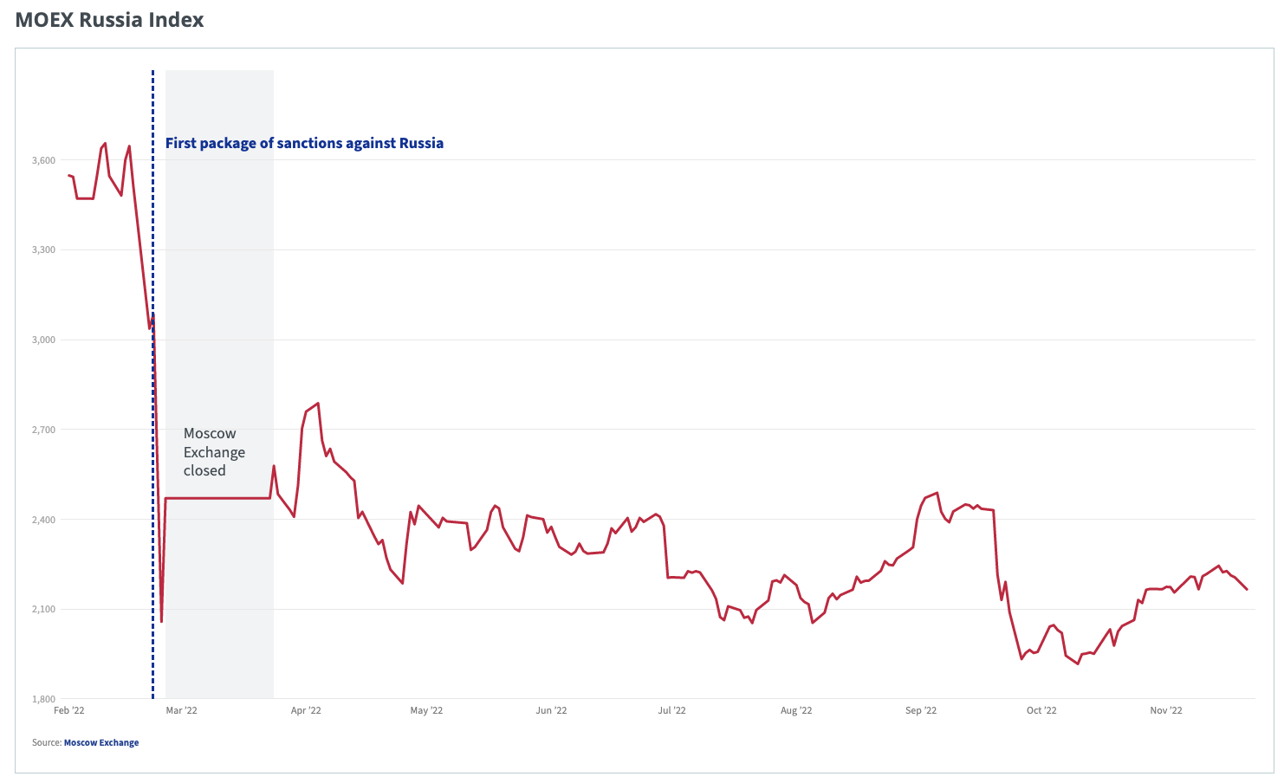
Effects of Russia Sanctions
Source: Moscow Exchange via European Council
Notes:
European Council, Infographic - Impact of sanctions on the Russian economy
https://www.consilium.europa.eu/en/infographics/impact-sanctions-russian-economy/

Slide 28
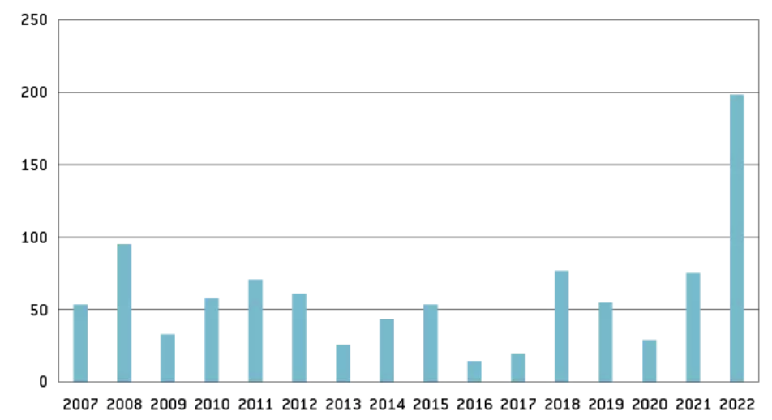
Effects of Russia Sanctions
Figure 1: Russia’s current account reached a record high $198 billion during Jan-Sept 2022
Source: Bruegel Policy Brief, October 26, 2022
Notes:
Bruegel Policy Brief, “How have sanctions impacted Russia?” 26 October 2022
Authors: Maria Demertzis Benjamin Hilgenstock Ben McWilliams Elina Ribakova Simone Tagliapietra
https://www.bruegel.org/policy-brief/how-have-sanctions-impacted-Russia

Slide 29
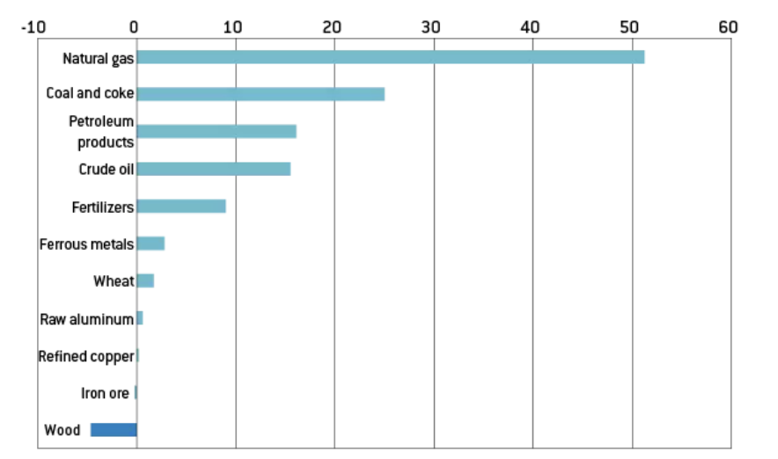
Effects of Russia Sanctions
Figure 2: High energy prices contributed significantly to the increased value of Russia exports, Jan-Sept 2022
Source: Bruegel Policy Brief, October 26, 2022
Notes:
Bruegel Policy Brief, “How have sanctions impacted Russia?” 26 October 2022
Authors: Maria Demertzis Benjamin Hilgenstock Ben McWilliams Elina Ribakova Simone Tagliapietra
https://www.bruegel.org/policy-brief/how-have-sanctions-impacted-Russia

Slide 30
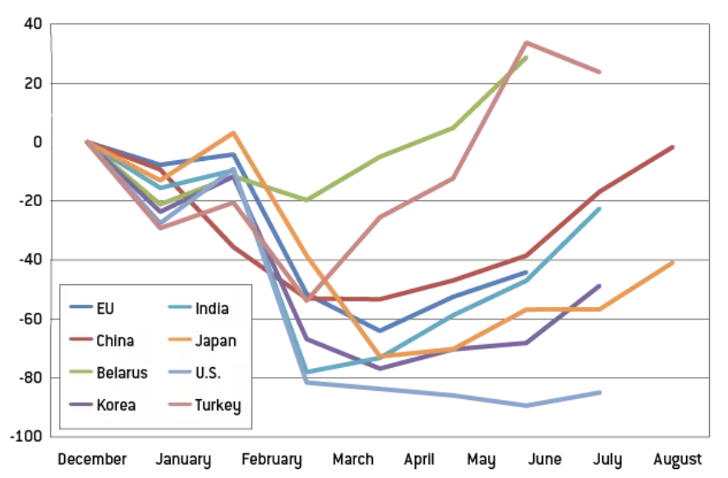
Effects of Russia Sanctions
Figure 3: Russian imports 2022 by origin
Source: Bruegel Policy Brief, October 26, 2022
Notes:
Bruegel Policy Brief, “How have sanctions impacted Russia?” 26 October 2022
Authors: Maria Demertzis Benjamin Hilgenstock Ben McWilliams Elina Ribakova Simone Tagliapietra
https://www.bruegel.org/policy-brief/how-have-sanctions-impacted-Russia

Slide 31
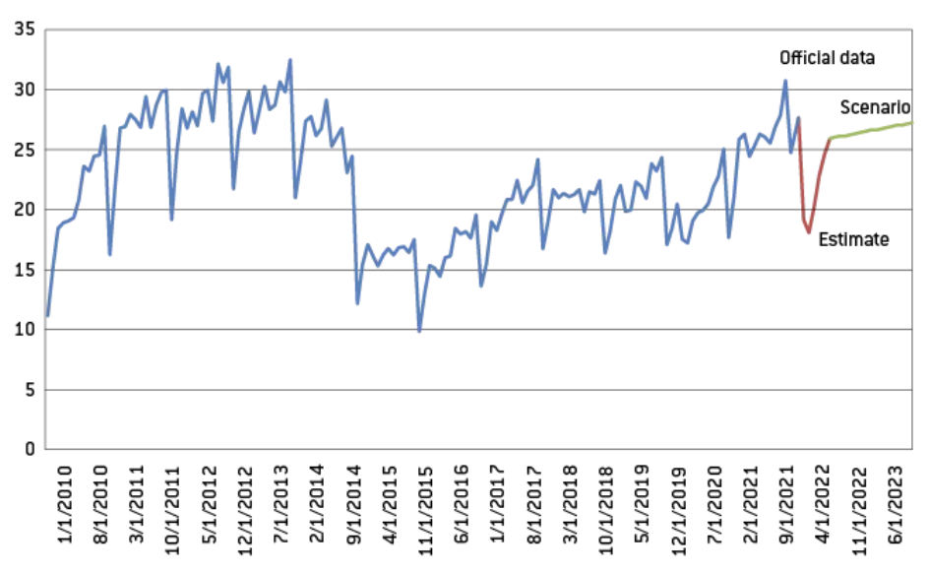
Effects of Russia Sanctions
Figure 4: Recovery in Russian imports
Source: Bruegel Policy Brief, October 26, 2022
Notes:
Bruegel Policy Brief, “How have sanctions impacted Russia?” 26 October 2022
Authors: Maria Demertzis Benjamin Hilgenstock Ben McWilliams Elina Ribakova Simone Tagliapietra
https://www.bruegel.org/policy-brief/how-have-sanctions-impacted-Russia

Slide 32
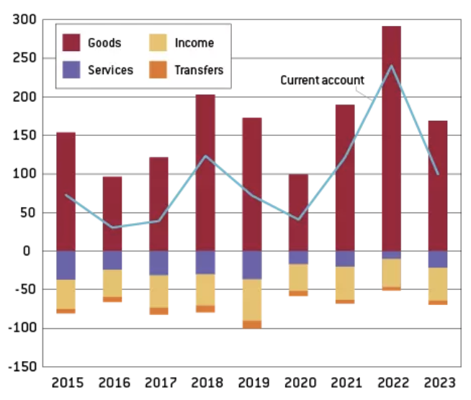
Effects of Russia Sanctions
Figure 5: Current account surplus to reach $240 billion in 2022
Source: Bruegel Policy Brief, October 26, 2022
Notes:
Bruegel Policy Brief, “How have sanctions impacted Russia?” 26 October 2022
Authors: Maria Demertzis Benjamin Hilgenstock Ben McWilliams Elina Ribakova Simone Tagliapietra
https://www.bruegel.org/policy-brief/how-have-sanctions-impacted-Russia

Slide 33
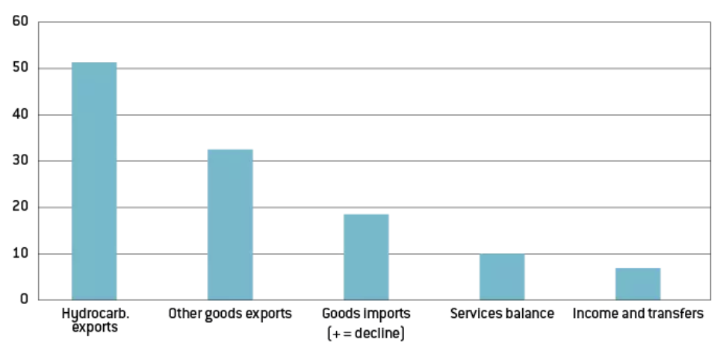
Effects of Russia Sanctions
Figure 6: Higher hydrocarbon exports drive shift in current account
Source: Bruegel Policy Brief, October 26, 2022
Notes:
Bruegel Policy Brief, “How have sanctions impacted Russia?” 26 October 2022
Authors: Maria Demertzis Benjamin Hilgenstock Ben McWilliams Elina Ribakova Simone Tagliapietra
https://www.bruegel.org/policy-brief/how-have-sanctions-impacted-Russia

Slide 34
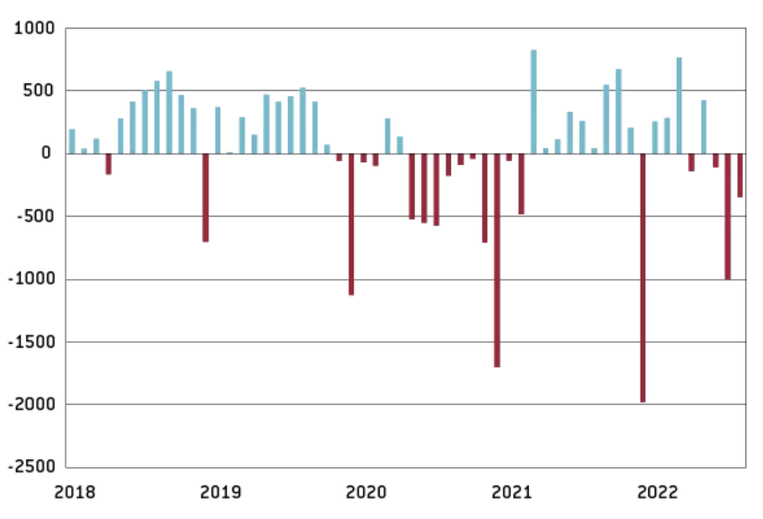
Effects of Russia Sanctions
Figure 7: The federal government balance shifted to a deficit in June-August 2022
Source: Bruegel Policy Brief, October 26, 2022
Notes:
Bruegel Policy Brief, “How have sanctions impacted Russia?” 26 October 2022
Authors: Maria Demertzis Benjamin Hilgenstock Ben McWilliams Elina Ribakova Simone Tagliapietra
https://www.bruegel.org/policy-brief/how-have-sanctions-impacted-Russia

Slide 35
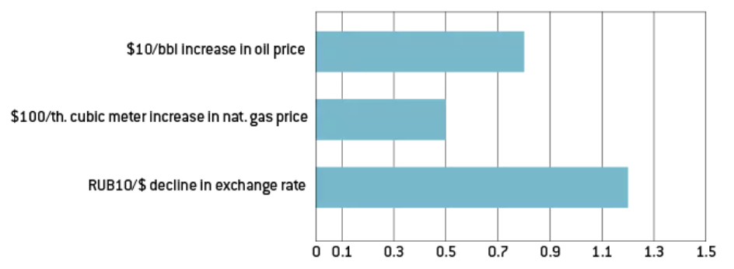
Effects of Russia Sanctions
Figure 8: Impact of energy prices and the ruble exchange rate on the fiscal balance
Source: Bruegel Policy Brief, October 26, 2022
Notes:
Bruegel Policy Brief, “How have sanctions impacted Russia?” 26 October 2022
Authors: Maria Demertzis Benjamin Hilgenstock Ben McWilliams Elina Ribakova Simone Tagliapietra
https://www.bruegel.org/policy-brief/how-have-sanctions-impacted-Russia

Slide 36
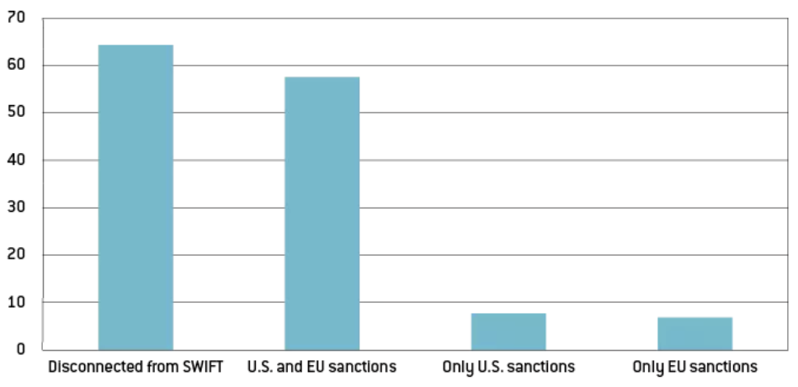
Effects of Russia Sanctions
Figure 9: Share of the Russian financial system under sanctions
Source: Bruegel Policy Brief, October 26, 2022
Notes:
Bruegel Policy Brief, “How have sanctions impacted Russia?” 26 October 2022
Authors: Maria Demertzis Benjamin Hilgenstock Ben McWilliams Elina Ribakova Simone Tagliapietra
https://www.bruegel.org/policy-brief/how-have-sanctions-impacted-Russia

Slide 37
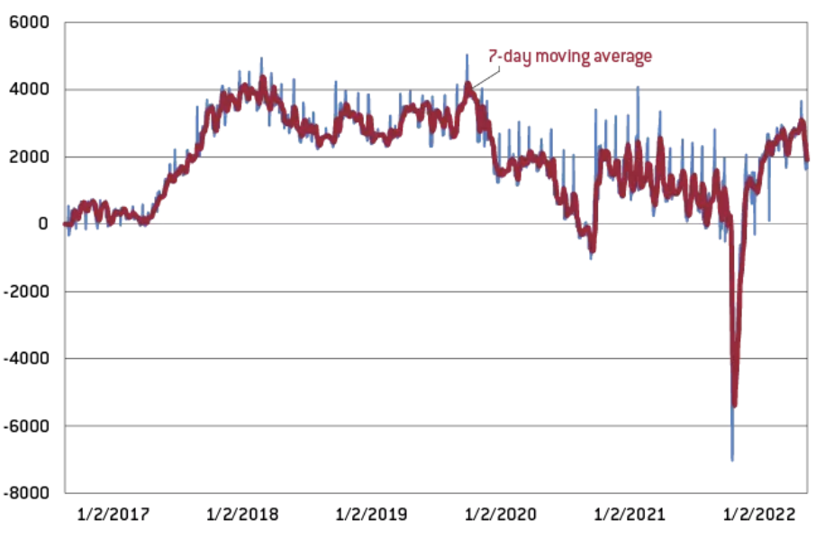
Effects of Russia Sanctions
Figure 10: The banking system’s structural liquidity surplus has returned to pre-war levels
Source: Bruegel Policy Brief, October 26, 2022
Notes:
Bruegel Policy Brief, “How have sanctions impacted Russia?” 26 October 2022
Authors: Maria Demertzis Benjamin Hilgenstock Ben McWilliams Elina Ribakova Simone Tagliapietra
https://www.bruegel.org/policy-brief/how-have-sanctions-impacted-Russia

Slide 38
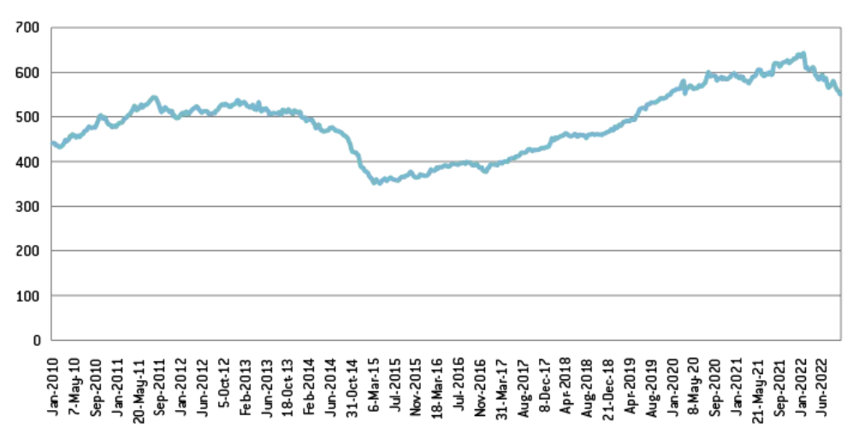
Effects of Russia Sanctions
Figure 11: The Bank of Russia’s reserves declined by close to $100 billion
Source: Bruegel Policy Brief, October 26, 2022
Notes:
Bruegel Policy Brief, “How have sanctions impacted Russia?” 26 October 2022
Authors: Maria Demertzis Benjamin Hilgenstock Ben McWilliams Elina Ribakova Simone Tagliapietra
https://www.bruegel.org/policy-brief/how-have-sanctions-impacted-Russia

Slide 39
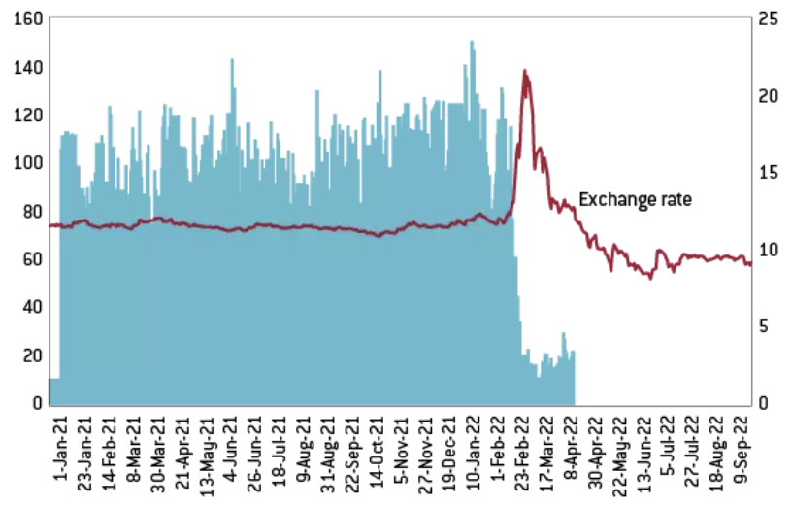
Effects of Russia Sanctions
Figure 12: Ruble trading volumes fell sharply after sanctions were imposed
Source: Bruegel Policy Brief, October 26, 2022
Notes:
Bruegel Policy Brief, “How have sanctions impacted Russia?” 26 October 2022
Authors: Maria Demertzis Benjamin Hilgenstock Ben McWilliams Elina Ribakova Simone Tagliapietra
https://www.bruegel.org/policy-brief/how-have-sanctions-impacted-Russia

Slide 40
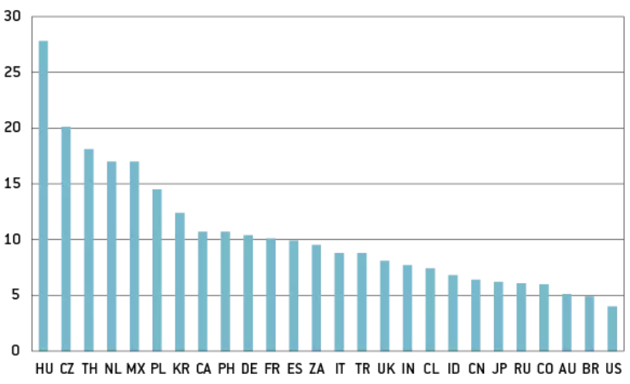
Effects of Russia Sanctions
Figure 13: Russia, import content by country
Source: Bruegel Policy Brief, October 26, 2022
Notes:
Bruegel Policy Brief, “How have sanctions impacted Russia?” 26 October 2022
Authors: Maria Demertzis Benjamin Hilgenstock Ben McWilliams Elina Ribakova Simone Tagliapietra
https://www.bruegel.org/policy-brief/how-have-sanctions-impacted-Russia

Slide 41
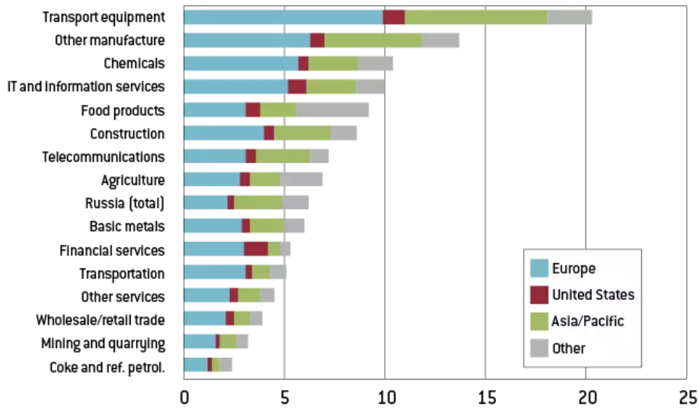
Effects of Russia Sanctions
Figure 14: Russia, import content by sector
Source: Bruegel Policy Brief, October 26, 2022
Notes:
Bruegel Policy Brief, “How have sanctions impacted Russia?” 26 October 2022
Authors: Maria Demertzis Benjamin Hilgenstock Ben McWilliams Elina Ribakova Simone Tagliapietra
https://www.bruegel.org/policy-brief/how-have-sanctions-impacted-Russia

Slide 42
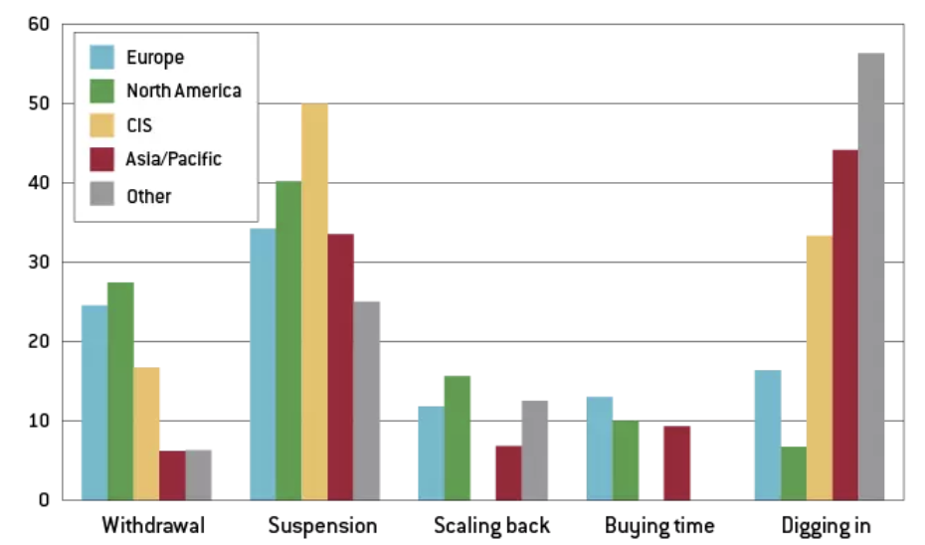
Effects of Russia Sanctions
Figure 15: Status of foreign companies in Russia by origin
Source: Bruegel Policy Brief, October 26, 2022
Notes:
Bruegel Policy Brief, “How have sanctions impacted Russia?” 26 October 2022
Authors: Maria Demertzis Benjamin Hilgenstock Ben McWilliams Elina Ribakova Simone Tagliapietra
https://www.bruegel.org/policy-brief/how-have-sanctions-impacted-Russia

Slide 43
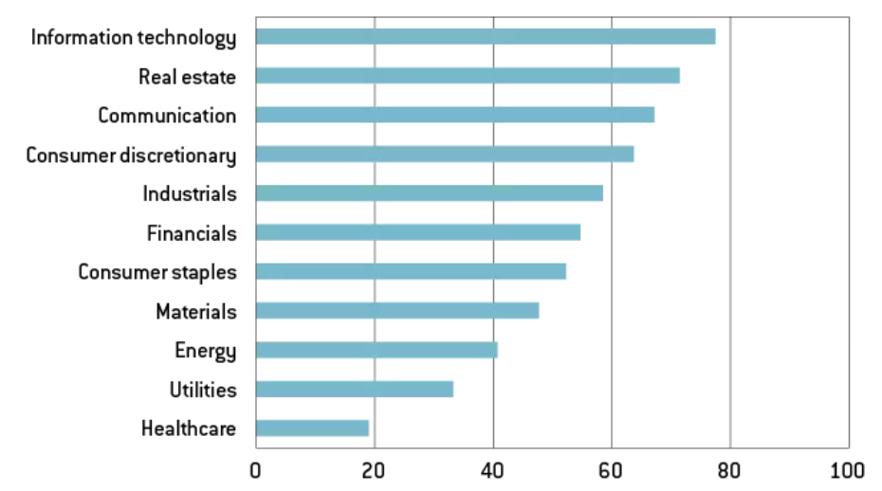
Effects of Russia Sanctions
Figure 16: Extent of foreign companies' departure differs by sector
Source: Bruegel Policy Brief, October 26, 2022
Notes:
Bruegel Policy Brief, “How have sanctions impacted Russia?” 26 October 2022
Authors: Maria Demertzis Benjamin Hilgenstock Ben McWilliams Elina Ribakova Simone Tagliapietra
https://www.bruegel.org/policy-brief/how-have-sanctions-impacted-Russia

Slide 44
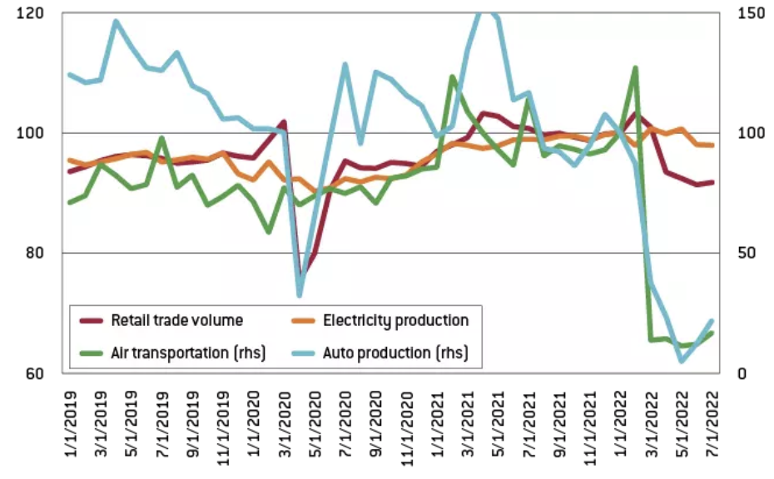
Effects of Russia Sanctions
Figure 17: Export controls have had a big impact on activity
Source: Bruegel Policy Brief, October 26, 2022
Notes:
Bruegel Policy Brief, “How have sanctions impacted Russia?” 26 October 2022
Authors: Maria Demertzis Benjamin Hilgenstock Ben McWilliams Elina Ribakova Simone Tagliapietra
https://www.bruegel.org/policy-brief/how-have-sanctions-impacted-Russia

Slide 45
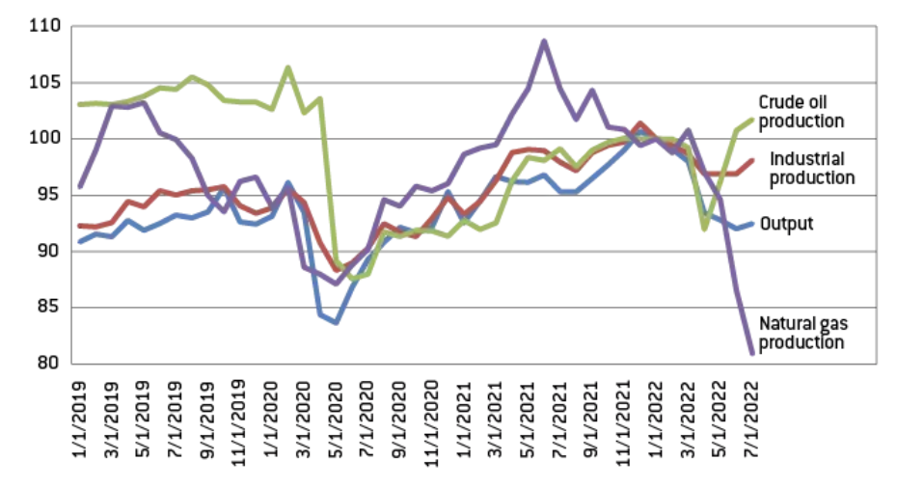
Effects of Russia Sanctions
Figure 18: Natural gas production is down sharply
Source: Bruegel Policy Brief, October 26, 2022
Notes:
Bruegel Policy Brief, “How have sanctions impacted Russia?” 26 October 2022
Authors: Maria Demertzis Benjamin Hilgenstock Ben McWilliams Elina Ribakova Simone Tagliapietra
https://www.bruegel.org/policy-brief/how-have-sanctions-impacted-Russia

Slide 46
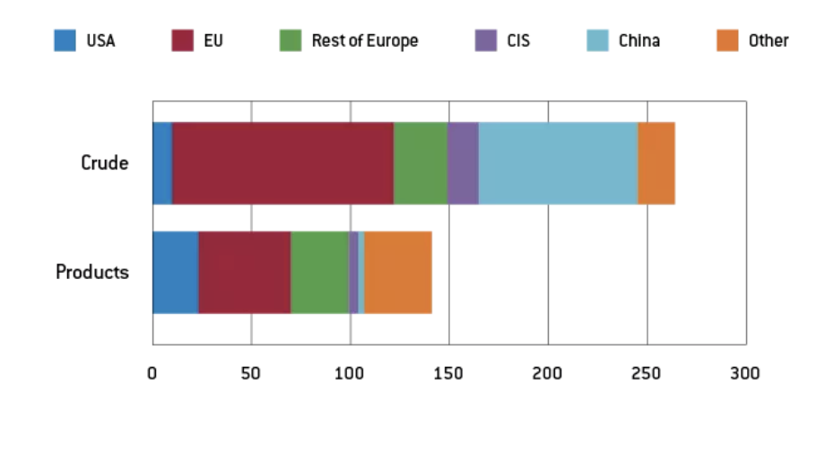
Effects of Russia Sanctions
Figure 19: Russian crude oil and oil product exports (2021, million tonnes)
Source: Bruegel Policy Brief, October 26, 2022
Notes:
Bruegel Policy Brief, “How have sanctions impacted Russia?” 26 October 2022
Authors: Maria Demertzis Benjamin Hilgenstock Ben McWilliams Elina Ribakova Simone Tagliapietra
https://www.bruegel.org/policy-brief/how-have-sanctions-impacted-Russia

Slide 47
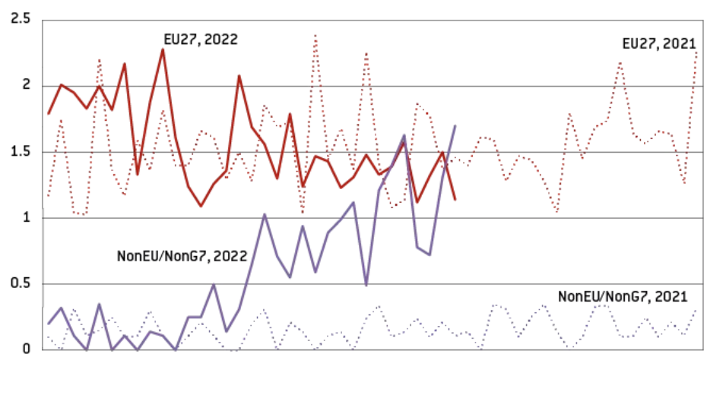
Effects of Russia Sanctions
Figure 20: Weekly Russian crude oil exports from Russia’s western ports (Its eastern ports are not subject to sanctions)
Source: Bruegel Policy Brief, October 26, 2022
Notes:
Bruegel Policy Brief, “How have sanctions impacted Russia?” 26 October 2022
Authors: Maria Demertzis Benjamin Hilgenstock Ben McWilliams Elina Ribakova Simone Tagliapietra
https://www.bruegel.org/policy-brief/how-have-sanctions-impacted-Russia

Slide 48
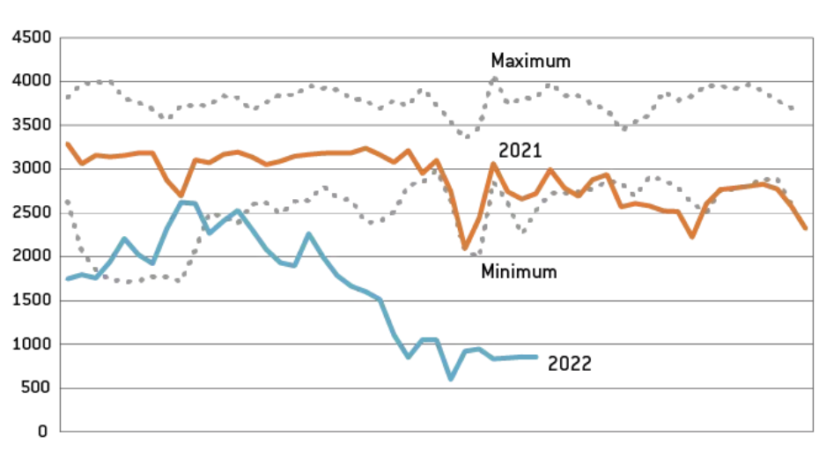
Effects of Russia Sanctions
Figure 21: EU and UK natural gas imports from Russia
Source: Bruegel Policy Brief, October 26, 2022
Notes:
Bruegel Policy Brief, “How have sanctions impacted Russia?” 26 October 2022
Authors: Maria Demertzis Benjamin Hilgenstock Ben McWilliams Elina Ribakova Simone Tagliapietra
https://www.bruegel.org/policy-brief/how-have-sanctions-impacted-Russia

Slide 49
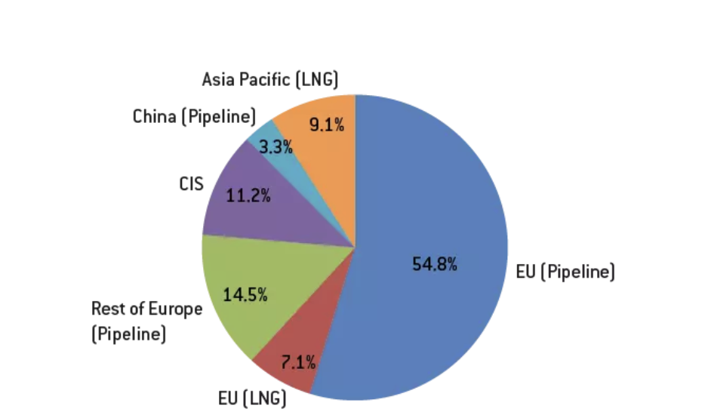
Effects of Russia Sanctions
Figure 22: Russia natural gas exports (2021)
Source: Bruegel Policy Brief, October 26, 2022
Notes:
Bruegel Policy Brief, “How have sanctions impacted Russia?” 26 October 2022
Authors: Maria Demertzis Benjamin Hilgenstock Ben McWilliams Elina Ribakova Simone Tagliapietra
https://www.bruegel.org/policy-brief/how-have-sanctions-impacted-Russia

Slide 50
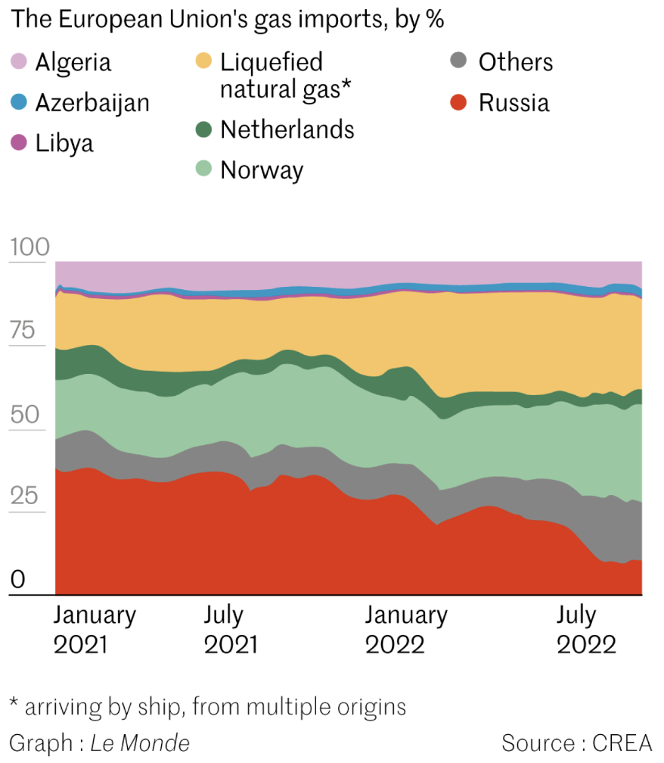
Effects of Russia Sanctions
In six months, Russia became a minority gas provider for Europe
Notes:
Romain Geoffroy and Assma Maad, “How has the Russian economy withstood the effects of sanctions?” Le Monde, October 4, 2022.
https://www.lemonde.fr/en/les-decodeurs/article/2022/10/04/how-has-the-russian-economy-withstood-the-effects-of-sanctions_5999030_8.html

