Slide 1
Class 12 Export Policies by Alan V. Deardorff University of Michigan 2022
PubPol/Econ 541

Slide 2
Pause for News

Slide 3
News
WTO Sees Sharp Slowdown in Global Trade, Pointing to Possible Recession,”
WSJ Oct 6, 2022.
Notes:
Hannon, Paul, “WTO Sees Sharp Slowdown in Global Trade, Pointing to Possible Recession,” WSJ Oct 6, 2022.
https://www.wsj.com/articles/sharp-slowdown-in-global-trade-points-to-possible-recession-lower-inflation-11664964002?mod=itp_wsj&ru=yahoo

Slide 4
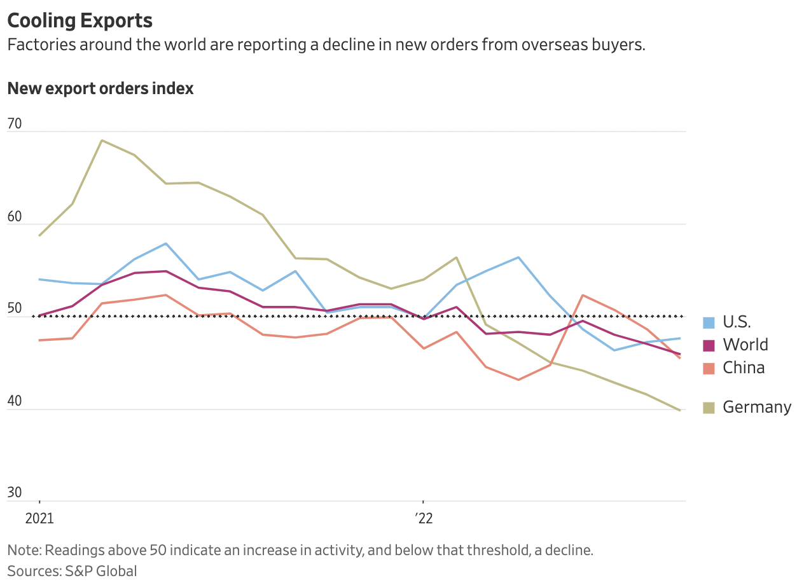
Notes:
Hannon, Paul, “WTO Sees Sharp Slowdown in Global Trade, Pointing to Possible Recession,” WSJ Oct 6, 2022.
https://www.wsj.com/articles/sharp-slowdown-in-global-trade-points-to-possible-recession-lower-inflation-11664964002?mod=itp_wsj&ru=yahoo

Slide 5
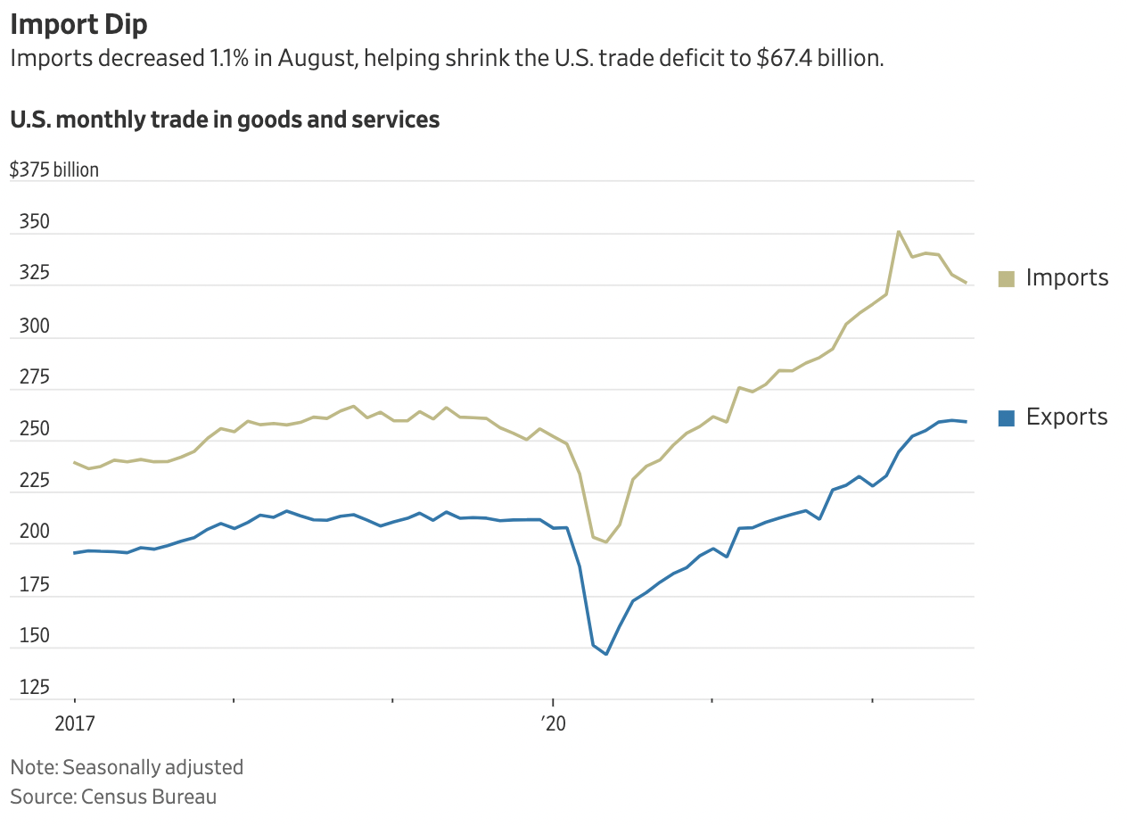
Notes:
Hannon, Paul, “WTO Sees Sharp Slowdown in Global Trade, Pointing to Possible Recession,” WSJ Oct 6, 2022.
https://www.wsj.com/articles/sharp-slowdown-in-global-trade-points-to-possible-recession-lower-inflation-11664964002?mod=itp_wsj&ru=yahoo

Slide 6
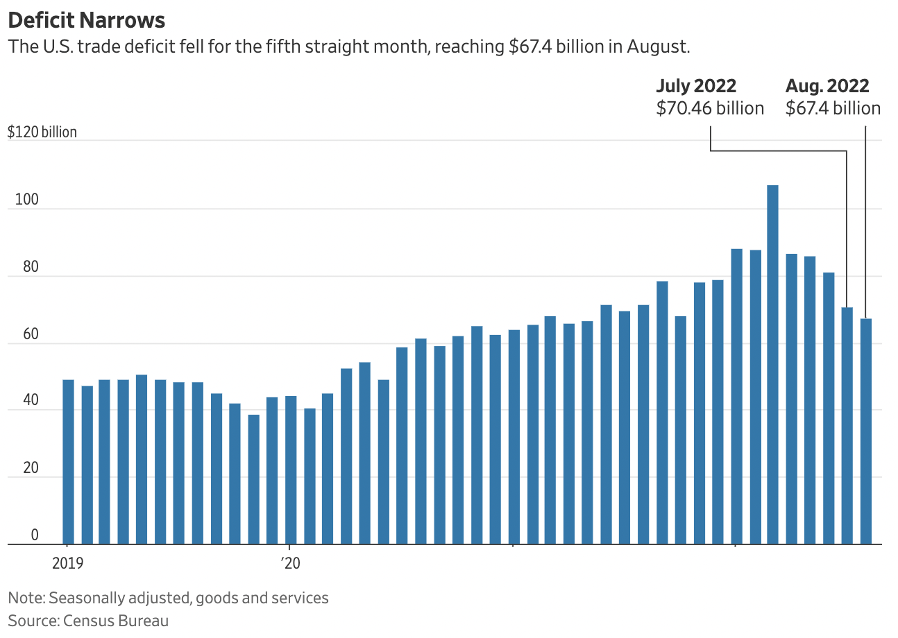
Notes:
Hannon, Paul, “WTO Sees Sharp Slowdown in Global Trade, Pointing to Possible Recession,” WSJ Oct 6, 2022.
https://www.wsj.com/articles/sharp-slowdown-in-global-trade-points-to-possible-recession-lower-inflation-11664964002?mod=itp_wsj&ru=yahoo

Slide 7
Announcements
Quiz question 4
In US trade law, how do the injury requirements differ for anti-dumping and safeguards?
Correct:
Greater injury is required for safeguards than for anti-dumping
Incorrect but agrees with incorrect statement I made in lecture Sep 29:
Greater injury is required for anti-dumping than for safeguards
I’ve now given credit for both

Slide 8
Announcements
Quiz Scores
 | Q3 | Q4 | Q5
Mean | 6.78 | 8.03 | 8.62
Median | 6.5 | 8 | 9
Max | 9.5 | 10 | 10
Min | 4 | 5.5 | 6
S.D. | 1.97 | 1.24 | 1.21

Slide 9
Announcements
Tuesday, 10/18: No class (Fall Break)
Quizzes
Quiz 6 on NTBs & Export Policies this Thursday Oct 13
No quiz Oct 20
Quiz 7 Oct 27

Slide 10
Paper #1 Feedback
Rent is not deadweight loss
Why consumer cost per job saved
Discussion different for policy already in place than for a prospective one
Partial equilibrium and other markets:
Not that they don’t exist or don’t matter
Just that their prices are held fixed
I now suggest using 3 significant digits, not less
Report the elasticities that you use
Foreign lost sales are not a welfare loss
Revenue falls, but so does cost.

Slide 11
For this Thursday
If you’ve time and interest,
Optional: read and view:
Scott and Trade Talk on trade and women
Economist on Making trade greener: When environmental protection turns into trade protection
Economist on The urge to protect: How trade restrictions are being used as a tool to protect human rights
Think of ways that trade may hurt or help, such as
Gender inequality
Racial inequality
Income and wealth inequality
Environment
Exploitation
And more…?

Slide 12
Outline
Export policies
How common are they
Economic analysis
Empirics of export restrictions
Recent uses

Slide 13
Export policies
Types of export policies
Bans
Taxes
Subsidies

Slide 14
Export policies
Reasons for export policies
Bans
To keep products away from other countries
To lower prices to home consumers
Taxes
To raise revenue
To lower prices to home consumers
Subsidies (see later, Dec 6. Not GATT-legal)
To support domestic producers

Slide 15
Outline
Export policies
How common are they
Economic analysis
Empirics of export restrictions
Recent uses

Slide 16
How common are export taxes
See Laborde et al.
Note first why they’ve been neglected:
Countries usually want to export more, not less
Export taxes are used by about 1/3 of WTO members
Average was 0.48% per cent in 2007
This is less than half a percent. This must be an average of ones that are zero.

Slide 17
How common are export taxes
Export taxes are concentrated on
Raw agricultural products
Minerals
Processed oilseeds
Aluminum and iron
Timber.
Energy products (esp. Russia natural gas)

Slide 18
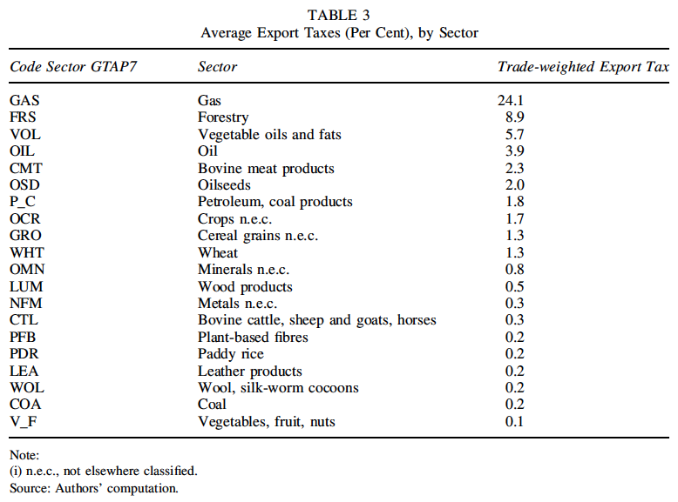
Note bias: High taxes cause less trade and lower weight.
Notes:
Laborde, David, Carmen Estrades, and Antoine Bouët, “A Global Assessment of the Economic Effects of Export Taxes,” The World Economy, 36(10), October, 2013, pp. 1333–1354.

Slide 19
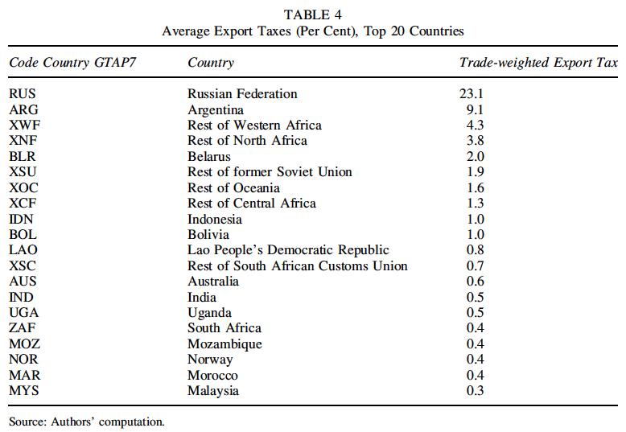
Notes:
Laborde, David, Carmen Estrades, and Antoine Bouët, “A Global Assessment of the Economic Effects of Export Taxes,” The World Economy, 36(10), October, 2013, pp. 1333–1354.

Slide 20
Pause for Discussion

Slide 21
Questions on Laborde et al.
In 2006, what sector had the most export taxes?
What are some of the motives for export taxes mentioned?

Slide 22
Outline
Export policies
How common are they
Economic analysis
Empirics of export restrictions
Recent uses

Slide 23
Economic Analysis
Use the same tools and assumptions as for tariffs
Export tax causes domestic price to be below the world price by the amount of the tax (if country still exports)
Why? If suppliers continue to sell both at home and for export,
They must get the same at home as for export
And that is the world price minus the tax

Slide 24
Small country export tax
P
Effects of an export tax, starting from free trade
Price falls
Quantity demanded rises
Quantity supplied falls
Quantity of exports falls
Tax revenue rises from zero
D
S
P₀=P_{W}
t
P₁=P_{W}–t
P_{aut}
X₀
D₀
D₁
S₁
S₀
Q
X₁
Specific Export Tax t

Slide 25
Small country export tax
P
Welfare effects of an export tax, starting from free trade
Suppliers lose −(a+b+c+d+e)
Demanders gain +(a+b)
Government gains +d
Country loses −(c+e)
D
S
P₀=P_{W}
c
e
t
a
d
b
f
P₁=P_{W}–t
P_{aut}
“Dead Weight Loss” =
X₀
D₀
D₁
S₁
S₀
Q
X₁
Specific Export Tax t

Slide 26
Small country export tax
P
Welfare effects of an export tax, starting from free trade
Suppliers lose −(a+b+c+d+e)
Demanders gain −(a+b)
Government gains +d
Country loses −(c+e)
D
S
P₀=P_{W}
c
e
t
a
d
b
f
P₁=P_{W}–t
P_{aut}
“Dead Weight Loss” =
X₀
D₀
D₁
S₁
S₀
Q
X₁
Specific Export Tax t

Slide 27
Large country, World Market
Welfare effects of a large-country tariff, starting from free trade
Home:
Private sector (S&D) loses −(c+d)
Government gains +(a+c)
Country may gain or lose: +a−d
Foreign
Private sector (S&D) loses −(a+b)
World loses −(b+d)
World Market
Home is Exporter
Foreign (*) is Importer
P
XS
P*₁
a
b
t
c
d
P₁
MD*
X₁=M*₁
X₀=M*₀
M*,X
“Dead Weight Loss” =

Slide 28
Large country, World Market
Thus large country, again, will gain from export tax if a>d
What is area a?
The portion of the tax paid by foreign importers, who pay a higher price
A transfer from foreign demanders to the home government
The result, again, of improving the home country’s
“terms of trade”
World Market
Home is Exporter
Foreign (*) is Importer
P
XS
P*₁
a
b
t
c
d
P₁
MD*
X₁=M*₁
X₀=M*₀
M*,X
“Terms of Trade” ≡ Relative price of exports = P^{X}/P^{M}

Slide 29
Pause for Discussion

Slide 30
Questions (not asked about readings)
Explain why an export tax pushes down the price at home.
Explain why an export tax pushes up the price abroad.
Who are hurt and who are helped by an export tax?
Statement above said
“Export tax causes domestic price to be below the world price by the amount of the tax (if country still exports)”
What happens if exports stop?

Slide 31
Outline
Export policies
How common are they
Economic analysis
Empirics of export restrictions
Recent uses

Slide 32
Empirics
Laborde et al.
Use computer model of trade to quantify the effects of removing export taxes that existed in 2007
(CGE Model = Computable General Equilibrium Model)

Slide 33
Empirics
Findings: Export tax removal causes
an overall gain of 0.24 per cent in world real income
+1.6 per cent in oil-exporting countries,
+0.2 per cent in developed countries and
+0.1 per cent in other developing countries.
boosts world trade volumes by 2.8 per cent
reduces the world price of these products.

Slide 34
Empirics
Findings on export tax removal:
The largest winner is the CIS block (whose real income increases by 3.5 per cent)
Other oil exporters are negatively hit
Importing countries can benefit
May cause deindustrialization
Despite their much smaller size, export taxes effects on real incomes are more than half those of import taxes

Slide 35
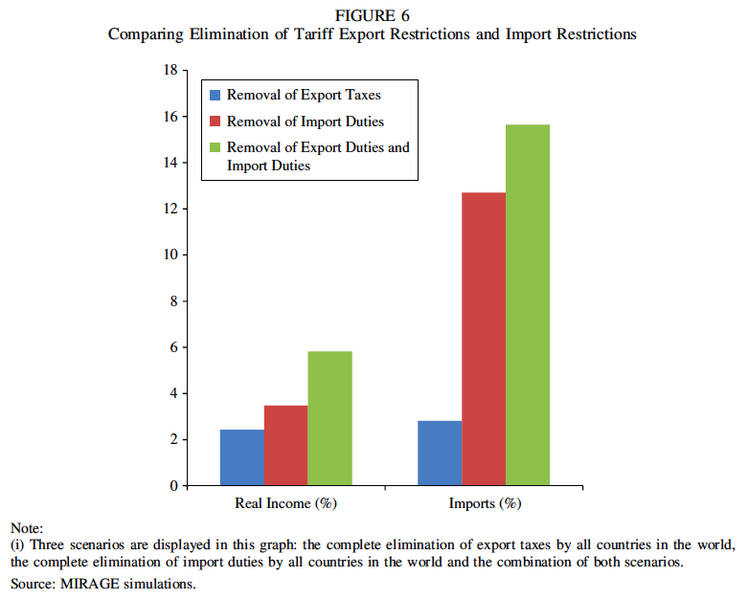
Notes:
Laborde, David, Carmen Estrades, and Antoine Bouët, “A Global Assessment of the Economic Effects of Export Taxes,” The World Economy, 36(10), October, 2013, pp. 1333–1354.

Slide 36
Empirics
Beckman et al.
Reports effect of export taxes in agriculture, 2006-2008
“In times of high or volatile prices, they are generally applied to guarantee domestic food supply and lower domestic prices.”
Results from both a partial equilibrium model and a CGE model

Slide 37
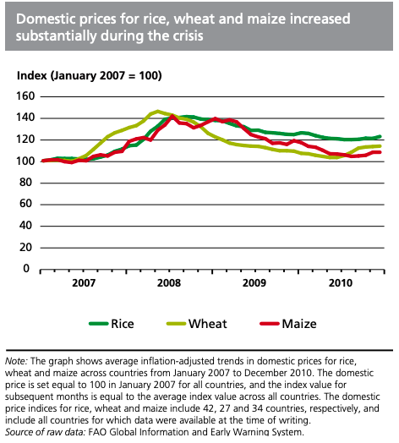
Notes:
FAO: “Lessons from the world food crisis of 2006–08”
http://www.fao.org/3/i2330e/i2330e04.pdf

Slide 38
Empirics
Effects of export taxes, Beckman et al.:
lower domestic prices.
increased international prices
if exporter is large or if many exporters tax
negative impacts on welfare
countries that implemented these policies tended to weather the food-price crisis the best.
countries that are dependent on food imports were not as insulated

Slide 39
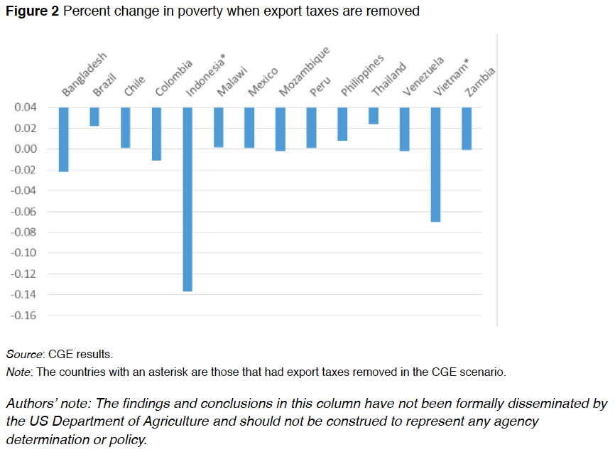
Note the zero line. This is an odd way to present results.
Notes:
Beckman, Jayson, Carmen Estrades, Manuel Flores, and Angel Aguiar, “The impacts of export taxes on agricultural trade,” VOX^{EU}, CEPR Policy Portal, October 3, 2018.
https://voxeu.org/article/impacts-export-taxes-agricultural-trade

Slide 40
Pause for Discussion

Slide 41
Questions on Laborde et al., “Economic Effects of Export Taxes”
What are some of the main effects of removing export taxes?
What are some of the limitations of this analysis?

Slide 42
Questions on Beckman et al., “Export taxes on agricultural …”
What was the main reason for export taxes examined here?
Can you tell from this whether the policies have the desired effects?
Does Figure 2 show poverty falling in all the countries?

Slide 43
Outline
Export policies
How common are they
Economic analysis
Empirics of export restrictions
Recent uses

Slide 44
Recent Uses
India: Banned all export of onions in 2020
Due to drought, then rain, and resulting onion shortage
Neighboring country consumers hit hard
Notes:
Gettleman, Jeffrey, Julfikar Ali Manik, and Suhasini Raj, “India Isnʼt Letting a Single Onion Leave the Country,” New York Times, October 1, 2019. [2p]
https://www.nytimes.com/2019/10/01/world/asia/india-modi-onion-prices.html

Slide 45
Recent Uses
Mozambique: Cashews
Export tax of 18-22% on raw cashews
Export tax of zero on processed cashews
Purpose: to support processing industry
Growers are hurt, but the processing industry has thrived
Quality of raw cashews became “one of the lowest in the world”
Notes:
Economist, “Of cashews and cash: Mozambique’s nut factories have made a cracking comeback,” The Economist, September 12, 2019. [2p]
https://www.economist.com/middle-east-and-africa/2019/09/12/mozambiques-nut-factories-have-made-a-cracking-comeback

Slide 46
Recent Uses
Bans on export of sand
Several countries
Indonesia in 2003, Vietnam in 2010, Cambodia in 2017, Malaysia in 1997-2015, and again in 2020.
Why?
Mining sand threatens natural habitats
Huge amounts needed for construction and land reclamation.
Many countries but especially
China
Singapore
Notes:
Bruce-Lockhart, Chelsea, “Boom in global sand trade fuels fears over conservation,” Financial Times, December 30, 2019. [7p]
https://www.ft.com/content/aa614ec6-21ae-11ea-b8a1-584213ee7b2b

Slide 47
Recent Uses
Cocoa
“Governments of Ghana and Ivory Coast formed a cocoa cartel that will charge an extra $400 per metric ton of the crop to give a better deal to farmers.”
Why might this succeed?
The two produce about 65% of the world’s cocoa.
Smaller producers can’t serve the needs of the largest brands
Notes:
Ryan, Carol, “Cocoa Cartel Is Less Bitter for Luxury Chocolate,” Wall Street Journal, January 17, 2020. [3p]
https://www.wsj.com/articles/cocoa-cartel-is-less-bitter-for-luxury-chocolate-11579256986?mod=itp_wsj&ru=yahoo

Slide 48
Recent Uses
Rare earths (see Yu & Savastopolu)
China may limit production and export of 17 rare earths
It controls ~80% of world supply
Crucial for many high-tech products
Including American F-35 fighter jets
Note:
Trump had done this for “sensitive US technology, such as high-end semiconductors”
Biden would too, together with allies

Slide 49
Recent Uses
Medical, PPE, Vaccines
As we saw earlier, countries’ responses to pandemic often included export restrictions

Slide 50
Pause for Discussion

Slide 51
Questions on Yu & Savastopolu
Would a limit on exports of rare earths matter only for weapons?
Why would an export limit be a “double edged sword”?
What has been suggested as a way for the US to protect itself from this?
Is China a net exporter of rare earths?

Slide 52
Questions on Douglas et al. “Export Curbs Spread…”
Why are export restrictions both caused by, and cause of, high world prices?
Do export restrictions cause prices to rise at home in the restricting country?
What product’s world price, as of this report, had risen the most?
How does the WTO deal with export restrictions?
How many countries (as of this report) have implemented export restrictions, and how does this compare to past experience?
Have the US and other advanced countries restricted exports?

