Slide 1
Class 1 The State of Play in International Trade and Trade Policy I: Trade Wars by Alan V. Deardorff University of Michigan 2022
PubPol/Econ 541

Slide 2
Announcements
Next Tuesday I’ll start by asking you for News, then discuss that and what I’ve noticed myself.
Note that if I don’t get through all my slides, you should view them later. (But not the Aug 30 class.)
Office hours:
Feel free to enter even if others are there
If you want a private meeting, email me to schedule

Slide 3
Trade Wars
Notes:
Pinn, Ingram, “Ingram Pinn’s illustration of the week: Trading tariffs,” Financial Times, June 22, 2018.
https://www.ft.com/content/c56ebb64-7579-11e8-b326-75a27d27ea5f

Slide 4
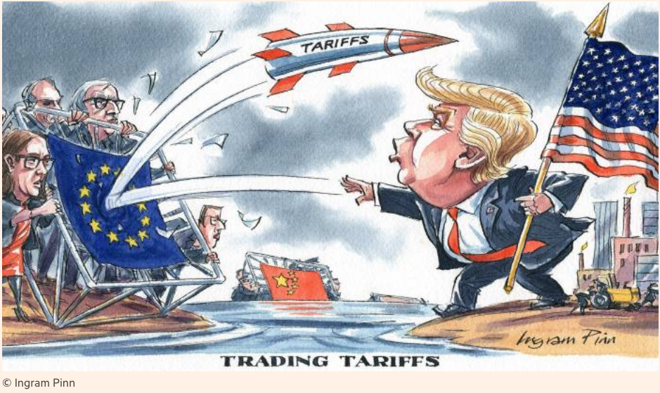
Notes:
Pinn, Ingram, “Ingram Pinn’s illustration of the week: Trading tariffs,” Financial Times, June 22, 2018.
https://www.ft.com/content/c56ebb64-7579-11e8-b326-75a27d27ea5f

Slide 5
Bown, Chad P. and Melina Kolb, "Trump's Trade War Timeline
We’ll focus on these two only
Notes:
Pinn, Ingram, “Ingram Pinn’s illustration of the week: Trading tariffs,” Financial Times, June 22, 2018.
https://www.ft.com/content/c56ebb64-7579-11e8-b326-75a27d27ea5f

Slide 6
Pause for Discussion

Slide 7
Questions on Bown & Kolb
With what countries is the US engaged in a trade war?
What have been the legal bases (within the US) for tariffs and threats of tariffs?
What is the current status of the trade war with China?
To what extent has President Biden reversed the tariffs begun by Trump?

Slide 8
Trade Wars, 2018-2021
Outline
Battles in the Trade Wars
(Washing Machines & Solar Panels)
Steel & Aluminum
Intellectual Property / US-China Trade War
(Cars)
(Mexico migration)
Targeting Companies
Imports from Xinjiang, China

Slide 9
Steel & Aluminum
National Security
Section 232 of US trade law
Tariffs on imports that “threaten national security”
“National security” is not defined
Legality in WTO is unclear

Slide 10
Steel & Aluminum
National Security
Mar 1, 2018: Trump levies tariffs
25% on steel, 10% on aluminum
Against all countries
A few removed shortly thereafter
Remained in place on EU, China, Canada, Mexico, and others
Retaliation by all
(Tariffs on Canada & Mexico later removed)

Slide 11
Steel & Aluminum
US-EU and other
Negotiations began under Biden May 17, 2021
US lifts some tariffs but keeps them on over-quota quantities (“tariff-rate quota”) and partners remove retaliatory tariffs on US:
EU: Oct 31, 2021
Japan: Feb 7, 2022
UK: Mar 22, 2022
Ukraine: May 9, 2022

Slide 12
Pause for Discussion

Slide 13
Questions on Swanson & Rogers (re EU)
Are the tariffs simply being removed?
Is there any restriction on which EU products will qualify for zero tariff?
Does the steel quota look like it will be binding?
Are US industries other than steel and aluminum happy with this?

Slide 14
Questions on Hayashi (re Japan)
How does this deal with Japan compare to the one with the EU?
Does Japan see this as a final deal?
What is Japan doing in return?

Slide 15
Questions on Williams (re UK)
How does this deal compare to those with the EU and Japan?
What complicated these negotiations?
How did USTR Tai respond when asked about the likelihood of a UK-US FTA?

Slide 16
US-China Trade War
Legal basis of US tariffs on China was mostly on intellectual property
IP includes patents, trademarks, copyrights, and trade secrets
US (and others) claim that China
Steals technology secrets
Forces investors to turn over technologies in joint ventures

Slide 17
US-China Trade War
USTR (United States Trade Representative) under Trump
Initiated investigation of China’s IP practices
Under Section 301 of US trade law – Unfair trade practices
This is not something permitted by the WTO

Slide 18
US-China Trade War
March 22, 2018: Report found unfair trade practices
IP violations (see above)
Also subsidies to firms and state-owned enterprises (SOEs) to trade unfairly
Trump announced tariffs on up to $60 billion of China’s exports to US

Slide 19
US-China Trade War
US and China levied tariffs on each other
Three times in 2018, twice in 2019
Trump either added new tariffs on China exports or raised them
Each time, China responded with more tariffs on US exports
Threat of more in December 2019 was suspended by the “Phase One” US-China Trade Deal

Slide 20
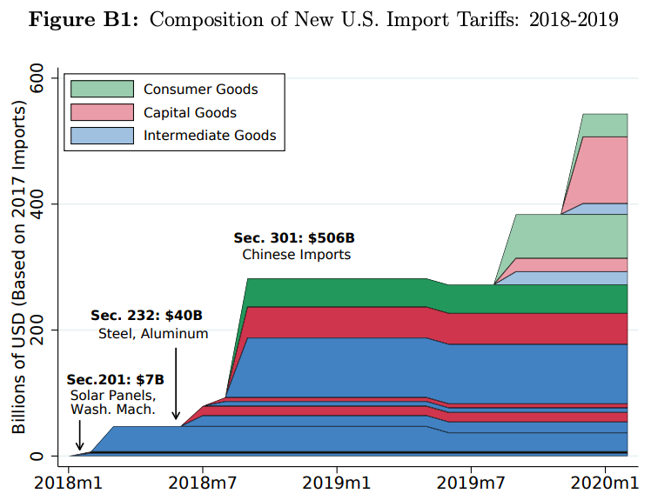
Trump Tariffs, 2018
Source: Flaan & Pierce 2020
Notes:
Flaan and Pierce 2020
https://www.federalreserve.gov/econres/feds/files/2019086pap.pdf

Slide 21
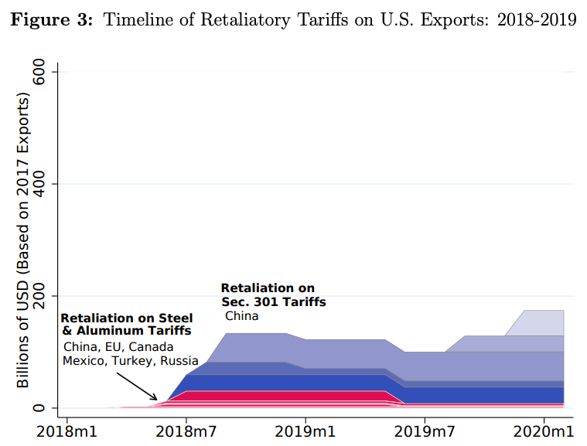
Source: Flaan & Pierce 2020
Notes:
Flaan and Pierce 2020
https://www.federalreserve.gov/econres/feds/files/2019086pap.pdf

Slide 22
US-China Trade War
Phase One Deal
In anticipation, Trump called off December 2019 tariffs
Agreement signed January 15, 2020
Content of Deal:
China to buy $200 billion more US exports
US to reduce a few tariffs on China
China to stop forcing foreign companies to transfer technology
Most tariffs remain in place by both, and China did not address subsidies and SOEs

Slide 23
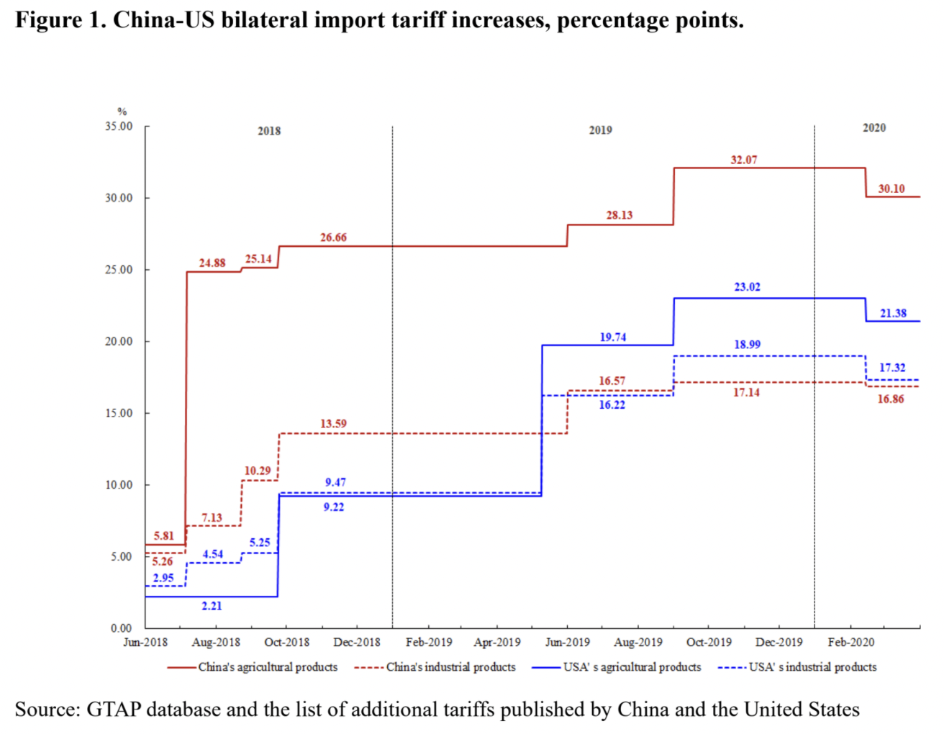
Phase One Agreement Reductions Jan 2020
US tariffs on China
Agriculture
Industrial
China tariffs on US
Agriculture
Industrial
Source: Zheng et al. Oct 2021
Notes:
Zheng, Jian, Shudong Zhou, Xingzi Li, Antonio Domingos Padula, Will Martin, “Effects of Eliminating the US-China Trade War Tariffs,” 27 October 2021

Slide 24
US-China Trade War
Effects of the trade war
Economist, “New research counts the costs of the Sino-American trade war,” The Economist, January 1, 2022.
Tariffs rose:
US on China 3% to 19%
China on US 8% to 21%
Compared to Smoot-Hawley tariffs of 1930
Covered more trade as share of GDP
Caused smaller harm to GDP (“effects muffled by complex supply chains”)
US prices of imports rose by 90% of tariffs
Reduced US manufacturing employment by 1.4%
Notes:
Economist, “New research counts the costs of the Sino-American trade war,” The Economist, January 1, 2022. [3p].
https://www.economist.com/finance-and-economics/2022/01/01/new-research-counts-the-costs-of-the-sino-american-trade-war

Slide 25
Pause for Discussion

Slide 26
Questions on Economist, “New Research…”
What did China promise in the Phase One deal, and to what extent did they do as promised?
How did US import patterns change?
Are the changes in US import patterns good or bad for the US?

Slide 27
Questions on Economist, “Artful Dodging…”
What are the ways mentioned for avoiding US tariffs?
Why has the de minimus loophole gotten bigger?
What has one congressman proposed to fix this?
Is this hurting the US?

Slide 28
Questions on Swanson, “China Continues to…”
What was the basis for US tariffs on China?
What had Trump’s deal with China gotten them to promise regarding this issue?
What has China done in response?
What issue is mentioned here between the US and the EU?

Slide 29
Questions on Sevastopulo, “Joe Biden’s administration…”
What is the tradeoff that Biden is confronting?
Who (in US gov’t) are in favor of tariff cuts on China, and who are opposed?
What policy is suggested to try to achieve both of Biden’s aims?
What is said to be likely to happen?

Slide 30
Targeting Chinese Companies
US Entity List
“A tool utilized by BIS to restrict the export, reexport, and transfer (in-country) of items … reasonably believed to be … contrary to the national security or foreign policy interests of the United States.”
Department of Commerce, Bureau of Industry and Security (BIS)
List has many entities from many countries (474 pages of them)
Exports are not necessarily banned, but require a license
Notes:
https://www.commerce.gov/news/press-releases/2021/07/commerce-department-adds-34-entities-entity-list-target-enablers-chinas
https://www.bis.doc.gov/index.php/documents/regulations-docs/2326-supplement-no-4-to-part-744-entity-list-4/file

Slide 31
Targeting Chinese Companies
US Entity List (cont.)
Recently expanded the number of Chinese companies on the list
Trump added “dozens of Chinese companies”
Biden added firms building supercomputers
Notes:
https://www.commerce.gov/news/press-releases/2021/07/commerce-department-adds-34-entities-entity-list-target-enablers-chinas

Slide 32
Targeting Chinese Companies
Trump and Biden have also banned investment in some Chinese companies
Based on links to China’s military
Current investors have 1 year to divest
Notes:
https://www.commerce.gov/news/press-releases/2021/07/commerce-department-adds-34-entities-entity-list-target-enablers-chinas

Slide 33
Targeting Chinese Companies
Trump used national security as the grounds for a series of actions against Chinese companies
ZTE
Huawei
TikTok

Slide 34
Targeting Chinese Companies
Huawei
The world’s largest telecommunications equipment maker
US worried that, although a private company, the Chinese government could use it to spy
2012: US firms were encouraged not to buy from Huawei
2018: US asked allies not to buy from Huawei, but few complied (New Zealand, UK)
Notes:
Swanson & Vogel, “Faced With Crippling Sanctions, ZTE Loaded Up on Lobbyists,” New Hork Times, Aug 1, 2018.
https://www.nytimes.com/2018/08/01/us/politics/zte-sanctions-lobbying.html?rref=collection%2Fissuecollection%2Ftodays-new-york-times&action=click&contentCollection=todayspaper&region=rank&module=package&version=highlights&contentPlacement=5&pgtype=collection

Slide 35
Targeting Chinese Companies
Huawei (cont.)
May 2019: US firms were banned from selling chips made in US to Huawei
Aug 2020: US prohibited anyone from selling chips to Huawei, custom or not, if produced with American technology”
Based on “foreign direct product rule” – stronger than entities list
Governments in Africa, Asia, and Latin America are still buying from them
“77% of these countries are “not free” or “partly free” according to Freedom House.

Slide 36
Pause for Discussion

Slide 37
Questions on Strumpf, “U.S. Set Out to Hobble…”
What has the US government done to Huawei?
Has this hurt Huawei?
Is this the sort of action that they US has taken against a foreign company often?
How is Huawei dealing with this?

Slide 38
Imports from Xinjiang, China
The concern (in US and EU)
Human rights
“Rights groups, researchers, former residents and some Western lawmakers and officials say Xinjiang authorities have facilitated forced labor by detaining around a million Uyghurs and other primarily Muslim minorities since 2016.”

Slide 39
Imports from Xinjiang, China
Previous actions
US banned specific imports from Xinjiang:
Tomatoes (January 2021)
Cotton (January 2021)
Some solar products (June 2021)
French investigation into four fashion retailers

Slide 40
Imports from Xinjiang, China
The US policy
Since the Tariff Act of 1930, US law has banned imports produced with forced labor
New law likely to be enacted:
Uyghur Forced Labor Prevention Act
Creates “rebuttable presumption” that goods produced in Xinjiang use force labor

Slide 41
Imports from Xinjiang, China
Private-sector actions
Suppliers to several companies (Apple, Nike) are phasing out employment of “Uyghur factory workers transferred from Xinjiang through a state-backed labor program.”
China’s response: “state-run transfers of Uyghur, Kazakh and other mostly Muslim minority laborers are part of poverty-alleviation programs”

Slide 42
Pause for Discussion

Slide 43
Questions on Yeung, “US Bans Imports from…”
Is there any exception for importers wanting to import from Xinjiang?
What harms does the US government say are being done to people in Xinjiang?
What does China say it is doing?

