Slide 1
Class 20
FTAs and Other Trade Deals by
Alan V. Deardorff
University of Michigan
2021
PubPol/Econ 541

Slide 2
Outline
FTAs in general
North America
  NAFTA
  USMCA
RCEP
CPTPP
Other

Slide 3
FTAs in General
Types
  Free Trade Agreement (FTA)
    Zero tariffs on (most) imports from partners
    Unequal tariffs on imports from outsiders
    Rules of origin (ROOs)
  Customs Union
    Zero tariffs on imports from partners
    Common external tariffs on outsiders
    No need for ROOs
  Common Market
    Customs Union plus other free movement

Slide 4
FTAs in General
Proliferation: Now more than 300, involving a significant fraction of possible country pairs
Most are FTAs
WTO reports all as Regional Trade Agreements (RTAs), though many include distant countries

Slide 5
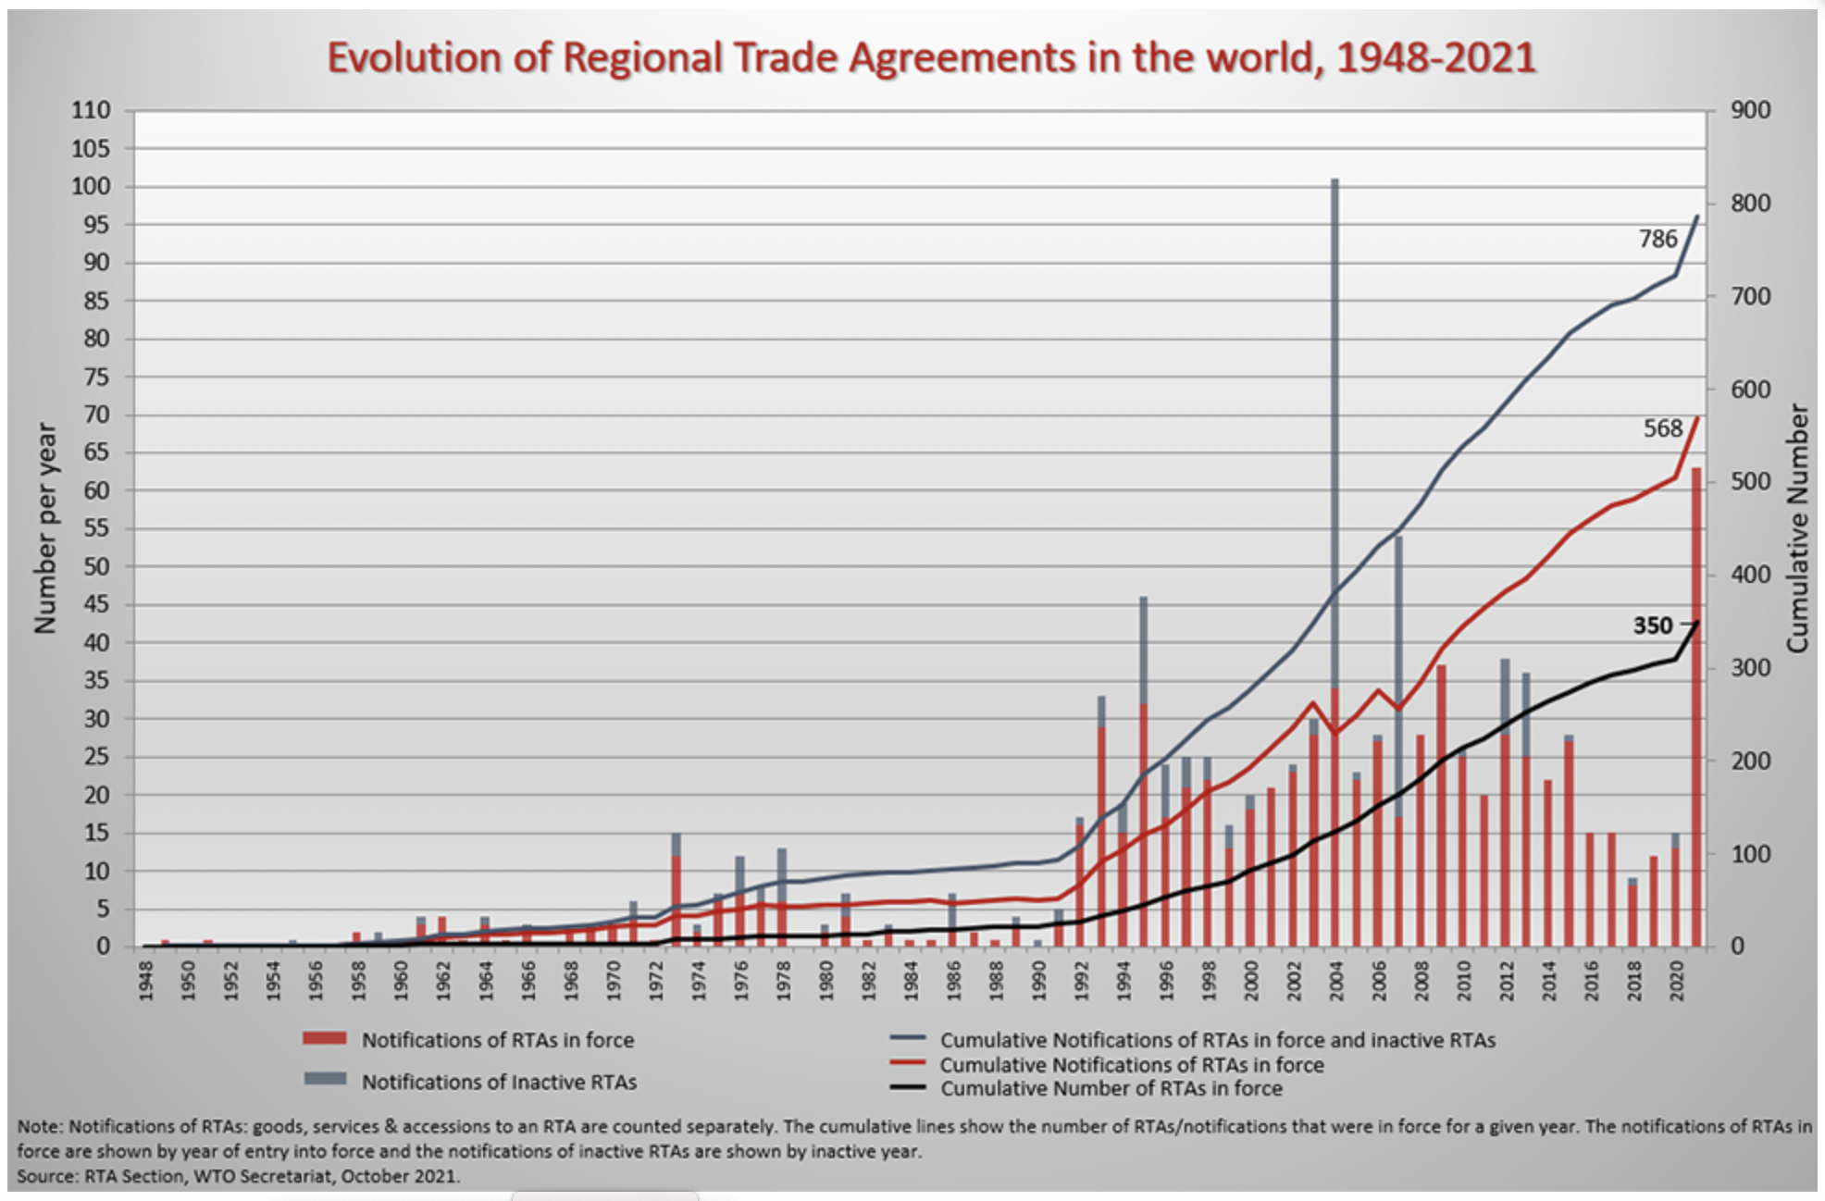
Source: WTO
Notes:
https://www.wto.org/english/tratop_e/region_e/region_e.htm

Slide 14
Pause for Discussion

Slide 15
  Questions
Why are ROOs necessary in FTA but not in Customs Union?
Why is the matrix of FTAs plus CUs so much fuller than the matrix of just FTAs? Are there really a lot of CUs?

Slide 16
NAFTA
What it was
  An FTA between US, Canada, and Mexico
  Went into effect Jan 1, 1994
Effects
  Trade
  Wages
  Employment
  Supply chains
  Consumers

Slide 17
NAFTA Effects
Trade
  Grew massively across N. America
  US bilateral trade with Mexico became deficits: US imports > US exports
  Supply chains, especially in autos, extended across North America

Slide 18
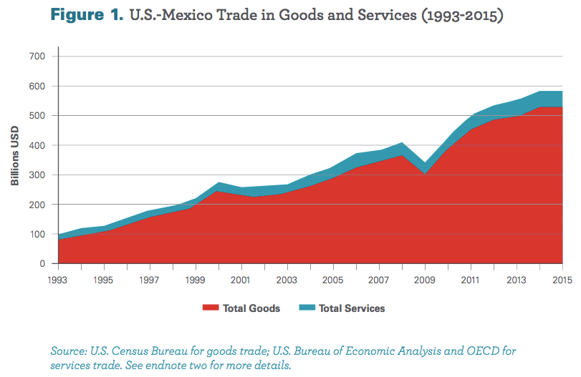
From: Wilson, Christopher, Growing Together: Economic Ties between the United States and Mexico, Wilson Center, March 2017.

Slide 19
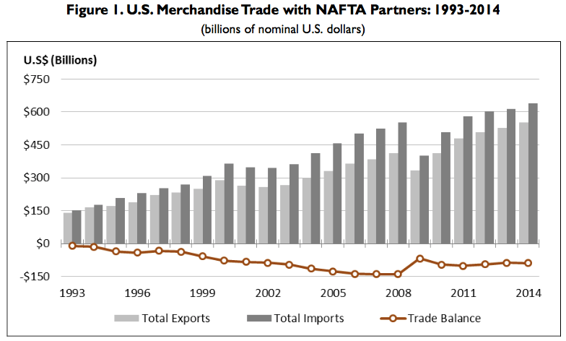
Source: Congressional Research Service (2015)

Slide 20
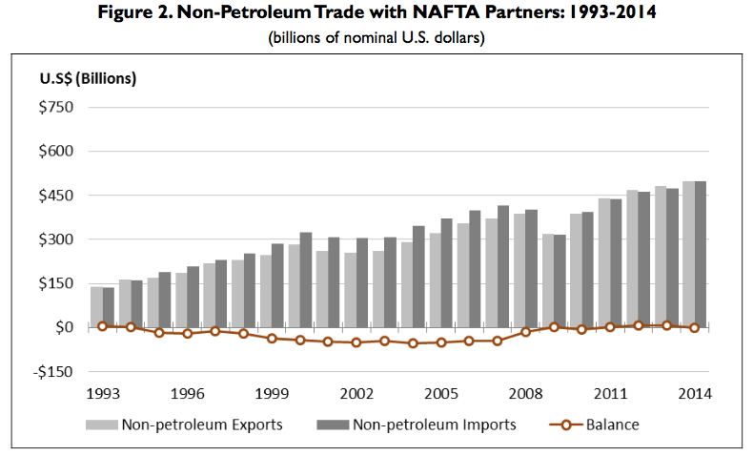
Note near balance
Source: Congressional Research Service (2015)

Slide 21
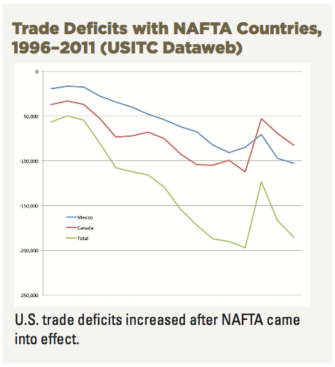
Source: AFL-CIO, “NAFTA at 20”

Slide 22
NAFTA Effects
Wages
  Fell in Mexico
  No effect on average in US

Slide 23
Real Wages Plummeted!
What Happened: Mexico
NAFTA
Peso Crisis

Slide 24
Real Wage: No Change
What Happened: U.S.
NAFTA
Peso Crisis

Slide 25
NAFTA Effects
Employment
  No effect on overall US employment or unemployment
  Pockets of disruption across US

Slide 26
Unemployment: No effect (or fell)
What Happened: U.S.
NAFTA
Peso Crisis

Slide 27
NAFTA Effects
Supply chains
  US manufacturing moved inputs to low-cost locations across N. America

Slide 28

NAFTA and the Auto Supply Chain
Black, Diamond, and Merrill, “One Tiny Widget’s Dizzying Journey Shows Just How Critical Nafta Has Become,” Bloomberg, February 2, 2017.

Slide 29

NAFTA and the Auto Supply Chain
Black, Diamond, and Merrill, “One Tiny Widget’s Dizzying Journey Shows Just How Critical Nafta Has Become,” Bloomberg, February 2, 2017.

Slide 30

NAFTA and the Auto Supply Chain
Black, Diamond, and Merrill, “One Tiny Widget’s Dizzying Journey Shows Just How Critical Nafta Has Become,” Bloomberg, February 2, 2017.

Slide 31

NAFTA and the Auto Supply Chain
Black, Diamond, and Merrill, “One Tiny Widget’s Dizzying Journey Shows Just How Critical Nafta Has Become,” Bloomberg, February 2, 2017.

Slide 32

NAFTA and the Auto Supply Chain
Black, Diamond, and Merrill, “One Tiny Widget’s Dizzying Journey Shows Just How Critical Nafta Has Become,” Bloomberg, February 2, 2017.

Slide 33

NAFTA and the Auto Supply Chain
Black, Diamond, and Merrill, “One Tiny Widget’s Dizzying Journey Shows Just How Critical Nafta Has Become,” Bloomberg, February 2, 2017.

Slide 34
NAFTA Effects
Consumers
  As always with freer trade, the ultimate beneficiaries are consumers
    Lower prices for
      Imported consumer goods
      Domestically produced goods and services that use cheaper imported inputs
    Greater variety of goods to choose from
  These gains are hard to measure
    One indicator may be the low rates of price inflation experienced under NAFTA

Slide 35
Pause for Discussion

Slide 36
  Questions
I’ve not assigned anything evaluating NAFTA, since it’s been replaced by USMCA. But what were, and are, your impressions of NAFTA?

Slide 37
USMCA
What it is
  “United States, Mexico, Canada Agreement”
  Result of Trump’s renegotiation of NAFTA
  Mostly the same as NAFTA
Why replace NAFTA?
  Trump opposed NAFTA as early as 1993
    “The Mexicans want it, and that doesn't sound good to me.”
    Trump sees trade as zero-sum game
  Opposition to NAFTA was popular

Slide 38
USMCA Timeline
Renegotiation
  May 18, 2017: Renegotiation began
  Aug 27, 2018: Agreement between US and Mexico
  Sep 30, 2018: Agreement with Canada to join
Approval and Implementation
  Dec 19, 2019: US House approved (contentious)
  Jan 17, 2020: Senate approved (expected)
  Jan 29, 2020: Trump signed into law
  Jul 1, 2020: Agreement goes into effect

Slide 39
USMCA Features
Car incentives
  ROO raised from 62.5% to 75%
  70% of steel & aluminum must come from NA
  40-45% of value added from >$16/hr labor
Dairy: Some opening of US dairy to Canada
ISDS only between US & Mexico (was for all in NAFTA)
  ISDS = Investor-State Dispute Settlement
Commitments on labor & IP standards
“Sunset Clause”: Review after 6 years
Inform US if negotiate with NME (China)
Commitment not to manipulate currencies

Slide 40
Pause for Discussion

Slide 41
  Questions on Kirby
How big a change is USMCA compared to NAFTA?
What industry or product seems to have gotten the most attention in the changes made to USMCA?
How are the rules of origin for cars and car parts changed in USMCA compared to NAFTA?
What is the “rapid-response mechanism”?

Slide 42
  Questions on
  Swanson & Tankersley
Is Canada dropping its protectionist policies on dairy?
Is intellectual property protection being increased or decreased?
What is the Sunset Clause?

Slide 43
  Questions on Nakayama, “Japanese carmakers …”
How are Japanese car companies responding to USMCA rules?
Can you tell from this what the tariff rate would be if cars made in Mexico don’t have 40% of value from high-wage workers?
What are companies doing to respond to the USMCA rules?
What will USMCA do to the prices of cars in the US?

Slide 44
  Questions on Kaplan, “Complaint Accuses Mexican Factories …”
What “trade pact” is being tested here, and in what sense?
What is the company accused of doing?
Does the company allow a union for its workers?
Is the company Mexican owned?

Slide 45
  Questions on Zumbrun,
  “U.S. Initiates Trade Dispute…”
What does the US claim?
What can you tell, from this, about the process for a dispute under the USMCA?
Is dairy a new issue between the US and Canada?

Slide 46
RCEP
RCEP
  “Regional Comprehensive Economic Partnership”
  Large FTA negotiated since 2013 by
    ASEAN 10 countries plus 5: China, Japan, South Korea, Australia and New Zealand
    India also, until it recently dropped out
  Signed Nov 15, 2020

Slide 47
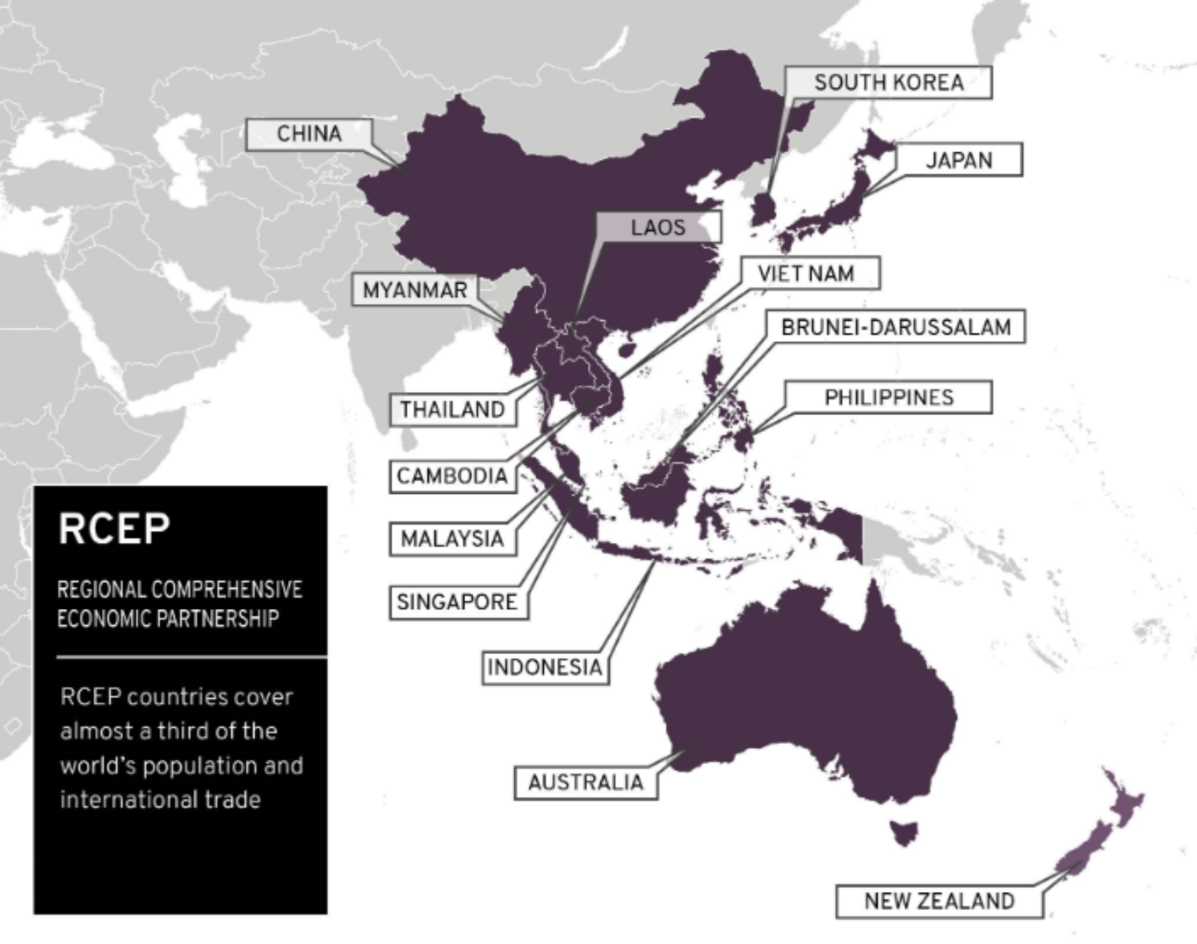
Notes:
https://www.mfat.govt.nz/en/trade/free-trade-agreements/free-trade-agreements-concluded-but-not-in-force/regional-comprehensive-economic-partnership-rcep/rcep-overview

Slide 48
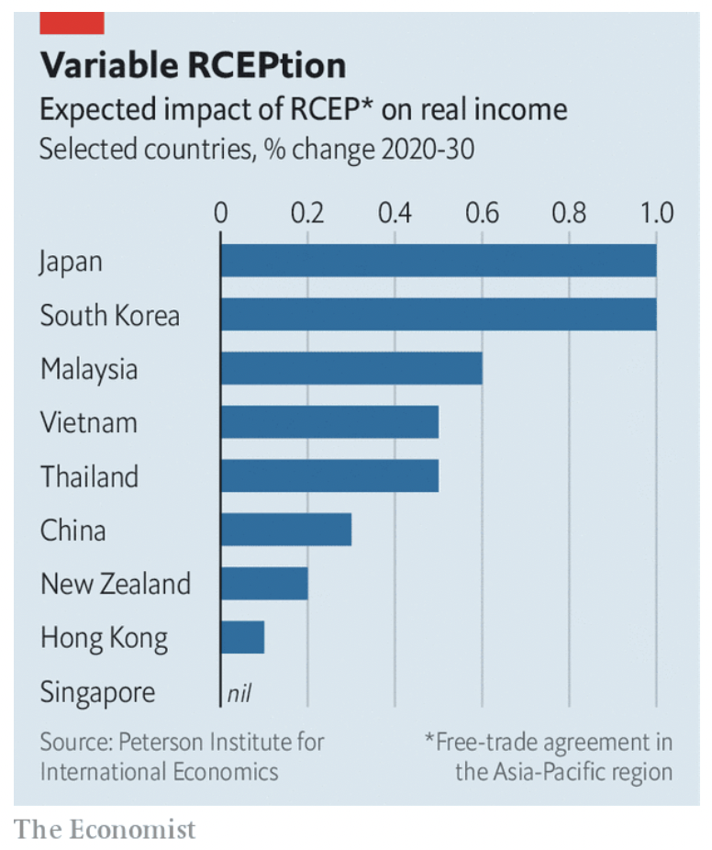
Notes:
Economist, "Big deal: Who gains from RCEP, Asia’s new trade pact?," The Economist, November 21, 2020.

Slide 49
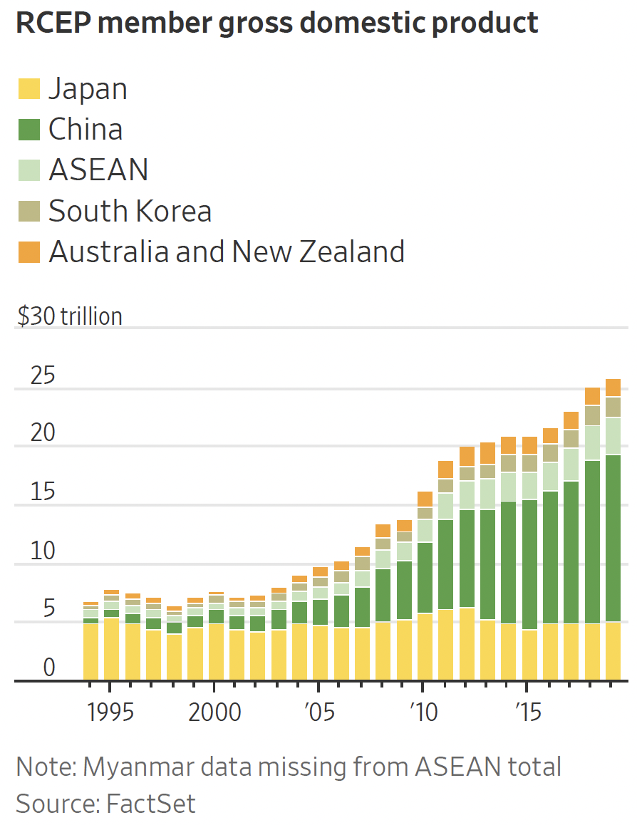
Notes:
Bird, Mike, "Asia’s Massive New Trade Deal Is No Big Victory for Beijing," Wall Street Journal, November 16, 2020.

Slide 50
Pause for Discussion

Slide 51
  Questions on Economist,
  “Big Deal…”
When was RCEP signed, by whom, and after how many years of negotiation?
By when is it expected to be ratified?
In what ways is RCEP weaker than other agreements?
Of the trade of these countries, how much will be newly covered by a trade agreement? Why?

Slide 52
CPTPP
CPTPP
  “Comprehensive and Progressive Trans-Pacific Partnership”
  Successor to TPP after Trump pulled US out
  Includes 11 countries, including
    Japan
    Canada
    Mexico
    Australia
    Chile

Slide 53
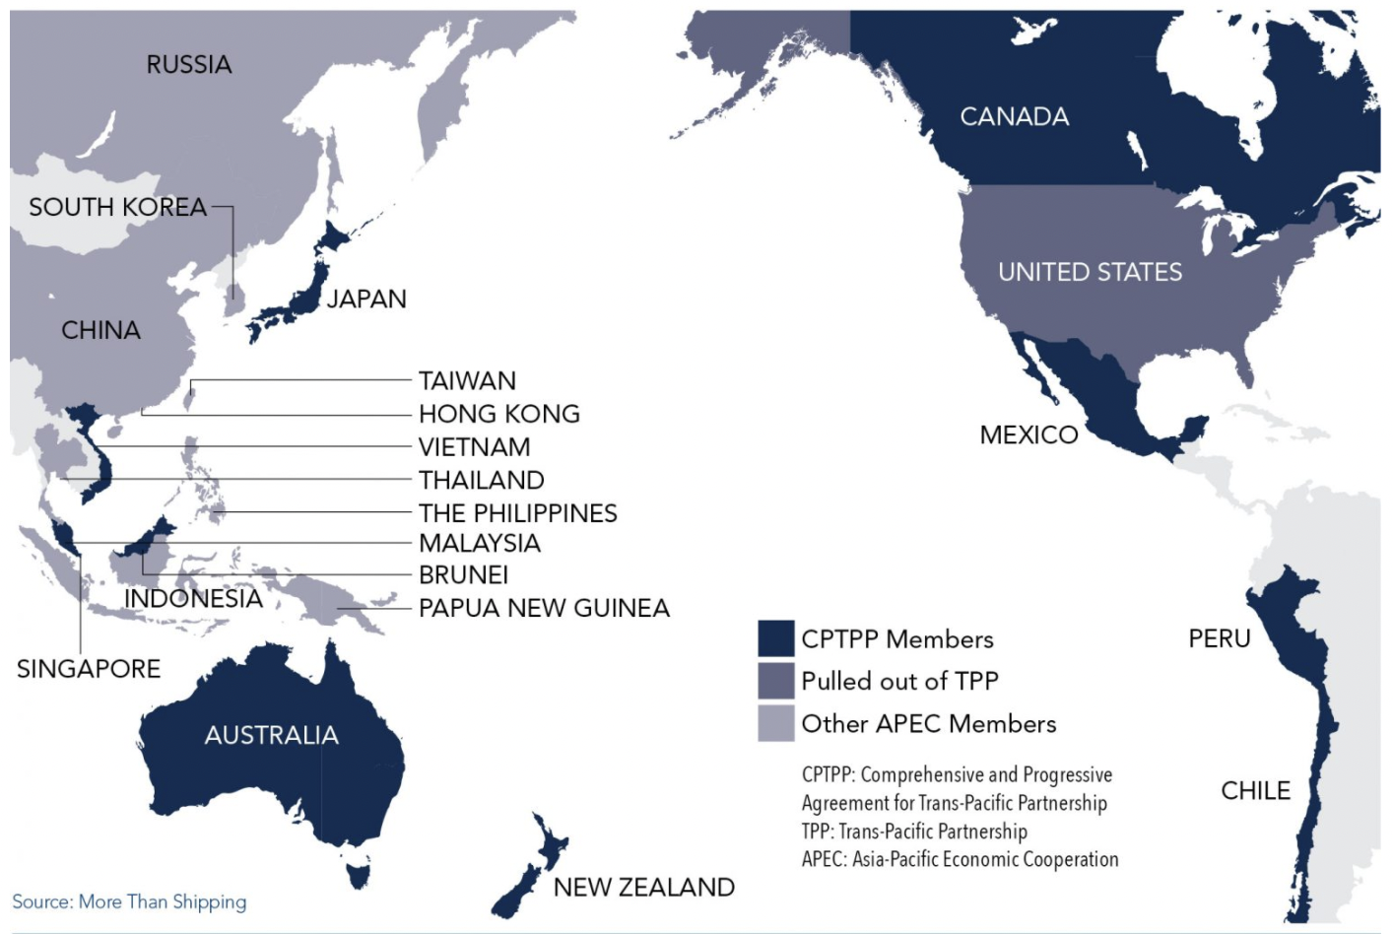
Notes:
https://advocacy.calchamber.com/policy/issues/trans-pacific-trade-relations/

Slide 54
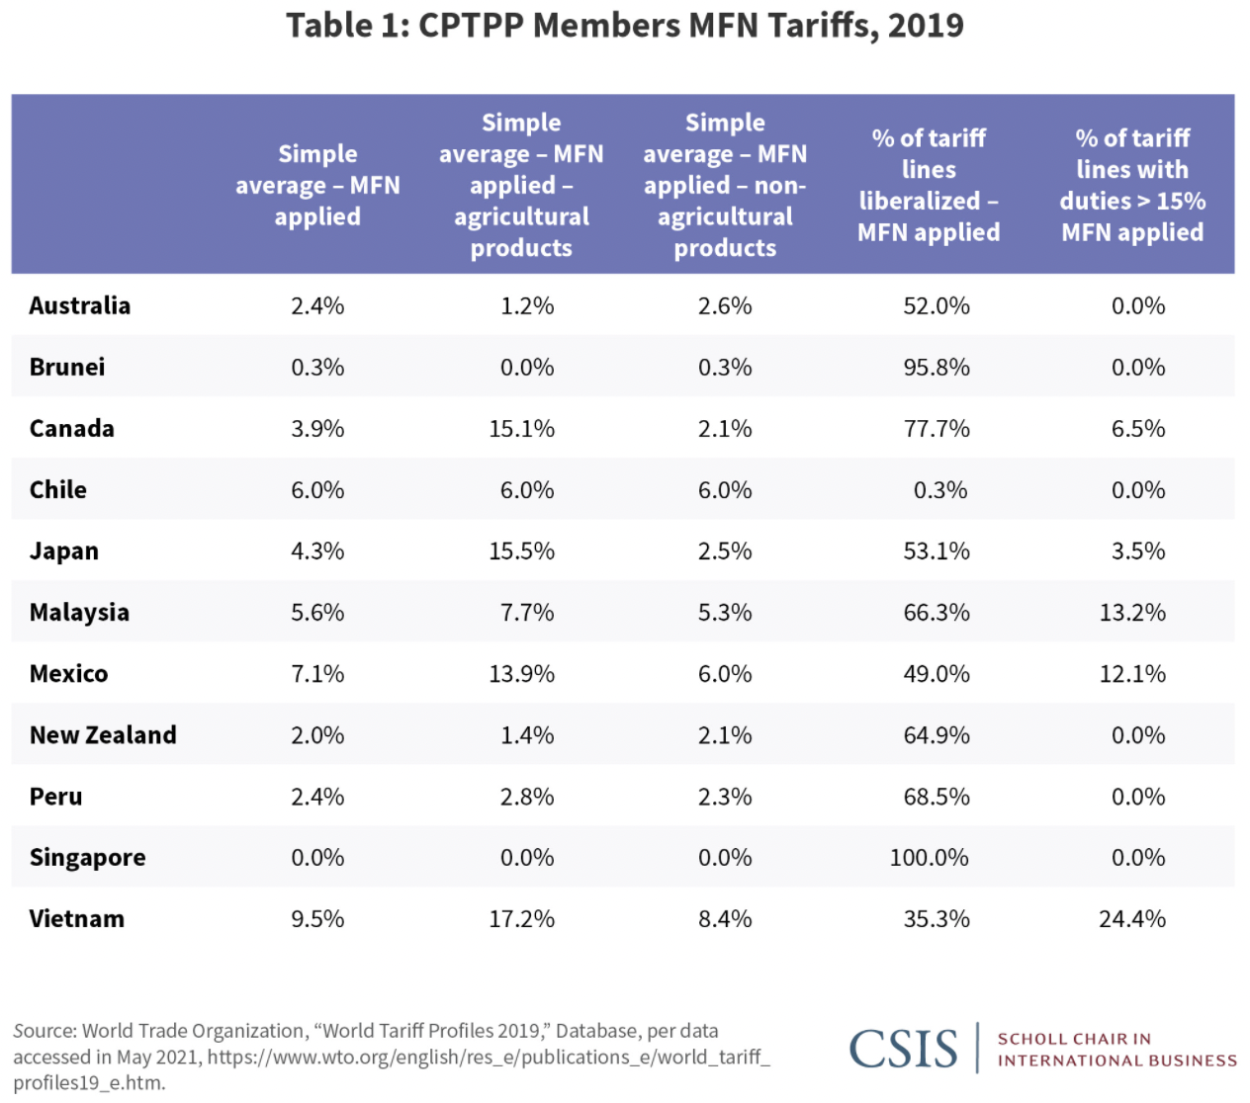
Notes:
“Two Years into CPTPP”, CSIS, August 9, 2021
https://www.csis.org/analysis/two-years-cptpp

Slide 55
Pause for Discussion

Slide 56
  Questions on Bird, “…Japan’s Beef With American Farmers”
Why are US beef exporters at a disadvantage selling to Japan?
If beef exports by US or others to Japan surge in the future, will Japan levy a higher tariff?
Why is this author hoping that the US will join CPTPP?

Slide 57
  Questions on Donnan, “Biden’s Road Back to TPP”
If this is about the US and TPP, why does it start with China and RCEP?
What does this suggest to make rejoining TPP more palatable politically?

Slide 58
Other FTA News
UK-US
  Brexit was motivated, in small part, by UK wanting freedom to have FTA with US, which it could not do as part of EU customs union
  US under Biden is not pursuing this
  UK government still wants it, but population is concerned about US food standards
    Chlorinated chicken

Slide 59
Pause for Discussion

Slide 60
  Questions on Segal,
  “ ‘Chlorinated’ US Chickens…”
Why are chickens a sticking point in the negotiation of a trade agreement between the UK and the US?
Why is this said to be a deeper issue than just chicken?
What is the “precautionary principle” and how is it relevant here?
How much of US chicken is actually chlorinated?

Slide 61
Other FTA News
Africa: AfCFTA
  “African Continental Free Trade Area”
  Founded 2018, in effect since Jan 1, 2021
  Includes 54 of the 55 African Union countries

Slide 62
Pause for Discussion

Slide 63
  Questions on Pilling,
  “African countries not ready …”
How many had ratified it as of this writing?
In what ways are the countries not ready?
What is the main purpose of AfCFTA?
What is the relevance of “economies of scale”?

Slide 64
Other FTA News
EU and other
  Switzerland:
    Not EU member but has many agreements
    Frictions may undermine these
  India: Discussion of FTA has been renewed
  Mercosur
    EU-Mercosur FTA was signed in 2019
    Still not ratified, and may never be

Slide 65
Pause for Discussion

Slide 66
  Questions on FT,
  “Switzerland’s slow-motion Swexit”
What, apparently, is “Swexit”? Is it Switzerland leaving the European Union?
What benefits does Switzerland enjoy with respect to the EU?
Who wanted these negotiations for a “framework agreement” and why?
Was it the Swiss government that ended this by pulling out of the negotiations?

Slide 67
  Questions on Fleming & Brunsden,
  “EU and India agree to relaunch …”
Have the EU and India had talks like these before?
What motivates them to talk now?
What are some of the contentious issues between them?

Slide 68
  Questions on Brunsden & Fleming,
  “… EU ‘credibility’ on the line …”
What is holding it up the EU-Mercosur FTA?
Does the agreement remove all of Mercosur’s tariffs on EU exports?
How are views divided among EU countries?
Why is re-opening the agreement said to be a bad idea? What is the alternative?

Slide 69
Other FTA News
UK and other
  First job after Brexit was to get new FTAs with EU FTA partners
  Now free to do FTAs with new countries
    Australia (as of Jun 16, 2021)
    New Zealand (as of Oct 20, 2021)
  Has also applied to join the CPTPP

Slide 70
Pause for Discussion

Slide 71
  Questions on Economist,
  “Britain successfully rolled over”
How many trade deals had the UK completed by the date of this article (January 20, 2021)?
Why were these deals easier to reach than future ones will be?

Slide 72
  Questions on Nelson,
  “Britain … Deal With Australia ”
How long did these negotiations take?
Will this eliminate all tariffs? When?
What will the UK be able to export more freely to Australia?
Why is this a “gateway”?

Slide 73
  Questions on Parker & Williams,
  “UK applies to join …”
What is the main benefit the UK Prime Minister Johnson seems to be hoping for by joining the CPTPP?
Is he likely to get this benefit?
Why are the economic benefits of UK joining CPTPP so small?

Slide 74
Other FTA News
US and other
  Negotiating with Taiwan
    Earlier negotiations collapsed
    Now restarting
  Signed a “Limited Trade Deal” with Brazil
    Note that Brazil is part of Mercosur, so not free to do FTA with US

Slide 75
Pause for Discussion

Slide 76
  Questions on Zumbrun & Deng,
  “U.S., Taiwan Revive Trade Talks”
These talks are being restarted. What had been a “sticking point” for such negotiations previously?
The countries pledged to “keep supply chains free of forced labor”? Why?
Do they expect an agreement as comprehensive as the USMCA?

Slide 77
  Questions on Swanson,
  “U.S. to Sign … Deal With Brazil”
Why was Trump negotiating such “mini” trade deals, and with whom has he succeeded?
Why could it be agreed and finalized so quickly?
What does this say the deal will do?
What does this do to tariffs?

Slide 78
Other FTA News
Other
  Uruguay is seeking FTAs with countries outside Mercosur

Slide 79
Pause for Discussion

Slide 80
  Questions on Mander,
  “Uruguay roils Mercosur bloc …”
What countries are part of Mercosur, and what kind of trade agreement is it?
Why does Uruguay want to do separate trade deals with outside countries?
Is it possible for a member of Mercosur to agree on tariff cuts with outside countries?
Does Mercosur as a group have any trade agreements with outside countries?

