Slide 1
Class 14 Why Countries Restrict Trade by Alan V. Deardorff University of Michigan 2021
PubPol/Econ 541

Slide 2
Announcements
Would any of you prefer to have quizzes available starting on Tuesdays? (But still due Friday night)
Note that Paper 2 is due Nov 12. Confer with your team soon and look at the assignment, so that you can ask any questions.

Slide 3
Announcements
I may have to cancel class on Tuesday Nov 30. If so:
Dumping will be covered Dec 2, 7
Subsidies Dec 9
No quiz Dec 2-3
Final quiz Dec 9-10 on both dumping and subsidies

Slide 4
Outline
Multiple reasons
Second best use of tariffs
Political economy
Why are trade barriers so low?
Recent uses of protection

Slide 5
Pause for Discussion

Slide 6
Questions on KOM
What benefits from free trade are not captured in the partial equilibrium model?
The textbook mentions only two arguments against free trade: terms of trade and market failure. Can you think of others?

Slide 7
Outline
Multiple reasons
Second best use of tariffs
Political economy
Why are trade barriers so low?
Recent uses of protection

Slide 8
Multiple Reasons
See my Glossary:
Lists / Arguments for Protection
I list 26, and our examples later suggest more

Slide 9
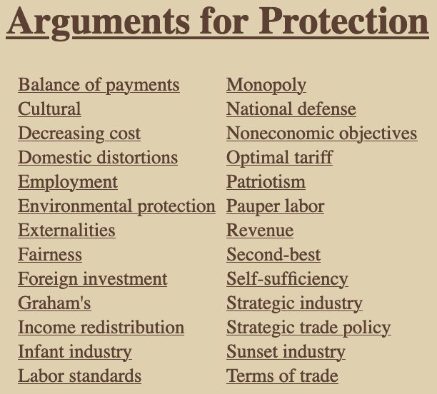

Slide 10
Multiple Reasons
Details on just a few
Cultural: Sustain a distinctive culture that would be undermined by imports
Foreign investment: Use tariff to induce foreign companies to invest instead of export
Infant industry: Let new industry “learn by doing” behind tariff wall
Patriotism: Support our own producers

Slide 11
Pause for Discussion

Slide 12
Questions (not asked before)
Which of these seem to have motivated Trump’s tariffs?
Which look like they may be legal under GATT/WTO?

Slide 13
Outline
Multiple reasons
Second best use of tariffs
Political economy
Why are trade barriers so low?
Recent uses of protection

Slide 14
Second best use of tariffs
First, why do economists expect undistorted markets to do well?
To the extent that
Supply curves measure marginal cost (MC), and
Demand curves measure marginal benefit (MB),
Then market price equates these
MC=MB is the recipe for maximizing benefit net of cost
But what if the curves don’t measure these?
Then we say there are “distortions” and market price is not optimal.
The harm done by a tariff is an example of this.

Slide 15
Second best use of tariffs
Our model says tariffs hurt if all else is perfect. What if there are
Market failures?
Distortions?
Externalities?
Imperfect competition?
Etc.

Slide 16
Second best use of tariffs
Answer
A tariff can offset some distortions and therefore may raise welfare
But there is always another policy that will do better
Reason: A tariff creates two distortions (see our triangles of dead-weight loss)
One may offset a distortion, but the other makes things worse
Hence tariff is “second best”

Slide 17
Second best use of tariffs
Example
Suppose production yields a “positive externality”
Production provides a benefit not captured (or charged for) by producers
A tariff stimulates production and so generates more of the externality – That’s good!
For example, European farms make countryside attractive to tourists

Slide 18
Small country with positive externality
P
S
= Marginal cost of firms
= Marginal private cost
P_{aut}
MC–E = MSC
This is the marginal social cost of the good.
That is, the marginal cost to society, not just to the firm.
P₀=P_{W}
D
E
S₀
D₀
Q
Positive Externality, E

Slide 19
Small country tariff with positive externality
P
Welfare effects of a tariff, if set equal to E, starting from free trade:
Suppliers gain +a
Demanders lose −(a+b+c+d)
Government gains +c
Externality benefit +(b+e)
Country gain or loss +e −d
S
P_{aut}
MC–E
P₁=P_{W}+t
t=E
a
c
b
d
P₀=P_{W}
e
D
E
S₀
S₁
D₁
D₀
Q
Specific Tariff t=E

Slide 20
Second best use of tariffs
Result
Tariff raises welfare if e > d
That is, if
the benefit of increased externality exceeds
the demand-distortion loss of the tariff

Slide 21
Second best use of tariffs
But there’s a better policy: subsidize supply:
That leaves demanders facing world price
Lets suppliers be paid P_{W}+E
Causes only one distortion, of supply, and
That is beneficial because
It corrects the distortion of the externality
Without also distorting demand

Slide 22
Small country production subsidy with positive externality
P
Welfare effects of a subsidy, if set equal to E, starting from free trade
Suppliers gain +a
Demanders lose 0
Government loses –(a+b)
Externality benefit +(b+e)
Country gains +e
S
P_{aut}
MC–E
s=E
a
c
b
d
P₀=P_{W}
e
D
E
But note that:
Tariff creates revenue
Subsidy costs the gov’t
S₀
S₁
D₁
D₀
Q
Production subsidy s=E

Slide 23
Second best use of tariffs
In general, distortions (market failures) distort only supply or demand
A tariff can only correct one by hurting the other
A more direct policy – tax or subsidy on distorted behavior – will be “first best”
Except for budget implications

Slide 24
Pause for Discussion

Slide 25
Questions on KOM
How does the theory of the second best provide reasons that tariffs may be beneficial?
How does it also provide reasons why tariffs are not the best policy in such cases?

Slide 26
Outline
Multiple reasons
Second best use of tariffs
Political economy
Why are trade barriers so low?
Recent uses of protection

Slide 27
Political Economy
Explain policies based on features of the political process
Allow for
Voting
Lobbying
Other forms of political pressure by interest groups
But also allow policymakers to care about economic well-being as in our models

Slide 28
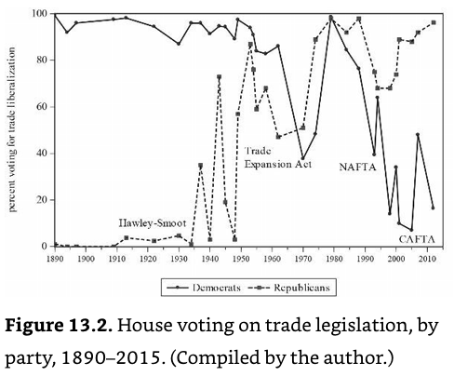
Source: Irwin, p. 788
Notes:
Irwin, Doug, Clashing Over Commerce

Slide 29
Pause for Discussion

Slide 30
Questions on KOM
What is the “median voter theory,” and why does it seem not to explain protection?

Slide 31
Questions on Baldwin & Magee “Is Trade Policy for Sale?”
By what mechanisms do theorists suggest that political contributions result in votes for and against trade liberalization?
Do businesses and labor groups in the US tend to contribute in favor of protection or free trade?
What were the three Congressional votes studied by Baldwin and Magee? Which side – labor or business – had the greater effect on the voting?

Slide 32
Questions on Baldwin & Magee “Is Trade Policy for Sale?”
What do they estimate as the “price” of one congressional vote against NAFTA or the WTO?
Were campaign contributions the only thing that mattered for congressional votes on these trade issues?

Slide 33
Outline
Multiple reasons
Second best use of tariffs
Political economy
Why are trade barriers so low?
Recent uses of protection

Slide 34
Why Aren’t Tariffs Higher?
Magee lists 6 possible reasons why tariffs are not higher:
Politicians are not responsive to lobbying efforts
Welfare costs of tariffs are higher than traditionally measured
The GATT was successful in reducing trade barriers
Free riding by firms hinders lobby organization
Users of imported goods lobby against tariffs
Protection is given, but by non-tariff barriers, which are high
Magee’s view of the evidence
#1, 5 not important
#2, 3, 4 play a small role
#6 is most important: actual protection is much higher than tariffs
✗
✓
✓
✓
✗
✓✓✓

Slide 35
Pause for Discussion

Slide 36
Questions on Magee “Why Are Trade Barriers So Low?”
Does the main “political economy” model for explaining tariffs say that politicians care only about campaign contributions?
Why does Magee give only partial credit to GATT negotiations in explaining the fall of tariffs since the 1930s?

Slide 37
Questions on Magee “Why Are Trade Barriers So Low?”
How do the following terms or concepts figure in explanations for why trade barriers are low:
free riding;
peace;
imported inputs;
non-tariff barriers?

Slide 38
Outline
Multiple reasons
Second best use of tariffs
Political economy
Why are trade barriers so low?
Recent uses of protection

Slide 39
Recent uses of protection
Some examples from earlier (not in this year’s readings):
India considers tariffs on China after border conflict
Pakistan to ”halt trade with India” after actions on Kashmir
Japan uses export controls on S Korea after Korea seeks compensation for forced labor
US bars arms exports to Hong Kong after China reduces Hong Kong independence

Slide 40
Recent uses of protection
More from earlier:
China puts tariffs on Australian barley after Australia seeks inquiry on origins of coronavirus
US may stop cocoa imports from Ivory Coast for using child labor
China blocked meat imports from Canada after Canada arrested daughter of Huawei founder
China had a ban (and has now lifted it) on US chicken due to outbreak of avian flu.

Slide 41
Recent uses of protection
Message from much of this:
Countries often restrict trade to hurt other countries that they are angry at.

Slide 42
Pause for Discussion

Slide 43
Questions on Krugman “Two Cheers for Carbon Tariffs”
Why would Krugman favor a carbon tariff even if it were as economically harmful as a tariff usually is?
Why does he discuss the economics of the value added tax?
A carbon tariff set equal to a domestic carbon tax makes sense, but what if the domestic policy is regulation, not tax?
Why does he give only two cheers, not the usual three?

