Slide 1
Class 6 International Transactions and the Trade Balance by Alan V. Deardorff University of Michigan 2021
PubPol/Econ 541

Slide 2
Announcements
Papers
Group assignments in Canvas: Files / Paper Assignments
Assignments are also there, and on website under Paper Assignments
First paper is due Thu, Oct 7, 8:30 AM on Canvas
These groups are set in Canvas; turn in once per group
Questions
At a request from a student last year, I’ve now put answers to the questions on the readings in Canvas. I doafter the class where they may have been used.

Slide 3
Quiz Scores
 | Q1 | Q2
Mean | 8.97 | 7.22
Median | 9 | 7.75
Max | 10 | 9.5
Min | 6.5 | 4
S.D. | 1.09 | 1.75

Slide 4
Outline
A Bit of Macroeconomics
The Balance of Payments Accounts
Surpluses and Deficits
They Add to Zero
What a Deficit Means
The Assumption of Balanced Trade

Slide 5
A Bit of Macroeconomics
From KOM:
Y = C + I + G + (X – M)
Where
Y = GDP = Gross Domestic Product
C = Consumption
I = Investment
G = Government purchases
X = Exports
M = Imports

Slide 6
A Bit of Macroeconomics
GDP measures
The economy’s output of goods and services
Essentially the same as National Income
GDP is positively related to, but not the same as
Employment
Welfare
Happiness
And there are problems even with measuring output. E.g., it misses all that we produce in our homes

Slide 7
Pause for Discussion

Slide 8
Questions on KOM
What’s the difference between GNP and GDP?
Why does GNP (or GDP) only include consumption of final goods, not firms’ purchases of intermediate inputs?
Why are imports subtracted from C+I+G+X–M in calculating GDP? Is it because imports cause unemployment?

Slide 9
More Questions on KOM
What distinguishes credits and debits in the balance of payments?
What distinguishes the current account from the financial account?
For which categories of transactions did credits exceed debits for the United States in 2015 (the year reported in KOM)?
Trade in goods
Trade in services
Investment (i.e., “primary income”)
Transfer payments (i.e., “secondary income”)
Changes in asset holdings

Slide 10
The Balance of Payments Accounts
Recording International Transactions
Credits versus debits
Credits correspond to payments that would flow into the country
Exports
Borrowing from foreigners
Collection of interest and dividends from foreigners
Debits correspond to payments that would flow out of the country
Imports, etc.
This use of the words “credit” and “debit” is specific to the international accounts. It is NOT the same as their use in accounting or in other contexts.

Slide 11
The Balance of Payments Accounts
Recording International Transactions
Current versus Financial Accounts
Financial account is (only) changes in holding of assets by one country in another
Current account is everything else
Trade (both goods and services)
Income payments (wages, interest, & dividends)
Transfers (Gifts, remittances, and foreign aid)

Slide 12
The Balance of Payments Accounts
Accounts |  |  |  | Credits | Debits
 | Current Account
 |  | Exports |  | +
 |  |  | Goods
 |  |  | Services (including investment income rcvd)
 |  | Imports |  |  | –
 |  |  | Goods
 |  |  | Services (including investment income paid)
 |  | Transfers |  | + (in) | – (out)
 | Financial Account
 |  | Change in US assets held abroad |  |  | –
 |  | Change in foreign holdings of assets in US |  | +
Balance on Current Account: Credits minus Debits
Balance on Financial Account: Credits minus Debits

Slide 13
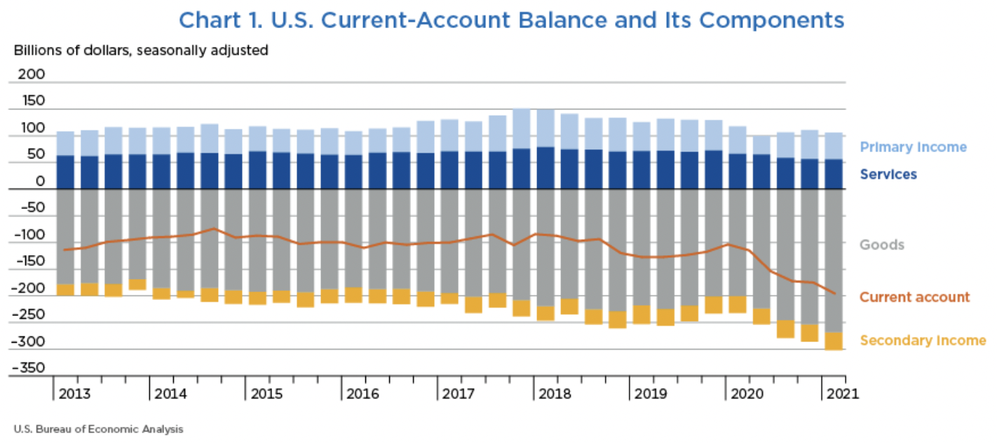
Notes:
Telles, Rudy, Jr., “U.S. International Transactions: First Quarter 2021,” Survey of Current Business, 101(7), July 2021.
https://apps.bea.gov/scb/2021/07-july/0721-quarterly-international-transactions.htm

Slide 14
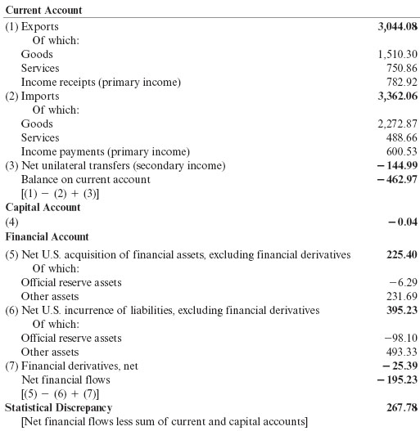
Table 13.2 U.S. Balance of Payments Accounts for 2015 (billions of dollars)
Source: U.S. Department of Commerce, Bureau of Economic Analysis, June 16, 2016, release. Totals may differ from sums because of rounding.

Slide 15
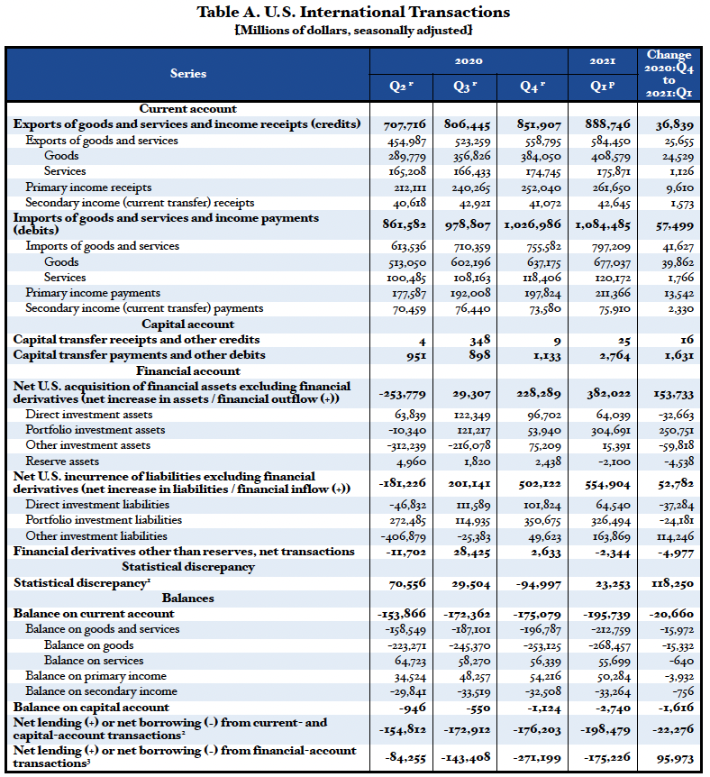
Note that Bal on CA is –153,866
= 707,716 – 861,582
These are all debits and therefore negative.
Ignore this.
It’s small.
These are also debits and therefore negative.
Really, errors and omissions
Notes:
Garber, Molly, “U.S. International Transactions: First Quarter 2020,” Survey of Current Business, 100(7), July 2020.
https://apps.bea.gov/scb/2020/07-july/pdf/0720-quarterly-international-transactions.pdf

Slide 16
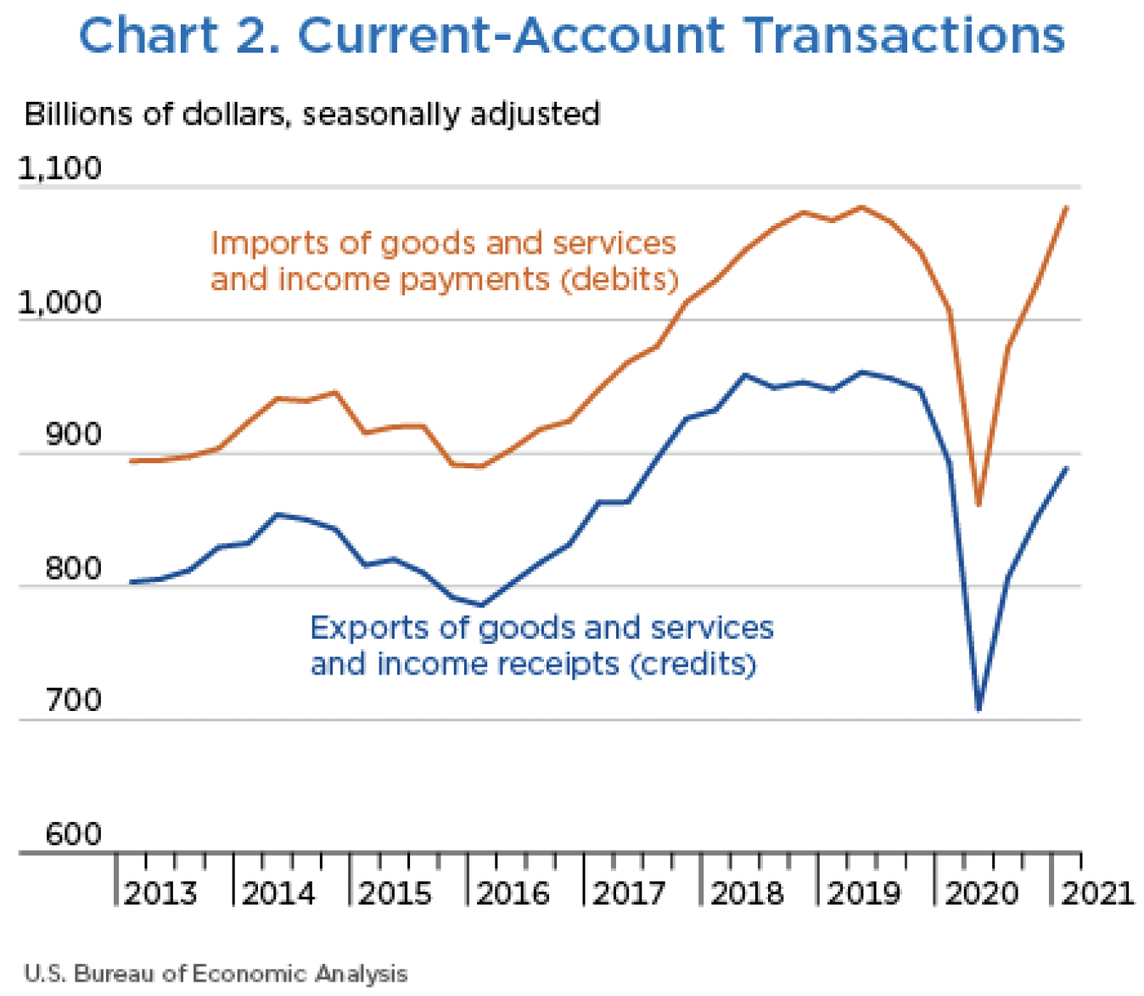
Trade War
Covid-19
Notes:
Telles, Rudy, Jr., “U.S. International Transactions: First Quarter 2021,” Survey of Current Business, 101(7), July 2021.
https://apps.bea.gov/scb/2021/07-july/0721-quarterly-international-transactions.htm

Slide 17
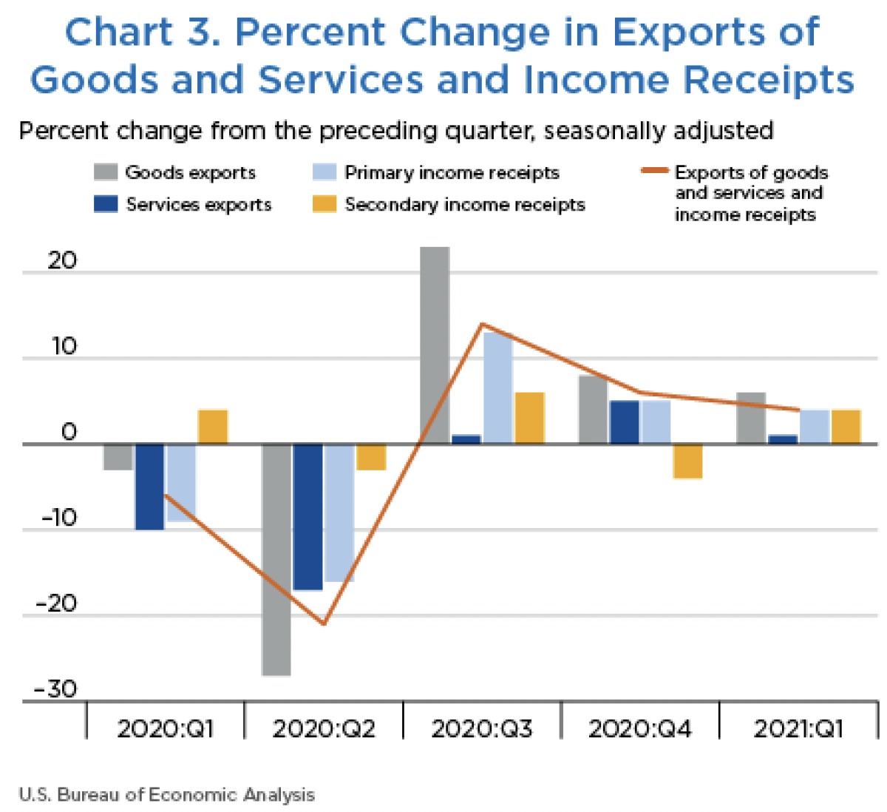
Notes:
Telles, Rudy, Jr., “U.S. International Transactions: First Quarter 2021,” Survey of Current Business, 101(7), July 2021.
https://apps.bea.gov/scb/2021/07-july/0721-quarterly-international-transactions.htm

Slide 18
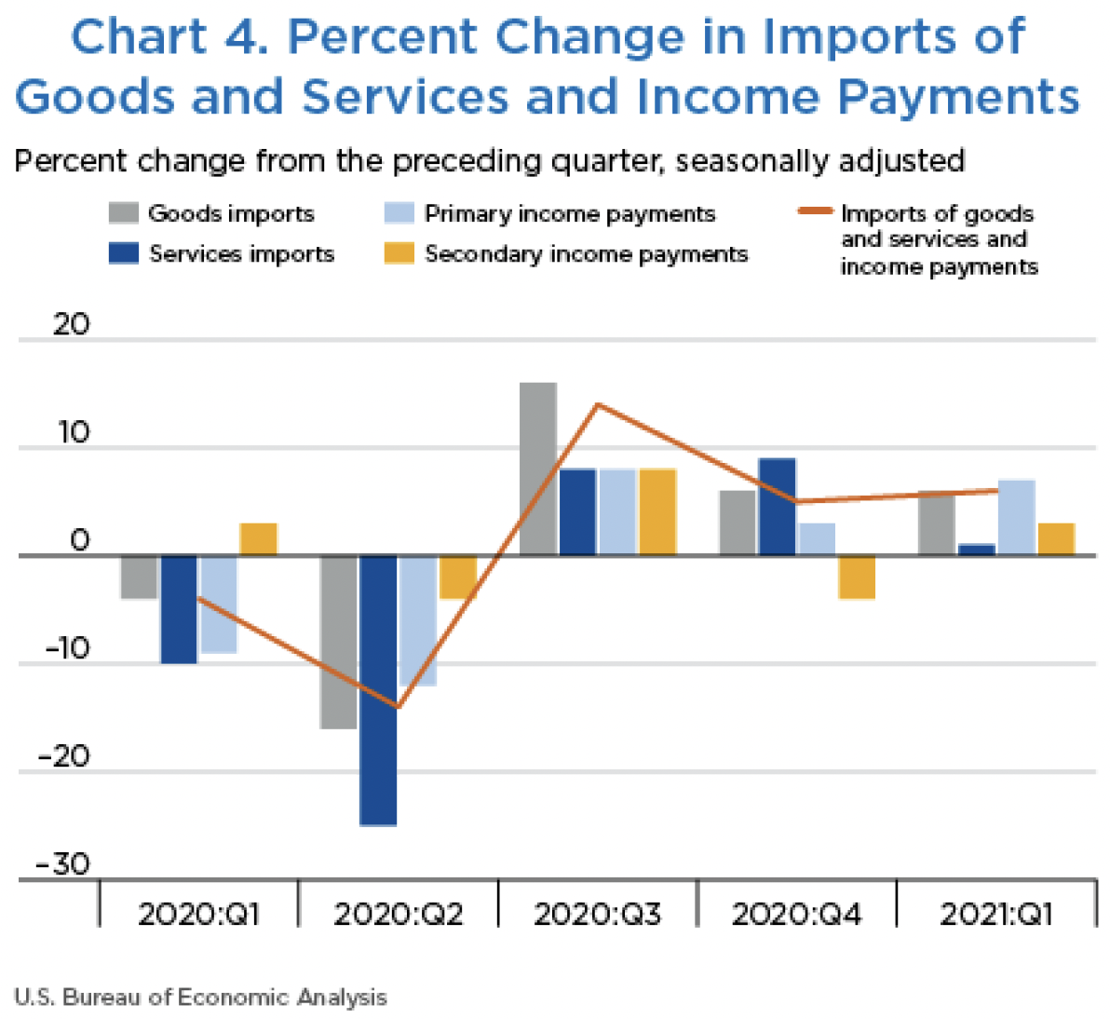
Notes:
Telles, Rudy, Jr., “U.S. International Transactions: First Quarter 2021,” Survey of Current Business, 101(7), July 2021.
https://apps.bea.gov/scb/2021/07-july/0721-quarterly-international-transactions.htm

Slide 19
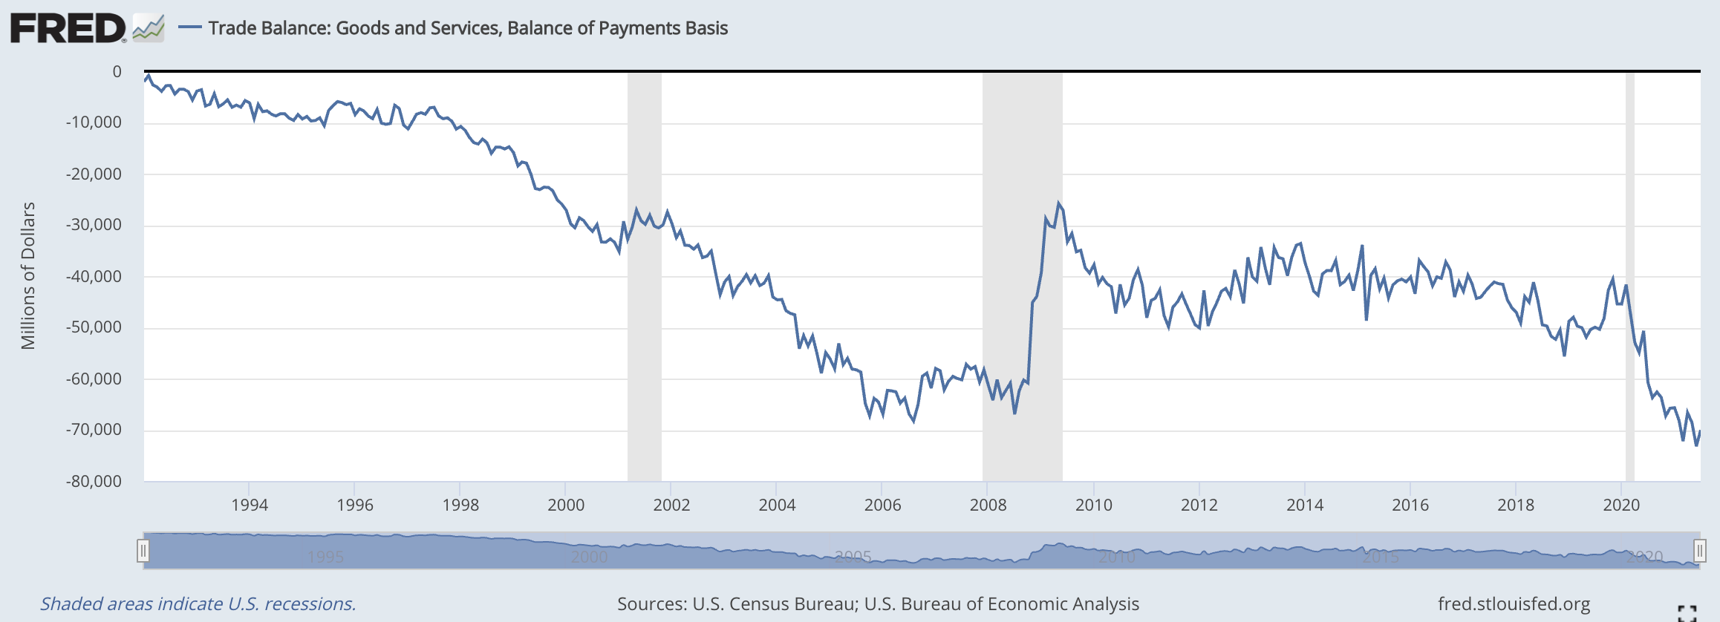
Note the zero. This whole thing is negative – a deficit!
Notes:
FRED,
https://fred.stlouisfed.org/series/BOPGSTB

Slide 20
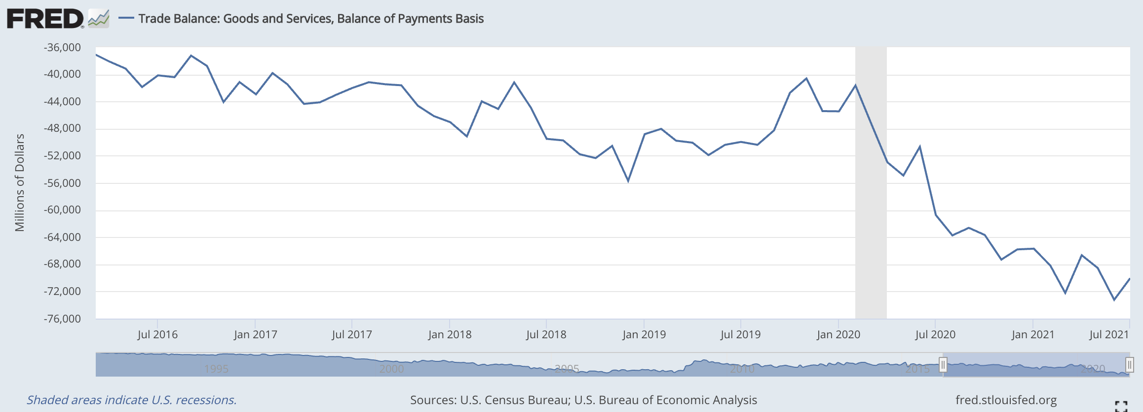
Deficit grew larger...
…then smaller…
…then much larger
Trump
Notes:
FRED,
https://fred.stlouisfed.org/series/BOPGSTB

Slide 21
The US Trade Deficit
Grew from about $2 billion in 1992 to almost $70 billion in 2006
Shrank in the recessions of 2001 & 2008, but not 2020
Grew for Trump’s first two years, then fell until 2020
Has grown to past the 2006 level in 2020

Slide 22
Pause for Discussion

Slide 23
Questions
What mostly happened to current account transactions in Q1 of 2021 compared to Q4 of 2020? (the most recent change in the BEA table, in its far-right column)
What happened to financial transactions?

Slide 24
Surpluses and Deficits
For any subset of transactions
“Surplus” is credits > debits
“Deficit” is debits > credits
Common “balances”:
Balance of Merchandise Trade (i.e., goods)
Balance on Goods and Services
Balance on Current Account
Balance on Financial Account
=Capital inflows minus capital outflows

Slide 25
They Add to Zero
If all transaction were captured perfectly, then all would add to zero
∑ credits = ∑ debits
Thus
Balance on Current Account
+
Balance on Financial Account
= 0
(If they don’t, there must be errors, hence “statistical discrepancy”)

Slide 26
They Add to Zero
Why?
Every actual transaction has two parts, and these cancel each other
Example: I buy a book for $10 from the UK
That’s a US debit 0f $10
If the seller keeps the $10 cash, it’s an increase in that foreigner’s holdings of US assets (the $10 bill), a US credit
They may do many other things with the $10, but each of them would result in either a $10 US credit or reversing a $10 US debit

Slide 27
They Add to Zero
Implication
A trade (or current account) deficit must be accompanied by
Financial account surplus
Thus net capital inflow
How does it happen?
Credits correspond to supply of foreign exchange
Debits correspond to demand for foreign exchange
So exchange-market equilibrium
Implies supply = demand
Implies credits = debits

Slide 28
What a Deficit Means
Recall (from macroeconomics) the definition of GDP
GDP = Y = C + I + G + (X – M)
(C + I + G) equals expenditure, E
(X–M) equals trade surplus
So:
X – M = Y – E
Trade surplus equals
Income minus expenditure

Slide 29
What a Deficit Means
Interpretations of a trade deficit
(as the US has had for decades)
We are spending more than our income
We are consuming (and investing in) more goods that we are producing
We are borrowing from (or selling assets to) foreigners

Slide 30
What a Deficit Means
Another Interpretation
With T = net taxes, then Y–T is “disposable income”
Rearrange: Y = C + I + G + (X – M)
Y – C – G – I = (X – M)
(Y – T – C) + (T – G) – I = (X – M)
Private savings + Government saving – I = (X – M)
Total Saving – Investment = (X – M)
Thus
X – M = S – I

Slide 31
What a Deficit Does Not Mean
That foreign trade barriers are hurting our exports
That other countries are engaged in unfair trade
That our firms are not competitive
That we are losing jobs to other countries
That we need to restrict trade
(But note that many disagree, including Trump and two of the optional readings: Scott and Mokhiber, and Buffet)

Slide 32
Pause for Discussion

Slide 33
Questions
Why must credits and debits exactly offset if measured accurately?
KOM defines a country’s current account surplus as its exports minus its imports. Why is this also said to equal “net foreign investment”?
What are, and what are not, the implications of a trade deficit? Jobs? Debt? Trade barriers? Competitiveness?

Slide 34
What a Deficit Means
Is a trade (or current account) deficit good or bad?
It depends

Slide 35
Pause for Discussion

Slide 36
Questions from Obstfeld
Is a country with a trade deficit losing from trade?
What determines a country’s bilateral deficits and surpluses?
Why does the fact that the US was at full employment matter for the discussion in Obstfeld?

Slide 37
What a Deficit Means
Many trade sceptics, such as Scott, associate trade deficits with lost jobs.
In other work (not assigned) Scott "measures” the lost jobs by comparing
The jobs producing US exports
to
The jobs the US would need to produce US imports here
By this measure, “jobs lost” are sometimes more than the unemployed

Slide 38
Questions from ~Scott
Which has risen most, the US trade deficit in goods or in manufacturing? Why is this important, according to Scott?
What does Scott blame for the high and rising US trade deficits?
What does Scott mean by “tariff circumvention”?

Slide 39
Balanced Trade
In this course we will assume either
Trade is balanced, or
The trade imbalance does not change
Why?
Because the trade imbalance depends
On macroeconomic factors, such as monetary and fiscal policies
Not on the trade policies will are studying

