Slide 1
Class 10 Policies and Institutions: National, Other by Alan V. Deardorff University of Michigan 2020
PubPol/Econ 541

Slide 2
Announcement
Quizzes
Results:
Note: We do have a quiz this week, like all weeks.
 | Q1 | Q2 | Q3 | Q4
Mean | 8.74 | 7.10 | 6.70 | 8.40
Median | 9 | 7 | 6.5 | 8.5
Max | 10 | 10 | 10 | 10
Min | 5.5 | 2 | 3 | 5
S.D. | 1.20 | 1.75 | 2.02 | 1.47

Slide 3
Outline
European Union
Japan
China
Other

Slide 4
European Union
History
1957 Treaty of Rome created European Economics Community (EEC) as a ”common market”
Eliminated barriers to movement of goods, services, capital, and labor
Prohibited policies to inhibit market competition
Adopted Common Agricultural Policy (CAP)
Adopted common external trade policy
(Hence a Customs Union)
Original Six countries: Belgium, France, Germany, Italy, Luxembourg, Netherlands
Added 6 more: 1973: Denmark, Ireland, UK; 1981: Greece; 1986: Portugal, Spain (and E. Germany 1990)
Notes:
Gabel, Matthew J., “European Union,” Encyclopedia Britanica, 2020.
https://www.britannica.com/topic/European-Union/The-Maastricht-Treaty

Slide 5
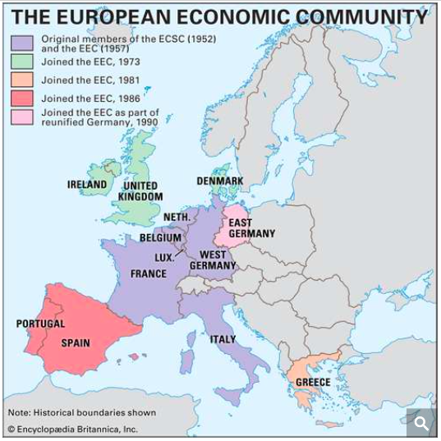
As of 1990
Notes:
Gabel, Matthew J., “European Union,” Encyclopedia Britanica, 2020.
https://www.britannica.com/topic/European-Union/The-Maastricht-Treaty

Slide 6
European Union
History
Europe 1992: Treaty on European Union, signed Feb 7, 1992, in Maastricht, Netherlands
“Four Freedoms” became reality: free movement of goods, services, people, and money
Set rules for single currency
1995: Added Austria, Finland, Sweden
2004: Added 10 more: 8 from former Soviet Bloc, plus Malta an Cyprus
2007: Added Bulgaria and Romania
2013: Added Croatia
2020: Subtracted United Kingdom
Notes:
Gabel, Matthew J., “European Union,” Encyclopedia Britanica, 2020.
https://www.britannica.com/topic/European-Union/The-Maastricht-Treaty

Slide 7
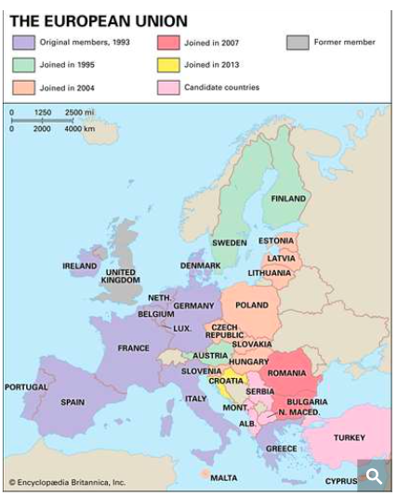
As of 2020
Notes:
Gabel, Matthew J., “European Union,” Encyclopedia Britanica, 2020.
https://www.britannica.com/topic/European-Union/The-Maastricht-Treaty

Slide 8
European Union
The EU today
27 Countries
Note who is not in
UK
Switzerland
Norway
Iceland
Official candidates: Turkey and several parts of former Yugoslavia
Potential candidates: Other parts of former Yugoslavia
Notes:
Gabel, Matthew J., “European Union,” Encyclopedia Britanica, 2020.
https://www.britannica.com/topic/European-Union/The-Maastricht-Treaty

Slide 9
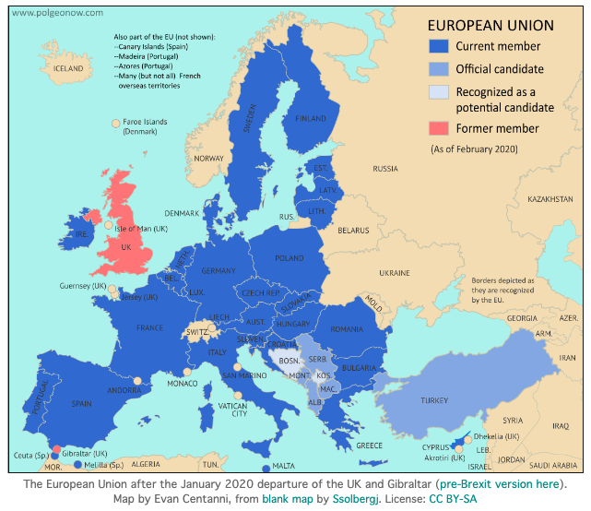
Notes:
https://www.polgeonow.com/2016/06/map-which-countries-are-in-the-eu.html

Slide 10
European Union
Two main institutions
European Council
Heads of national governments, expressing their national interests
Presidency rotates among member states every six months
Not a person, but a country. Currently Germany.
Though a person has title President, and runs meetings
European Commission
Represents the whole of the EU, not the individual national interests
Drafts legislation and handles day-to-day running of EU
Current President is Ursula von der Leyen
Notes:
Gabel, Matthew J., “European Union,” Encyclopedia Britanica, 2020.
https://www.britannica.com/topic/European-Union/The-Maastricht-Treaty

Slide 11
European Union
Other institutions
Council of the European Union
Not the same as European Council
National ministries, a Council for each area
European Parliament
Court of Justice
European Central Bank
Court of Auditors
Notes:
Gabel, Matthew J., “European Union,” Encyclopedia Britanica, 2020.
https://www.britannica.com/topic/European-Union/The-Maastricht-Treaty

Slide 12
European Union
How it functions
Commission “proposes”
Council “adopts”: seeks unanimity, but if not, it votes
Proportional to population
But with small countries over-represented
Notes:
Gabel, Matthew J., “European Union,” Encyclopedia Britanica, 2020.
https://www.britannica.com/topic/European-Union/The-Maastricht-Treaty

Slide 13
European Union
Features relevant for trade
Common external tariff
Countries therefore can’t join FTAs on their own
Value-added tax (VAT)
Rebated on exports
Common agricultural policy (CAP)
System of subsidies and support programs for agriculture
Variable levies
Numerous (42) FTAs with other countries, including with former colonies
Banana War: US-EU dispute over EU preference for former colonies’ banana. US won case at WTO
State aid for firms is prohibited (unlike US)
Notes:
Gabel, Matthew J., “European Union,” Encyclopedia Britanica, 2020.
https://www.britannica.com/topic/European-Union/The-Maastricht-Treaty

Slide 14
Pause for Discussion

Slide 15
Questions
What are the six entities that play constitutional roles in the European Community?
What does the “single market” entail?
What are the three entities through which EU citizens and members states are represented?
Why and when did it change its name from EEC to EU?

Slide 16
Questions
What sorts of policy are the “exclusive power of the EU,” meaning that they cannot be done by member states individually?
Which part of the EU negotiates trade agreements with other countries? Is that entity constrained in any way as to with whom it can negotiate and what its objectives should be?
Once a trade agreement is negotiated, who approves it?

Slide 17
Questions on Economist, “The Trade War Within”
To what extent are EU countries largely free-traders?
Why was the EU considering taking some developing countries off the list for GSP treatment? Can you find out whether it did in fact do this for Brazil, Russia, Saudi Arabia, South Africa?
What are the 3 levels of EU GSP and what do they mean?
What is meant by the need for “reciprocity”?

Slide 18
Questions on Brunsden “EU revokes…Cambodia”
What is EBA?
Why did the EU raise tariffs on Cambodia?
How much trade is now subject to tariffs, and at what levels?
What is the EU’s worry about doing this?
What is the relevance of the EU’s FTA with Vietnam?

Slide 19
Outline
European Union
Japan
China
Other

Slide 20
Japan
Portions of government dealing with trade
METI = Ministry of Economy, Trade, and Industry
Previously MITI, Ministry of International Trade and Industry
MAFF = Ministry of Agriculture, Forestry, and Fisheries
Handles all agriculture trade (with high tariffs)
MOFA = Ministry of Foreign Affairs

Slide 21
Pause for Discussion

Slide 22
Questions
Why is Japan a less complicated country than the US and EU to understand its interaction with international trade law and negotiations?
What is METI’s “general rule”?
What are some of the exceptions to free trade that they base their trade controls on?
What are some of the things that METI does?

Slide 23
Questions on Japan’s “Trade Policy Review 2020”
What seem to be the biggest changes in trade policy during the 2017-20 period reported here?
Which sectors are the largest in Japan?
How large are Japan’s tariffs?
Does Japan use tariff-rate quotas?
What change has Japan made that may be most criticized by others?

Slide 24
Outline
European Union
Japan
China
Other

Slide 25
China
Part of government dealing with trade
MOFCOM = Ministry of Commerce
Mission: To draft the laws and regulations governing foreign trade

Slide 26
Pause for Discussion

Slide 27
Questions on China’s “Trade Policy Review 2018”
How had (as of this 2018 report) China’s GDP growth rate changed? How had its current account surplus changed?
Did the government intend to eliminate State Owned Enterprises?
How, if at all, does China manage inward foreign direct investment?
Does China require technology transfer by foreign investors?

Slide 28
Questions on “Trade Policy Review 2018” continued
How high are China’s tariffs?
What is China’s policy regarding trade in garbage (solid waste)?
What other forms of trade policy does China have besides tariffs?

Slide 29
Outline
European Union
Japan
China
Other

Slide 30
Other
Australia
Minister for Trade, Tourism and Investment
Senator the Hon Simon Birmingham since 2018
Anti-Dumping Commission
Handles ADD & CVD

Slide 31
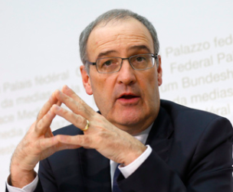
Other
Switzerland
Federal Department of Economic Affairs, Education and Research
Headed by Guy Parmelin since 2019
Does not use ADD, CVD, safeguards, or quotas
Has many FTAs, including with EU

Slide 32
Other
Trade Ministers:
Afghanistan: Ministry of Commerce and Industry, Anwar-Ul-Haq Ahady since 2010
Argentina: Ministry of Productive Development, Matías Kulfas since 10 Dec 2019
Indonesia: Ministry of Trade, Agus Suparmanto
Dominican Republic:
Ministry of Foreign Affairs, Roberto Álvarez Gil
Ministry of Economy, Planning, and Development, Miguel Ceara Hatton

