Slide 1
Class 9 Policies and Institutions: National, United States by Alan V. Deardorff University of Michigan 2020
PubPol/Econ 541

Slide 2
Announcements
More on Papers
Linear supply and demand are fine
Results in table, with just discussion in text and conclusion
Agriculture, alternative crops: just say a little
Ratio of output to employment: use data on production and employment
Always: be careful and explicit of units of measurement

Slide 3
Pause for Discussion

Slide 4
Questions
Should (according to Jackson), and do, international institutions like the WTO interfere with the sovereignty of its member states?

Slide 5
Outline
Parts of the US Government that Handle Trade
Main Features of US Trade Policies
Tariffs, Quotas, VERs
Escape Clause
Unfair Trade Laws
Section 301
Trade Adjustment Assistance
Fast Track
GSP
US Trade Policy under Trump

Slide 6
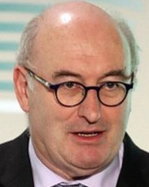
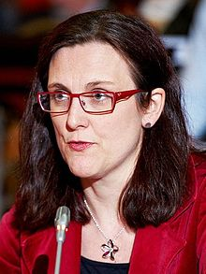
US Trade Institutions
US does NOT have a “ministry” or “department” of international trade
Most other countries do; e.g. …
Canada: Department of International Trade
Japan: Ministry of Economy, Trade and Industry (METI) (Used to be MITI)
EU: Directorate General Trade
Trade Commissioner:
Phil Hogan
until Aug 26, 2020
Now Valdis Dombrovskis

Slide 7
US Trade Institutions
In US, responsibility for trade issues is spread over many entities
Congress
USTR
Commerce Department
US International Trade Commission
Export-Import Bank
and several others
Obama said several years ago that he sought to consolidate many of these in a single agency
He never did

Slide 8
US Trade Institutions
USTR = United States Trade Representative
Handles negotiations on trade issues with
Other governments
WTO
Drafts trade legislation for Congress
Does NOT set or implement trade policies

Slide 9
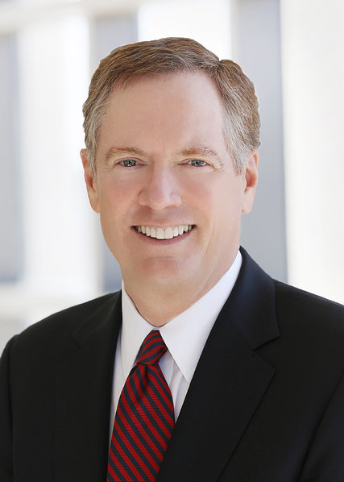
US Trade Institutions
Trump’s USTR is Robert Lighthizer
Cabinet-level official of US government

Slide 10
US Trade Institutions
Congress
Sets tariffs and other trade policies (thus approves trade agreements)
Two committees are responsible
House: Ways and Means
Senate: Finance
Why these?
Because trade policy was originally about collecting revenue

Slide 11
US Trade Institutions
Administrative Agencies
ITA = International Trade Administration
Part of Department of Commerce
Main Function: Determines “fairness” in unfair trade cases
Are imports “dumped”?
Are they “subsidized”?
Orientation of ITA: very much favors US businesses

Slide 12
US Trade Institutions
Administrative Agencies
ITC = USITC = United States International Trade Commission
Independent agency
Commissioners (6) are nominated by President and confirmed by Senate
After that they are on their own
Main Function: To determine “injury” in cases of
Anti-Dumping
Countervailing duties (subsidies)
Safeguards (a.k.a., Escape Clause)

Slide 13
US Trade Institutions
Export-Import Bank
Official export credit agency of the US
Assists foreign purchasers of US exports
With loans
Loan guarantees
Etc.
Was target of Tea Party in 2015 as “crony capitalism”
Was prevented July, 2015 to May 2019 from funding projects of over $10 million

Slide 14
Pause for Discussion

Slide 15
Questions
To what part of the US government does the US constitution assign responsibility for commercial policy?
What does this imply for the procedures by which the US enters into trade agreements?
Can the US federal government enter into international agreements that constrain the US states?
Does the same apply to other negotiating units’ (e.g., Canada, the EU) abilities to commit their sub-units?
What units of the US government have responsibilities for aspects of US trade policies?

Slide 16
Features of US Trade Policies
Tariffs
Column 2: Tariffs left over from pre-1934
They apply only to N. Korea and Cuba
Column 1: Tariffs applied to almost all countries
MFN rates for WTO members and others
Negotiated mostly zero rates for FTA members

Slide 18
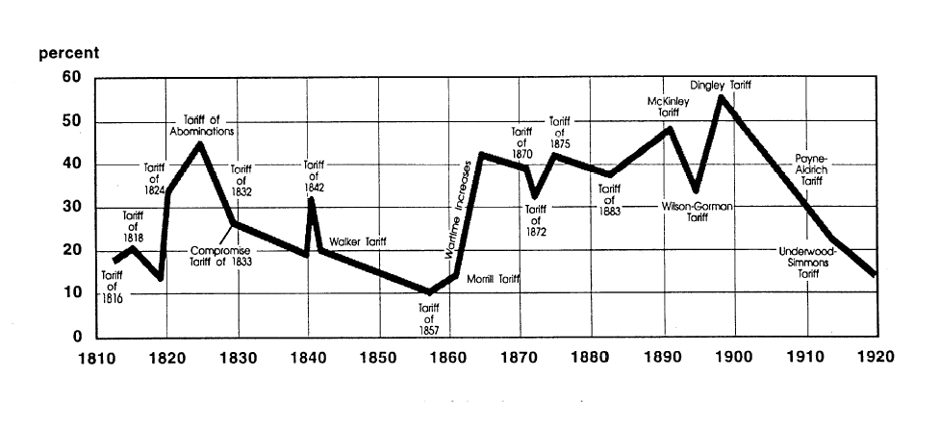
US tariff history: 1810-1920
Today
landandfreedoml.org
Notes:
Source: landandfreedom.org

Slide 19
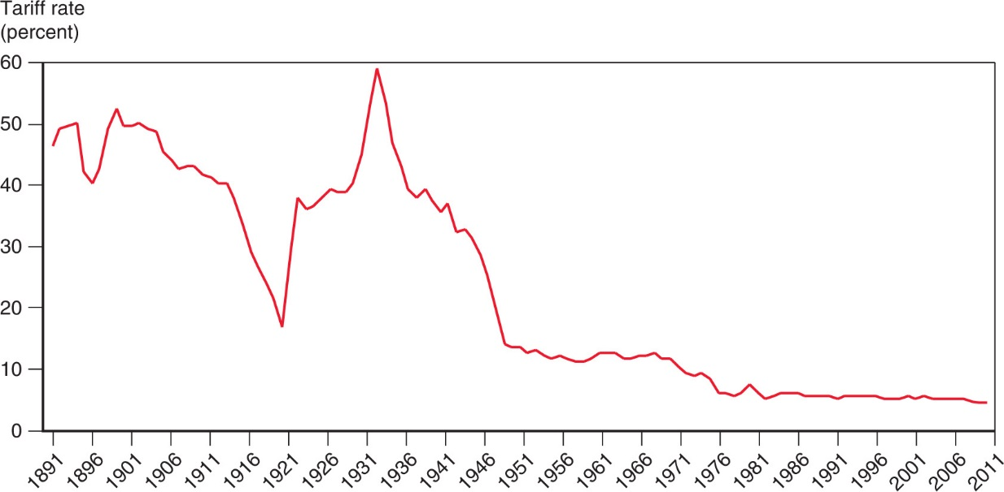
Figure 10.5 The U.S. Tariff Rate
Smoot-Hawley Tariff
1934 Reciprocal Trade Agreements Act
1947 GATT
1995 WTO
After rising sharply at the beginning of the 1930s, the average tariff rate of the United States has steadily declined.

Slide 20
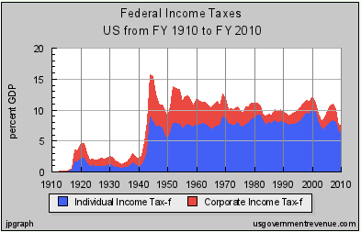
Features of US Trade Policies
Why the decline in tariffs? Partly due to revenues from income tax:
Notes:
Source: Irwin, Doug, “Trade Restrictiveness and Deadweight Losses from U.S. Tariffs,” 22 December 2008, Figure 1.

Slide 21
Features of US Trade Policies
Tariffs, quotas, etc.
We still have high tariffs on some products
Textiles, apparel
Agriculture
Quotas are still common in agriculture
VERs: Voluntary Export Restraints
No longer
But Trump has negotiated something like VERs
With Trump we have more high tariffs

Slide 22
Features of US Trade Policies
Escape Clause = Section 201
Called “Safeguards” in WTO
Permits temporary protection from injurious imports
Does NOT allege that the imports are “unfair”
Eligibility is decided by USITC alone
Injury (must be serious)
Causation (must be due to imports)
Implemented by President, who may say NO.
This was used under Trump for solar panels and washing machines
We’ll study it more on Nov 17

Slide 23
Features of US Trade Policies
Unfair Trade Laws
Permit protection (not temporary) from “unfair” imports
Must also be injurious, but less so than for escape clause (“material injury”)
“Unfair” if
Subsidized by foreign government
“Dumped”, i.e., priced too low by firm (more on this below)

Slide 24
Features of US Trade Policies
Unfair Trade Laws
Fairness decided by ITA
Injury decided by USITC
President is NOT permitted to say NO
We’ll study these more Dec 1-8

Slide 25
Features of US Trade Policies
Section 301 of the Trade Act of 1974
US law permitting tariffs on countries that engage in ”unfair trade” (other than dumping and subsidies)
What is unfair trade? “acts that are ‘unjustifiable’ or ‘unreasonable’ and burden U.S. commerce.”
Before 1995, used extensively by US to pressure other countries
2018 applied to China by USTR: “practices related to technology transfer, intellectual property, and innovation are unreasonable or discriminatory, and burden or restrict U.S. commerce.”
Notes:
Andres B. Schwarzenberg, “Section 301 of the Trade Act of 1974,” Congressional Research Service, Updated Aug 31, 2020.
https://crsreports.congress.gov/product/pdf/IF/IF11346#:~:text=Overview%20of%20Section%20301&text=U.S.%20commerce.,their%20markets%20to%20U.S.%20exports.

Slide 26
Features of US Trade Policies
Trade Adjustment Assistance (TAA)
Provides temporary help (not tariff protection) for firms and workers hurt by imports
Gives workers access to income support, relocation allowances, job search allowances, health coverage tax credit, and occupational training
As of 2002, Alternative Trade Adjustment Assistance (ATAA) also provides limited “wage insurance” for trade-displaced older workers
Will study more Nov 19

Slide 27
Features of US Trade Policies
Fast Track -- officially “Trade Promotion Authority” (TPA)
Procedure, imposed by Congress on itself, requiring it to
Relevant for approval of FTAs and some other trade deals
Congress approved TPA in July 2015, good until July 1 2018, later extended to July 1, 2021
So Trump has it, for a while, for deals with UK, etc.
Consider trade legislation without amendment

Slide 28
Features of US Trade Policies
GSP = Generalized System of Preferences
Charge lower tariffs on some exports from some developing countries than we charge other countries
Other developed countries do this too (permitted by WTO)
Trump has withdrawn GSP
From India in Jun 2019, prompting retaliation
From Thailand in Oct 2019 (see Politi & Reed)

Slide 29
Pause for Discussion

Slide 30
Questions
Who has "standing" under the antidumping law? Who determines whether there is dumping?
How do the injury requirements differ for antidumping and for safeguards? Do either require that the domestic firms make losses?
What can a U.S. producer do if it believes that its competitors in another country are engaging in anticompetitive conduct that is being tolerated by their government?

Slide 31
Questions
Why did Fast Track, or something like it, become necessary only after trade negotiations were moving on from tariffs to negotiating non-tariff measures?
Is US withdrawal of GSP preferences from Thailand based on the belief that Thailand is no longer a developing country?
Who requested the withdrawal of GSP from Thailand, and why was the Trump administration willing to do it?

Slide 32
US Trade Policies under Trump
2017: Not much
2018-20: See State of Play, Sep 3
Tariffs on steel and aluminum (Section 232)
Tariffs on China (Section 301)
Threat of tariffs on cars (Section 232)
Threat of tariffs on Mexico
Actions targeting firms (ZTE, Huawei, TikTok)

Slide 33
US Trade Policies under Trump
USTR Lighthizer’s US accomplishments
Phase 1 deal with China
USMCA
Deals with Japan
Airbus retaliation
France digital tax retaliation
Actions against the WTO
“brought about a fundamental rethinking of the World Trade Organization”

Slide 34
Pause for Discussion

Slide 35
Questions on USTR “Agenda”
Who in the US as benefited from these policies?
What do they plan for the next year?

Slide 36
US Trade Policies under Trump
Section 232 Tariffs
Used by Trump on Steel and Aluminum
Threatened by Trump on cars & car parts
Has basis in US law, but legality still questioned (see Fefer et al.)
Investigation underway on electrical grid imports (see Williams)
Even some Republicans want to change the law (see Elis)

Slide 37
Pause for Discussion

Slide 38
Questions on Fefer “Section 232”
Under what circumstances does Section 232 of the 1962 Trade Act permit the President to levy tariffs?
Who conducts the investigation to determine if this is the case? If the answer is yes, must the President levy tariffs?
Must the tariffs apply to all imports of the product? If not, do we know why not?
Is the use of Section 232 legal under the rules of the WTO?

Slide 39
Questions on Williams, “electrical grid imports”
What is the basis for the investigation of imported electrical grid parts?
Has the US already blocked any imports of these products?
What portion of the US economy might be protected by a tariff on the type of electrical steel used in transformers?

Slide 40
Questions on Ellis, “Grassley”
What trade law is being considered for change?
How has Trump used this law?
Is this only a Democrat seeking to stop Trump?

Slide 41
US Trade Policies under Trump
Other
US may allow some drug imports (see Armour & Burton)
Congress may ban buses, railcars from China (see Wise & Ferek)
Sanctions

Slide 42
Pause for Discussion

Slide 43
Questions on Armour & Burton, Drug Imports
Is it legal now for Americans to import drugs from Canada?
Why are drug prices lower in Canada and other countries than in the US?
Is the purpose here really to make drugs cheaper to US consumers, and will it work?

Slide 44
Questions on Wise & Ferek, “Ban Chinese Buses”
What is the lawmakers’ concern about imports of railcars and buses from China?
For other products mentioned here, is that also the concern?

Slide 45
Questions on Rappeport & Rogers, “Sanctions”
How does the use of sanctions by the Trump administration compare to prior administrations?
Has Trump been consistent in his use of sanctions?
How do other countries respond to sanctions?
Will Trump’s use of sanctions make the US more powerful after he leaves?

