Slide 1
Class 5 Exchange Rates by Alan V. Deardorff University of Michigan 2020
PubPol/Econ 541

Slide 2
Outline
Exchange markets: What they are
Supply and Demand
Two Simple Theories
Pegged Exchange Rates
Exchange Regimes

Slide 3
Exchange Market
Exchange rate is
Price of one currency in terms of another
E.g., $/£ or £/$

Slide 4
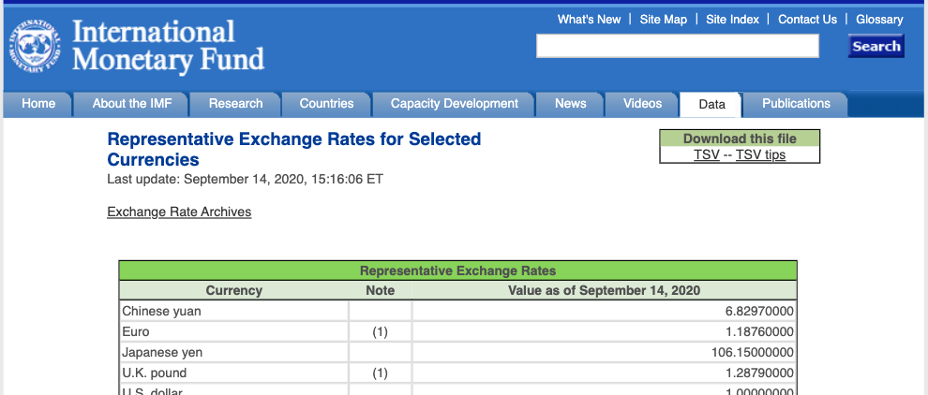

Slide 5
Pause for Discussion

Slide 6
Questions
Is an exchange rate the price of one country’s goods in terms of another’s, or the price of one country’s assets in terms of another’s?
On what transactions are reported rates based?
What hours of the day are the exchange markets open?

Slide 7
Exchange Market
Types of exchange rate
Spot
Forward
Bilateral
Futures
Trade weighted
Real

Slide 8
Source: Federal Reserve, “Broad Index” based on a large group of currencies, monthly data
Notes:
http://www.federalreserve.gov/releases/h10/summary/

Slide 9
Source: Federal Reserve, “Broad Index” based on a large group of currencies, monthly data
Notes:
http://www.federalreserve.gov/releases/h10/Summary/indexbc_m.txt
Dollar Index Broad Real 2007.xls

Slide 10
Exchange Market
Who uses the exchange market
Traders
Travelers (but that’s trade)
International borrowing, lending, and asset trade
Speculators
Hedgers
Arbitragers

Slide 11
Pause for Discussion

Slide 12
Questions
What is “arbitrage” ” in the foreign exchange market?
What is “hedging” in the foreign exchange market?
What role does the US dollar play in international finance?

Slide 13
Supply and Demand for Foreign Exchange
Questions:
Who demands €?
Who supplies €?
Market Model:
E ($/€)
S€
S€
E₀
D€
Q€

Slide 14
Exchange Market
Traders respond to
Prices of goods
Rise in home prices causes currency to fall
Capital movements respond to
Interest rates
Rise in home interest rate causes currency to rise
Expectations
Expectation of any change causes that change

Slide 15
Two Simple Theories
Asset Theory
Simple: E is whatever it is expected to be
If it were not, its expected change would drive capital flows that would swamp the market
Works best in short run (but not useful)
PPP = Purchasing Power Parity
Exchange rate reflects the prices of goods
See Big Mac Index
Works best in long run

Slide 16
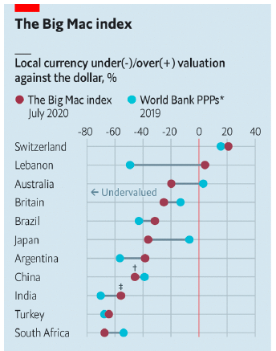
Notes:
Economist, “Patty power: How big is China’s economy? Let the Big Mac decide,” The Economist, July 18, 2020.
https://www.economist.com/finance-and-economics/2020/07/18/how-big-is-chinas-economy-let-the-big-mac-decide

Slide 17
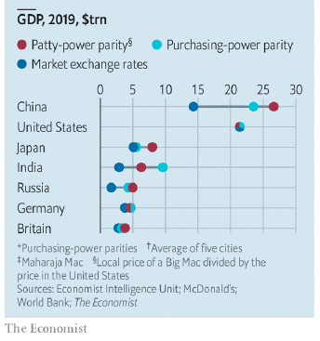
Notes:
Economist, “Patty power: How big is China’s economy? Let the Big Mac decide,” The Economist, July 18, 2020.
https://www.economist.com/finance-and-economics/2020/07/18/how-big-is-chinas-economy-let-the-big-mac-decide

Slide 18
Pause for Discussion

Slide 19
Questions
How does one know if a currency is over- or under-valued, based on the price of the Big Mac?
Why is comparing prices across countries hard?
Is China bigger than the US? Has it ever been?
What caused Iran’s inflation that led to a change?

Slide 20
Pegged Exchange Rates
Bretton-Woods System
Successor to the Gold Standard
Most currencies pegged to US $
How to peg
Need “reserves” of foreign currency
Use them to buy or sell own currency as needed
Does it work? Yes and no

Slide 21
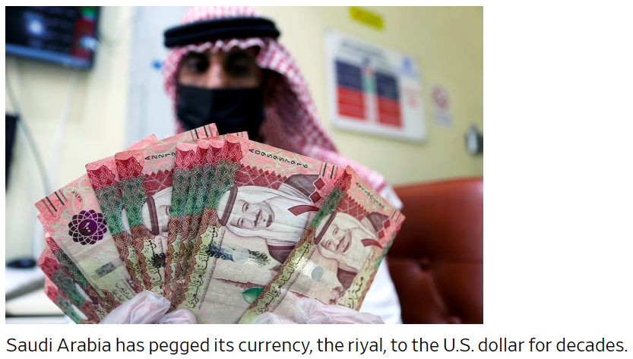
Notes:
Chilkoti, Avantika, “Investors Bet Oil Crash Will Weaken Middle East Currency Pegs,” Wall Street Journal, May 1, 2020.
https://www.wsj.com/articles/investors-bet-oil-crash-will-weaken-middle-east-currency-pegs-11588325401?mod=itp_wsj&ru=yahoo

Slide 22
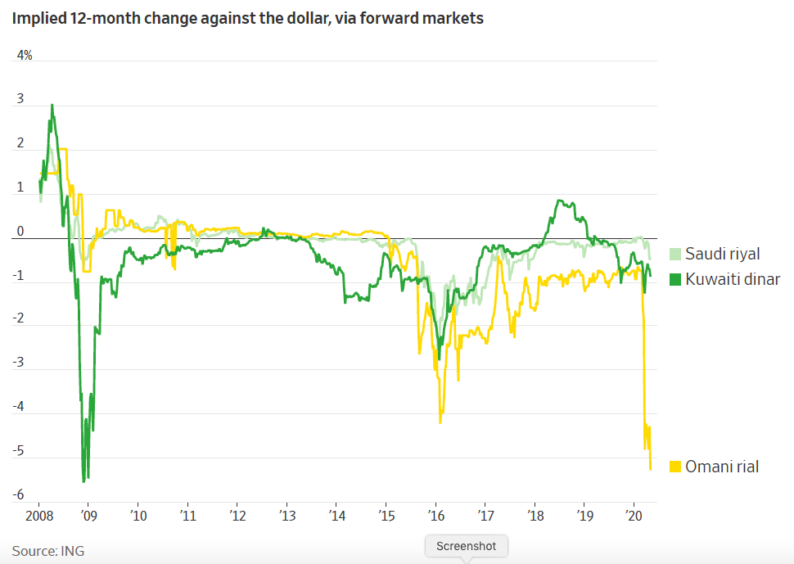
Notes:
Chilkoti, Avantika, “Investors Bet Oil Crash Will Weaken Middle East Currency Pegs,” Wall Street Journal, May 1, 2020.
https://www.wsj.com/articles/investors-bet-oil-crash-will-weaken-middle-east-currency-pegs-11588325401?mod=itp_wsj&ru=yahoo

Slide 23
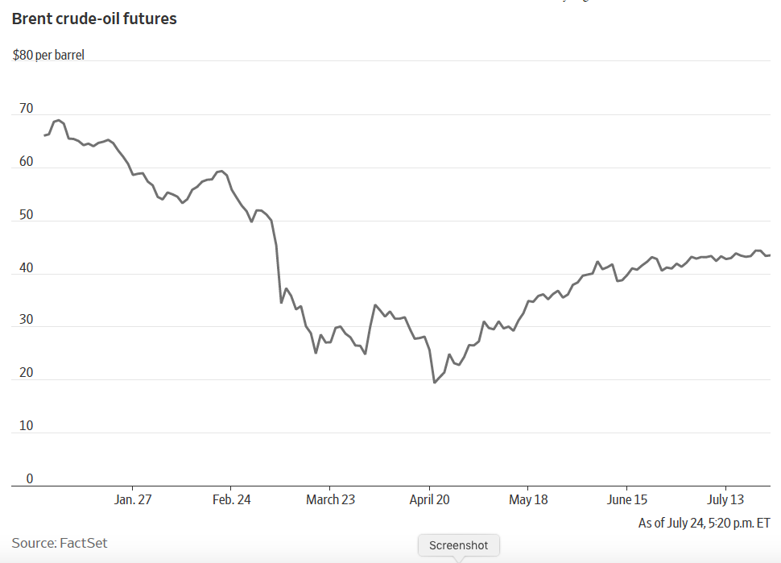
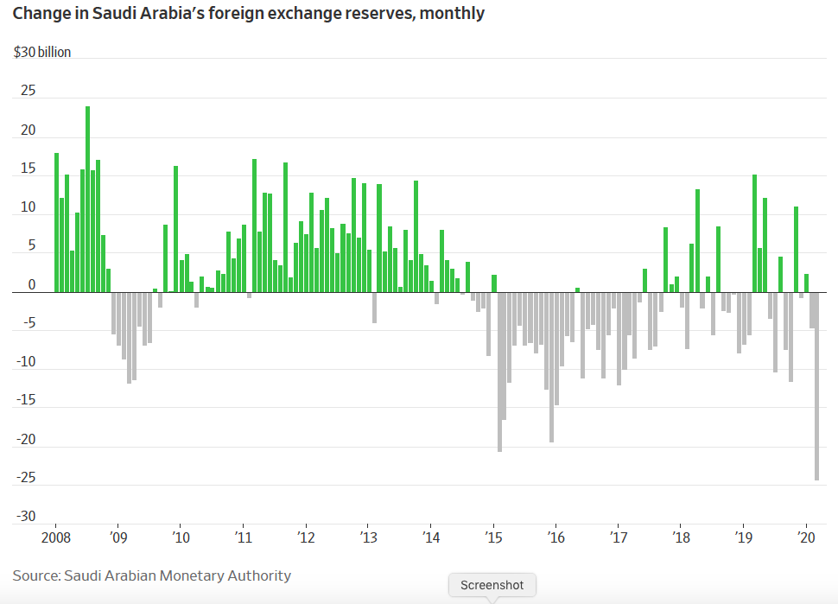
Notes:
Chilkoti, Avantika, “Investors Bet Oil Crash Will Weaken Middle East Currency Pegs,” Wall Street Journal, May 1, 2020.
https://www.wsj.com/articles/investors-bet-oil-crash-will-weaken-middle-east-currency-pegs-11588325401?mod=itp_wsj&ru=yahoo

Slide 24
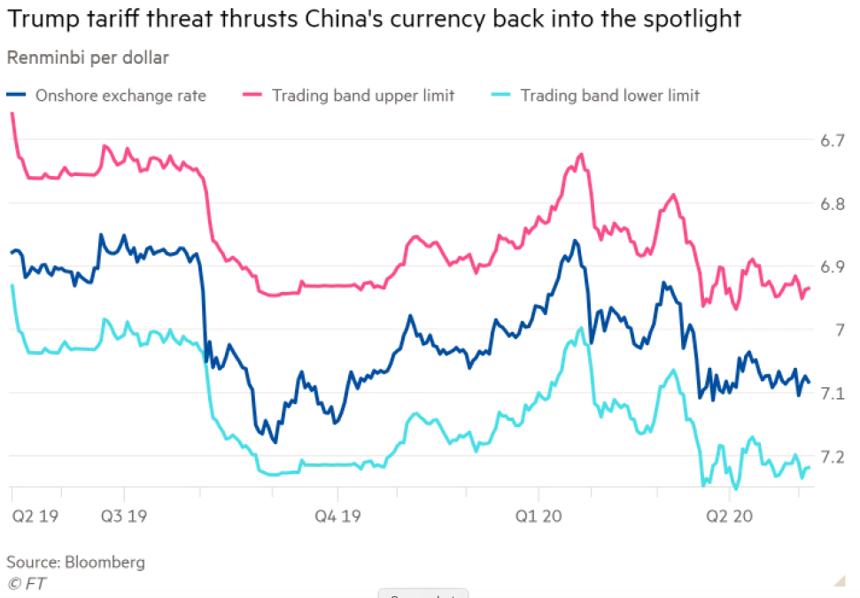
Notes:
Lockett, Hudson and Anna Gross, “Trump threats to China over coronavirus pile pressure on renminbi,” Financial Times, May 13, 2020.
https://www.ft.com/content/bb212e49-74a5-47fc-b68d-45e12d746553

Slide 25
Pause for Discussion

Slide 26
Questions
What names and characteristics describe the three international monetary regimes that the Economist article describes, the last of which may be coming to an end?
Why is currency stability so hard to achieve?
What change is Iran making, and will it be simple?

Slide 27
Questions
Why are markets expecting the Saudi and other currencies to fall? And how do we know that?
Why do the countries resist letting their currencies fall?

Slide 28
Questions on Trump v China
What action did Trump take in response to his claim that China was responsible for the pandemic?
Why do Trump’s threats against China cause its currency to fall?
Has China been labelled a “currency manipulator”?
What would China do if it wanted to “export itself out of the coronavirus crisis”?

