Slide 1
Class 24 Economic Sanctions by Alan V. Deardorff University of Michigan 2023
PubPol/Econ 541

Slide 2
Outline
What are sanctions?
Who has used them, and why?
What effects do they have?
Do they work?
Effects of Russia sanctions

Slide 3
What economic sanctions are
From my Glossary:
Sanctions are “coercive measures used by a nation or group of nations against another as a penalty for violating international law or international norms”
Most apply to economic transactions or assets, and thus are “economic sanctions”
From Masters:
“the withdrawal of customary trade and financial relations for foreign- and security-policy purposes”

Slide 4
What economic sanctions are
Types of sanctions
Primary: When a a government prohibits its own people and firms from doing business with a target country
Secondary: When a a government prohibits people and firms of third countries from doing business with a target country
Also “extraterritorial”.
Many governments object to these
Smart: sanctions that “aim to minimize the suffering of innocent civilians”

Slide 5
What economic sanctions are
Forms of sanctions (per Masters)
*Travel bans
*Asset freezes
*Arms embargoes
Capital restraints
Foreign aid reductions
Trade restrictions
Other forms (per Haass)
Negative votes in international financial institutions
Withdrawal of diplomatic relations
Visa denials
Cancellation of air links
*Most common types of UN sanctions, per Masters (2019)
Notes:
Masters, Jonathan, “What Are Economic Sanctions?” Backgrounder, Council on Foreign Relations, August 12, 2019. 12 pp.
https://www.cfr.org/backgrounder/what-are-economic-sanctions

Slide 6
What economic sanctions are
Purposes of sanctions (per Masters)
counterterrorism,
counternarcotics,
nonproliferation,
democracy and human rights promotion,
conflict resolution, and
cybersecurity.
Other purposes (per Haass)
Discourage WMDs
Thwart drug trafficking
Discourage armed aggression
Promote market access
Protect environment
Replace governments
Notes:
Masters, Jonathan, “What Are Economic Sanctions?” Backgrounder, Council on Foreign Relations, August 12, 2019. 12 pp.
https://www.cfr.org/backgrounder/what-are-economic-sanctions

Slide 7
Sanctions Regimes
Masters (2019) identifies 3 regimes of sanctions:
United Nations
Decided by Security Council
European Union (but called “restrictive measures”)
Requires unanimous consent by member states
Member states are free to impose harsher ones
United States
Originate in either executive or legislative branch
“US uses [them] more than any other country”
Notes:
Masters, Jonathan, “What Are Economic Sanctions?” Backgrounder, Council on Foreign Relations, August 12, 2019. 12 pp.
https://www.cfr.org/backgrounder/what-are-economic-sanctions

Slide 8
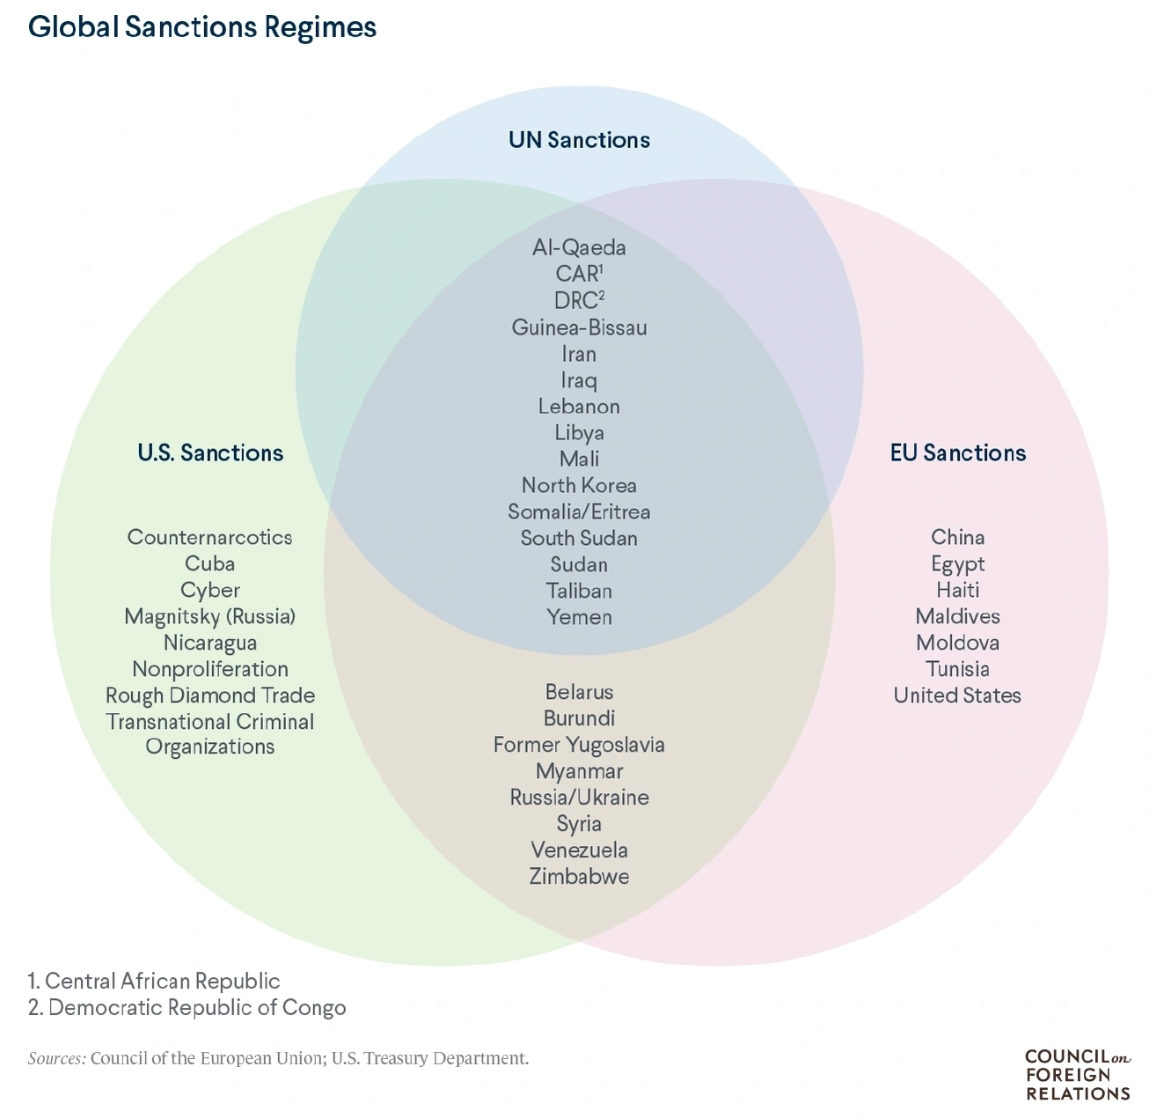
Notes:
Masters, Jonathan, “What Are Economic Sanctions?” Backgrounder, Council on Foreign Relations, August 12, 2019. 12 pp.
https://www.cfr.org/backgrounder/what-are-economic-sanctions

Slide 9
Sanctions Regimes
Sanctions used by others
China on
Australia 2020
Lithuania 2021
Taiwan 2022

Slide 10
Pause for Discussion

Slide 11
Questions on Masters, “What Are Economic Sanctions?
Are trade restrictions among the most used forms of sanctions by the UN?
Does this say that sanctions work?
Why is the US best positioned to use sanctions, and why might their use undermine that position?

Slide 12
Questions on Haass, “Too Much of a Bad Thing”
Why are economic sanctions so popular?
Overall, does Haass favor the use of sanctions?
He argues for comparing costs and benefits with those of alternatives. What alternatives does he mention?

Slide 13
Sanctions History
After World War I:
Sanctions were envisioned as alternative to war
League of Nations tried to oversee their use
Used in 1935 against Mussolini’s invasion of Ethiopia by Italy
Sanctions implemented by 52 states, but not US and Germany
Failed to stop Italy’s conquest of Ethiopia
Used against Japan 1939-41, prompting attack on
European colonies in Southeast Asia
US
Notes:
Mulder, Nicholas, “The Sanctions Weapon,” Finance and Development, June 2022, pp. 20-23. 4 pp.
https://www.imf.org/en/Publications/fandd/issues/2022/06/the-sanctions-weapon-mulder

Slide 14
Sanctions History
After World War II:
UN and Western sanctions against Rhodesia (now Zimbabwe)
UN against apartheid-era South Africa
US against Cuba and Iran
Notes:
Mulder, Nicholas, “The Sanctions Weapon,” Finance and Development, June 2022, pp. 20-23. 4 pp.
https://www.imf.org/en/Publications/fandd/issues/2022/06/the-sanctions-weapon-mulder

Slide 15
Do Sanctions Work?
Elliott [optional reading]
Writing in 1997, she reports that US sanctions since 1970 have
Achieved foreign policy objectives only 13% of the time\
Cost US $15-19 billion annually in potential exports
Cost >200,000 jobs in (high-wage) export sector
Conclusion: “unilateral economic sanctions are decreasingly useful yet increasingly costly”

Slide 16
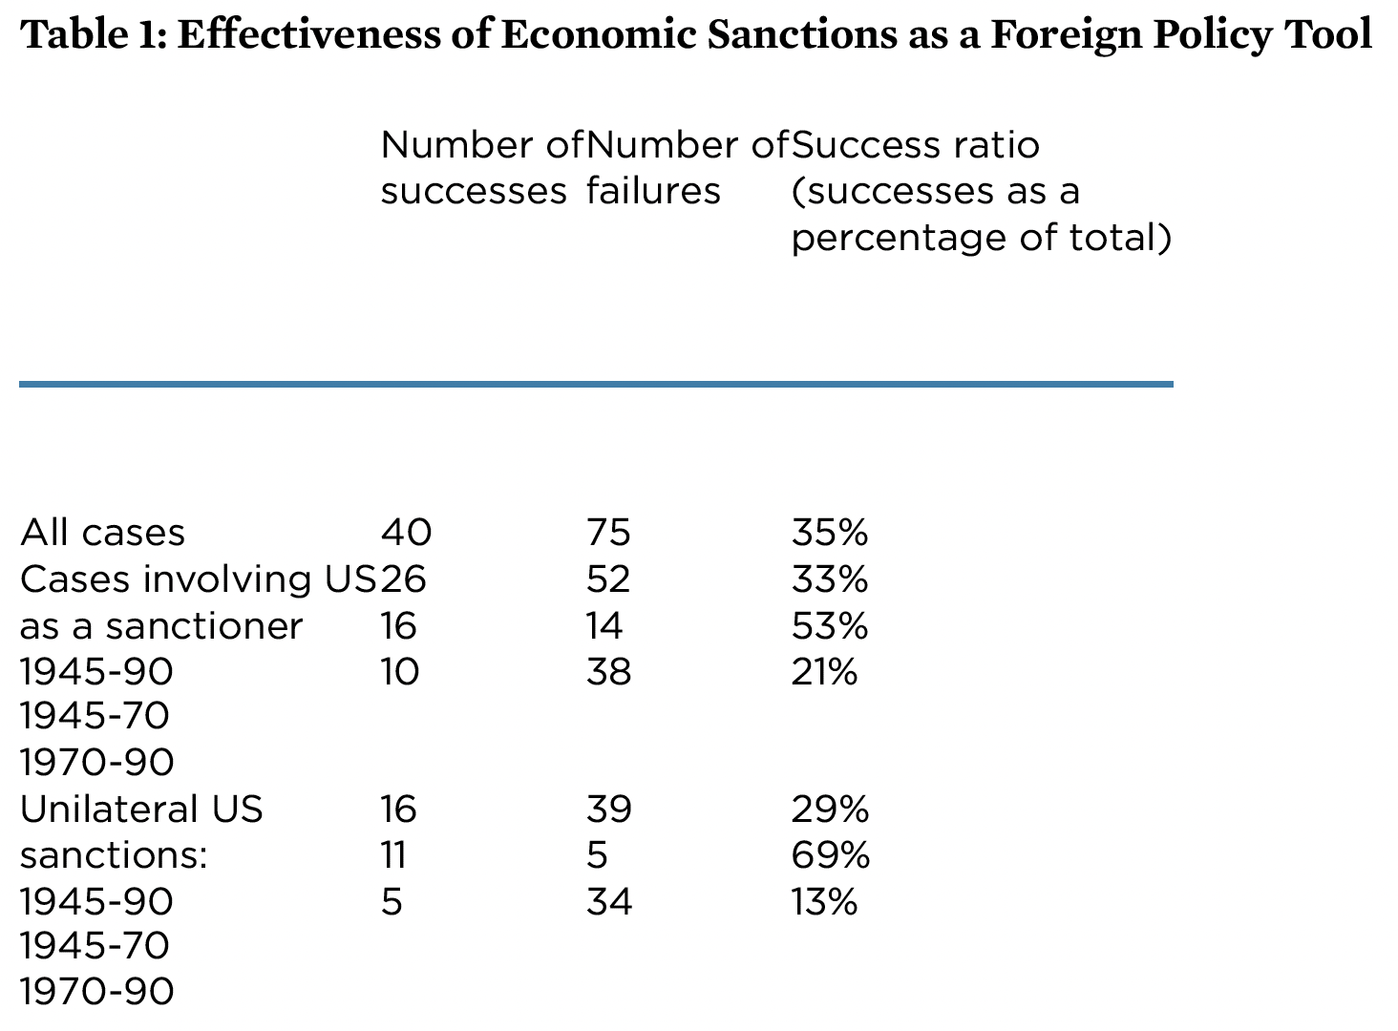
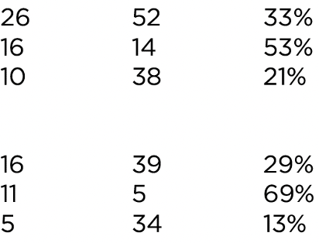
Notes:
Elliott, Kimberly Ann, “Evidence on the Costs and Benefits of Economic Sanctions,” Speech given before the Subcommittee on Trade Committee on Ways and Means United States House of Representatives Washington, DC, October 23, 1997, Peterson Institute for International Economics. 6 pp.
https://www.piie.com/commentary/testimonies/evidence-costs-and-benefits-economic-sanctions
[Original had data too high. I moved it down.]

Slide 17
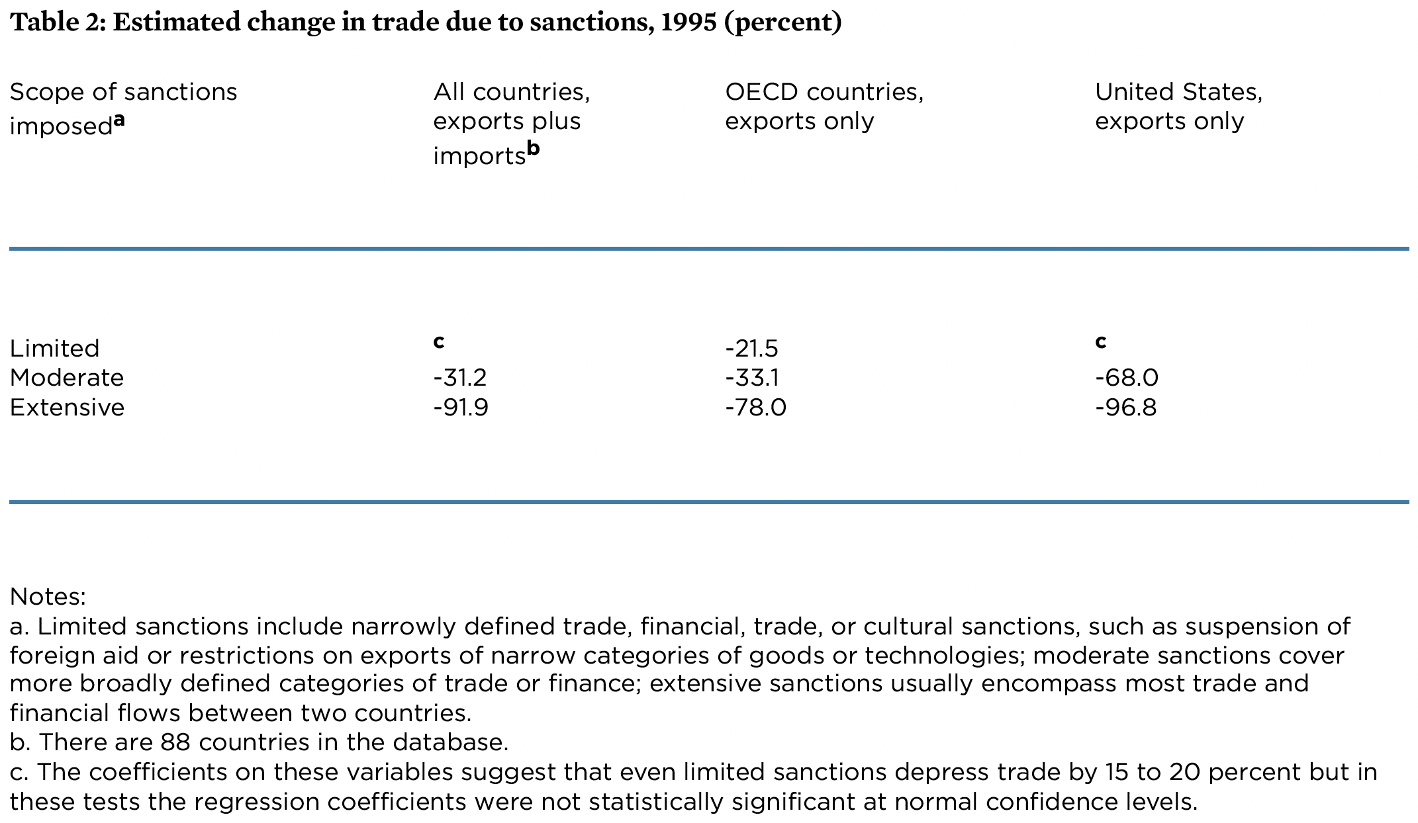
Notes:
Elliott, Kimberly Ann, “Evidence on the Costs and Benefits of Economic Sanctions,” Speech given before the Subcommittee on Trade Committee on Ways and Means United States House of Representatives Washington, DC, October 23, 1997, Peterson Institute for International Economics. 6 pp.
https://www.piie.com/commentary/testimonies/evidence-costs-and-benefits-economic-sanctions

Slide 18
Pause for Discussion

Slide 19
Questions on Rodriguez, “The harm that sanctions do …”
What percentages of countries and the world economy are subject to sanctions now? What were those percentages in the 1990s?
What measures of living conditions are mentioned as being made worse by sanctions?
What measures of living conditions are mentioned as being made worse by sanctions?
How big is the hit on GDP estimated to be in one study?

Slide 20
Effects of Russia sanctions
Russia sanctions began with Russia’s Feb 24, 2022, invasion of Ukraine
Recall what we saw Sep 6:
Economic sanctions by governments
Financial linkages
Trade
Private companies said they would stop dealing with Russia
Many have found it hard to do this.
Only on Aug 25 this year did I hear (on NPR) that Heineken just succeeded in selling its operations there for 1 euro
Notes:
https://www.reuters.com/markets/europe/heineken-exits-russia-with-one-euro-sale-operations-2023-08-25/

Slide 21
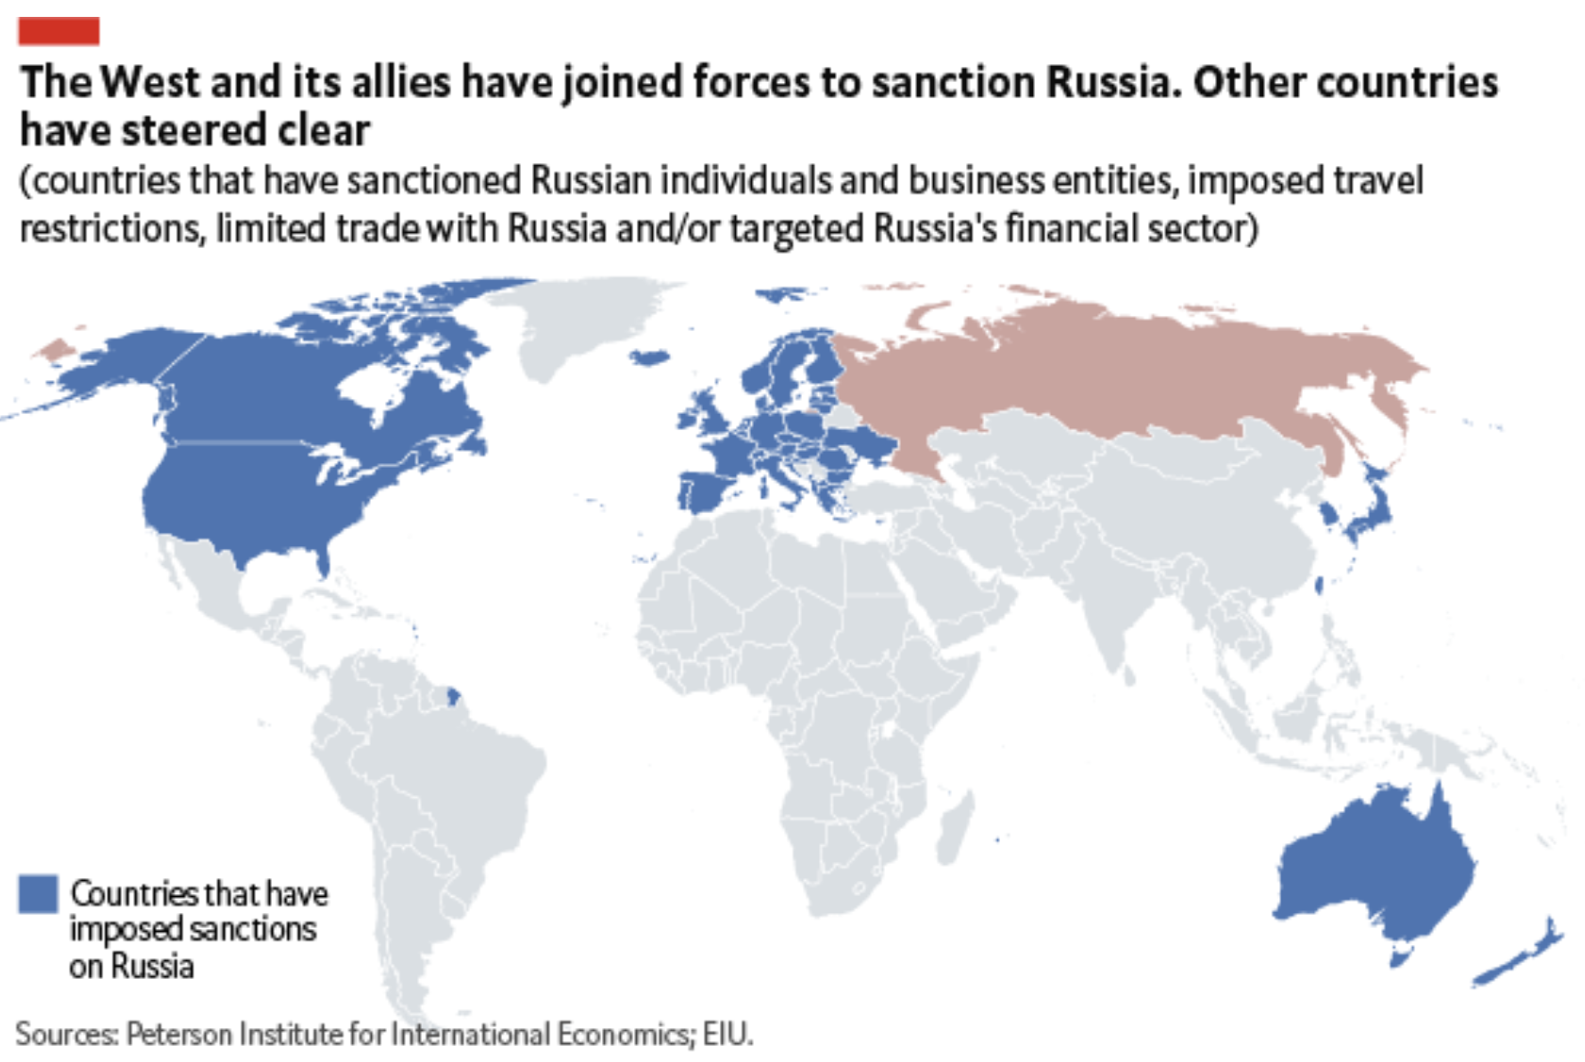
Source: Economist Intelligence Unit, April 13, 2022

Slide 22
Effects of Russia Sanctions
Per Mulder, June 2022
Today’s sanctions have greater effects than seen before, due to
More integrated global economy
Russia’s importance as exporter of
Grain
Oil
“…globalization has thereby increased the economic costs of using sanctions against large, highly integrated economies.”

Slide 23
Pause for Discussion

Slide 24
Questions on Mulder, “The Sanctions Weapon”
How many governments imposed sanctions on Russia, and from which continents?
Why does the author view sanctions as more problematic today than previously?
What “policy adjustments” does he suggest?

Slide 25
Questions on Alderman, “Leave Russia? A Year Later…”
Many companies announced last year that they were leaving Russia. Have they?
What fraction are still there?
What has Russia done to keep them from leaving?

Slide 26
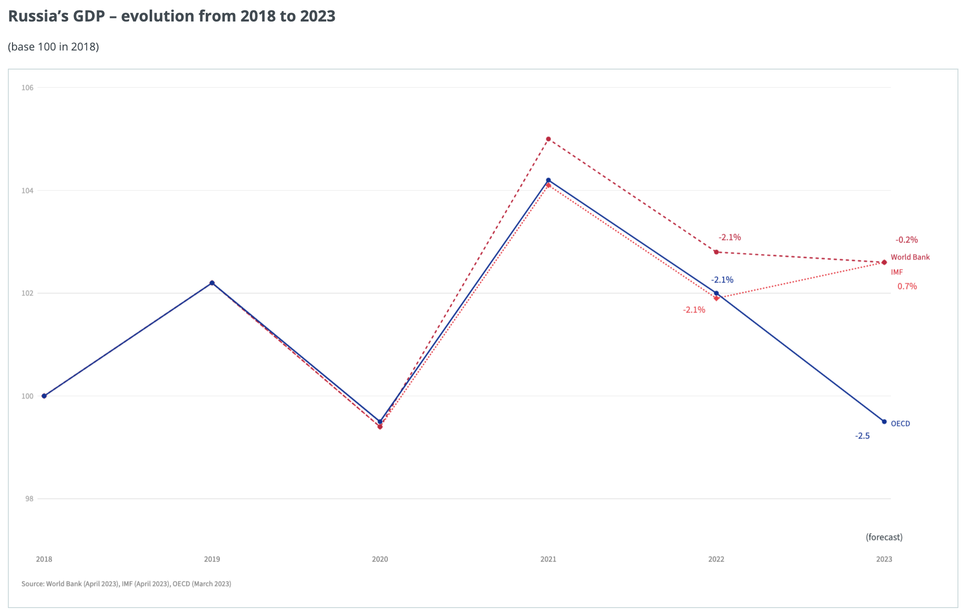
Effects of Russia Sanctions
Sources: IMF, WB, OECD, via European Council
Notes:
European Council, Infographic - Impact of sanctions on the Russian economy
https://www.consilium.europa.eu/en/infographics/impact-sanctions-russian-economy/

Slide 27
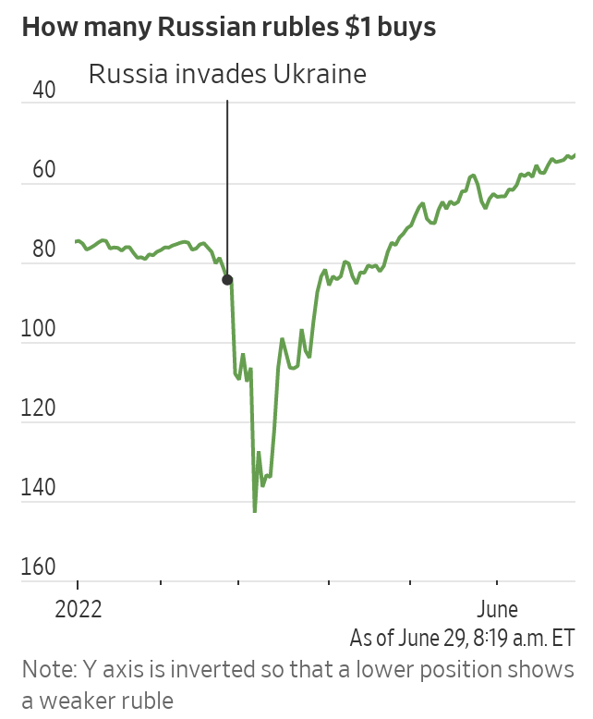
Russia’s Surprising Economic Headache: A Strong Ruble
Wall Street Journal
June 29, 2022
Notes:
McCabe, Caitlin and Kate Vtorygina, “Russia’s Surprising Economic Headache: A Strong Ruble,” Wall Street Journal, June 29, 2022.
https://www.wsj.com/articles/russias-surprising-economic-headache-a-strong-ruble-11656530936

Slide 28
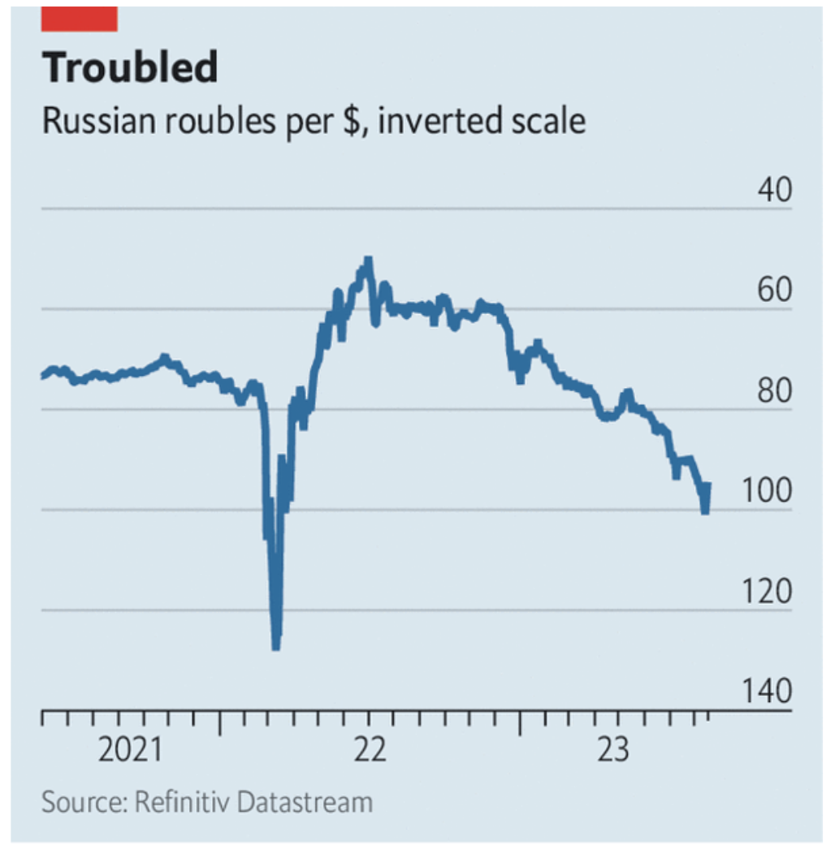
Source: Economist, August 14, 2023

Slide 29
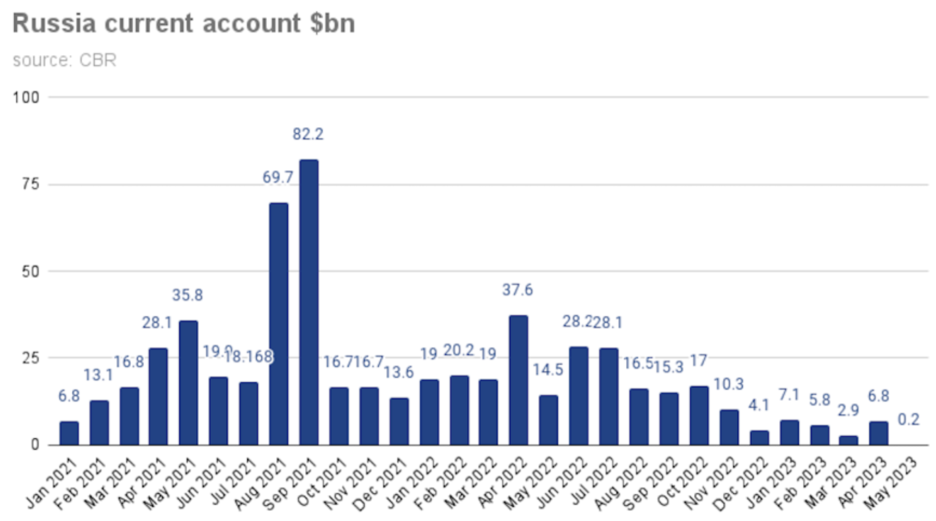
Source: BNE Intellinews, June 14, 2023
Notes:
“Russia’s current account surplus slashed in 5M23,” BNE Intellinews, June 14, 2023
https://intellinews.com/karins-to-step-down-as-latvian-prime-minister-288127/?source=baltic-states

Slide 30
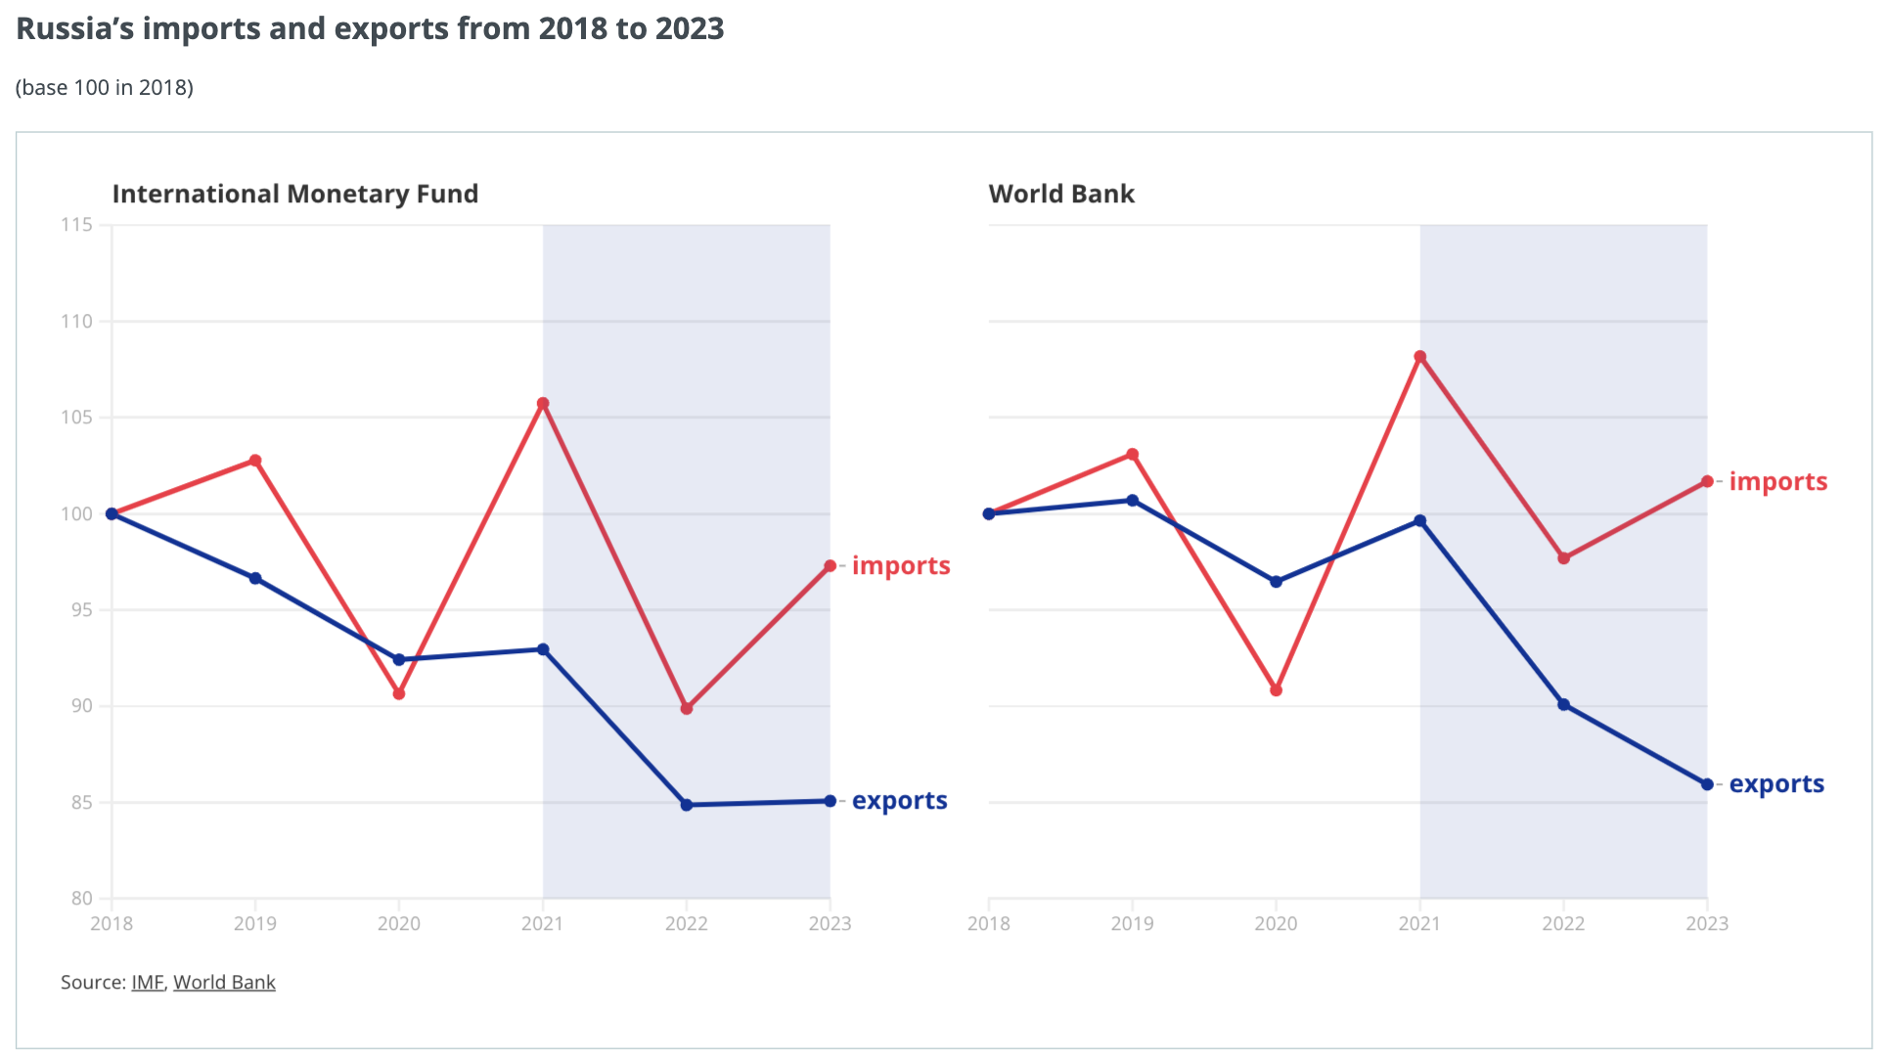
Effects of Russia Sanctions
Source: IMF, WB, via European Council
Notes:
European Council, Infographic - Impact of sanctions on the Russian economy
https://www.consilium.europa.eu/en/infographics/impact-sanctions-russian-economy/

Slide 31
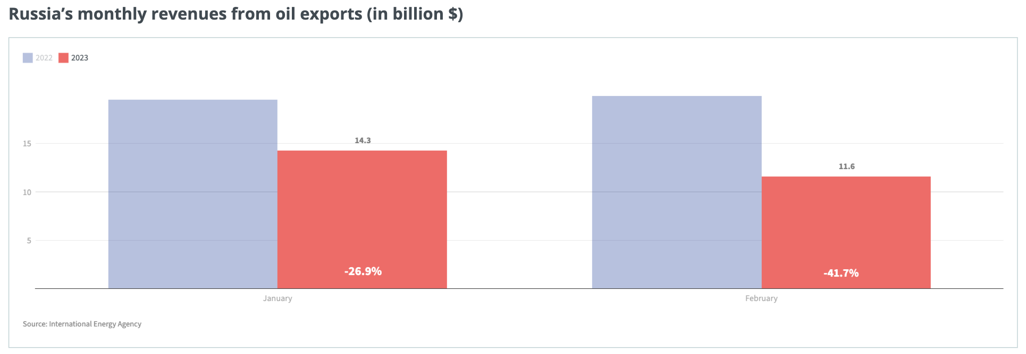
Effects of Russia Sanctions
Source: International Energy Agency
Notes:
European Council, Infographic - Impact of sanctions on the Russian economy
https://www.consilium.europa.eu/en/infographics/impact-sanctions-russian-economy/

Slide 32
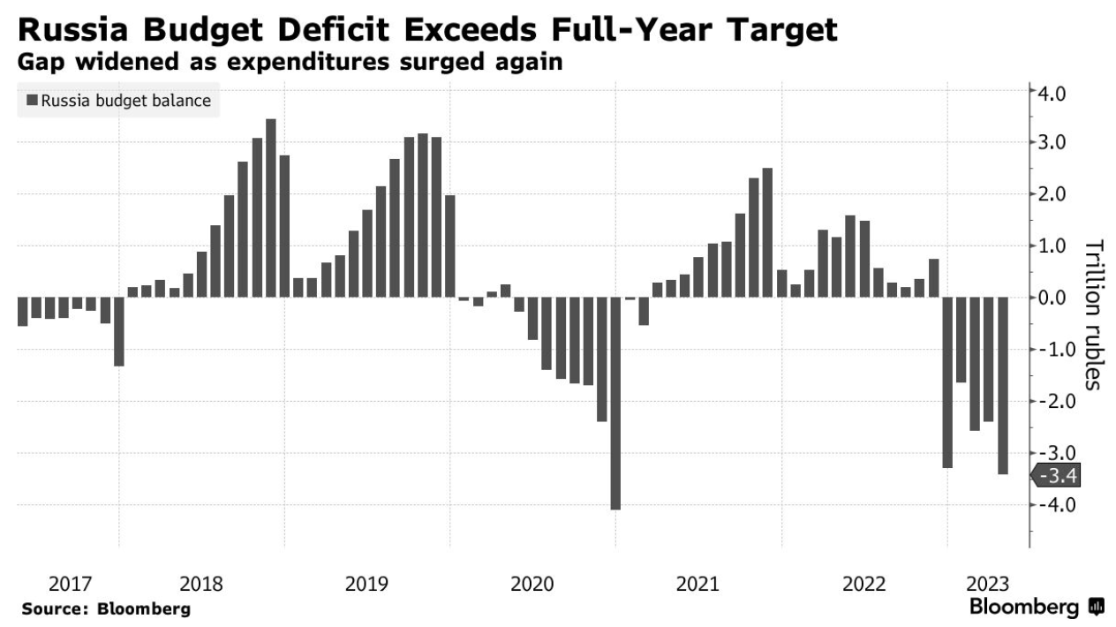
Effects of Russia Sanctions
Source: Bloomberg, July 7, 2023
Notes:
Alberto Nardelli, “EU Says Cost of Sanctions Will Hit Russia Harder Over Time,” July 7, 2023.
https://www.bloomberg.com/news/articles/2023-07-07/eu-says-high-cost-of-sanctions-on-russia-will-grow-for-years#xj4y7vzkg

Slide 33
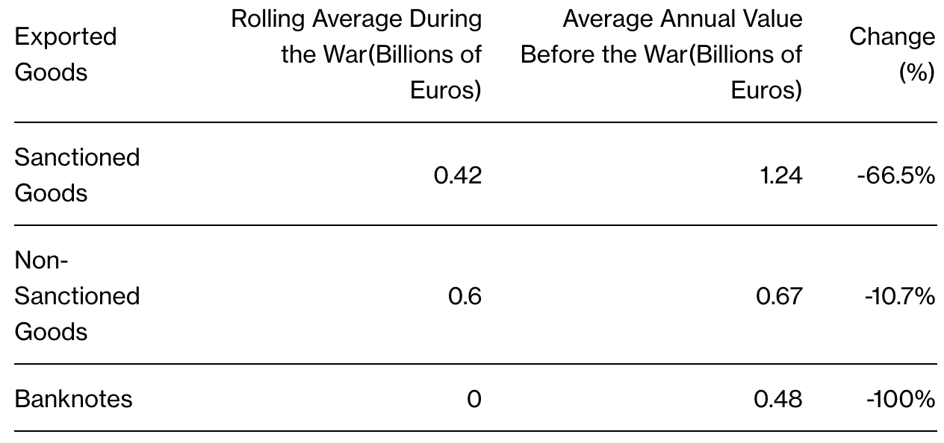
Effects of Russia Sanctions
Source: Bloomberg, July 7, 2023
Notes:
Alberto Nardelli, “EU Says Cost of Sanctions Will Hit Russia Harder Over Time,” July 7, 2023.
https://www.bloomberg.com/news/articles/2023-07-07/eu-says-high-cost-of-sanctions-on-russia-will-grow-for-years#xj4y7vzkg

Slide 34
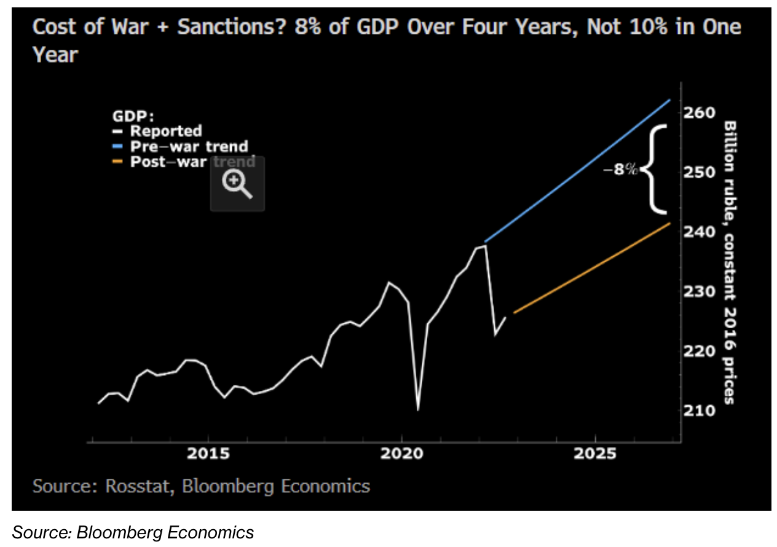
Effects of Russia Sanctions
Source: Bloomberg, July 7, 2023
Notes:
Alberto Nardelli, “EU Says Cost of Sanctions Will Hit Russia Harder Over Time,” July 7, 2023.
https://www.bloomberg.com/news/articles/2023-07-07/eu-says-high-cost-of-sanctions-on-russia-will-grow-for-years#xj4y7vzkg

Slide 35
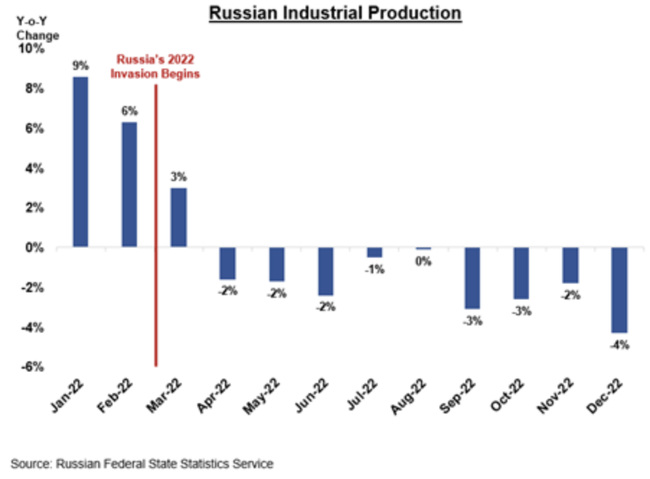
Effects of Russia Sanctions
Source: US Treasury, Feb 24, 2023
Notes:
“FACT SHEET: Disrupting and Degrading – One Year of U.S. Sanctions on Russia and Its Enablers,” US Department of Treasury, February 24, 2023.
https://home.treasury.gov/news/press-releases/jy1298

Slide 36
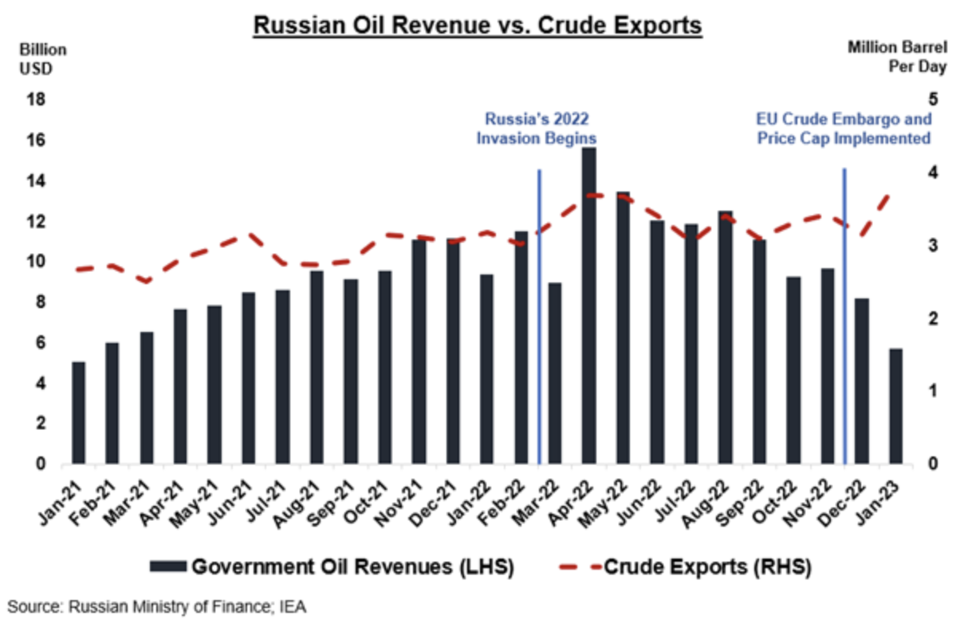
Effects of Russia Sanctions
Source: US Treasury, Feb 24, 2023
Notes:
“FACT SHEET: Disrupting and Degrading – One Year of U.S. Sanctions on Russia and Its Enablers,” US Department of Treasury, February 24, 2023.
https://home.treasury.gov/news/press-releases/jy1298

Slide 37
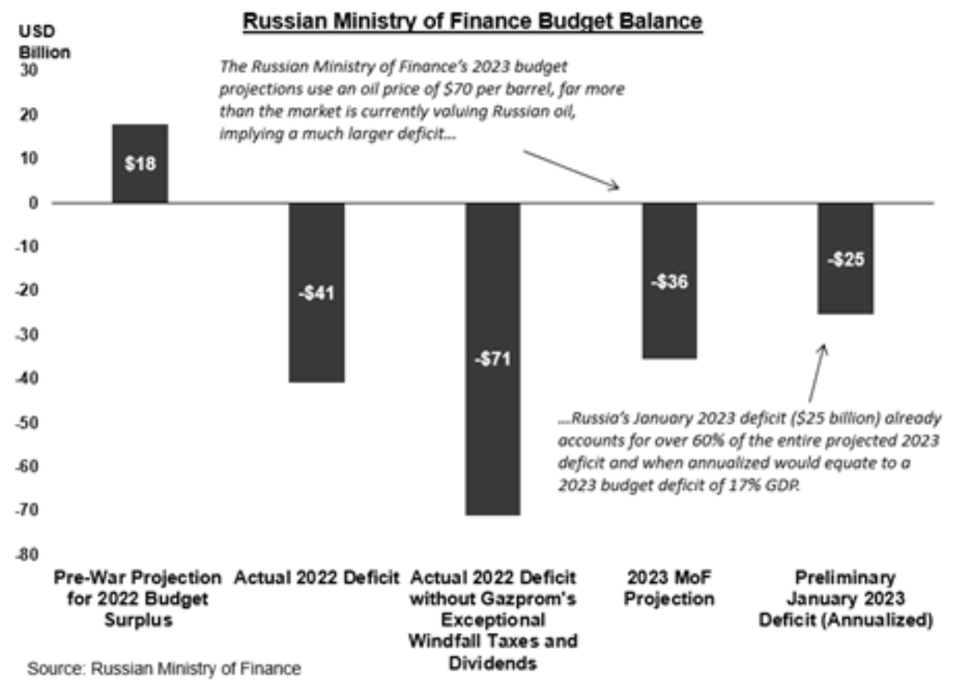
Effects of Russia Sanctions
Source: US Treasury, Feb 24, 2023
Notes:
“FACT SHEET: Disrupting and Degrading – One Year of U.S. Sanctions on Russia and Its Enablers,” US Department of Treasury, February 24, 2023.
https://home.treasury.gov/news/press-releases/jy1298

Slide 38
Pause for Discussion

Slide 39
Questions on WP Editors, “…make the sanctions hurt…”
What are the two purposes of sanctions against Russia?
Have the sanctions worked?
How is the oil price cap enforced and does it work?
What does this article recommend?
Should Russia’s frozen central bank assets be used to rebuild Ukraine?

Slide 40
Questions on Kantchev, “How Sanctioned Western Goods …”
What is being called the “Eurasian roundabout”?
What countries are said to be involved?
What is the evidence that this is happening?
What can be done about it?

