Slide 1
Class 22 Trade Adjustment Assistance by Alan V. Deardorff University of Michigan 2023
PubPol/Econ 541

Slide 2
Pause for News

Slide 3
Announcements
No class this Wednesday, Nov 22 (due to Thanksgiving, sort of)
There is a quiz due on Friday, Nov 24, covering:
Last Wednesday, Safeguards
Today, TAA

Slide 4
Quiz Results
 | Q8 | Q9 | Q10
Mean | 8.00 | 7.67 | 7.63
Median | 9 | 8 | 7
Max | 10 | 10 | 10
Min | 4 | 3.5 | 3
S.D. | 2.07 | 2.21 | 2.07

Slide 5
TAA: Trade Adjustment Assistance
The US program
Wage Insurance (ATAA)
Arguments against
Current status of TAA

Slide 6
TAA: Trade Adjustment Assistance
The US program
Wage Insurance (ATAA)
Arguments against
Current status of TAA

Slide 7
US TAA
Started 1962
Reason (Kennedy)
“Obligation to render assistance to those who suffer as a result of national trade policy”
Costs of trade are concentrated, compared to benefits
Latest expansion: 2002
New features, but few take advantage of them
Program stopped July 2022
Workers separated from job before June 30, 2022, still eligible
Needs re-authorization by Congress

Slide 8
Notes:
https://www.dol.gov/agencies/eta/tradeact

Slide 9
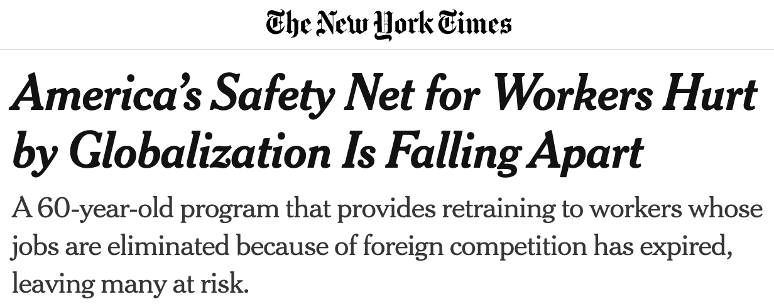
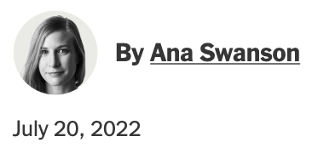
Notes:
https://www.nytimes.com/2022/07/20/business/economy/trade-adjustment-assistance-jobs.html

Slide 10
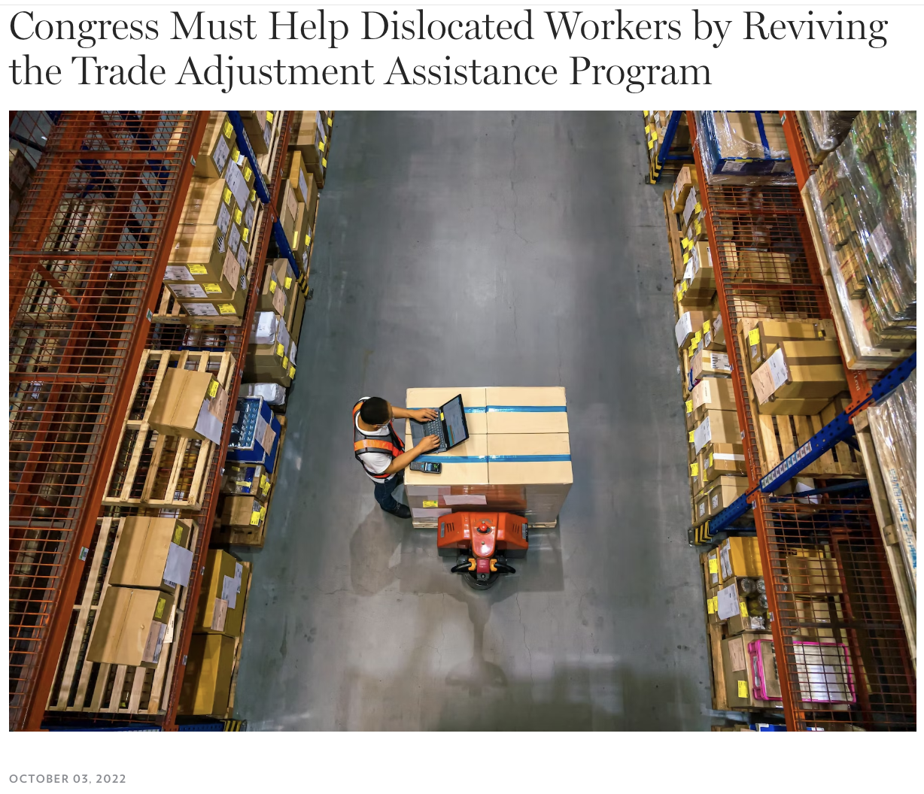
Notes:
https://tcf.org/content/about-tcf/congress-must-help-dislocated-workers-by-reviving-the-trade-adjustment-assistance-program/#:~:text=%E2%80%9CSadly%2C%20Congress%20let%20the%20authorization,receive%20benefits%20from%20the%20program.

Slide 11
US TAA
Types of TAA
Workers (since 1962)
Firms (since 1962)
Farmers and fishermen (since 2002)

Slide 12
US TAA
Eligibility: laid off due to
Increase in imports (most)
In upstream or downstream producers (secondary)
Shift in production abroad (2nd most)

Slide 13
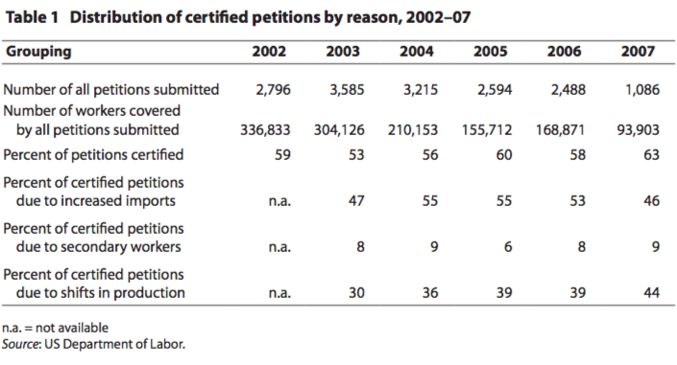
Source: Rosen (2008)
Notes:
Rosen, Howard F., “Strengthening Trade Adjustment Assistance,” Policy Brief No. PB08-2, Peterson Institute for International Economics, January 2008.

Slide 14
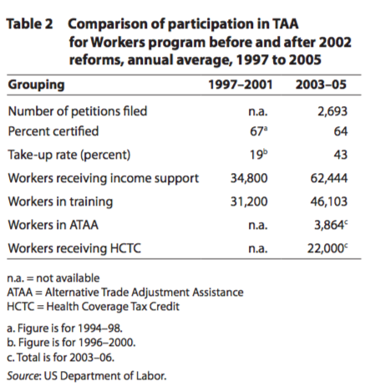
Source: Rosen (2008)
Notes:
Rosen, Howard F., “Strengthening Trade Adjustment Assistance,” Policy Brief No. PB08-2, Peterson Institute for International Economics, January 2008.

Slide 15
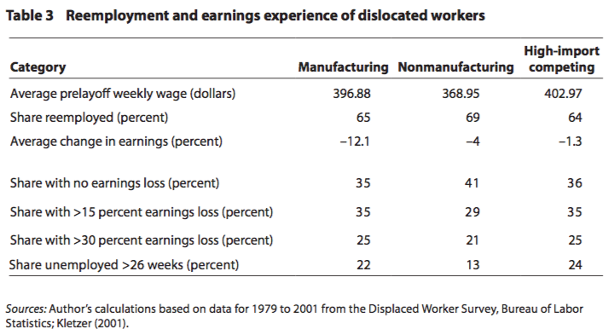
Source: Rosen (2008)
Notes:
Rosen, Howard F., “Strengthening Trade Adjustment Assistance,” Policy Brief No. PB08-2, Peterson Institute for International Economics, January 2008.

Slide 16
US TAA
Benefits:
Income maintenance
78 weeks vs. 26 weeks under UI
All training expenses
Health Coverage Tax Credit (HCTC)
Job search costs (90%)
Job relocation costs (90%)

Slide 17
US TAA
What’s wrong with TAA?
Workers are not informed (esp. HCTC)
Doesn’t cover service industries
Certification done by firms, not by industry
Money for training apportioned poorly
Some places run out, others leave $ unspent
Self-employed don’t qualify
No support for communities
US spends less than others (but was first)

Slide 18
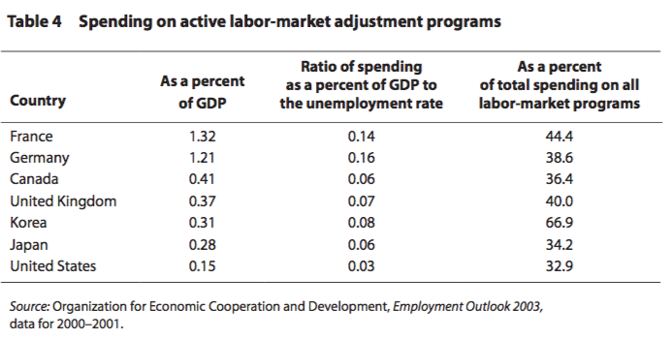
Source: Rosen (2008)
Notes:
Rosen, Howard F., “Strengthening Trade Adjustment Assistance,” Policy Brief No. PB08-2, Peterson Institute for International Economics, January 2008.

Slide 19
Pause for Discussion

Slide 20
Questions on Rosen, “Strengthening TAA”
Who qualifies for TAA, and what do they get?
How does US expenditure on TAA differ from expenditure on similar programs in other major countries?
What’s wrong with US TAA?

Slide 21
Questions on Lawrence, “A Numbers Argument…”
Are the gains from trade agreements large enough to justify the expenses of TAA?
Does Lawrence advocate for adjustment assistance only for trade-displaced workers?
Why does Lawrence associate TAA with passing Trade Promotion Authority?

Slide 22
TAA: Trade Adjustment Assistance
The US program
Wage Insurance (ATAA)
Arguments against
Current status of TAA

Slide 23
Wage Insurance
What is it?
Program that replaces a fraction (usually 50%) of any cut in wage when the unemployed take a new job. Workers get it for only a limited time
Object is to encourage taking a new job even at a lower wage, with the hope that wage will then rise with experience
Widely advocated by economists, not just for trade-displaced workers

Slide 24
Wage Insurance
ATAA: Alternative Trade Adjustment Assistance
Part of 2002 expansion of TAA
Available only to workers who are
Over 50
Earning less than $50,000 a year
If they get new employment within 26 weeks
Payment is
50% of drop in wage for at most 2 years
Not to exceed $10,000 per worker over the 2 years
Notes:
http://www.ctdol.state.ct.us/TradeAct/ataa%20presentation2a.pdf

Slide 25
Wage Insurance
Brainard and Litan argue
Wage insurance is needed for all workers
But especially for trade-displaced workers
Their unemployment lasts much longer
Their drop in wage is somewhat larger
TAA does very little
Advantage of wage insurance
Speeds re-employment
Subsidizes training (on the job)
Encourages workers to consider alternative jobs
Notes:
http://www.ctdol.state.ct.us/TradeAct/ataa%20presentation2a.pdf

Slide 26
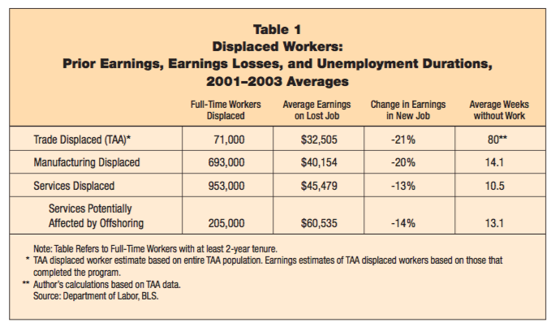
Source: Brainard et al. (2005)
Notes:
Brainard, Lael, Robert E. Litan, and Nicholas Warren, “Insuring America’s Workers in a New Era of Offshoring,” Policy Brief #143, The Brookings Institution, July 2005.

Slide 27
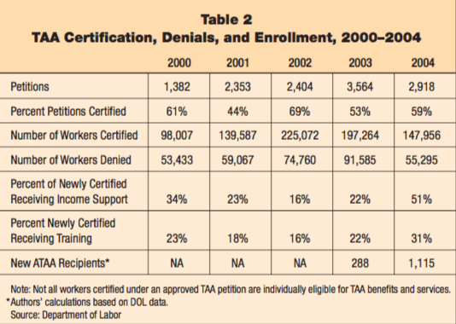
Recession
Source: Brainard et al. (2005)
Notes:
Brainard, Lael, Robert E. Litan, and Nicholas Warren, “Insuring America’s Workers in a New Era of Offshoring,” Policy Brief #143, The Brookings Institution, July 2005.

Slide 28
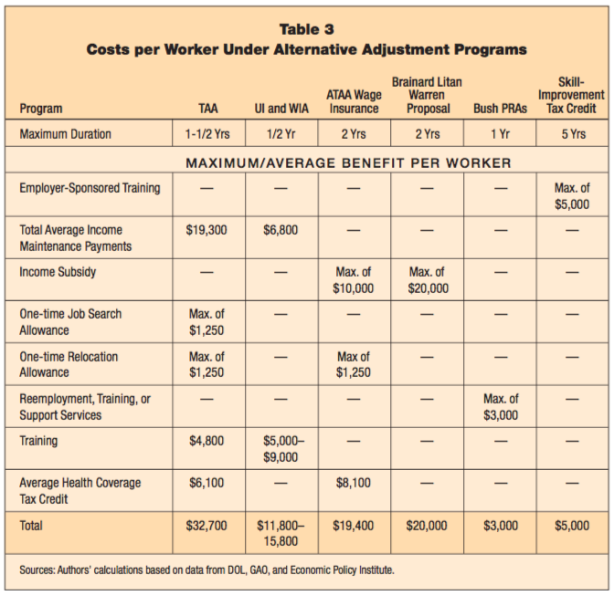
Source: Brainard et al. (2005)
Notes:
Brainard, Lael, Robert E. Litan, and Nicholas Warren, “Insuring America’s Workers in a New Era of Offshoring,” Policy Brief #143, The Brookings Institution, July 2005.

Slide 29
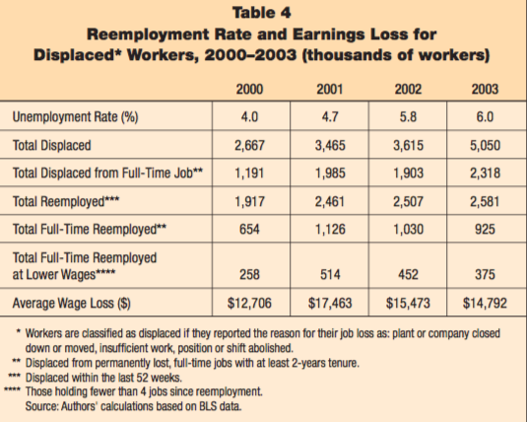
Source: Brainard et al. (2005)
Notes:
Brainard, Lael, Robert E. Litan, and Nicholas Warren, “Insuring America’s Workers in a New Era of Offshoring,” Policy Brief #143, The Brookings Institution, July 2005.

Slide 30
Pause for Discussion

Slide 31
Questions Brainard & Litan. “Insuring America’s Workers”
Why is wage insurance more likely to encourage reemployment than unemployment compensation?
Why do the authors argue that it should be given to all displaced workers, not just those displaced by trade?
Why does wage insurance lead to more effective retraining than TAA?

Slide 32
TAA: Trade Adjustment Assistance
The US program
Wage Insurance (ATAA)
Arguments against
Current status of TAA

Slide 33
Arguments against TAA
Arguments against US TAA (see James)
Note free-market orientation: “As long as property is acquired legally and not through fraud, inequality is not unfair”
Argument in favor was to get support for trade. That’s hasn’t worked.
Trade-impacted workers do not suffer more than other unemployed.
Program is not very effective or well-run.

Slide 34
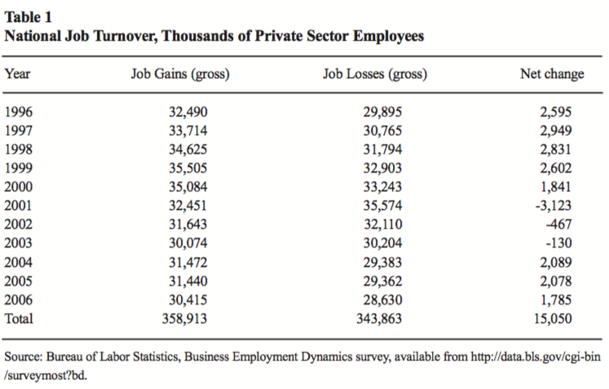
Source: James (2007)
Notes:
James, Sallie, “Maladjusted: The Misguided Policy of ‘Trade Adjustment Assistance’,” Briefing Paper No. 26, Center for Trade Policy Studies, Cato Institute, November 8, 2007.

Slide 35
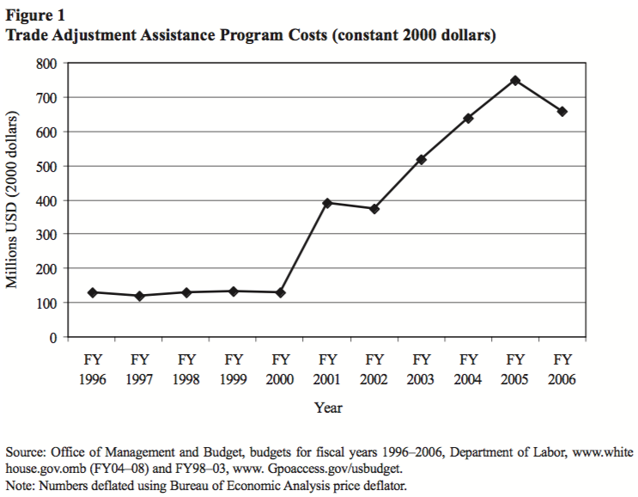
Source: James (2007)
Notes:
James, Sallie, “Maladjusted: The Misguided Policy of ‘Trade Adjustment Assistance’,” Briefing Paper No. 26, Center for Trade Policy Studies, Cato Institute, November 8, 2007.

Slide 36
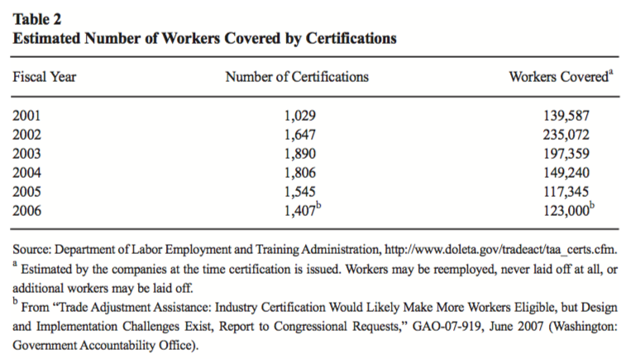
Source: James (2007)
Notes:
James, Sallie, “Maladjusted: The Misguided Policy of ‘Trade Adjustment Assistance’,” Briefing Paper No. 26, Center for Trade Policy Studies, Cato Institute, November 8, 2007.

Slide 37
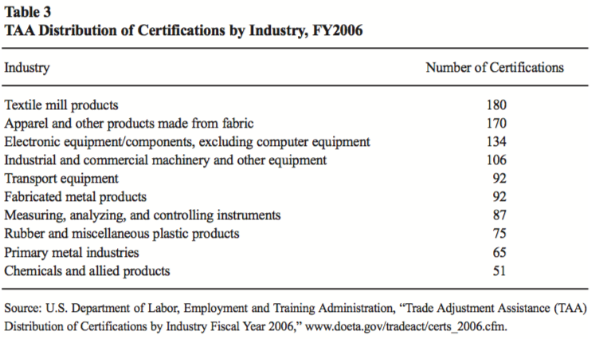
Source: James (2007)
Notes:
James, Sallie, “Maladjusted: The Misguided Policy of ‘Trade Adjustment Assistance’,” Briefing Paper No. 26, Center for Trade Policy Studies, Cato Institute, November 8, 2007.

Slide 38
Arguments against TAA
Arguments against EU TAA (see Beattie)
EU TAA is European Globalisatin Fund since 2007
Problems with it
Complicated to administer
Fails to provide much compensation
Contributes to the perception that trade is harmful.
Better would be “a Nordic-style comprehensive welfare and education system”

Slide 39
Pause for Discussion

Slide 40
Questions on James, “Maladjusted”
What has been the primary motivation for enacting and extending TAA?
What sectors of the US economy have had the most certifications for TAA, according to the FY2006 data presented?
Are trade displaced workers more in need of help than workers displaced by other causes?

Slide 41
Questions on Beattie, “Flaws of Trying…”
Does the author mention any examples of successful compensation of producers hurt by imports?
Does TAA achieve the aim of compensating losers from trade?
Does TAA achieve the aim of making trade agreements politically acceptable?
Why should advocates of globalization be opposed to TAA?

Slide 42
Questions on Beattie, “Flaws of Trying…”
Does the EU have a program analogous to Trade Adjustment Assistance?
How much money does TAA hand out, and to how many workers?
Does the author favor doing nothing to help those who lose from trade?

Slide 43
TAA: Trade Adjustment Assistance
The US program
Wage Insurance (ATAA)
Arguments against
Current status of TAA

Slide 44
Current status of TAA
2015: TAA was reauthorized through June 2022
”Phased termination” would begin then
“Sunset provisions” would apply starting July 2021
2021-22: Acts to reauthorize were passed in House, but omitted from bills passed by Senate
June 2023: American Worker and Trade Competitiveness Act (H.R. 4276) was introduced to
Extend TAA through FY 2030
Expand eligibility and benefits

Slide 45
Questions on Collins, “Trade Adjustment Assistance …”
What were the “sunset provisions” in that act, and when did they apply?
If workers were approved for TAA prior to July 2022, did they lose their benefits?
Has legislation been introduced to reauthorize TAA, and has it passed?
What is the status now?

