Slide 1
Class 20
FTAs and Other Trade Deals by
Alan V. Deardorff
University of Michigan
2023
PubPol/Econ 541

Slide 2
Quiz
 | Q7 | Q8 | Q9
Mean | 7.73 | 8.00 | 7.67
Median | 7.5 | 9 | 8
Max | 10 | 10 | 10
Min | 6 | 4 | 3.5
S.D. | 1.35 | 2.07 | 2.21

Slide 3
Pause for News

Slide 4
Outline
FTAs in general
Multicountry
  North America
    NAFTA
    USMCA
  RCEP
  CPTPP
EU and Other
UK and Other
US and Other
Other

Slide 5
FTAs in General
Types
  Free Trade Agreement (FTA)
    Zero tariffs on (most) imports from partners
    Unequal tariffs on imports from outsiders
    Rules of origin (ROOs)
  Customs Union
    Zero tariffs on imports from partners
    Common external tariffs on outsiders
    No need for ROOs
  Common Market
    Customs Union plus other free movement

Slide 6
FTAs in General
Proliferation: Now more than 300, involving a significant fraction of possible country pairs
Most are FTAs
WTO reports all as “Regional Trade Agreements” (RTAs), though many include distant countries

Slide 7
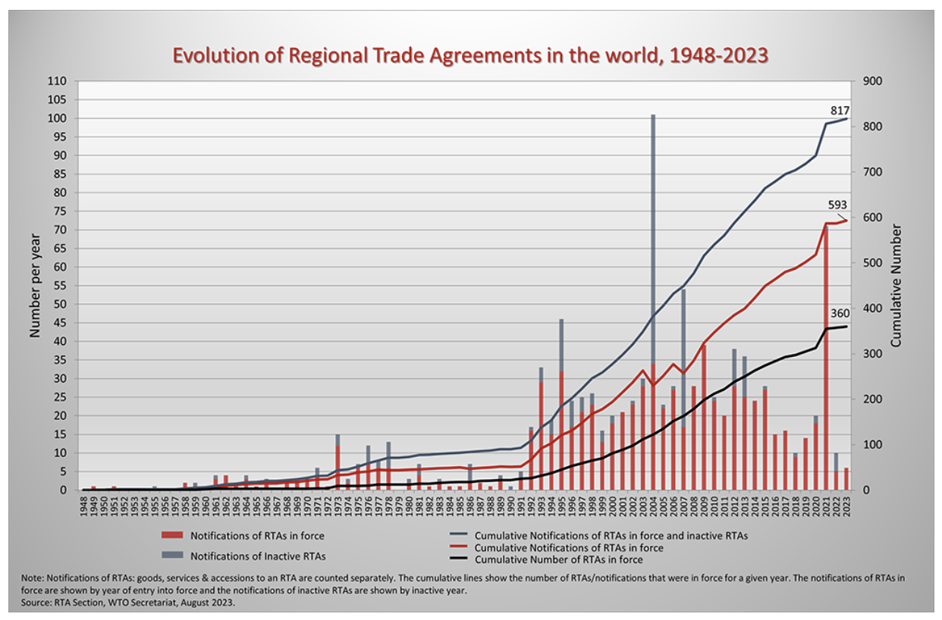
Surge in 2021 was mostly UK doing FTAs with former EU partners.
Source: WTO
Notes:
WTO
https://www.wto.org/english/tratop_e/region_e/region_e.htm#facts

Slide 16
Pause for Discussion

Slide 17
  Questions
  (Not asked before)
Why are ROOs necessary in FTA but not in Customs Union?
Why is the matrix of FTAs plus CUs so much fuller than the matrix of just FTAs? Are there really a lot of CUs?

Slide 18
NAFTA
What it was
  An FTA between US, Canada, and Mexico
  Went into effect Jan 1, 1994
Effects
  Trade
  Wages
  Employment
  Supply chains
  Consumers

Slide 19
NAFTA Effects
Trade
  Grew massively across N. America
  US bilateral trade with Mexico became deficits: US imports > US exports
  Supply chains, especially in autos, extended across North America

Slide 20
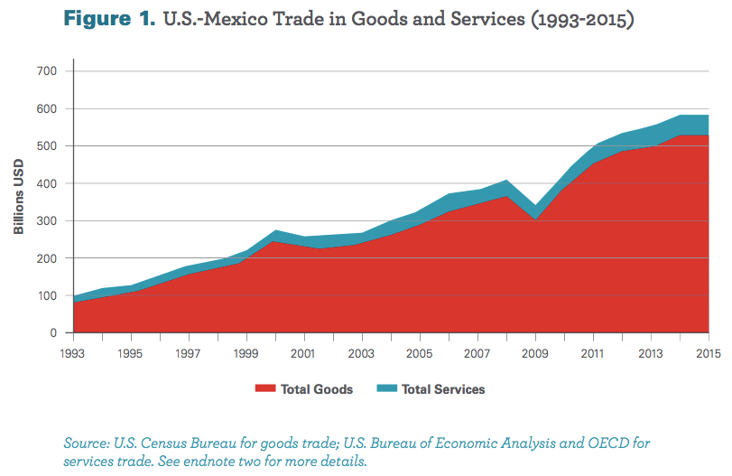
From: Wilson, Christopher, Growing Together: Economic Ties between the United States and Mexico, Wilson Center, March 2017.

Slide 21
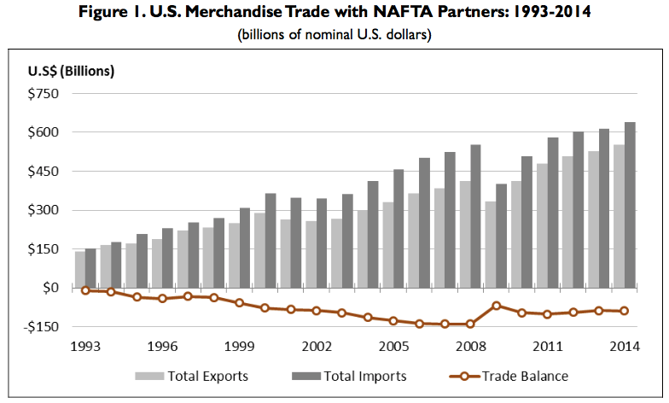
Source: Congressional Research Service (2015)

Slide 22
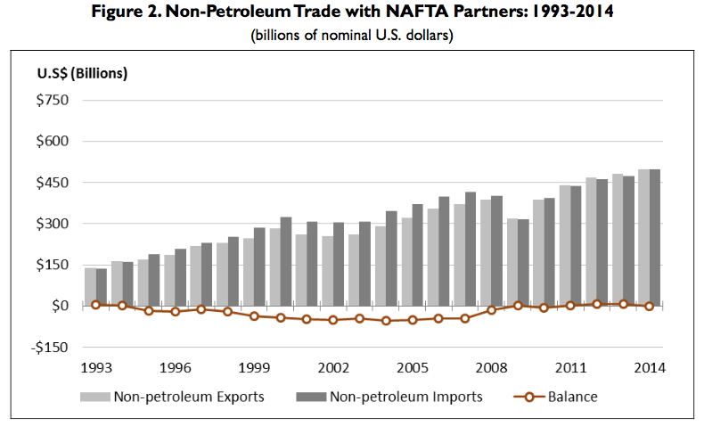
Note near balance
Source: Congressional Research Service (2015)

Slide 23
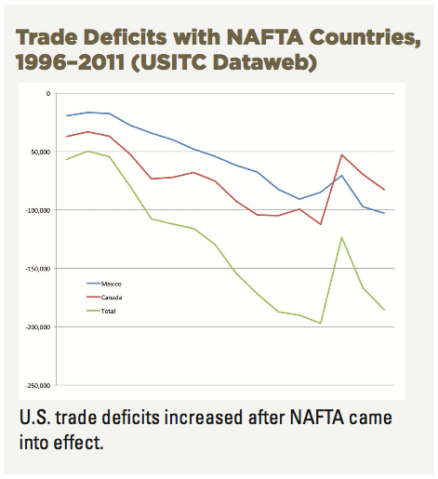
Source: AFL-CIO, “NAFTA at 20”

Slide 24
NAFTA Effects
Wages
  Fell in Mexico
  No effect on average in US

Slide 25
Real Wages Plummeted!
What Happened: Mexico
NAFTA
Peso Crisis

Slide 26
Real Wage: No Change
What Happened: U.S.
NAFTA
Peso Crisis

Slide 27
NAFTA Effects
Employment
  No effect on overall US employment or unemployment
  Pockets of disruption across US

Slide 28
Unemployment: No effect (or fell)
What Happened: U.S.
NAFTA
Peso Crisis

Slide 29
NAFTA Effects
Supply chains
  US manufacturing moved inputs to low-cost locations across N. America

Slide 30

NAFTA and the Auto Supply Chain
Black, Diamond, and Merrill, “One Tiny Widget’s Dizzying Journey Shows Just How Critical Nafta Has Become,” Bloomberg, February 2, 2017.

Slide 31

NAFTA and the Auto Supply Chain
Black, Diamond, and Merrill, “One Tiny Widget’s Dizzying Journey Shows Just How Critical Nafta Has Become,” Bloomberg, February 2, 2017.

Slide 32

NAFTA and the Auto Supply Chain
Black, Diamond, and Merrill, “One Tiny Widget’s Dizzying Journey Shows Just How Critical Nafta Has Become,” Bloomberg, February 2, 2017.

Slide 33

NAFTA and the Auto Supply Chain
Black, Diamond, and Merrill, “One Tiny Widget’s Dizzying Journey Shows Just How Critical Nafta Has Become,” Bloomberg, February 2, 2017.

Slide 34

NAFTA and the Auto Supply Chain
Black, Diamond, and Merrill, “One Tiny Widget’s Dizzying Journey Shows Just How Critical Nafta Has Become,” Bloomberg, February 2, 2017.

Slide 35

NAFTA and the Auto Supply Chain
Black, Diamond, and Merrill, “One Tiny Widget’s Dizzying Journey Shows Just How Critical Nafta Has Become,” Bloomberg, February 2, 2017.

Slide 36
NAFTA Effects
Consumers
  As always with freer trade, the ultimate beneficiaries are consumers
    Lower prices for
      Imported consumer goods
      Domestically produced goods and services that use cheaper imported inputs
    Greater variety of goods to choose from
  These gains are hard to measure
    One indicator may be the low rates of price inflation experienced under NAFTA

Slide 37
Pause for Discussion

Slide 38
  Questions
I’ve not assigned anything evaluating NAFTA, since it’s been replaced by USMCA. But what were, and are, your own impressions of NAFTA?

Slide 39
USMCA
What it is
  “United States, Mexico, Canada Agreement”
  Result of Trump’s renegotiation of NAFTA
  Mostly the same as NAFTA
Why replace NAFTA?
  Trump opposed NAFTA as early as 1993
    “The Mexicans want it, and that doesn't sound good to me.”
    Trump sees trade as zero-sum game
  Opposition to NAFTA was popular

Slide 40
USMCA Timeline
Renegotiation
  May 18, 2017: Renegotiation began
  Aug 27, 2018: Agreement between US and Mexico
  Sep 30, 2018: Agreement with Canada to join
Approval and Implementation
  Dec 19, 2019: US House approved (contentious)
  Jan 17, 2020: Senate approved (expected)
  Jan 29, 2020: Trump signed into law
  Jul 1, 2020: Agreement went into effect

Slide 41
USMCA Features
Car incentives
  ROO raised from 62.5% to 75%
  70% of steel & aluminum must come from NA
  40-45% of value added from >$16/hr labor
Dairy: Some opening of US dairy to Canada
ISDS only between US & Mexico (was for all in NAFTA)
  ISDS = Investor-State Dispute Settlement
Commitments on labor & IP standards
“Sunset Clause”: Review after 6 years
Inform US if negotiate with NME (China)
Commitment not to manipulate currencies
NEW

Slide 42
Pause for Discussion

Slide 43
  Questions on Kirby
How big a change is USMCA compared to NAFTA?
What industry or product seems to have gotten the most attention in the changes made to USMCA?
How are the rules of origin for cars and car parts changed in USMCA compared to NAFTA?
What is the “rapid-response mechanism”?

Slide 44
RCEP
RCEP
  “Regional Comprehensive Economic Partnership”
  Large FTA negotiated since 2013 by
    ASEAN 10 countries plus 5: China, Japan, South Korea, Australia and New Zealand
    India also, until it dropped out in November 2019
  Signed Nov 15, 2020

Slide 45
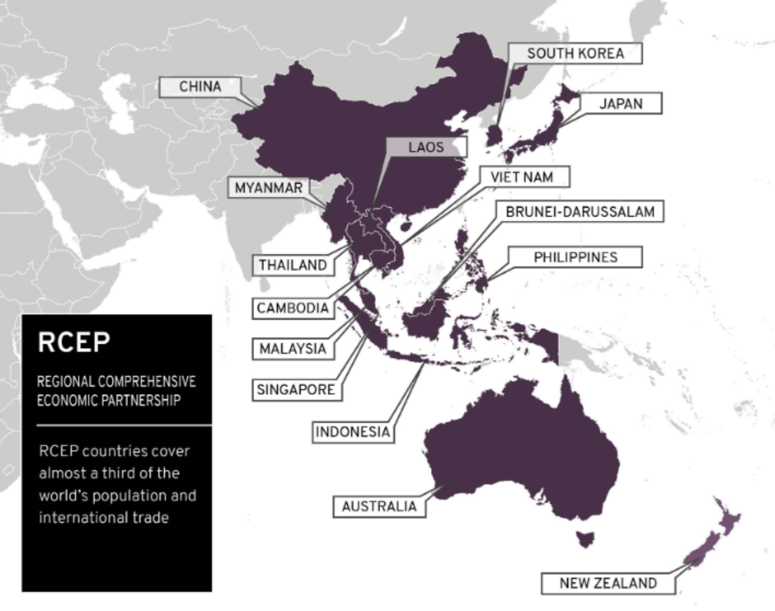
Notes:
https://www.mfat.govt.nz/en/trade/free-trade-agreements/free-trade-agreements-concluded-but-not-in-force/regional-comprehensive-economic-partnership-rcep/rcep-overview

Slide 46
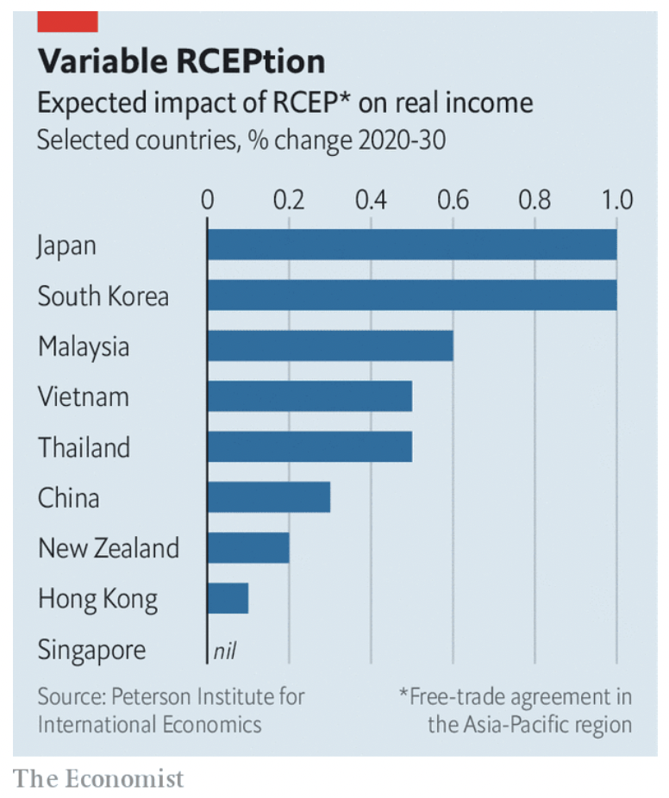
Notes:
Economist, "Big deal: Who gains from RCEP, Asia’s new trade pact?," The Economist, November 21, 2020.

Slide 47
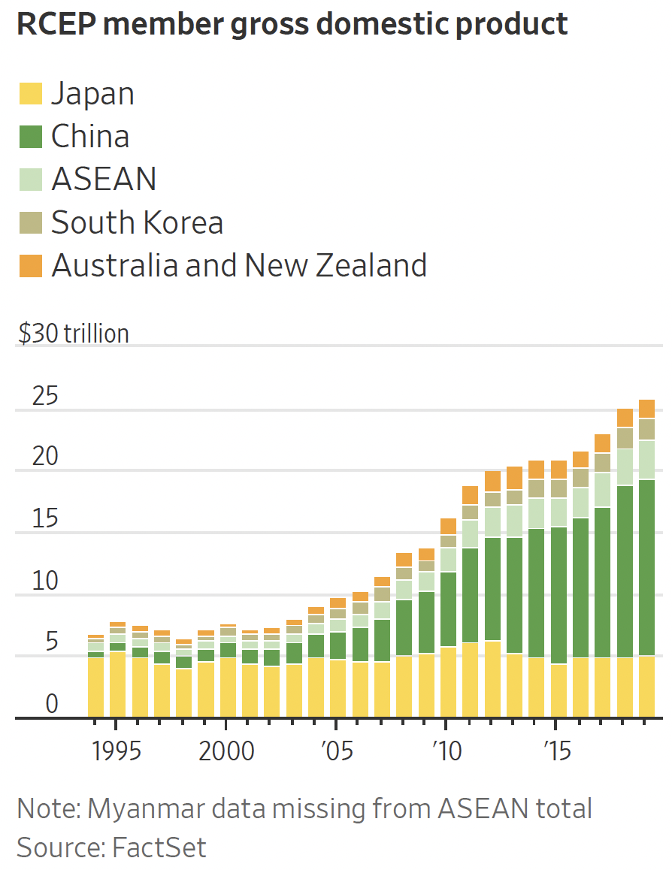
Notes:
Bird, Mike, "Asia’s Massive New Trade Deal Is No Big Victory for Beijing," Wall Street Journal, November 16, 2020.

Slide 48
Pause for Discussion

Slide 49
  Questions on Hayashi,
  “U.S. on Sidelines as …”
How many countries are in RCEP, and how does it compare in size to other trade agreements?
Who initiated the negotiations for RCEP?
Over what period are the tariff reductions of RCEP scheduled?
Does it eliminate all tariffs among the countries?
What rule of origin is applied in RCEP?

Slide 50
CPTPP
CPTPP
  “Comprehensive and Progressive Trans-Pacific Partnership”
  Successor to TPP after Trump pulled US out
  Includes 11 countries, including
    Japan
    Canada
    Mexico
    Australia
    Chile

Slide 51
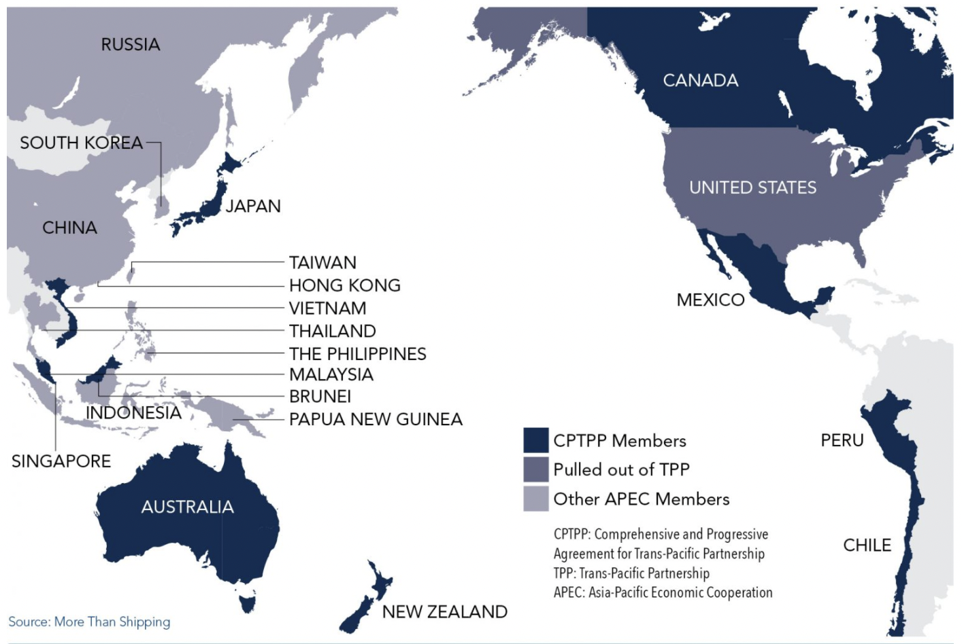
Notes:
https://advocacy.calchamber.com/policy/issues/trans-pacific-trade-relations/

Slide 52
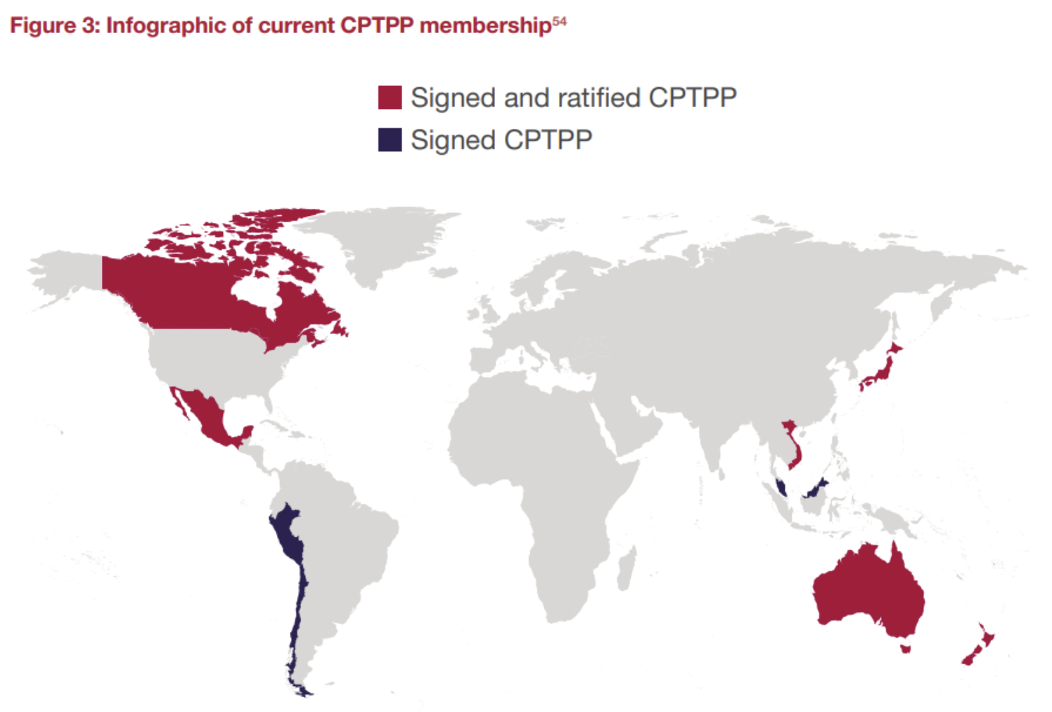
Source:
Edmond April 2023
There are 11 CPTPP members currently, accounting for 14% of global GDP.
Notes:
Edmond, Charlotte, "The United Kingdom Is Set to Join the Trans-Pacific Free Trade Pact. Here's What You Need to Know," World Economic Forum, April 3, 2023. [4p]
https://www.weforum.org/agenda/2023/04/cptpp-trade-tariff-brexit-uk/

Slide 53
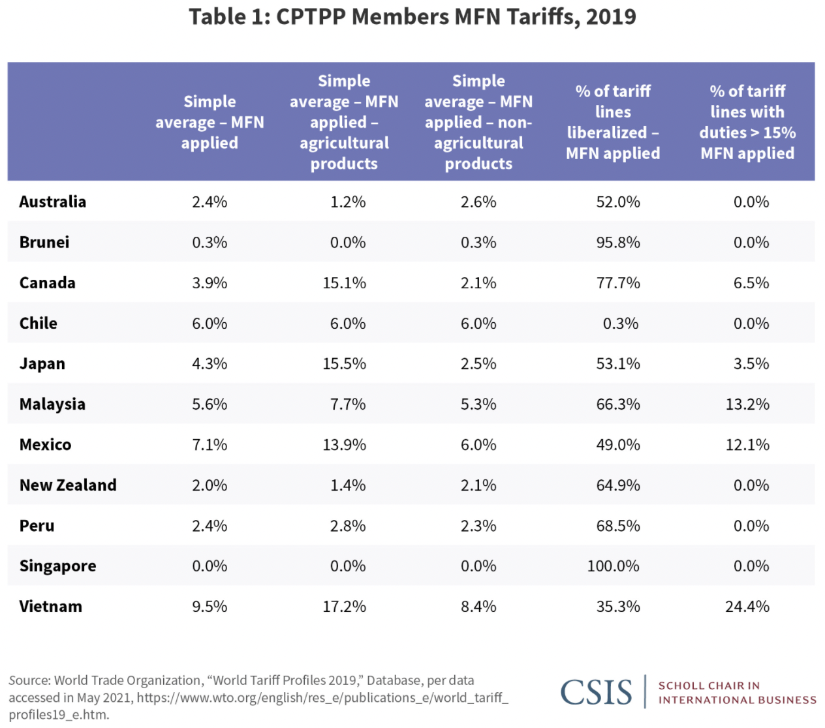
Notes:
“Two Years into CPTPP”, CSIS, August 9, 2021
https://www.csis.org/analysis/two-years-cptpp

Slide 54
Pause for Discussion

Slide 55
  Questions on Edmond,
  “The United Kingdom Is Set …”
How many countries are in the CPTPP including UK, and how many will be in it after those who’ve applied join?
Will all tariffs be removed for trade among these countries?
By how much does UK GDP stand to grow as a result of joining the CPTPP?

Slide 56
EU and Other
The EU has trade agreements with many other countries
  These have all reduced tariffs
  But the EU is concerned that many tariffs have been replaced by NTBs
It is dealing with possible FTAs with
  Chile
  MERCOSUR
  Australia
  Kenya

Slide 57
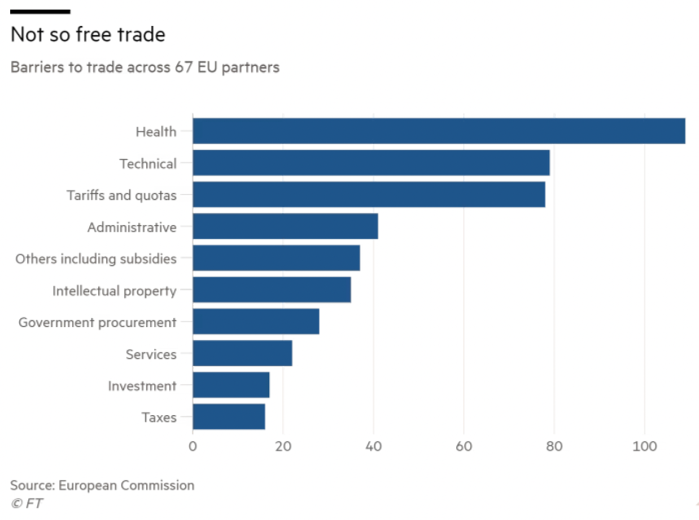
Notes:
Bounds, Andy, “EU steps up pressure to dismantle trade barriers,” Financial Times, October 27, 2021. [3p].
https://www.ft.com/content/b988cf7d-baf6-49ca-97c2-1ba16c6bdd10

Slide 58
Pause for Discussion

Slide 59
  Questions on Bounds,
  “EU Seals Chile Trade Deal …”
Will Chile remove all tariffs on EU exports?
Will the EU remove all tariffs on Chile?
What objections had to be overcome to achieve this agreement?
Is this just a simple FTA dealing only with tariffs?
Is this a done deal, or do more things have to happen for it to be final?

Slide 60
  Questions on Bounds & Johnston , re EU FTA with Brazil
What is the trade deal that is discussed here?
Why is Lula refusing to sign?
When was this agreement provisionally reached, and how long did the negotiations to achieve it take?
What does China have to do with any of this?

Slide 61
  Questions on Johnston & Bounds,
  “Australia-EU trade deal stalls …”
Why does Australia want an FTA with the EU?
Why does the EU want an FTA with Australia?
What is the main issue in the way of agreement?
What other issues are mentioned as outstanding?

Slide 62
UK and Other
UK was unable to do FTAs while part of EU.
Since leaving EU,
  It completed 30 FTAs with former EU partners and the EU, effective Jan 1, 2021
  It has completed 8 more FTAs, including one with EU. (Per WTO, Aug 23, 2023)
Notes:
http://rtais.wto.org/UI/PublicAllRTAList.aspx

Slide 63
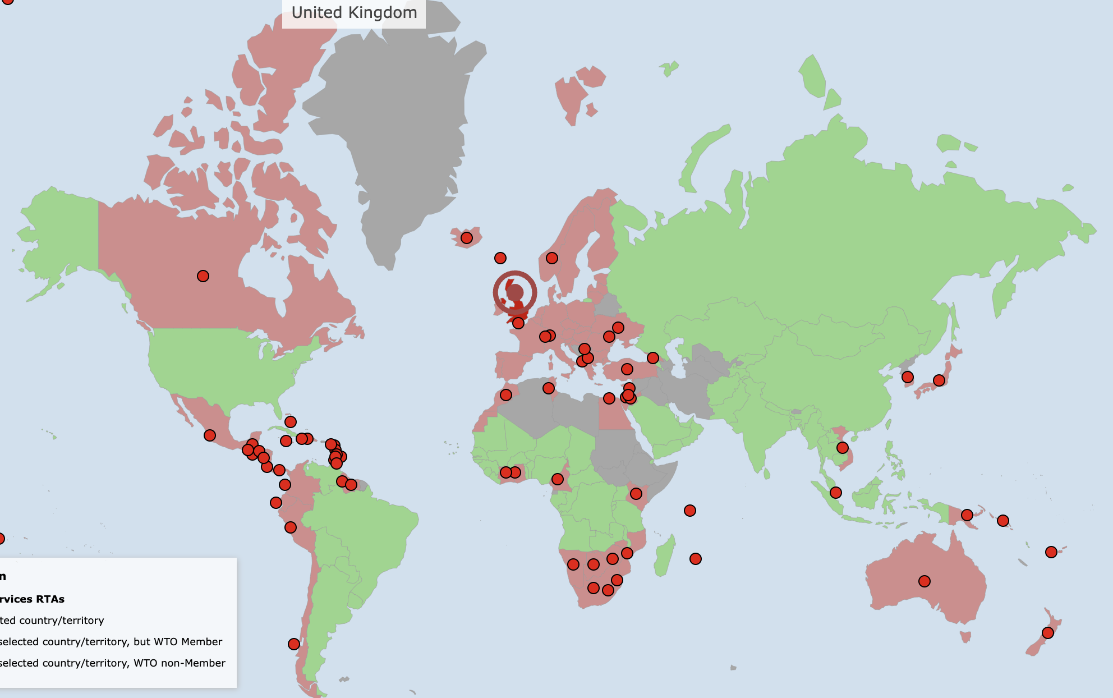
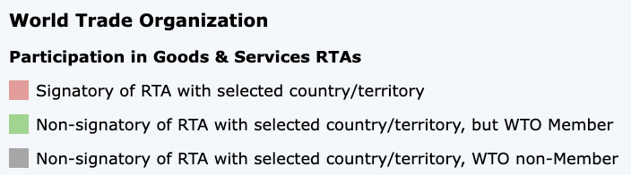
Notes:
http://rtais.wto.org/UI/PublicMaintainRTAHome.aspx

Slide 64
Pause for Discussion

Slide 65
  Questions on Alim, re UK FTA with Australia
When was the FTA between UK and Australia signed?
What does the environmental group claim is wrong with it?
Is there evidence to support their claim?
How does the UK government respond?

Slide 66
  Questions on Reed et al., re UK FTA with India
What is the deal being discussed?
What is the visa issue?
What is the issue about automotive and spirits?
How big is the India economy compared to the UK?
When might the trade deal be reached?

Slide 67
  Questions on Fedor & Politi.,
  “US Calls for Revived UK…”
Why was the Windsor Framework important for getting negotiations on a UK-US FTA?
What action was actually taken toward that objective?
Has the Biden administration said it wants to pursue this?

Slide 68
US and Other
US has not attempted any actual new FTAs since 2012
What it has done instead:
  US-Japan trade agreement, 2020
    Improved market access for US into Japan
    US reduced or eliminated some tariffs on Japan
  Indo-Pacific Economic Framework (IPEF)
  Trade deal with Taiwan
Notes:
http://rtais.wto.org/UI/PublicAllRTAList.aspx

Slide 69
Pause for Discussion

Slide 70
  Questions on Economist,
  “The Great Steeplechase”
What are the two trade agreements that are competing here?
Which of them reduce tariffs the most?
What does IPEF mainly do?
What does RCEP mainly do?
What is taken to signal that the US will do little in the near future to liberalize trade?

Slide 71
  Questions on Beattie,
  “US Trade Pledge to the Indo-Pacific”
How many countries other than the US are included in this agreement?
What new bodies does it set up, and with what purpose?
Why does this author say that this agreement can accomplish little?
Since IPEF is “empty,” has it met no resistance?

Slide 72
  Questions on Areddy,
  “U.S., Taiwan Reach Trade Deal…”
What does the agreement cover?
What does the agreement NOT cover?
Why is the agreement not an FTA?
When did US relations with Taiwan cease formal diplomatic relations with Taiwan, and why?

Slide 73
Other Trade Deals
China is negotiating deals with various countries in Latin America
United Arab Emirates is having trade talks with Ukraine

Slide 74
Pause for Discussion

Slide 75
  Questions on Daniels & Leahy, re China-Ecuador FTA
With what Latin American countries did China have FTAs before this?
Why does Ecuador prefer having an FTA with China rather than the US?
Will this FTA be ratified in Ecuador?
Does Ecuador export more to China or to the US?

Slide 76
  Questions on Kerr,
  “UAE and Ukraine Trade Talks”
What do these talks hope to achieve?
Where does UAE stand on the Russia-Ukraine war?
Does UAE have, or is it pursuing, other such trade deals?

