Slide 1
Class 19
Preferential Trading Arrangements by
Alan V. Deardorff
University of Michigan
2023
PubPol/Econ 541

Slide 2
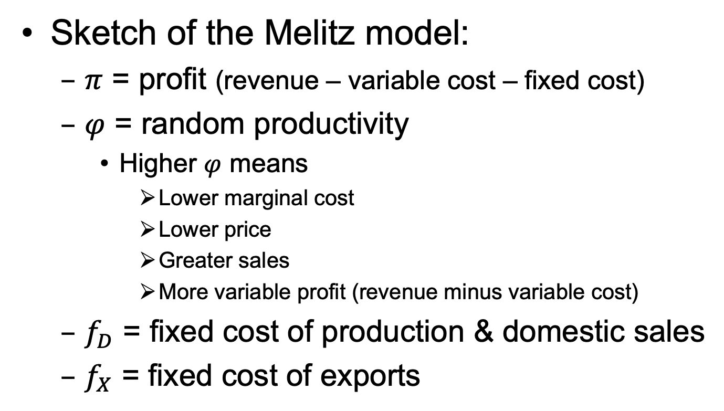
Heterogeneous Firms
Left-over from last time:
Sketch of the Melitz model:
  $π$ = profit (revenue – variable cost – fixed cost)
  $φ$ = random productivity
    Higher $φ$ means
      Lower marginal cost
      Lower price
      Greater sales
      More variable profit (revenue minus variable cost)
  $f_{D}$ = fixed cost of production & domestic sales
  $f_{X}$ = fixed cost of exports
Notes:
Adapted from José Pulido, “El Modelo de Melitz (2003)”, Universidad del Rosario.
https://josepulido.net/wp-content/uploads/Melitz-1.pdf

Slide 3






Equilibrium in Autarky
Left-over from last time:
$$π$$
$$π_{autarky}$$
Profit
Don’t produce
$$φ_{a}^{∗}$$
$$0$$
$$φ$$
Produce
Productivity
$$f_{D}$$
Notes:
Adapted from José Pulido, “El Modelo de Melitz (2003)”, Universidad del Rosario.
https://josepulido.net/wp-content/uploads/Melitz-1.pdf

Slide 4





Equilibrium with Trade
Left-over from last time:
$$π$$
Profit
$$π$$
$$π_{D}$$
Produce & sell only domestic
$$π_{X}$$
Don’t produce
Produce & sell both domestic and export
$$0$$
$$φ_{D}^{∗}$$
$$φ_{X}^{∗}$$
$$φ$$
$$f_{D}$$
Productivity
$$f_{X}$$
Notes:
Adapted from José Pulido, “El Modelo de Melitz (2003)”, Universidad del Rosario.
https://josepulido.net/wp-content/uploads/Melitz-1.pdf

Slide 5



Move Autarky to Trade
Left-over from last time:
Firms shut down
Firms survive by exporting
Firms export & expand
Profit falls due to greater competition and lower price with trade.
$$π$$
Firms shrink
$$π_{autarky}$$
Profit
$$π$$
$$π_{D}$$
$$π_{X}$$
$$φ_{a}^{∗}$$
$$0$$
$$φ_{D}^{∗}$$
$$φ_{X}^{∗}$$
$$φ$$
$$f_{D}$$
Productivity
$$f_{X}$$
Notes:
Adapted from José Pulido, “El Modelo de Melitz (2003)”, Universidad del Rosario.
https://josepulido.net/wp-content/uploads/Melitz-1.pdf

Slide 6
Pause for Discussion
Left-over from last time:

Slide 7
  Questions (not asked before)
Left-over from last time:
It seems obvious that firms differ. Why was that not allowed with perfect competition?
Explain the new source of gain from trade that the heterogeneous firm model introduces?

Slide 8
Papers
Paper #2 was due today
Paper #3
  Will be due December 6, the last day of class
  Note that you will be selecting your own topic for this
  Confer with your group soon to discuss what topic you will select
  Suggestion: Select a simple topic, similar to what you’ve done in papers #1-2
  Feel free to consult me about your topic ideas
    By email
    Or ask for group zoom meeting with me

Slide 9
Outline
Background on PTAs
Simplest model: horizontal supplies
Upward-sloping supplies
  3-country case, in graphs
  Somewhat more general case, in equations
  4-country case, in graphs (probably omit)
Are FTAs Beneficial?

Slide 10
Outline
Background on PTAs
Simplest model: horizontal supplies
Upward-sloping supplies
  3-country case, in graphs
  Somewhat more general case, in equations
  4-country case, in graphs
Are FTAs Beneficial?

Slide 11
Background
A Preferential Trading Arrangement (PTA)
  Exists when a country uses a lower tariff on one country than on another
Examples
  Free Trade Agreements and Customs Unions
    Zero tariff on (almost) all goods from partner country (ies)
  Generalized System of Preferences (GSP)
    Lower than WTO MFN tariffs on some exports of selected developing countries
  ADD, CVD
    High tariff on only target country (ies)
    (Not Safeguards tariffs, which must apply to all)

Slide 12
Background
A PTA is not the same as lowering a tariff on imports from all countries
Reason: There is both…
  … “Trade creation”
    Increased imports from the favored partner instead of buying from domestic producers
  … “Trade diversion”
    Switch to import from favored partner instead of from another country (”third country”)

Slide 13
Background
Viner’s (1950) trade creation and trade diversion are usually illustrated with
  Constant costs
  2-country FTA or CU plus rest of world
Then we’ll look at cases with
  Upward sloping supplies
  And in the last case, an FTA when there is another pre-existing FTA

Slide 14
Pause for Discussion

Slide 15
  Questions on KOM
Why does the text say that the GATT permission for countries to form FTAs is a “rather strange exception”?
Why do members of a customs union “cede part of their national sovereignty to a supranational entity”?
Why are rules of origin needed in a Free Trade Agreement but not in a Customs Union?

Slide 16
Outline
Background
Simplest model: horizontal supplies
Upward-sloping supplies
  3-country case, in graphs
  Somewhat more general case, in equations
  4-country case, in graphs
Are FTAs Beneficial?

Slide 17
Simplest Model
Assume
  Partial-equilibrium model of trade in a good
    All the same assumptions we’ve used before for tariffs
  3 countries:
    Home, A
    Potential Partner 1, B, and
    Potential Partner 2, C
  B and C have constant costs of exporting to A, at prices P_{B} < P_{C}
  A initially has tariff, t, on both B anad C, t > P_{C} – P_{B}

Slide 18
No FTA
Home Country A
P
Without FTA
  Since P_{B}+t < P_{C}+t Home imports only from B
S
P_{aut}
P_{C}+t
P_{B}+t
P_{C}
P_{B}
D
S₀
D₀
Q
M₀

Slide 19
FTA with low-cost country, B
Home Country A
P
FTA with B
Since P_{B} < P_{C}+t Home still imports only from B
Country C plays no role
S
P_{aut}
P_{C}+t
P_{B}+t
Welfare
Suppliers lose –a
Demanders gain +(a+b+c+d)
Government loses –c
Country gains +(b+d)
P_{C}
a
b
c
d
P_{B}
D
S₁
S₀
D₀
D₁
Q
M₀
Same as Free Trade

Slide 20
FTA with low-cost country, B
Home Country A
P
S
P_{aut}
P_{C}+t
P_{B}+t
P_{C}
a
b
c
d
P_{B}
D
D₁
S₀
D₀
D₁
Q
M₀
Trade Creation

Slide 21
FTA with high-cost country, C
Home Country A
P
FTA with C
Since P_{C} < P_{B}+t Home now imports only from C
S
P_{aut}
P_{C}+t
Welfare
Suppliers lose –a
Demanders gain +(a+b+c+d)
Government loses –(c+e)
Country: –e+(b+d)
P_{B}+t
a
b
c
d
P_{C}
e
P_{B}
D
Not same as Free Trade
and may be a loss, if e>(b+d)
S₁
S₀
D₀
D₁
Q
M₀

Slide 22
FTA with high-cost country, C
Home Country A
P
S
P_{aut}
P_{C}+t
P_{B}+t
a
b
c
d
P_{C}
e
P_{B}
Trade Diversion
D
S₁
S₀
D₀
D₁
Q
M₀
Trade Creation

Slide 23
Pause for Discussion

Slide 24
  Questions
On KOM:
If consumers in an FTA buy imports from their FTA partner rather than a non-member due to their paying a lower price, how can that be harmful for the country?
On WTO:
The examples show only trade creation if the PTA is with the low-cost country. Should countries therefore only form PTAs with low-cost countries?

Slide 25
Trade in Services
Trade in a service is not subject to tariffs, since nothing physical crosses borders
It is subject to regulatory standards, which also raise cost, by some amount, say “s”.
Assume that FTA removes this cost through
  Harmonization of standards, or
  Mutual recognition
The difference is that
  Tariff t is revenue to government
  Regulatory cost s is a real cost, using real resources, and not a transfer or benefit to anyone
Pictures look the same as before, except for interpretation of this cost.

Slide 26
Service FTA with low-cost, B
Home Country A
P
FTA with B
Since P_{B} < P_{C}+s Home still imports only from B
Country C plays no role
S
P_{aut}
P_{C}+s
P_{B}+s
Welfare
Suppliers lose –a
Demanders gain +(a+b+c+d)
Government loses 0
Country gains +(b+c+d)
P_{C}
a
b
c
d
P_{B}
D
S₁
S₀
D₀
D₁
Q
M₀

Slide 27
Service FTA with high-cost, C
Home Country A
P
FTA with C
Since P_{C} < P_{B}+s Home now imports only from C
S
P_{aut}
P_{C}+s
Welfare
Suppliers lose –a
Demanders gain +(a+b+c+d)
Government loses 0
Country gains +(b+c+d)
P_{B}+s
a
b
c
d
P_{C}
e
P_{B}
D
Certain gain, but not as large as with country B
S₁
S₀
D₀
D₁
Q
M₀

Slide 28
Pause for Discussion

Slide 29
  Questions on WTO,
  “Causes and Effects of PTAs”
What is the main difference between the effects of a PTA in goods and one in services?

Slide 30
Outline
Background
Simplest model: horizontal supplies
Upward-sloping supplies
  3-country case, in graphs
  Somewhat more general case, in equations
  4-country case, in graphs
Are FTAs Beneficial?

Slide 31
Upward-sloping Supplies
3-country case*
Assume
  Partial-equilibrium model of trade in a good
    All the same assumptions we’ve used before for tariffs
  Three countries, one importer A, and two exporters B, and C
  Export supply and import demands are linear
  Countries B and C are identical
For simplicity
*Much of this is an elaboration of material in World Trade Organization, "Causes and Effects of PTAs: Is it all about preferences?", Ch. C: World Trade Report 2011, pp. 92-121.

Slide 32
Upward-sloping Supplies
3-country case
Two equilibria:
  0: MFN specific tariff t on exports of both B and C
  1: FTA of A and B:
    tariff t on exports of C;
    zero tariff on exports of B
Assume also: A imports from both B and C in both equilibria
  That’s not guaranteed, but it’s possible as we’ll see, and other cases would be harder

Slide 33






Export Supplies
Export Supplies of B and C
Exports to Country A
P
P
$X^{Bt}+X^{Ct}$
MFN
$X^{Bt}, X^{Ct}$
FTA
$X^{Bf}, X^{Cf}$
$X^{Bf}+X^{Ct}$
$$t$$
$a^{B}=a^{C}$
Q
Q

Slide 34





MFN Equilibrium
Export Supplies
Import Market
P
P
$X^{Bt}+X^{Ct}$
MFN
$X^{Bt}, X^{Ct}$
FTA
$X^{Bf}, X^{Cf}$
$$p_{0}^{A}$$
$X^{Bf}+X^{Ct}$
$$M^{A}$$
$$t$$
$a^{B}=a^{C}$
$$X_{0}^{B}=X_{0}^{C}$$
Q
$$M_{0}^{A}{=X}_{0}^{B}+X_{0}^{C}$$
Q

Slide 35








FTA Equilibrium
Export Supplies
Import Market
P
P
$X^{Bt}+X^{Ct}$
MFN
$X^{Bt}, X^{Ct}$
FTA
$X^{Bf}, X^{Cf}$
$$p_{0}^{A}$$
$X^{Bf}+X^{Ct}$
$$p_{1}^{A}$$
$$M^{A}$$
$$t$$
$a^{B}=a^{C}$
$$X_{0}^{B}$$
$$=X_{0}^{C}$$
Q
Q
$$X_{1}^{C}$$
$$X_{1}^{B}$$
$$M_{0}^{A}$$
$$M_{1}^{A}$$

Slide 36














Trade Creation and Diversion
Export Supplies
Import Market
P
P
$X^{Bt}+X^{Ct}$
MFN
$X^{Bt}, X^{Ct}$
FTA
$X^{Bf}, X^{Cf}$
$$p_{0}^{A}$$
$X^{Bf}+X^{Ct}$
$$p_{1}^{A}$$
$$M^{A}$$
$$t$$
$a^{B}=a^{C}$
TD
TC
$$X_{0}^{B}$$
$$=X_{0}^{C}$$
Q
Q
$$X_{1}^{C}$$
$$X_{1}^{B}$$
$$M_{0}^{A}$$
$$M_{1}^{A}$$

Slide 37


TC & TD, another View
Export Supplies
Import Market
$p^{A}$
$p^{A}$
MFN
$X^{Bt}, X^{Ct}$
$X^{Bt}+X^{Ct}$
FTA
$X^{Bf}, X^{Cf}$
$$p_{0}^{A}$$
$X^{Bf}+X^{Ct}$
$$p_{1}^{A}$$
$$M^{A}$$
$$t$$
TD
$a^{B}=a^{C}$
TC
TC
TD
$$X_{0}^{B}$$
$$=X_{0}^{C}$$
Q
Q
$$X_{1}^{C}$$
$$X_{1}^{B}$$
$$M_{0}^{A}$$
$$M_{1}^{A}$$

Slide 38



Welfare Effects on Country A
Export Supplies
Import Market
Tariff revenue lost from
B C
Net gain of A’s private sector
$p^{A}$
$p^{A}$
MFN
$X^{Bt}, X^{Ct}$
$X^{Bt}+X^{Ct}$
FTA
$X^{Bf}, X^{Cf}$
$$p_{0}^{A}$$
$X^{Bf}+X^{Ct}$
$$p_{1}^{A}$$
$$M^{A}$$
$$t$$
TD
$$a^{B}=a^{C}$$
TC
TC
TD
$$X_{0}^{B}$$
$$=X_{0}^{C}$$
Q
Q
$$X_{1}^{C}$$
$$X_{1}^{B}$$
$$M_{0}^{A}$$
$$M_{1}^{A}$$
See immediately that country A
Gains from trade creation
Loses from trade diversion
As well as from lost revenue from country B

Slide 39

Welfare Effects on Countries B and C
Export Supplies
Import Market
$p^{A}$
$p^{A}$
MFN
Gain by partner country B
$X^{Bt}, X^{Ct}$
$X^{Bt}+X^{Ct}$
FTA
$X^{Bf}, X^{Cf}$
$$p_{0}^{A}$$
$X^{Bf}+X^{Ct}$
$$p_{1}^{A}$$
Loss by outside country C
$$M^{A}$$
$$t$$
TD
$$a^{B}=a^{C}$$
TC
TC
TD
$$X_{0}^{B}$$
$$=X_{0}^{C}$$
Q
Q
$$X_{1}^{C}$$
$$X_{1}^{B}$$
$$M_{0}^{A}$$
$$M_{1}^{A}$$

Slide 40


Welfare Effects on the World
Export Supplies
Import Market
$p^{A}$
$p^{A}$
MFN
$X^{Bt}, X^{Ct}$
$X^{Bt}+X^{Ct}$
FTA
$X^{Bf}, X^{Cf}$
$$p_{0}^{A}$$
$X^{Bf}+X^{Ct}$
$$p_{1}^{A}$$
$$M^{A}$$
$$t$$
TD
$$a^{B}=a^{C}$$
TC
TC
TD
$$X_{0}^{B}$$
$$=X_{0}^{C}$$
Q
Q
$$X_{1}^{C}$$
$$X_{1}^{B}$$
$$M_{0}^{A}$$
$$M_{1}^{A}$$
These add up, with much cancellation, to yield the following:

Slide 41







Welfare Effects on the World
Export Supplies
Import Market
$p^{A}$
$p^{A}$
MFN
$X^{Bt}, X^{Ct}$
$X^{Bt}+X^{Ct}$
FTA
$X^{Bf}, X^{Cf}$
$$p_{0}^{A}$$
$X^{Bf}+X^{Ct}$
$$p_{1}^{A}$$
$$M^{A}$$
$$t$$
TD
$$a^{B}=a^{C}$$
TC
TC
TD
$$X_{0}^{B}$$
$$=X_{0}^{C}$$
Q
Q
$$X_{1}^{C}$$
$$X_{1}^{B}$$
$$M_{0}^{A}$$
$$M_{1}^{A}$$

Slide 42
Welfare Effects on the World
Export Supplies
Import Market
$p^{A}$
$p^{A}$
MFN
$X^{Bt}, X^{Ct}$
$X^{Bt}+X^{Ct}$
FTA
$X^{Bf}, X^{Cf}$
$$p_{0}^{A}$$
$X^{Bf}+X^{Ct}$
$$p_{1}^{A}$$
$$M^{A}$$
$$t$$
TD
$$a^{B}=a^{C}$$
TC
TC
TD
$$X_{0}^{B}$$
$$=X_{0}^{C}$$
Q
Q
$$X_{1}^{C}$$
$$X_{1}^{B}$$
$$M_{0}^{A}$$
$$M_{1}^{A}$$

Slide 43
Welfare Effects on the World
Export Supplies
Import Market
$p^{A}$
$p^{A}$
MFN
$X^{Bt}, X^{Ct}$
$X^{Bt}+X^{Ct}$
FTA
$X^{Bf}, X^{Cf}$
$$p_{0}^{A}$$
$X^{Bf}+X^{Ct}$
$$p_{1}^{A}$$
$$M^{A}$$
$$t$$
TD
$$a^{B}=a^{C}$$
TC
TC
TD
$$X_{0}^{B}$$
$$=X_{0}^{C}$$
Q
Q
$$X_{1}^{C}$$
$$X_{1}^{B}$$
$$M_{0}^{A}$$
$$M_{1}^{A}$$

Slide 44
Welfare Effects on the World
Export Supplies
Import Market
$p^{A}$
$p^{A}$
MFN
$X^{Bt}, X^{Ct}$
$X^{Bt}+X^{Ct}$
FTA
$X^{Bf}, X^{Cf}$
$$p_{0}^{A}$$
$X^{Bf}+X^{Ct}$
$$p_{1}^{A}$$
=
$$M^{A}$$
$$t$$
TD
$$a^{B}=a^{C}$$
TC
TC
TD
$$X_{0}^{B}$$
$$=X_{0}^{C}$$
Q
Q
$$X_{1}^{C}$$
$$X_{1}^{B}$$
$$M_{0}^{A}$$
$$M_{1}^{A}$$

Slide 45
Welfare Effects on the World
Export Supplies
Import Market
$p^{A}$
$p^{A}$
MFN
$X^{Bt}, X^{Ct}$
$X^{Bt}+X^{Ct}$
FTA
$X^{Bf}, X^{Cf}$
$$p_{0}^{A}$$
$X^{Bf}+X^{Ct}$
$$p_{1}^{A}$$
$$M^{A}$$
$$t$$
TD
$$a^{B}=a^{C}$$
TC
TC
TD
$$X_{0}^{B}$$
$$=X_{0}^{C}$$
Q
Q
$$X_{1}^{C}$$
$$X_{1}^{B}$$
$$M_{0}^{A}$$
$$M_{1}^{A}$$

Slide 46
Welfare Effects on the World
Export Supplies
Import Market
$p^{A}$
$p^{A}$
MFN
$X^{Bt}, X^{Ct}$
$X^{Bt}+X^{Ct}$
FTA
$X^{Bf}, X^{Cf}$
$$p_{0}^{A}$$
$X^{Bf}+X^{Ct}$
$$p_{1}^{A}$$
$$M^{A}$$
$$t$$
TD
$$a^{B}=a^{C}$$
TC
TC
TD
$$X_{0}^{B}$$
$$=X_{0}^{C}$$
Q
Q
$$X_{1}^{C}$$
$$X_{1}^{B}$$
$$M_{0}^{A}$$
$$M_{1}^{A}$$

Slide 47
Welfare Effects on the World
Export Supplies
Import Market
$p^{A}$
$p^{A}$
MFN
Loss from trade diversion
$X^{Bt}+X^{Ct}$
$X^{Bt}, X^{Ct}$
FTA
$X^{Bf}, X^{Cf}$
$$p_{0}^{A}$$
$X^{Bf}+X^{Ct}$
$$p_{1}^{A}$$
Gain from trade creation
$$M^{A}$$
$$t$$
TD
$a^{B}=a^{C}$
TC
TC
TD
$$X_{0}^{B}$$
$$=X_{0}^{C}$$
Q
Q
$$X_{1}^{C}$$
$$X_{1}^{B}$$
$$M_{0}^{A}$$
$$M_{1}^{A}$$

Slide 48






Why the Loss from Trade Diversion
Export Supplies
Import Market
$p^{A}$
$p^{A}$
MFN
$X^{Bt}, X^{Ct}$
$X^{Bt}+X^{Ct}$
FTA
$X^{Bf}, X^{Cf}$
$$p_{0}^{A}$$
$X^{Bf}+X^{Ct}$
$$p_{1}^{A}$$
$$M^{A}$$
$$t$$
TD
$a^{B}=a^{C}$
TC
TC
TD
$$X_{0}^{B}$$
$$=X_{0}^{C}$$
Q
Q
$$X_{1}^{C}$$
$$X_{1}^{B}$$
$$M_{0}^{A}$$
$$M_{1}^{A}$$
C’s fall in cost
B’s rise in cost

Slide 49
Welfare Effects on the World
Export Supplies
Import Market
$p^{A}$
$p^{A}$
MFN
Loss from trade diversion
$X^{Bt}+X^{Ct}$
$X^{Bt}, X^{Ct}$
FTA
$X^{Bf}, X^{Cf}$
$$p_{0}^{A}$$
$X^{Bf}+X^{Ct}$
$$p_{1}^{A}$$
Gain from trade creation
$$M^{A}$$
$$t$$
TD
$a^{B}=a^{C}$
TC
TC
TD
$$X_{0}^{B}$$
$$=X_{0}^{C}$$
Q
Q
$$X_{1}^{C}$$
$$X_{1}^{B}$$
$$M_{0}^{A}$$
$$M_{1}^{A}$$
Loss is an area, product of the price change and the quantity of trade diversion, with the latter depending on the former.
So the loss rises with the square of trade diversion.

Slide 50
Pause for Discussion

Slide 51
  Questions
  (Not asked before)
Why did we need to assume that “A imports from both B and C in both equilibria.”
  Could it have been otherwise?
  Would it matter for any results?
Why is trade diversion harmful if both exporters initially charge the same price?

Slide 52
Outline
Background
Simplest model: horizontal supplies
Upward-sloping supplies
  3-country case, in graphs
  Somewhat more general case, in equations
  4-country case, in graphs
Are FTAs Beneficial?

Slide 53
Four-Country Model in Equations
Assume
  Partial-equilibrium model of trade in a good
    All the same assumptions we’ve used before for tariffs
  Four countries, one importer A, and three exporters B, C, and D
  Export supply and import demands are linear
  Countries B, C, and D are not assumed identical
Purpose
  To see effect of country A adding a new FTA (with B) when it already has an FTA (with D). (Country C remains an outside country, the rest of world.)

Slide 54
Four-Country Model in Equations
Three equilibria
  0: MFN tariff t on exports of B, C, and D
  1: FTA of A and D:
    Tariff t on exports of B and C;
    Zero tariff on exports of D
  2: FTA of A with B, keeping FTA with D
    Tariff t on exports of C only
    Zero tariff on exports of B and D
Consider only cases with positive exports to A from all three of B, C, and D in all equilibria
Skip to results

Slide 55

The Model
Exports:
Imports:
Equilibrium:
$$X^{i}=b^{i}\left(p^{i}−a^{i}\right), i=B,C,D, p^{i}≥a^{i}$$
$$M^{A}=b^{A}\left(a^{A}−p^{A}\right), { p}^{A}≤a^{A}$$
$$M^{A}=X^{B}+X^{C}+X^{D}$$

Slide 56


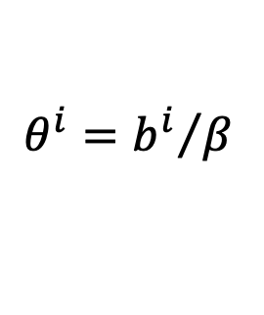

The Model
Let:
Then solution is:
$$β=b^{A}+b^{B}+b^{C}+b^{D}$$
$$θ^{i}={b^{i}}/β$$
$$γ=θ^{A}a^{A}+θ^{B}a^{B}+θ^{C}a^{C}+θ^{D}a^{D}$$
$$p^{A}=γ+θ^{B}t^{B}+θ^{C}t^{C}+θ^{D}t^{D}$$

Slide 57
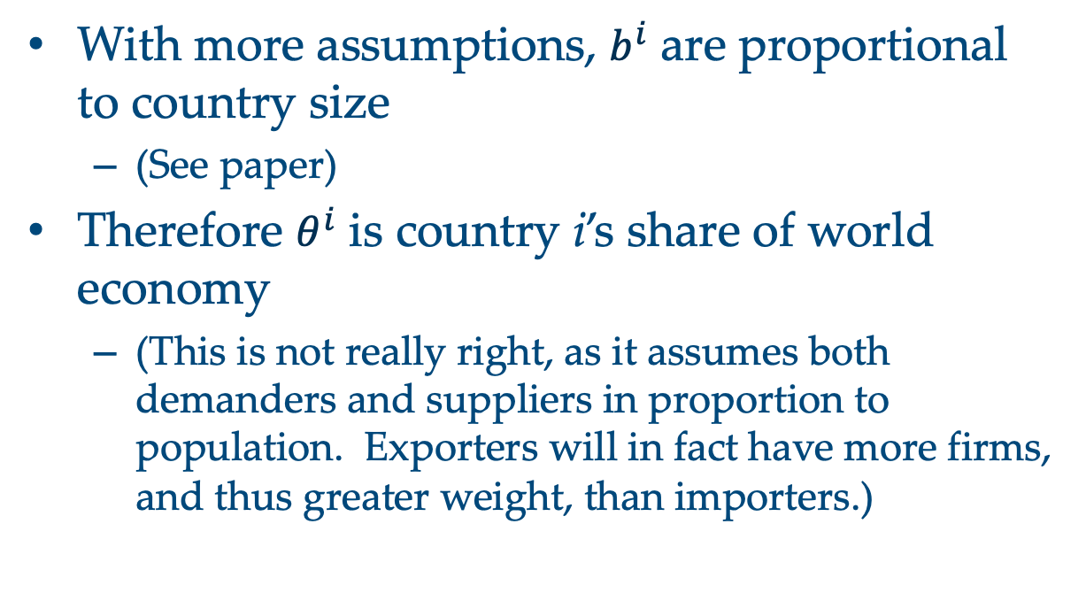
The Model
With more assumptions, $b^{i}$ are proportional to country size
  (See paper)
Therefore $θ^{i}$ is country i’s share of world economy
  (This is not really right, as it assumes both demanders and suppliers in proportion to population. Exporters will in fact have more firms, and thus greater weight, than importers.)

Slide 58

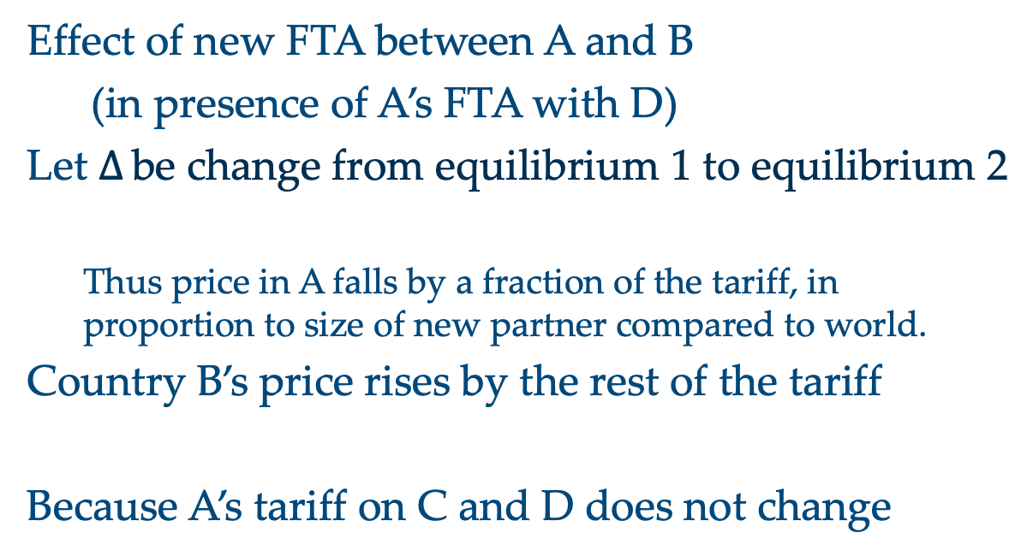


The Model
Effect of new FTA between A and B
(in presence of A’s FTA with D)
Let $∆$ be change from equilibrium 1 to equilibrium 2
  Thus price in A falls by a fraction of the tariff, in proportion to size of new partner compared to world.
Country B’s price rises by the rest of the tariff
Because A’s tariff on C and D does not change
$$∆p^{A}=−θ^{B}t$$
$$∆p^{B}=(1−θ^{B})t$$
$$∆p^{C}=∆p^{D}=∆p^{A}=−θ^{B}t$$

Slide 59




The Model
From the price changes, one derives the following changes in quantities of trade:
$${∆M}^{A}=θ^{B}b^{A}t>0$$
$${∆X}^{B}=θ^{B}\left({b^{A}+b}^{C}+a^{D}\right)t>0$$
$${∆X}^{C}=−θ^{B}b^{C}t<0$$
$${∆X}^{D}=−θ^{B}b^{D}t<0$$

Slide 60
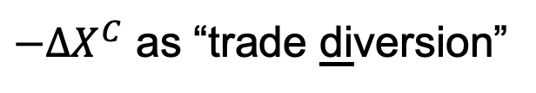

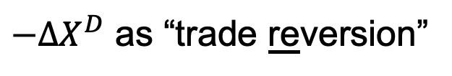
The Model
As must be true from market equilibrium
Thus the added exports of the partner country include the new imports of country A plus the reduced exports of countries C and D.
We label
and
because it is reversal of trade diversion from the prior FTA.
${∆X}^{B}={∆M}^{A}−{∆X}^{C}$ $−{∆X}^{D}$
$−{∆X}^{C}$ as “trade diversion”
$−{∆X}^{D}$ as “trade reversion”

Slide 61

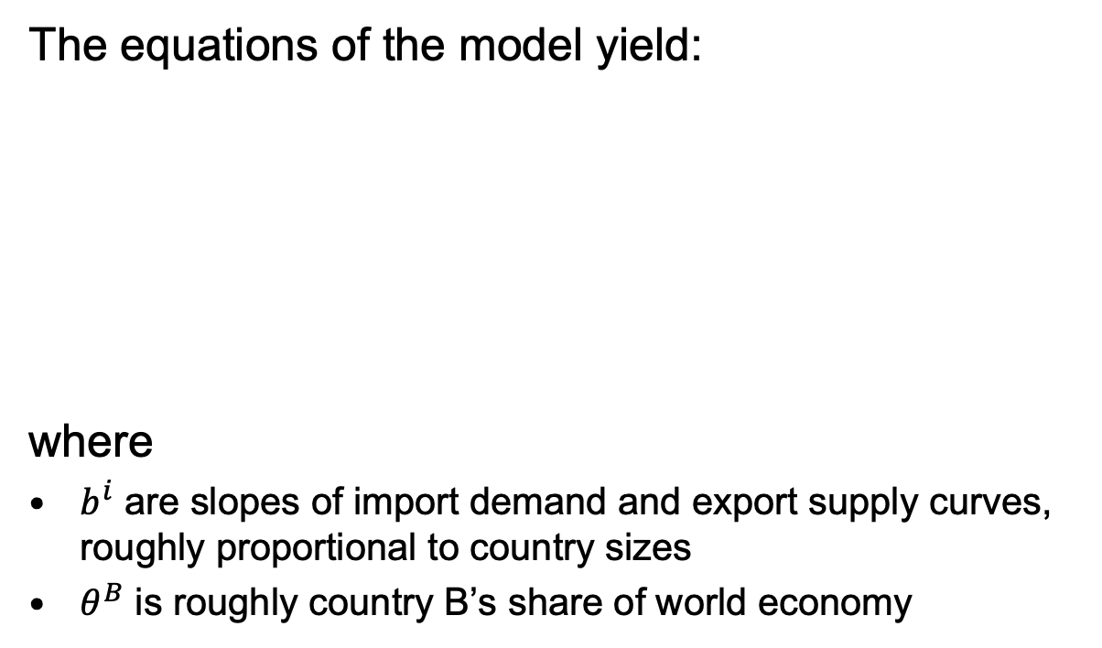


The Model
The equations of the model yield:
where
$b^{i}$ are slopes of import demand and export supply curves, roughly proportional to country sizes
$θ^{B}$ is roughly country B’s share of world economy
$$Trade Creation=TC=θ^{B}b^{A}t>0$$
$$Trade Diversion=TD=θ^{B}b^{C}t>0$$
$$Trade Reversion=TR=θ^{B}b^{D}t>0$$

Slide 62
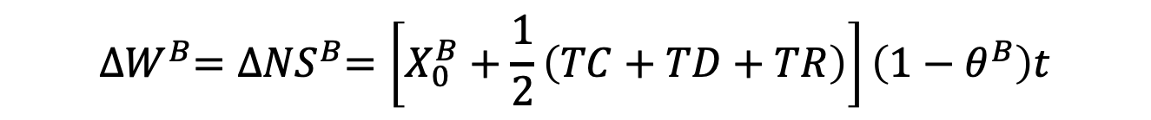
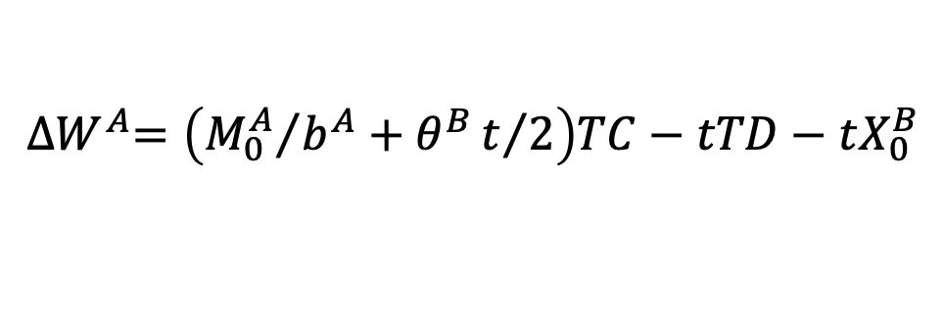
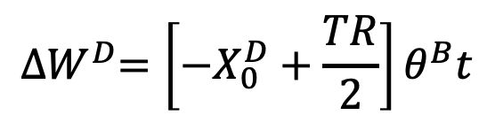
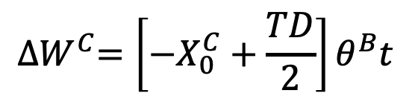
The Model
Welfare effects of new FTA
Country A (home):
Country B (new partner):
Country C (outside world):
Country D (old partner):
Lost tariff revenue
$${∆W}^{A}=\left({M_{0}^{A}}/{b^{A}}+θ^{B}t/2\right)TC−tTD−tX_{0}^{B}$$
$${∆W}^{B}={∆NS}^{B}=\left[X_{0}^{B}+\frac{1}{2}\left(TC+TD+TR\right)\right]\left(1−θ^{B}\right)t$$
$${∆W}^{C}=\left[−X_{0}^{C}+\frac{TD}{2}\right]θ^{B}t$$
$${∆W}^{D}=\left[−X_{0}^{D}+\frac{TR}{2}\right]θ^{B}t$$

Slide 63
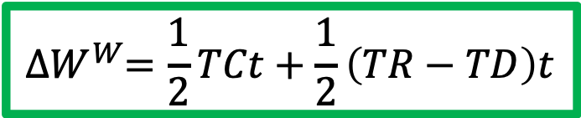
The Model
Welfare effects of new FTA on the World
World (A+B+C+D):
$${∆W}^{W}=\frac{1}{2}TCt+\frac{1}{2}\left(TR−TD\right)t$$

Slide 64
Pause for Discussion

Slide 65
  Questions on Deardorff & Sharma,
  “The Simple Analytics…”
Under what circumstances will adding a second FTA be harmful for the world?

Slide 66
Outline
Background
Simplest model: horizontal supplies
Upward-sloping supplies
  3-country case, in graphs
  Somewhat more general case, in equations
  4-country case, in graphs
Are FTAs Beneficial?
Skipping this unless there’s extra time

Slide 67
Four-Country Model in Figures
Four countries:
  Importer A
  Exporters B, C, and D
Export supply and import demands are linear
Countries B, C, and D are identical
For simplicity

Slide 68
Four-Country Model in Figures
Two equilibria
  1: MFN tariff t on exports of both B and C
    Zero tariff on exports of old FTA partner D
  2: New FTA of A and B:
    Tariff t on exports of C only;
    Zero tariff on exports of two FTA partners B and D

Slide 69









Export Supplies
Export Supplies of B, C, and D
Export Supplies to Country B
P
$$X^{Bt}, X^{Ct},X^{Dt}$$
P
${{∑X}_{1}=X}^{Bt}+X^{Ct}$ $+X^{Df}$
$X^{Bf}, { X}^{Cf}$, $X^{Df}$
${{∑X}_{0}=X}^{Bt}+X^{Ct}$ $+X^{Dt}$
${{∑X}_{2}=X}^{Bf}+X^{Ct}$ $+X^{Df}$
$$t$$
$a^{B}=a^{C}$ = $a^{D}$
$b^{B}=b^{C}$ = $b^{D}$
${{∑X}_{f}=X}^{Bf}+X^{Cf}$ $+X^{Df}$
Q
Q

Slide 70



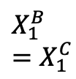


Equilibrium 1: A has FTA with 1 country, D
Export Supplies of B, C, and D
Import Market
P
$$X^{Bt}, X^{Ct},X^{Dt}$$
P
$${∑X}_{1}$$
$X^{Bf}, { X}^{Cf}$, $X^{Df}$
$${∑X}_{2}$$
$$M^{A}$$
$$t$$
$$X_{1}^{B}=X_{1}^{C}$$
$$X_{1}^{D}$$
Q
$$M_{1}^{A}$$
$${=X}_{1}^{B}+X_{1}^{C}+X_{1}^{D}$$
Q

Slide 71



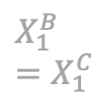

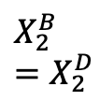


Equilibrium 2: A has FTA with 2 countries, B & D
Export Supplies of B, C, and D
Import Market
P
$$X^{Bt}, X^{Ct},X^{Dt}$$
P
$${∑X}_{1}$$
$X^{Bf}, { X}^{Cf}$, $X^{Df}$
$${∑X}_{2}$$
$$M^{A}$$
$$t$$
$$X_{2}^{C}$$
$$X_{1}^{B}=X_{1}^{C}$$
$$X_{2}^{B}=X_{2}^{D}$$
$$X_{1}^{D}$$
Q
$$M_{1}^{A}$$
$$M_{2}^{A}$$
Q

Slide 72





Changes in Trade from expanding FTA to Country B
Export Supplies of B, C, and D
Import Market
P
$$X^{Bt}, X^{Ct},X^{Dt}$$
P
$${∑X}_{1}$$
$X^{Bf}, { X}^{Cf}$, $X^{Df}$
$${∑X}_{2}$$
$$M^{A}$$
$$t$$
$${∆X}^{C}$$
$${∆X}^{B}$$
$${∆X}^{D}$$
$${∆M}^{A}$$
$$X_{2}^{C}$$
$$X_{1}^{B}=X_{1}^{C}$$
$$X_{2}^{B}=X_{2}^{D}$$
$$X_{1}^{D}$$
Q
$$M_{1}^{A}$$
$$M_{2}^{A}$$
Q

Slide 73

Trade Creation
Trade Creation (TC), Diversion (TD), and Reversion (TR)
Export Supplies of B, C, and D
Import Market
P
$$X^{Bt}, X^{Ct},X^{Dt}$$
P
$${∑X}_{1}$$
$X^{Bf}, { X}^{Cf}$, $X^{Df}$
$${∑X}_{2}$$
$$M^{A}$$
$$t$$
$${∆X}^{C}$$
$${∆X}^{B}$$
$${∆X}^{D}$$
$${∆M}^{A}$$
TD
TR
TC
Q
Q
Trade Diversion
Trade Reversion
Trade Creation

Slide 74



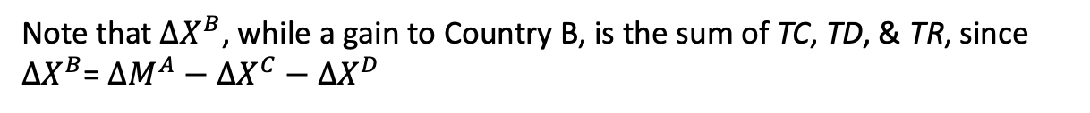

Trade Creation (TC), Diversion (TD), and Reversion (TR)
Export Supplies of B, C, and D
Import Market
P
$$X^{Bt}, X^{Ct},X^{Dt}$$
P
$${∑X}_{1}$$
$X^{Bf}, { X}^{Cf}$, $X^{Df}$
$${∑X}_{2}$$
$$M^{A}$$
$$t$$
$${∆X}^{C}$$
$${∆X}^{B}$$
$${∆X}^{D}$$
$${∆M}^{A}$$
TD
TR
TC
Q
Q
TD
TC
TR
Note that ${∆X}^{B}$, while a gain to Country B, is the sum of TC, TD, & TR, since ${∆X}^{B}$= ${∆M}^{A}−$ ${∆X}^{C}−{∆X}^{D}$

Slide 75



Welfare Effects on Country A
Tariff revenue lost from
Export Supplies of B, C, and D
Import Market
P
$$X^{Bt}, X^{Ct},X^{Dt}$$
P
Net gain of A’s private sector
$${∑X}_{1}$$
B
C
$X^{Bf}, { X}^{Cf}$, $X^{Df}$
$${∑X}_{2}$$
$$M^{A}$$
$$t$$
$${∆X}^{C}$$
$${∆X}^{B}$$
$${∆X}^{D}$$
$${∆M}^{A}$$
TD
TR
TC
$${∆X}^{C}$$
$${∆M}^{A}$$
$${∆X}^{D}$$
Q
Q
TD
TC
TR
Note that trade reversion does not appear to affect A’s welfare. I suspect this is an artifact of making export supplies from B and D the same.

Slide 76
Welfare Effect on Country B
Export Supplies of B, C, and D
Import Market
P
$$X^{Bt}, X^{Ct},X^{Dt}$$
P
$${∑X}_{1}$$
Net gain of B’s private sector
$X^{Bf}, { X}^{Cf}$, $X^{Df}$
$${∑X}_{2}$$
$$M^{A}$$
$$t$$
TD
TR
TC
Q
Q
TD
TC
TR

Slide 77
Welfare Effect on Country C
Export Supplies of B, C, and D
Import Market
P
$$X^{Bt}, X^{Ct},X^{Dt}$$
P
$${∑X}_{1}$$
$X^{Bf}, { X}^{Cf}$, $X^{Df}$
$${∑X}_{2}$$
Net loss of C’s private sector
$$M^{A}$$
$$t$$
TD
TR
TC
Q
Q
TD
TC
TR

Slide 78
Welfare Effect on Country D
Export Supplies of B, C, and D
Import Market
P
Net loss of D’s private sector
$$X^{Bt}, X^{Ct},X^{Dt}$$
P
$${∑X}_{1}$$
$X^{Bf}, { X}^{Cf}$, $X^{Df}$
$${∑X}_{2}$$
$$M^{A}$$
$$t$$
TD
TR
TC
Q
Q
TD
TC
TR

Slide 79
Welfare Effects on World
Export Supplies of B, C, and D
Import Market
P
$$X^{Bt}, X^{Ct},X^{Dt}$$
P
$${∑X}_{1}$$
$X^{Bf}, { X}^{Cf}$, $X^{Df}$
$${∑X}_{2}$$
$$M^{A}$$
$$t$$
TD
TR
TC
Q
Q
TD
TC
TR
I claim that these gains and losses mostly cancel out to reduce to the following:

Slide 80
Welfare Effect on World
Export Supplies of B, C, and D
Import Market
P
$$X^{Bt}, X^{Ct},X^{Dt}$$
P
$${∑X}_{1}$$
$X^{Bf}, { X}^{Cf}$, $X^{Df}$
$${∑X}_{2}$$
$$M^{A}$$
$$t$$
TD
TR
TC
Q
Q
TD
TC
TR

Slide 81
Welfare Effects on World
Export Supplies of B, C, and D
Import Market
P
$$X^{Bt}, X^{Ct},X^{Dt}$$
P
$${∑X}_{1}$$
$X^{Bf}, { X}^{Cf}$, $X^{Df}$
$${∑X}_{2}$$
$$M^{A}$$
$$t$$
TD
TR
TC
Q
Q
TD
TC
TR

Slide 82
Welfare Effects on World
Export Supplies of B, C, and D
Import Market
P
$$X^{Bt}, X^{Ct},X^{Dt}$$
P
$${∑X}_{1}$$
$X^{Bf}, { X}^{Cf}$, $X^{Df}$
$${∑X}_{2}$$
$$M^{A}$$
$$t$$
TD
TR
TC
Q
Q
TD
TC
TR

Slide 83
Welfare Effects on World
Export Supplies of B, C, and D
Import Market
P
$$X^{Bt}, X^{Ct},X^{Dt}$$
P
$${∑X}_{1}$$
$X^{Bf}, { X}^{Cf}$, $X^{Df}$
$${∑X}_{2}$$
$$M^{A}$$
$$t$$
TD
TR
TC
Q
Q
TD
TC
TR

Slide 84
Welfare Effects on World
Export Supplies of B, C, and D
Import Market
P
$$X^{Bt}, X^{Ct},X^{Dt}$$
P
$${∑X}_{1}$$
$X^{Bf}, { X}^{Cf}$, $X^{Df}$
$${∑X}_{2}$$
$$M^{A}$$
$$t$$
TD
TR
TC
Q
Q
TD
TC
TR

Slide 85
Welfare Effects on World
Export Supplies of B, C, and D
Import Market
P
$$X^{Bt}, X^{Ct},X^{Dt}$$
P
$${∑X}_{1}$$
$X^{Bf}, { X}^{Cf}$, $X^{Df}$
$${∑X}_{2}$$
$$M^{A}$$
$$t$$
TD
TR
TC
Q
Q
TD
TC
TR

Slide 86
Welfare Effects on World
Export Supplies of B, C, and D
Import Market
P
$$X^{Bt}, X^{Ct},X^{Dt}$$
P
$${∑X}_{1}$$
$X^{Bf}, { X}^{Cf}$, $X^{Df}$
$${∑X}_{2}$$
$$M^{A}$$
$$t$$
TD
TR
TC
Q
Q
TD
TC
TR

Slide 87
Welfare Effects on World
Export Supplies of B, C, and D
Import Market
P
$$X^{Bt}, X^{Ct},X^{Dt}$$
P
$${∑X}_{1}$$
$X^{Bf}, { X}^{Cf}$, $X^{Df}$
$${∑X}_{2}$$
$$M^{A}$$
$$t$$
TD
TR
TC
Q
Q
TD
TC
TR

Slide 88





Welfare Effects on World
Export Supplies of B, C, and D
Import Market
P
$$X_{1}^{D}$$
$$X^{Bt}, X^{Ct},X^{Dt}$$
P
$${∑X}_{1}$$
$X^{Bf}, { X}^{Cf}$, $X^{Df}$
$$X_{1}^{B}$$
$$X_{1}^{C}$$
$$X_{1}^{D}$$
$$X_{1}^{B}$$
$$=X_{1}^{C}$$
$${∑X}_{2}$$
$$M^{A}$$
$$t$$
TD
TR
TC
Q
Q
TD
TC
TR

Slide 89
Welfare Effects on World
Export Supplies of B, C, and D
Import Market
P
$$X_{1}^{D}$$
$$X^{Bt}, X^{Ct},X^{Dt}$$
P
$${∑X}_{1}$$
$X^{Bf}, { X}^{Cf}$, $X^{Df}$
$$X_{1}^{B}$$
$$X_{1}^{C}$$
$$X_{1}^{D}$$
$$X_{1}^{B}$$
$$=X_{1}^{C}$$
$${∑X}_{2}$$
$$M^{A}$$
$$t$$
TD
TR
TC
Q
Q
TD
TC
TR

Slide 90
Welfare Effects on World
Export Supplies of B, C, and D
Import Market
P
$$X_{1}^{D}$$
$$X^{Bt}, X^{Ct},X^{Dt}$$
P
$${∑X}_{1}$$
$X^{Bf}, { X}^{Cf}$, $X^{Df}$
$$X_{1}^{B}$$
$$X_{1}^{C}$$
$$X_{1}^{D}$$
$$X_{1}^{B}$$
$$=X_{1}^{C}$$
$${∑X}_{2}$$
$$M^{A}$$
$$t$$
TD
TR
TC
Q
Q
TD
TC
TR

Slide 91
Welfare Effects on World
Export Supplies of B, C, and D
Import Market
P
$$X^{Bt}, X^{Ct},X^{Dt}$$
P
$${∑X}_{1}$$
$X^{Bf}, { X}^{Cf}$, $X^{Df}$
$${∑X}_{2}$$
$$M^{A}$$
$$t$$
TD
TR
TC
Q
Q
TD
TC
TR

Slide 92
Welfare Effect on World
Export Supplies of B, C, and D
Import Market
P
$$X^{Bt}, X^{Ct},X^{Dt}$$
P
$${∑X}_{1}$$
$X^{Bf}, { X}^{Cf}$, $X^{Df}$
$${∑X}_{2}$$
$$M^{A}$$
$$t$$
TD
TR
TC
Q
Q
TD
TC
TR

Slide 93
Welfare Effect on World
Export Supplies of B, C, and D
Import Market
P
$$X^{Bt}, X^{Ct},X^{Dt}$$
P
$${∑X}_{1}$$
$X^{Bf}, { X}^{Cf}$, $X^{Df}$
$${∑X}_{2}$$
$$M^{A}$$
$$t$$
TD
TR
TC
Q
Q
TD
TC
TR

Slide 94
Welfare Effect on World
Export Supplies of B, C, and D
Import Market
P
$$X^{Bt}, X^{Ct},X^{Dt}$$
P
$${∑X}_{1}$$
$X^{Bf}, { X}^{Cf}$, $X^{Df}$
$${∑X}_{2}$$
$$M^{A}$$
$$t$$
TD
TR
TC
Q
Q
TD
TC
TR

Slide 95
Welfare Effect on World
Export Supplies of B, C, and D
Import Market
P
$$X^{Bt}, X^{Ct},X^{Dt}$$
P
$${∑X}_{1}$$
$X^{Bf}, { X}^{Cf}$, $X^{Df}$
$${∑X}_{2}$$
$$M^{A}$$
$$t$$
TD
TR
TC
Q
Q
TD
TC
TR

Slide 96
Welfare Effect on World
Export Supplies of B, C, and D
Import Market
P
$$X^{Bt}, X^{Ct},X^{Dt}$$
P
$${∑X}_{1}$$
$X^{Bf}, { X}^{Cf}$, $X^{Df}$
$${∑X}_{2}$$
$$M^{A}$$
$$t$$
TD
TR
TC
Q
Q
TD
TC
TR

Slide 97
Welfare Effect on World
Export Supplies of B, C, and D
Import Market
P
$$X^{Bt}, X^{Ct},X^{Dt}$$
P
$${∑X}_{1}$$
$X^{Bf}, { X}^{Cf}$, $X^{Df}$
$${∑X}_{2}$$
$$M^{A}$$
$$t$$
TD
TR
TC
Q
Q
TD
TC
TR

Slide 98
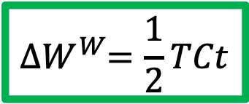
4-country case
Result:
  World welfare rises with second FTA, by amount depending on trade creation and the tariff
Recall from model:
Here, because we’ve assumed countries B and D are the same, TR=TD
$${∆W}^{W}=\frac{1}{2}TCt+\frac{1}{2}\left(TR−TD\right)t$$
$${∆W}^{W}=\frac{1}{2}TCt$$

Slide 99
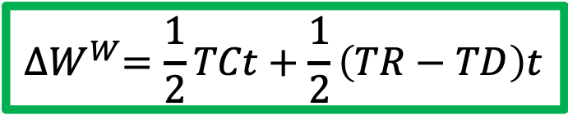

4-country case
In general, $TR≠TD$
Which is larger depends just on country size, size both face the same price change.
If the new partner is smaller than the old, $TR>TD , and world gain will be larger$
If new partner is bigger than old, then $TR<TD$ and world gain will be smaller and perhaps a loss.
$${∆W}^{W}=\frac{1}{2}TCt+\frac{1}{2}\left(TR−TD\right)t$$

Slide 100
Conclusion
Analysis of FTAs shouldn’t treat each independently of FTAs that already exist
Sequencing of FTAs can matter.

Slide 101
Pause for Discussion

Slide 102
  Questions on Deardorff & Sharma
Why is adding a second FTA not harmful for the world in the graphs, but may be harmful in the world in the equations?

Slide 103
Outline
Background
Simplest model: horizontal supplies
Upward-sloping supplies
  3-country case, in graphs
  Somewhat more general case, in equations
  4-country case, in graphs
Are FTAs Beneficial?

Slide 104
Are FTAs Beneficial?
My own work suggests that they usually are, though the benefits are not huge
But many (not economists) disagree
Much has been said about NAFTA
  It’s political reputation has been negative
    Labor unions
    Democrats
    Trump
  Economists have been more positive
    See Posen (economist and President of Peterson Institute of International Economics)

Slide 105
Are FTAs Beneficial
Posen’s points
  Consumers in all three countries have gained.
  Workers have suffered, but not from NAFTA.
  “Recent research has found that, on average, for every 100 jobs US manufacturers created in Mexican manufacturing, they added nearly 250 jobs at their larger US home operations…”
  Until the financial crisis of 2008, US unemployment was lower after NAFTA than before.
  Concern that displaced Mexican farmers would come north were not justified, as border apprehensions have declined steadily since 2000. The recent surge of minors crossing from Central America has nothing to do with NAFTA.
  Critics estimate job losses due to NAFTA of 45,000 a year. But that is less than 0.1 percent of turnover.

Slide 106
Pause for Discussion

Slide 107
  Questions on Posen,
  “The Errors of Conservatives …”
How does Posen counter the argument against new trade agreements that they will have the same harmful effects as the NAFTA?
Posen seems to accept the critics’ claim that the NAFTA caused 45,000 job losses in the US per year, but seems not to care. Why?
What were some of the other claims by critics of the NAFTA, and how does Posen respond to them?

Slide 108
Are FTAs Beneficial
Russ paper
  Prompted by USITC report on trade agreements negotiated under Trade Promotion Authority (TPA), as TPA was set to expire
  Covers 12 bilateral FTAs and 2 regional ones, NAFTA and CAFTA-DR
  Results:
    They “resulted in the US economy being one half of a percent bigger than what it would have been without the agreements in place”
    Responsible for “almost half a million additional jobs”

Slide 109
  Questions on Russ
Can you tell from this what TPA was?
Does the study cover all agreements that were done under TPA, and all aspects of the ones that is does cover?
How large were the effects of the FTAs according to the reported study?
Extra time?

