Slide 1
Class 14 Why Countries Restrict Trade by Alan V. Deardorff University of Michigan 2023
PubPol/Econ 541

Slide 2
Clarification from last time

Slide 3
Tariff on Input to Production of
Non-Traded Final Good
Final Good
Imported Input
P^{F}
$$S^{F}\left(P^{F},P_{1}^{I}\right)$$
P^{I}
$$D^{I}\left(P^{I},\text{P}\text{F} (P^{I})\right)$$
$$S^{F}\left(P^{F},P_{0}^{I}\right)$$
$$P_{1}^{F}$$
$$\left.P_{1}^{I}=(1+t\right)P_{0}^{I}$$
$$P_{0}^{F}$$
$$P_{0}^{I}$$
$$S_{}^{M}$$
$$D^{I}\left(P^{I},P_{1}^{F}\right)$$
$$D^{F}\left(P^{F}\right)$$
$$D^{I}\left(P^{I},P_{0}^{F}\right)$$
$$Q_{1}^{F}$$
$$Q_{0}^{F}$$
$$Q_{}^{F}$$
$$Q_{1}^{I}$$
$$Q_{}^{I}$$
$$Q_{0}^{I}$$
Figure 5
Tariff on Imported Input to Production of Non-traded Final Good

Slide 4
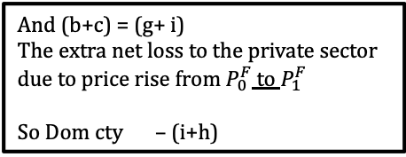
Tariff on Input to Production of
Non-Traded Final Good
Final Good
Imported Input
P^{F}
$$S^{F}\left(P^{F},P_{1}^{I}\right)$$
P^{I}
$$D^{I}\left(P^{I},\text{P}\text{F} (P^{I})\right)$$
$$S^{F}\left(P^{F},P_{0}^{I}\right)$$
d
e
$$P_{1}^{F}$$
a
b
$$\left.P_{1}^{I}=(1+t\right)P_{0}^{I}$$
g
$$P_{0}^{F}$$
c
i
If P ^{F} did not rise
f
$$P_{0}^{I}$$
h
$$S_{}^{M}$$
$$D^{I}\left(P^{I},P_{1}^{F}\right)$$
$$D^{F}\left(P^{F}\right)$$
$$D^{I}\left(P^{I},P_{0}^{F}\right)$$
$$Q_{1}^{F}$$
$$Q_{0}^{F}$$
$$Q_{}^{F}$$
$$Q_{1}^{I}$$
$$Q_{}^{I}$$
$$Q_{0}^{I}$$
Welfare Effects of Input Tariff:
Dom sup’s –(d+e)
Dom dem’s –(a+b+c)
Dom gov’t +(f+g)
Dom cty –(a+b+c+d+e)+(f+g)
But (a+d+e) = (f+h)
= what suppliers would have lost if P^{F} had not risen
So Dom cty –(a+b+c+d+e)+(f+g) =–(b+c) –(f+h) + (f+g)
= –(b+c+h)+g
And (b+c) = (g+ i)
The extra net loss to the private sector due to price rise from $P_{0}^{F}$ to $P_{1}^{F}$
So Dom cty – (i+h)
Figure 5
Tariff on Imported Input to Production of Non-traded Final Good

Slide 5
Pause for News

Slide 6
Announcements
Note that Paper 2 is due Nov 8. Confer with your team soon and look at the assignment, so that you can ask any questions.

Slide 7
Outline
Multiple reasons
Second best use of tariffs
Political economy
Why are trade barriers so low?
Recent uses of protection

Slide 8
Pause for Discussion

Slide 9
Questions on KOM
What benefits from free trade are not captured in the partial equilibrium model?
The textbook mentions only two arguments against free trade: terms of trade and market failure. Can you think of others?

Slide 10
Outline
Multiple reasons
Second best use of tariffs
Political economy
Why are trade barriers so low?
Recent uses of protection

Slide 11
Multiple Reasons
See my Glossary:
Lists: Arguments for Protection
I list 26, and our examples later suggest more

Slide 12
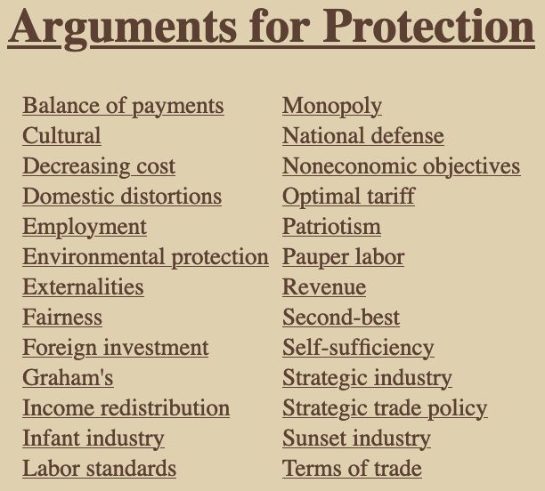

Slide 13
Multiple Reasons
Details on just a few
Cultural: Sustain a distinctive culture that would be undermined by imports
Foreign investment: Use tariff to induce foreign companies to invest instead of export
Infant industry: Let new industry “learn by doing” behind tariff wall
Patriotism: Support our own producers

Slide 14
Pause for Discussion

Slide 15
Questions (not asked before)
Which of these seem to have motivated Trump’s tariffs?
Which look like they may be legal under GATT/WTO?

Slide 16
Outline
Multiple reasons
Second best use of tariffs
Political economy
Why are trade barriers so low?
Recent uses of protection

Slide 17
Second best use of tariffs
First, why do economists expect undistorted markets to do well?
To the extent that
Supply curves measure marginal cost (MC), and
Demand curves measure marginal benefit (MB),
Then market price equates these
MC=MB is the recipe for maximizing benefit net of cost
But what if the curves don’t measure these?
Then we say there are “distortions” and market price is not optimal.
The harm done by a tariff is an example of this.

Slide 18
Second best use of tariffs
Our model says tariffs hurt if all else is perfect. What if there are
Market failures?
Distortions?
Externalities?
Imperfect competition?
Etc.

Slide 19
Second best use of tariffs
Answer
A tariff can offset some distortions and therefore may raise welfare
But there is always another policy that will do better
Reason: A tariff creates two distortions (see our triangles of dead-weight loss)
One may offset a distortion, but the other makes things worse
Hence tariff is “second best”

Slide 20
Second best use of tariffs
Example
Suppose production yields a “positive externality”
Production provides a benefit not captured (or charged for) by producers
A tariff stimulates production and so generates more of the externality – That’s good!
For example, European farms make countryside attractive to tourists

Slide 21
Small country with positive externality
P
S
= Marginal cost of firms
= Marginal private cost
P_{aut}
MC–E = MSC
This is the marginal social cost of the good.
That is, the marginal cost to society, not just to the firm.
P₀=P_{W}
D
E
S₀
D₀
Q
Positive Externality, E

Slide 22
Small country tariff with positive externality
P
Welfare effects of a tariff, if set equal to E, starting from free trade:
Suppliers gain +a
Demanders lose −(a+b+c+d)
Government gains +c
Externality benefit +(b+e)
Country gain or loss +e −d
S
P_{aut}
MC–E
P₁=P_{W}+t
t=E
a
c
b
d
P₀=P_{W}
e
D
E
S₀
S₁
D₁
D₀
Q
Specific Tariff t=E

Slide 23
Second best use of tariffs
Result
Tariff raises welfare if e > d
That is, if
the benefit of increased externality exceeds
the demand-distortion loss of the tariff

Slide 24
Second best use of tariffs
But there’s a better policy: subsidize supply:
That leaves demanders facing world price
Lets suppliers be paid P_{W}+E
Causes only one distortion, of supply, and
That is beneficial because
It corrects the distortion of the externality
Without also distorting demand

Slide 25
Small country production subsidy with positive externality
P
Welfare effects of a subsidy, if set equal to E, starting from free trade
Suppliers gain +a
Demanders lose 0
Government loses –(a+b)
Externality benefit +(b+e)
Country gains +e
S
P_{aut}
MC–E
s=E
a
c
b
d
P₀=P_{W}
e
D
E
But note that:
Tariff creates revenue
Subsidy costs the gov’t
S₀
S₁
D₁
D₀
Q
Production subsidy s=E

Slide 26
Second best use of tariffs
In general, distortions (market failures) distort only supply or demand
A tariff can only correct one by hurting the other
A more direct policy – tax or subsidy on distorted behavior – will be “first best”
Except for budget implications

Slide 27
Pause for Discussion

Slide 28
Questions on KOM
How does the theory of the second best provide reasons that tariffs may be beneficial?
How does it also provide reasons why tariffs are not the best policy in such cases?

Slide 29
Outline
Multiple reasons
Second best use of tariffs
Political economy
Why are trade barriers so low?
Recent uses of protection

Slide 30
Political Economy
Explain policies based on features of the political process
Allow for
Voting
Lobbying
Other forms of political pressure by interest groups
But also allow policymakers to care about economic well-being as in our models

Slide 31
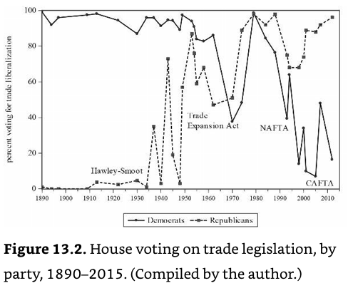
Democrats
Votes for freer trade
Republicans
Source: Irwin, p. 788
Notes:
Irwin, Doug, Clashing Over Commerce

Slide 32
Political Economy
Politics of tariffs in US 2024 election
See Ponnuru
Trump promises new tariffs
“End our gaping trade deficits”
“Bring back millions of American jobs”
“Bring trillions and trillions of dollars pouring into the United States Treasury from foreign countries”
Biden does not, but he’s been aggressive on other trade-related policies
China policies
IRA subsidy conditions
Favors unions, who are protectionist

Slide 33
Political Economy
Politics of tariffs in US 2024 election
Trumps “tariffs have become an item of bipartisan consensus.”
But public is more positive on trade than the politicians and than they were 10 years ago
“Gallup finds that Americans are more likely to consider trade an opportunity, and less likely to consider it a threat, than they were 10 years ago.”
“That’s especially true among Democrats.”

Slide 34
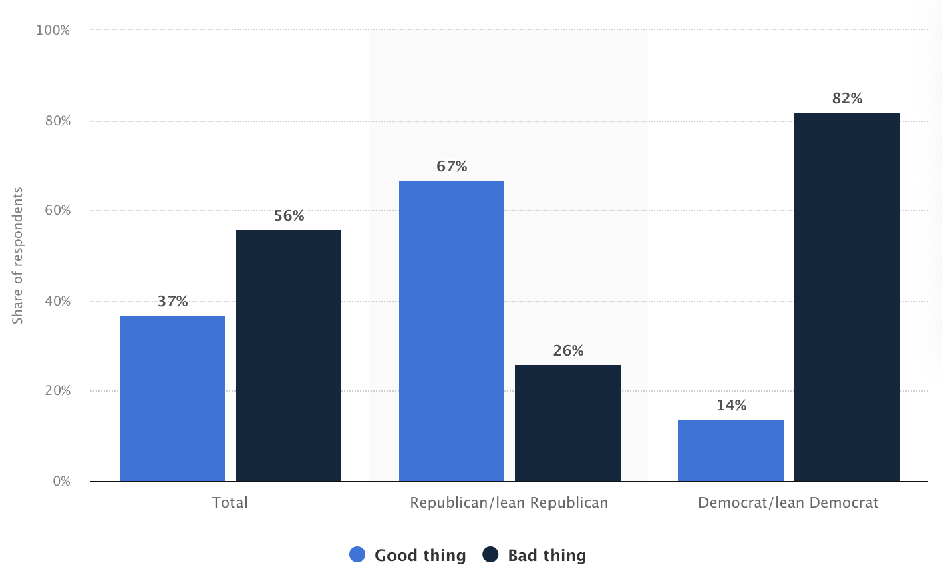
Share of people in the United States who think increased tariffs between the United States and its trading partners is a good thing for the country in 2019, by party
Notes:
https://www.statista.com/statistics/913391/share-americans-support-raising-tariffs-steel-aluminum-party/

Slide 35
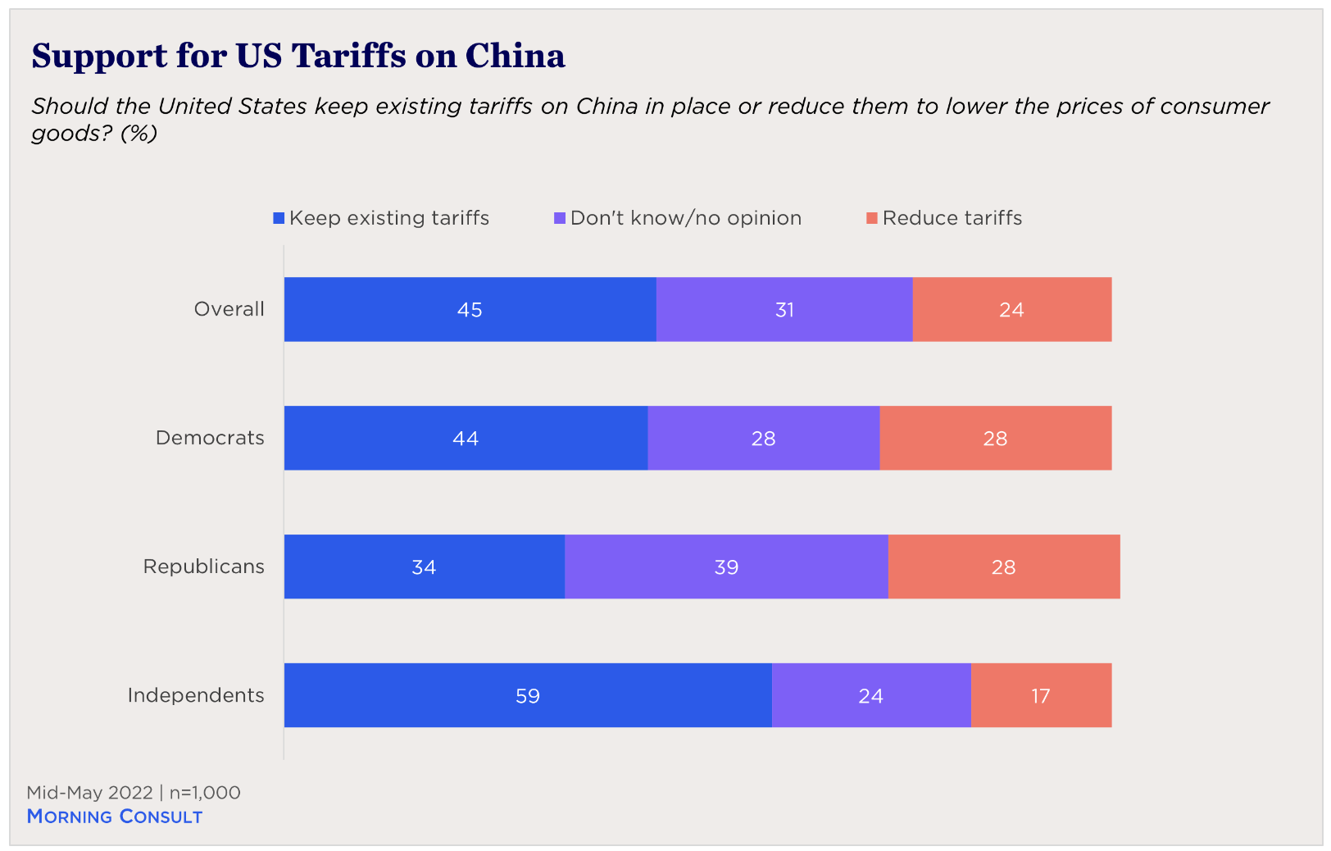
(from poll Mid-May 2022)
Notes:
Phillip Meng, “Free Trade with Exceptions: Public Opinion and Industrial Policy,” The Chicago Council on Global Affairs, January 25, 2023.
https://globalaffairs.org/commentary-and-analysis/blogs/free-trade-exceptions-public-opinion-and-industrial-policy

Slide 36
Pause for Discussion

Slide 37
Questions on KOM
What is the “median voter theory,” and why does it seem not to explain protection?

Slide 38
Questions on Baldwin & Magee “Is Trade Policy for Sale?”
By what mechanisms do theorists suggest that political contributions result in votes for and against trade liberalization?
Do businesses and labor groups in the US tend to contribute in favor of protection or free trade?
What were the three Congressional votes studied by Baldwin and Magee? Which side – labor or business – had the greater effect on the voting?

Slide 39
Questions on Baldwin & Magee “Is Trade Policy for Sale?”
What do they estimate as the “price” of one congressional vote against NAFTA or the WTO?
Were campaign contributions the only thing that mattered for congressional votes on these trade issues?

Slide 40
Questions on Ponnuru, “The Politics of Trade Favor …”
Does Trump promise more tariffs?
What does he claim tariffs will do?
Why are two of his claims contradictory?
And why are all proven wrong by experience?
Why do politicians favor tariffs?
Will there be lots of new tariffs?

Slide 41
Outline
Multiple reasons
Second best use of tariffs
Political economy
Why are trade barriers so low?
Recent uses of protection

Slide 42
Why Aren’t Tariffs Higher?
Magee lists 6 possible reasons why tariffs are not higher:
Politicians are not responsive to lobbying efforts
Welfare costs of tariffs are higher than traditionally measured
The GATT was successful in reducing trade barriers
Free riding by firms hinders lobby organization
Users of imported goods lobby against tariffs
Protection is given, but by non-tariff barriers, which are high
Magee’s view of the evidence
#1, 5 not important
#2, 3, 4 play a small role
#6 is most important: actual protection is much higher than tariffs
✗
✓
✓
✓
✗
✓✓✓

Slide 43
Pause for Discussion

Slide 44
Questions on Magee “Why Are Trade Barriers So Low?”
Does the main “political economy” model for explaining tariffs say that politicians care only about campaign contributions?
Why does Magee give only partial credit to GATT negotiations in explaining the fall of tariffs since the 1930s?

Slide 45
Questions on Magee “Why Are Trade Barriers So Low?”
How do the following terms or concepts figure in explanations for why trade barriers are low:
free riding;
peace;
imported inputs;
non-tariff barriers?

Slide 46
Outline
Multiple reasons
Second best use of tariffs
Political economy
Why are trade barriers so low?
Recent uses of protection

Slide 47
Recent uses of protection
Some examples from earlier (not in this year’s readings):
India considers tariffs on China after border conflict
Pakistan to “halt trade with India” after actions on Kashmir
Japan uses export controls on S Korea after Korea seeks compensation for forced labor in WWII
US bars arms exports to Hong Kong after China reduces Hong Kong independence

Slide 48
Recent uses of protection
More from earlier:
China puts tariffs on Australian barley after Australia seeks inquiry on origins of coronavirus.
US may stop cocoa imports from Ivory Coast for using child labor.
China blocked meat imports from Canada after Canada arrested daughter of Huawei founder.
China had a ban (and has now lifted it) on US chicken due to outbreak of avian flu.

Slide 49
Recent uses of protection
From last year:
US banned avocados from Mexico due to verbal threat made to US inspector in Mexico.
US threatened tariffs on countries using a digital services tax.
China suspended imports of many food products from Taiwan in response to Nancy Pelosi visit.

Slide 50
Recent uses of protection
From this year:
Mexico banned GM corn
India regulates imports of laptops

Slide 51
Recent uses of protection
Message from much of this:
Countries often restrict trade to hurt other countries that they are angry at.

Slide 52
Pause for Discussion

Slide 53
Questions on Krugman “Two Cheers for Carbon Tariffs”
Why would Krugman favor a carbon tariff even if it were as economically harmful as a tariff usually is?
Why does he discuss the economics of the value added tax?
A carbon tariff set equal to a domestic carbon tax makes sense, but what if the domestic policy is regulation, not tax?
Why does he give only two cheers, not the usual three?

