Slide 1
Class 10 Policies and Institutions: National, Other by Alan V. Deardorff University of Michigan 2023
PubPol/Econ 541

Slide 2
Pause for News

Slide 3
Announcements
Mid-term feedback:
Ford School students are asked for feedback, which will be shared anonymously with instructors.
Quizzes
Results:

Slide 4
Outline
European Union
Japan
China
Other

Slide 5
European Union
History
1957 Treaty of Rome created European Economic Community (EEC) as a ”common market”
Eliminated barriers to movement of goods, services, capital, and labor (eventually)
Prohibited policies to inhibit market competition
Adopted Common Agricultural Policy (CAP)
Adopted common external trade policy
(Hence a Customs Union, not a Free Trade Area)
Original Six countries: Belgium, France, Germany, Italy, Luxembourg, Netherlands
Added 6 more: 1973: Denmark, Ireland, UK; 1981: Greece; 1986: Portugal, Spain (also E. Germany 1990)
Notes:
Gabel, Matthew J., “European Union,” Encyclopedia Britanica, 2020.
https://www.britannica.com/topic/European-Union/The-Maastricht-Treaty

Slide 6
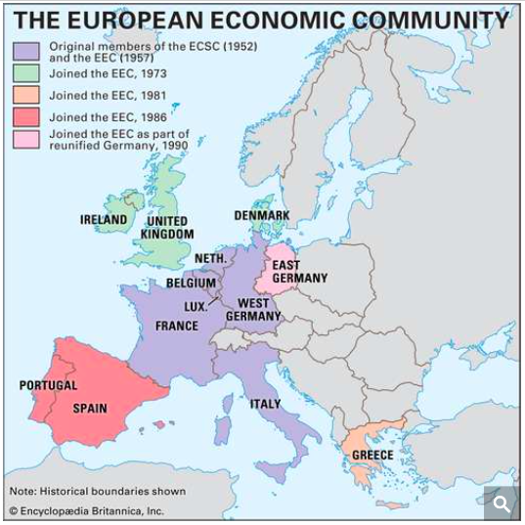
As of 1990
Notes:
Gabel, Matthew J., “European Union,” Encyclopedia Britanica, 2020.
https://www.britannica.com/topic/European-Union/The-Maastricht-Treaty

Slide 7
European Union
History
“Europe 1992”: Treaty on European Union, signed Feb 7, 1992, in Maastricht, Netherlands
“Four Freedoms” became reality: free movement of goods, services, people, and money
Set rules for (future) single currency
1995: Added Austria, Finland, Sweden
2004: Added 10 more: 8 from former Soviet Bloc, plus Malta and Cyprus
2007: Added Bulgaria and Romania
2013: Added Croatia
2020: Subtracted United Kingdom
Notes:
Gabel, Matthew J., “European Union,” Encyclopedia Britanica, 2020.
https://www.britannica.com/topic/European-Union/The-Maastricht-Treaty

Slide 8
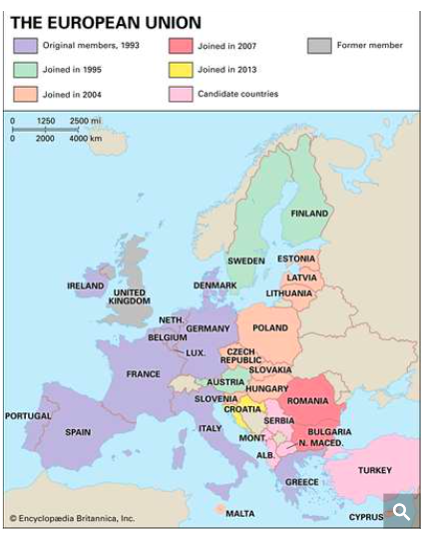
As of 2020
NOTE:
Not yet members, and maybe never:
Serbia
Montenegro
N. Macedonia
Albania
Turkey
Notes:
Gabel, Matthew J., “European Union,” Encyclopedia Britanica, 2020.
https://www.britannica.com/topic/European-Union/The-Maastricht-Treaty

Slide 9
European Union
The EU today
27 Countries
Note who is not in
UK (anymore)
Switzerland
Norway
Iceland
Official candidates: Turkey and several parts of former Yugoslavia
Potential candidates: Other parts of former Yugoslavia
Notes:
Gabel, Matthew J., “European Union,” Encyclopedia Britanica, 2020.
https://www.britannica.com/topic/European-Union/The-Maastricht-Treaty

Slide 10
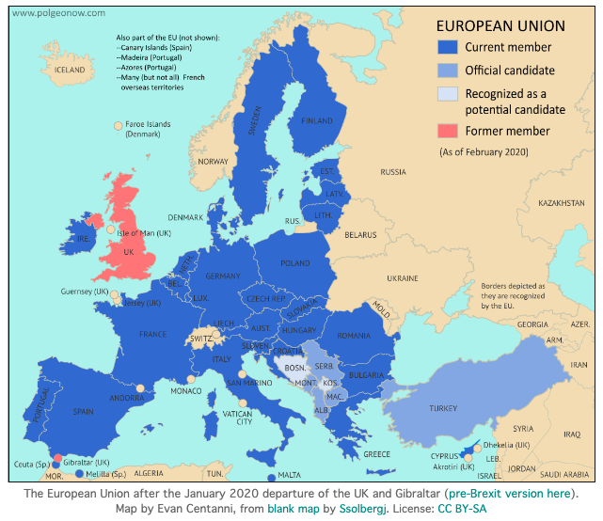
Notes:
https://www.polgeonow.com/2016/06/map-which-countries-are-in-the-eu.html

Slide 11
European Union
Two main institutions
European Council
European Commission
Notes:
Gabel, Matthew J., “European Union,” Encyclopedia Britanica, 2020.
https://www.britannica.com/topic/European-Union/The-Maastricht-Treaty

Slide 12
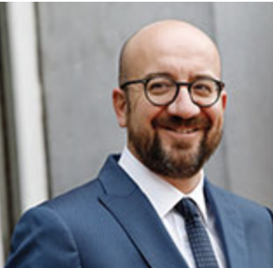
European Union
European Council
Heads of national governments, expressing their national interests
Presidency rotates among member states every six months
Not a person, but a country. Currently Spain (July-December 2023)
There is also a person with the title President of the European Council: Charles Michel
Runs meetings
Represents EU externally

Slide 13
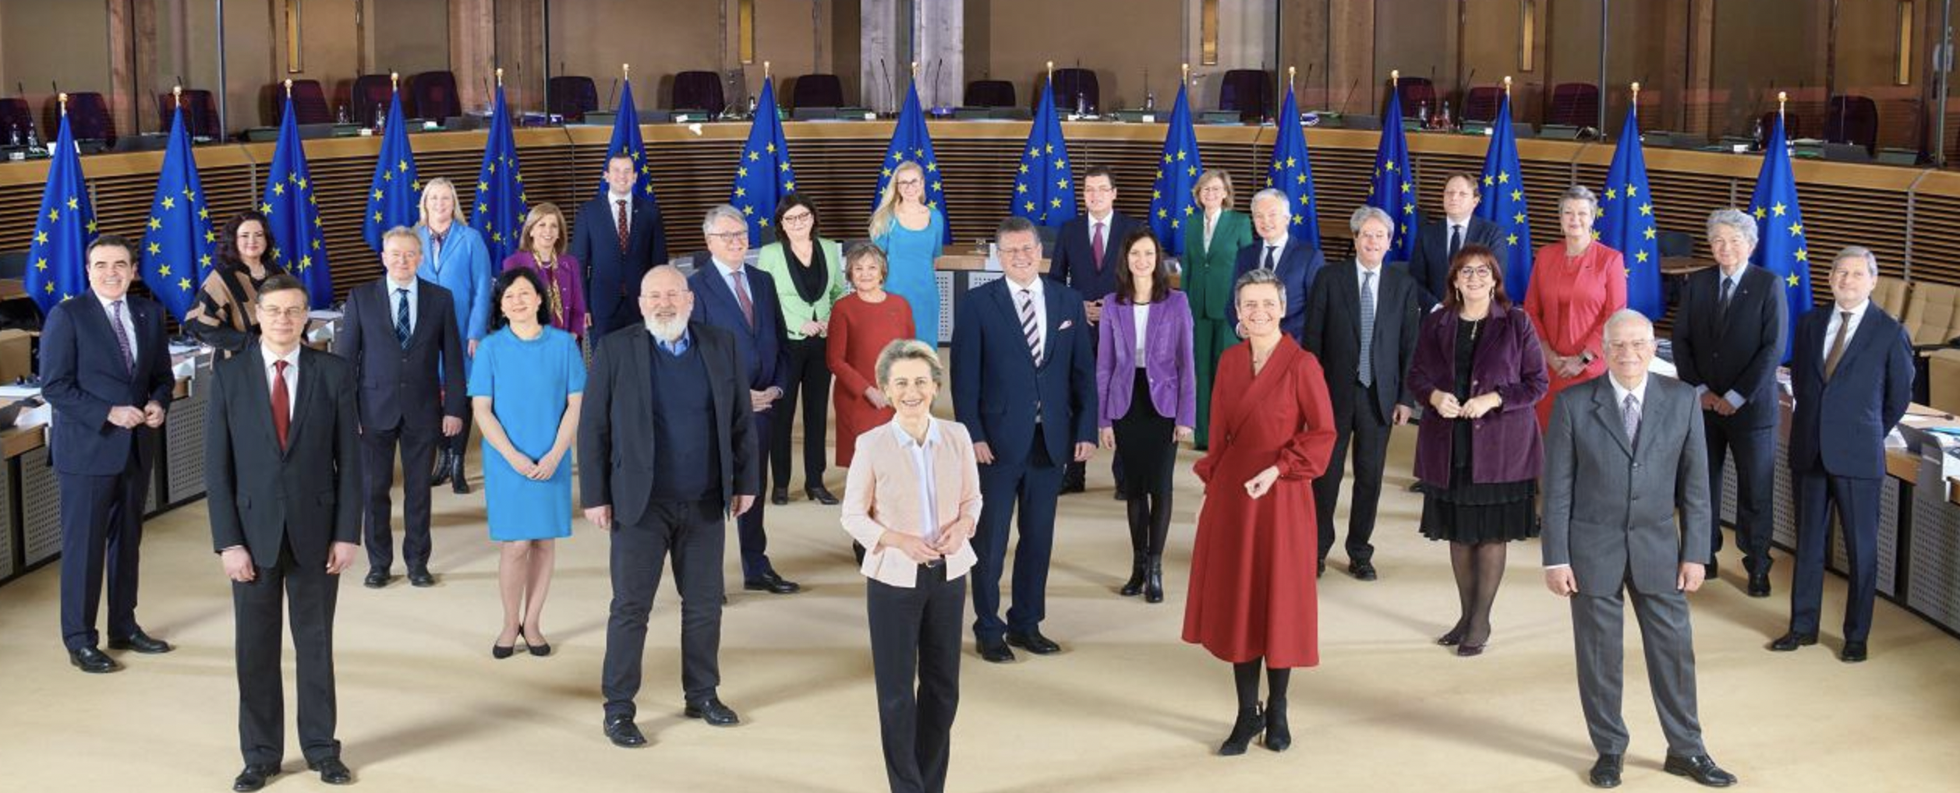
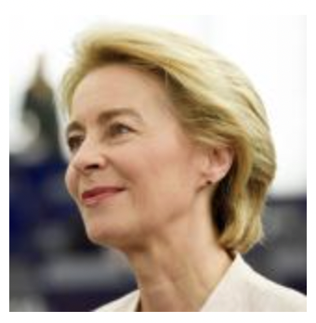
European Union
European Commission
27 Commissioners, one from each member country
Represents the whole of the EU, not the individual national interests
Drafts legislation and handles day-to-day running of EU
Current President is Ursula von der Leyen

Slide 14
European Union
Other institutions
Council of the European Union
Not the same as European Council
National ministries, a Council for each area
European Parliament
Court of Justice
European Central Bank
Court of Auditors
Notes:
Gabel, Matthew J., “European Union,” Encyclopedia Britanica, 2020.
https://www.britannica.com/topic/European-Union/The-Maastricht-Treaty

Slide 15
European Union
How it functions
Commission “proposes”
Council “adopts”: seeks unanimity, but if not, it votes
Proportional to population
But with small countries over-represented
Notes:
Gabel, Matthew J., “European Union,” Encyclopedia Britanica, 2020.
https://www.britannica.com/topic/European-Union/The-Maastricht-Treaty

Slide 16
European Union
Features relevant for trade
Common external tariff (it’s a “customs union”)
Countries therefore can not join FTAs on their own
Value-added tax (VAT)
Rebated on exports
Common agricultural policy (CAP)
System of subsidies and support programs for agriculture
Variable levies
Numerous (~42) FTAs with other countries & groups of countries, including with former colonies
Banana War: US-EU dispute over EU preference for former colonies’ bananas. US won case at WTO
State aid for firms is prohibited (unlike US)
Notes:
Gabel, Matthew J., “European Union,” Encyclopedia Britanica, 2020.
https://www.britannica.com/topic/European-Union/The-Maastricht-Treaty

Slide 17
European Union
Tariffs and Trade Disputes
The following 3 slides come from WTO, Member Information, downloaded 9/22/22
Tariffs: I assume they are up to date, as of 8/20/23
Disputes: These are the total numbers of disputes since 1995.
RTAs (Regional Trade Agreements, WTO term for FTAs, etc.)

Slide 18
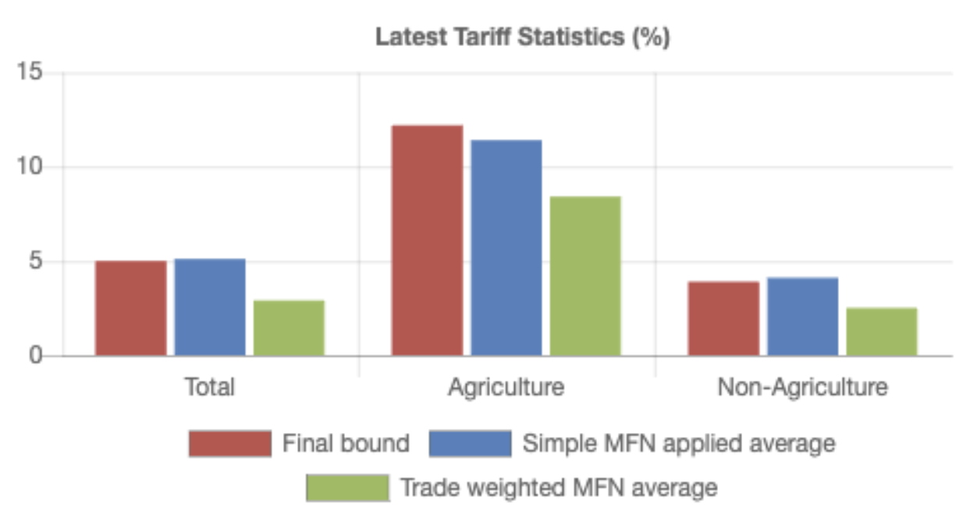
EU Tariffs per WTO
Notes:
https://www.wto.org/english/thewto_e/countries_e/european_communities_e.htm

Slide 19
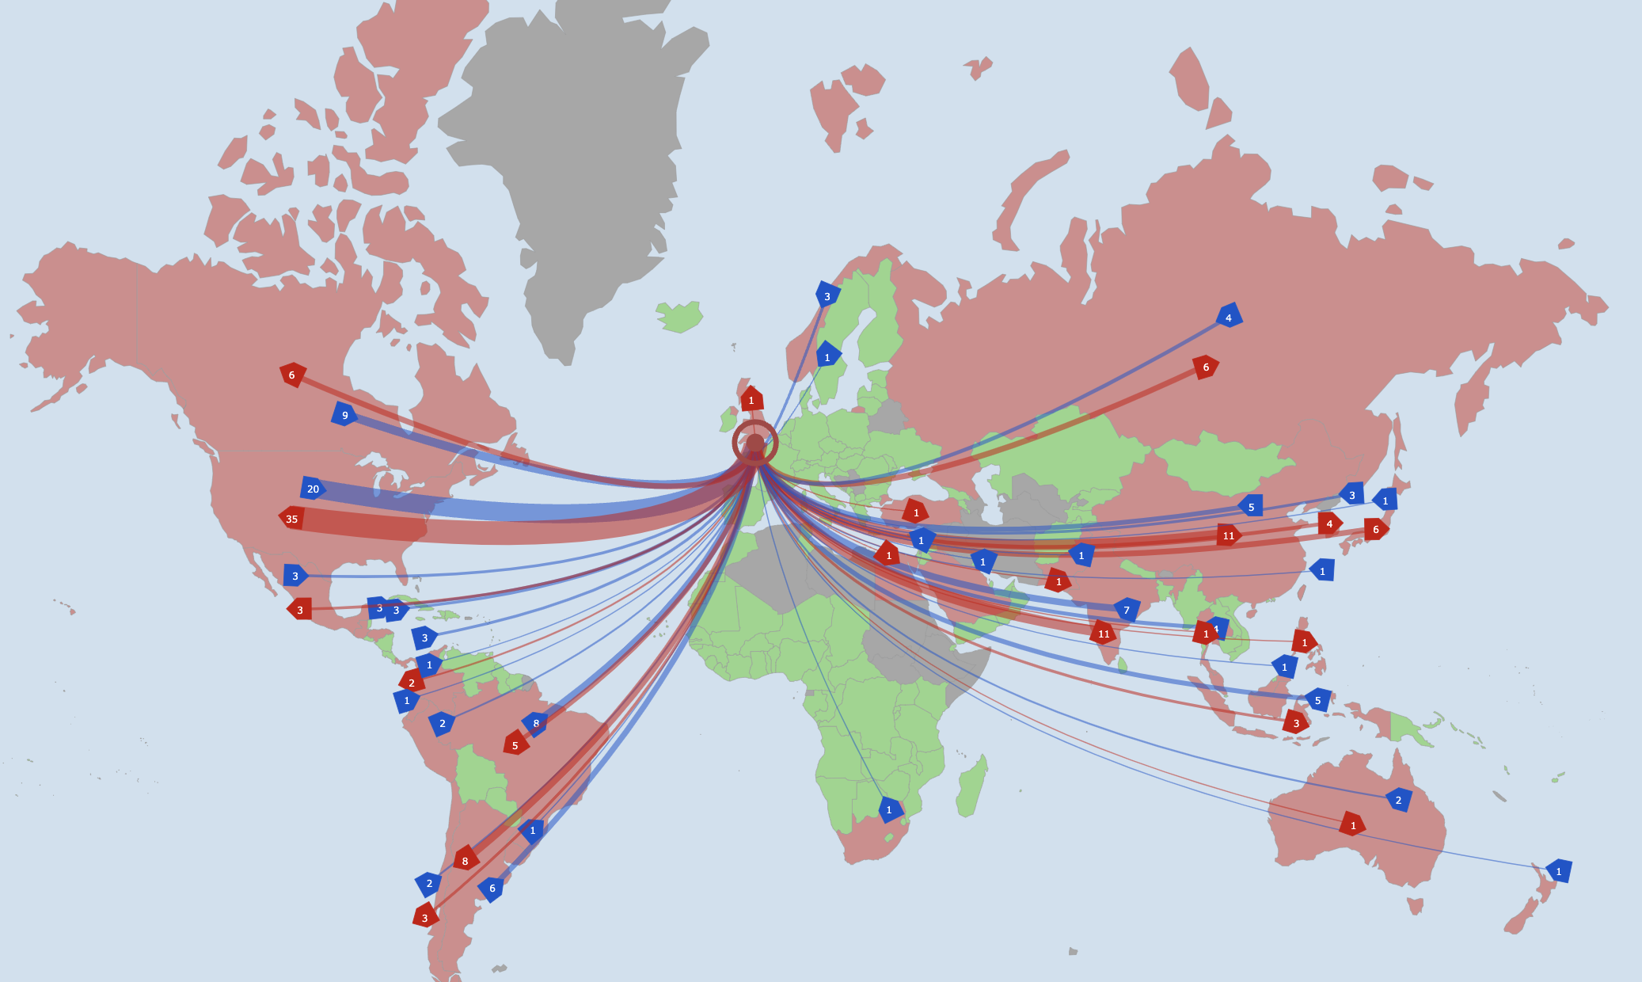
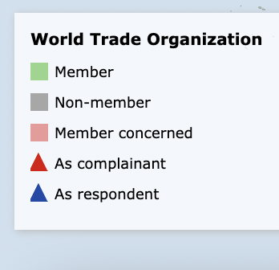
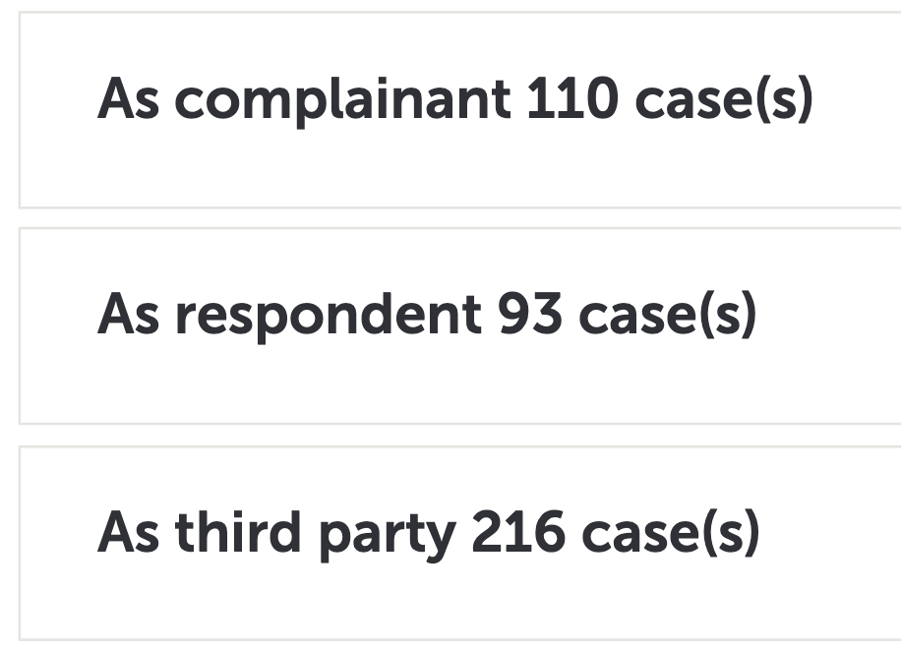
Disputes Involving EU
per WTO
Notes:
https://www.wto.org/english/tratop_e/dispu_e/dispu_maps_iframe_e.htm?country_selected=EEC&sense=e

Slide 20
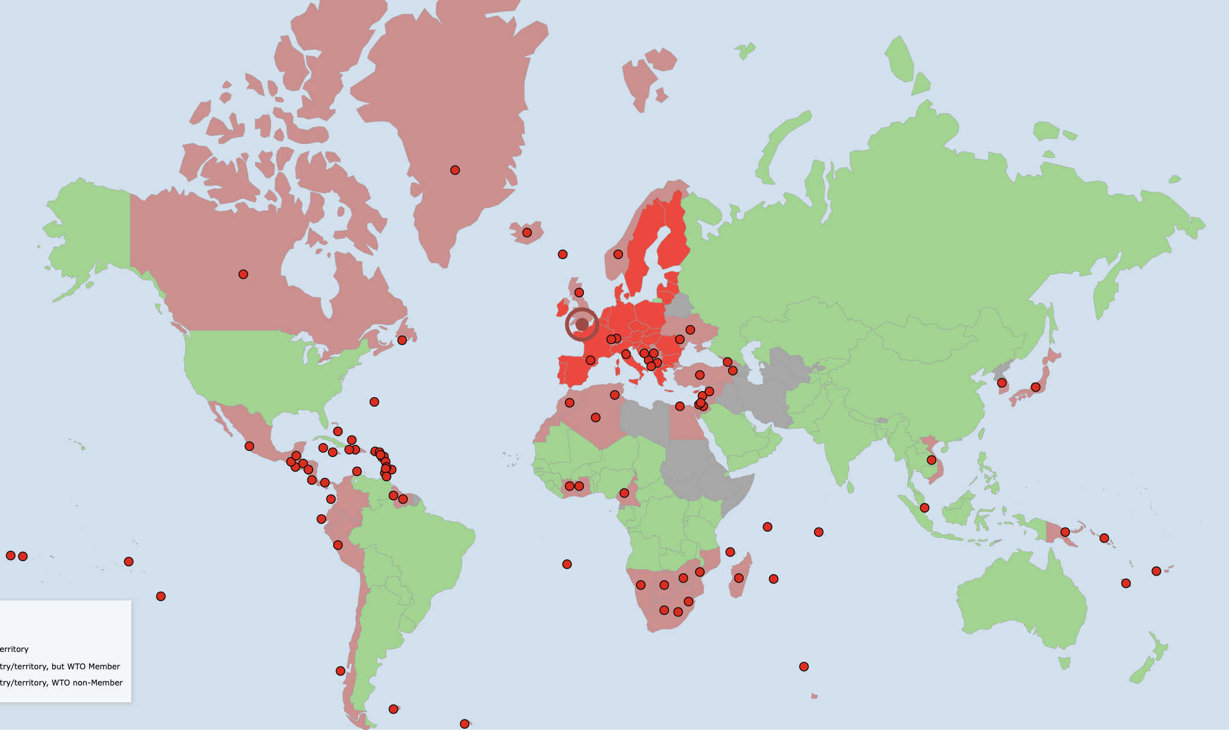
EU Membership in RTAs and PTAs
Notes:
https://www.wto.org/english/tratop_e/region_e/rta_participation_map_iframe_e.htm?country_selected=EEC&sense=b

Slide 21
Compare with US

Slide 22
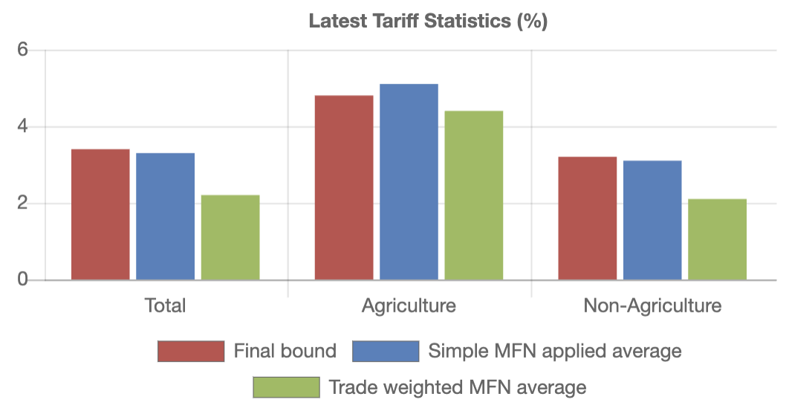
US Tariffs per WTO
How is this possible? I don’t know. See notes to slide.
Notes:
https://www.wto.org/english/thewto_e/countries_e/usa_e.htm
How can MFN in agriculture be larger than Final bound? Bound excludes unbound lines, but US has 100% bound in all but petroleum (83.3%), where average tariff is lower than bound, so I don’t see how that could be it.
US has higher applied than bound in several sectors: dairy 19.4>17.2, oilseeds 7.2>3.9, sugars 14.9>13.6, beverages & tobacco 18.1>14.0. But I don’t know how that is possible.

Slide 23
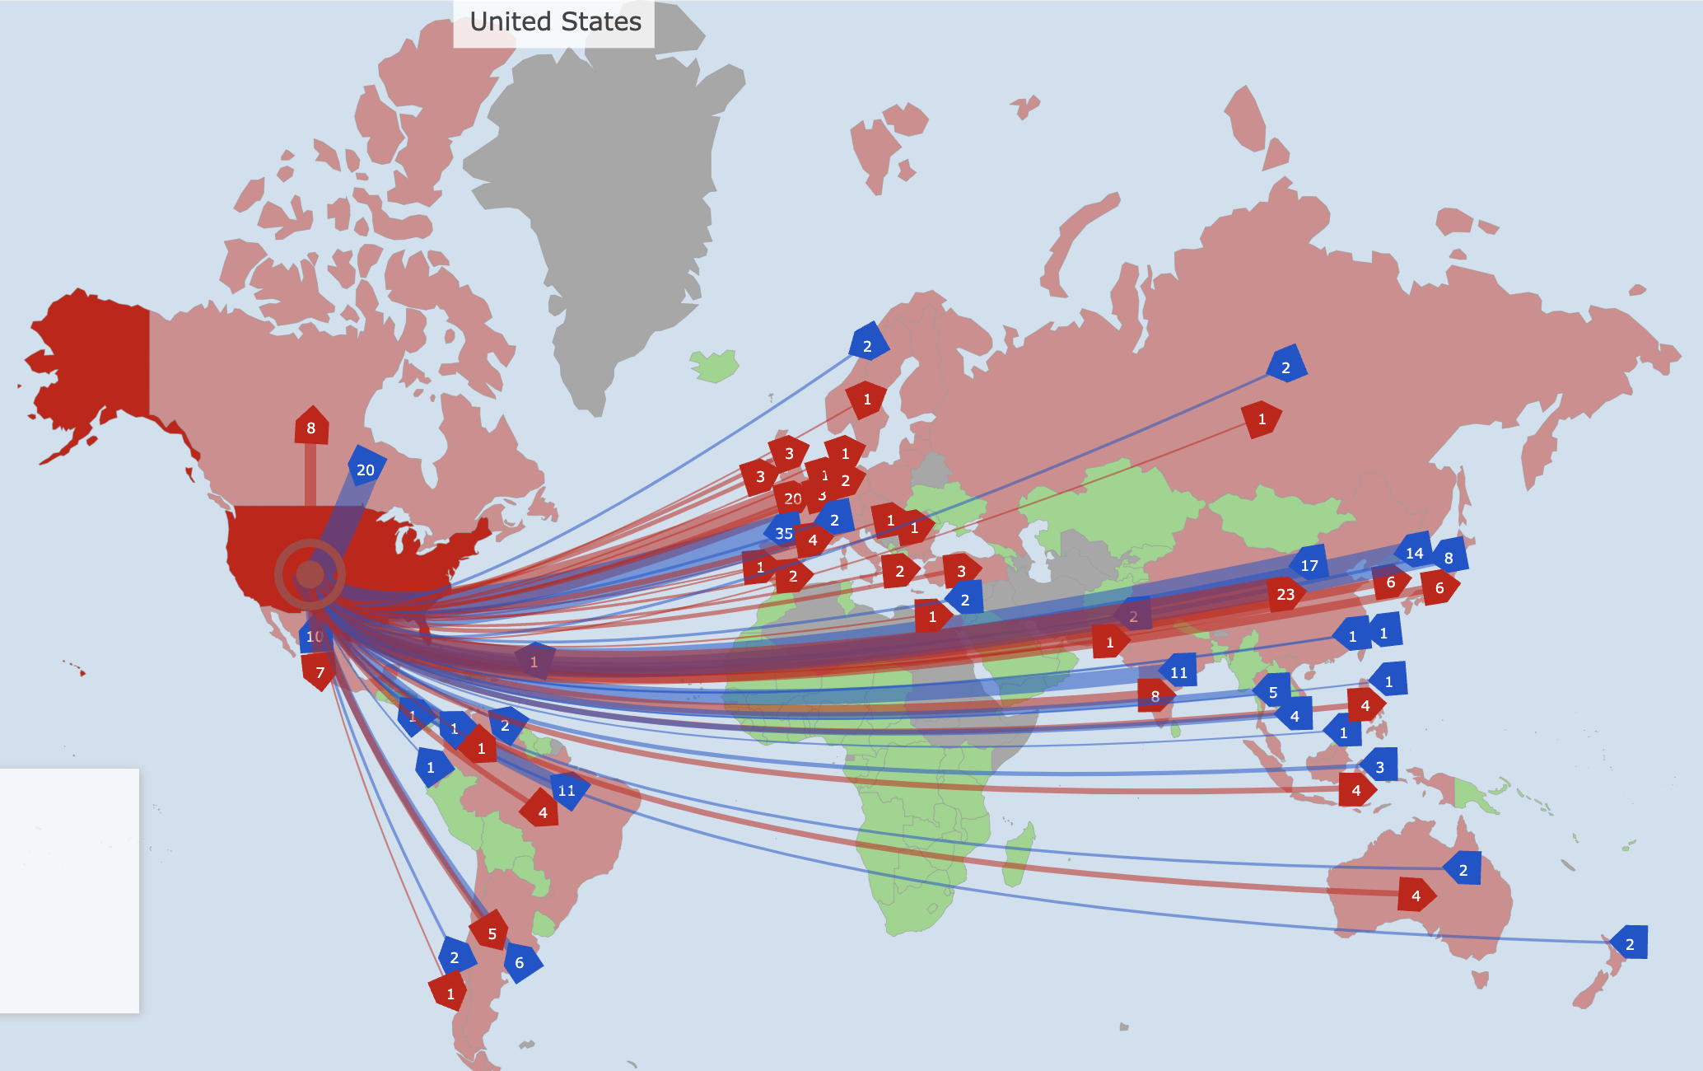
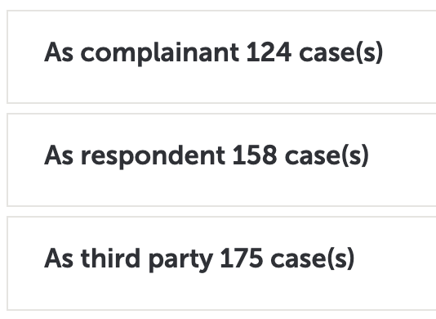
Disputes Involving US
per WTO
Notes:
https://www.wto.org/english/thewto_e/countries_e/usa_e.htm

Slide 24
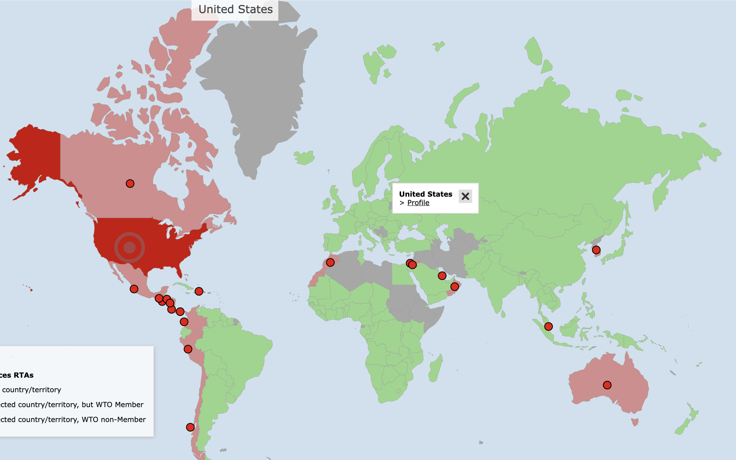
US Membership in RTAs and PTAs
Notes:
https://www.wto.org/english/tratop_e/region_e/rta_participation_map_iframe_e.htm?country_selected=USA&sense=b

Slide 25
Comparison of EU with US Tariffs
EU
US
These look comparable until you note the scales.

Slide 26
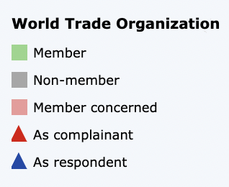
Comparison of EU with US Disputes
EU
US

Slide 27
Comparison of EU with US FTAs
EU
US

Slide 28
European Union
Disputes at WTO in 2022-23: Respondent Complainant
DS618: European Union - Countervailing duties on imports of biodiesel from Indonesia
In consultations since 15 August 2023
DS616: European Union - Countervailing and Anti-Dumping Duties on Stainless Steel Cold-Rolled Flat Products from Indonesia
Consultations requested 24 January 2023; panel established but not yet composed
DS613: European Union — Measures concerning the importation of citrus fruit from South Africa
In consultations since 27 July 2022
DS612: United Kingdom— Measures relating to the allocation of contracts for difference in low carbon energy generation, EU
In consultations since 28 March 2022
DS611: China— Enforcement of intellectual property rights, EU
In consultations since 18 February 2022; panel composed

Slide 29
Pause for Discussion

Slide 30
Questions
On Jackson:
What are the six entities that play constitutional roles in the European Community?
On “European Union in Brief”:
What does the “single market” entail?
What are the three entities through which EU citizens and members states are represented?
Why and when did it change its name from EEC to EU?

Slide 31
Questions on EU Commission “Making Trade Policy”
What sorts of policy are the “exclusive power of the EU,” meaning that they cannot be done by member states individually?
Which part of the EU negotiates trade agreements with other countries? Is that entity constrained in any way as to with whom it can negotiate and what its objectives should be?
Once a trade agreement is negotiated, who approves it?

Slide 32
Questions on, Matthias & Parsons, “Single-Market Power…”
Which of the US and EU have the more integrated markets?
If indeed the US is less integrated, why is there so much greater interstate trade and mobility?
How does California restrict imports of eggs from some other states?
Can colleges in the US and EU charge different tuitions for students from outside their state or country?

Slide 33
Questions on Economist, “The Trade War Within”
To what extent are EU countries largely free-traders?
Why was the EU considering taking some developing countries off the list for GSP treatment? Can you find out whether it did in fact do this for Brazil, Russia, Saudi Arabia, South Africa?
What are the 3 levels of EU GSP and what do they mean?
What is meant by the need for “reciprocity”?

Slide 34
Questions on Bounds, “EU Seeks Protected Status”
Once a product has protected status, what does this mean?
Does the WTO accept the idea of protected status?
What are some examples of currently protected products?
Over what part(s) of the world do the EU designations of protected status apply?

Slide 35
Outline
European Union
Japan
China
Other

Slide 36
Japan
Portions of government dealing with trade
METI = Ministry of Economy, Trade, and Industry
Previously MITI, Ministry of International Trade and Industry
MAFF = Ministry of Agriculture, Forestry, and Fisheries
Handles all agriculture trade (with high tariffs)
MOFA = Ministry of Foreign Affairs

Slide 37
Japan
Japan’s trade disputes
Most serious recent dispute has been with South Korea
2018: S.K. Supreme Court ordered reparations from 2 Japanese companies for WWII forced labor.
S.K. also continues concerns about WWII “comfort women”
2019: Japan tightened export controls to S.K. and dropped S.K. from its “white list” for ”fast-track exports”
S.K cancelled military intelligence sharing
2-way trade dropped 41%
As we saw Sep 4, they have now resolved the issue
Notes:
https://www.usip.org/publications/2022/07/mended-ties-between-japan-and-south-korea-would-boost-regional-security

Slide 38
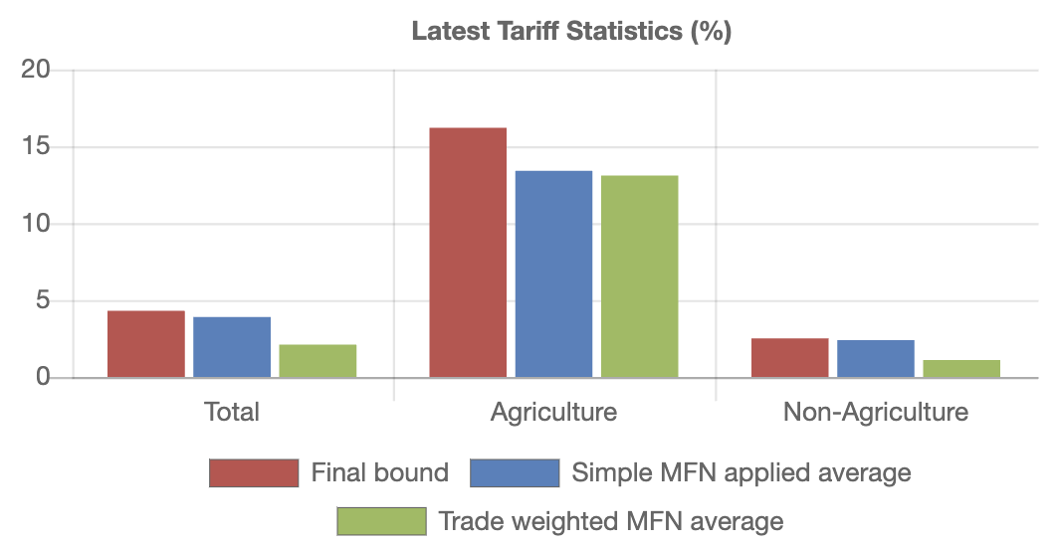
Japan Tariffs per WTO
Notes:
https://www.wto.org/english/thewto_e/countries_e/japan_e.htm

Slide 39
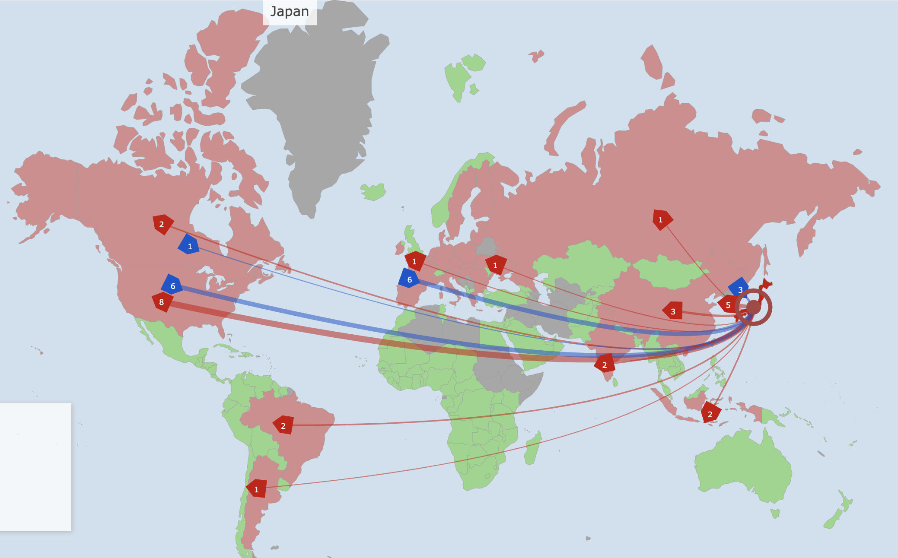
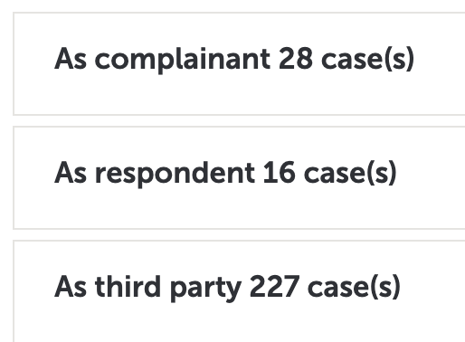
Disputes Involving Japan per WTO
Notes:
https://www.wto.org/english/thewto_e/countries_e/japan_e.htm

Slide 40
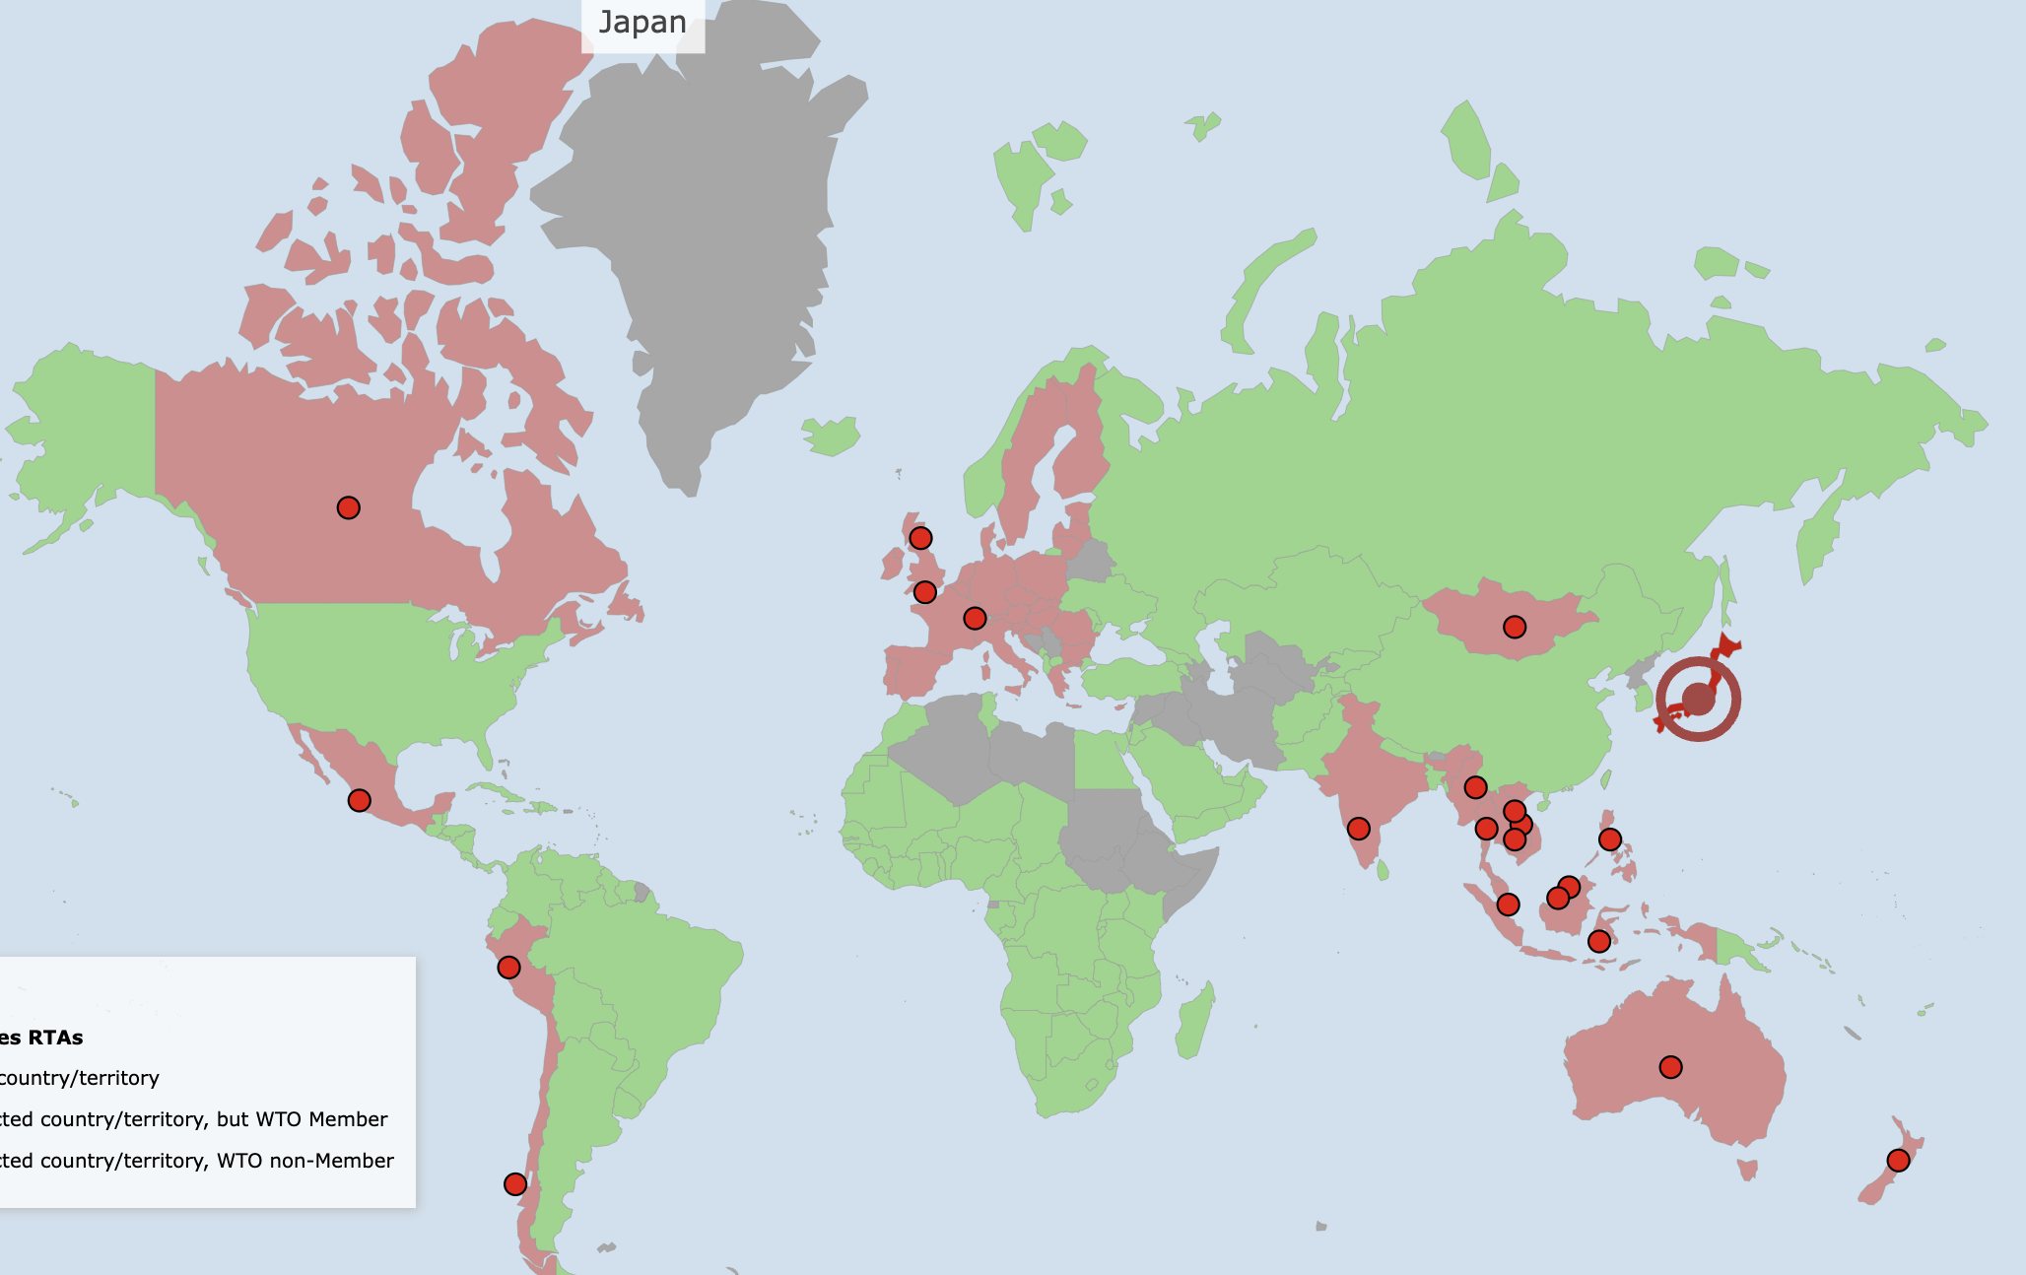
FTAs Involving Japan per WTO
Notes:
https://www.wto.org/english/thewto_e/countries_e/japan_e.htm

Slide 41
Japan
Disputes at WTO in 2020-21: Respondent Complainant
DS601: China — Anti-Dumping measures on stainless steel products from Japan
Consultations requested 11 June 2021
Report(s) adopted with recommendation to bring measures into conformity
DS594: Korea — Measures Affecting Trade in Commercial Vessels (second complaint) (Japan)
In consultations since 31 January 2020
Notes:
Gabel, Matthew J., “European Union,” Encyclopedia Britanica, 2020.
https://www.britannica.com/topic/European-Union/The-Maastricht-Treaty

Slide 42
Pause for Discussion

Slide 43
Questions
From Jackson:
Why is Japan a less complicated country than the US and EU for understanding its interaction with international trade law and negotiations?
From METI:
What is METI’s “general rule”?
What are some of the exceptions to free trade that they base their trade controls on?
What are some of the things that METI does?

Slide 44
Questions on Japan’s “Trade Policy Review 2023”
What are some unusual features of Japan’s international economic situation?
On what are Japan’s highest MFN tariffs?
Has Japan recently adopted new industrial policy?

Slide 45
Outline
European Union
Japan
China
Other

Slide 46
China
Part of government dealing with trade
MOFCOM = Ministry of Commerce
Mission: To draft the laws and regulations governing foreign trade

Slide 47
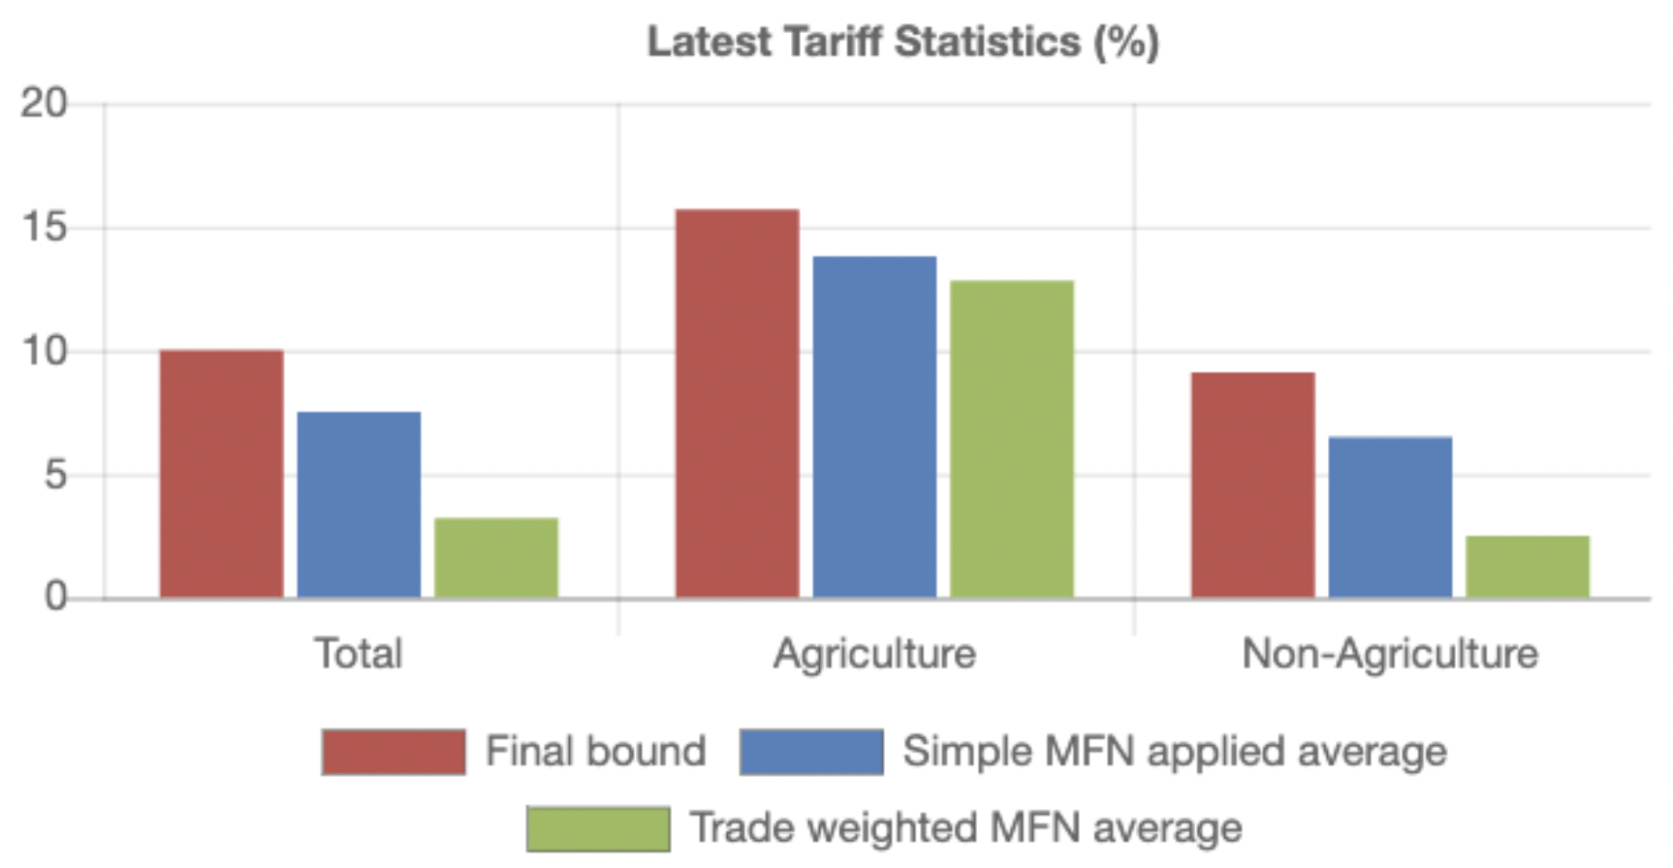
China Tariffs per WTO
This is from earlier year. This year WTO says “No Data found”
Notes:
https://www.wto.org/english/thewto_e/countries_e/china_e.htm

Slide 48
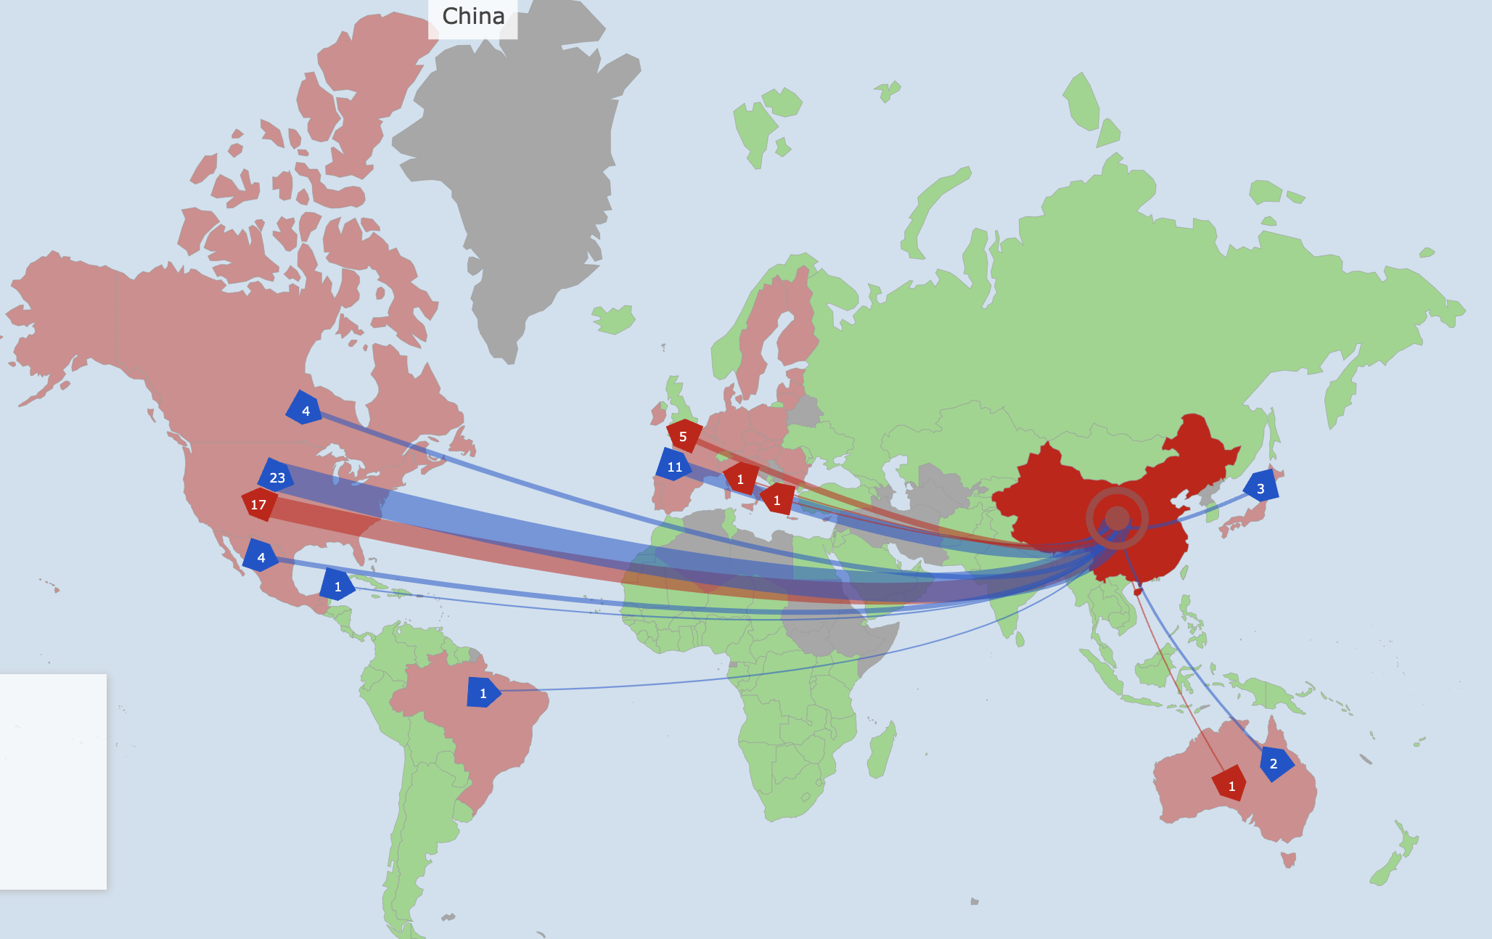
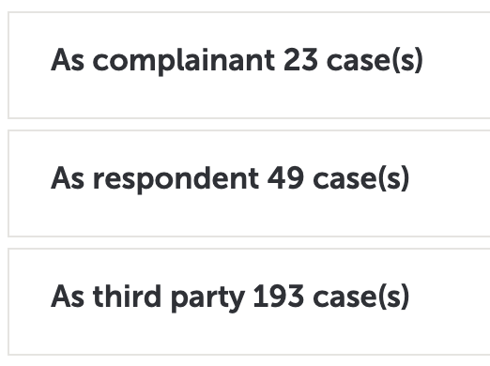
Disputes Involving China per WTO
Notes:
https://www.wto.org/english/tratop_e/dispu_e/dispu_maps_iframe_e.htm?country_selected=CHN&sense=e

Slide 49
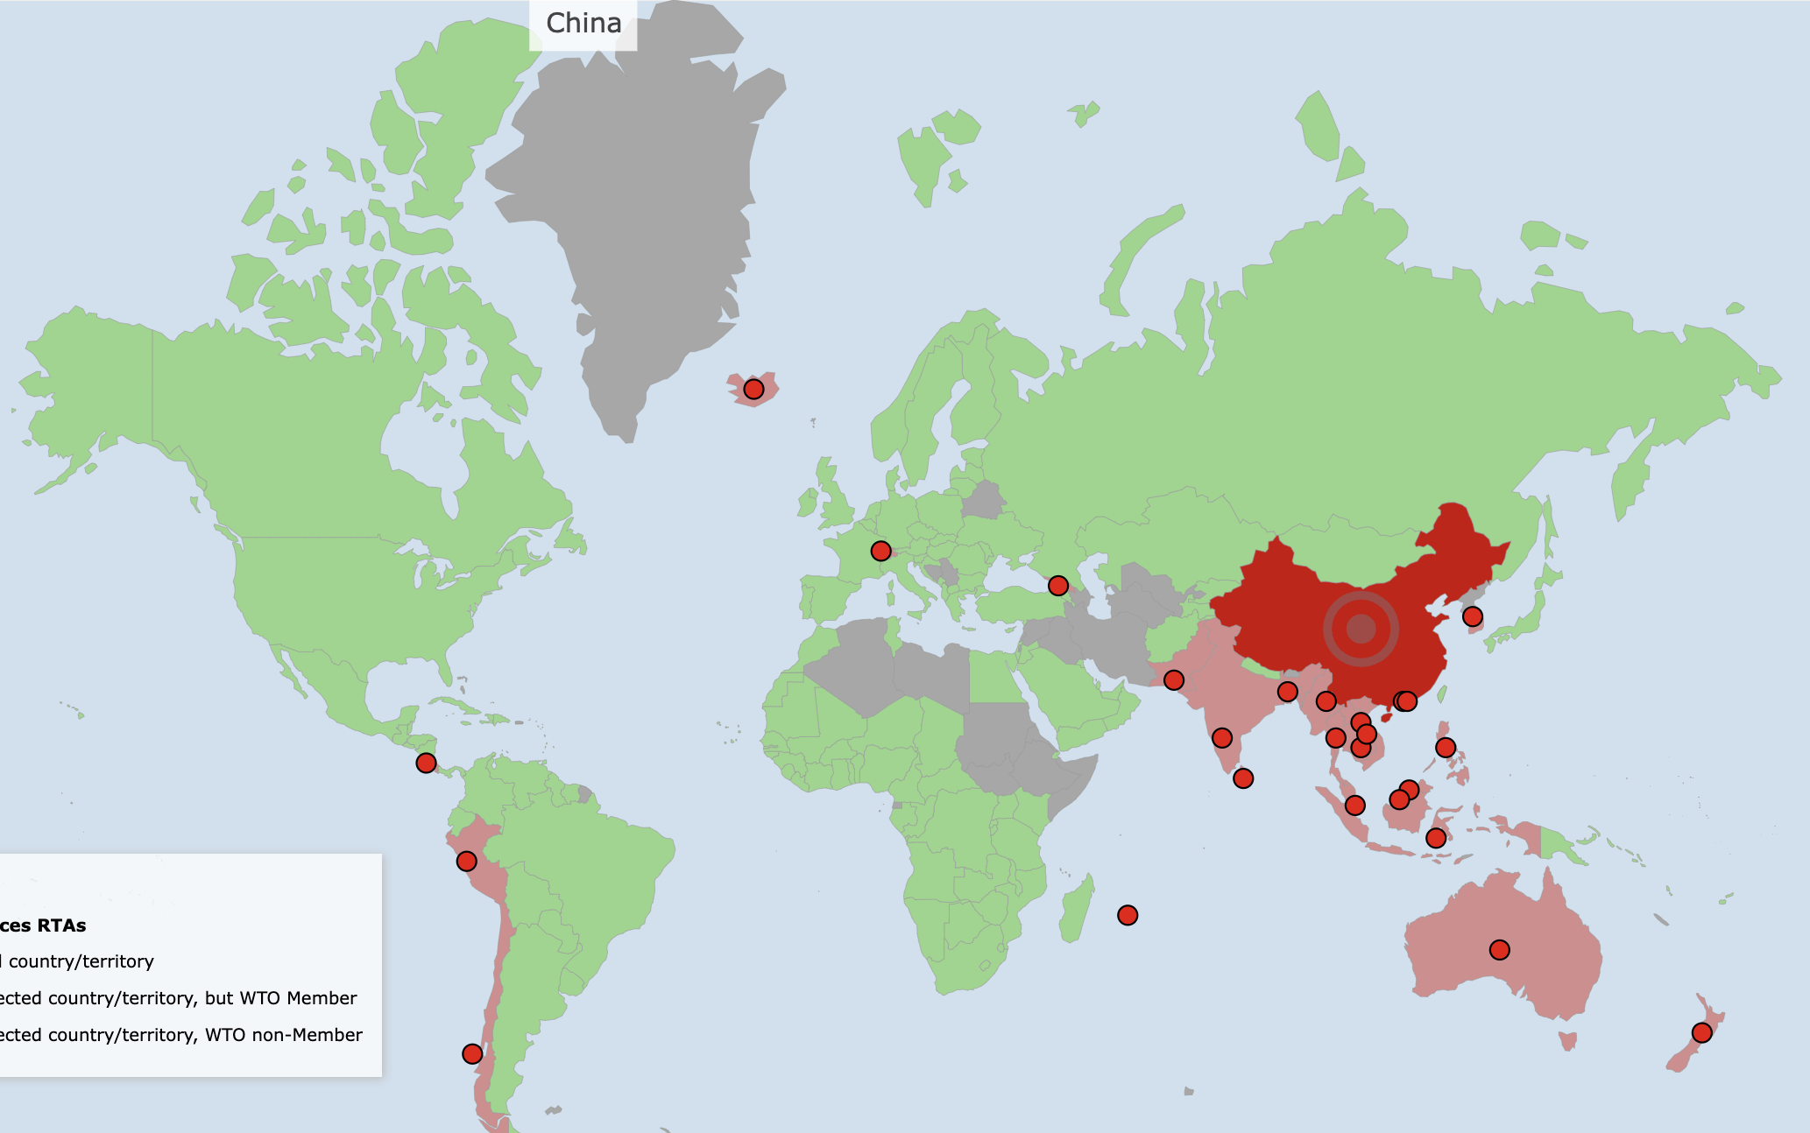
FTAs Involving China per WTO
Notes:
https://www.wto.org/english/tratop_e/dispu_e/dispu_maps_iframe_e.htm?country_selected=CHN&sense=e

Slide 50
China
Disputes at WTO in 2022-23: Respondent Complainant
DS615: United States - Measures on Certain Semiconductor and other Products, and Related Services and Technologies, China
In consultations since 12 December 2022
DS611: China— Enforcement of intellectual property rights, EU
Consultations requested 18 February 2022; panel composed
DS610: China—Measures concerning trade in goods and services, EU
Consultations requested 27 January 2022; panel composed
DS603: Australia—Anti-dumping and countervailing duty measures on certain products from China
Consultations requested 24 June 2021; panel composed
DS602: China—Anti-dumping and countervailing duty measures on wine from Australia
Consultations requested 22 June 2021; panel composed
Notes:
Gabel, Matthew J., “European Union,” Encyclopedia Britanica, 2020.
https://www.britannica.com/topic/European-Union/The-Maastricht-Treaty

Slide 51
Pause for Discussion

Slide 52
Questions on China’s “Trade Policy Review 2021”
How has China’s GDP growth rate changed? How has its current account surplus changed?
Does the government intend to eliminate State Owned Enterprises?
How, if at all, does China manage inward foreign direct investment?

Slide 53
Questions on “Trade Policy Review 2021” continued
How high are China’s tariffs?
What is China’s policy regarding trade in garbage (solid waste)?
Does China use tariff-rate quotas?
Has China made any changes in its intellectual property rules and procedures?

Slide 54
Questions on Wei “China Spends Far More Than Others”
As percent of GDP, how does China’s government support compare to US and also the second most supported?
Might the US respond to this with policy?
What forms does China’s government support take?

Slide 55
Outline
European Union
Japan
China
Other

Slide 56
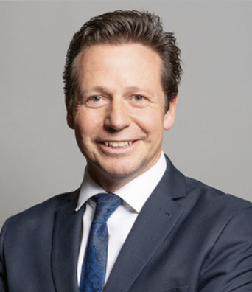
Other
United Kingdom
Department for International Business and Trade
Minister of State for Trade: Nigel Huddleston since February 2023
Trade Secretary: Kemi Badenoch since September 2022
“Secretary of State for Business and Trade”
UK Trade Remedies Authority
Handles AD, CVD, and Safeguards

Slide 57
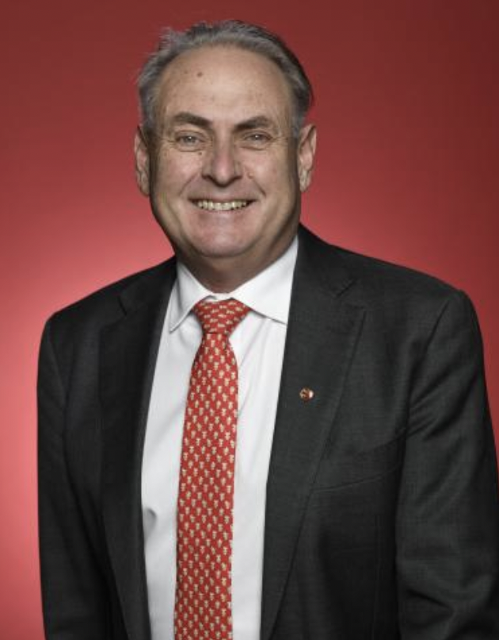
Other
Australia
Minister for Trade and Tourism
Senator the Hon Don Farrell since June 1, 2022
Anti-Dumping Commission
Handles ADD & CVD

Slide 58
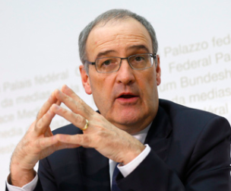
Other
Switzerland
Federal Department of Economic Affairs, Education and Research
Headed by Guy Parmelin since 2019
(Now also President)
Does not use ADD, CVD, safeguards, or quotas
Has many FTAs, including with EU

Slide 59
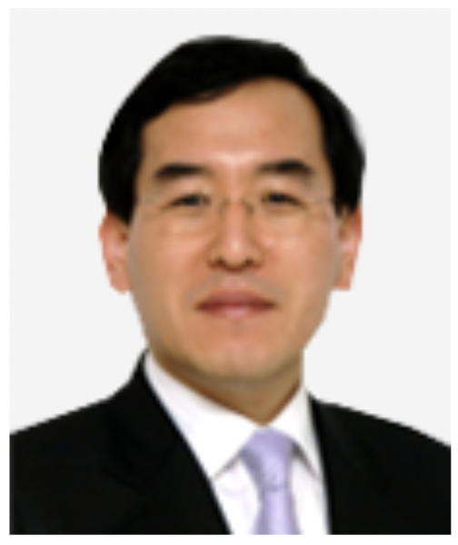
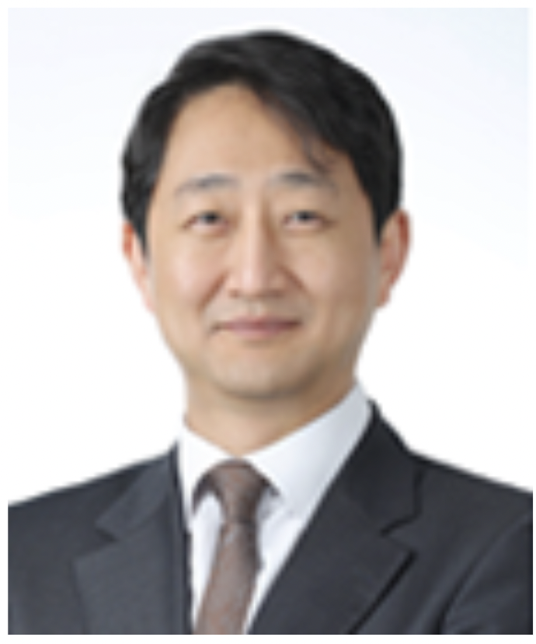
Other
South Korea
Ministry of Trade, Industry, and Energy
Minister: Lee Chang-yang
Since May 2022
Minister for Trade: Ahn Duk-geun
Since ? 2022
PhD Econ UM under Deardorff

