Slide 1
Classes 7, 8 Policies and Institutions: International by Alan V. Deardorff University of Michigan 2023
PubPol/Econ 541

Slide 2
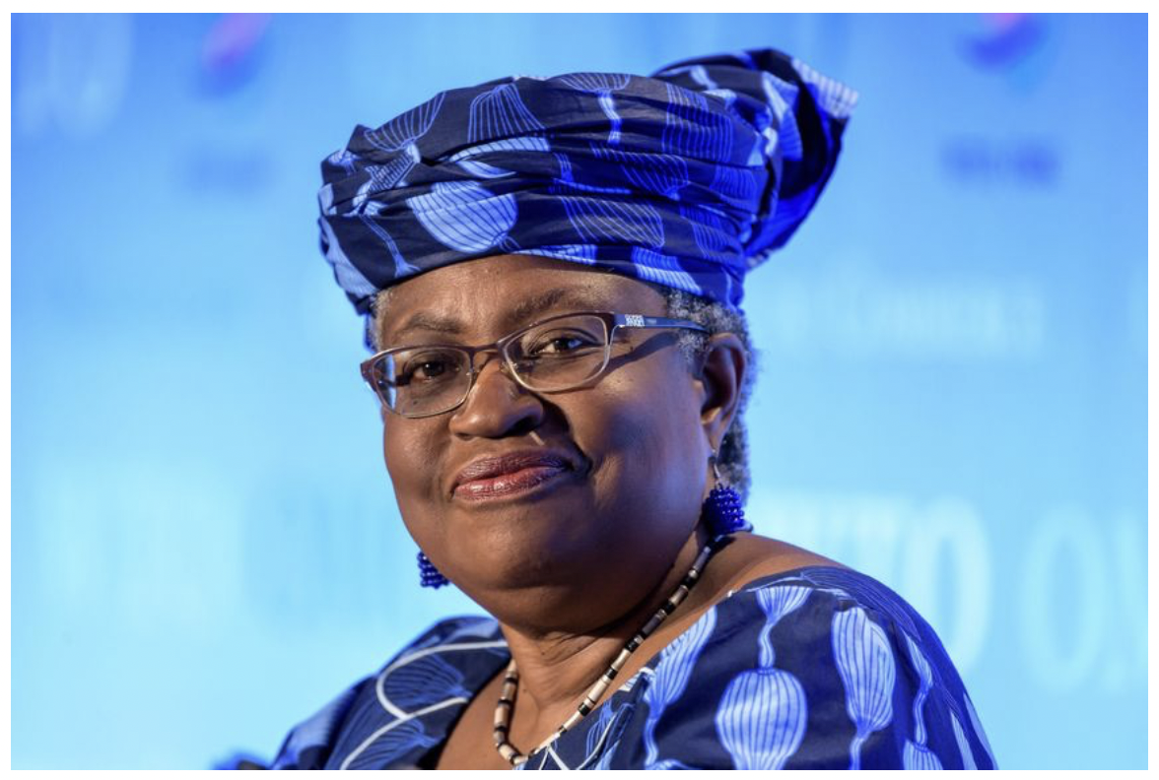
Notes:
Norman, Laurence. “WTO Appoints Nigeria’s Ngozi Okonjo-Iweala as First Female Leader,” Wall Street Journal, February 15, 2021.

Slide 3
FROM REQUIRED READINGS

Slide 4
Geneva Trade Platform

Slide 5
Parties to the MPIA
The following WTO members are parties to the MPIA: Australia; Benin; Brazil; Canada;
China; Chile; Colombia; Costa Rica; Ecuador; European Union; Guatemala; Hong
Kong, China; Iceland; Japan; Macao, China; Mexico; Montenegro; New Zealand; Nicaragua; Norway; Pakistan; Peru; Singapore; Switzerland; Ukraine and Uruguay.
Notes:
Geneva Trade Platform, “Multi-Party Interim Appeal Arbitration Arrangement (MPIA),” Geneva Graduate Institute, Konrad Adenauer Stiftung, undated. [4p]
https://wtoplurilaterals.info/plural_initiative/the-mpia/#:~:text=Known%20as%20the%20Multiparty%20Interim,and%20staffed%20WTO%20Appellate%20Body

Slide 6
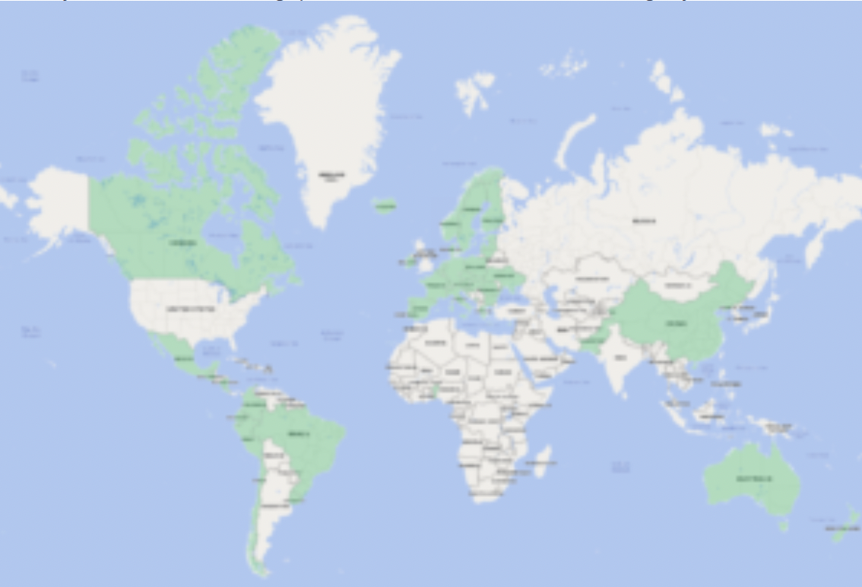
Also Japan
Notes:
Geneva Trade Platform, “Multi-Party Interim Appeal Arbitration Arrangement (MPIA),” Geneva Graduate Institute, Konrad Adenauer Stiftung, undated. [4p]
https://wtoplurilaterals.info/plural_initiative/the-mpia/#:~:text=Known%20as%20the%20Multiparty%20Interim,and%20staffed%20WTO%20Appellate%20Body

Slide 7
FROM OPTIONAL READINGS

Slide 8
Schlesinger

Slide 9
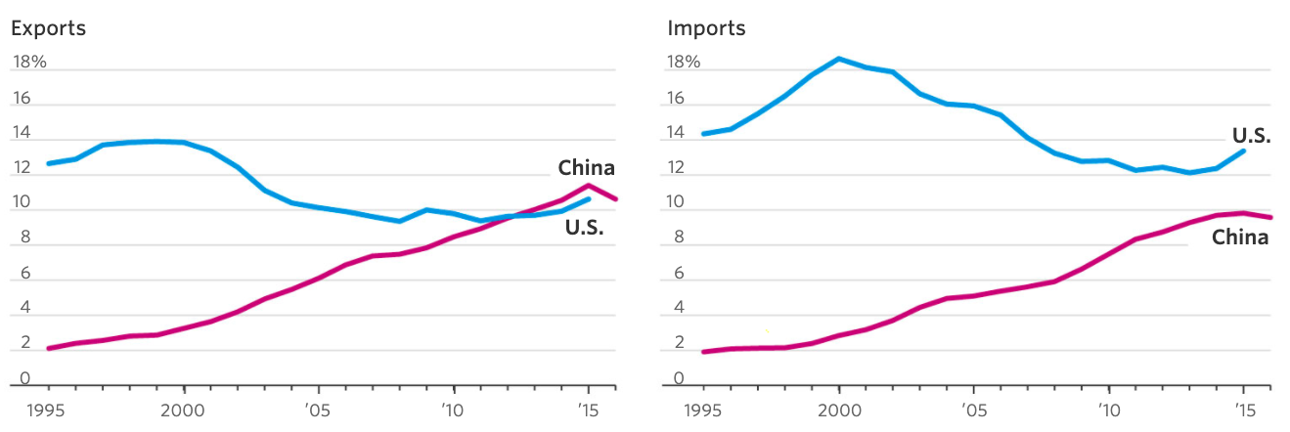
Notes:
Schlesinger, Jacob M., “How China Swallowed the WTO,” Wall Street Journal, November 2, 2017.
https://www.wsj.com/articles/how-china-swallowed-the-wto-1509551308

Slide 10
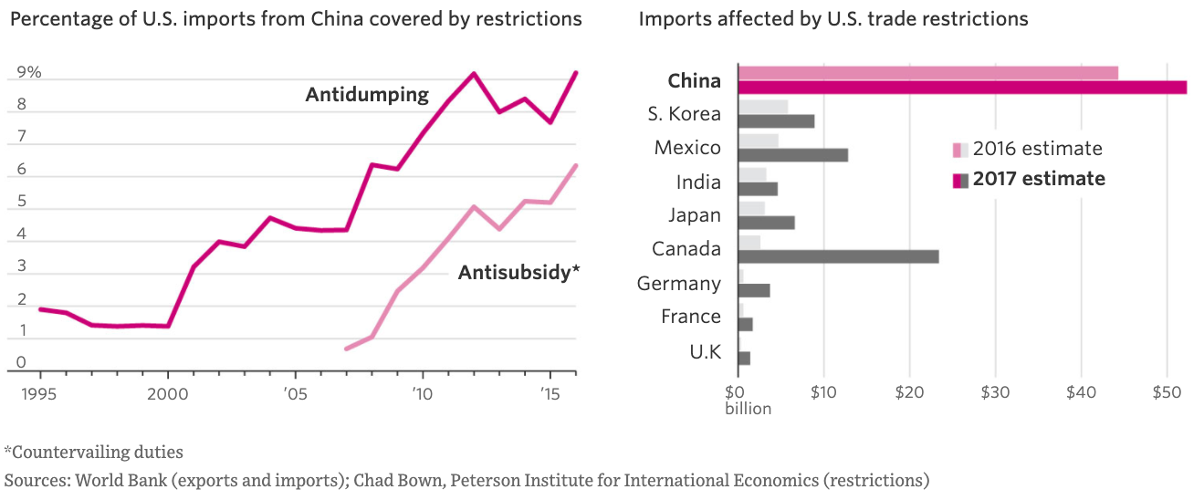
Notes:
Schlesinger, Jacob M., “How China Swallowed the WTO,” Wall Street Journal, November 2, 2017.
https://www.wsj.com/articles/how-china-swallowed-the-wto-1509551308

Slide 11
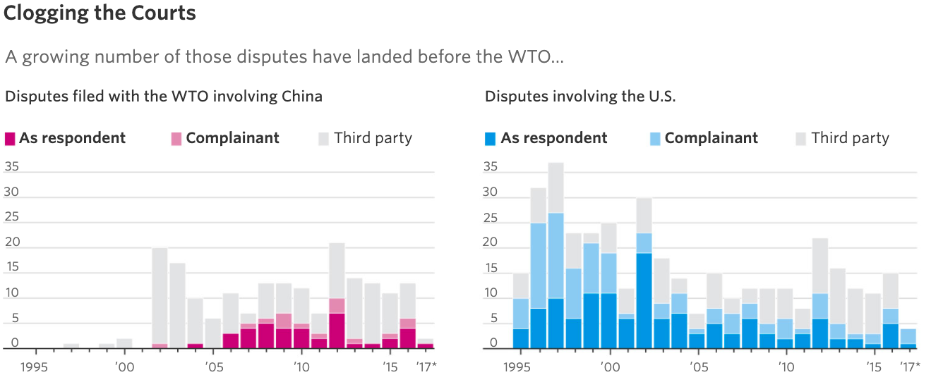
Notes:
Schlesinger, Jacob M., “How China Swallowed the WTO,” Wall Street Journal, November 2, 2017.
https://www.wsj.com/articles/how-china-swallowed-the-wto-1509551308

Slide 12
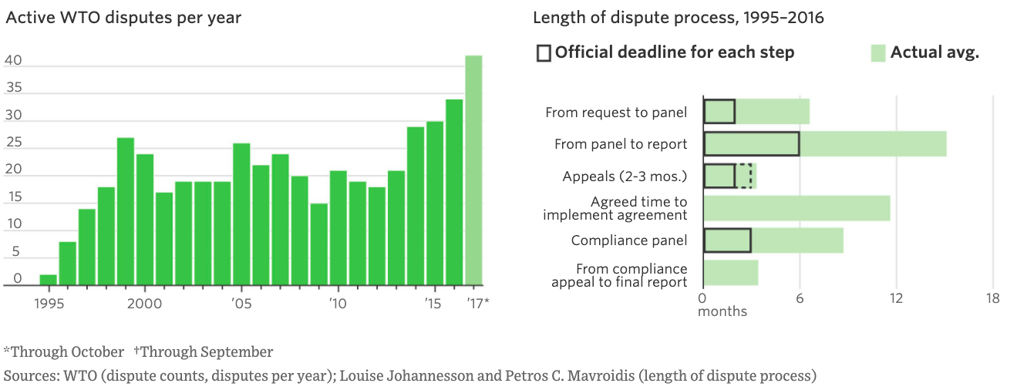
Notes:
Schlesinger, Jacob M., “How China Swallowed the WTO,” Wall Street Journal, November 2, 2017.
https://www.wsj.com/articles/how-china-swallowed-the-wto-1509551308

Slide 13
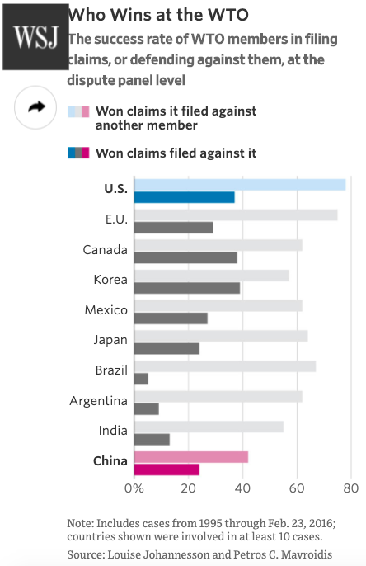
Notes:
Schlesinger, Jacob M., “How China Swallowed the WTO,” Wall Street Journal, November 2, 2017.
https://www.wsj.com/articles/how-china-swallowed-the-wto-1509551308

