Slide 1
Class 6 International Transactions and the Trade Balance by Alan V. Deardorff University of Michigan 2023
PubPol/Econ 541

Slide 2
Announcements
Papers
Monday was the drop/add deadline, so I’ll be doing the paper assignments soon
Group assignments will be in Canvas: Files / Paper Assignments
Assignments will also be there, and on website under Paper Assignments
First paper is due Wed, Oct 4, 8:30 AM in Canvas
The groups will be set in Canvas; turn in once per group

Slide 3
Announcements
Office hour tomorrow: I have a meeting at 10:30, so if you want to see me, come between 10 and 10:25.

Slide 4
Outline
A Bit of Macroeconomics
The Balance of Payments Accounts
Surpluses and Deficits
They Add to Zero
What a Deficit Means
The Assumption of Balanced Trade

Slide 5
A Bit of Macroeconomics
From KOM:
Y = C + I + G + (X – M)
Where
Y = GDP = Gross Domestic Product
C = Consumption
I = Investment
G = Government purchases
X = Exports
M = Imports

Slide 6
A Bit of Macroeconomics
GDP measures
The economy’s output of goods and services
Essentially the same as National Income
Wages, salaries, interest, rent, and profits
=GDP since production generates income
GDP is positively related to, but not the same as
Employment
Welfare
Happiness
And there are problems even with measuring output. E.g., it misses all that we produce in our homes

Slide 7
The Balance of Payments Accounts
Recording International Transactions
Credits versus debits
Credits correspond to payments that would flow into the country
Exports
Borrowing from foreigners
Collection of interest and dividends from foreigners
Debits correspond to payments that would flow out of the country
Imports, etc.
This use of the words “credit” and “debit” is specific to the international accounts. It is NOT the same as their use in accounting or in other contexts.

Slide 8
The Balance of Payments Accounts
Recording International Transactions
Current versus Financial Accounts
Financial account is (only) changes in holding of assets by one country in another
Current account all other international transactions:
Trade (both goods and services)
Income payments (wages, interest, & dividends)
Transfers (Gifts, remittances, and foreign aid)

Slide 9
Table 13.2 U.S. Balance of Payments Accounts for 2019 (Billions of Dollars) (1 of 2)
Current Account | Blank | Blank
(1) | Exports and current transfer receipts Of which: | 3,805.94
 | Goods | 1,652.44
 | Services | 875.83
 | Income receipts (primary income) | 1,135.69
 | Current transfer receipts (secondary income) | 141.98
(2) | Imports and current transfer payments Of which: | 4,286.16
 | Goods | 2,516.77
 | Services | 588.36
 | Income receipts (primary income) | 899.35
 | Current transfer receipts (secondary income) | 281.69
 | Balance on current account left bracket left parenthesis 1 right parenthesis minus left parenthesis 2 right parenthesis right bracket | negative 480.22
(3) | Capital Account | negative 6.24
Credits
Debits
Source: U.S. Department of Commerce, Bureau of Economic Analysis, June 196, 2020, release. Totals may differ from sums because of rounding.
?
Notes:
KOM, 2022

Slide 10
Table 13.2 U.S. Balance of Payments Accounts for 2019 (Billions of Dollars) (2 of 2)
Financial Account | Blank | Blank
(4) | Net U.S. acquisition of financial assets, excluding financial derivatives Of which: | 440.75
Blank | Official reserve assets | 4.66
Blank | Other assets | 436.09
(5) | Net U.S. incurrence of liabilities, excluding financial derivatives Of which: | 797.96
Blank | Official reserve assets | 61.63
Blank | Other assets | 736.33
(6) | Financial derivatives, other than reserves, net | negative 38.34
Blank | Net financial flows Left bracket left parenthesis 4 right parenthesis minus left parenthesis 5 right parenthesis minus left parenthesis 6 right parenthesis right bracket | negative 395.54
Statistical Discrepancy | Blank | 90.92
Blank | [Net financial flows less sum of current and capital accounts] | Blank
Debits
These are both changes from end of last year to end of this year.
Credits
Source: U.S. Department of Commerce, Bureau of Economic Analysis, June 196, 2020, release. Totals may differ from sums because of rounding.
Notes:
KOM, 2022

Slide 11
Pause for Discussion

Slide 12
Questions on KOM
What’s the difference between GNP and GDP?
Why does GNP (or GDP) only include consumption of final goods, not firms’ purchases of intermediate inputs?
Why are imports subtracted from C+I+G+X–M in calculating GDP? Is it because imports cause unemployment?

Slide 13
More Questions on KOM
What distinguishes credits and debits in the balance of payments?
What distinguishes the current account from the financial account?
For which categories of transactions did credits exceed debits for the United States in 2019 (the year reported in KOM)?
Trade in goods
Trade in services
Investment (i.e., “primary income”)
Transfer payments (i.e., “secondary income”)
Changes in asset holdings

Slide 14
The Balance of Payments Accounts
Accounts |  |  |  | Credits | Debits
 | Current Account
 |  | Exports |  | +
 |  |  | Goods
 |  |  | Services (including investment income rcvd)
 |  | Imports |  |  | –
 |  |  | Goods
 |  |  | Services (including investment income paid)
 |  | Transfers |  | + (in) | – (out)
 | Financial Account
 |  | Change in US assets held abroad |  |  | –
 |  | Change in foreign holdings of assets in US |  | +
Balance on Current Account: Credits minus Debits
Balance on Financial Account: Credits minus Debits

Slide 15
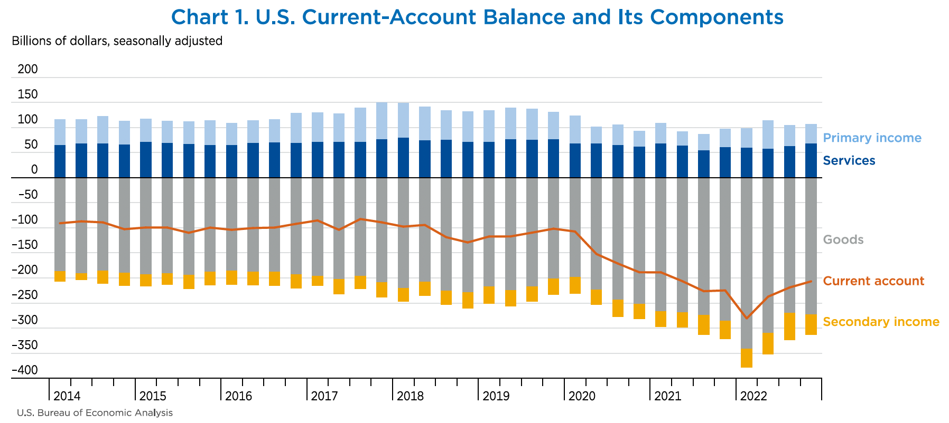
Notes:
Berg, Elliot, Jr., "A Look at the U.S. International Transactions Fourth Quarter and Year 2022," Survey of Current Business, Bureau of Economic Analysis, April 11, 2023. [15p]
https://apps.bea.gov/scb/issues/2023/04-April/0423-quarterly-International-transactions.htm

Slide 16
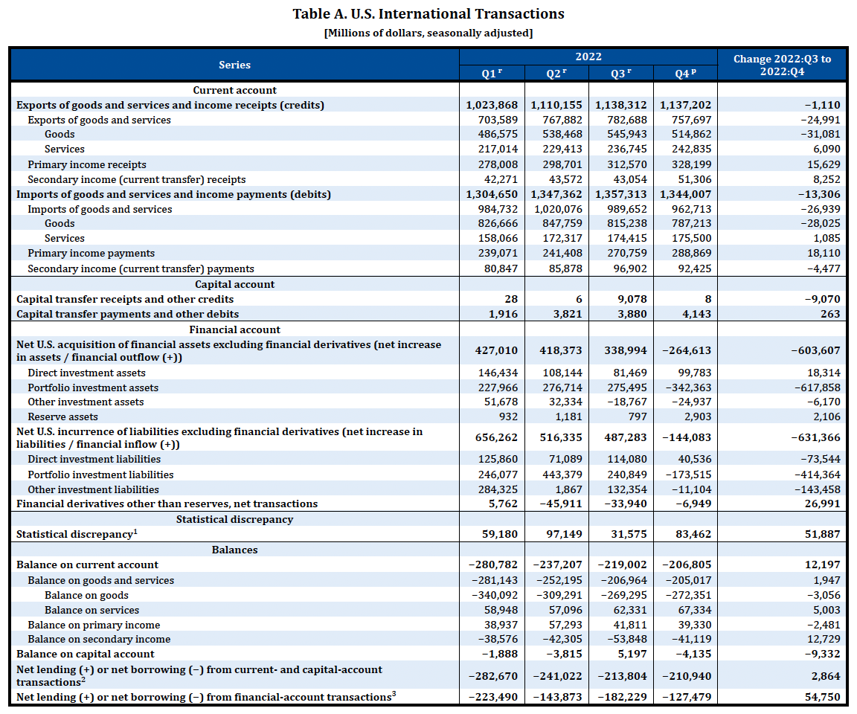
Note that Bal on CA is –280,783
= 1,023,8868 – 1,304,650
These are all debits and therefore negative.
Ignore this. It’s small.
These are also debits and therefore negative.
Really, errors and omissions
Notes:
Telles, Rudy, Jr., “U.S. International Transactions: First Quarter 2022,” Survey of Current Business, 102(7), July 2022. [11p]
https://apps.bea.gov/scb/2022/07-july/0722-quarterly-international-transactions.htm

Slide 17
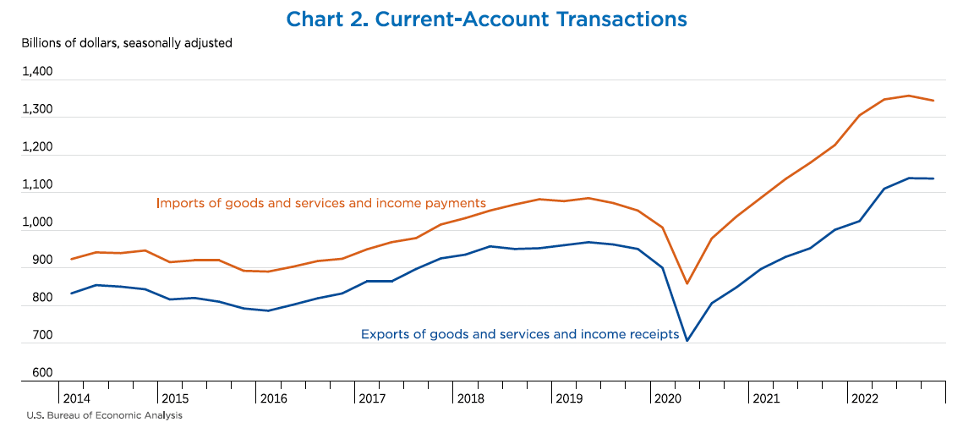
Trade War
Covid-19 Pandemic
Notes:
Telles, Rudy, Jr., “U.S. International Transactions: First Quarter 2022,” Survey of Current Business, 102(7), July 2022. [11p]
https://apps.bea.gov/scb/2022/07-july/0722-quarterly-international-transactions.htm

Slide 18
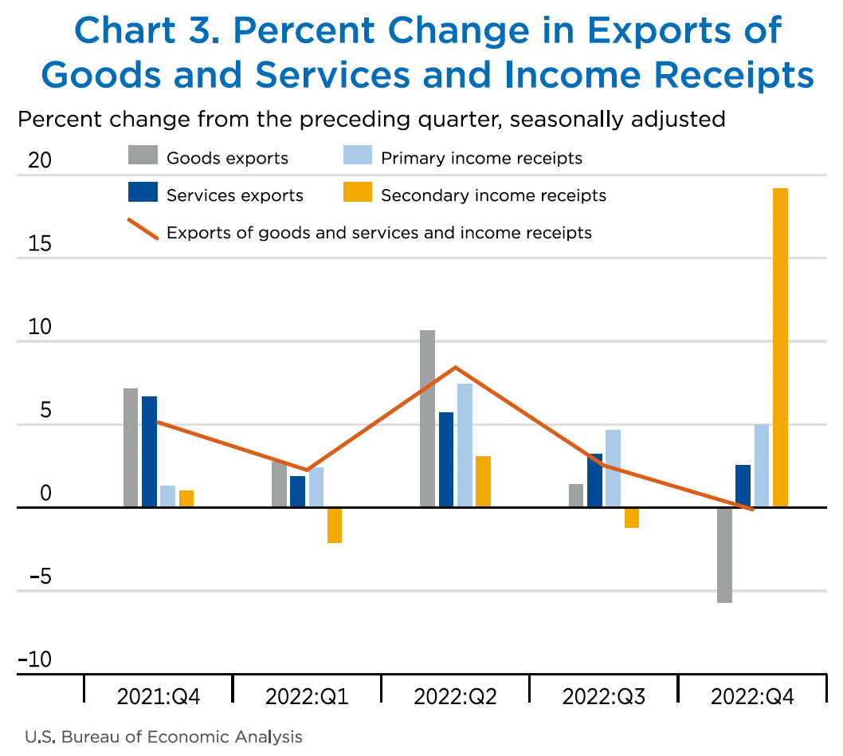
Notes:
Berg, Elliot, Jr., "A Look at the U.S. International Transactions Fourth Quarter and Year 2022," Survey of Current Business, Bureau of Economic Analysis, April 11, 2023. [15p]
https://apps.bea.gov/scb/issues/2023/04-April/0423-quarterly-International-transactions.htm

Slide 19
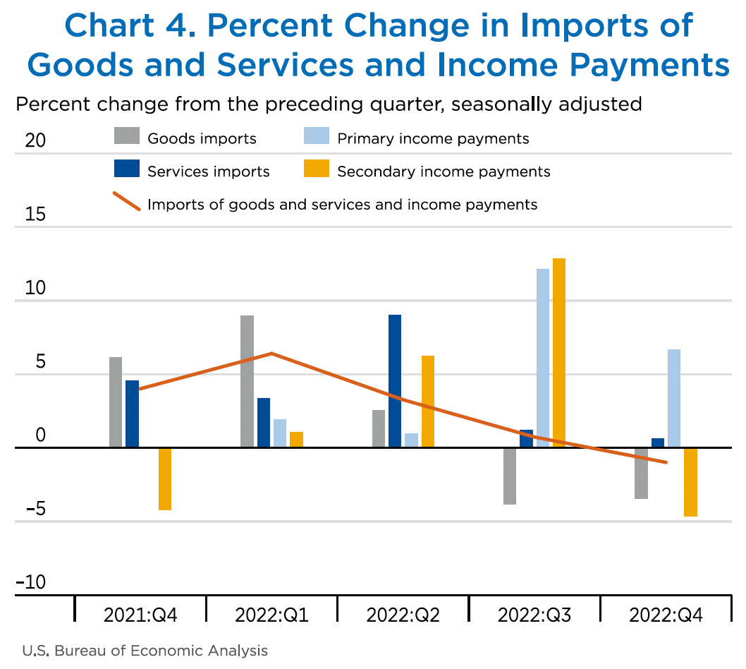
Notes:
Berg, Elliot, Jr., "A Look at the U.S. International Transactions Fourth Quarter and Year 2022," Survey of Current Business, Bureau of Economic Analysis, April 11, 2023. [15p]
https://apps.bea.gov/scb/issues/2023/04-April/0423-quarterly-International-transactions.htm

Slide 20
Note the zero. This whole thing is negative – a deficit!
Notes:
FRED,
https://fred.stlouisfed.org/series/BOPGSTB

Slide 21
…then smaller…
Deficit grew larger...
…then much larger
Biden
Trump
Notes:
FRED,
https://fred.stlouisfed.org/series/BOPGSTB

Slide 22
The US Trade Deficit
Grew from about $2 billion in 1992 to almost $70 billion in 2006
Shrank in the recessions of 2001 & 2008, but not 2020
Grew for Trump’s first two years, then fell until 2020
Grew past the 2006 level in 2020
And even more in 2021 and early 2022
Has declined since early 2022

Slide 23
Pause for Discussion

Slide 24
Questions on Berg, Survey of Current Business
What mostly happened to current account transactions in Q4 of 2022 compared to Q3? (the most recent change in the BEA table, in its far-right column)
What happened to financial transactions?

Slide 25
Questions on Swanson, “America’s Trade Deficit …”
Why does this show the US trade deficit most recently growing when the Berg reading shows it falling?
How did inflation contribute to the increase in the deficit?
How is it possible that the trade deficit grew when “US exports grew more swiftly than imports”?
This mentions a “reshuffling” of trade away from China. Did the US trade deficit with China fall?

Slide 26
Surpluses and Deficits
For any subset of transactions
“Surplus” is credits > debits
“Deficit” is debits > credits
Common “balances”:
Balance of Merchandise Trade (i.e., goods)
Balance on Goods and Services
Balance on Current Account
Balance on Financial Account
= Financial inflows minus financial outflows

Slide 27
They Add to Zero
If all transaction were captured perfectly, then all would add to zero
∑ credits = ∑ debits
Thus
Balance on Current Account
+
Balance on Financial Account
= 0
(If they don’t, there must be errors, hence “statistical discrepancy”)

Slide 28
They Add to Zero
Why?
Every actual transaction has two parts, and these cancel each other
Example: I buy a book for $10 from the UK
That’s a US debit of $10
If the seller does nothing (keeps the $10 cash), it’s an increase in that foreigner’s holdings of US assets (the $10 bill), a US credit
The seller may instead do many other things with the $10, but each of them would result in either a $10 US credit or reversing a $10 US debit

Slide 29
They Add to Zero
Examples:
Buy a US export (US credit in trade account)
Pay interest on debt to US (US credit in primary income)
Give to US charity (US credit in secondary income)
Deposit in US bank (US credit in financial account)
Borrow less from NY bank (reverse US debit in financial account)
Sell for £ to someone who uses $10 for one of above
Why?
Every actual transaction has two parts, and these cancel each other
Example: I buy a book for $10 from the UK
That’s a US debit of $10
If the seller does nothing (keeps the $10 cash), it’s an increase in that foreigner’s holdings of US assets (the $10 bill), a US credit
The seller may instead do many other things with the $10, but each of them would result in either a $10 US credit or reversing a $10 US debit

Slide 30
They Add to Zero
Implication
A trade (or current account) deficit must be accompanied by
Financial account surplus
Thus net capital inflow
How does it happen?
Credits correspond to supply of foreign exchange
Debits correspond to demand for foreign exchange
So exchange-market equilibrium
Implies supply = demand
Implies credits = debits

Slide 31
What a Deficit Means
Recall (from macroeconomics) the definition of GDP
GDP = Y = C + I + G + (X – M)
(C + I + G) equals expenditure, E
(X–M) equals trade surplus
So:
X – M = Y – E
Trade surplus equals
Income minus expenditure

Slide 32
What a Deficit Means
Interpretations of a trade deficit
(as the US has had for decades)
We are spending more than our income
We are consuming (and investing in) more goods that we are producing
We are borrowing from (or selling assets to) foreigners

Slide 33
What a Deficit Means
Another Interpretation
With T = net taxes, then Y–T is “disposable income”
Rearrange: Y = C + I + G + (X – M)
Y – C – G – I = (X – M)
(Y – T – C) + (T – G) – I = (X – M)
Private savings + Government saving – I = (X – M)
Total Saving – Investment = (X – M)
Thus
X – M = S – I

Slide 34
What a Deficit Does Not Mean
That foreign trade barriers are hurting our exports
That other countries are engaged in unfair trade
That our firms are not competitive
That we are losing jobs to other countries
That we need to restrict trade
(But note: many disagree, including Trump and two of the optional readings: Scott and Mokhiber, and Buffet)

Slide 35
Pause for Discussion

Slide 36
More Questions on KOM
Why must credits and debits exactly offset if measured accurately?
KOM defines a country’s current account surplus as its exports minus its imports. Why is this also said to equal “net foreign investment”?
What are, and what are not, the implications of a trade deficit? Jobs? Debt? Trade barriers? Competitiveness?

Slide 37
What a Deficit Means
Is a trade (or current account) deficit good or bad?
It depends

Slide 38
Pause for Discussion

Slide 39
Questions from Obstfeld
Is a country with a trade deficit losing from trade?
What determines a country’s bilateral deficits and surpluses?
Why does the fact that the US was at full employment matter for the discussion in Obstfeld?

Slide 40
What a Deficit Means
Many trade sceptics, such as Scott, associate trade deficits with lost jobs.
In other work (not assigned) Scott "measures” the lost jobs by comparing
The jobs producing US exports
to
The jobs the US would need to produce US imports here
By this measure, “jobs lost” are sometimes more than the unemployed

Slide 41
Questions from ~Scott
Which has risen most, the US trade deficit in goods or in manufacturing? Why is this important, according to Scott?
What does Scott blame for the high and rising US trade deficits?
What US policy changes does he call for?

Slide 42
Balanced Trade
In this course we will assume either
Trade is balanced, or
The trade imbalance does not change
Why?
Because the trade imbalance depends
On macroeconomic factors, such as monetary and fiscal policies
Not on the trade policies will are studying

Slide 43
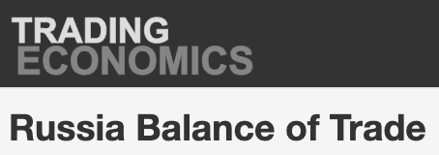
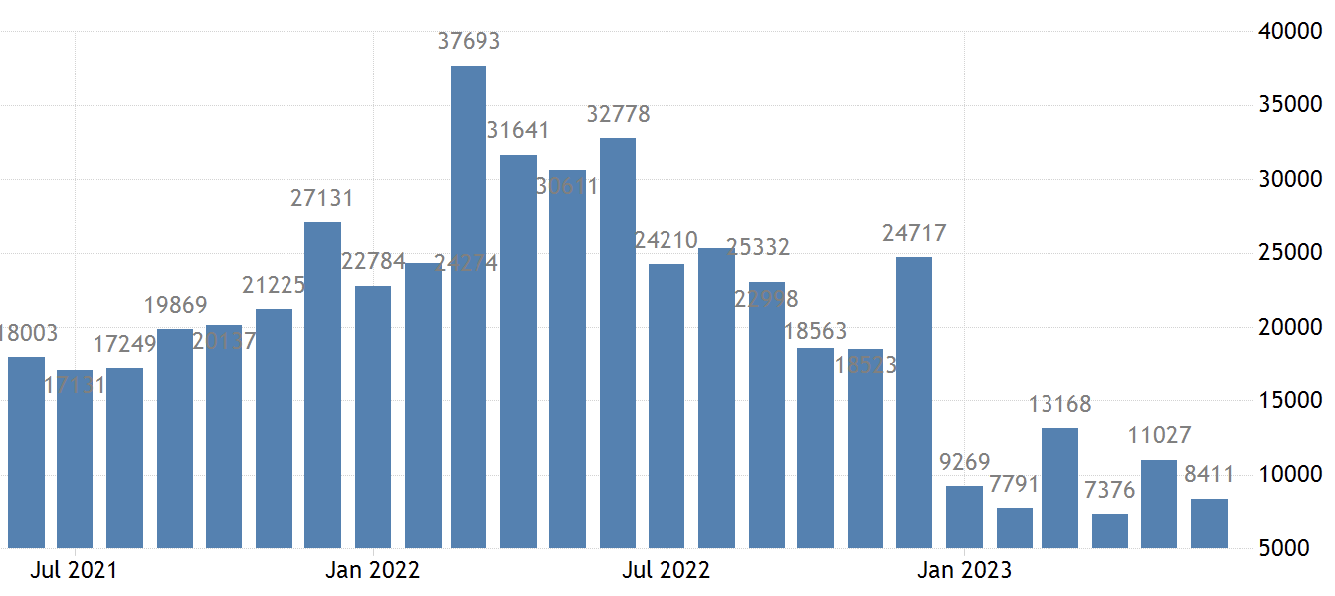
$ million

Slide 44
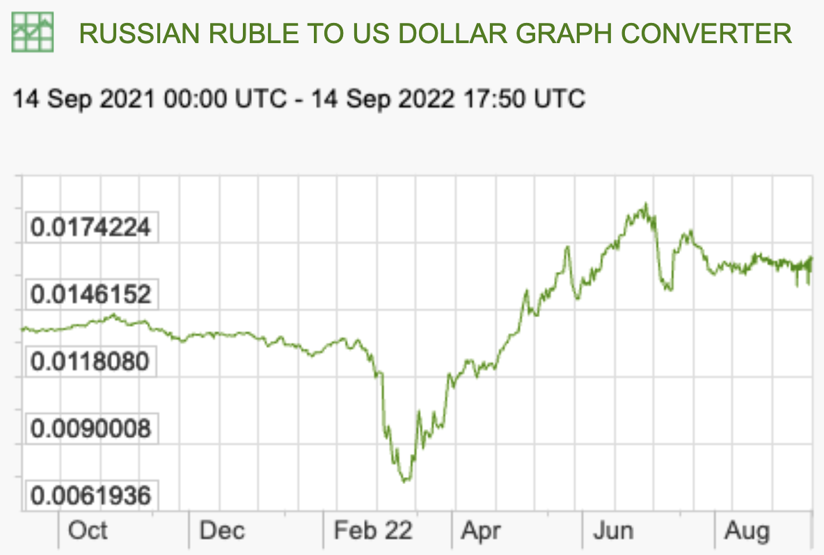
Recent Rate Movements: Russia
Last Year:
Notes:
https://www.x-rates.com/graph/?from=RUB&to=USD&amount=1

Slide 45
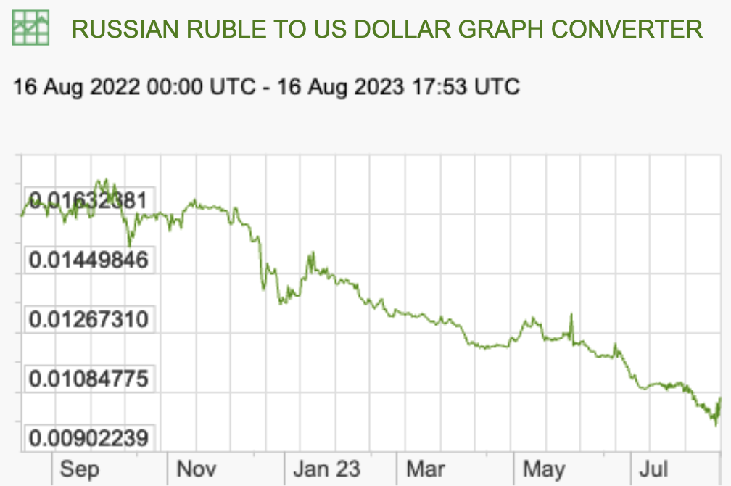
Recent Rate Movements: Russia
This Year:
Notes:
https://www.x-rates.com/graph/?from=RUB&to=USD&amount=1

Slide 46
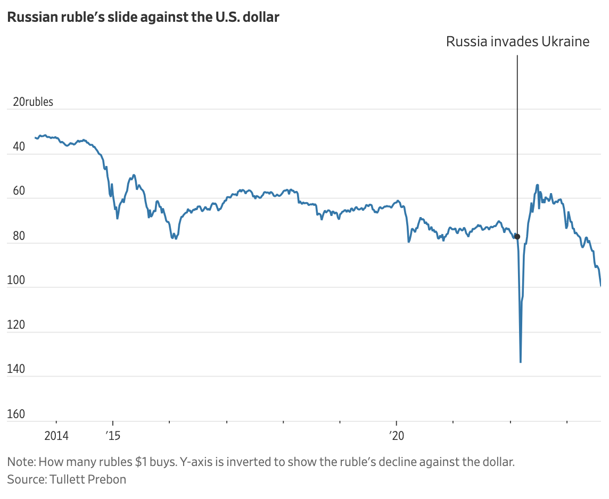
WSJ: August 14, 2023
Notes:
Chelsey Dulaney and Georgi Kanchev, “Russian Ruble at Weakest Level Since Early Days of Ukraine War,” Wall Street Journal, August 14, 2023.
https://www.wsj.com/articles/russian-ruble-at-weakest-level-since-early-days-of-ukraine-war-eaef275f

Slide 47
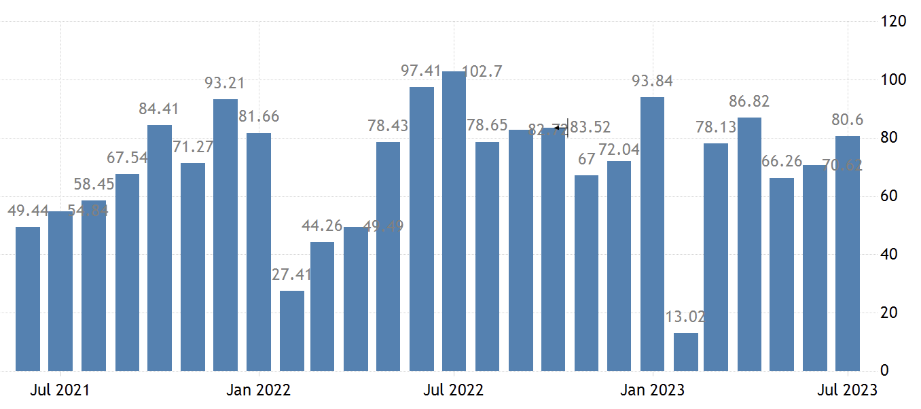
$ billion
Why do you suppose China’s surplus is smallest in February?
Notes:
https://tradingeconomics.com/china/balance-of-trade#:~:text=Balance%20of%20Trade%20in%20China,Billion%20in%20February%20of%202020.

Slide 48
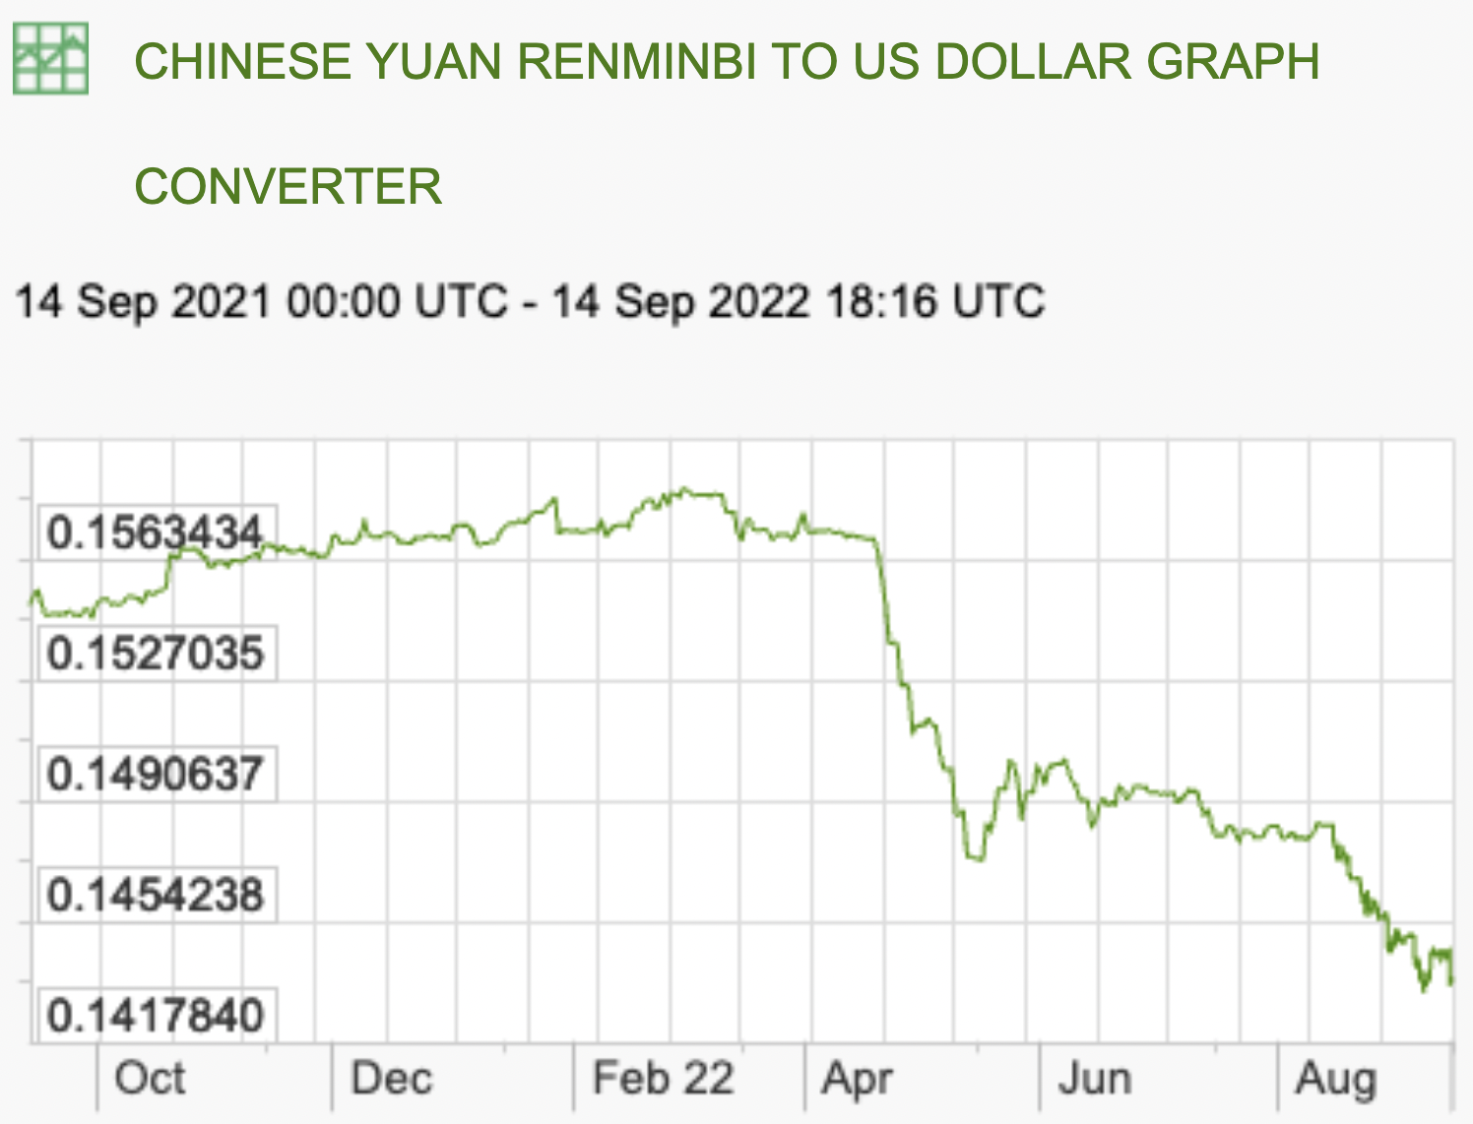
Recent Rate Movements: China
Last Year:
Notes:
https://www.x-rates.com/graph/?from=RUB&to=USD&amount=1

Slide 49
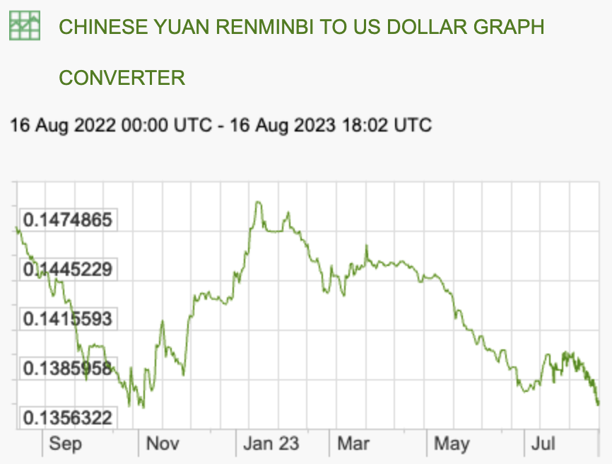
Recent Rate Movements: China
This Year:
Notes:
https://www.x-rates.com/graph/?from=RUB&to=USD&amount=1

Slide 50
Questions from Krugman
What does Krugman say is the source of Russia’s trade surplus?
What does he say is the source of China’s trade surplus?
Why does he say that the surpluses are good for other countries?
Why (according to him) are dictators more likely to have these problems?

