Slide 1
Class 5 Exchange Rates by Alan V. Deardorff University of Michigan 2023
PubPol/Econ 541

Slide 2
 | Q1 | Q2
Mean | 7.80 | 6.79
Median | 8 | 6.5
Max | 10 | 10
Min | 1 | 4
S.D. | 2.19 | 1.84

Slide 3
Pause for News

Slide 4
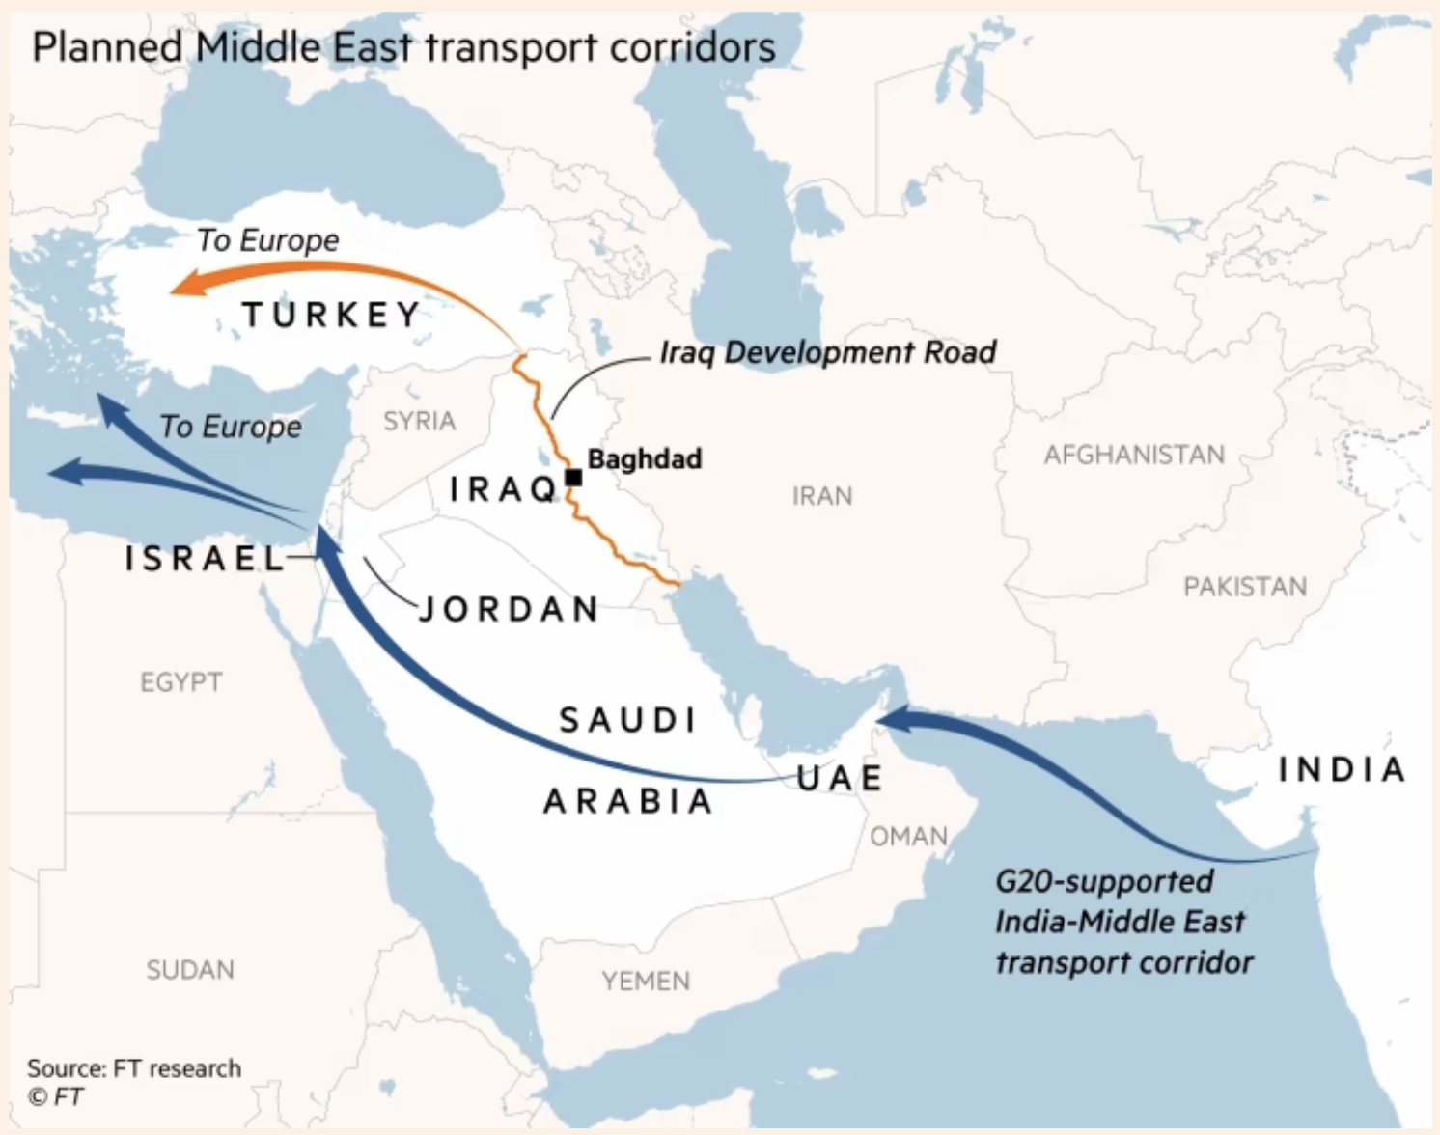
Notes:
https://www.ft.com/content/0673f928-dec9-48fb-83b3-8b868a9dcbbe

Slide 5
Outline
Exchange markets: What they are
Supply and Demand
Two Simple Theories
Pegged Exchange Rates

Slide 6
Exchange Market
Exchange rate is
Price of one currency in terms of another
E.g., $/£ or £/$

Slide 7
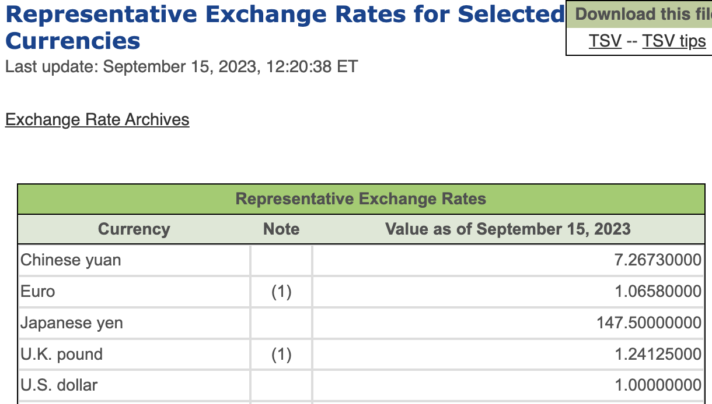
Notes:
https://www.imf.org/external/np/fin/data/rms_rep.aspx

Slide 8
Pause for Discussion

Slide 9
Questions on KOM, Ch 14
Is an exchange rate the price of one country’s goods in terms of another’s, or the price of one country’s assets in terms of another’s?
On what transactions are reported rates based?
What hours of the day are the exchange markets open?

Slide 10
Exchange Market
Types of exchange rate
Spot
For exchange of currencies today
Forward
Contracts for exchange of currencies 30, 60, 90 etc. days from the present
Both payment and receipt happen then, not now
Futures –
Like forward market, but for specific calendar dates in future

Slide 11
Exchange Market
Types of exchange rate, continued
Bilateral
For exchange of 2 currencies
Trade weighted
For one currency relative to multiple others
An average, or index
Real
Adjusted for inflation, both at home and abroad

Slide 12
US Exchange Rate
Rose because US had lower inflation than others
Source: Federal Reserve
Notes:
https://www.federalreserve.gov/releases/h10/summary/jrxwtfb_nm.htm
Jun 12, 2023
Presentations/OLLI/Trade Deficits & Exchange Rates/Dollar Index Broad.xlsx

Slide 13
US Exchange Rate
Dollar rose due to Volker Interest rate rise, fighting inflation.
Caused severe recession in US.
Source: Federal Reserve
Notes:
https://www.federalreserve.gov/releases/h10/summary/jrxwtfb_nm.htm
Jun 12, 2023
Presentations/OLLI/Trade Deficits & Exchange Rates/Dollar Index Broad.xlsx

Slide 14
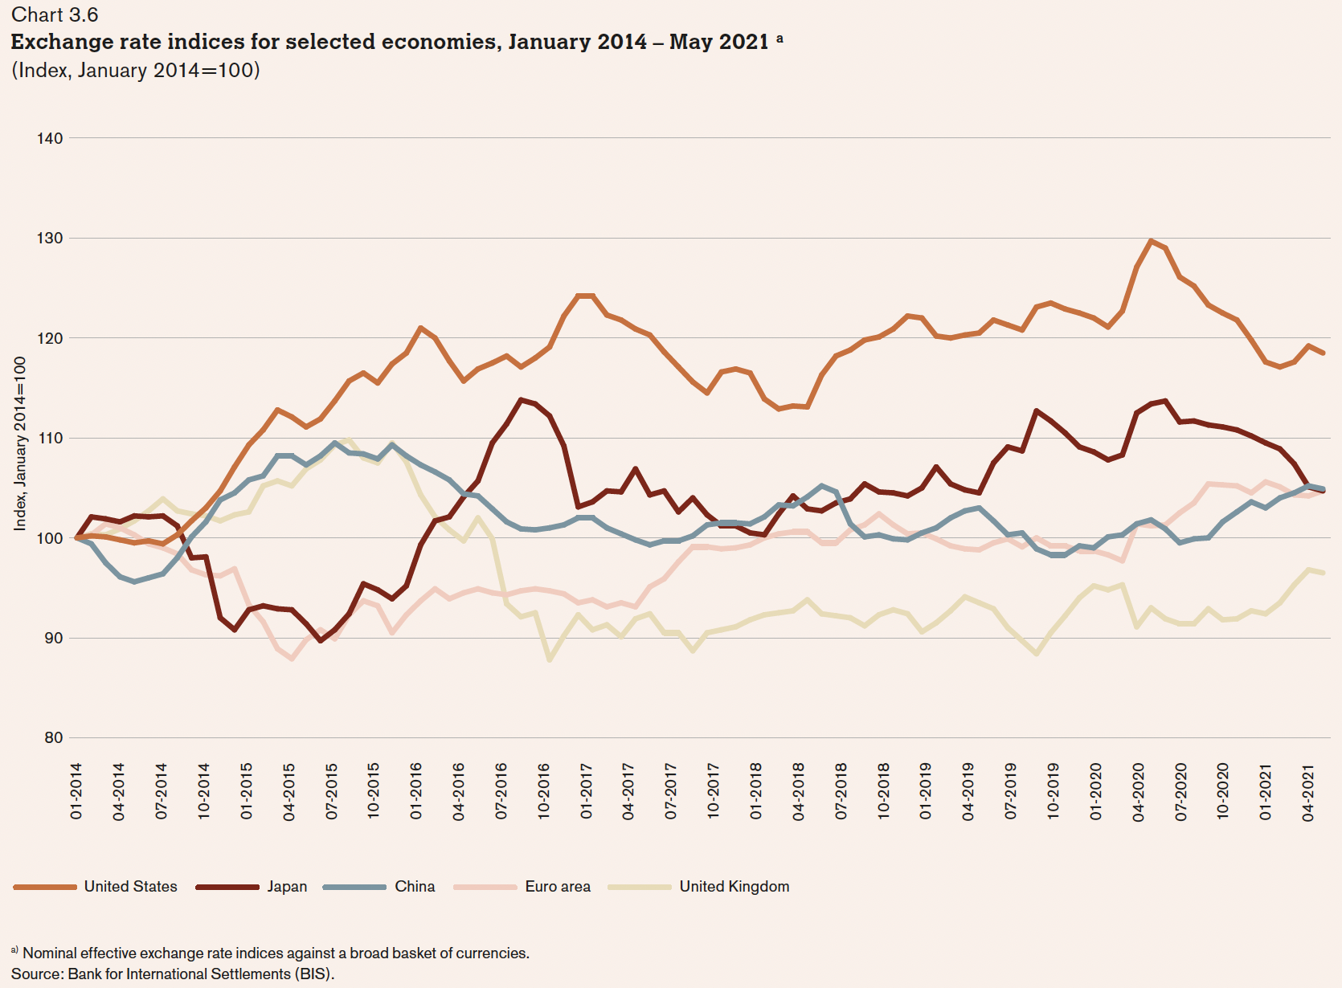
US $
Japan
Euro €
China
UK £
01-2014
04-2021
Notes:
World Trade Organization, Chapters II and III of World Trade Statistical Review 2021, pp. 10-39.
https://www.wto.org/english/res_e/statis_e/wts2021_e/wts2021_e.pdf
[Volume for 2022 not yet available.]

Slide 15
Exchange Market
Who uses the exchange market
Traders in both goods and services
Also travelers (but that’s trade)
International borrowing, lending, and asset trade
Speculators
Buyers or sellers who hope to profit from future exchange-rate change
Hedgers
Arbitragers

Slide 16
Pause for Discussion

Slide 17
More Questions from KOM
What is “arbitrage” in the foreign exchange market?
What is “hedging” in the foreign exchange market?
What role does the US dollar play in international finance?

Slide 18
Supply and Demand for Foreign Exchange
Questions:
Who demands €?
Who supplies €?
Market Model:
E ($/€)
S€
E₀
D€
Q€

Slide 19
Exchange Market
Traders respond to
Prices of goods
Rise in home prices causes currency to fall
Capital movements respond to
Interest rates
Rise in home interest rate causes currency to rise
Expectations
Expectation of any change causes that change

Slide 20
Two Simple Theories
Asset Theory
Simple: E is whatever it is expected to be
If it were not, its expected change would drive capital flows that would swamp the market
Works best in short run (but not useful)
PPP = Purchasing Power Parity
Exchange rate reflects the prices of goods
See Big Mac Index
Works best in long run

Slide 21
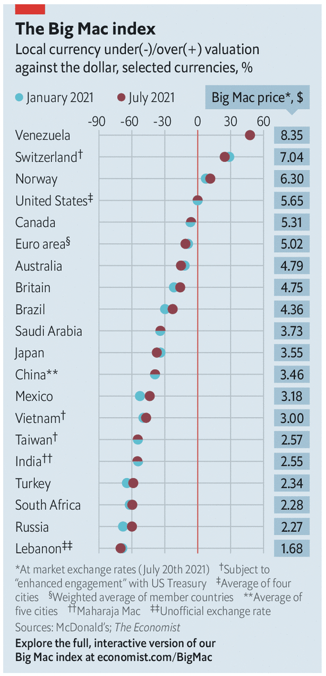
Notes:
Economist, “The Big Mac index: What the Big Mac index says about the dollar and the dong,” The Economist, July 24, 2021.
https://www.economist.com/finance-and-economics/2021/07/24/what-the-big-mac-index-says-about-the-dollar-and-the-dong

Slide 22
Pause for Discussion

Slide 23
Questions on Economist, “Big Mac index”
On what basis does this article rank countries?
Why does this article focus on the Vietnamese currency, the dong?
What criteria does the US Treasury use to identify an undervalued currency?
Is Vietnam’s poverty relevant to this?

Slide 24
Pegged Exchange Rates
Bretton-Woods System
Successor to the Gold Standard
Most currencies pegged to US $
How to peg
Need “reserves” of foreign currency
Use them to buy or sell own currency as needed
Does it work? Yes and no

Slide 25
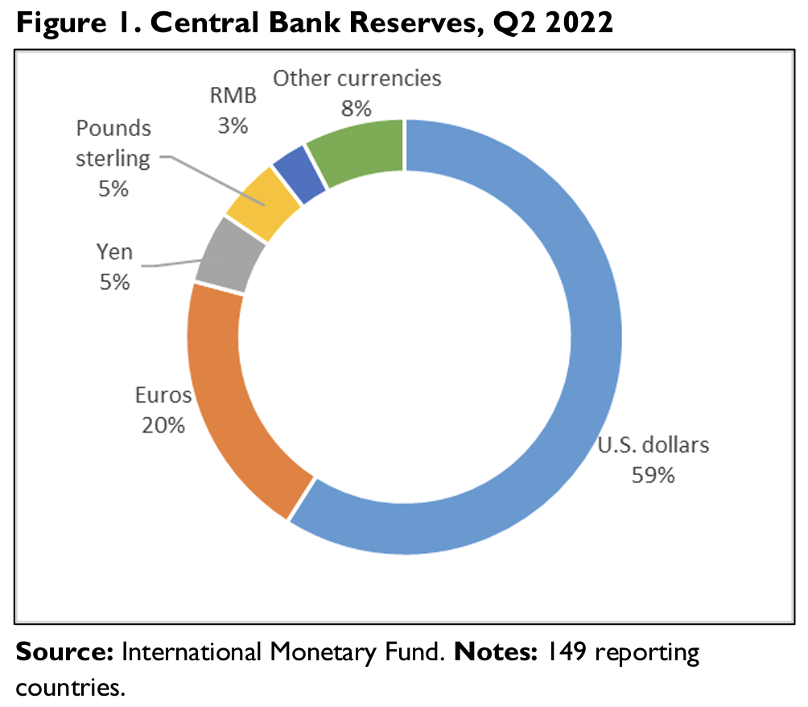
Notes:
Rebecca M. Nelson and Martin A. Weiss, “The U.S. Dollar as the World’s Dominant Reserve Currency,” In Focus, Congressional Reserve Service, September 15, 2022.
https://crsreports.congress.gov/product/pdf/IF/IF11707

Slide 26
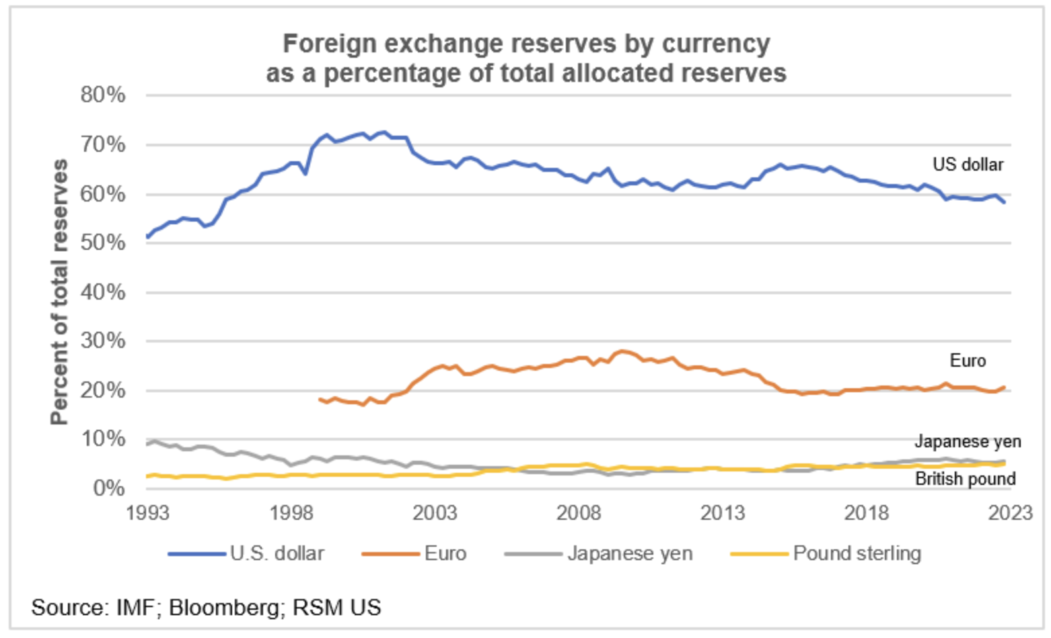
Notes:
Joseph Brusuelas, “Why the dollar remains the world’s reserve currency, and will stay that way,” The Real Economy Blog, April 17, 2023.
https://realeconomy.rsmus.com/why-the-dollar-remains-the-worlds-reserve-currency/

Slide 27
Pause for Discussion

Slide 28
Questions on Economist, “…Bretton Woods…”
What names and characteristics describe the three international monetary regimes that the Economist article describes, the last of which may be coming to an end?
Why did the world not shift to using dollars, euros, and renminbi more equally for transactions and reserves?
Why is currency stability so hard to achieve?

Slide 29
Questions on McDougall, “US Dollar to Maintain…”
Why do central banks hold foreign-currency reserves?
Has holding of US dollar reserves by central banks declined over time, and what is expected in the near and farther future?
Who is mentioned as wanting reduced reliance on the dollar?
What currency is most likely to expand being held?

Slide 30
Some Recent Exchange Rate Movements
Most from X-rates.com
Most are US $ per country currency
Showing
Major currencies last year and this
This year only for currencies of current students in the course
If you have comments on yours, I’d welcome them

Slide 31
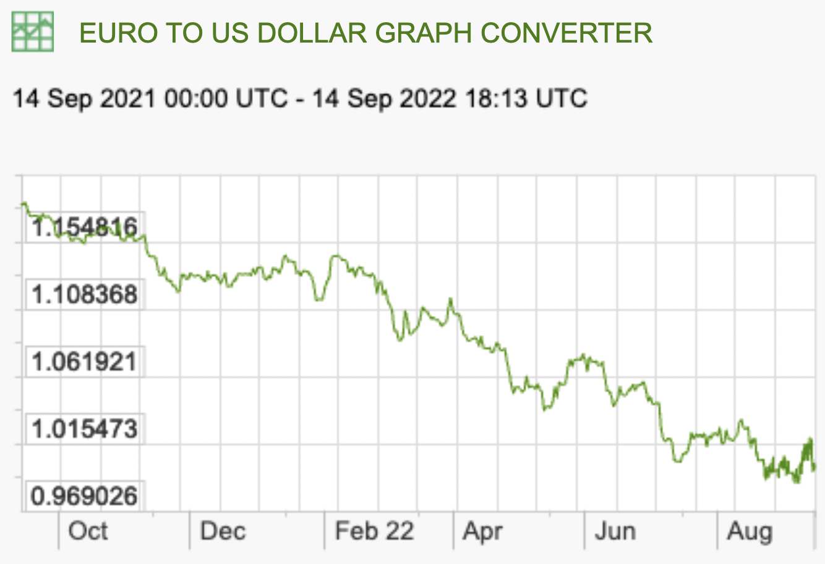
Recent Rate Movements: Euro
Last Year:
Source: X-rates.com
Notes:
https://www.x-rates.com/graph/?from=RUB&to=USD&amount=1

Slide 32
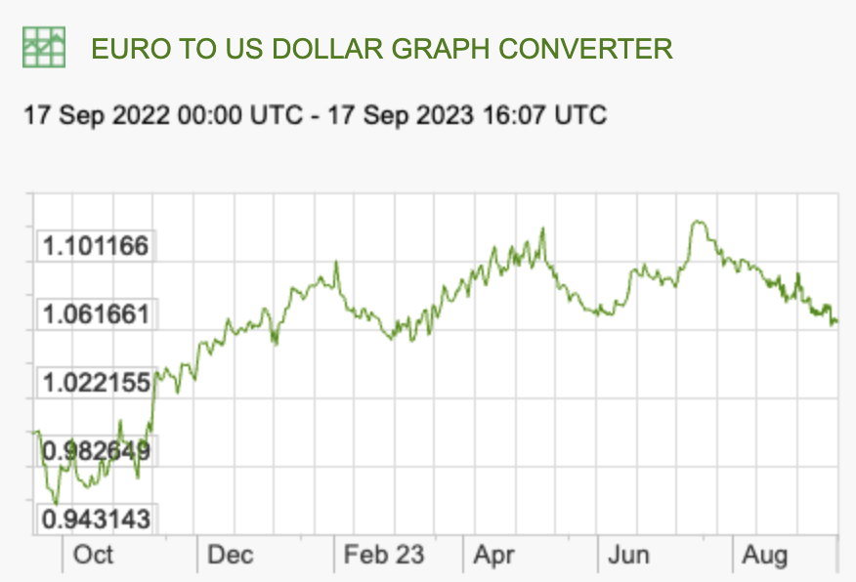
Recent Rate Movements: Euro
This Year:
Source: X-rates.com
Notes:
https://www.x-rates.com/graph/?from=RUB&to=USD&amount=1

Slide 33
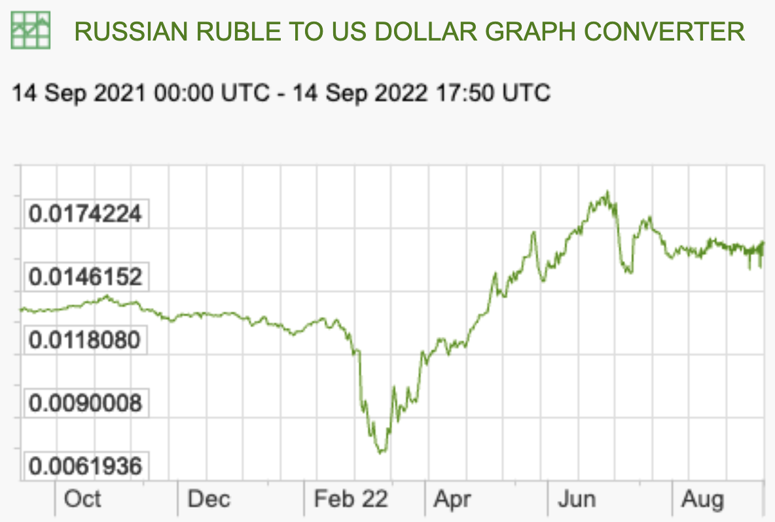
Recent Rate Movements: Russia
Last Year:
Source: X-rates.com
Notes:
https://www.x-rates.com/graph/?from=RUB&to=USD&amount=1

Slide 34
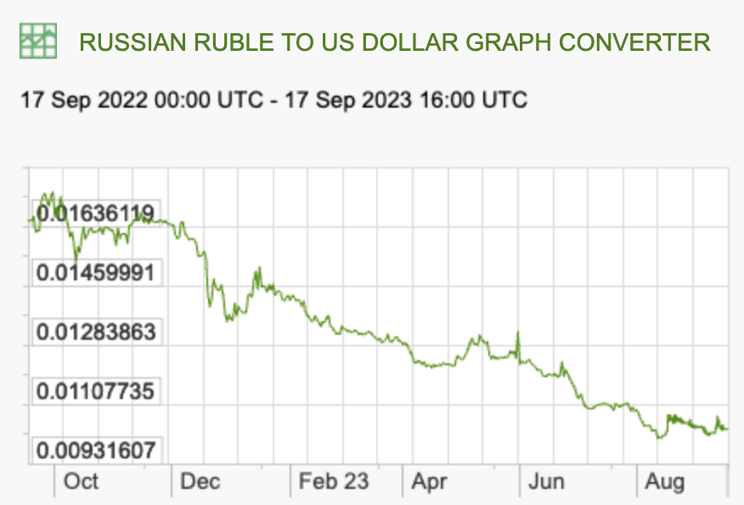
Recent Rate Movements: Russia
This Year:
Source: X-rates.com
Notes:
https://www.x-rates.com/graph/?from=RUB&to=USD&amount=1

Slide 35
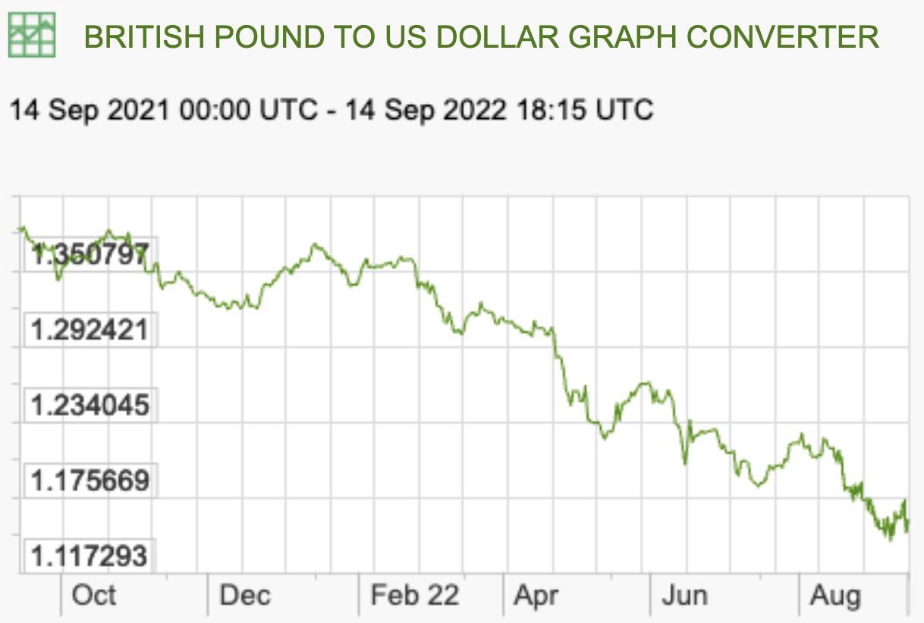
Recent Rate Movements: UK
Last Year:
Source: X-rates.com
Notes:
https://www.x-rates.com/graph/?from=RUB&to=USD&amount=1

Slide 36
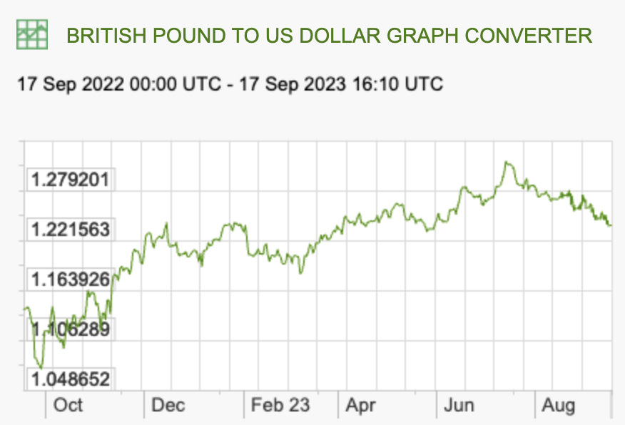
Recent Rate Movements: UK
This Year:
Source: X-rates.com
Notes:
https://www.x-rates.com/graph/?from=RUB&to=USD&amount=1

Slide 37
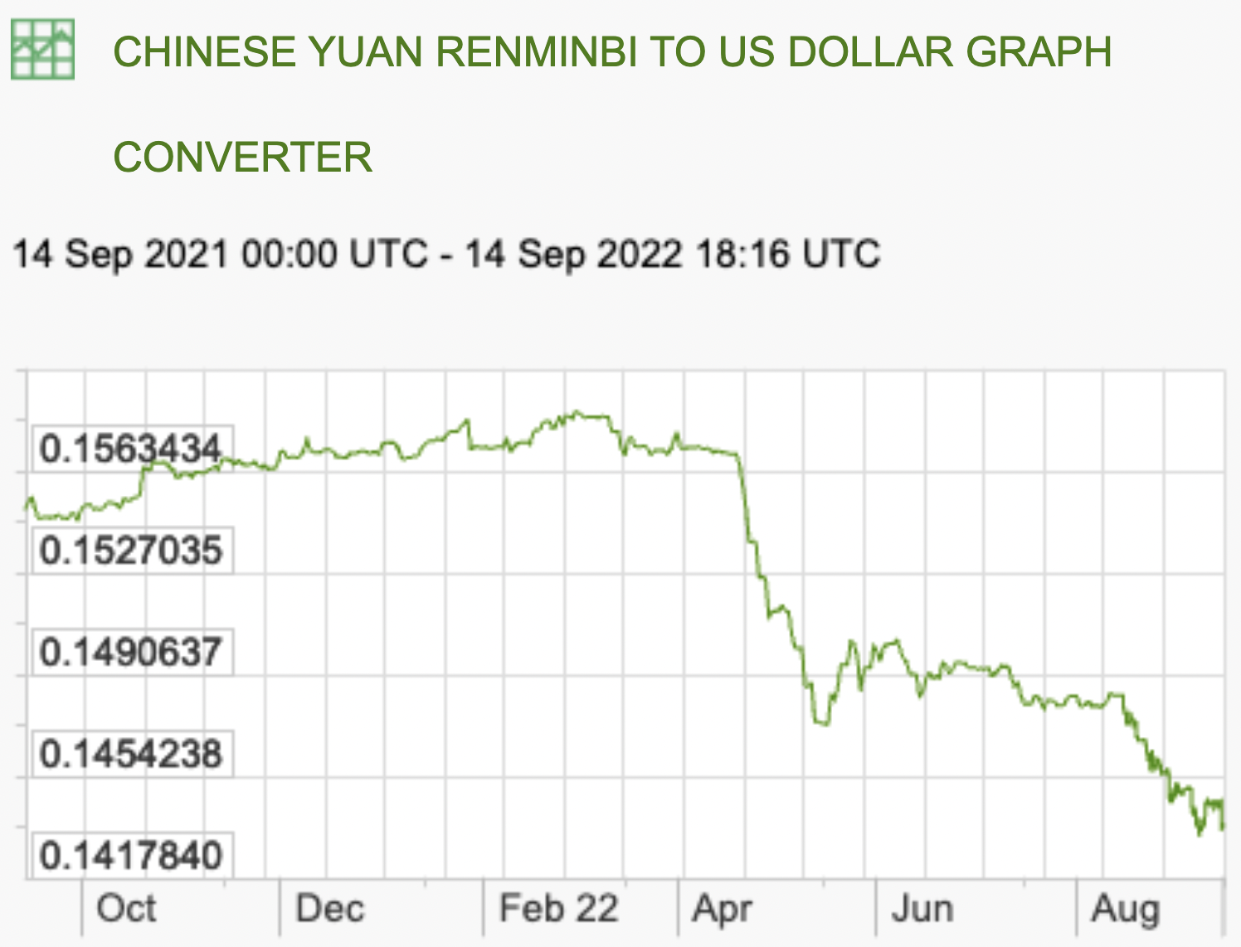
Recent Rate Movements: China
Last Year:
Source: X-rates.com
Notes:
https://www.x-rates.com/graph/?from=RUB&to=USD&amount=1

Slide 38
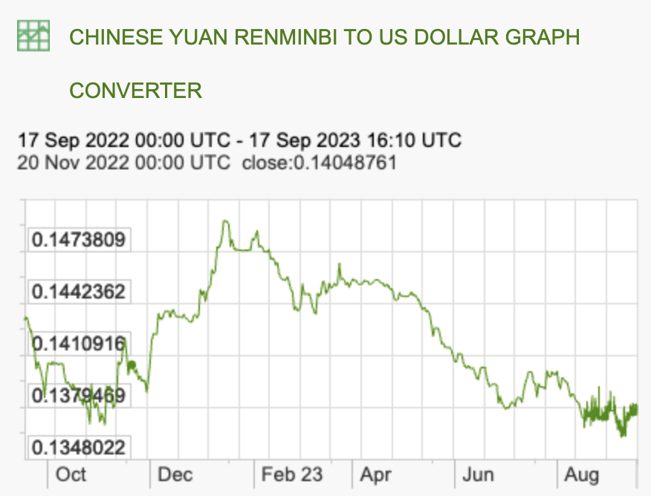
Recent Rate Movements: China
This Year:
Source: X-rates.com
Notes:
https://www.x-rates.com/graph/?from=RUB&to=USD&amount=1

Slide 39
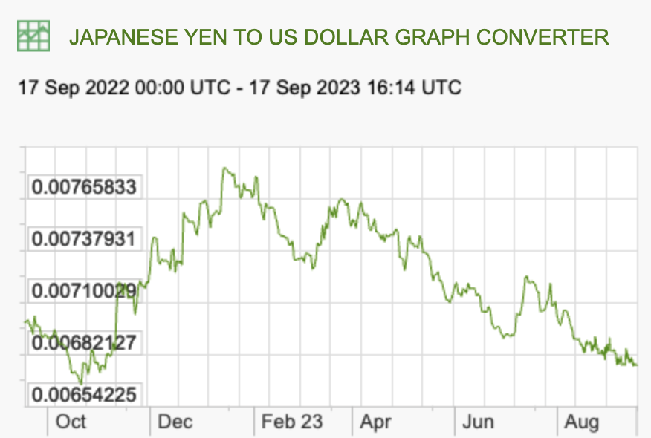
Recent Rate Movements: Japan
Source: X-rates.com
Notes:
https://www.x-rates.com/graph/?from=RUB&to=USD&amount=1

Slide 40
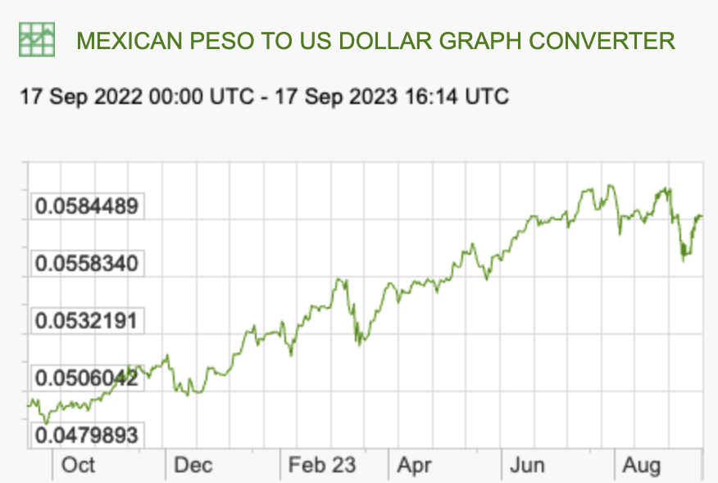
Recent Rate Movements: Mexico
Source: X-rates.com
Notes:
https://www.x-rates.com/graph/?from=RUB&to=USD&amount=1

Slide 41
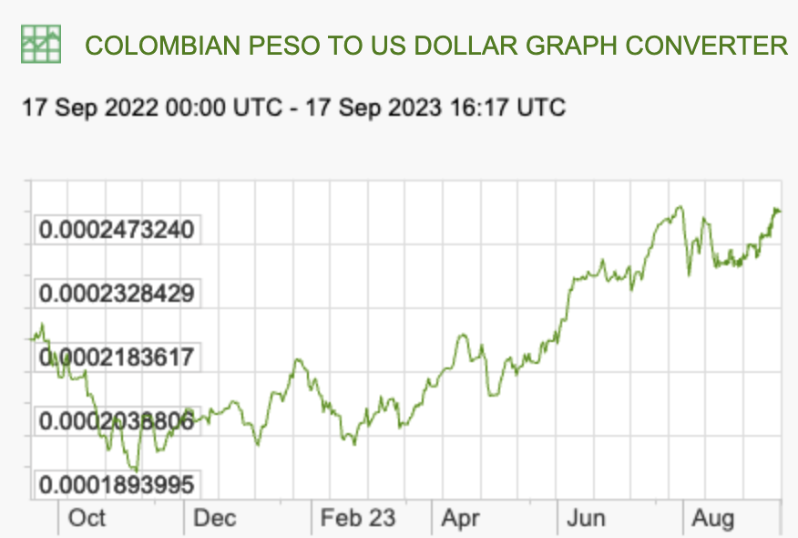
Recent Rate Movements: Colombia
Source: X-rates.com
Notes:
https://www.x-rates.com/graph/?from=RUB&to=USD&amount=1

Slide 42
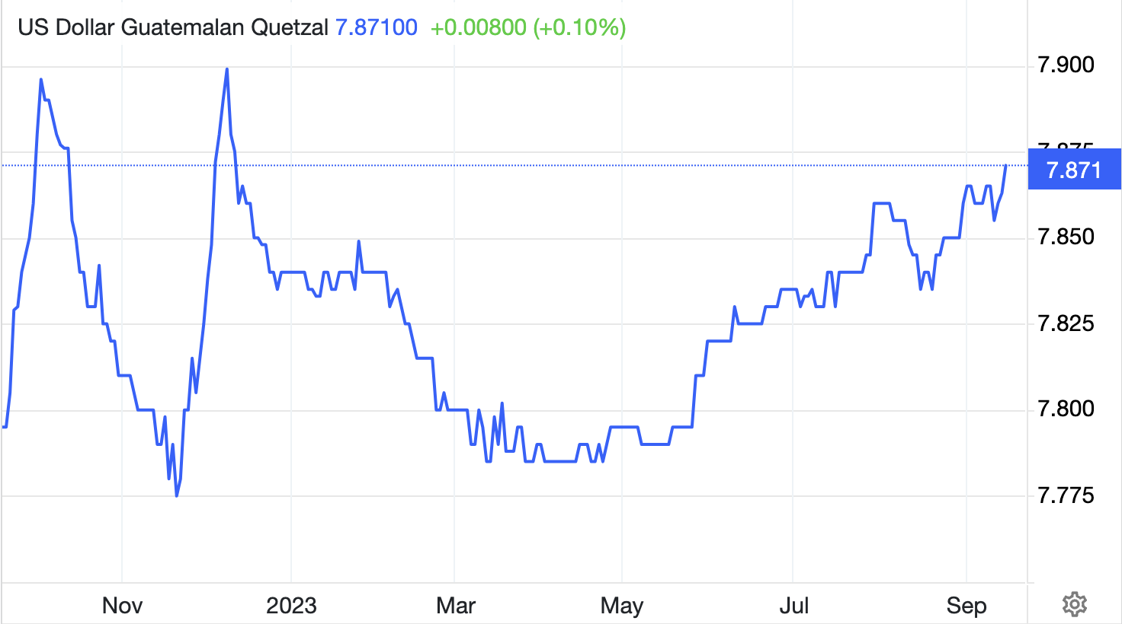
Recent Rate Movements: Guatemala
This is quetzals per dollar, not dollars per quetzal
Source: TradingEconomics.com
Notes:
https://tradingeconomics.com/guatemala/currency

Slide 43
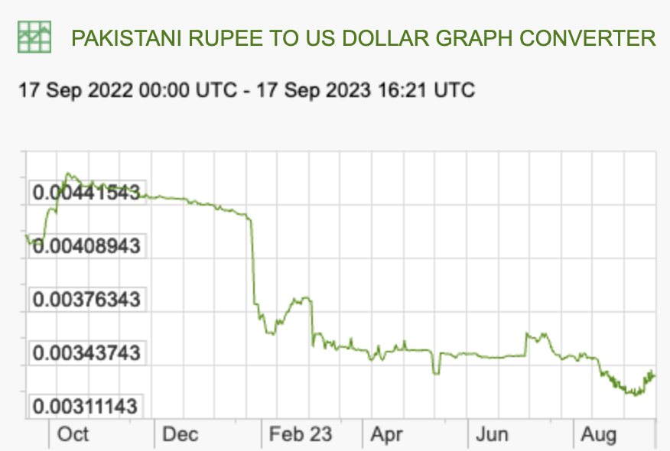
Recent Rate Movements: Pakistan
Source: X-rates.com
Notes:
https://www.x-rates.com/graph/?from=RUB&to=USD&amount=1

Slide 44
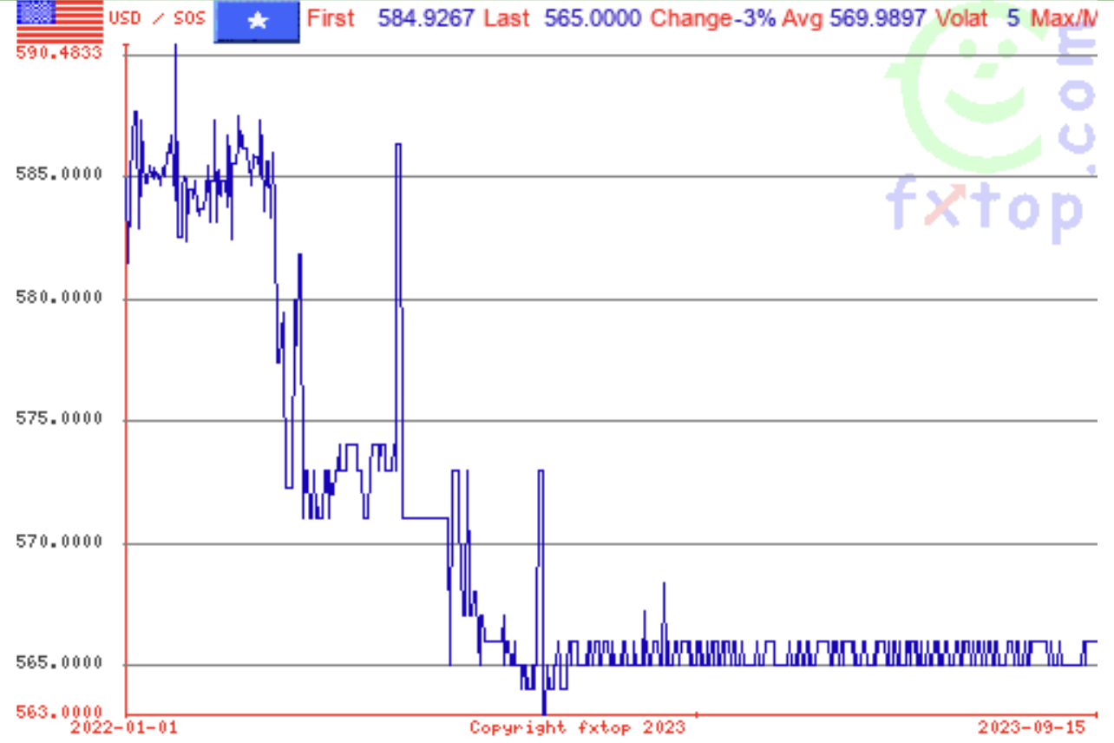
Recent Rate Movements: Somalia
This is Somali shillings per dollar, not dollars per Somali shillings
Source: fxtop.com
Notes:
https://fxtop.com/c/en/SOS

