Slide 1
Class 1 The State of Play in International Trade and Trade Policy I: Trade Wars by Alan V. Deardorff University of Michigan 2023
PubPol/Econ 541

Slide 2
Announcements
Next Monday I’ll start by asking you for News, then discuss that and what I’ve noticed myself.
Note that if I don’t get through all my slides, you should view them later. (But not the Aug 28 class.)
Office hours:
Feel free to enter even if others are there
If you want a private meeting, email me to schedule

Slide 3
Trade Wars
Notes:
Pinn, Ingram, “Ingram Pinn’s illustration of the week: Trading tariffs,” Financial Times, June 22, 2018.
https://www.ft.com/content/c56ebb64-7579-11e8-b326-75a27d27ea5f

Slide 4
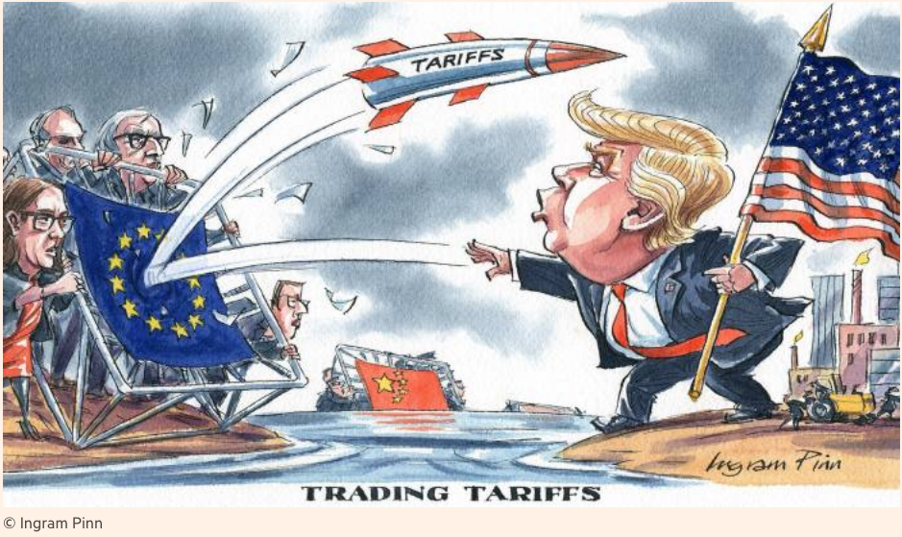
Notes:
Pinn, Ingram, “Ingram Pinn’s illustration of the week: Trading tariffs,” Financial Times, June 22, 2018.
https://www.ft.com/content/c56ebb64-7579-11e8-b326-75a27d27ea5f

Slide 5
Bown, Chad P. and Melina Kolb, "Trump's Trade War Timeline
We’ll focus on these three only
Notes:
Pinn, Ingram, “Ingram Pinn’s illustration of the week: Trading tariffs,” Financial Times, June 22, 2018.
https://www.ft.com/content/c56ebb64-7579-11e8-b326-75a27d27ea5f

Slide 6
Pause for Discussion

Slide 7
Questions on Bown & Kolb
With what countries is/was the US engaged in a trade war?
What have been the legal bases (within the US) for tariffs and threats of tariffs?
What is the current status of the trade war with China?
To what extent has President Biden reversed the tariffs begun by Trump?
What main new actions have happened under Biden?

Slide 8
Trade Wars, 2018-2021
Outline
Battles in the Trade Wars
(Washing Machines & Solar Panels)
Steel & Aluminum
US-China Trade War (re Intellectual Property)
(Cars)
(Mexico migration)
Semiconductors

Slide 9
Steel & Aluminum
National Security
Section 232 of US trade law
Tariffs on imports that “threaten national security”
“National security” is not defined
Legality in WTO is unclear

Slide 10
Steel & Aluminum
National Security
Mar 1, 2018: Trump levies tariffs
25% on steel, 10% on aluminum
Against all countries
A few removed shortly thereafter
Remained in place on EU, China, Canada, Mexico, and others
Retaliation by all
(Tariffs on Canada & Mexico later removed)

Slide 11
Steel & Aluminum
US-EU and other
Negotiations began under Biden May 17, 2021
US lifts some tariffs but keeps them on over-quota quantities (“tariff-rate quota”) and partners remove retaliatory tariffs on US:
EU: Oct 31, 2021
Japan: Feb 7, 2022
UK: Mar 22, 2022
Ukraine: May 9, 2022
WTO panel rules on Trump’s tariffs (“inconsistent”)

Slide 12
Pause for Discussion

Slide 13
Questions on Williams, “Biden Official Says…”
Trump imposed tariffs on steel based on “national security.” Does Biden agree? Why or why not?
A November deadline is mentioned. When is that? What happens then?
What alternatives to simply removing the tariffs are mentioned?

Slide 14
Questions on Bounds, “EU rejects US …”
What is the “green steel club” that EU and US are striving for, and what is its more formal name?
What policies do the EU and US favor, and why do they disagree?
What was the truce that they agreed to earlier, and when does it expire?
The EU is also concerned about the IRA. What is that, and why are they concerned?

Slide 15
US-China Trade War
Legal basis for US tariffs on China was mostly on intellectual property
IP includes patents, trademarks, copyrights, and trade secrets
US (and others) claim that China
Steals technology secrets
Forces investors to turn over technologies in joint ventures

Slide 16
US-China Trade War
USTR (United States Trade Representative) under Trump
Initiated investigation of China’s IP practices
Under Section 301 of US trade law – Unfair trade practices
This is not something permitted by the WTO

Slide 17
US-China Trade War
March 22, 2018: Report found unfair trade practices
IP violations (see above)
Also subsidies to firms and state-owned enterprises (SOEs) to trade unfairly
Trump announced tariffs on up to $60 billion of China’s exports to US

Slide 18
US-China Trade War
US and China levied tariffs on each other
Three times in 2018, twice in 2019
Trump either added new tariffs on China exports or raised them
Each time, China responded with more tariffs on US exports
Threat of more in December 2019 was suspended by the “Phase One” US-China Trade Deal

Slide 19
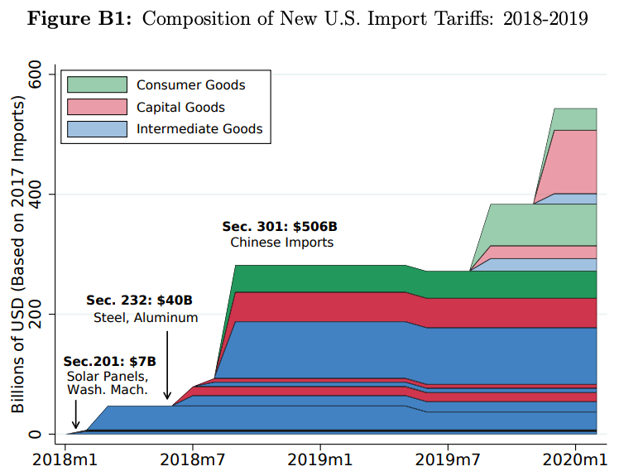
Trump Tariffs, 2018
Source: Flaan & Pierce 2020
Notes:
Flaan and Pierce 2020
https://www.federalreserve.gov/econres/feds/files/2019086pap.pdf

Slide 20
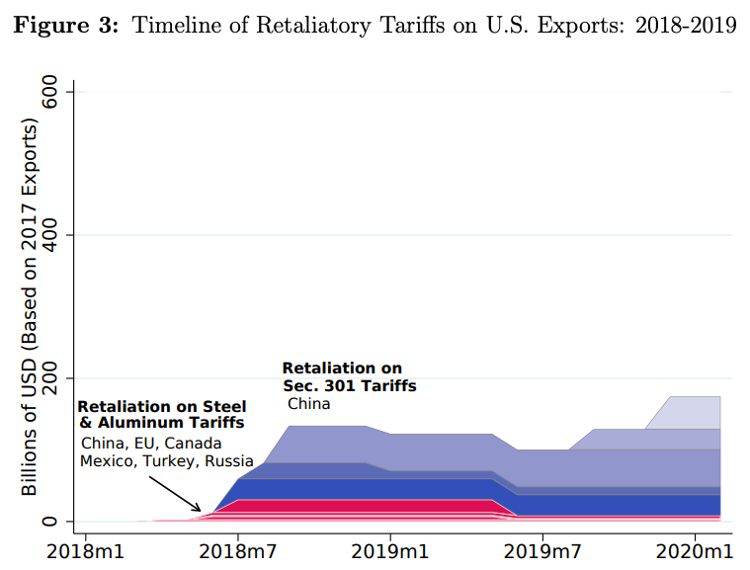
Source: Flaan & Pierce 2020
Notes:
Flaan and Pierce 2020
https://www.federalreserve.gov/econres/feds/files/2019086pap.pdf

Slide 21
US-China Trade War
Phase One Deal
In anticipation, Trump called off December 2019 tariffs
Agreement signed January 15, 2020
Content of Deal:
China to buy $200 billion more US exports
US to reduce a few tariffs on China
China to stop forcing foreign companies to transfer technology
Most tariffs remain in place by both, and China did not address subsidies and SOEs

Slide 22
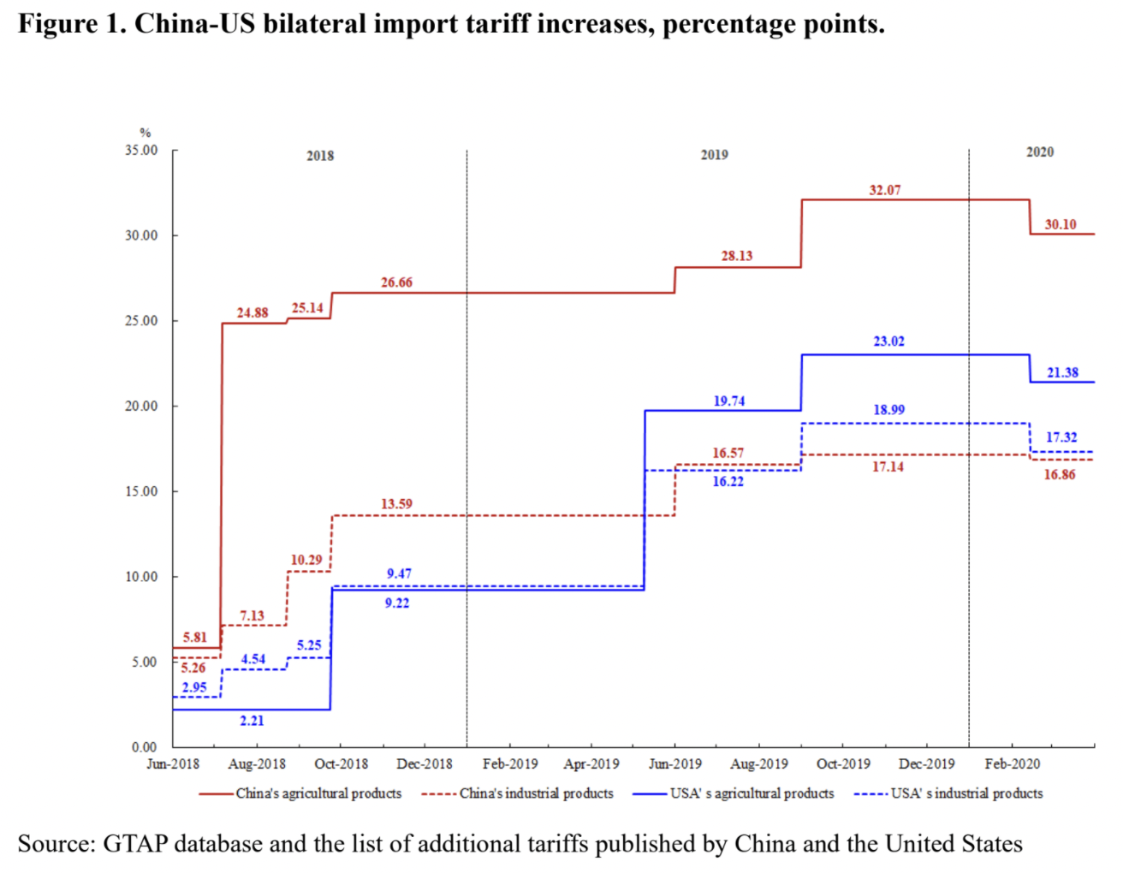
Phase One Agreement Reductions Jan 2020
US tariffs on China
Agriculture
Industrial
China tariffs on US
Agriculture
Industrial
Source: Zheng et al. Oct 2021
Notes:
Zheng, Jian, Shudong Zhou, Xingzi Li, Antonio Domingos Padula, Will Martin, “Effects of Eliminating the US-China Trade War Tariffs,” 27 October 2021

Slide 23
US-China Trade War
Effects of the trade war
Economist, “New research counts the costs of the Sino-American trade war,” The Economist, January 1, 2022.
Tariffs rose:
US on China 3% to 19%
China on US 8% to 21%
Compared to Smoot-Hawley tariffs of 1930
Covered more trade as share of GDP
Caused smaller harm to GDP (“effects muffled by complex supply chains”)
US prices of imports rose by 90% of tariffs
Reduced US manufacturing employment by 1.4%
Notes:
Economist, “New research counts the costs of the Sino-American trade war,” The Economist, January 1, 2022. [3p].
https://www.economist.com/finance-and-economics/2022/01/01/new-research-counts-the-costs-of-the-sino-american-trade-war

Slide 24
US-China Trade War
Other effects of the trade war
With higher tariffs, exporters are re-packaging to keep values under the “de minimis” threshold
Into US, imports under $800 pay no tariff
See Economist, “Artful dodging: America’s tariff wall on Chinese imports looks increasingly like Swiss cheese,” Feb 26, 2022 (Not assigned)
What happened to trade?
US imports from China: following from unassigned reading by Bown (2022)
US exports to China: following from optional reading, Bown and Wang (2023)
Notes:
Economist, “New research counts the costs of the Sino-American trade war,” The Economist, January 1, 2022. [3p].
https://www.economist.com/finance-and-economics/2022/01/01/new-research-counts-the-costs-of-the-sino-american-trade-war

Slide 25
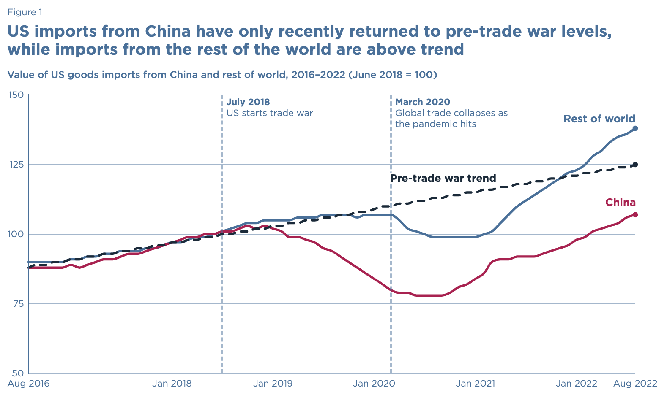
Source: Bown, 2022
Notes:
Bown, Chad P., “Four years into the trade war, are the US and China decoupling?,” Realtime Economics, Peterson Institute of International Economics, October 20,, 2022.
https://www.piie.com/blogs/realtime-economics/four-years-trade-war-are-us-and-china-decoupling

Slide 26
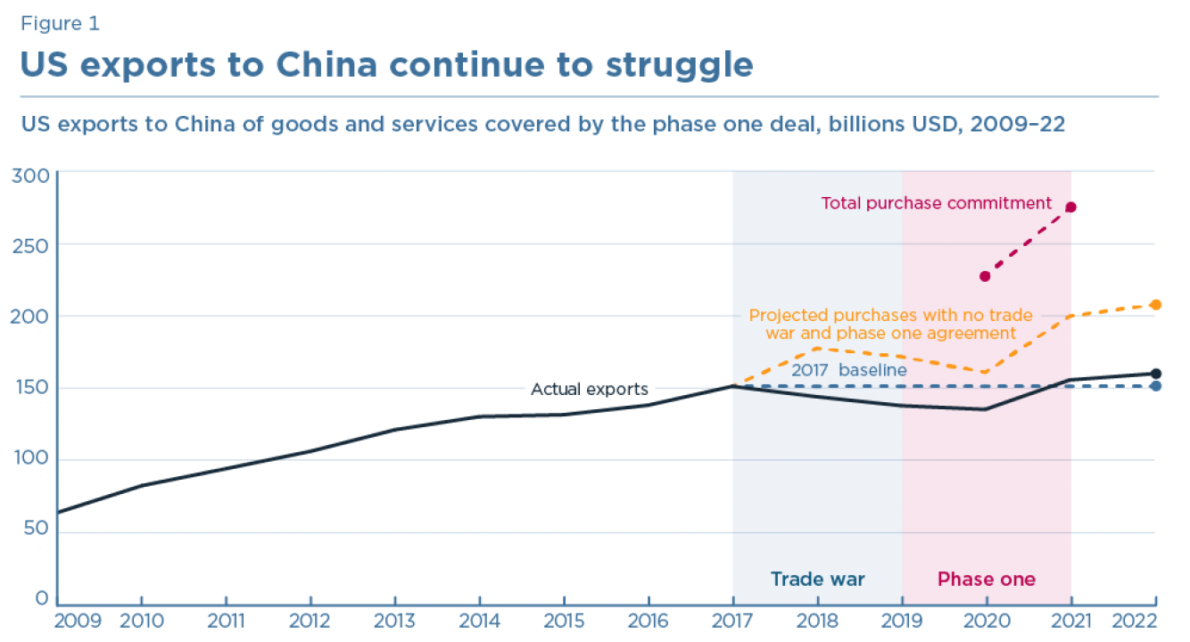
Source: Bown and Wang, 2023
Notes:
Bown, Chad P. and Yilin Wang, "Five Years Into the Trade War, China Continues Its Slow Decoupling From US Exports," Realtime Economics, Peterson Institute of International Economics, March 16, 2023.
https://www.piie.com/blogs/realtime-economics/five-years-trade-war-china-continues-its-slow-decoupling-us-exports

Slide 27
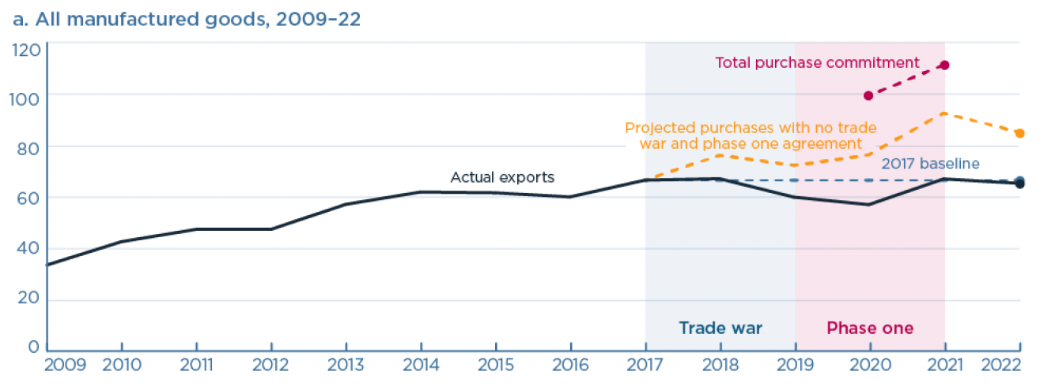
Source: Bown and Wang, 2023
Notes:
Bown, Chad P. and Yilin Wang, "Five Years Into the Trade War, China Continues Its Slow Decoupling From US Exports," Realtime Economics, Peterson Institute of International Economics, March 16, 2023.
https://www.piie.com/blogs/realtime-economics/five-years-trade-war-china-continues-its-slow-decoupling-us-exports

Slide 28
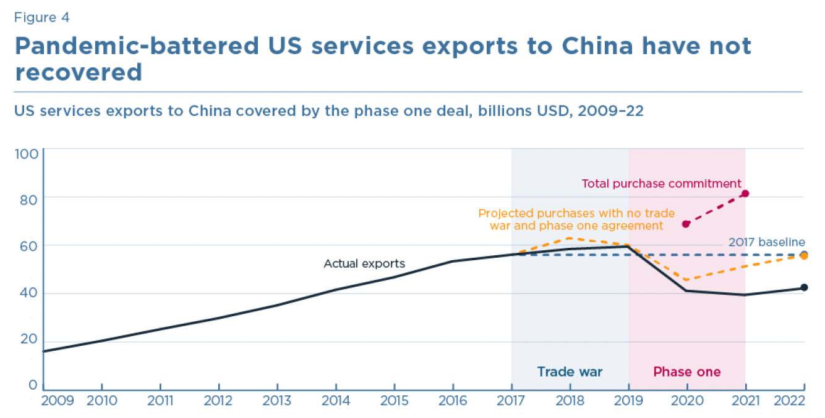
Source: Bown and Wang, 2023
Notes:
Bown, Chad P. and Yilin Wang, "Five Years Into the Trade War, China Continues Its Slow Decoupling From US Exports," Realtime Economics, Peterson Institute of International Economics, March 16, 2023.
https://www.piie.com/blogs/realtime-economics/five-years-trade-war-china-continues-its-slow-decoupling-us-exports

Slide 29
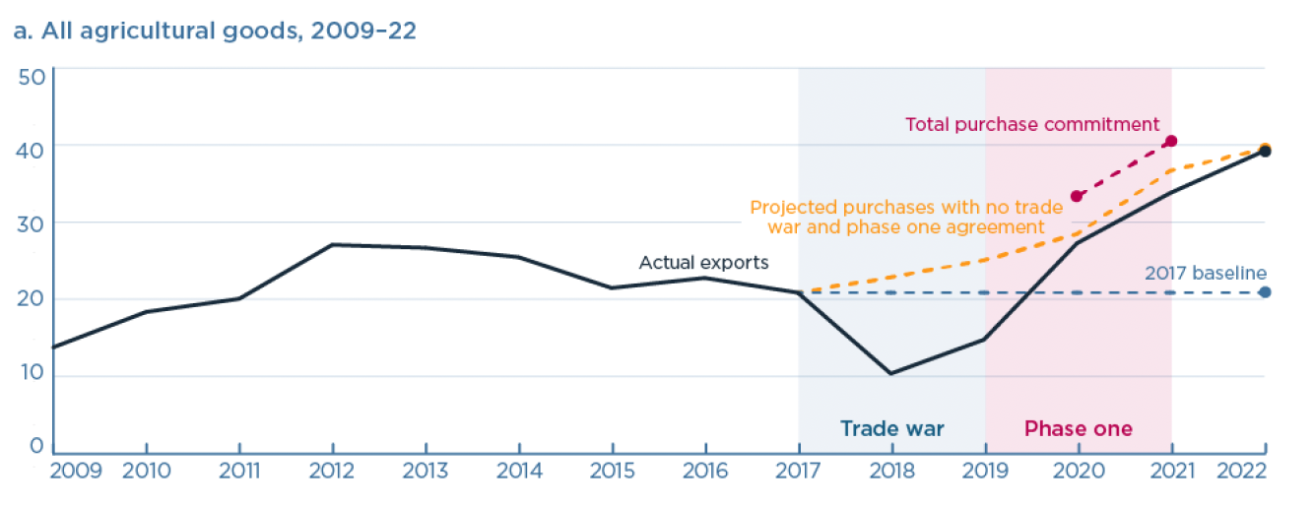
Source: Bown and Wang, 2023
Notes:
Bown, Chad P. and Yilin Wang, "Five Years Into the Trade War, China Continues Its Slow Decoupling From US Exports," Realtime Economics, Peterson Institute of International Economics, March 16, 2023.
https://www.piie.com/blogs/realtime-economics/five-years-trade-war-china-continues-its-slow-decoupling-us-exports

Slide 30
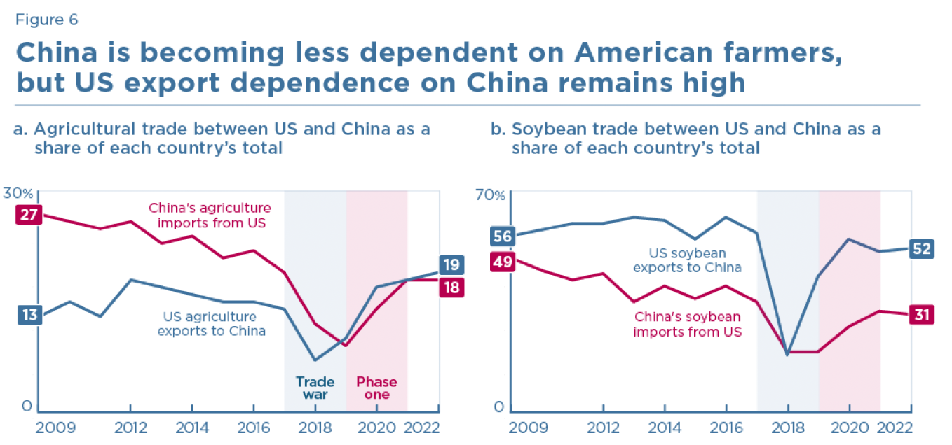
Source: Bown and Wang, 2023
Notes:
Bown, Chad P. and Yilin Wang, "Five Years Into the Trade War, China Continues Its Slow Decoupling From US Exports," Realtime Economics, Peterson Institute of International Economics, March 16, 2023.
https://www.piie.com/blogs/realtime-economics/five-years-trade-war-china-continues-its-slow-decoupling-us-exports

Slide 31
Pause for Discussion

Slide 32
Questions on Economist, “New Research…”
What did China promise in the Phase One deal, and to what extent did they do as promised?
How did US import patterns change?
Are the changes in US import patterns good or bad for the US?

Slide 33
Questions on Manak et al., “Cost of Trump’s Trade War …”
What reviews have been undertaken of Trump’s tariffs on China?
What is the consensus of the feedback?
How did the tariffs on imports affect US exports?
One responder said the tariffs caused them to move their production to China. Why would that be?

Slide 34
Questions on Swanson, “Contentious U.S.-China…”
Is China’s economy bigger or smaller than the US economy?
Where does China stand as a trading partner of the US?
Does China make cars?
Is the US eager to export all products to China?

Slide 35
Semiconductors
As early as 2016 (under Obama), the US was taking actions to “Safeguard US Semiconductor Supremacy”
Placed Chinese companies on its “Entity List”
2016: ZTE, a partially state-owned technology company that specializes in telecommunication
2019: Huawei, the world's largest supplier of telecommunications network equipment
2020: SMIC, a semiconductor foundry company

Slide 36
Semiconductors
2022
Aug 9: US passes CHIPS Act
“invests $280 billion to bolster US semiconductor capacity, catalyze R&D, and create regional high-tech hubs and a bigger, more inclusive STEM workforce.” (per McKinsey & Co)
Aug 31: US Imposes New Controls on Advanced Chip Exports
Sep 16: US Redefines National Security
“maintain as large a lead as possible in foundational technologies”
Oct &: New export controls
Notes:
McKinsey & Co, “” The CHIPS and Science Act: Here’s what’s in it,” October 4, 2022.
https://www.mckinsey.com/industries/public-sector/our-insights/the-chips-and-science-act-heres-whats-in-it

Slide 37
Semiconductors
2023
Mar 8: Netherlands Joins US Export Controls
Mar 31: Japan Restricts Chipmaking Equipment Exports
May 21: China Bans Some Chips from US-Based Micron
Sep 1: US, Japan, & Netherlands require permit to export high-end chip-making machines made by Dutch company, ASML
China says this is a “technological blockade against China”

Slide 38
Pause for Discussion

Slide 39
Questions on Mozur & Nicholas, “With Ban on Micron…”
What was China’s claimed basis for blocking purchases of chips from Micron?
What actions had the US taken previously that might have motivated this?
What actions had China taken previously in this area?

Slide 40
Questions on Hayashi & McKinnon, “U.S. Looks to Restrict …”
Why is restriction of Chinese access to US cloud services closing a loophole in previous US export restrictions?
What had China done just before this announcement?
What else is the US worried about China cutting off?

Slide 41
Questions on Sohn et al., “China’s Export Curb …”
Who is China targeting with its new restrictions on exports of gallium and germanium?
What are the aims of China and the US?
What steps does South Korea say it will pursue to deal with this?
Does China have a natural monopoly on these materials?

