Slide 1
Lecture 23 Environment, Labor Standards, and Trade
Econ 340
Notes:
Add Porter

Slide 2
Outline: Environment, Labor Standards, and Trade
The Issues
Environment
Examples
Policies
International Problems
Role of the WTO
Labor Standards
Fundamental ILO Conventions
United States Role
Issues

Slide 3
The Issues
Environment
Does trade hurt the environment?
Does international competition weaken environmental laws?
Labor Standards
Does trade hurt workers?
Does international competition weaken labor standards?
Role of the WTO in both
Do WTO rules
Limit countries’ abilities to raise standards?
Or lead them to reduce standards (“race to the bottom”)?
Should trade policy be used to improve standards?
Should trade policy be used if countries’ standards or policies differ?

Slide 4
Outline: Environment, Labor Standards, and Trade
The Issues
Environment
Examples
Policies
International Problems
Role of the WTO
Labor Standards
Fundamental ILO Conventions
United States Role
Issues

Slide 5
Environment
The problem: Externalities
Externality is: Cost or benefit of an activity that is not borne by the actor.
Examples: Pollution, global warming, destruction of species
The issues:
How should externalities be dealt with?
Is doing this made harder or easier by trade and trade policy, or by the WTO?

Slide 6
Outline: Environment, Labor Standards, and Trade
The Issues
Environment
Examples
Policies
International Problems
Role of the WTO
Labor Standards
Fundamental ILO Conventions
United States Role
Issues

Slide 7
Environment: Examples
Pollution along the Mexican border
Caused by production, for export to U.S.
Stimulated by
Maquiladoras (Firms given special tariff treatment on processing for U.S. firms)
NAFTA

Slide 8
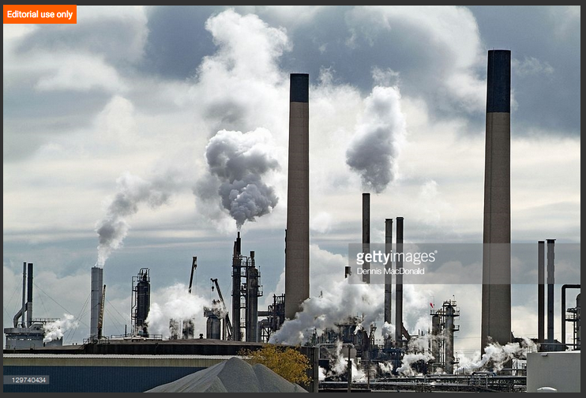
Notes:
https://www.gettyimages.com/detail/photo/chemical-industry-plants-spew-air-pollution-high-res-stock-photography/129740434

Slide 9
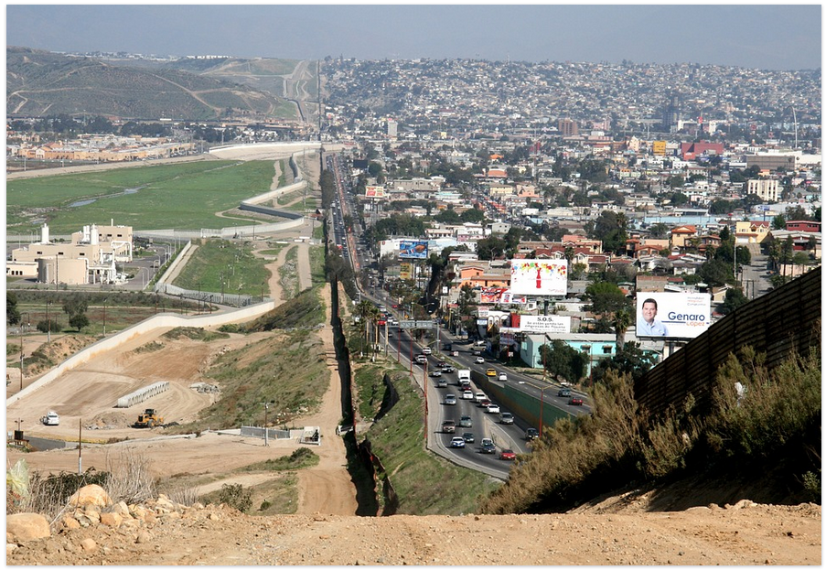
Notes:
http://geo-mexico.com/?tag=border

Slide 10
Environment: Examples
Pollution along the Mexican border
Caused by production, for export to U.S.
Stimulated by
Maquiladoras (Firms given special tariff treatment on processing for U.S. firms)
NAFTA
U.S. laws struck down by GATT / WTO
Tuna-dolphin case
Shrimp-turtle case
US laws banned imports
… hurts these
Struck Down by GATT/WTO!
Fishing for these…

Slide 11
Outline: Environment, Labor Standards, and Trade
The Issues
Environment
Examples
Policies
International Problems
Role of the WTO
Labor Standards
Fundamental ILO Conventions
United States Role
Issues

Slide 12
Environment: Policies
How to deal with a negative externality
Regulate: Prohibit or limit activity
Tax: Make activity more costly
By setting tax equal to cost to others, government can “internalize” the externality.
Hybrid: Tradable licenses
Number of licenses set by regulation
Market determines who uses licenses
= “cap and trade”

Slide 13
Environment: Policies
What is the “Optimal” level of a negative externality?
It is not zero!
It is found by equating
marginal benefit (of reducing externality) to
marginal cost (of reducing externality)

Slide 14
Environment: Policies
What is the “Optimal” level of a negative externality?
$
Marginal cost …
Marginal benefit …
… of reducing pollution
Optimal pollution
Zero pollution

Slide 15
Environment: More Examples
Air pollution
Water pollution
Acid rain
CO₂ emission (global warming)
Destruction of rain forest
Destruction of species
Endangered (sea turtles)
Favored (dolphin)
Overuse of natural resources (over-fishing)

Slide 16
Clicker Question
What is an “externality”?
A cost of production that occurs outside of a country, due to offshoring.
The amount a firm must pay in interest if it borrows to finance investment.
The harm done to consumers of exported products such as cigarettes.
The negative effect of imports on domestic employment.
A cost or benefit of an activity that is not borne by the actor.
✓

Slide 17
Clicker Question
What is the optimal level of a air pollution?
The level that would occur if markets were free.
The level beyond which the harm from pollution would increase.
The level beyond which the harm from pollution would decrease.
The level at which there is no pollution.
The level at which the marginal benefit from reducing pollution equals the marginal cost.
✓

Slide 18
Outline: Environment, Labor Standards, and Trade
The Issues
Environment
Examples
Policies
International Problems
Role of the WTO
Labor Standards
Fundamental ILO Conventions
United States Role
Issues

Slide 19
Environment: International Problems
Cross-border Externalities
Contrast with local externalities
Local government has ability and incentive to act
Cross-border: No incentive to incur a local cost in order to limit harm to foreigners.
Need international agreement
Example:
CFCs (Chloroflorocarbons) that caused the hole in the ozone.
Dealt with by Montreal Protocol (1987)

Slide 20
Environment: International Problems
Effects on Competitiveness
Pollution tax raises costs of
Exporters
Import-competitors
If foreign firms are not taxed, this is viewed as unfair
Countries with weak regulations become “pollution havens”
But Jones says there is little evidence that this happens – it’s not worth it
“Race to the bottom”: Countries compete by lowering their environmental standards
Solution (?): International agreement for all to tax equally
Called “harmonization”

Slide 21
Environment: International Problems
Differences in Optimal Policy
Optimal policy may depend on a country’s income
Poor countries can’t afford strict regulations
The environment is “income elastic” or a “superior good” – that is, countries demand more of it as their incomes rise.
Thus taxes on local pollution should not be the same

Slide 22
Environment: International Problems
Example: Internal memo by Larry Summers when at World Bank:
[He goes on to give several reasons.]
“ ‘Dirty’ Industries: Just between you and me, shouldn’t the World Bank be encouraging MORE migration of the dirty industries to LDCs?”

Slide 23
Clicker Question
What agreement dealt with CFCs (chloroflorocarbons), and why?
The Montreal Protocol, because CFCs were destroying ozone.
NAFTA, because CFCs cause lung cancer.
The Plaza Accord, because CFCs were causing Legionnaires’ disease.
The Doha Disagreement, because CFCs are a substitute for petroleum.
The Paris Agreement, because CFCs contribute to climate change.
✓

Slide 24
Clicker Question
Why might a country be reluctant to levy a pollution tax on its producers in order to clean its own air if other countries do not do the same?
It raises the cost of production for export.
It reduces the competitiveness of local producers who compete with imports.
It’s not fair.
It encourages producers to relocate abroad.
All of the above.
✓

Slide 25
Outline: Environment, Labor Standards, and Trade
The Issues
Environment
Examples
Policies
International Problems
Role of the WTO
Labor Standards
Fundamental ILO Conventions
United States Role
Issues

Slide 26
Environment: Role of the WTO
Does WTO permit limits on imports for environmental reasons?
Yes, if the imports themselves would do damage inside importing country.
No, for damage done abroad.
Any policy must not discriminate.
May not limit imports based on process by which they were produced.

Slide 27
Policy Options
Use WTO (These options are not in fact permitted, and they are not good ideas)
Treat environmental violations as trade violations
Some environmentalists would like this, because the WTO has “teeth”
Define environmentally harmful production of exported goods as “unfair,” and permit AD & CVD

Slide 28
Policy Options
Carbon Tariff
If some but not all countries
use carbon tax or cap-and-trade to raise price of carbon
to fight global climate change
Then many would advocate a carbon tariff on imports of goods from non-participating countries
Problem:
Benefits (to world) of reducing carbon may be the same
But the costs (to the country) are not

Slide 29
Policy Options
Carbon Tariff: Arguments for and against
Krugman is for
Failure to use them will cause consumer substitution toward cheaper products made in countries that do not tax or restrict carbon emissions
[Economist 2018: “carbon leakage” – the possibility that places with laxer climate policies will produce commodities more cheaply]
Should be legal under WTO, like “border tax adjustments” used when countries taxation systems differ
China (per Reuters) is against
Calls carbon tariffs “protectionist”
Predicts use of carbon tariffs would cause trade war
Says not legal under WTO
Notes:
Economist quote: November 29, 2018, in “Decarbonising industry: How to get the carbon out of industry”

Slide 30
Clicker Question
Why might Larry Summers have argued that dirty industries should be located in poor countries?
It would be less costly for them to clean their air than for rich countries.
He believes that international policies should be most beneficial for those who can pay for them.
Larry Summers is a jerk.
Poor countries value the income from those industries more, relative to clean air.
Wind speeds tend to be higher in poor countries and will blow away the pollution.
✓

Slide 31
Clicker Question
Why have environmentalists been critical of the WTO?
The WTO requires that countries permit imports that will foul the environment.
International trade contributes to global warming.
Policies intended to help the environment have been struck down by the WTO.
WTO disputes are handled in Switzerland, whose environmental policies are weak.
The WTO opposes the Convention on International Trade in Endangered Species.
✓

Slide 32
Outline: Environment, Labor Standards, and Trade
The Issues
Environment
Examples
Policies
International Problems
Role of the WTO
Labor Standards
Fundamental ILO Conventions
United States Role
Issues

Slide 33
Labor Standards
What are they?
Formal list of “conventions” (190) and “recommendations” (206) regarding treatment and conditions of labor, established by
The ILO = International Labour Organization
These include 8
“Fundamental ILO Conventions”
Numbers in parentheses below: numbers of countries that have ratified the conventions (as of 11/27/2019) out of 187 members
Notes:
http://www.ilo.org/public/english/standards/relm/country.htm

Slide 34
Labor Standards: Fundamental ILO Conventions
Freedom of Association
Right to Organize (155)
Right to Collective Bargaining (167)
Abolition of Forced Labor
Forced Labor (178)
Abolition of Forced Labor (175*)
Notes:
1a: http://www.ilo.org/dyn/normlex/en/f?p=1000:11300:0::NO:11300:P11300_INSTRUMENT_ID:312232
1b: http://www.ilo.org/dyn/normlex/en/f?p=1000:11300:0::NO:11300:P11300_INSTRUMENT_ID:312243
2a: http://www.ilo.org/dyn/normlex/en/f?p=1000:11300:0::NO:11300:P11300_INSTRUMENT_ID:312174
2b: http://www.ilo.org/dyn/normlex/en/f?p=1000:11300:0::NO:11300:P11300_INSTRUMENT_ID:312250

Slide 35
Labor Standards: Fundamental ILO Conventions
Equality
Discrimination (175)
Equal Remuneration (173)
Elimination of Child Labor
Minimum Age (172)
Worst Forms of Child Labor (186*)
Notes:
3a: http://www.ilo.org/dyn/normlex/en/f?p=1000:11300:0::NO:11300:P11300_INSTRUMENT_ID:312256
3b: http://www.ilo.org/dyn/normlex/en/f?p=1000:11300:0::NO:11300:P11300_INSTRUMENT_ID:312245
4a: http://www.ilo.org/dyn/normlex/en/f?p=1000:11300:0::NO:11300:P11300_INSTRUMENT_ID:312283
4b: http://www.ilo.org/dyn/normlex/en/f?p=1000:11300:0::NO:11300:P11300_INSTRUMENT_ID:312327

Slide 36
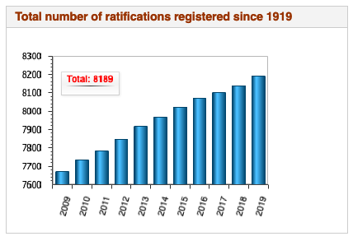
Notes:
http://www.ilo.org/dyn/normlex/en/f?p=NORMLEXPUB:1:0::NO:::

Slide 37
Outline: Environment, Labor Standards, and Trade
The Issues
Environment
Examples
Policies
International Problems
Role of the WTO
Labor Standards
Fundamental ILO Conventions
United States Role
Issues

Slide 38
Labor Standards: Fundamental ILO Conventions
*Fundamental Conventions ratified by U.S.:
ONLY:
Abolition of Forced Labor
Worst Forms of Child Labor
Notes:
http://www.ilo.org/dyn/normlex/en/f?p=1000:12001:0::NO:::

Slide 39
Labor Standards: Fundamental ILO Conventions
United States
Has not ratified many of the conventions
But… in spite of that, US enforces many labor standards through its trade laws

Slide 40
Labor Standards: Found in U.S. Trade Law
Freedom of Association
Right to Organize and Bargain Collectively
Forced Labor
Minimum Age for Employment
Acceptable Conditions of Work
(not “Fundamental” in ILO)
Minimum wage
Hours of work
Safety and Health
Enforcement

Slide 41
U.S. Labor Standards
US pushes labor standards in trade agreements
Side agreement in NAFTA & was included in TPP
Now included in USMCA
Purpose is to
Improve labor conditions abroad
Protect labor standards in the US
Do they work? No, says Porter

Slide 42
U.S. Labor Standards
Porter:
US labor standards are
Among the lowest in OECD countries
Weaker than in EU
Also weak in US:
Unions
Safety net
Could a trade agreement help?
Porter says yes: the TTIP with EU could harmonize labor standards in US up to EU levels
(But TTIP is now unlikely, post-Trump.)

Slide 43
Clicker Question
Which of the following is not one of the eight core labor standards of the ILO?
Abolition of forced labor
Minimum wage
Right to collective bargaining
Nondiscrimination
Right to organize
✓

Slide 44
Clicker Question
Why is the article by Porter critical of US labor standards?
They are weaker than those of the EU.
Unions in the US have less power than abroad.
Compared to other rich countries, the safety net for US workers is weak.
All of the above.
None of the above.
✓

Slide 45
Outline: Environment, Labor Standards, and Trade
The Issues
Environment
Examples
Policies
International Problems
Role of the WTO
Labor Standards
Fundamental ILO Conventions
United States Role
Issues

Slide 46
Labor Standards: Issues
Should labor standards be promoted?
Of course?
Yes, but only if it will help the people involved, the workers themselves
What if the true purpose is to help workers in rich countries?

Slide 47
Labor Standards: Issues
Effect of labor standards:
w = wage
S
D
L = labor

Slide 48
Labor Standards: Issues
Effect of labor standards: Minimum wage
w
And creates unemployment
S
Raises wage
Does labor benefit?
Yes, if still employed
No if not
D
But lowers employment
L

Slide 49
Labor Standards: Issues
Effect of labor standards:
Legislating Better conditions
Raises costs of employers, thus lowers the benefit of hiring labor. Thus shifts demand curve down.
w
S
Lowers wage
Does labor benefit?
Yes, if still employed and conditions worth the fall in wage
No if not
D
D′
And lowers employment
L

Slide 50
Labor Standards: Issues
Should trade policies be used for labor standards?
NO, say
Trade economists
Trade lawyers
Developing countries (even some of their labor unions)
MNEs (who would pay the cost)
Most Republicans
But this is (weakly) a part of USMCA

Slide 51
Labor Standards: Issues
Should trade policies be used for labor standards?
YES, say
Most Democrats
US labor unions
Many NGOs
(NGO=non-governmental organization)

Slide 52
Labor Standards: Issues
Should trade policies be used for labor standards?
PRO (assuming standards themselves are good):
Trade is the only tool we have (ILO is “toothless”)
WTO already does this in TRIPs (why help corporations and not labor?)
It is wrong to benefit from abuse of labor

Slide 53
Labor Standards: Issues
Should trade policies be used for labor standards?
CON:
Slippery slope to enforcing harmful labor standards
Trade restrictions make countries poorer, hurting their workers
Trade restrictions cost everybody
Incentive for protectionist claims of low labor standards

Slide 54
Labor Standards: Issues
Are trade policies used to enforce labor standards?
No, not in the WTO in the way some would like (by limiting imports from weak-standard places)
But US is including them in FTAs.

Slide 55
Labor Standards: Issues
What to do when labor standards are violated
Example: Fires in garment factories in Bangladesh and Pakistan (see Bhagwati)
Stop buying the brands who manufactured there?
No. That just destroys the jobs of poor-country garment workers.
Hold local governments responsible?
Yes. They need pressure to enforce labor standards.

Slide 56
Labor Standards: Issues
UM response to Bangladesh fire (from University Record, 4/12/14):
President Mary Sue Coleman announced Tuesday that U-M will adopt the recommendation of the President's Advisory Committee on Labor Standards and Human Rights that all U-M licensees either sign and abide by a worker safety initiative called the Accord on Fire and Building Safety in Bangladesh or demonstrate that they have an equivalent safety plan.
Accord on Fire and Building Safety in Bangladesh
calls for public reporting, independent fire and building safety inspectors at factories, and a commitment to workers in improving factory safety practices.

Slide 57
Clicker Question
Who benefits from a law requiring improved standards for workers in factories?
The firms that own the factories.
Those workers who are laid off from factories where they were mistreated.
Those workers who value the improved conditions more than any loss of wages.
Those who buy the products of the factories, the prices of which will fall
Nobody. Legislated labor standards only cause inefficiency.
✓

Slide 58
Clicker Question
Why should the WTO not permit countries to use tariffs against imports from countries that have low labor standards?
Tariffs would cause deadweight loss to the importing countries.
This would encourage industries to claim low standards just to get protection.
Such tariffs would likely lead to a trade war.
Low labor standards are beneficial to the countries that have them.
Strong labor standards are adequately enforced already by the International Labor Organization.
✓

Slide 59
Clicker Question
Why should the WTO permit countries to use tariffs against imports from countries that have low labor standards?
The ILO is toothless.
The WTO already protects owners of capital and should do the same for labor.
Low labor standards give producers a cost advantage, similar to dumping.
By championing workers, the WTO would make globalization more popular.
Only then could the United States be induced to improve its own labor standards.
✓

Slide 60
Clicker Question
Which of the following might the graph below represent?
A minimum wage
An incentive for more workers to seek jobs
A rise in employers’ the cost of making the workplace safe
Union negotiation of a wage agreement
Migration of workers out of the country
✓
w
S
D
D′
L

Slide 61
Next Time, and After That
Last Class, Wed Dec 11
Review
Final Exam: Fri, Dec 13, 1:30-3:30 PM

