Slide 1
Lecture 21 International Policies for Economic Development: Aid
Econ 340
Notes:
Add Economist Size Matters

Slide 2
News: Nov 25 – Dec 1
World trade slows down -- WSJ: 11/25 | Canvas
Global trade shrank in September, continuing weak performance during the last year.
Trade had risen the previous two months, even though both were below the previous year, creating hope that weakness was reversing, but that seems not to be the case.
Trade between the US and China fell the most, but trade has weakened across much of the world, as global supply chains have been disrupted and business investment has been lower.
China-US trade talks continue despite US support for Hong Kong -- WSJ: 11/28 | Canvas | NYT: 11/18 | Canvas
President Trump signed the Hong Kong Human Rights and Democracy Act passed by Congress supporting the protesters in Hong Kong, in spite of concern that this might disrupt the trade talks between the U.S. and China.
So far, however, although China denounced the new law as illegal interference in its own affairs, it has done nothing else to retaliate and the trade talks are continuing. Both China and the U.S. have said that the talks are nearly complete.
China sees it as in its interest to achieve a trade deal with the U.S., and therefore to keep concerns about Hong Kong separate from concerns about trade.
US becomes net exporter of oil -- FT: 11/29 | Canvas
The US exported 89,000 more barrels of oil per day (b/d) in September than it imported, the first full month of positive net exports since the 1940s. A decade ago, imports exceeded exports by 12 million b/d.
Contributing to this were several things: increasing production from shale; end of a ban on crude exports in 2015; and fuel economy improvements in cars, limiting demand.
The net-exports number is dwarfed by gross flows in both directions: imports of 8.668m b/d and exports of 8.757m b/d. The US exports the light oil produced from shale and imports heavier oil from abroad, as its refineries are designed to process it.

Slide 3
News: Nov 25 – Dec 1
World trade slows down
Global trade shrank in September, continuing weak performance during the last year.
Trade had risen the previous two months, even though both were below the previous year, creating hope that weakness was reversing, but that seems not to be the case.
Trade between the US and China fell the most, but trade has weakened across much of the world, as global supply chains have been disrupted and business investment has been lower.

Slide 4
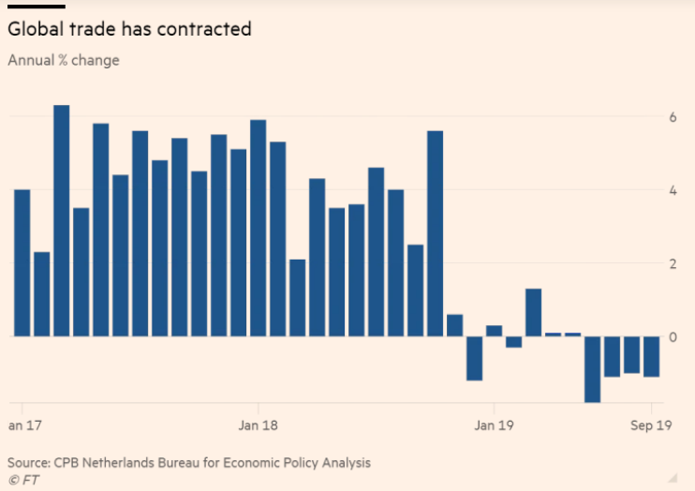
(These are year-on-year changes.)

Slide 5
News: Nov 25 – Dec 1
China-US trade talks continue despite US support for Hong Kong
President Trump signed the Hong Kong Human Rights and Democracy Act passed by Congress supporting the protesters in Hong Kong, in spite of concern that this might disrupt the trade talks between the U.S. and China.
So far, however, although China denounced the new law as illegal interference in its own affairs, it has done nothing else to retaliate and the trade talks are continuing. Both China and the U.S. have said that the talks are nearly complete.
China sees it as in its interest to achieve a trade deal with the U.S., and therefore to keep concerns about Hong Kong separate from concerns about trade.

Slide 6
News: Nov 25 – Dec 1
US becomes net exporter of oil
The US exported 89,000 more barrels of oil per day (b/d) in September than it imported, the first full month of positive net exports since the 1940s. A decade ago, imports exceeded exports by 12 million b/d.
Contributing to this were several things: increasing production from shale; end of a ban on crude exports in 2015; and fuel economy improvements in cars, limiting demand.
The net-exports number is dwarfed by gross flows in both directions: imports of 8.668m b/d and exports of 8.757m b/d. The US exports the light oil produced from shale and imports heavier oil from abroad, as its refineries are designed to process it.

Slide 7
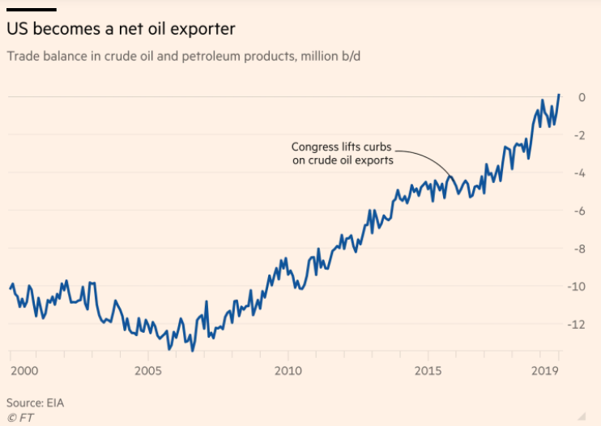

Slide 8
Announcements
Slides are now posted for the remaining lectures
Final class will be “Review”
Slides include lists of terms and acronyms from each lecture that you may want to use in studying
See example from Lecture 1 on next slide

Slide 9
Lecture 1: Overview of the World Economy
Terms
Globalization
Openness
Gross domestic product
Regional trade agreement
Capital flow
Shallow integration
Supply chain
Emerging market
Beggar they neighbor
Bretton Woods
Acronyms
CIA
IMF
WTO
GATT
IBRD
FDI
RTA
NAFTA
SDR

Slide 10
Lecture 21 Outline: International Policies for Economic Development: Aid
Why Should We Care?
Who Gives Aid?
Does Aid Work?
Pros and Cons of Aid
Policy Recommendations
Where We Stand in Development

Slide 11
Why Should We Care about Poverty in Other Countries?
Best reason: Morality, ethics
Need has been stressed by many
Example: Bob Geldof - rock star (is he still?)
Video series Geldof in Africa (2005)
Documented that “War, Famine, Plague and Death are the four horsemen of the Apocalypse and these days they're riding hard through the back roads of Africa.”
Organized “Live” concerts to promote aid to poor countries
“Live Aid” in1985
“Live 8” in 2005 (ahead of G8 meeting)

Slide 12
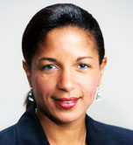
Why Should We Care about Poverty in Other Countries?
Self interest (see Rice)
(Note: Rice is former US Ambassador to UN and was US National Security Advisor under Obama)
Poverty abroad threatens US security
Fosters conflict
Terrorists take sanctuary in poorest countries
Extremist groups win over populations by providing services
Poverty breeds diseases, which may cross borders
SARS, bird flu, swine flu, ebola

Slide 13
Why Should We Care about Poverty in Other Countries?
Regarding conflict and poverty:
Rice cites study showing that probability of armed conflict within 5 years is
15% at per capita incomes below $250
1% at per capita incomes above $5,000
Thus poverty alleviation is important for the world, because conflicts often extend outside of countries in which they begin

Slide 14
Lecture 21 Outline: International Policies for Economic Development: Aid
Why Should We Care?
Who Gives Aid?
Does Aid Work?
Pros and Cons of Aid
Policy Recommendations
Where We Stand in Development

Slide 15
Who Gives Aid?
See Economics Focus article, “Gauging Generosity”
Regarding aid, specifically ODA (Official Development Assistance)
US gives more total aid than any other country
But in proportion to its size, US gives less per GDP aid than any other rich country
The top givers are the Scandinavian countries: Denmark, Norway, & Sweden
Also Luxembourg and Netherlands

Slide 16
Who Gives Aid?
Net Official Development Assistance in 2005
Total Amount Given
Notes:
Source: OECD, “Aid flows top USD 100 billion in 2005 “, http://www.oecd.org/document/40/0,2340,en_2649_201185_36418344_1_1_1_1,00.html
http://www.oecd.org/dataoecd/34/26/36418606.pdf

Slide 17
Who Gives Aid?
Net Official Development Assistance in 2005
As Percent of National Income

Slide 18
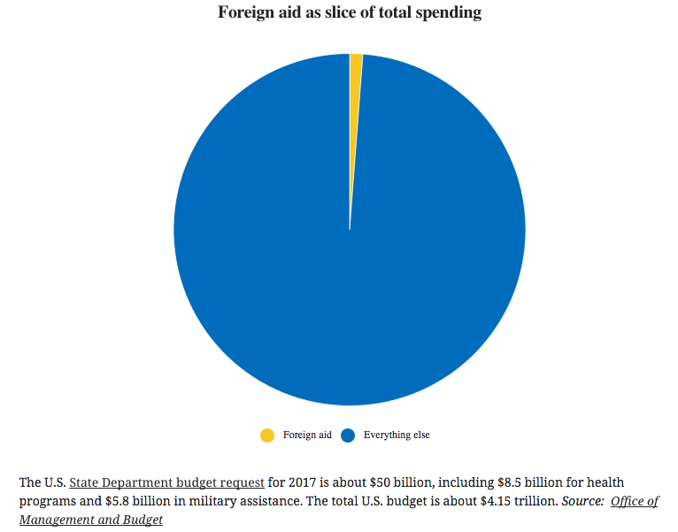
US Foreign Aid in US Budget
Source:
Politifact
Notes:
http://www.politifact.com/global-news/statements/2016/nov/09/john-kerry/yep-most-people-clueless-us-foreign-aid-spending/

Slide 19
Who Gives Aid?
But see also Schaefer on “American Generosity…”
These figures ignore private aid
But his figures say our private aid in 2000 was $33.6 billion.
That would only about triple what we give, raising our contribution to 0.45%, still well below that of Norway.
Schaefer also says these numbers confuse “inputs” with “outputs.”
He notes that many countries have done poorly even with aid.
So, apparently, giving only little is not a shame if giving won’t do much good.
But see below for how aid may be targeted more effectively

Slide 20
Who Gives Aid?
Several years ago, aid became a popular cause, pushed by Rock Star Bob Geldof
“Live 8” concerts, held all over the world, preceded the G8 summit conference in July 2005. Goal was to “Make Poverty History” by
Getting the G8 to commit 0.7% of GDP to aid by 2015
Eliminating agricultural subsidies
Eradicating disease

Slide 21
Bob Geldof and stars at the Live 8 concert in Hyde Park, which he says helped change opinions.

Slide 22
Who Gives Aid?
For most donors, aid does not fluctuate with income
Fluctuations in aid are larger than fluctuations in GDP, but due to other factors (political)
In other words, the timing of aid is not driven by need.

Slide 23
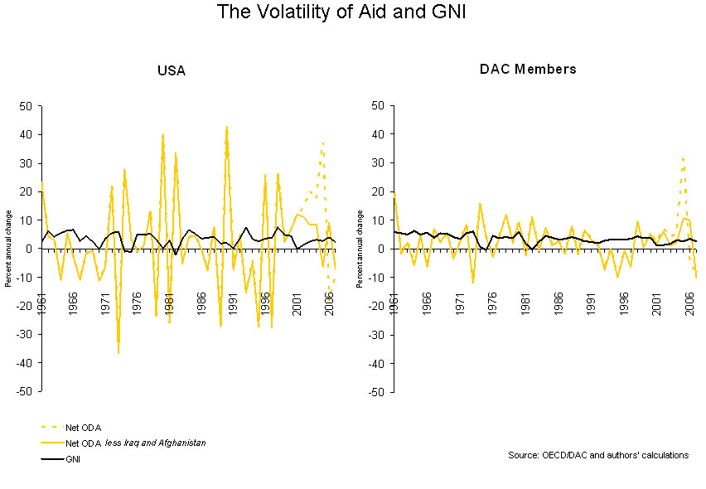
?

Slide 24
Who Gives Aid?
DAC?
= Development Assistance Committee
Group of the richer countries in the OECD
29 countries plus EU
Members confer on providing aid to developing countries.

Slide 25
Who Gets Aid?
See Economist: “Size Matters: Where does the aid go?”
Things that don’t matter:
Being well governed
Being poor
What does matter:
Being small:
Big countries get the least aid relative to size
Small countries get the most

Slide 26
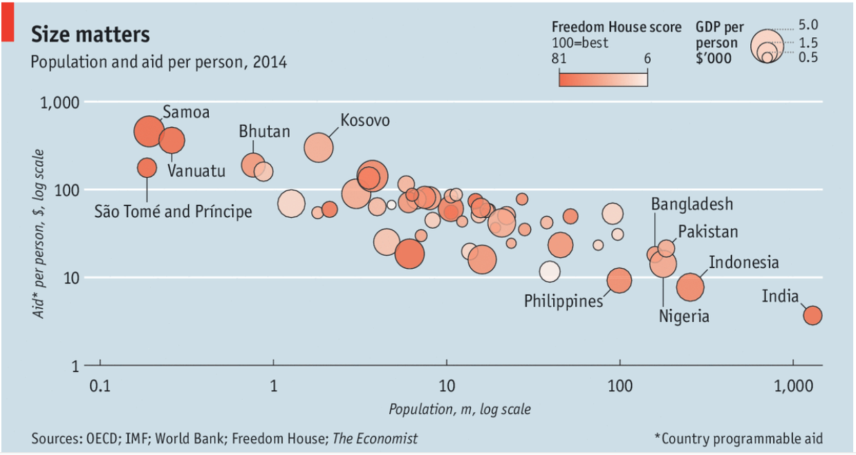
Who Gets Aid?

Slide 27
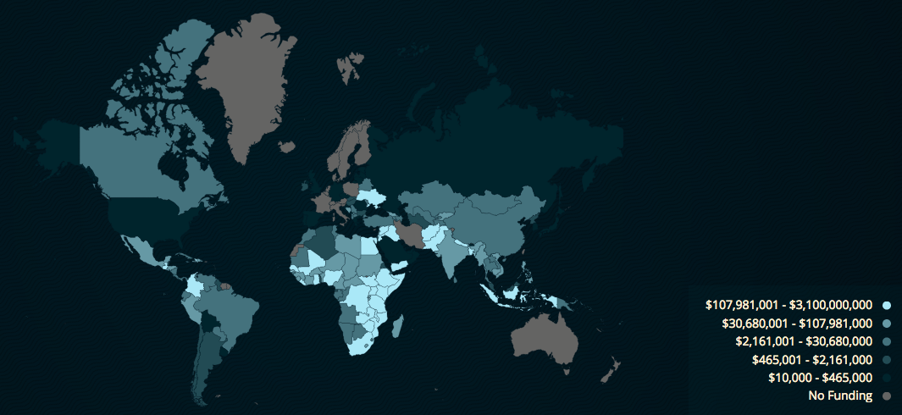
Who Gets US Foreign Assistance?
Source: US State Dept.
This reports: Spent, 2018
Notes:
https://foreignassistance.gov/explore

Slide 28
Clicker Question
Which of the following is not one of the top five countries in terms of official development assistance as a percentage of national income
Luxembourg
Sweden
United States
Norway
Netherlands
✓

Slide 29
Clicker Question
What fraction of GDP should countries give as foreign aid according to the Live 8 campaigners?
0.2%
0.7%
2%
7%
12%
✓

Slide 30
Clicker Question
According to the Economist article, “Size Matters,” which of the following types of countries tend to get the most aid per capita?
Countries with large populations
Countries with small populations
Poor countries
Countries with few natural resources
Countries with good governance
✓

Slide 31
Lecture 21 Outline: International Policies for Economic Development: Aid
Why Should We Care?
Who Gives Aid?
Does Aid Work?
Pros and Cons of Aid
Policy Recommendations
Where We Stand in Development

Slide 32
Does Aid Work?
Not always: Many countries that have gotten aid have become poorer
Most attempts to find evidence of a positive effect of aid on economic growth have failed
Rajan and Subramanian (not assigned) looked at experience of many countries over 1960-2000
They found no evidence that aid mattered for growth
Policies and institutions of countries did not matter
Type of aid did not matter
This does not mean that aid doesn’t reduce poverty; they didn’t look at that (they looked at growth)

Slide 33
Does Aid Work?
Eberstadt and Adelman (assigned reading) review the track record of aid:
“…it has not been demonstrated that official development assistance makes a regular and predictable contribution to overall macroeconomic growth.”
“The [World] Bank’s evaluation unit found that its poverty reduction record remains problematic.”

Slide 34
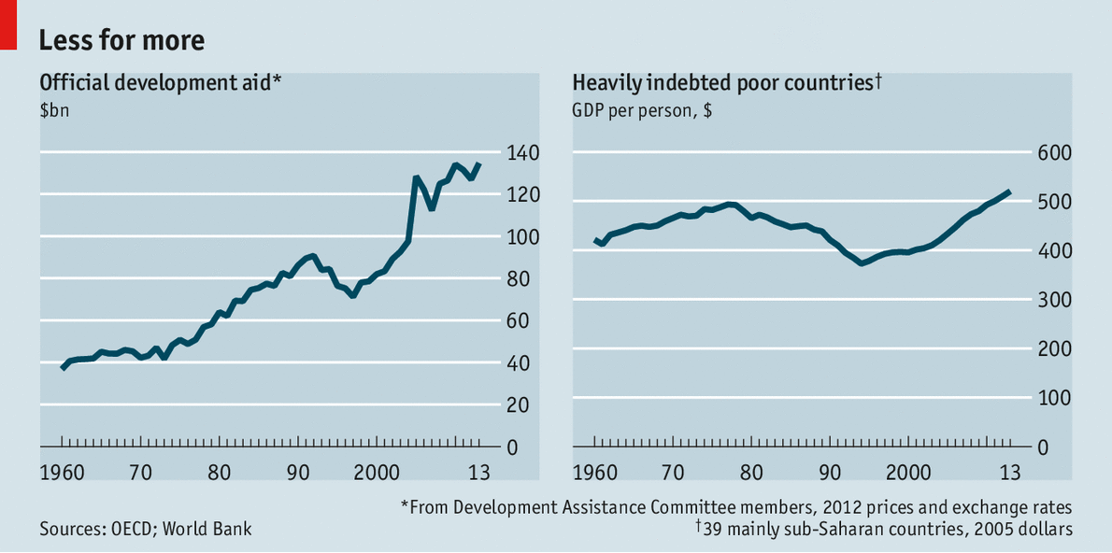
Does Aid Work?
HIPC
Economist, “Aid to the Rescue” 2014

Slide 35
Does Aid Work?
Economist, “Aid to the Rescue” 2014
Cites new work that does show positive causal link between aid and growth
Answering this question is hard because causation goes both directions
Study cited uses as “instrumental variable”: crossing the $1,200 per capita income threshold where aid is cut off
But effect is small, and may not be worth the money spent, even though aid is still well below the target of 0.7% of GDP

Slide 36
Does Aid Work?
Economist, “Aid to the Rescue” 2014
Reasons why aid may be harmful:
Fostering dependency
Propping up oppressive or incompetent regimes
Pushing up the value of poor countries’ currencies, thereby undermining the competitiveness of their exports

Slide 37
Clicker Question
Does aid help poor countries grow?
Many studies fail to find evidence that it does
One study finds a causal link from aid to growth
The evidence is mixed
All of the above
None of the above
✓

Slide 38
Clicker Question
What effect does aid to a country have on the value of its currency?
Causes it to appreciate, hurting its exports
Causes it to depreciate, hurting its exports
Causes it to appreciate, hurting it imports
Causes it to depreciate, hurting it imports
There is no effect of aid on the exchange rate
✓

Slide 39
Lecture 21 Outline: International Policies for Economic Development: Aid
Why Should We Care?
Who Gives Aid?
Does Aid Work?
Pros and Cons of Aid
Policy Recommendations

Slide 40
Pros and Cons of Aid
Pro: Much is needed
Con: Much is wasted

Slide 41
How Aid Is Wasted
Example: Côte d’Ivoire (See Fraser Institute: “When Foreign Aid Doesn’t”)
Country was turned from being an economic miracle to a disaster by foreign aid
Grew at 8% a year for 35 years after World War II
Moved toward state control starting in 1960s
Foreign capital for development went to large “inefficient” projects benefiting the ruling class – hydroelectric plants, and new capital city
Health spending went mainly to the wealthy urban population
50-80% of education spending on higher education, benefiting the wealthy elite, while 40% of children 6-12 do not attend school
GDP fell 4.3% per year from 1985 to 1994

Slide 42
Lecture 21 Outline: International Policies for Economic Development: Aid
Why Should We Care?
Who Gives Aid?
Does Aid Work?
Pros and Cons of Aid
Policy Recommendations
Where We Stand in Development

Slide 43
Policy Recommendations
Jeff Sachs, famous advocate for greater aid (not assigned)
Steps out of poverty:
Boost food production to end famine.
Improve health conditions.
End economic isolation (thus trade, or more generally, what he calls “connectivity”)

Slide 44
Policy Recommendations
Jeff Sachs
Standards for successful aid
Targeted
Specific
Measurable
Accountable
Scalable
Should support “triple transformation” in agriculture, health, and “connectivity”

Slide 45
Policy Recommendations
William Easterly, famous aid skeptic (not assigned)
Critic of Sachs, and of aid as it is mostly done
What is needed, he says: CIAO
C = Customer Feedback
I = Incentives
A = Accountability
O = Outcomes
Existing programs, including those pushed by Jeff Sachs, have none of this (he says)

Slide 46
Policy Recommendations
Easterly also has pointed out
Africa is doing better than the activists suggest
Bob Geldof’s “Four Horsemen” -- War, Famine, Plague & Death -- are actually not common
e.g., annual war deaths have averaged 1 per 10,800 for 4 decades
Recent growth has been highest in Africa’s history
Failure to meet the Millennium Development Goals is understandable, given the low start
Africa actually made good progress toward them

Slide 47
Policy Recommendations
Improve developing country governments and policies
Importance of Economic Freedom
Millennium Challenge Account (see Roberts)
This is a US program begun 2004 that gives aid to developing countries only if they demonstrate the ability to use it productively with
Good policies
Responsible government
Needed because so much foreign aid has been wasted

Slide 48
Policy Recommendations
What about Tied Aid and Food Aid?
Tied Aid: Money that must be spent on the donor’s exports
Inefficient, since a developing country could usually get more value buying elsewhere
See Economist
Food Aid: Agricultural products given directly to countries
Products chosen to support farmers in donor country
Effect on competing farmers in LDCs can be serious
But see Levinsohn and McMillan:
In Ethiopia, the farmers are not poor, so food aid does help the poor

Slide 49
Policy Recommendations
“Doing Business”
World Bank, each year, measures the ease of doing 10 different activities in each of 190 countries. Examples
Starting a business
Getting credit
Enforcing contracts
It publishes country rankings
This puts pressure on countries to improve

Slide 50
Notes:
http://www.doingbusiness.org/
(Searched for a more recent version of this without success.)

Slide 51
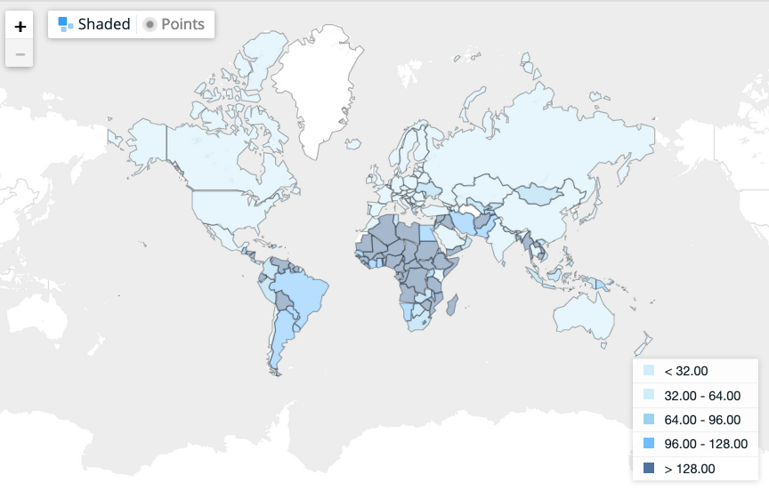
Ease of doing business index (1=most business-friendly regulations)
2019
Source: World Bank
Notes:
https://data.worldbank.org/indicator/IC.BUS.EASE.XQ?view=map

Slide 52
Clicker Question
Who benefits when rich countries give food aid to poor countries?
Farmers in both rich and poor countries
Farmers in rich countries and consumers in poor countries
Consumers in rich countries and farmers in poor countries
Consumer in both rich and poor countries
Taxpayers in both rich and poor countries
✓

Slide 53
Clicker Question
On what continent are the largest number of countries that score poorly on the World Bank’s Doing Business Index?
North America
South America
Europe
Asia
Africa
✓

Slide 54
Lecture 21 Outline: International Policies for Economic Development: Aid
Why Should We Care?
Who Gives Aid?
Does Aid Work?
Pros and Cons of Aid
Policy Recommendations
Where We Stand in Development

Slide 55
Where We Stand in Development
Millennium Development Goals (MDGs)
8 goals identified and agreed in 2005 by the United Nations to be achieved by 2015
Overall there was significant progress, and many countries achieved the MDGs
Many others did not, but many of them did make good progress

Slide 56
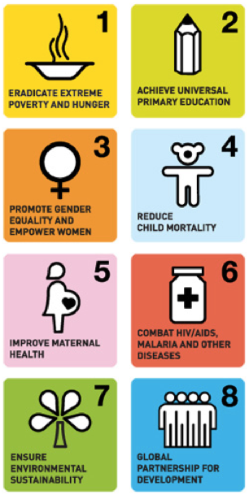
Where We Stand in Development
The MDGs
Eradicate Extreme Poverty and Hunger
Achieve Universal Primary Education
Promote Gender Equality and Empower Women
Reduce Child Mortality
Improve Maternal Health
Combat HIV/AIDS, Malaria and Other Diseases
Ensure Environmental Sustainability
Develop a Global Partnership for Development

Slide 57
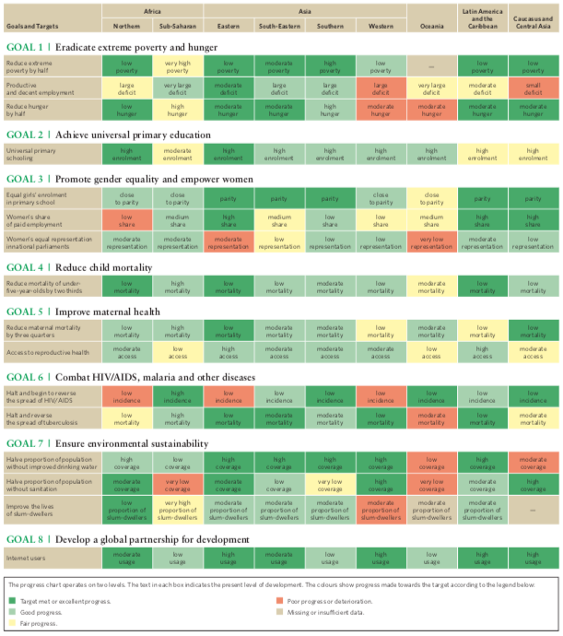
MDG Progress 2015
Notes:
https://www.google.com/url?sa=t&rct=j&q=&esrc=s&source=web&cd=1&ved=2ahUKEwiBjLXVkvfeAhUk6IMKHQwVA6wQFjAAegQIBBAC&url=http%3A%2F%2Fwww.un.org%2Fmillenniumgoals%2F2015_MDG_Report%2Fpdf%2FMDG%25202015%2520PC%2520final.pdf&usg=AOvVaw0Ox_wx_GubM6MC2Eet3rBd

Slide 58
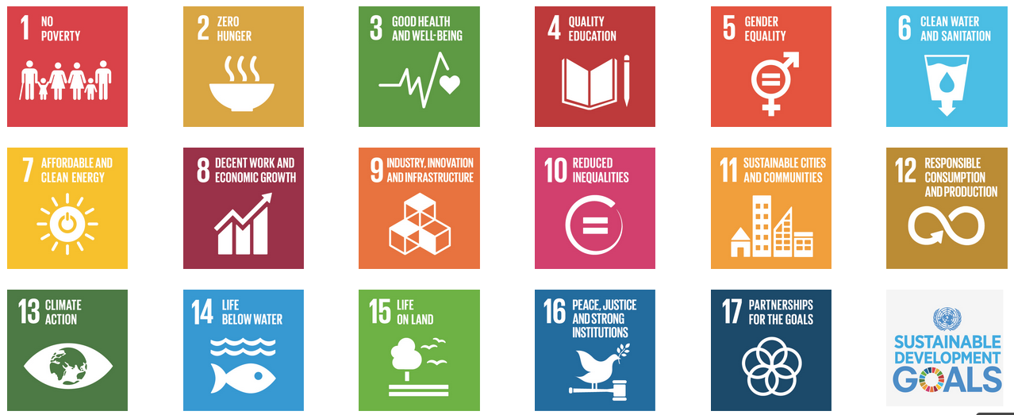
Where We Stand in Development
Sustainable Development Goals (SDGs)
17 goals identified and agreed in 2015 by the United Nations to be achieved by 2030

Slide 59
Clicker Question
What institution was behind the Millennium Development Goals and is now behind the Sustainable Development Goals?
The United States Agency for International Development
The World Bank
The United Nations
The International Monetary Fund
The World Health Organization
✓

Slide 60
Next Time
Outsourcing and Offshoring
Definitions
Effects
Facts
Policies

