Slide 1
Lecture 16 Currency Manipulation and Currency Wars
Econ 340

Slide 2
Outline: Currency Manipulation and Currency Wars
Currency Manipulation
What it is
Chinese currency manipulation
Other currency manipulation
Currency Wars
History
Currency war today?
Currency war effects

Slide 3
Outline: Currency Manipulation and Currency Wars
Currency Manipulation
What it is
Chinese currency manipulation
Other currency manipulation
Currency Wars
History
Currency war today?
Currency war effects

Slide 4
Currency Manipulation
Currency Manipulation
Usually defined as intervention intended to reduce the value of a country’s own currency
In order to make its exports more competitive, and
Discourage imports
Other countries object to it, because it reduces their exports
Congress requires the US Treasury Department to report twice a year on currency manipulation

Slide 5
Currency Manipulation
Currency Manipulation
Many have accused China, especially, of currency manipulation over the years
Trump promised, during the campaign, to label China a currency manipulator “on his first day in office.” He did not.
Had he done so, according to one source, it
would have authorized “the US to do nothing except negotiate with Beijing over the renminbi, which it is already doing.”

Slide 6
Currency Manipulation
Currency Manipulation
In September 2018, Trump told Reuters: “I think China's manipulating their currency, absolutely. And I think the euro is being manipulated also.”
In October 2018 and against in May 2019, the fourth and fifth such reports under Trump did not label China a currency manipulator
In August 2019, without such a report, the US Treasury did label China a currency manipulator
Since 2013, Treasury has issued a report every April/May and October. No second report has appeared yet this year.
Notes:
https://seekingalpha.com/article/4207807-trump-renews-charges-chinese-currency-manipulation
https://www.nytimes.com/2018/10/17/business/china-currency-manipulation.html

Slide 7
Currency Manipulation
The Trade Facilitation and Trade Enforcement Act of 2015 requires
Treasury to report twice a year on foreign exchange rate policies of major US trading partners.
Major trading partners are those that conduct at least $55 billion of trade with the US per year
The Act’s Criteria, to be a currency manipulator, a country must have
A significant bilateral trade surplus with the US
A material currency account surplus (multilateral)
Engaged in persistent one-sided intervention in the foreign exchange market

Slide 8
Currency Manipulation
The Treasury’s Criteria: To be labelled a currency manipulator, a country must
(As of May 2019, per Treasury Department Report)
Run a bilateral trade surplus with the United States exceeding $20 billion over the past 12 months;
Run a global current account surplus exceeding 2 percent of the country’s GDP over the past 12 months; and
Engage repeatedly in net foreign exchange purchases exceeding 2 percent of the country’s GDP over the past 12 months.
Notes:
https://home.treasury.gov/system/files/206/2019-05-28-May-2019-FX-Report.pdf

Slide 9
Currency Manipulation
Treasury’s May 2019 Report:
No country met all three criteria
Seven countries met criteria #1 and #2:
Germany, Ireland, Italy, Japan, Korea*, Malaysia, Singapore, and Vietnam
One country, Singapore, met criteria #2 & #3
China met only criterion #1, but its bilateral surplus was so large that Treasury kept it on its “monitoring list”
*Korea met only one in May 2019, but had met two in six previous reports, and so was included.
Notes:
https://home.treasury.gov/system/files/206/2019-05-28-May-2019-FX-Report.pdf

Slide 10
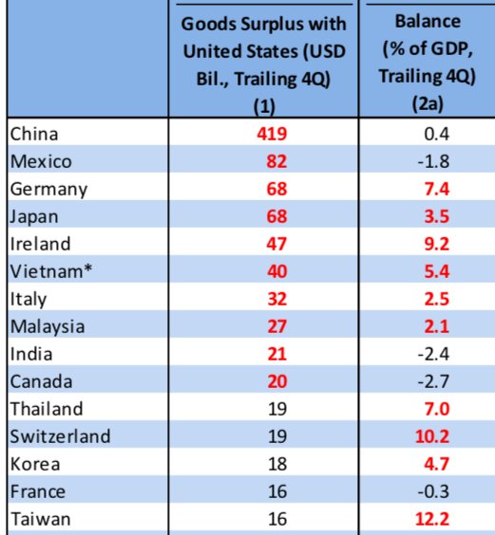
Notes:
https://home.treasury.gov/system/files/206/2019-05-28-May-2019-FX-Report.pdf
Table 2

Slide 11
Outline: Currency Manipulation and Currency Wars
Currency Manipulation
What it is
Chinese currency manipulation
Other currency manipulation
Currency Wars
History
Currency war today?
Currency war effects

Slide 12
Chinese Currency Manipulation
Most often accused of currency manipulation is China
What has been its experience?
Look at the data on
The exchange rate
China’s reserves
Recall that: in order to push down your currency, you must
Buy foreign currency
And thus add to reserves
Notes:
https://home.treasury.gov/system/files/206/2019-05-28-May-2019-FX-Report.pdf

Slide 13
Chinese Currency Manipulation
Note first how a floating exchange rate, without manipulation, performs over time
Then compare to the Chinese currency, the renminbi (aka, yuan)
Notes:
https://home.treasury.gov/system/files/206/2019-05-28-May-2019-FX-Report.pdf

Slide 14
How a Floating Exchange Rate Behaves US$/euro Exchange Rate
It moves up and down a lot.

Slide 15
China’s Exchange Rate, US$/Yuan, 2000-2005
The exchange rate did not change at all between 2000 and 2005
Notes:
China currency.xlsx
From IMF, IFS

Slide 16
And reserves more than quadrupled!
Notes:
See China Currency.xlsx

Slide 17
Chinese Currency Manipulation
During 2000-2005
China was intervening keep its rate constant
Since it was adding to reserves, it must have been
Buying dollars
Keeping the yuan below its market clearing value
Thus is was manipulating
But it did not push the yuan down
It was only keeping it from rising

Slide 18
China’s Exchange Rate, US$/Yuan, 2000-2008
The yuan appreciated steadily between 2005 and 2008
Notes:
China currency.xlsx
From IMF, IFS

Slide 19
Reserves continued to rise, to almost $2 trillion
Notes:
See China Currency.xlsx

Slide 20
Chinese Currency Manipulation
During 2005-2008
China allowed the yuan to rise
In response to pressure from US and others
But China’s reserves continued to rise, indicating that it was still buying dollars.
Was it manipulating?
Yes: yuan was below its market value
But only to slow its rise

Slide 21
China’s Exchange Rate, US$/Yuan, 2000-2014
The yuan stopped rising in 2008, then rose slowly
Notes:
China currency.xlsx
From IMF, IFS

Slide 22
Reserves mostly rose after 2008, to over $4 trillion in 2014
Notes:
See China Currency.xlsx

Slide 23
Chinese Currency Manipulation
During 2008-2014
The financial crisis of 2008 slowed down both
The appreciation of the renminbi, and
The growth of reserves
But both continued after a pause
Why did the appreciation pause?
“Flight to safety” led US $ to appreciate
China let ¥ rise with $, but not faster
Was it manipulating?
Yes, to keep it from rising faster than $

Slide 24
Chinese Currency Manipulation
Then all changed in 2014

Slide 25
China’s Exchange Rate, US$/Yuan, 2000-2017
The yuan reached its peak in 2013, and began to fall in 2015
Notes:
China currency.xlsx
From IMF, IFS

Slide 26
From 2014-16, China’s reserves were falling
Notes:
See China Currency.xlsx

Slide 27
Chinese Currency Manipulation
Conclusion:
China did intervene extensively 2000-2014,
Sometimes to keep the yuan from moving,
Other times to slow its rise
But since 2014, until 2017,
Although the yuan was falling in value until 2017,
This was in spite of Chinese intervention, not because of it
They sold close to $1 trillion of reserves, slowing its fall (over $1 trillion as of March 2017)

Slide 28
Chinese Currency Manipulation
During 2014-2017
China’s currency fell by about 12%
But so did China’s reserves, by $1 trillion
Was China intervening? Yes!
But was it manipulating? No!
It was intervening to slow the fall, not cause it.

Slide 29
China’s Exchange Rate, US$/Yuan, 2000-2019
Most recently, the yuan has moved up in 2017, down in 2018/19
Notes:
China currency.xlsx
From IMF, IFS

Slide 30
While reserves have moved little
Notes:
See China Currency.xlsx

Slide 31
Chinese Currency Manipulation
Since 2017
China’s currency has moved up and down, much more like a normal floating exchange rate
Its reserves have changed little
Is China manipulating? No

Slide 32
Outline: Currency Manipulation and Currency Wars
Currency Manipulation
What it is
Chinese currency manipulation
Other currency manipulation
Currency Wars
History
Currency war today?
Currency war effects

Slide 33
Other Currency Manipulation
The Economist in March 2017 devised a measure of currency manipulation based on
Current account balances
Foreign asset purchases relative to GDP

Slide 34
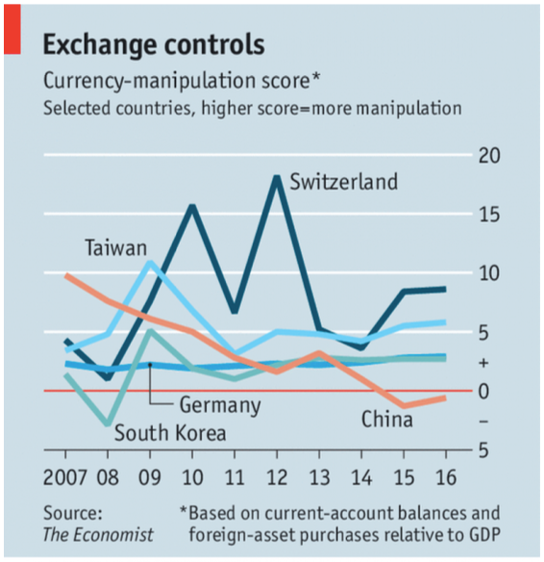

Slide 35
Other Currency Manipulation
They found that
China’s manipulation score was
High in 2007
Declining since
Negative since 2014
Score was positive for Germany, South Korea, and Taiwan
Highest for Switzerland
But based on prices, the Swiss franc was the most over-valued, not under-valued.
That’s why the Swiss were intervening.

Slide 36
Other Currency Manipulation
In June 2019, Trump accused the European Central Bank of acting to deliberately weaken the euro
His basis: ECB President Draghi’s statement that “additional stimulus would be required.”
Does that make sense?
Yes: Reducing interest rates tends to weaken the currency
The ECB’s interest rate was already below zero

Slide 37
Other Currency Manipulation
Is monetary policy currency manipulation?
Not by normal definitions
Most would say that countries with weak economies
Are right to lower interest rates,
Even though that will depreciate their currencies

Slide 38
Other Currency Manipulation
In 2010, Brazil’s finance minister complained that
The US and others were using monetary expansion (due to the recession)
This was causing the dollar and other currencies to fall
Hurting Brazil and other emerging economies
He didn’t call it “currency manipulation” but he did complain of a “currency war,” a term that he coined.

Slide 39
Outline: Currency Manipulation and Currency Wars
Currency Manipulation
What it is
Chinese currency manipulation
Other currency manipulation
Currency Wars
History
Currency war today?
Currency war effects

Slide 40
Currency Wars
Currency war defined:
Competitive currency depreciations
Multiple countries engaging in currency manipulation
Competitive devaluations of pegged exchange rates

Slide 41
Outline: Currency Manipulation and Currency Wars
Currency Manipulation
What it is
Chinese currency manipulation
Other currency manipulation
Currency Wars
History
Currency war today?
Currency war effects

Slide 42
Currency War History
1930s (See Mihm reading)
Competitive devaluations accompanied the higher tariffs of the trade war
One after another countries left the gold standard and let their currencies depreciate
Unlike tariffs, which may be targeted at individual countries, currencies affect all other countries
Thus a currency war can’t be confined to a pair of countries

Slide 43
Currency War History
1934 US Silver Purchase Act*
Roosevelt administration bought large amounts of silver
At the time, China was on a silver standard (defining their currency in terms of silver)
By buying silver, the US pushed up its price, and thus the value of China’s currency
*Source: Hanke, Steve, “U.S. Currency Wars With China—Past And Present,” Forbes, August 6, 2019.
Notes:
https://www.forbes.com/sites/stevehanke/2019/08/06/us-currency-wars-with-chinapast-and-present/#1ba55ea36da3

Slide 44
Currency War History
1971 Nixon Shock*
President Nixon suddenly ended dollar convertibility to gold, his purpose being to
Stop countries pegging to the dollar and
Let the dollar depreciate
*Source: Wolf, Martin, “Currencies clash in new age of beggar-my-neighbour,” Financial Times, September 28, 2010.
Notes:
https://www.ft.com/content/9fa5bd4a-cb2e-11df-95c0-00144feab49a

Slide 45
Currency War History
1985 Plaza Accord*
After the US dollar had appreciated some 50% during 1980-85, governments (France, West Germany, Japan, US, UK) met at Plaza Hotel in NYC
Agreed to push for dollar depreciation
*Source: Wolf, Martin, “Currencies clash in new age of beggar-my-neighbour,” Financial Times, September 28, 2010.
Notes:
https://www.ft.com/content/9fa5bd4a-cb2e-11df-95c0-00144feab49a

Slide 46
Currency War History
2010 Response to Great Recession*
Guido Mantega, finance minister of Brazil:
“We’re in the midst of an international currency war, a general weakening of currency. This threatens us because it takes away our competitiveness.”
He was responding to
Monetary expansion by US and others
Currency intervention by others
*Source: Wolf, Martin, “Currencies clash in new age of beggar-my-neighbour,” Financial Times, September 28, 2010.
Notes:
https://www.ft.com/content/9fa5bd4a-cb2e-11df-95c0-00144feab49a

Slide 47
Outline: Currency Manipulation and Currency Wars
Currency Manipulation
What it is
Chinese currency manipulation
Other currency manipulation
Currency Wars
History
Currency war today?
Currency war effects

Slide 48
Currency War Today?
2019 News headlines with “currency war”
None before June 22
June 22, Economist: “Low interest rates and sluggish growth may lead to currency wars"
Since June 22, many:
6/27, 7/1, 7/15, 8/5, 8/6, 8/7, 8/8, 8/9 (3),8/10, 9/3,

Slide 49
Currency War Today?
2019 Current signs of looming currency war (See Prasad)
Some countries have cut interest rates to weaken their currencies (India, New Zealand, Thailand)
Trump has threatened to devalue the dollar (not clear how)
News of possible currency war proliferates as
US labels China a currency manipulator
China (lets its?) currency depreciate past 7 ¥/$
Trump calls on Fed to lower interest rates

Slide 50
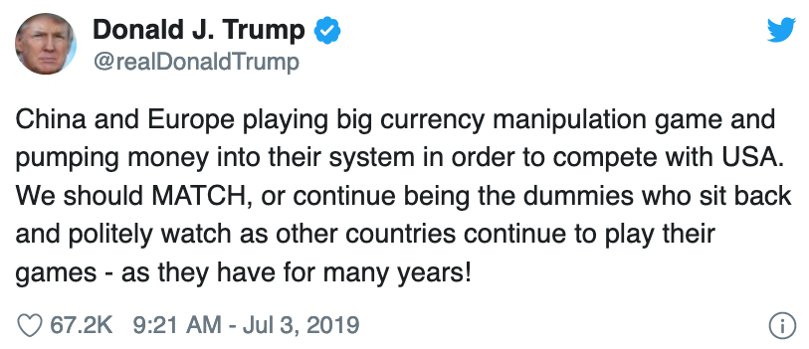
Currency War Today?

Slide 51
Outline: Currency Manipulation and Currency Wars
Currency Manipulation
What it is
Chinese currency manipulation
Other currency manipulation
Currency Wars
History
Currency war today?
Currency war effects

Slide 52
Currency War Effects
Prasad argues that currency war would actually cause dollar to rise, due to uncertainty and “flight to safety”
Note too that while people speak of a “US-China currency war,” neither country can depreciate only with respect to the other.
Their depreciations will hurt others, who will likely respond in kind.

Slide 53
Currency War Effects
If all countries participate, each depreciating by the same percentage, then
Exchange rates do not change
Only effect is the movement of assets into central bank reserves
If only some countries participate (or participants depreciate by different amounts) then
Those who depreciate most get increased exports
Stimulating their economies to higher incomes and/or prices
Those who depreciate least get reduced exports
Weakening incomes and prices there
Ideally, countries may use different macro policies to handle these effects

Slide 54
Currency War Effects
Currency War versus Trade War
The tariffs of a trade war distort choices, cause inefficiencies, and reduce welfare
The currency depreciations of a currency war need not distort anything, especially if macro policies adjust for any differences
Thus, if given a choice, I’d prefer a currency war

Slide 55
Next Time
The Euro
What is it?
History of European monetary integration
Pros and cons of currency unification
Effects on US
What happened?

