Slide 1
Lecture 9
World Trade Arrangements and the WTO
Econ 340
Notes:
Added Donnan 2016 on US as bully in WTO

Slide 2
News: Sep 30 – Oct 6
WTO approves US tariffs on EU -- WSJ: 10/2 | Canvas | NYT: 10/2 | Canvas | FT: 10/2 | Canvas
  In the latest step in the US-EU Boeing-Airbus dispute at the WTO, the WTO has approved US tariffs on %7.5 billion of EU exports, the largest retaliation ever approved by the WTO.
  The US will levy tariffs of 25% on a range of goods ("including cheese, olives, business suits and sweaters") and 10% on aircraft from the EU. It plans to levy the tariffs by October 18. These may rise, as the WTO has approved tariffs of as high as 100%.
  This is the result of WTO finding in a 15-year-old case that EU subsidized Airbus in competition with Boeing. In another case, still to be completed, the WTO also found that the US subsidized Boeing, so tariffs in the other direction are likely to be approved as well. Though the case long preceded Trump, he takes credit: "They think I don’t like the WTO and they want to make sure I’m happy."
UK's Johnson offered Brexit plan to EU, and EU was skeptical -- WSJ: 10/3 | Canvas | NYT: 10/3 | Canvas | FT: 10/2 | Canvas | WP: 10/3 | Canvas
  Boris Johnson, UK Prime Minister, managed to construct a plan for Brexit that UK parliament would likely accept, but the EU appears unreceptive.
  The plan would try to minimize customs checks at the Ireland-Northern Ireland border, by using technology in some way, while having Northern Ireland leave the EU customs union. It would also keep Northern Ireland obeying many EU regulations and standards.
  The UK is currently scheduled to leave the EU on October 31, though the UK parliament has passed a law requiring that it ask for an extension if no deal is reached.
India blocks all exports of onions -- NYT: 10/1 | Canvas | BBC: 10/5
  Prompted by an onion shortage due to drought, then monsoon rains, prices nearly tripled in recent months. Onions are central to cuisines in both India and its neighbors, many of whom rely on India's exports. They could buy from China, but they view China's onions as inferior.
  This week, the administration of Prime Minister Modi not only banned all onion exports, but also cracked down on onion hoarding.
  The policy is starting to bring down the price of onions in India, but it is upsetting India's farmers and prompting complaints from neighboring countries, where onion prices are rising even more.

Slide 3
News: Sep 30 – Oct 6
WTO approves US tariffs on EU
  In the latest step in the US-EU Boeing-Airbus dispute at the WTO, the WTO has approved US tariffs on %7.5 billion of EU exports, the largest retaliation ever approved by the WTO.
  The US will levy tariffs of 25% on a range of goods ("including cheese, olives, business suits and sweaters") and 10% on aircraft from the EU. It plans to levy the tariffs by October 18. These may rise, as the WTO has approved tariffs of as high as 100%.
  This is the result of WTO finding in a 15-year-old case that EU subsidized Airbus in competition with Boeing. In another case, still to be completed, the WTO also found that the US subsidized Boeing, so tariffs in the other direction are likely to be approved as well. Though the case long preceded Trump, he takes credit: "They think I don’t like the WTO and they want to make sure I’m happy."

Slide 4
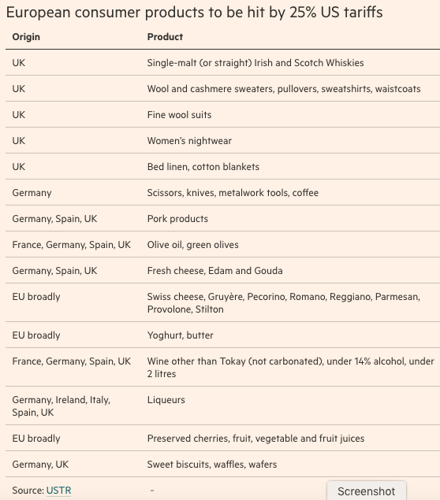

Slide 5
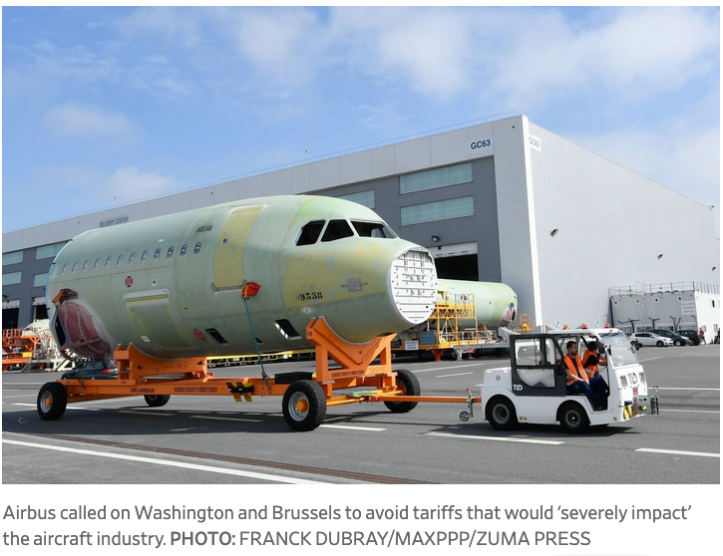

Slide 6
News: Sep 30 – Oct 6
UK's Johnson offered Brexit plan to EU, and EU was skeptical
  Boris Johnson, UK Prime Minister, managed to construct a plan for Brexit that UK parliament would likely accept, but the EU appears unreceptive.
  The plan would try to minimize customs checks at the Ireland-Northern Ireland border, by using technology in some way, while having Northern Ireland leave the EU customs union. It would also keep Northern Ireland obeying many EU regulations and standards.
  The UK is currently scheduled to leave the EU on October 31, though the UK parliament has passed a law requiring that it ask for an extension if no deal is reached.

Slide 7
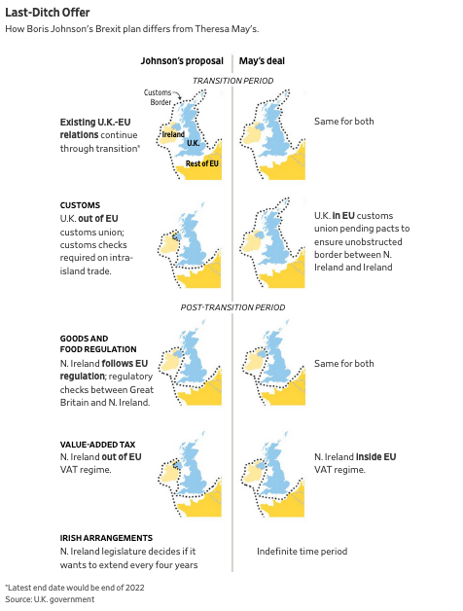

Slide 8
News: Sep 30 – Oct 6
India blocks all exports of onions
  Prompted by an onion shortage due to drought, then monsoon rains, prices nearly tripled in recent months. Onions are central to cuisines in both India and its neighbors, many of whom rely on India's exports. They could buy from China, but they view China's onions as inferior.
  This week, the administration of Prime Minister Modi not only banned all onion exports, but also cracked down on onion hoarding.
  The policy is starting to bring down the price of onions in India, but it is upsetting India's farmers and prompting complaints from neighboring countries, where onion prices are rising even more.

Slide 9
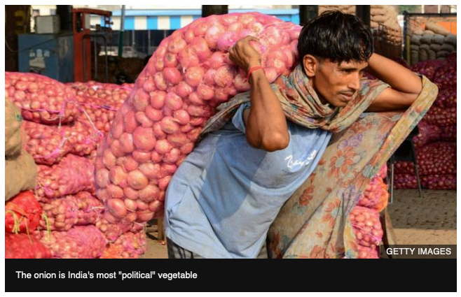

Slide 10
Outline: World Trade Arrangements and the WTO
International Organizations
World Trade Organization
  History, as GATT
  GATT Rounds
  WTO Today
  Functions
Current Issues
  Seattle Protests and Beyond
  Doha Round
  Disputes
  Other Issues
WTO Critiques

Slide 11
International Organizations
International Organizations Related to Trade
  WTO = World Trade Organization
    Formerly GATT = General Agreement on Tariffs and Trade
    More on this below

Slide 12
International Organizations
International Organizations Related to Trade
  OECD = Organization for Economic Cooperation and Development
    Group of mostly rich countries
      Collects data
      Discusses reforms
    36 members
      Including Mexico, Korea, Czech Rep., Poland
      Most recent: Lithuania, added 5 July 2018
    Russia is not a member (discussions of that were postponed in 2014)

Slide 13
International Organizations
International Organizations Related to Trade
  EU = European Union
    Group of 28 countries, among which there is free flow of
      Goods
      Capital
      Labor (but not yet including Croatia, which joined most recently)
    Added 10 countries Jan 1, 2004
    Added Romania and Bulgaria on Jan 1, 2007
    Added Croatia July 1, 2013
    UK voted to leave June 23, 2016 (Brexit)
      Initiated the process at end of March, 2017
      That started 2-year period to negotiate terms of “Brexit”
      Deadline: March 29, 2019, postponed to October 31, 2019

Slide 14
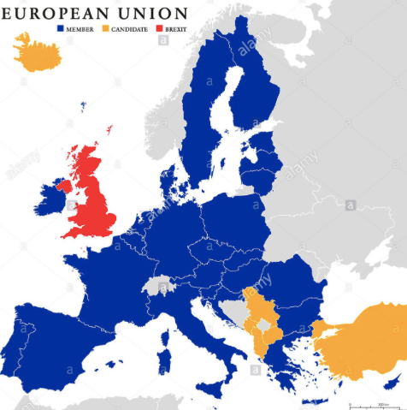
Note who is missing:
  Switzerland
  Norway
  Former Yugoslavia except Slovenia & Croatia

Slide 15
International Organizations
International Organizations Related to Trade
  NAFTA = North American Free Trade Agreement
    Group of 3 countries, US, Canada, Mexico that have
      Zero tariffs on each other’s exports
      Rules to facilitate investment, intellectual property, etc.
    We’ll learn more about it later in the course
    President Trump has now renegotiated it
      USMCA: United State, Mexico, Canada Agreement

Slide 16
International Organizations
United Nations (UN) Organizations
  UNCTAD = UN Conference for Trade and Development
    Voices views of developing countries
  ILO = International Labor Organization
    Promotes labor standards and rights
    Has no authority to limit trade
  WIPO = World Intellectual Property Organization
    Promotes use and protection of intellectual property (Copyrights, Trademarks, Patents)
    Also has no authority to limit trade

Slide 17
International Organizations
Non-governmental Organizations (NGOs)
  Far too many to list – here are a few
    Fraser Institute
    Oxfam International
    Third World Network
    Worldgrowth.org
  NGOs have been increasingly active in trying to influence trade policies and negotiations

Slide 18
Clicker Question
Which international organization voices the interests of developing countries?
  UNCTAD
  OECD
  WIPO
  ILO
  EU
✓

Slide 19
Outline: World Trade Arrangements and the WTO
International Organizations
World Trade Organization
  History, as GATT
  GATT Rounds
  WTO Today
  Functions
Current Issues
  Seattle Protests and Beyond
  Doha Round
  Disputes
  Other Issues
WTO Critiques

Slide 20
World Trade Organization: History
1930s:
  Tariffs raised, to high levels
  1930 US Smoot-Hawley Tariff Act
    Raised tariffs on 890 items
    Prompted retaliation by other countries, who then also raised tariffs
Notes:
Source: Economist, “The battle of Smoot-Hawley,” December 18, 2008.

Slide 21
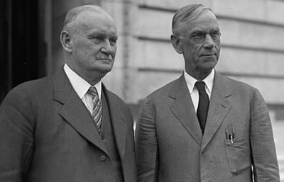
Hawley
Smoot

Slide 22
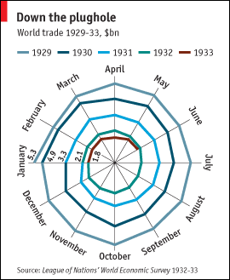
Source: Economist, “The battle of Smoot-Hawley,” December 18, 2008.

Slide 23
World Trade Organization: History
Mid-1940s:
  Created IMF and World Bank at meeting in Bretton Woods, New Hampshire
  US tried to create ITO = International Trade Organization
  Interim agreement: GATT = General Agreement on Tariffs and Trade
  When ITO failed to be approved (by US!), GATT governed trade policy by default

Slide 24
World Trade Organization: History
What GATT Does
  (GATT is still the largest part of WTO)
  Rules for trade policy
  Forum for negotiation
    Of both trade policies (e.g., tariffs) and rules
    Major negotiations took place in “Negotiating Rounds”
    Decisions made at occasional meetings of trade ministers: “Ministerial Meetings”

Slide 25
Clicker Question
What country prevented the formation of the International Trade Organization?
  India
  Russia
  The U.K.
  The U.S.
  Japan
✓

Slide 26
Outline: World Trade Arrangements and the WTO
International Organizations
World Trade Organization
  History, as GATT
  GATT Rounds
  WTO Today
  Functions
Current Issues
  Seattle Protests and Beyond
  Doha Round
  Disputes
  Other Issues
WTO Critiques

Slide 27
World Trade Organization: Rounds
Rounds of GATT Multilateral Trade Negotiations
No. | Years | Name | Accomplishments
1-5 | 1947-61 |  | Reduced tariffs

Slide 28
World Trade Organization: Rounds
Rounds of GATT Multilateral Trade Negotiations
No. | Years | Name | Accomplishments
1-5 | 1947-61 |  | Reduced tariffs
6 | 1964-67 | Kennedy | Tariffs + anti-dumping

Slide 29
World Trade Organization: Rounds
Rounds of GATT Multilateral Trade Negotiations
No. | Years | Name | Accomplishments
1-5 | 1947-61 |  | Reduced tariffs
6 | 1964-67 | Kennedy | Tariffs + anti-dumping
7 | 1973-79 | Tokyo | Tariffs + NTBs

Slide 30
World Trade Organization: Rounds
Rounds of GATT Multilateral Trade Negotiations
No. | Years | Name | Accomplishments
1-5 | 1947-61 |  | Reduced tariffs
6 | 1964-67 | Kennedy | Tariffs + anti-dumping
7 | 1973-79 | Tokyo | Tariffs + NTBs
8 | 1986-94 | Uruguay | Tariffs, NTBs, Services, Intellectual Property, Textiles, Ag., Dispute Settlement, Created WTO

Slide 31
World Trade Organization: Rounds
Rounds of GATT Multilateral Trade Negotiations
No. | Years | Name | Accomplishments
1-5 | 1947-61 |  | Reduced tariffs
6 | 1964-67 | Kennedy | Tariffs + anti-dumping
7 | 1973-79 | Tokyo | Tariffs + NTBs
8 | 1986-94 | Uruguay | Tariffs, NTBs, Services, Intellectual Property, Textiles, Ag., Dispute Settlement, Created WTO
9 | 2001-15 | Doha | FAILED: Doha Development Agenda

Slide 32
World Trade Organization: Rounds
How negotiations took place
  Tariffs:
    In early rounds, tariff cuts were negotiated between “principal supplier” country and “principal demander” country
      Cuts are extended to all other members (MFN)
      But large countries dominate this process
    In recent rounds, negotiations start with a formula for tariff cuts, then negotiate exceptions
    Swiss Formula: Z = AX/(A+X)
        X = initial tariff rate
        A = coefficient and maximum tariff rate
        Z = resulting lower tariff rate
      Proposed by Switzerland in Tokyo Round
      Reduces high tariffs more than low tariffs

Slide 33
World Trade Organization: Rounds
How negotiations took place
  Rules:
    Groups of countries draft changes, then persuade others
    Again, large countries dominate

Slide 34
World Trade Organization: Rounds
Do small and poor countries lose?
  They need not lose, if they participate in the process
    They benefit from the “rule of law”: Otherwise the large countries would be even more powerful
    By grouping together, small countries can also exert bargaining power
  They may well lose if they do not participate: growth of trade may exclude them
    Tariffs did not fall on their major exports

Slide 35
Outline: World Trade Arrangements and the WTO
International Organizations
World Trade Organization
  History, as GATT
  GATT Rounds
  WTO Today
  Functions
Current Issues
  Seattle Protests and Beyond
  Doha Round
  Disputes
  Other Issues
WTO Critiques

Slide 36
World Trade Organization: Today
WTO Today
  Established Jan 1, 1995
  Members: 164
    Most recent: Afghanistan 2016
    Including:
      China (as of 2001)
      Russia (as of 2012)
    Not including: Iran, Iraq, N. Korea
  Headquarters: Geneva, Switzerland
  (also home of ILO, WIPO, and others)

Slide 37
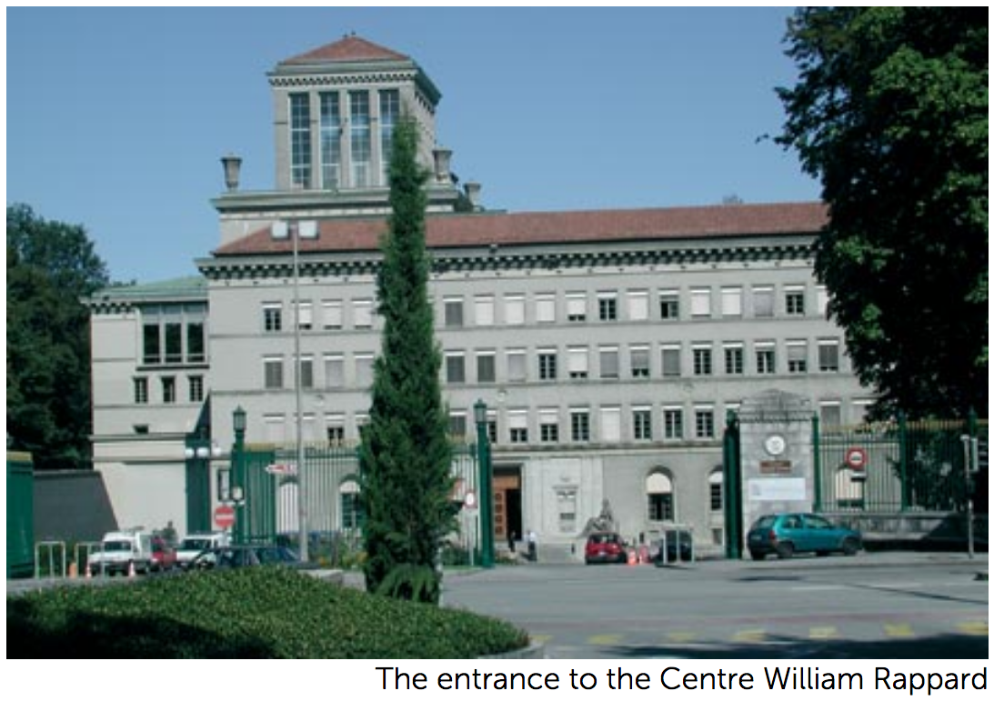

Slide 38
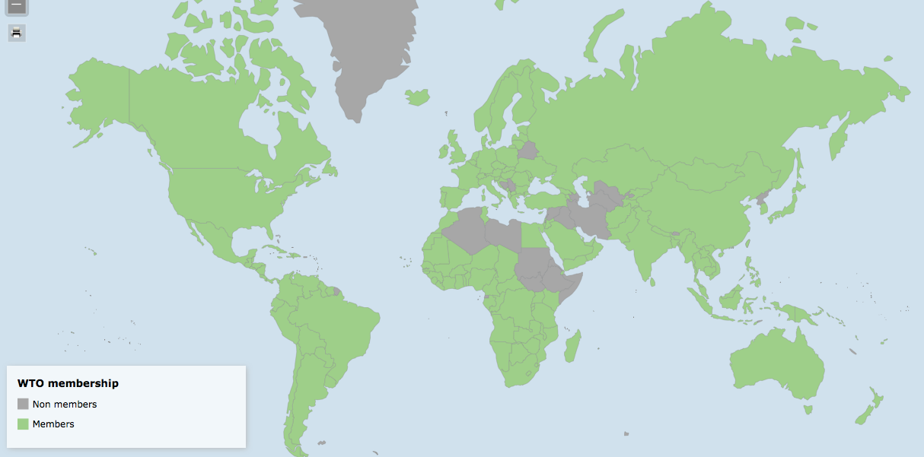
Interactive: https://www.wto.org/english/res_e/statis_e/statis_maps_e.htm

Slide 39
World Trade Organization: Today
WTO’s Three Parts
  GATT (Still exists, as largest part of WTO)
  GATS = General Agreement on Trade in Services
  TRIPs Agreement = Trade Related aspects of Intellectual Property Rights

Slide 40
World Trade Organization: Today
WTO’s Two Basic Principles
  MFN = Most Favored Nation
    Each member country should treat all members as well as it treats its “most favored nation” (i.e., the member that it treats the best)
  National Treatment
    Once a product or seller has entered a country, it should be treated the same as products or sellers that originated inside that country
  (There are many permitted exceptions to both of these principles)

Slide 41
World Trade Organization: Today
WTO Decision Making
  Decisions by consensus: all countries present at ministerial meetings must agree,
    Alternatively, a certain fraction, 2/3 or 3/4, of all members must agree
  In practice, large and rich countries dominate this process
    They first agree among themselves
      (This originally done in “Green Room”, hence “Green Room Group”)
    Then seek consensus based on that
  Is this “democratic”?
    Yes: Every country has one vote
    No: Rich countries dominate decisions in practice

Slide 42
Clicker Question
Who is not a member of the WTO
  Russia
  China
  Iraq
  All of the above
  None of the above (i.e., all are members)
✓

Slide 43
Clicker Question
When a vote is taken at a WTO ministerial meeting, what percentage of those present must vote yes for the vote to pass?
  33.3%
  50%
  60%
  85%
  100%
✓

Slide 44
Outline: World Trade Arrangements and the WTO
International Organizations
World Trade Organization
  History, as GATT
  GATT Rounds
  WTO Today
  Functions
Current Issues
  Seattle Protests and Beyond
  Doha Round
  Disputes
  Other Issues
WTO Critiques

Slide 45
WTO Functions
See table in Deardorff
Functional Outline of the World Trade Organization
Communication
Constraints
Exceptions
Dispute Settlement

Slide 46
WTO Functions
Communication | Ministerials
 | Negotiating Rounds
 | Working Groups
 | Trade Policy Review Mechanism
 | Councils and Committees
Trade Ministers (USTR, etc.) Meet Every Two Years
Tariff Reductions; Changes in Rules

Slide 47
WTO Functions
National Treatment for Service Firms (only in some industries)
Constraints | Tariff Bindings
 | Customs Valuation
 | Product Regulations
 | Quantitative Restrictions
 | Subsidies
 | Foreign Direct Investment (TRIMS)
 | Services (GATS)
 | Intellectual Property (TRIPs)
Countries negotiate and commit to maximum tariffs
Enforce Patents, Copyrights, Trademarks

Slide 48
WTO Functions
Most commonly used
Exceptions | Anti-Dumping
 | Countervailing Duties
 | Safeguards
 | Balance of Payments Protection
 | Preferential Trade Agreements
Permitted; not required
Allows NAFTA, EU, etc.

Slide 49
WTO Functions
Standing Committee that reviews most cases
Dispute Settlement | Consultation
 | Panel Recommendation
 | Appellate Body
 | Remedy | Implementation
 |  | Compensation
 |  | Retaliation
3-person Panel Decides Case
The Ultimate Remedy: Permit Tariffs

Slide 50
Clicker Question
How often are the trade ministers of WTO members supposed to meet?
  Every 6 months
  Every year
  Every two years
  Every five years
  It varies, depending on circumstances and needs
✓

Slide 51
Clicker Question
What is a tariff binding?
  A tax on imports of adhesives
  A commitment not to raise a tariff above some maximum
  A commitment not to lower a tariff below some minimum
  A promise by two countries to reduce tariffs on each others’ exports
  The WTO rule that countries must not charge higher tariffs on some members than on others
✓

Slide 52
Outline: World Trade Arrangements and the WTO
International Organizations
World Trade Organization
  History, as GATT
  GATT Rounds
  WTO Today
  Functions
Current Issues
  Seattle Protests and Beyond
  Doha Round
  Disputes
  Other Issues
WTO Critiques

Slide 53
WTO Current Issues
Seattle Protest and Beyond
  Seattle Ministerial – December 1999
    Intended to start a new Round
    Protesters flocked to Seattle, with objections

Slide 54
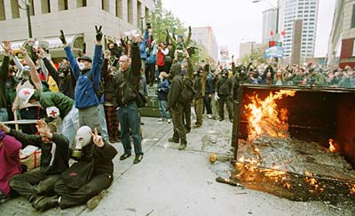

Slide 55
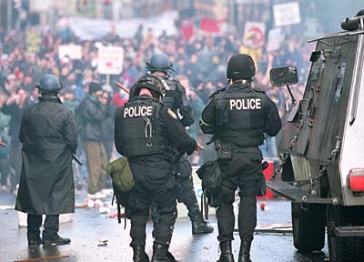

Slide 56
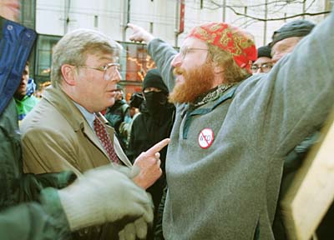

Slide 57
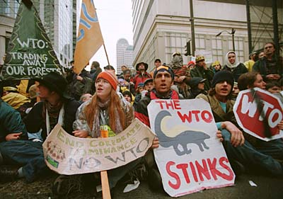

Slide 58
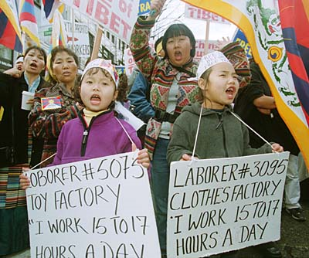

Slide 59
WTO Current Issues
Seattle Protest and Beyond
  Seattle Ministerial – December 1999
    Intended to start a new Round
    Protesters flocked to Seattle, with objections
      Labor issues
      Environmental issues
      Corporate dominance
      Lack of transparency, democracy
    Meeting ended in failure

Slide 60
Outline: World Trade Arrangements and the WTO
International Organizations
World Trade Organization
  History, as GATT
  GATT Rounds
  WTO Today
  Functions
Current Issues
  Seattle Protests and Beyond
  Doha Round
  Disputes
  Other Issues
WTO Critiques

Slide 61
WTO Current Issues
Doha Round
  Began at WTO Ministerial at Doha, Qatar, Fall 2001 (after Sep 11)
  Emphasis on development:
  “Doha Development Agenda”
  Major issues to be included
    US and EU agricultural subsidies and tariffs
    Developing-country tariffs on manufactures
    Market access for services into developing countries

Slide 62
WTO Current Issues
Doha Round
  December 2015: Nairobi Ministerial meeting
    Ended without reaffirming intent to complete the Doha Round
    Implicitly, that was admission that it had ended in failure

Slide 63
WTO Current Issues
What happens without Doha?
  Tariffs may rise because bound tariffs won’t fall
  Bound tariffs are almost twice as high as applied ones
  Some argue that world trade will fall
    Has it happened?
    Trade stopped growing for a while, then grew again
    Not clear that tariffs rose (until Trump)

Slide 64
WTO Current Issues
Other negotiations have been more successful
  December 2013: Bali Ministerial salvaged a limited agreement, mainly on Trade Facilitation
    July 2014: Implementation of the “Bali Package” was delayed by objections from the new India Prime Minister Modi
    November 2014: Modi and Obama met and resolved the disagreement. Bali Package was adopted at WTO.
  December 2015: Nairobi Ministerial agreed on several commitments, including to
    Abolish export subsidies on farm exports.
  December 2017: Buenos Aries Ministerial met but accomplished essentially nothing
    Was more about friction between US (Trump) & others

Slide 65
WTO Current Issues
WTO has also succeeded in negotiating “plurilateral agreements”
  These are agreements the members can sign or not, and are only binding on those who do
  Agreements that have been negotiated:
    Information Technology Agreement (with an update currently being negotiated)
    Financial Services Agreement
    Basic Telecommunication Services Agreement
    Anti-Counterfeiting Trade Agreement

Slide 66
Clicker Question
How many rounds of multilateral tariff negotiation have been successfully concluded by the WTO?
  None
  One
  Five
  Eight
  Nine
✓
    Eight rounds were concluded under the GATT, but the only round since the creation of the WTO, the Doha Round, failed.

Slide 67
Clicker Question
What is a plurilateral agreement?
  An agreement among countries that are not members of the WTO
  A Free Trade Agreement, such as NAFTA
  An decision by all WTO members to multiply their tariffs
  An agreement that WTO members may sign or not, as they please
  An agreement among a subset of WTO members that is not open to other members
✓

Slide 68
Outline: World Trade Arrangements and the WTO
International Organizations
World Trade Organization
  History, as GATT
  GATT Rounds
  WTO Today
  Functions
Current Issues
  Seattle Protests and Beyond
  Doha Round
  Disputes
  Other Issues
WTO Critiques

Slide 69
WTO Current Issues
WTO Disputes
  There have been 590 disputes brought to the WTO since its creation in 1995 (as of 10/1/19)
  Some of the more notable are (or were)
    EU ban on hormone treated beef (ruled by WTO to have no scientific basis)
    US shrimp-turtle import prohibition (struck down by WTO)

Slide 70
WTO Current Issues
WTO Disputes
  More
    Boeing-Airbus dispute over subsidies by EU and US (WTO ruled that both were using illegal subsidies)
    Canada and Mexico complaint about US Country-of-Origin Labeling (COOL) law for meats (WTO ruled against US law)

Slide 71
Outline: World Trade Arrangements and the WTO
International Organizations
World Trade Organization
  History, as GATT
  GATT Rounds
  WTO Today
  Functions
Current Issues
  Seattle Protests and Beyond
  Doha Round
  Disputes
  Other Issues
WTO Critiques

Slide 72
WTO Current Issues
Other WTO Issues
  Independence
    US (under Obama) vetoed reappointment of a member of the Appellate Body
    He had found against the US in several cases
    Others worried that this would undermine the body’s independence
    It made US look like a bully to others
  Since then, US under Trump has blocked further appointments (see Schlesinger)
    The Appellate Body may soon (Dec 2019) lack a quorum to make decisions.

Slide 73
WTO Current Issues
Other WTO Issues
  China’s “market economy status” (see Schlesinger)
    Because China is currently classed as a non-market economy, its prices need not be used in deciding anti-dumping cases
    This leaves others free to base dumping decisions on prices in other countries, hurting China
    China is arguing for market economy status, and the issue is likely to be addressed soon by the Appellate Body

Slide 74
Clicker Question
What is the Appellate Body of the WTO?
  It is the name of the building in Geneva, Switzerland, where the WTO is located
  The committee that reviews the decisions of most dispute settlement cases
  The agency that oversees the naming of products that are traded internationally
  The panel that makes the initial decision about whether a country has violated WTO rules
  The document spelling out the rules of the WTO
✓

Slide 75
Clicker Question
Why does China want to be treated as a market economy?
  This would make it exempt from other countries’ tariffs
  It’s a matter of national pride, as this was an objective of Chairman Mao
  Market-economy status would allow it to subsidize exports
  Market-economy status would lead to smaller anti-dumping duties against it
  International banks refuse to lend to firms in a non-market economy
✓

Slide 76
Outline: World Trade Arrangements and the WTO
International Organizations
World Trade Organization
  History, as GATT
  GATT Rounds
  WTO Today
  Functions
Current Issues
  Seattle Protests and Beyond
  Doha Round
  Disputes
  Other Issues
WTO Critiques

Slide 77
WTO Critiques
Trump
  Oct 25, 2017, on Fox interview with Lou Dobbs:
    “The WTO, World Trade Organization, was set up for the benefit for everybody but us.”
    “we lose the lawsuits, almost all of the lawsuits … within the WTO”
  In fact, like other countries, US
    Wins most of the cases it brings
    Loses most the cases brought against it
  Since 1995, in all cases complainant has won 90%
    As complainant, US has won 91%
    As respondent, US has lost 89%
  But…Trump may be closer to right if we’ve been respondent much more than complainant

Slide 78
WTO Critiques
Trump
  Oct 30, 2018, FT:
    Donald Trump threatens to pull US out of the WTO
    “If they don’t shape up, I would withdraw from the WTO,” Mr Trump said in an interview.

Slide 79
WTO Critiques
Rodrik
  WTO extended GATT into “inside the border” policies that countries resist
  It is not well suited to dealing with countries that are very different (China)
  US would have had a hard time developing under WTO rules
  WTO has been unable to adapt to change, and instead the Appellate Body has made new law

Slide 80
WTO Critiques
The future of WTO?
  May slip into irrelevance as US and others ignore its rules
  Or maybe these issues will prompt it to restructure itself to work better

Slide 81
Clicker Question
How does the US do in WTO disputes as complainant and as respondent?
  It loses most as both
  It loses most as complainant but wins most as respondent
  It loses most as respondent but wins most as complainant
  It wins most as both
✓

Slide 82
Next Time
Migration
  Causes
  Effects
  Policies

