Slide 1


Deep Visual Analogy-Making
Scott Reed Yi Zhang Yuting Zhang Honglak Lee
University of Michigan, Ann Arbor

Slide 2
Text analogies
KING : QUEEN :: MAN :
Notes:
We are familiar with word analogies like the following…

Slide 3
Text analogies
KING : QUEEN :: MAN :
WOMAN

Slide 4
Text analogies
KING : QUEEN :: MAN :
WOMAN
PARIS: FRANCE :: BEIJING:

Slide 5
Text analogies
KING : QUEEN :: MAN :
WOMAN
PARIS: FRANCE :: BEIJING:
CHINA

Slide 6
Text analogies
KING : QUEEN :: MAN :
WOMAN
PARIS: FRANCE :: BEIJING:
CHINA
BILL: HILLARY :: BARACK:

Slide 7
Text analogies
KING : QUEEN :: MAN :
WOMAN
PARIS: FRANCE :: BEIJING:
CHINA
BILL: HILLARY :: BARACK:
MICHELLE

Slide 8
2D projection of embeddings
Mikolov, Tomas, et al. "Distributed representations of words and phrases and their compositionality." In NIPS, 2013.
T. Mikolov et al. : Linguistic Regularities in Continuous Space Word Representations, NAACL 2013.
Notes:
Neural word embeddings have been found to exhibit regularities allowing analogical reasoning by *vector* addition.
https://code.google.com/p/word2vec/

Slide 9
2D projection of embeddings
Man
King
Woman
Queen
Mikolov, Tomas, et al. "Distributed representations of words and phrases and their compositionality." In NIPS, 2013.
T. Mikolov et al. : Linguistic Regularities in Continuous Space Word Representations, NAACL 2013.
Notes:
https://code.google.com/p/word2vec/

Slide 10
Visual analogy-making
:
: :
:
Changing color
:
: :
:
Changing shape
:
: :
:
Changing size
:
: :
:
?
Notes:
We can also make up *visual* analogy problems.

Slide 11
Visual analogy-making
:
: :
:
Changing color
:
: :
:
Changing shape
:
: :
:
Changing size
:
: :
:
Notes:
Can we take a similar approach as for the neural word embedding models?
Solving the analogy requires 2 things:
We understand the visual relationship of the first pair of images
We can correctly apply the transformation to a query image

Slide 12
Related work
Tenenbaum and Freeman, 2000. Separating style and content with bilinear models
Hertzmann et al., 2001: Image Analogies
Dollár et al., 2007: Learning to traverse image manifolds (Locally-smooth manifold learning)
Memisevic & Hinton, 2010: Learning to represent spatial transformations with factored higher-order Boltzmann Machines
Susskind et al., 2011. Modeling the joint density of two images under a variety of transformations
Hwang et al., 2013. Analogy-preserving semantic embedding for visual object categorization
Notes:
Tenenbaum: factorize representation into style and content units so they can be separately adjusted
Hertzmann: change image textures / style by example
Dollar: traverse image manifold induced by transformations (e.g. out of place rotations)
Memisevic: Boltzmann machine learns to represent relation between transformation pair, apply transformation to queries
Hwang: Use image analogies for regularization to improve classification performance

Slide 13
Very recent / contemporary work
Zhu et al., 2014. Multi-view perceptron
Michalski et al., 2014. Modeling deep temporal dependencies with recurrent grammar cells.
Kiros et al, 2014. Unifying visual-semantic embeddings with multimodal neural language models
Dosovitskiy et al., 2015. Learning to generate chairs with convolutional neural networks
Kulkarni et al., 2015. Deep convolutional inverse graphics network
Cohen and Welling, 2014. Learning the irreducible representations of commutative Lie groups.
Cohen and Welling, 2015: Transformation properties of learned visual representations
Notes:
Zhu: Deep network disentangling face identity and viewpoint
Michalsky: Multiplicative and recurrent sequence prediction, multi-step transformations
Kiros: Regularities in multi-modal embedding space, showed some correct analogy image *retrieval* by vector addition
Dosovitsky: Showed that high-quality images can be rendered by convnet
Kulkarni: Deep VAE model with disentangled representation
Cohen: develop model with tractable probabilistic inference over compact commutative Lie group (includes rotation and cyclic translation), later extended to 3D rotation (NORB)
What we do differently:
- simple deep convolutional encoder-decoder architecture
- training objective is end-to-end analogy completion
- we can also learn disentangled representations as as a special case

Slide 14
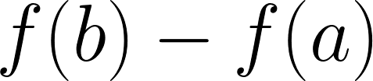
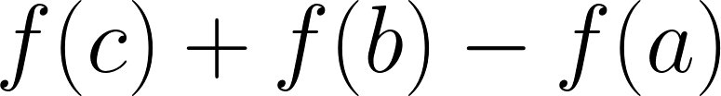




Notes:
Here I will walk through a cartoon example of our approach:

Slide 15
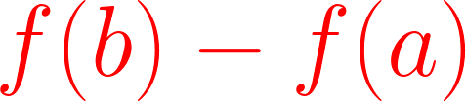




Slide 16


Slide 17
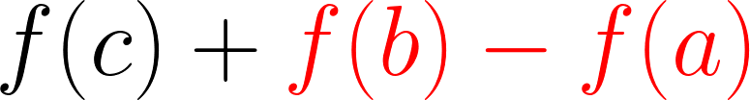

Slide 18


Slide 19
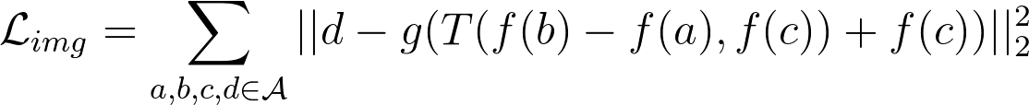
Analogy image prediction objective:
Research questions:
  1) What form should encoder f and decoder g take?
  2) What form should the transformation T take?

Slide 20
1) What form should f and g take?

Slide 21
2) What form should T take?
Add:
Multiply:
Deep:

Slide 23

Manifold regularization
* Note: there is no decoder here.
Idea: We also want the increment T to be close to difference of embeddings f(d) – f(c).
  Stronger local gradient signal for encoder
  In practice, helps to traverse image manifolds
  Allows repeated application of analogies
  Use weighted combination,
Notes:
Force the transformation increment T to match the actual step on the manifold from C to D.

Slide 24
Traversing image manifolds - algorithm
z = f(c)
for i = 1 to N do
z = z + T(f(b) – f(a) , z)
x_{i} = g(z)
end
return generated images x
a
b
c
x₁
x₂
x₃
x₄

Slide 25
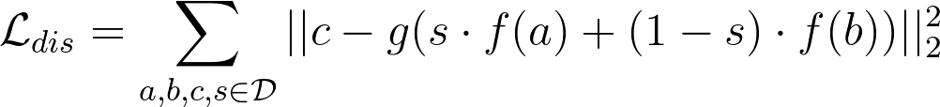
Learning a disentangled representation

Slide 26
Disentangling + analogy training
Notes:
Perform analogy-making on the pose units, disentangle from these the identity units.

Slide 27
Classification + analogy training
Notes:
Perform analogy-making on the pose units, classification on the separate identity units. Note that identity units are also used in decoding.

Slide 28
Experiments

Slide 29
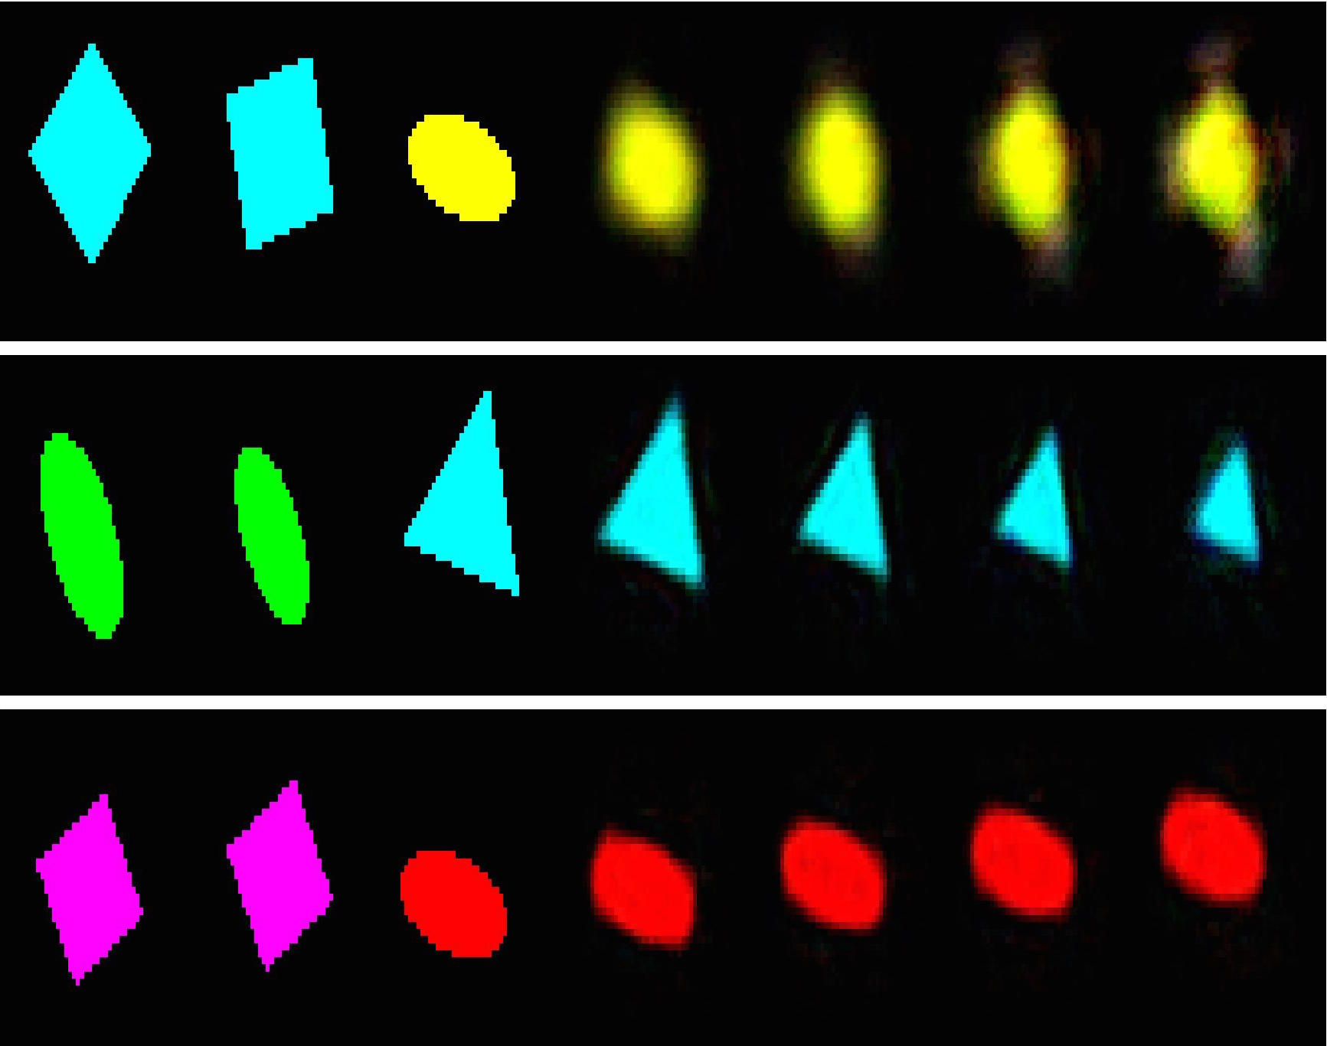
Shape predictions: additive model
rotate
scale
shift
ref
out
query
t=2
t=3
t=4
t=1
predictions

Slide 30
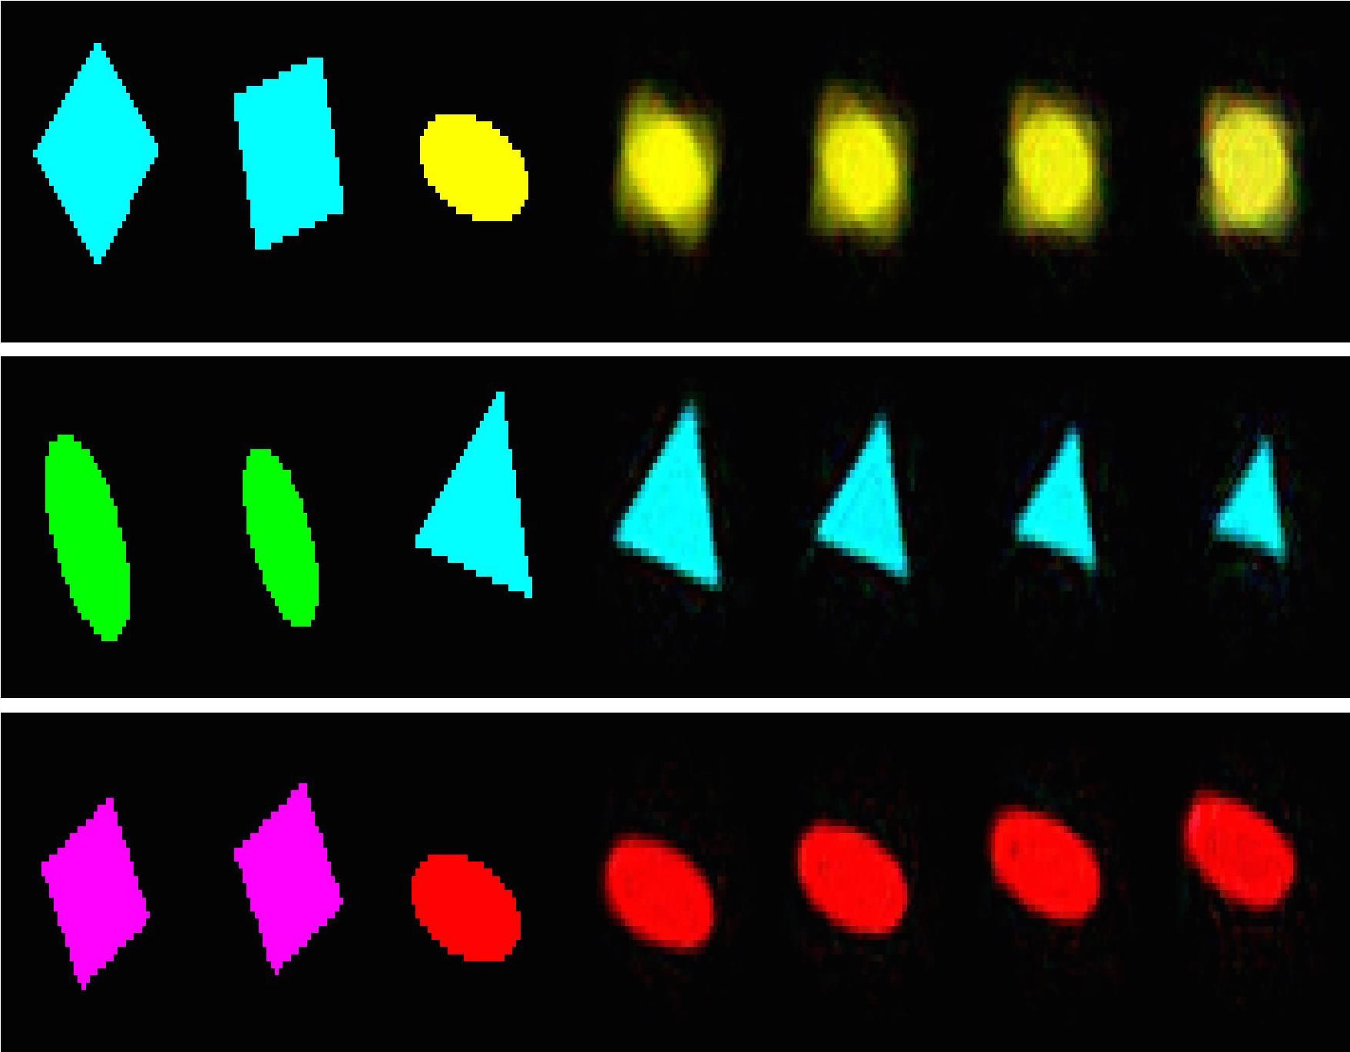
Shape predictions: multiplicative model
rotate
scale
shift
ref
out
query
t=2
t=3
t=4
t=1
predictions

Slide 31
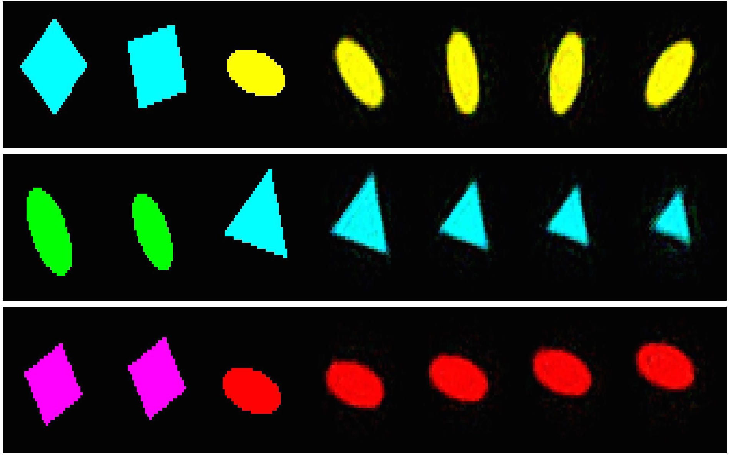
Shape predictions: deep model
rotate
scale
shift
ref
out
query
t=2
t=3
t=4
t=1
predictions

Slide 32
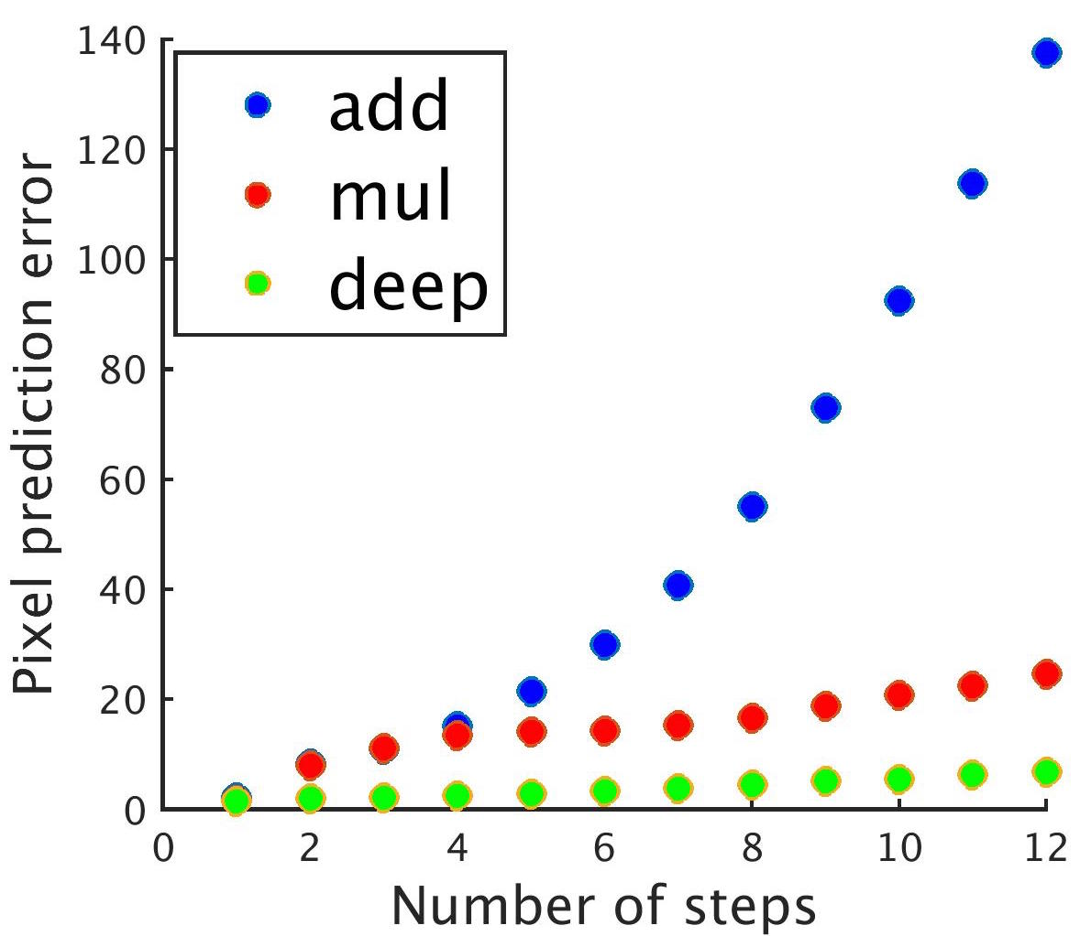
Repeated rotation prediction

Slide 33
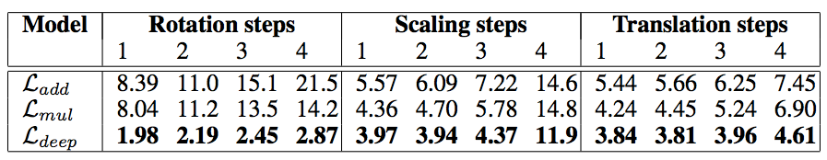
Shapes – quantitative comparison

Slide 34
Shapes – quantitative comparison
The multiplicative (mul) is slightly better than additive (add) model, but

Slide 35
Shapes – quantitative comparison
The multiplicative (mul) is slightly better than additive (add) model, but
Only the deep network model (deep) can learn repeated rotation analogies.

Slide 36
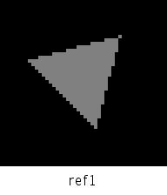
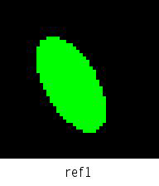
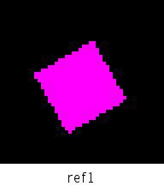
Rotation
Scaling
Translation
Scale + Translate
Rotate + Translate
Scale + Rotate
Notes:
Note that a single model can do all of these (multi-task). We do not train 1 model for each transformation.

Slide 37
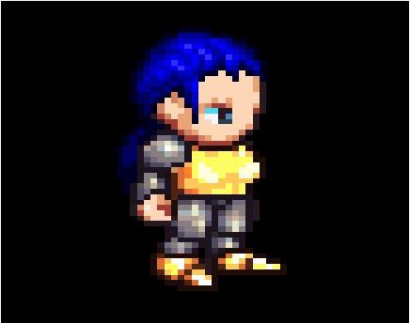
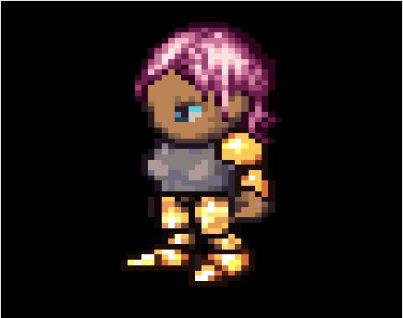

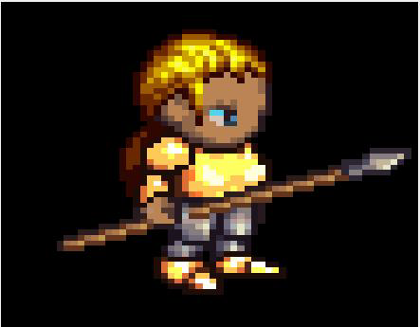


Reference animation
Query start frame
Walk
Thrust
Spell-cast
Notes:
Transfer the *trajectory* from the reference to the query frame.
At each step, we get a new transformation [ f(x_t) – f(x_{t-1}) ]
Apply this transformation to the current query embedding (all updates happening on the manifold)

Slide 38

Animation transfer - quantitative

Slide 39
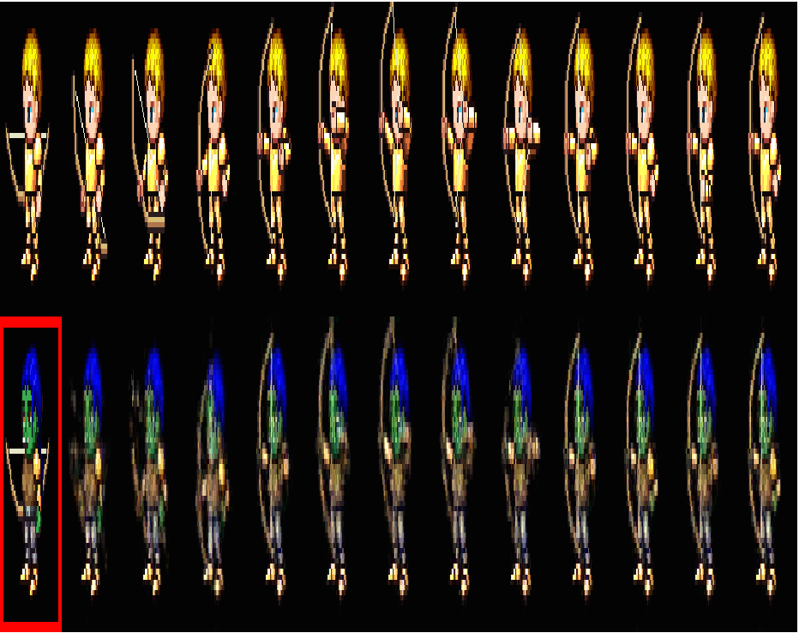
Animation transfer - quantitative
Additive and disentangling objectives perform comparably, generating reasonable results.
The best performance by a wide margin is achieved by disentangling + attribute classifier training, generating almost perfect results.

Slide 40
Extrapolating animations by analogy
Idea: Generate training examples in which the transformation is advancing frames in the animation.

Slide 41
Extrapolating animations by analogy

Slide 42
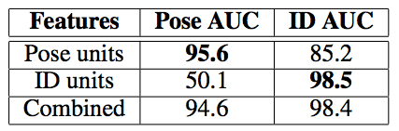
Disentangling car pose and appearance
Pose units are discriminative for same-or-different pose verification, but not for ID verification.
ID units are discriminative for ID verification, but less discriminative for pose.

Slide 43
Repeated rotation analogy applied to 3D car CAD models

Slide 44
Conclusions
We proposed novel deep architectures that can perform visual analogy making by simple operations in an embedding space.
Convolutional encoder-decoder networks can effectively generate transformed images.
Modeling transformations by vector addition in embedding space works for simple problems, but multi-layer networks are better.
Analogy and disentangling training methods can be combined together, and analogy representations can overcome limitations of disentangled representations by learning transformation manifold.

Slide 45
Thank You!

Slide 46
Questions?

