Slide 1
Lecture 1: Introduction to Introductory Macroeconomics
Required reading:
Ch 1: all, pp. 5-19
Ch 6: all, pp. 153-169
Econ 102, Fall 2011

Slide 2
Course structure
Book & required reading
GSIs / discussion sections
Attendance
i>clicker
Assignments
“Weekly” homework (0/1 graded)
3 Article responses
3 non-cumulative exams
Newspaper articles
Circulate WSJ sign-up in GSI session, next Tues
Can also sign up at WSJstudent.com
Notes:
I’ve helped to construct a “Study advice for econ 101 and 102” document, which gives advice on how to prepare for exams, complete homework, and approach article responses. Read it, it’s on CTools.

Slide 3
Course structure
My lecture notes serve for later study, as much as for in-class lecture notes
Contain lots of info; don’t try to just write what’s on the screen
Lecture is being recorded – if you miss something I said, mark “*” or “?” in your notes and listen again
I don’t recommend printing small slides with a few lines and taking notes there – too small, too little space to write.
When opening the computer file, most slides have “notes” of clarification that may be handy (and worth printing?)

Slide 4
Course structure
My goal for the class: to give you a language to speak about what’s going on in the current economy, and a framework in which to think about it
Discuss the recent recession/crisis as we go along
acknowledge that we’re never quite sure what is going on as we speak (nor is hindsight 20/20)
acknowledge that our explanation for what’s going on will likely change in the near/far future
The principles are here to understand WHY policies are being proposed (infrastructure stimulus, tax cuts, cuts to teacher salaries), and their pros and cons.
Notes:
One point of this slide is: we should always be humble about the state of our knowledge and the degree to which we know ”the truth”
In particular, notice that I didn’t say “THE framework in which to understand it”. We’re going to develop models that are powerful, useful, and sophisticated enough to go a long way towards understanding how the economy works. But it’s not by any means the only framework we COULD develop, and it’s not going to answer all our questions or be a completely satisfactory explanation for everything that’s going on. Such is the state of economics, such is the human condition.

Slide 5
Course structure
Macro can be counter-intuitive
Aggregate supply is NOT the sum of all market (micro) supply curves
Savings has a different effect, depending on whether we’re using short run or long run models
Adding more money to the economy can help in the short run, is harmful in the long run
➔ The total effect of the all behaviors of all people can compound and interact in (possibly) unexpected ways
Notice in Ch. 1 that we need separate “principles” (assumptions) for interactions between individuals and at the economy-wide level
Notes:
The first point is the main one: can’t just “add up” micro to get macro! People who understand micro may struggle with macro, people who struggle with micro may just “get” macro. They are more different than at first glance.
I’m going to breeze past those “12 principles” in class – when they become important as fundamental assumptions, I will bring them back up as the class progresses. For now, I’ll note here that the first economy-wide principle, “one person’s spending is another person’s income”, looks innocuous and obvious but a) it is an assumption, and b) it’s a tremendously powerful assumption that we’ll use again and again.

Slide 6
A brief history of macroeconomics
Turn of the (20th) century: classical economics
Macro per se (i.e., the study of economic aggregates) did not really exist
A competitive, supply and demand model of all (economic) aspects of the world
Self-regulating markets
Markets are efficient, markets clear
Competition implies that unemployment, for example, cannot really exist. Market clearing implies if you want work, you will get work
Believed that the economics of chapters 2-4 were sufficient to perform macro analysis
Notes:
We’ll define terms like “market clearing”, “self-regulating”, “competition”, and so on in the next few days.

Slide 7
A brief history of macroeconomics
The big shock: the Great Depression
Hard to argue that it was “efficient”
Hard to argue that labor market cleared over its course
25% unemployment at its peak
Most important response (in terms of the history of economic thought): The General Theory of Employment, Interest, and Money, by John Maynard Keynes

Slide 8
A brief history of macroeconomics
Keynesian Economics: A theory of how productive capacity and actual spending can get “out of sync”
The second principle of economy-wide interaction
Suggests two main governmental tools to correct this gap:
Fiscal Policy: The use of presidential and congressional spending and taxing powers to manipulate the state of the economy
Monetary Policy: Changing the quantity of the money in circulation to manipulate the state of the economy. Performed by central banks.
Notes:
Fisc pol examples: cash for clunkers, high speed rail, building bombers/tanks/aircraft carriers, tax cuts & rebates. Using the “purse strings” of the economy. Performed by the legislative and/or executive branches of the government
Mon Pol examples: lowering the interest rate, selling and buying government bonds. Performed by the Central Bank of the economy.

Slide 9
A brief history of macroeconomics
Keynesianism was the dominant paradigm in macro for almost 40 years
A “Neo-classical” revolution starting in the late 60s
Milton Friedman as its forerunner
Stresses the response of rational, forward-looking individuals to government policy
Many results are contradictory to Keynesianism:
absence of effects of government intervention,
possible harms of government intervention
Dominant 1970s → ? (2000? 2008? Today?)
Most policy debates in macro can in some sense be boiled down to “Keynesians” versus “Neo-classicals”
Notes:
Macro as one of the biggest battlegrounds of economics – many areas with lack of consensus, many open questions, many difficult questions to answer given the data at hand (there are only 187 countries that macroeconomists may analyze, unlike the billions of people that microeconomists may repeatedly analyze!)
There is a sense that the discipline may be heading back towards Keynesian attitudes in the current circumstances, but this has yet to be seen, IMHO

Slide 10
Macro has a case of the Runs
How could the two schools of thought come to so many contradictory conclusions?
As applied in this class, the models of each school are used to explain different time horizons
The Keynesian approach was constructed to explain the short run.
The short run describes the ups and downs of the economy
Often called the business cycle – the seemingly regular progression of the economy though contractions and expansions, booms and busts, recessions and prosperities

Slide 11
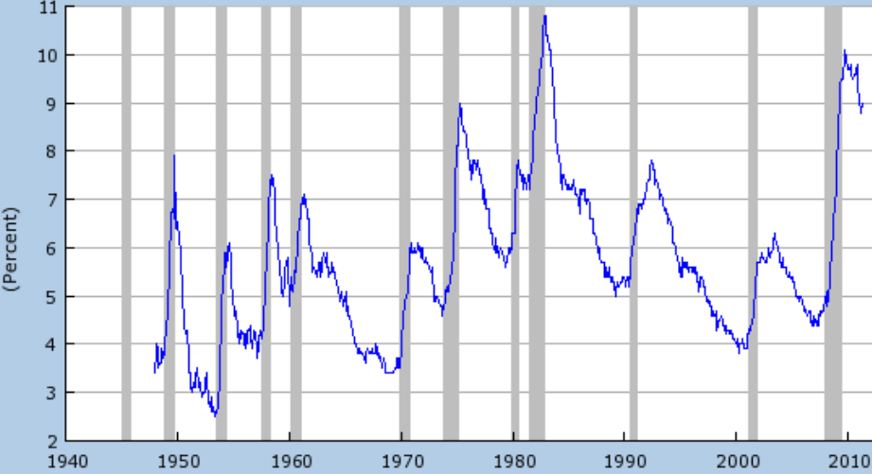
Macro has a case of the Runs
Unemployment rate up to May, 2011:
Notes:
Here I’m using unemployment as an indicator of the business cycle. In the shaded areas (recessions), U spikes up, and declines afterwards. The “spike” of 2008 is the single biggest the US has ever experienced. U was higher in 1981, but that was after a series of spikes and declines. And even in the GD, when U rose to 25%, it actually happened over a 3 year period from 1929-1932.
Note that the recession ended in mid (June) 2009, according to the traditional definition (2 or more consecutive periods of falling output) (http://www.nber.org/cycles/cyclesmain.html – the “recession dating” announcement is here: http://www.nber.org/cycles/sept2010.html)
Figure comes from http://research.stlouisfed.org/fred2/series/UNRATE

Slide 12
Macro has a case of the Runs
As applied in this class, the models of each school are used to explain different time horizons
On the other hand, we use a neoclassical model to explain the long run
The long run describes the changes in the economy over a broad time span: the tendency of an economy
The long run is the study of growth: on average, US economic output expands by 3.5% a year
A neoclassical model because it assumes a time span over which markets can adjust and utilize all its resources (prices adjust, markets clear)

Slide 13
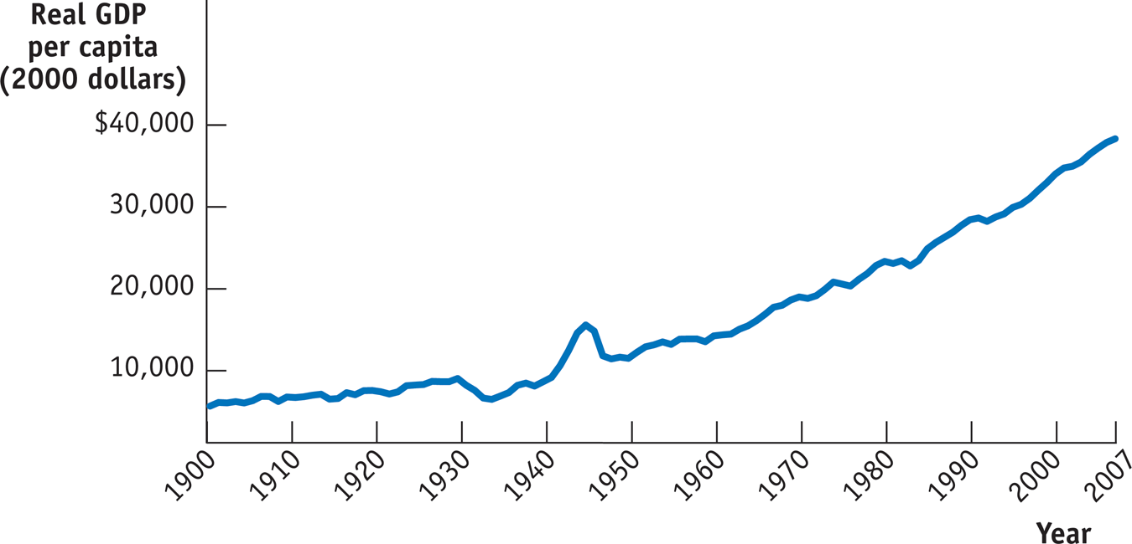
Macro has a case of the Runs
Notes:
Notice that here I’m using output (measured by GDP – we’ll get to that in Ch. 7) to measure the state of the economy
Notable features:
Up almost everywhere (even the big downturns – see 1974 – look small in the grand growth scheme)
Biggest downturn: great depression
biggest uptick: WWII (with a reversion back to the growth trend as soon as it ended)

Slide 14
Macro has a case of the Runs
From that last graph, you can see
the tendency of the US economy to expand: the long run growth trend
the fact that growth is not consistent: output wobbles around the growth trend.
Those “wobbles” are the short run
The biggest “wobble” is the Great Depression: gave birth to Keynesianism and “modern” Macro
The fact that we use different “types” of models for different macro phenomena isn’t without problems…
Notes:
Again, we’ll get to those “problems” later. Ch. 6 talks about the paradox of thrift as one example.

Slide 15
Macro has a case of the Runs
Macro is about explaining aggregate productivity and aggregate social choice
Both models are useful for thinking about these things
Both models have drawbacks: one “art” of economics is knowing which model to apply at what time, depending on the question at hand
The class is here to teach you the methods, and then to leave you, in your own life to apply the methods as you see fit (if you see fit!)

Slide 16
Thursday:
Supply and demand, and
equilibrium math
Notes:
16

